Slide 1
How to Get Your
DCA Loan Closed

Slide 2
Brought to
You by:
THE DCA CLOSING TEAM
Mitch Kelly – Director, Office of Housing Finance
Robert Keeler – Multifamily Underwriting Manager
Gary Huggins – Multifamily Construction Manager
Shon Walker – Federal Compliance Manager
Kemyatta Howard – Legal Consultant

Slide 3
TIMELINE

Slide 4
Tax Credit Award
9% Carryover Allocation
60 Day Submission
Review Submission
Loan Closing Submission
Drafting Loan Documents
Due Diligence Closing
Closing
4% Letter of Determination (LOD)/42M
Link to Construction Services documents on our public website to start submitting required submissions is included in award
Construction Services Team (CS) required submission
Due 60 days after Tax Credit Award
Start of Bi-monthly calls to keep deal moving
CS Team required submission
Due 45-60 days prior to sending the Loan Closing Submission
Used to review and confirm construction hard cost
Once confirmed, sent to Underwriting (UW) for review for Loan Closing approval
CS Team required submission
Due 10 days prior to closing
Construction hard cost should be same as submitted at Review Submission
Updated UW workbook due at this time with updated financial commitments
Full/final UW review
UW Team has finalized underwriting
CS Team has finalized construction hard costs to match UW workbook
John Grubb and/or Nick Sexton drafts closing documents based on finalized UW workbook
John Grubb and/or Nick Sexton works out issues and questions with Kemyatta, Mitch, UW, and CS
John Grubb and/or Nick Sexton coordinates with the developer’s attorney as well.
Developer/Owner signs closing documents for DCA
CS and Federal Compliance Team holds Pre-Construction Meeting with Development team for expectations on the awarded funds for draw submissions
NEPA Environmental Review Process
-process varies per funding source (HOME, NHTF, etc.)
Authority to Use Grant Funds (AUGF)
HUD sends AUGF to DCA
Must receive prior to acquiring property and starting construction

Slide 5
PRE-CLOSING
PROCESS

Slide 6
AFFORDABLE HOUSING DEVELOPMENT
DCA RESOURCES
DCA as the Housing Tax Credit (LIHTC) Allocator
9% Credits
4% Credits
DCA as a Lender
Home Investment Partnership Program (HOME)
National Housing Trust Fund (NHTF)
Tax Credit Assistance Program (TCAP)

Slide 7
Gap Funding Source | DCA/GHFA Uses | Income Requirements | Rents | Minimum Affordability Period | Typical Terms | NEPA/ Federal Environmental Review
HOME | -9% CHDO HOME -4% HOME gap financing (NOFA) -CHIP (single family | -100% LIHTC at (80% AMI) -20% rental units in deals of more than 5 HOME units for households at 50% AMI (remainder of HOME designated units are lessor of High HOME/60% AMI | -High HOME rents (including utilities) are capped at the lesser of the Fair Market Rent (FMR) for the area or 30% of the income of a household whose income is 65% AMI -Low HOME rents (including utilities) are capped at 30% of the income of a household whose income is 50% AMI | -20 years new construction -5, 10, 15 years for rehab depending on HOME amount | -0% construction -1% perm or based on % of cash flow | Yes
NHTF | 9% & 4% LIHTC gap financing | -100% at 30% AMI or families with incomes at or below the poverty line (whichever is greater) when HTF funds are less than $1 billion | -HTF rent plus utilities of an extremely low-income tenant shall not exceed the greater of 30% of federal poverty line or -30% of the income of a family whose annual income is 30% AMI | 30 years | 0% interest construction and permanent | Yes No public comment No RROF or AUGF
CDBG-DR | 9% CDBG-DR gap financing | -HUD requires that a minimum 70% of the total CDBG-DR funds benefit households of low to moderate income. -Low to moderate income households are defined as not exceeding 80% AMI for their area | 80% Area Median Income (AMI) | -15 years or more for rehab of deals with 8 or more units -20 years for new construction deals with 5 or more units | -0% construction -1% perm or based on % of cash flow | Yes
TCAP2 | Matching construction loan to HOME Construction Loan Acquisition loans | 80% Area Median Income (AMI) | 80% Area Median Income (AMI) | 15 years | 0% Construction | No
TCAP3 | TBD | *None-unrestricted funds / DCA discretion | *None-unrestricted funds / DCA discretion | TBD DCA Discretion | TBD | No
FUNDING SOURCE SUMMARY

Slide 8
How to Get Awarded with a DCA Loan
*Pre-App request
Notice of Funding
Availability (NOFA)
Request notated within 9% pre-application
Request notated within 4% pre-application
4% tax credit
9% tax credit
*only applicable if DCA announced so before a competitive round

Slide 9
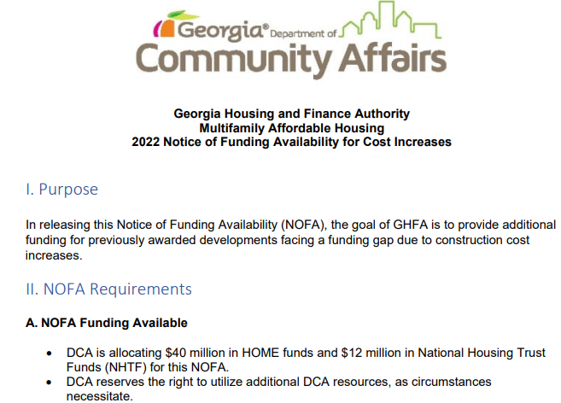
NOFAs / RFP

Slide 10

CONSENT LETTER
Notification of selection

Slide 11
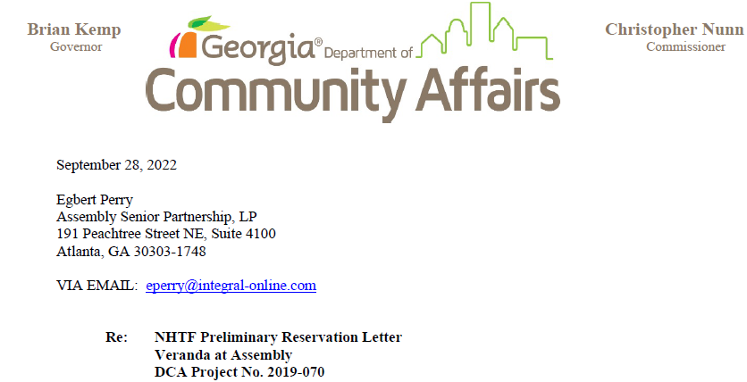
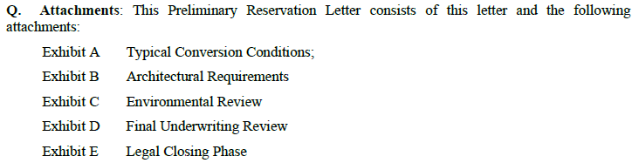
RESERVATION LETTER
General overview of submission requirements and closing process

Slide 12
The Office Housing Finance Team
Mitch Kelly
Office Director
Cheyenne Speakman
Administrative Assistant
Gary Huggins
Multifamily Construction Manager
Robert Keeler
Multifamily Underwriting Manager
Sherrie Potter
Assistant Office Director
Dezire Jackson
Construction Program Assistant
Willie Bolden
Construction Management Specialist
Gary Garner
Senior Tax Credit Underwriter
Licelotte Beato
Multifamily Underwriter Analyst
Maegan Lawter
Construction Management Specialist
Samoy Minter
Construction Management Specialist

Slide 13
The Office of Community Housing Development
Samanta Carvalho
Office Director
Lisa Ivy
Administrative Assistant
Shon Walker
Federal Compliance Manager
Joanna Jin
Federal Compliance Specialist - Environmental Review
Effie Greer
Federal Compliance Specialist – Davis Bacon, MBE/WBE & Section 3
Adam Graham
Federal Compliance Specialist -Environmental Review
Ilona Nagy
Relocation Specialist
Merranda James
Relocation Specialist
Shaniqua Robinson
Federal Compliance Specialist – Davis Bacon, MBE/WBE & Section 3

Slide 14
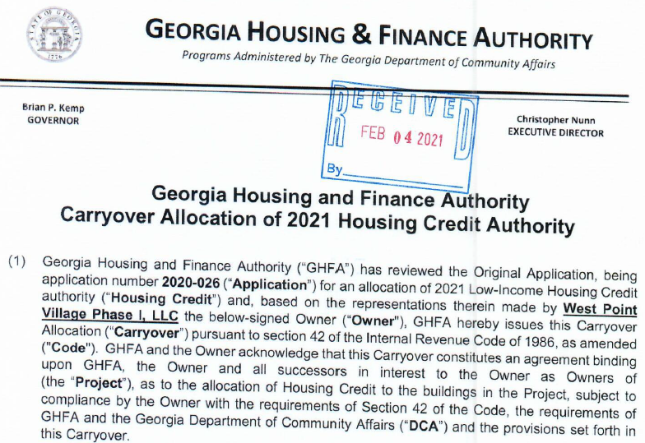
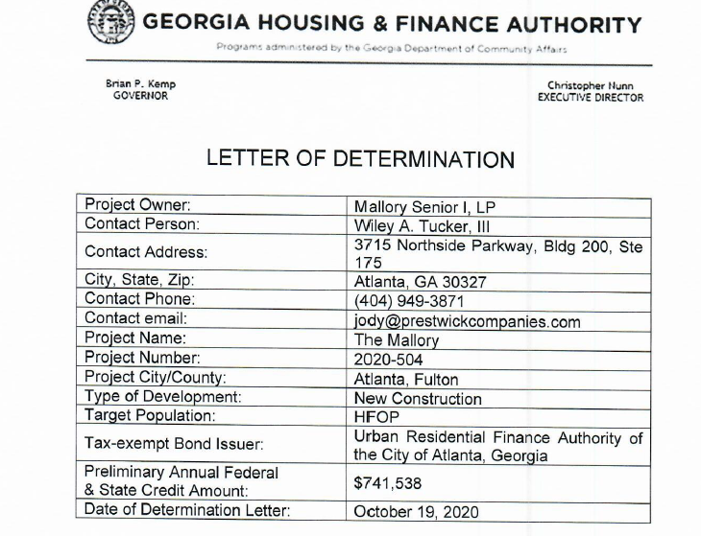
TAX CREDIT AWARDS
Preliminary award for Housing Tax Credits
Carryover Allocation (9% HTC)
Letter of Determination (LOD)/42M
(4% HTC/Bonds)

Slide 15

FEDERAL COMPLIANCE
Requirements vary per funding source
Pre-DCA closing encompasses environmental review and relocation (if applicable)
Post-DCA closing encompasses Davis Bacon (if applicable), MBE/WBE, and Section 3 (if applicable)

Slide 16
ENVIRONMENTAL REVIEW
REQUIREMENTS
Funding Source | DCA Checklist | NEPA Review | Tribal Consultation | Public Notice | HUD Request for Release of Funds
LIHTC | Yes | No | No | No | No
HOME | Yes | Yes | Yes | Yes | Yes
NHTF | Yes | Yes | No | No | No
TCAP | Yes | No | No | No | No

Slide 17
DAVIS BACON, MBE/WBE, and
SECTION 3 REQUIREMENTS
Funding Source | Davis Bacon | Section 3 | MBE/WBE
LIHTC | No | No | No
HOME | Yes – if 12 or more HOME assisted units | Yes | Yes
NHTF | No | Yes | Yes
TCAP | No | No | No

Slide 18
NEPA REVIEW PROCESS
NEPA review begins
Determination of level of environmental review
NEPA review conducted and documentation recorded in Environmental Review Record (ERR)
-If no clarifications needed, Conditions of Funding (COF) recorded and sent to the Developer
Completed ERR signed by DCA Signature Authority
-Upon completion of NEPA review and determination that no outstanding information is required
Notice of No Significant Impact and Request for Release of Funds
15-day public comment period
Notice of intent to Request Release of Funds (RROF) sent to HUD
-If no adverse comments are received or valid concerns found
HUD review process
(20 to 40 days)
HUD send DCA Authority to Use Grant Funds (AUGF)
-DCA Loan Committee convenes
Completed ERR is filed as a hard copy and digitally

Slide 19
ENVIRONMENTAL CONCERNS
Airport Hazards
Coastal Barrier
Air Quality
Coastal Zone Management
Site Contamination
Endangered Species
Explosive and Flammable Hazards
Farmlands Protection
Floodplain Management
Historic Preservation
Noise Abatement Control
Sole Source Aquifers
Wetland Protection
Wild and Scenic Rivers
Environmental Justice
Tribal Consultation

Slide 20
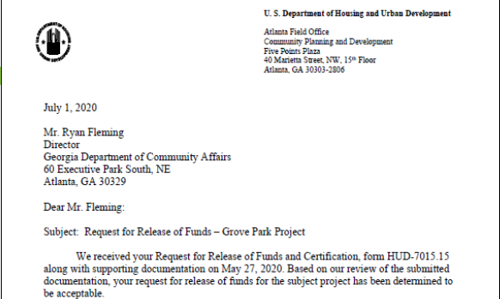
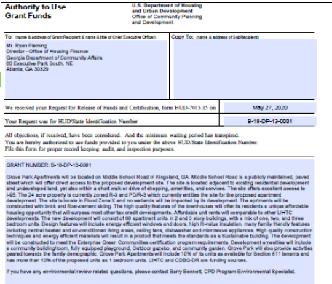
AFTER COMPLETING THE ENVIRONMENTAL REVIEW
Legal Notice
DCA publishes a notice in the local paper
15-day public comment period
Receive an affidavit from the newspaper
Request for Release of Funds (RROF)
If no adverse comments are received or valid concerns are found to exist, DCA then sends the RROF with a copy of the notice
Email to HUD with legal notice and “no comment” memo
Mail original to HUD
Authority to Use Grant Funds
HUD’s review generally takes about 20-40 days
Once completed, HUD will send the Authority to Use Grant Funds (AUGF) to DCA authorizing that DCA can use the funds as the Responsible Entity

Slide 21
CHOICE LIMITING ACTION - HOME
Activities that have physical impacts or which limit the choice of alternatives cannot be undertaken, even with the grantee or other project participant’s own funds, prior to obtaining environmental clearance, including but not limited to:
Expenditure of HOME funds
Demolition, dredging, filling, excavating
Acquisition of real property
Rehabilitation/construction of buildings or structures
Relocating buildings or structures
Conversion of land or buildings/structures

Slide 22
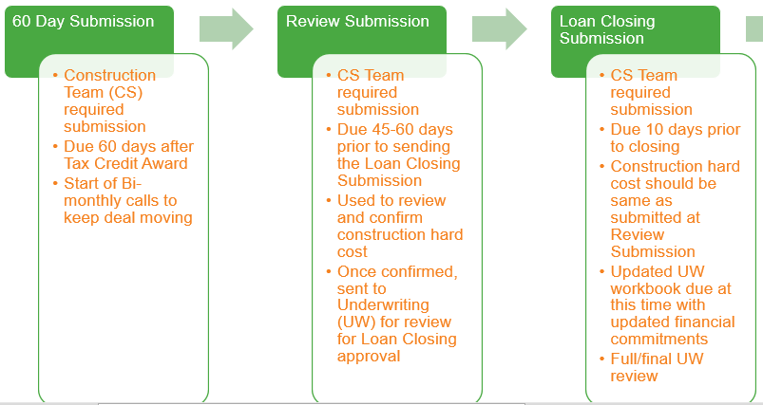
Construction Team
Three (3) submissions required for review pre-DCA closing
Approval is needed before the next submission can be electronically sent
Review Submission requires the most communication since construction hard cost amount is used to send approval to UW
If submitted prior to HOME/NHTF award, new submission will need to be submitted

Slide 23
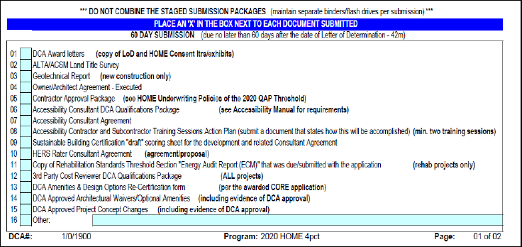
60 SUBMISSION
Common Roadblocks/Holdups
3rd Party Front End Cost Review (FECR) Consultant folder missing qualification package or required documents
Contractor Approval folder missing qualification package or required documents
Owner/Architect agreement draft instead of the finalized agreement
Submitting unsigned Accessibility Consultant Agreement
Amenities changed from awarded core application

Slide 24
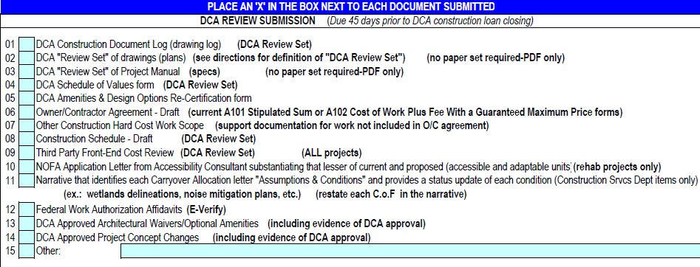
REVIEW SUBMISSION
Common Roadblocks/Holdups
FECR folder missing report or required documents
FECR report containing issues of concern from the Consultant
Schedule of Values (SoV) different from FECR report and/or
Owner/General Contractor draft agreement
SoV missing input of construction contingency and other construction hard costs by the Owner
Missing narrative identifying conditions of funding from award letter
Missing E-Verify from Owner, Developer, and General Contractor

Slide 25
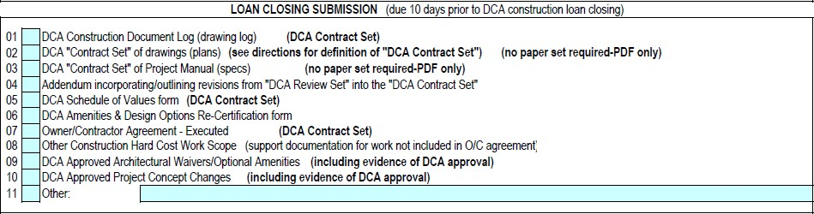
LOAN CLOSING SUBMISSION
Common Roadblocks/Holdups
Addendum of revisions to contract set drawings not submitted
Changes to SoV cost that effect both construction and underwriting numbers
Submitting the Owner/Contractor Agreement without signature

Slide 26
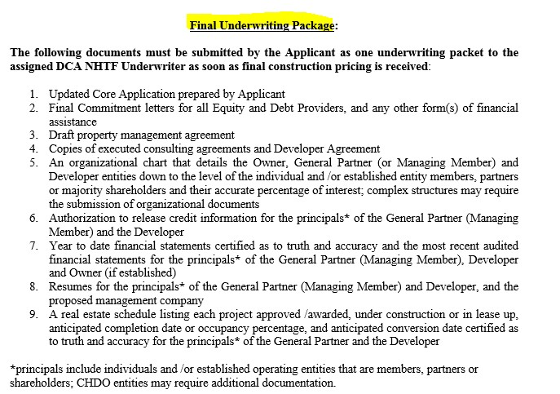

Underwriting Team

Slide 27
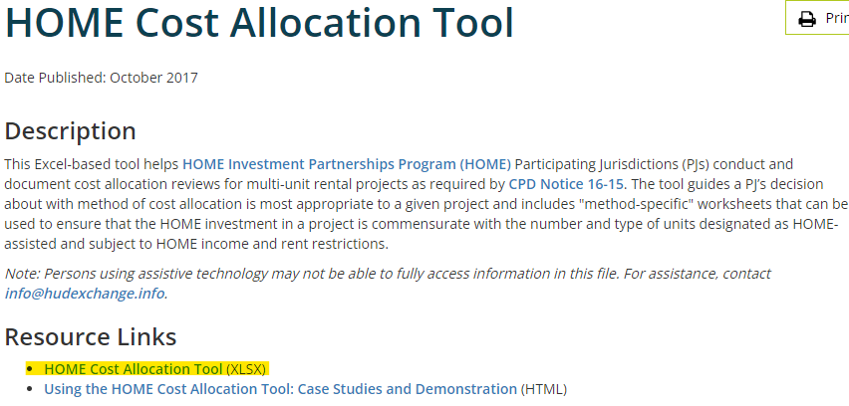
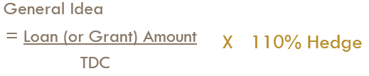
DETERMINING HOME/NHTF UNITS
HOME Cost Allocation Tool - HUD Exchange
Final amount determined at Final UW with finalized cost

Slide 28
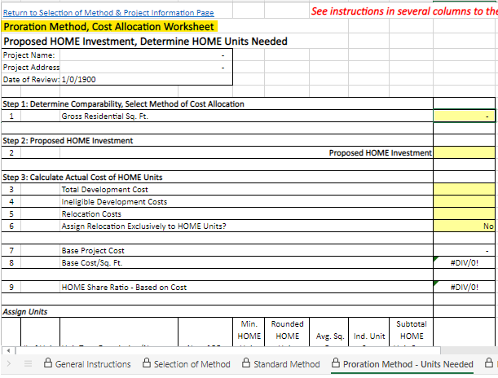
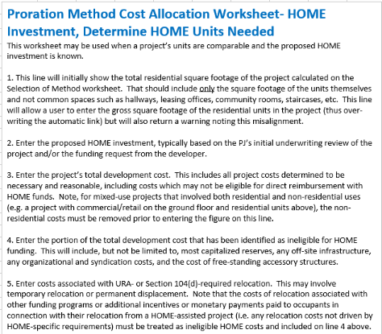
HUD’S COST ALLOCATION TOOL – PRORATION
METHOD

Slide 29
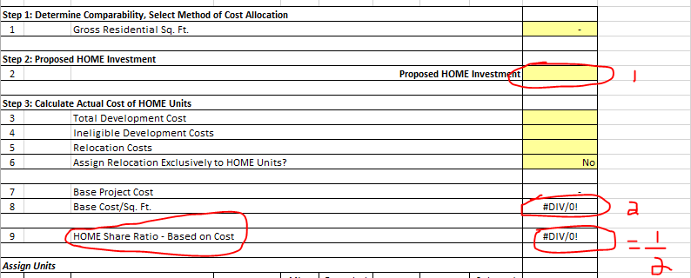
START WITH INVESTMENT AMOUNT $--- HOW MANY UNITS ARE NEEDED?
Purpose – to ensure enough HOME/NHTF/CDBG units are on the property to justify the loan/grant given to the development

Slide 30
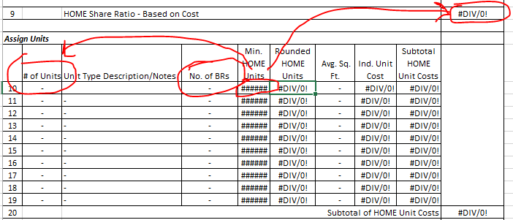
BASE COST % - HOW MANY UNITS FOR EACH BEDROOM SIZE ARE NEEDED?

Slide 31
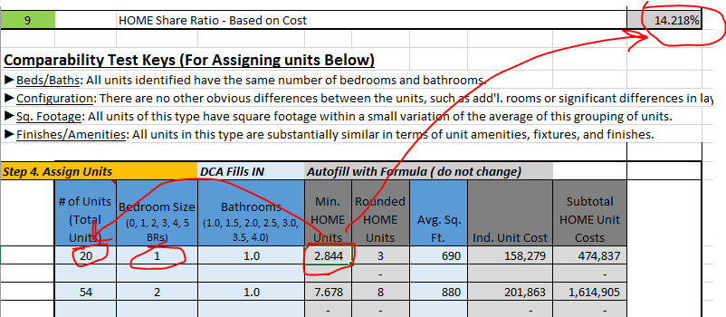

Slide 32
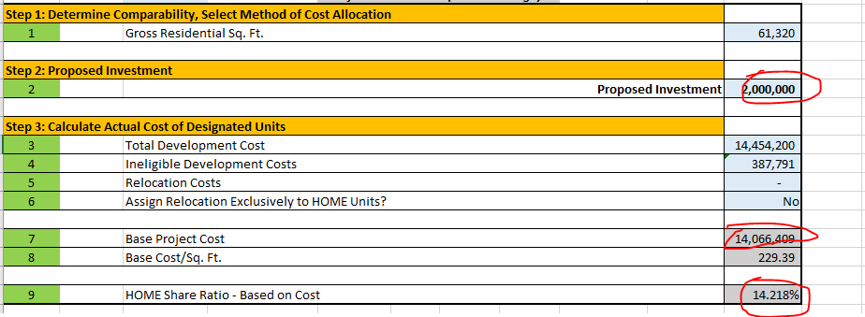

Slide 33
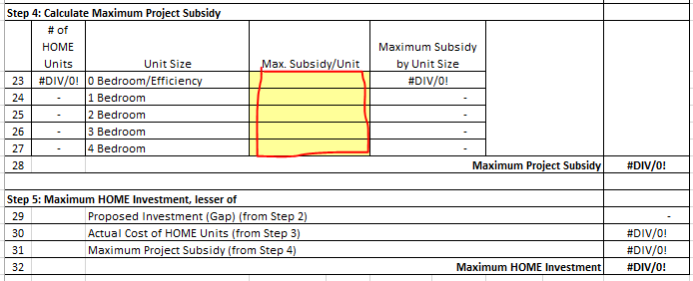
INVESTMENT SUBSIDY LIMIT

Slide 34
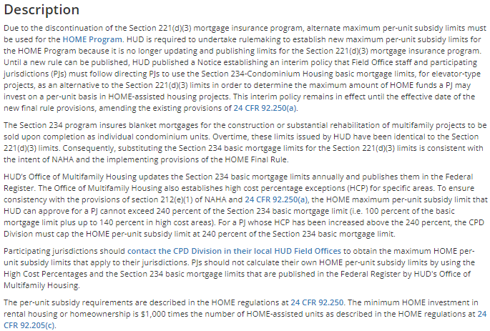
HOME MAXIMUM PER-UNIT SUBSIDY LIMITS
https://www.hudexchange.info/resource/2315/home-per-unit-subsidy/

Slide 35
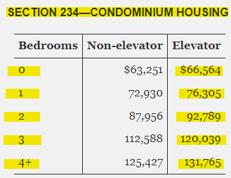
SECTION 234 BASIC MORTGAGE LIMITS
Federal Register :: Annual Indexing of Basic Statutory Mortgage Limits for Multifamily Housing Programs; Annual Indexing of Substantial Rehabilitation Threshold

Slide 36
SUBSIDY LIMITS
NHTF - The HTF regulation [24 CFR 93.300(a)] requires grantees (states) to establish the maximum amount of HTF funds that may be invested per-unit, with adjustments for the number of bedrooms and the geographic location of the project. The regulation requires the maximums be reasonable and based on actual costs of developing housing in the area of the project.
NHTF – DCA matches subsidy limits for HOME units
TCAP – no subsidy limit

Slide 37
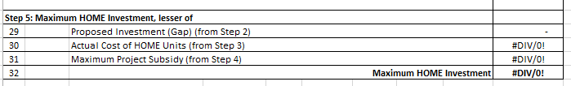
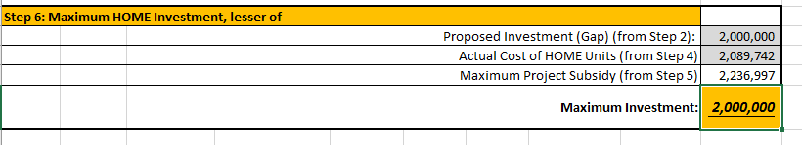
MAXIMUM HOME INVESTED

Slide 38
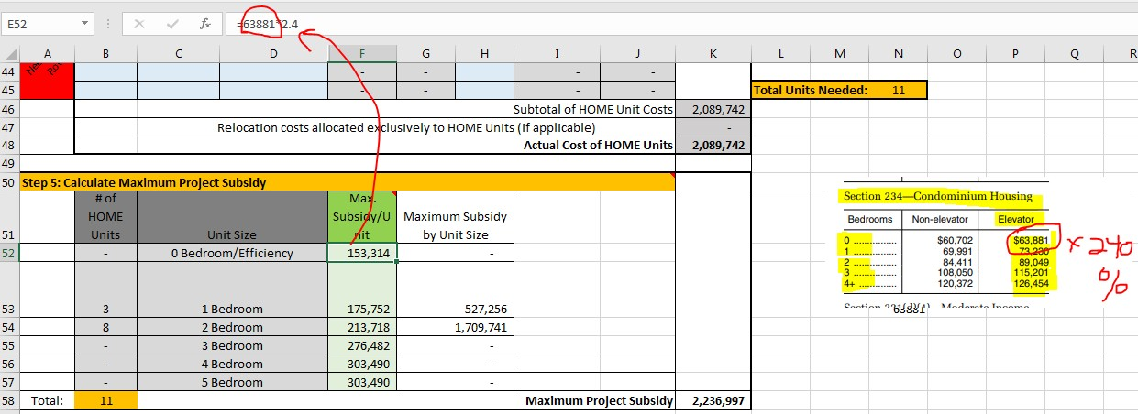
MAXIMUM SUBSIDY & DCA HEDGE
It is DCA's internal policy to increase the units needed by a 10% hedge
So 11 units needed would go to 12.1 (rounded to 13), adding 1 -1BR unit and 1 -2 BR unit
This accounts for any disputable costs and changes in costs

Slide 39
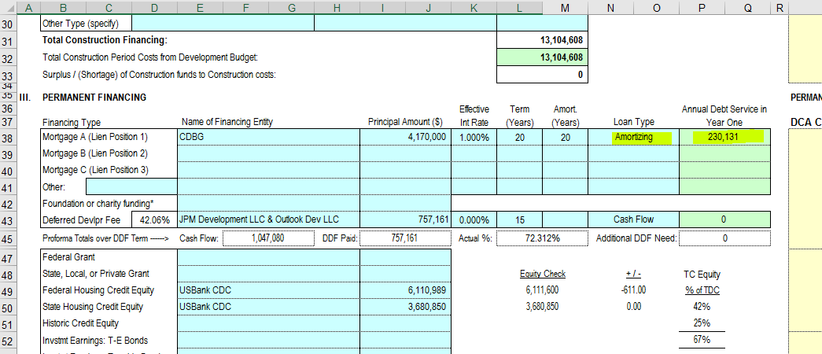
SOURCES OF FUNDS - PAYMENTS
Common holdups in the Underwriting review:
- Cost increases - ripple effect
Sources, uses, payments
Delays
- Unit mix changes
- Inconsistency with submitted construction hard cost

Slide 40
LOAN DOCUMENTS
Addendum
Affidavit
Architect Consent
Assignment
Closing statement
Contractor consent
GP Certificate
Guaranty _ ADC Communities
Guaranty _ KCG Communities
Guaranty _ RJ Pasquesi
HOME agmt
Loan agmt
LURA
LURC
Note
Opinion letter (AGG)
Opinion letter (FL)
Reserve agmt
Security deed
Title binder
Title policy
UCC Financing Statement (Central Index)
UCC
UCC-Re
Unrec docs
Documents completed depends on deal type and funding source(s).

Slide 41
Thanks!
Any questions?
Please reach out to: hfdround@dca.ga.gov

