Slide 1
Balance of State Continuum of Care
Statewide Membership Meeting
September 15, 2021 Webinar
Presented by DCA as Collaborative Applicant

Slide 2

WebEx Introduction
Notice the menu options at the bottom of your screen
Please remember to mute yourself unless you are talking
You are muted if the microphone is red
You can toggle the mute off and on by clicking the microphone
Board members MUST unmute and announce name to make motions
Board members MUST unmute in order to vote

Slide 3
WebEx Introduction
To view the participants click on the blue participant circle
To view the chat click on the circle with the chat bubble
Please make sure chat is set to “Everyone” for discussion

Slide 4
Agenda
Welcome and Introductions
COVID-19 Response
Balance of State CoC Updates
Homeless Initiatives in the Balance of State CoC
Public Comment

Slide 5
Balance of State Continuum of Care

Slide 6
Staff Updates
Shavona McCalep, HMIS Data Analyst
Diana Pitcher, Continuum of Care Co-Coordinator
Josh Gray, Continuum of Care Program Manager
John Shereikis, Interim Office Director
Daphne Walker, Division Director

Slide 7
HUD Continuum of Care
A Continuum of Care (CoC) is established by representatives of relevant organizations within a geographic area to carry out the responsibilities set forth in the CoC Program interim rule.
Georgia Balance of State CoC has152 counties.
Notes:
Tab B: Committee Member Appointments
Committee Appointments proposed for:
Assessment, Placement, and Services Committee
Homeless Management Information Systems Committee

Slide 8
HUD Continuum of Care Program
The CoC Program is designed to assist individuals and families experiencing homelessness and to provide the services needed to help them move into permanent housing, with the goal of long-term stability.
To develop a long-term strategic plan and manage a year-round planning effort that addresses
  the needs of homeless individuals and households;
  the availability and accessibility of existing housing and services; and
  the opportunities for linkages with mainstream housing and services resources.
To prepare an application for McKinney-Vento Homeless Assistance Act (McKinney-Vento) competitive grants.
To have an independent Board of Directors, maintain a written Governance Charter, set and meet goals to prevent and end homelessness, and implement all other requirements of the HEARTH Act

Slide 9
Collaborative Applicant (DCA) Responsibilities
To provide oversight for the Continuum in order to meet HUD’s rule for Continua of Care and to assure that requirements are met for the annual HUD Continuum of Care funding competition.
Maintain Continuum membership lists, conduct membership recruitment campaigns targeted to stakeholders, publish agendas for membership meetings, and assist the Board in conducting meetings of full membership not less than twice annually.
Consult with both ESG Entitlements and HUD Consolidated Planning jurisdictions.
Implement and coordinate the biennial unsheltered point in time count and the annual shelter survey.
Provide staff for planning and implementation of HEARTH Act requirements and overall CoC strategies

Slide 10
Membership
Formalized process
Agency representation and individuals
Voting – Designated voting member (agencies only)
Participation – Code of Conduct Policy approved 5/19/21
  Attend not less than one meeting (membership, Board, Committee, or Subcommittee) per year
  Agencies can substitute staff for meeting participation
  Inactive or non-voting members to be reviewed
CoC-funded providers are expected to participate (membership & attendance)

Slide 11
COVID-19 Response

Slide 12
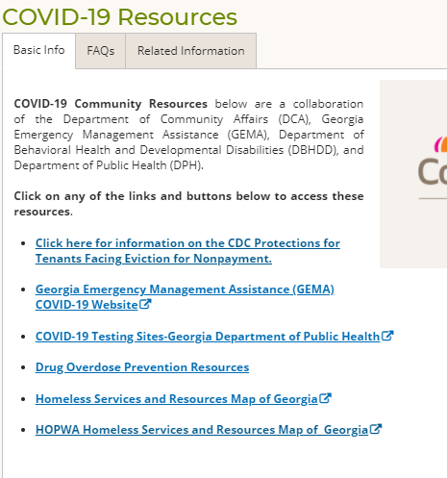
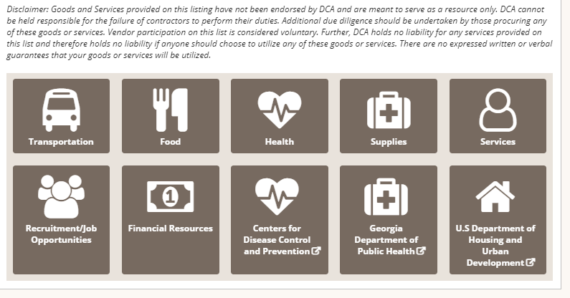
COVID-19 Update
Department of Community Affairs COVID-19 Resource Page:
  https://www.dca.ga.gov/safe-affordable-housing/homeless-special-needs-housing/covid-19-resources

Slide 13
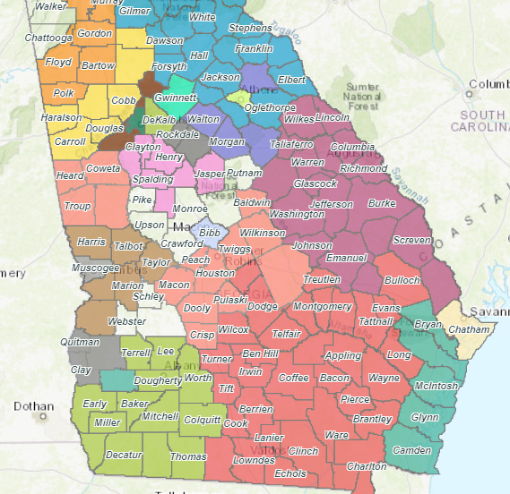
CARES Act ESG Resources
https://georgia-dca.maps.arcgis.com/apps/webappviewer/index.html?id=1d28c562b3ba4390a66640db23f713fe

Slide 14
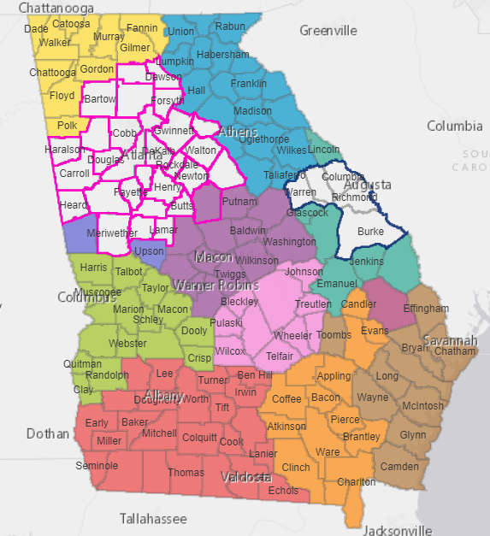
HOPWA Resources
https://georgia-dca.maps.arcgis.com/apps/webappviewer/index.html?id=28e98c7dea484a45ac5f836207e020ee

Slide 15
ESG-CV
HUD issued CPD-21-08 on July 19, 2021 which detailed new waivers and alternative requirements for ESG under the CARES Act.
New eligible funding activities including;
Cell phones and internet
Essential Services for RRH, HP, hotels/
motels
Vaccine Incentives
PPE for HP and RRH program participants
CE
Laundry
Furniture
& household furnishings
Renters insurance
Sponsor based rental assistance

Slide 16
ESG-CV
Extended deadline for spending on emergency shelter/temporary shelter (9/30/2022)
Time limit on medium-term rental assistance
  12-month limit on medium-term rental assistance is lifted.
Expansion of RRH and HP assistance
  Limit on maximum amount of rental assistance and services costs (24 months within 3 years) is waived.
  When a program participant moves into a unit in the middle of the month, the initial payment of the partial-month’s rent doesn’t count towards total rental assistance limit.
PBRA Flexibility
  When a program participant moves into a unit in the middle of the month, the initial payment of the partial-month’s rent doesn’t count towards total rental assistance limit.
  May pay rent for a maximum of 30 days from the end of the month in which the unit was vacated while attempting to housing another program participant in the unit.
  For more detailed information on the new eligible activities, alternative requirements and waivers please reach out to the ESG team. Marion.Goulbourne@dca.ga.gov.

Slide 17
CDC Eviction Moratorium
As of 8/26/2021, the CDC Eviction Moratorium has ended.
ESG-CV
Georgia Rental Assistance
EHV

Slide 18
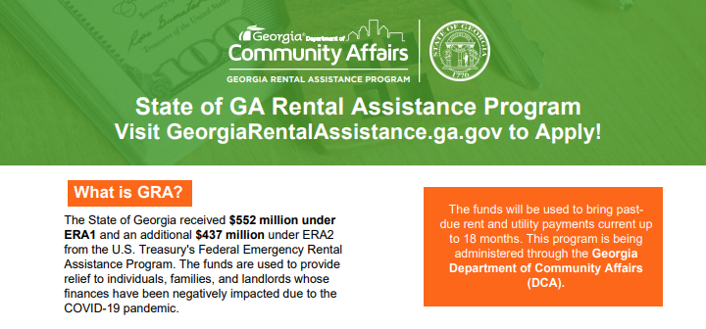

Slide 19
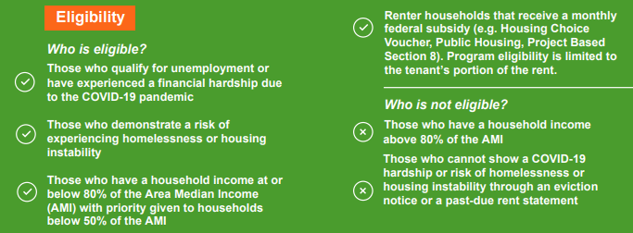

Slide 20
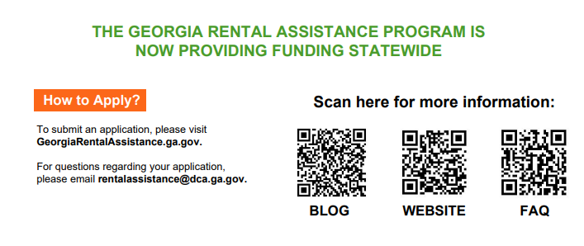

Slide 21


Slide 22
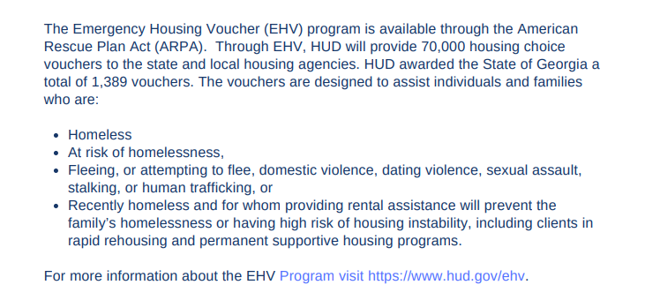

Slide 23
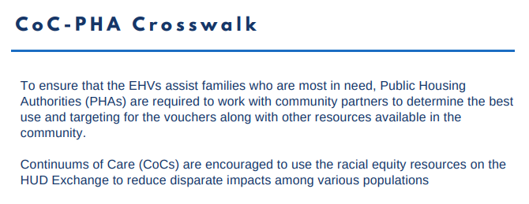

Slide 24
Emergency Housing Voucher (EHV) Program
Balance of State CoC will be working with the State's Housing Authority and the City of Albany's Housing Authority in their respective coverage areas.
  State’s Housing Authority awarded 798 vouchers
  City of Albany’s Housing Authority awarded 21 vouchers
Referrals to the EHV program are required to utilize the CoC’s Coordinated Entry Process. CES Leads act as referring agents.
If you are interested in learning more or becoming a referral agency, please reach out to CoC staff at bosehv@dca.ga.gov

Slide 25
Balance of State Continuum of Care Updates

Slide 26
Youth Homelessness Demonstration Project
The GA BoS CoC successfully submitted an application to the YHDP on August 27th.
Governance structure approved by CoC Board on 7-9-21 including:
  YAB Governance
  YAB Membership
We should know in the next few months if we were approved for YHDP funding.
Next steps:
  Community Plan
  Follow through with strategic plan to end youth homelessness regardless of funding.
Notes:
2020 Continuum of Care Competition Update
HUD is currently exploring alternative approaches to distributing FY 2020 CoC Program funds
If pending legislation passes to allow automatic renewals, HUD expects to start contract process in December
Absent Legislation, HUD will run full competition
Once HUD opens competition or releases more details, there will likely be a specially called meeting of the Standards, Rating, and Project Selection Committee as well as the CoC Board.
2020 Youth Homelessness Demonstration Program Competition Update
Expected at any time
HUD indicated that materials are working their way through clearance
Board review

Slide 27
Coordinated Entry Equity Demonstration
The Coordinated Entry Equity Demonstration (Demo) is a cohort of Continuums of Care (CoCs) that will work together to design more equitable assessment and prioritization processes to improve conditions and outcomes for Black, Brown, Indigenous, and all people of color.
In partnership with Black, Brown, Indigenous and people of color, as well as people with lived expertise, 8-10 CoCs will identify system disparities through local data, agree upon focus area(s) and test racially equitable CES processes in service of significantly transforming the experience and housing stability of those disproportionately represented in our homeless response systems.
The Georgia BoS CoC submitted a letter of interest to HUD to be a part of the CE Equity Demo.
Notes:
2020 Continuum of Care Competition Update
HUD is currently exploring alternative approaches to distributing FY 2020 CoC Program funds
If pending legislation passes to allow automatic renewals, HUD expects to start contract process in December
Absent Legislation, HUD will run full competition
Once HUD opens competition or releases more details, there will likely be a specially called meeting of the Standards, Rating, and Project Selection Committee as well as the CoC Board.
2020 Youth Homelessness Demonstration Program Competition Update
Expected at any time
HUD indicated that materials are working their way through clearance
Board review

Slide 28
Coordinated Entry Update
Glynn County Regional Expansion
"Coastal Coordinated Entry" now has community partners providing services in the following counties: Glynn, Camden, McIntosh, Bryan, Wayne, and most of Liberty
Lowndes County Soft Implementation
Lowndes County has begun the process of being an anchor community for CE in their area.
Upcoming Training Opportunities
Emergency Housing Voucher Training
VI-SPDAT Training
Notes:
2020 Continuum of Care Competition Update
HUD is currently exploring alternative approaches to distributing FY 2020 CoC Program funds
If pending legislation passes to allow automatic renewals, HUD expects to start contract process in December
Absent Legislation, HUD will run full competition
Once HUD opens competition or releases more details, there will likely be a specially called meeting of the Standards, Rating, and Project Selection Committee as well as the CoC Board.
2020 Youth Homelessness Demonstration Program Competition Update
Expected at any time
HUD indicated that materials are working their way through clearance
Board review

Slide 29
Homeless Initiatives in the Balance of State Continuum

Slide 30
2021
BoS CoC Competition Status Update
2021 Notice of Funding Opportunity was published on August 18th
Georgia Balance of State CoC Competition opened Tuesday, September 14th.
  Review Applications due September 28th/29th
  HUD Application (e-snaps) due October 13th
Competition documents and policy can be found on our website here
  https://www.dca.ga.gov/safe-affordable-housing/homeless-special-needs-housing/georgia-balance-state-continuum-care/2021
Notes:
2020 Continuum of Care Competition Update
HUD is currently exploring alternative approaches to distributing FY 2020 CoC Program funds
If pending legislation passes to allow automatic renewals, HUD expects to start contract process in December
Absent Legislation, HUD will run full competition
Once HUD opens competition or releases more details, there will likely be a specially called meeting of the Standards, Rating, and Project Selection Committee as well as the CoC Board.
2020 Youth Homelessness Demonstration Program Competition Update
Expected at any time
HUD indicated that materials are working their way through clearance
Board review

Slide 31
2021
BoS CoC Competition Status Update
New Application Webinars will take place on:
September 17th at 1 PM
  Register here.
September 22nd at 10 AM
  Register here.
Renewal Application Webinars will take place on:
September 17th at 10 AM
September 20th at 1 PM
Notes:
2020 Continuum of Care Competition Update
HUD is currently exploring alternative approaches to distributing FY 2020 CoC Program funds
If pending legislation passes to allow automatic renewals, HUD expects to start contract process in December
Absent Legislation, HUD will run full competition
Once HUD opens competition or releases more details, there will likely be a specially called meeting of the Standards, Rating, and Project Selection Committee as well as the CoC Board.
2020 Youth Homelessness Demonstration Program Competition Update
Expected at any time
HUD indicated that materials are working their way through clearance
Board review

Slide 32
Balance of State CoC
2021 Point In Time Count: Overview

Slide 33
Timeline
Training Part 1:
December 2020
Training Part 2:
January 2021
Point In Time
Monday, January 25, 2021
(sunset – sunrise)
Provider-level survey deadline:
Tuesday, February 2, 2021
Agency Follow up:
February 2021
DCA Analyze Data:
March 2021
HUD Submission:
April 2021
Service Based window: through Sunday, February 7, 2021
2021 Planning worksheet for count coordinator deadline: Wednesday, January 6, 2021
Notes:
This timeline contains all important dates related to the federal reporting process. I encourage everyone to print this timeline out and have it posted somewhere and/or create calendar notifications.
[Read Slide with below added notes]
Training part 2- will consist of details specific to the SimTech Solutions Application used to capture data for the PIT
The provider-level survey is the survey used to capture all sheltered homeless data for the PIT and HIC
During the month of February DCA will follow up with Count Coordinators and agencies related to data submission
During the month of March, the HMIS team will be conducting an extensive verification process of data submission

Slide 34
Unsheltered Count
(Street Count)

Slide 35
PIT Count Planning
Methodologies for the sheltered and unsheltered count, including enhanced approaches for hard-to-count geographies and subpopulations
A data quality plan
Identification and confirmation of locations to count sheltered and unsheltered people
Survey development
Volunteer roles, recruitment, and training
Use of incentives, if necessary
PIT count committee membership, roles, and responsibilities
Date and time for the count
The night of the count and any related count approaches occurring in the following 7-day period
Count publicity
Notes:
PIT Count Planning consist of: READ PIT COUNT PLANNING
DQ- collecting accurate data
Survey Development- in order to collect the demographic and characteristic information, this is done through a survey
Because the Balance of State consist of 152 counties, organizationally the CoC recruits County Count Coordinators and empower coordinators to completely plan and execute the PIT count locally. This is a role that is unique to balance of state CoC among other Georgia CoCs.
There is a lot of planning that goes into executing the PIT count. To further paint a visual, in order to collect information, on the night of the count, many volunteers will canvass the street for persons experiencing unsheltered homelessness and will conduct a survey on the individuals confirmed as meeting HUD’s definition of homelessness. Because of new COVID guidelines the count will vary in which Michael Thomas will give a more in depth presentation of these changes.

Slide 36
2021 Point in Time Homeless Count
The Point in Time (PIT) Homeless Count will begin on January 25, 2021
The street count will be followed by a 7-day service-based count
DCA is working with Simtech Solutions to target count coordinators in strategic areas
Data collection will focus on quality over quantity, with an emphasis on full county coverage
The Counting Us app will once again be used for survey collection
Simtech Solutions will provide a predictive statistical model to derive unsheltered homeless estimates in counties that are not physically counted
DCA is exploring further refinements to the final written report, including margins of error for estimates

Slide 37
Background and Methodology
First used in 2008
Continued use in 2009, 2011, 2013, 2015, 2017 & 2019
Physical count
Regression model
Predictive variables
Clusters (modified use in 2019)
Count Coordinator Confidence
Partnerships:
Simtech Solutions
Communities and homeless service providers statewide
Notes:
Regression Model- In statistical modeling, regression analysis is a set of statistical processes for estimating the relationships between a dependent variable and one or more independent variables
Significant changes:
- Use of the Counting Us App provided more accurate data submission and greater number of use of data
- Simtech solutions increased the accuracy of the predictive model

Slide 38
WAIVED

Slide 39
2011 – 2019 BoS Unsheltered PIT Counts
Notes:
As you can see from the trend line, unsheltered homelessness is overall declining though we witnessed a slight increase this year with 2,262 persons.
I’ll get into more details as to why we think we witnessed an increase in some later slides

Slide 40
Homeless Count Trend 2011 - 2019
Notes:
This trend line looks much like the unsheltered PIT
This graph represents a 13% increase from 2017

Slide 41
Sheltered Count

Slide 42
2021 Housing Inventory & Sheltered Homeless Count Overview
Similar to 2020, the Balance of State CoC conducted the 2021 Housing Inventory and Sheltered Homeless Point In Time count by distributing a provider-level survey to all Homeless Assistance agencies (funded and non-funded/ HMIS-participating and Non-HMIS participating) within the Balance of State 152-county jurisdiction.
Survey data was collected regarding Housing bed inventory and homeless count of the night of the count, Monday, January 25.
Survey Submission Deadline: Tuesday, February 1.
Completed surveys are submitted via a link
  No paper surveys should be collected this year
  Results will establish the housing capacity of the Balance of State CoC and count of sheltered persons on the night of the count.
Notes:
[Read Slide]
Again, the Balance of State uses this provider-level survey to capture both the Housing Inventory data which is the number of beds and units available on the night of the count that are dedicated to serve persons who are homeless AND the sheltered point in time count which is the census of all sheltered persons experiencing homelessness. This information helps the Balance of State understand our sheltered and housing bed capacity as well as utilization rate of our bed capacity on the night of the count.
It is imperative that we receive a completed survey from all homeless assistance projects within the Balance of State CoC to capture an accurate depiction of homelessness reported to HUD. All homeless assistance projects meaning those who are funded and non-funded, projects that utilize our HMIS system for data collection and non-HMIS participating agencies.
Polling Question
Who should submit a Sheltered Homeless Survey also known as the provider-level survey?
Only funded projects within the Balance of State CoC
Only HMIS-participating agencies within the Balance of State CoC
Only Emergency Sheltering projects within the Balance of State CoC
All homeless assistance projects (Emergency shelter, Transitional Housing, Permanent Support Housing, Rapid-ReHousing) within the Balance of State CoC

Slide 43
2011 – 2021 BoS Sheltered PIT Counts
Notes:
As you can see from the trend line, unsheltered homelessness is overall declining though we witnessed a slight increase this year with 1,921 persons.

Slide 44
2022 Balance of State CoC Homeless Count
Conducting an unsheltered count in 2022
  The 2021 unsheltered count was waived due to COVID-19
  Last unsheltered count was held in 2019
  Need to understand the number and characteristics of people experiencing homelessness at a point in time

Slide 45
2022 Balance of State CoC Homeless Count
Methodology and Process includes:
  Review of predictive model provided by Simtech Solutions
  Focus on Counting Us app for unsheltered count
  Extensive count coverage in targeted counties and street and service-based count
  Sheltered count provider surveys
  Data processing and Submission
Contingency Plan

Slide 46

2022 HMIS Data Standards
HUD released the 2022 HMIS Data Standards in August.
Expect changes in ClientTrack beginning 10/1/2021.
Updates to existing data elements, new data elements and removed some data elements.
Eccovia hosted a Data Standard Webinar on September 7th. Recording can be accessed here.
BoS HMIS User Group Quarterly Trainings
  Tuesday, September 21st at 10AM, Register here.
  Thursday, September 23rd at 11 AM, Register here.
An Interactive Tool of all the 2022 HUD Data Standard Changes can be found at this link: HUD Exchange
Have questions? Reach out to your local CoC HMIS Administrator or email your questions to GAHMISSupport@dca.ga.gov

Slide 47
2022 Data Standards: Updates to Existing Data Elements
Gender
  Gender field will be a multi-select picklist field (complies with HUD’s definition of a client’s self-identification)
Race
  The following picklist options will be updated to:
  American Indian, Alaska Native, or Indigenous
  Asian or Asian American
  Black, African American, or African
  Native Hawaiian or Pacific Islander
Ethnicity
  The following picklist options will be updated to:
  Non-Hispanic/Non-Latin(a)(o)(x)
  Hispanic/Latin(a)(o)(x)
Pregnancy Status
  “Pregnancy Status” will no longer be based on just “female” participants/clients to reflect that people other than those who identify as female can be pregnant.
Coordinated Entry Event
  The following new Referral Events options are being added:
  Referral to emergency assistance/flex fund/furniture assistance
  Referral to a Housing Stability Voucher
  Referral to Emergency Housing Voucher (EHV)
HOPWA-funded Medically Assisted Living Facility
  A new "HOPWA-funded Medically Assisted Living Facility” field is being added.
HOPWA Services Provided
  The HOPWA service category, “Substance abuse services/treatment” is being revised to “Substance use disorder services/treatment.”
Ryan White Medical or Dental
  There is a new “Receiving Ryan White-funded Medical or Dental Assistance” field is being added and will be captured/updated at program enrollment, annual assessment, and program exit.

Slide 48
2022 Data Standards: Updates to Existing Data Elements
RHY Service Connections
  “Substance abuse treatment” is being revised to “substance use disorder treatment”
  “Substance Abuse Ed/Prevention Services” is being revised to “Substance Use disorder Ed/Prevention Services”
Formerly a Ward of Juvenile Justice System
  “If Yes for ‘Formerly a Ward of Child Welfare or Foster Care Agency’” is being revised to “If Yes for ‘Formerly a Ward of Juvenile Justice System.’”
Funding Sources
The following new Funding Sources are being added:
  HUD: CoC - Joint Component RRH/PSH
  HUD: HOME (ARP)
  HUD: PIH (Emergency Housing Voucher)
Mental Health Problem
  “Mental Health Problem” is being revised to “Mental Health Disorder
Substance Use Problem
  Substance Use Problem” is being revised to “Substance Use Disorder”
General Health Status
The following Program Components and Project Types will now be required to collect General Health Status:
  Funder: Program-Component:
  HUD: HUD-VASH - Collection required for HUD/VASH-OTH
  HHS: RHY - Collection required for all components except for Street Outreach
  HUD: CoC - Permanent Supportive Housing
Project Type Applicability:
  Emergency Shelter
  Transitional Housing
  PH - Permanent Supportive Housing
  RH - Rapid Rehousing

Slide 49
2022 Data Standards: New Data Elements
Well-Being
  There is a new Data Element (for Head of Households only) containing five questions about client well-being that will be required for HUD-CoC Permanent Supportive Housing projects.
  This field will be captured/updated at program enrollment, annual assessment, and program exit.
Moving On Assistance
  A new service category of “Moving On Assistance Provided” is being added for HUD-CoC Permanent Supportive Housing projects.
Youth Education Status
  There is a new Data Element (for Head of Households only) containing three questions about youth educational status that will be required for HUD-CoC Youth Homeless Demonstration Program (YHDP) projects.
HOPWA: Prescribed Anti-Retroviral
  A new “Prescribed Anti-Retroviral” Data Element (required for all household members with HIV/AIDS) will be added to the HOPWA program enrollment, annual assessment, and program exit.

Slide 50
2022 Data Standards: Removed Data Elements
SSVF (All Components)
  The following Data Elements will no longer be required for VA: SSVF-funded projects:
  Physical Disability
  Developmental Disability
  Chronic Health Condition
  HIV/AIDS
  Mental Health Disorder
  Substance Use Disorder

Slide 51
Longitudinal System Analysis (LSA)
The Longitudinal Systems Analysis (LSA) report, produced by Homelessness Management Information System (HMIS) and submitted annually to HUD via HDX 2.0, provides HUD and the CoC with critical information about how people experiencing homelessness use their system of care.

Slide 52
Upcoming Trainings
EHV Referral Process: September 16th at 2 PM
BoS HMIS User Group Quarterly Training, September 21st at 10 AM
BoS HMIS User Group Quarterly Training, September 23rd at 11 AM
Coordinated Entry Written Standards and Policies and Procedures: TBD
Fair Housing and Equal Access: Date and Time TBD
VAWA: Date and Time TBD
BoS CoC Written Standards: Date and Time TBD
USICH Listening Session: October, Date and Time TBD

Slide 53
Public Comment

Slide 54
Questions?

Slide 55
Balance of State Staff Contacts
Amanda Brand, Coordinated Entry System Coordinator
  (470) 328-9686 / amanda.brand@dca.ga.gov
Ambra Houser, Data Analyst
  (404) 679-3102 / ambra.houser@dca.ga.gov
Chandra Woods McGhee, HMIS Data Analyst
  (404) 679-0655 / BosHMIS@dca.ga.gov
Diana Pitcher, CoC Program Coordinator
  (404) 679-0651 / diana.pitcher@dca.ga.gov
Isaac Davis, Coordinated Entry System Coordinator
  (404) 370-2985 / isaac.davis@dca.ga.gov
Johh Shereikis, Interim Office Director
  (470) 747-9331 / john.shereikis@dca.ga.gov
Josh Gray, CoC Program Manager
  (404) 327-6811 / Josh.Gray@dca.ga.gov
Rebecca Hickom, Continuum of Care Performance Coordinator
  (470) 423-1432 / rebecca.hickom@dca.ga.gov
Rick Heermans, Continuum of Care Assistant
      rick.heermans@dca.ga.gov
Shavona McCalep, HMIS Data Analyst
  (404) 486-0219 / BoSHMIS@dca.ga.gov
Tina Moore, CoC Program Coordinator
  (404) 679-0669 / tina.moore@dca.ga.gov

Slide 56
Thank You!
Any questions?
You can contact DCA at: Tina.Moore@dca.ga.gov or Josh.Gray@dca.ga.gov

