Slide 1
DCA Construction Codes Program Update
Revised: March 1, 2019
Ted Miltiades, Director of Codes and Industrialized Buildings

Slide 2
DCA Codes & Industrialized Buildings (IB) Staff
Ted Miltiades, Director Codes & IB, 404-679-3106 or ted.miltiades@dca.ga.gov
Jimmy Reynolds, Codes Consultant, 404-679-3104 or jim.reynolds@dca.ga.gov
Brendan Sexton, Codes Consultant, 404-679-1739 or brendan.sexton@dca.ga.gov
RC Connell, Industrialized Buildings Consultant, 404-679-3121 or r.c.connell@dca.ga.gov
Donna Brown, Codes Assistant, 404-679-3118 or donna.brown@dca.ga.gov
Webpage: www.dca.ga.gov/local-government-assistance

Slide 3
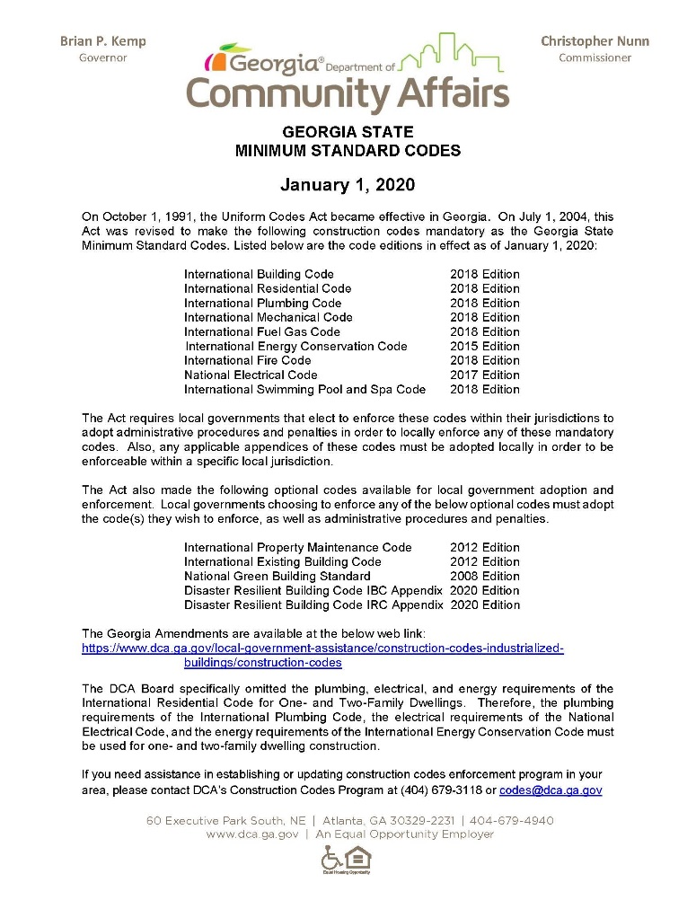
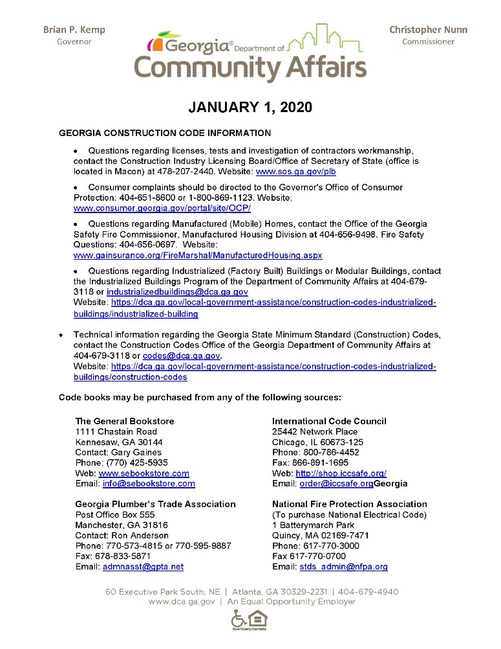
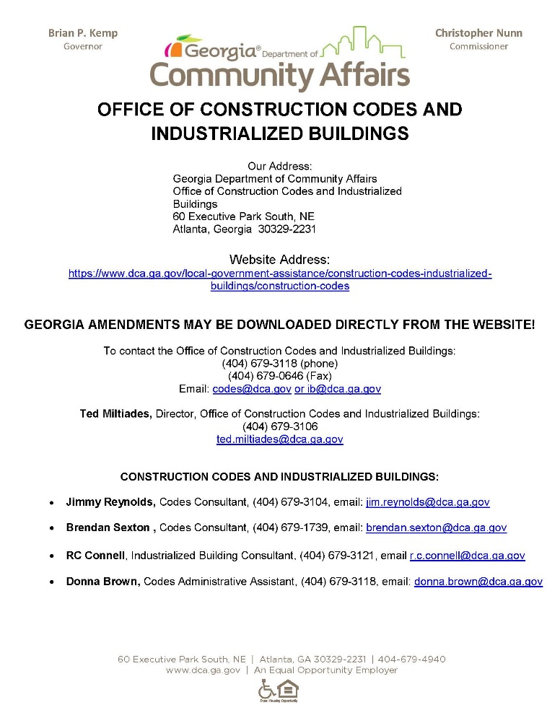
DCA Georgia Construction Information Sheets
Min Standard Codes
Construction Code Info
DCA Contact Info

Slide 4
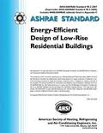
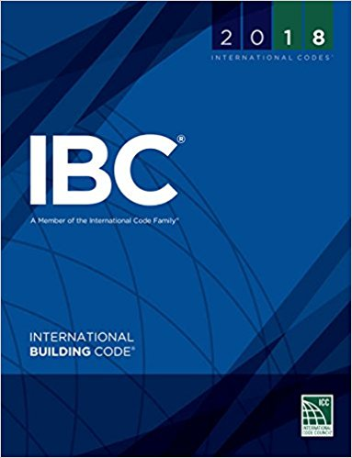
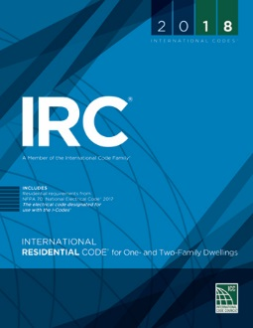
New Mandatory Codes - January 1, 2020
INTERNATION ENERGY CONSERVATION CODE (IECC), 2015 Edition
OPTIONAL: 2013 ASHRAE 90.1 STANDARD FOR COMMERCIAL BUILDINGS
INTERNATIONAL BUILDING CODE (IBC), 2018 Edition
INTERNATIONAL RESIDENTIAL CODE (IRC), 2018 Edition

Slide 5
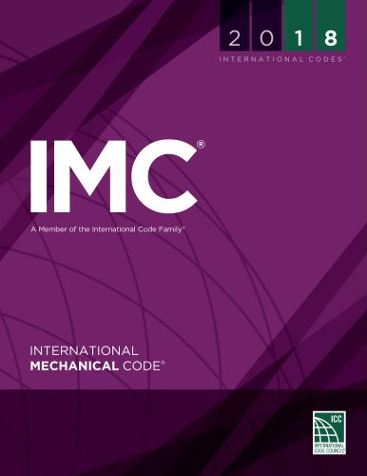
New Mandatory Codes – January 1, 2020
International Plumbing Code (IPC), 2018 Edition
International Swimming Pool and Spa Code (ISPSC), 2018 Edition
International Fuel Gas Code (IFGC), 2018 Edition
International Mechanical Code (IMC), 2018 Edition
International Fire Code (IFC), 2018 Edition

Slide 6
Link to 2020 GA Amendments & Top 20 Key Code Changes
CLICK HERE TO DOWNLOAD COPIES OF THE 2020 GA AMENDMENTS & TOP 20 KEY IBC/IRC CODE CHANGES:
https://www.dca.ga.gov/node/5689

Slide 7
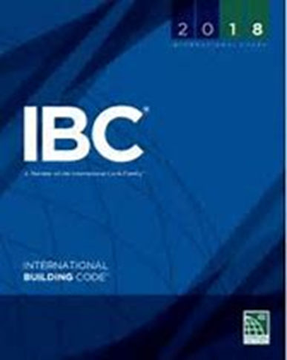
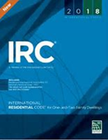
2018 IBC/IRC – Top 20 Key Code Changes

Slide 8
2018 IBC – Examples of Key Changes
Chapter 34 Reserved. Changed to read ‘Existing Buildings’ and all the provisions from Chapter 34 ‘Existing Buildings’ of the 2012 IBC were carried forward to the 2018 IBC. (GA amendment)
3401.7 Existing systems conformance. The 50% rule for the extent to which the existing systems are made to conform to the code requirements for new construction was clarified to state these requirements specifically apply to mechanical, electrical, plumbing and life safety systems. (GA amendment)

Slide 9
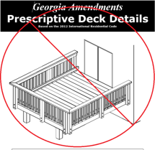
2018 IRC – Examples of Key Changes
R507 Exterior Decks. The Prescriptive Deck Details design
document was not brought forward in the 2020 GA Amendments.
The 2018 IRC reorganized R507 Decks which incorporated
many of the more useful illustrations and provisions to simplify
the prescriptive construction of a deck. R507 is now much
clearer in regards to deck materials, deck footing, joist spacing
and spans, and fastener requirements.
R303.4 Mechanical ventilation. Where the air infiltration rate of a dwelling unit is 5 3 air changes per hour or less where tested with a blower door at a pressure of 0.2 inch w.c. (50 Pa) in accordance with Section N1102.4.1.2, the dwelling unit shall be provided with whole-house mechanical ventilation in accordance with Section M1505.4. Important Note: Mechanical ventilation is not mandatory for all new home construction unless it tests 3 ACH or less.

Slide 10
2020 NEC Task Force – Mandatory Code
National Electrical Code (NEC) 2017 Edition without any Georgia State Code Amendments replaced the current NEC 2014 Edition
Effective January 1, 2018
National Electrical Code (NEC) 2020 Edition Task Force TBD
Tentative Effective Date January 1, 2021

Slide 11
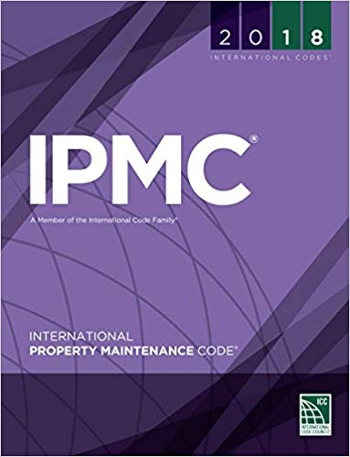
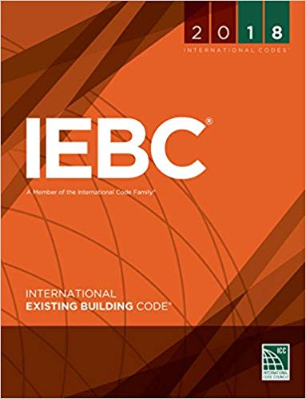
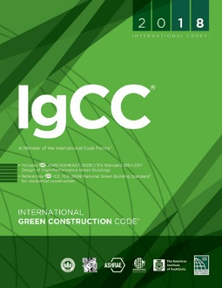
Future Task Forces – Permissive Codes
2018 International Property Maintenance Code (IPMC)
2018 International Existing Building Code (IEBC)
2018 National Green Building Standard (ICC-700)
2018 International Green Construction Code (IGCC) ?
Task Forces will be appointed at June SCAC meeting
2021?

Slide 12
2015 IECC Energy Code Training Workshops
REGISTER HERE!
Energy Code Workshop link: https://www.dca.ga.gov/node/5691
Date | Area |  | Date | Area |  | Date | Area
July 2nd | Buckhead |  | Aug 1st | Clayton County |  | Sept 5th | Commerce
July 9th | Newnan |  | Aug 13th | Norcross |  | Sept 10th | Tifton
July 10th | Dunwoody |  | Aug 14th | Athens |  | Sept 11th | Valdosta
July 16th | Canton |  | Aug 20th | Columbus |  | Sept 17th | Marietta
July 17th | Atlanta |  | Aug 22nd | Augusta |  | Sept 18th | Gwinnett
July 18th | Rome |  | Aug 27th | Atlanta |  | Sept 19th | Macon
July 23rd | Savannah |  | Aug 28th | Dunwoody |  | Sept 25th | Albany
July 24th | Savannah
July 30th | Gainesville
July 31st | Atlanta

Slide 13
2018 ISPSC Training Workshops
ISPSC Training Contact: Brendan Sexton, brendan.sexton@dca.ga.gov
Training Dates
Oct 9th Alpharetta
Oct 11th Savannah
Oct 21st Dallas
Oct 22nd Decatur
Dec 4th Columbus
Dec 5th Macon

Slide 14
Contact Information
GA Department of Community Affairs
Codes and Industrialized Buildings
60 Executive Park South, NE
Atlanta, Georgia 30329-2231
Phone: (404) 679-3118
Web: www.dca.ga.gov
Email: codes@dca.ga.gov
Email: ib@dca.ga.gov

