Slide 1
Water and Sewer Infrastructure Basics

Slide 2

About Melanie
MELANIE BRUEGGEMANN, PE
Business Development Manager
Auburn University
12+ years experience in the water industry
Professional Organizations
Engineering Georgia’s 2025 35 Under 35 Women to Know
Leadership Cobb Class of 2025
GAWWA Golden Hydrant Society 2025 Inductee
GAWEF 5S 2025 Inductee
Worked with Model Water Tower Committee/Events since 2018
2025 Model Water Tower Committee Secretary

Slide 3

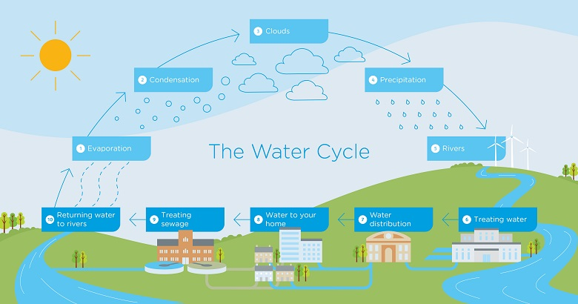
General Process

Slide 4
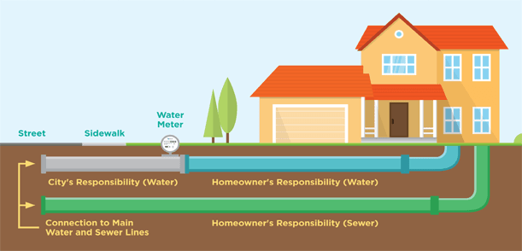
Ownership
Private Ownership
Developer Installed – Turn over to Utility
HOA Ownership
Homeowner
Public Ownership
City
County
Authority

Slide 5

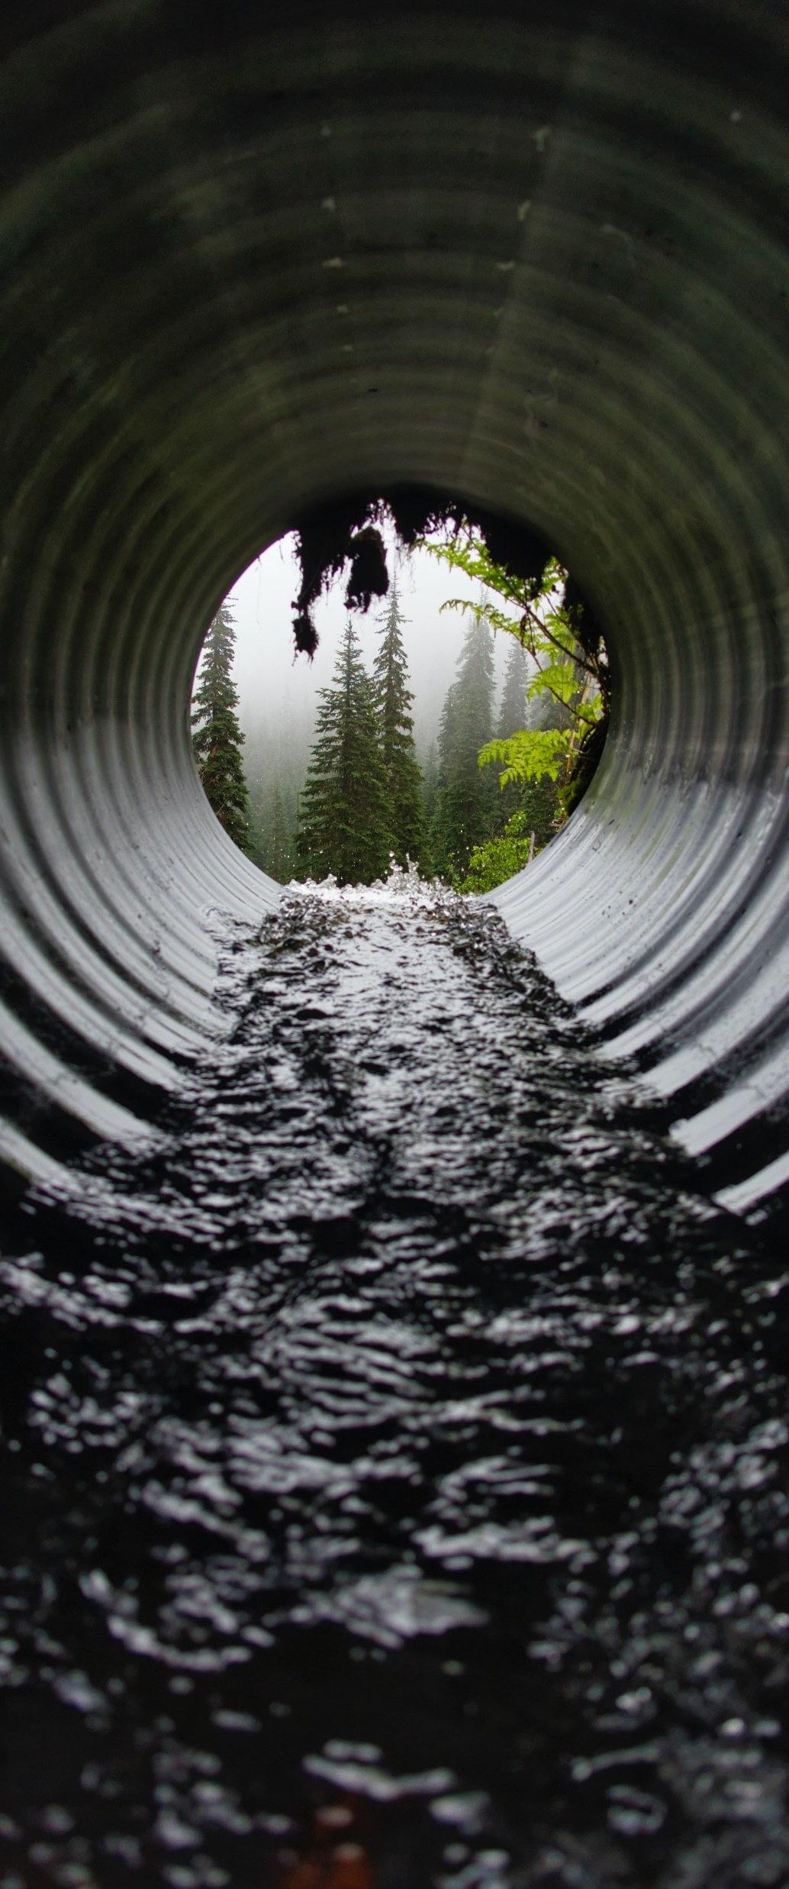


Types of Designs
SEWER
Municipal Public Sewer System
Septic Tanks
Low-Pressure Sewer Systems
WATER
Municipal Supply
Private Wells

Slide 6
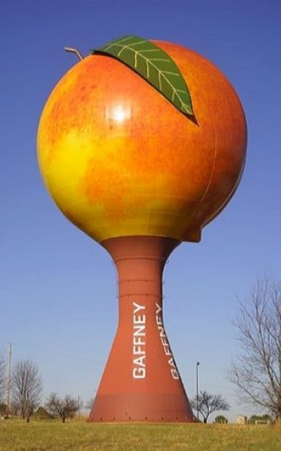
How to Design
WATER (MUNICIPAL SUPPLY)
Water Treatment Plant
  Sedimentation
  Filtration
  Disinfection
Pumping
  Required Pressures
  Domestic vs. Fire Flow
Storage
  Size
  Height
Distribution
  Pipe Sizing
  Pipe Material

Slide 7
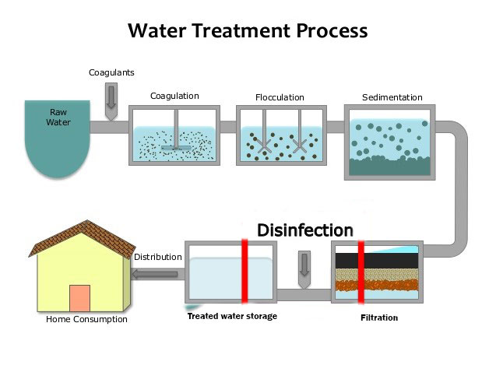
How to Design
Water Treatment Plant
Sedimentation
  "Pull Together Particles"
  Skim Clean Water
Filtration
  Sand Filtration
  Membrane Filtration
Disinfection
  NaCIO (Bleach)
  UV
Water Treatment Plant
All plant sizes require same basic process process
Sampling of water is required to determine further treatment

Slide 8
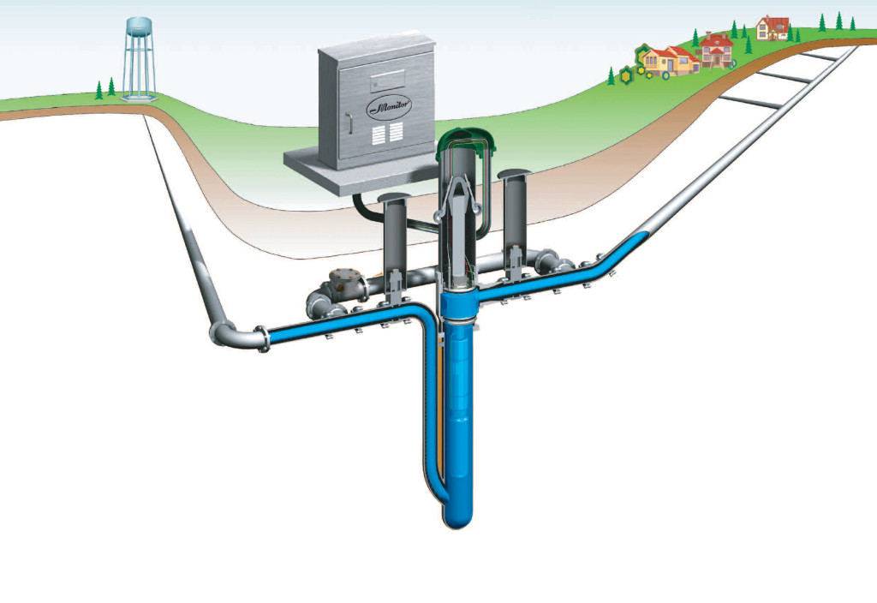
How to Design
Water Pumping
Estimated Flows
Required Pressures
  Too High – Blow Outs
  Too Low – Complaining Customers
Domestic vs. Fire Flow
  Domestic – 40psi
  Fire Flow – 20 psi

Slide 9
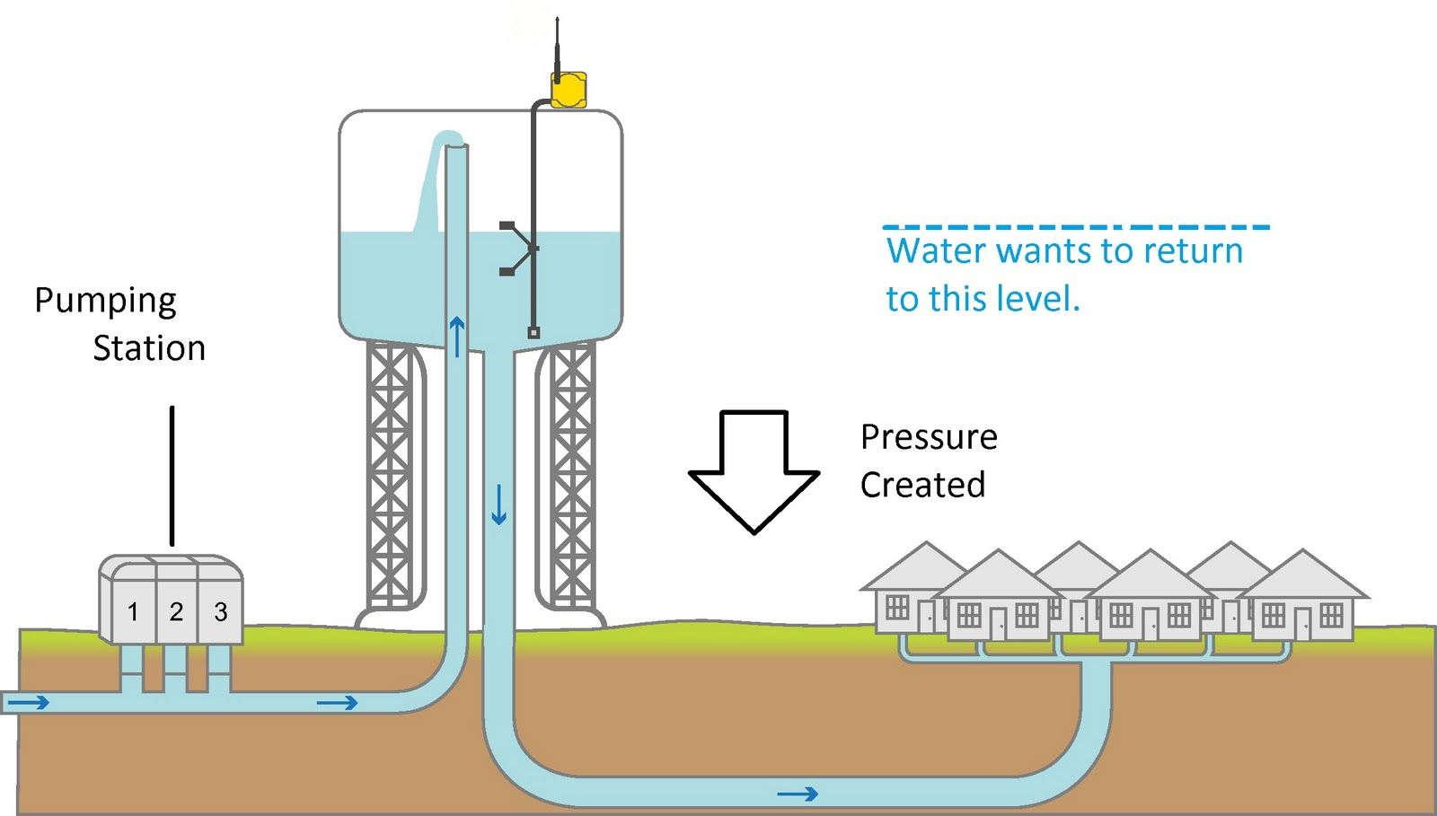
How to Design
Water Storage
Size
  24-hour storage
Height
  Head pressure
Location
  High Point
  Eliminate “elevated”
  Available property

Slide 10

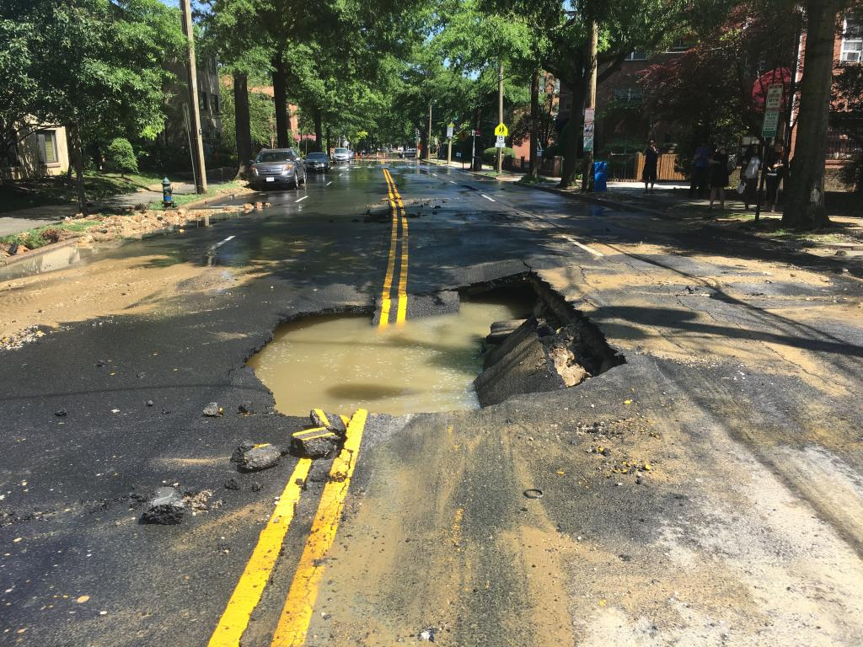
How to Design
Water Distribution
Pipe Material
  Ductile Iron, PVC, HDPE
  Type of Installation (grass pavement, etc)
Location
  Typically 4-feet underground
  Away from gas lines
  Outside of roadway, when possible

Slide 11
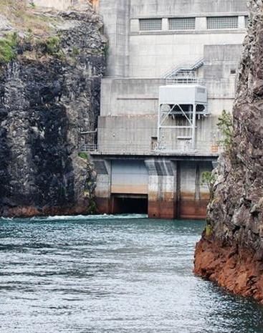
Municipal Supply Constraints
WTP
Need to be located near supply (i.e. River)
Droughts
Reservoir
Distribution
Pressure Systems
Redundancy

Slide 12
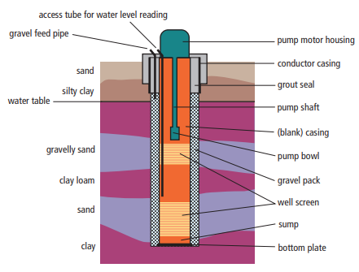
How to Design
Wells
  Typically in rural Areas
  Groundwater quality and supply most important consideration
  Screen
  Filter Casing
  Seals for contamination
Construction Constraints
  Rock
  Sulfur
  Fluctuating Water Table

Slide 13
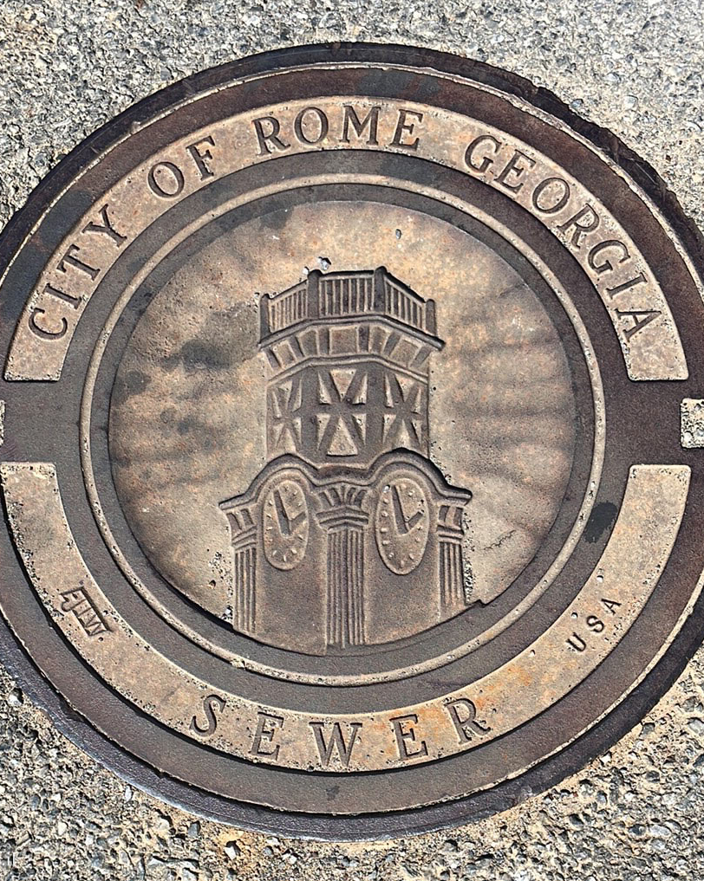
How to Design
Sewer
Collection System
  Pipe Material
  Gravity vs. Pumped
Pumping
  Force Main
  Low Flow vs. High Flow
Infiltration and Inflow
Wastewater Treatment
Disposal
  Discharge into River
  Land Application
  Water Reuse

Slide 14
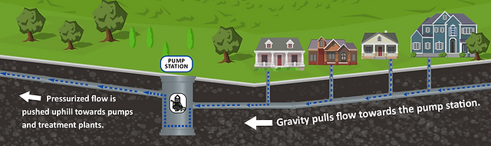
How to Design
Sewer
Collection System
Pipe Material
  Ductile Iron, PVC, HDPE
  Type if Installation (grass, pavement, etc.)
Gravity vs. Pumped
Downstream - Gravity
  Velocity – min. 2 ft/s
  Slope
  Size
Upstream - Pumped

Slide 15
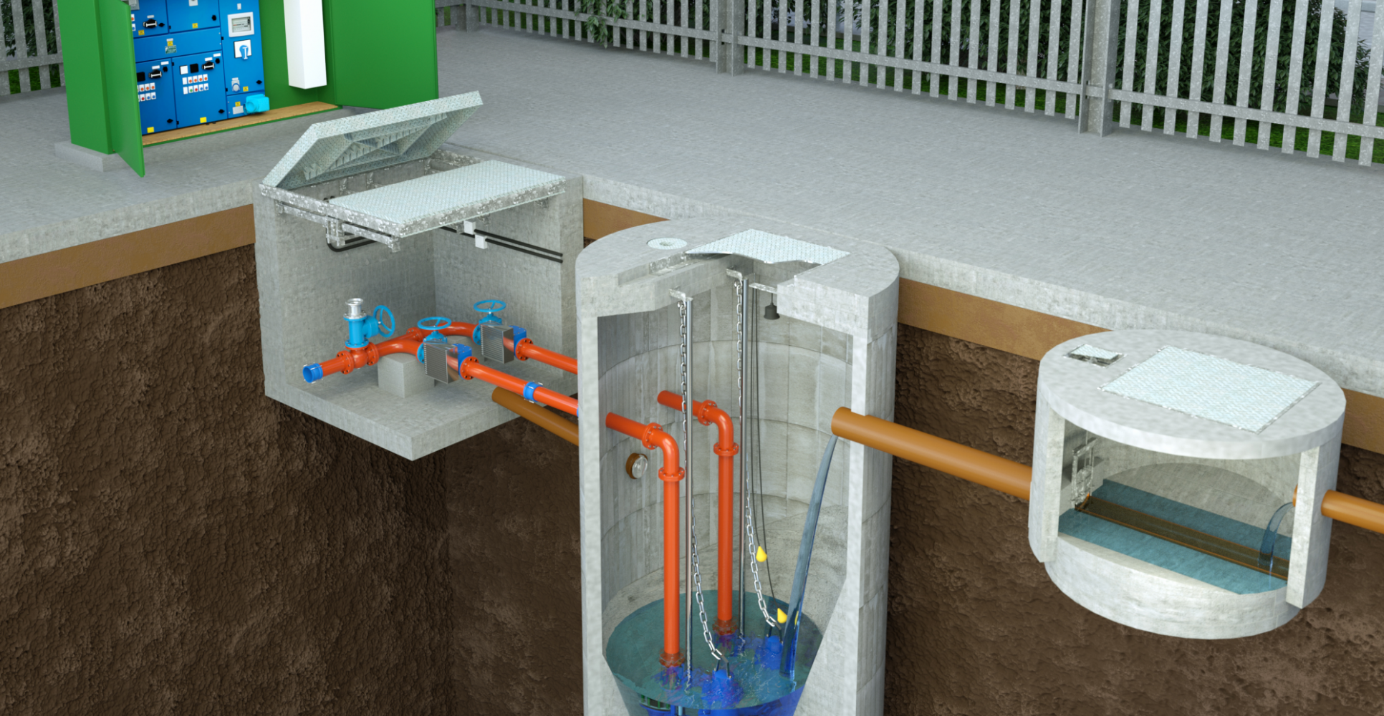
How to Design
Sewer Pumping
Force Main
  Velocity
  Flow/Pressure
  Air Release
Low Flow vs. High Flow
Wet Well Sizing
  Storage
  Invert Elevations
  Pump Size
  Check Valve
  Redundancy

Slide 16
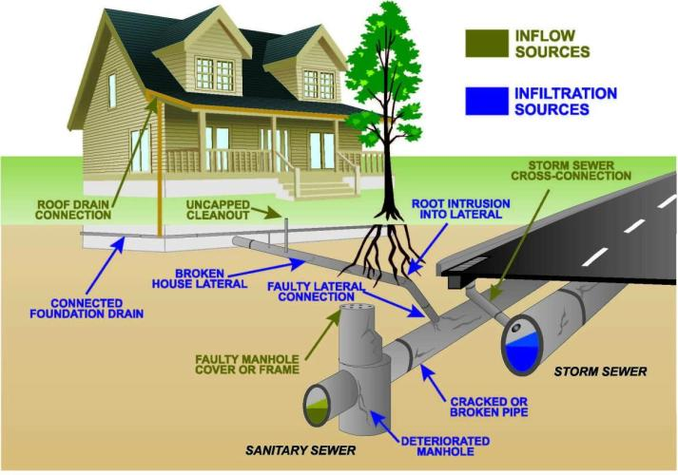
How to Design
Sewer Infiltration & Inflow
Infiltration
  Through Cracks/Joints
  Slowly Overtime
Inflow
  Open cleanout caps
  Manhole lids
  Quickly
4x Average Daily Flow

Slide 17
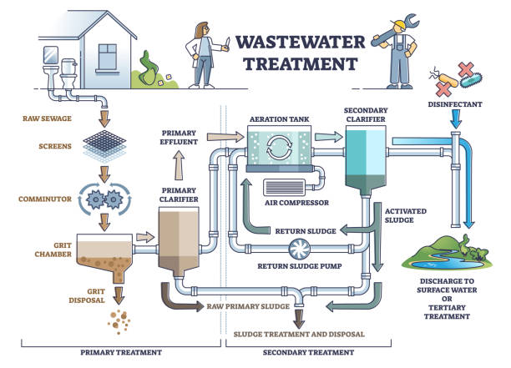
How to Design
Sewer
Wastewater

Slide 18
How to Design
SEWER – Types of Disposal
Land Application
Spray Irrigation
Drip Irrigation
Can harvest crops
Nutrient loading levels
Discharge into River
Meet NPDES Limits
Limits based on waterbody
Water Reuse
Requires more disinfection
Typically used for irrigation

Slide 19
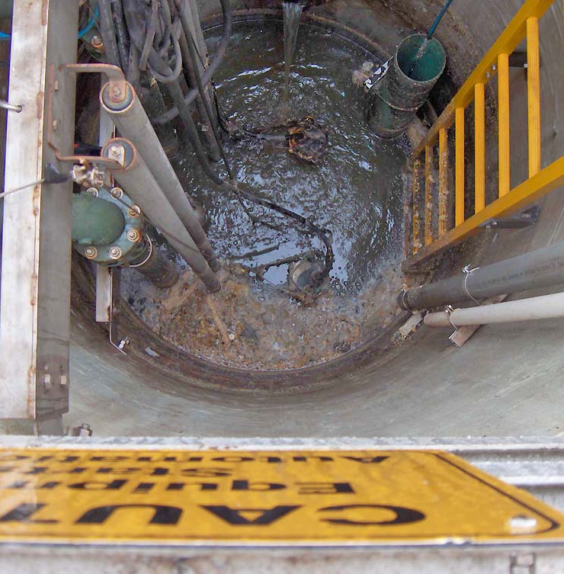
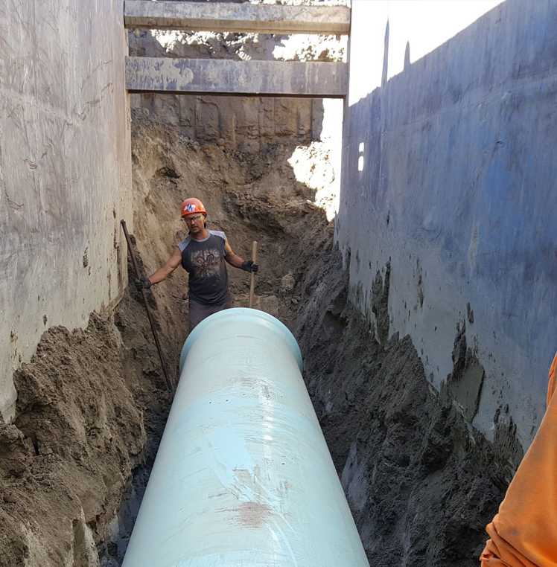
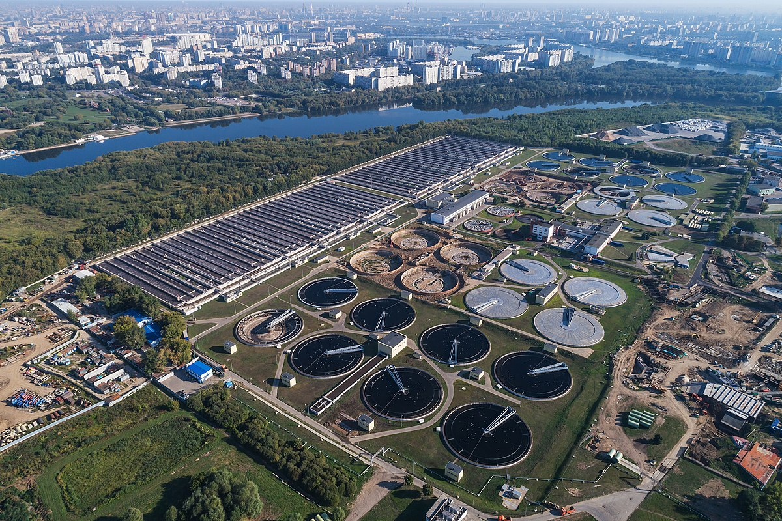
Typical Constraints
Sewer
WWTP
  Need to be located near discharge (i.e. River)
  Neighborhood
  Centralized location to collection
Land Application
  Slopes
  Rock
Collection System
  Shallow vs. Deep sewers
  Pump stations
  Odor control

Slide 20
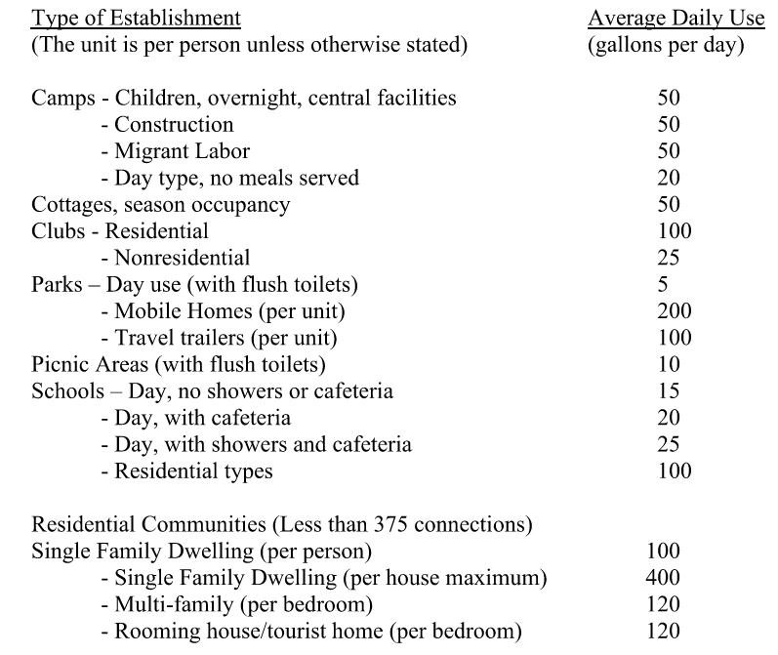
Flow Estimating
Water
Types of Flows
  Residential
  Commercial
  Weekend
Typical Domestic Flows
  100 gal/day/person
  3 persons/resident
Typical Commercial
  Restaurant: per customer
  Retail: per parking space
  School: per student

Slide 21
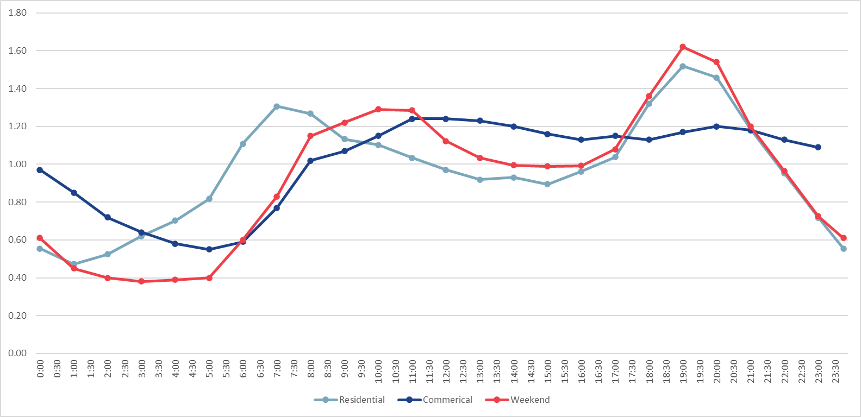
Flow Estimating
Water
Average Daily Demand
Maximum Daily Demand
  1.5 to 2 times Average
Maximum Hourly Demand
  6 to 10 times Average
Peak Demand
  Instantaneous
  Calculated by # of connections

Slide 22
Flow Estimating
Water
Sewer
Residential
60% to 85% of used water becomes wastewater
Fire Flows
  500 gpm rural
  1,000 gpm urban
  ~2,000 gpm for large development
Types
  Domestic (gal/capita)
  Commercial (gal/capita)
    800-1500 gal/acre/day
  Recreational
    Seasonal
    Irrigation
Duration: 1 hour

Slide 23
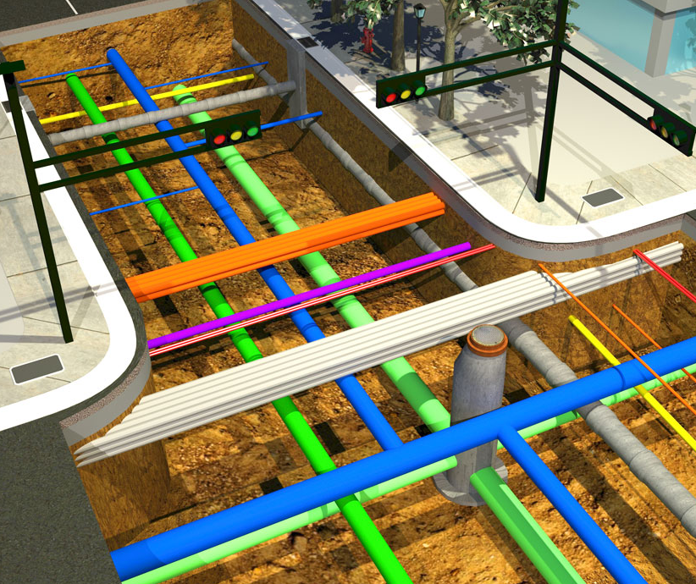
Other Considerations
Permitting
  Withdrawal Permit
  Discharge Permit
  Protected Species
  GDOT
  Creek Crossings
Schedules
  Coordination with Utilities
Sewer Infiltration and Inflow

Slide 24
Big Takeaways
1
2
3
UNDERSTAND LOCAL PLANNING
Who owns the water/sewer system?
State, County, Authority
Area constraints
Buy/Sell water from around other
Water source
UTILIZE ACCURATE CAPACITIES
Convert Land Planning into Water/Sewer Planning
Residential or Commercial vs. Available Capacity
REVIEW CONSTRAINTS
Geological constraints
Permitting constraints
Topography
Capacity

Slide 25
Helpful Resources
Design Documents
Georgia EPD – Minimum Standards for Public Water Systems
Georgia EPD – Planning for Domestic Wastewater Systems
Georgia EPD – Guidelines for Slow-Rate Land Treatment of Wastewater
McGraw-Hill – Water Resources and Environmental Engineering
Planning Documents
Georgia State Water Plan
  https://waterplanning.georgia.gov/
Georgia Regional Water Plan
Georgia Association of Water Professionals Technical Resources

