Slide 1
Regulatory Tools for Implementation
Zoning, Ordinances, Maps, and Enforcement:
It all starts with a PLAN
Paul Forgey, AICP, CFM
Director
Planning & Development Services
Albany/Dougherty County
Community Planning Institute
March 8, 2024
Carrollton, GA

Slide 2



The Comprehensive Plan
Required by state (but a very good idea anyhow)
Five-year updates
New plan every ten years

Slide 3
From Plan to Implementation
Land Use Element of Plan
Existing Land Use Map (not required)
Future Land Use Map
  Or, Character Areas Map
  Or, Land Based Classification Standards
  (one of these is required)
Certainly, other parts of Comprehensive Plan are important to implementation:
Economic Development
Housing
Natural and Cultural Resources
Transportation
That’s why its COMPREHENSIVE!

Slide 4
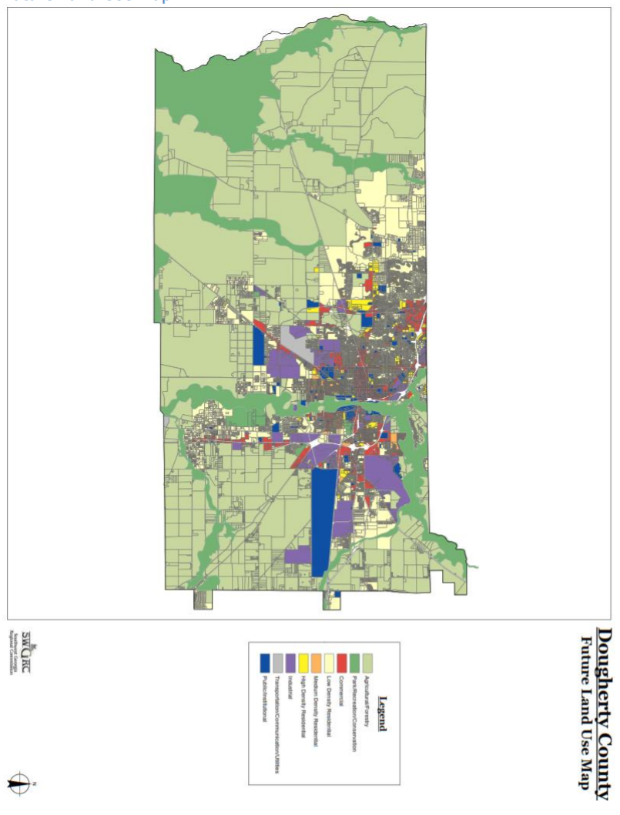
Future Land Use Map

Slide 5
The Zoning Ordinance
Implements the Comprehensive Plan
Based on the Future Land Use Map and the goals of the community
And of course, Georgia law
(zoning procedures law)
NOTE: If you have not updated your ordinance and procedures in the last year, YOU NEED TO.

Slide 6
Zoning
Ordinance
Usually includes more than the separation of land uses like residential, commercial, industrial, etc.
Basic Community Design Standards
Setbacks
Density
Height
Fencing
Parking
Sidewalks
Landscaping, open space
Screening
Standards for miscellaneous uses
Cell towers
Community Residences
Adult Entertainment
Solar power
Mobile homes
Tiny homes

Slide 7
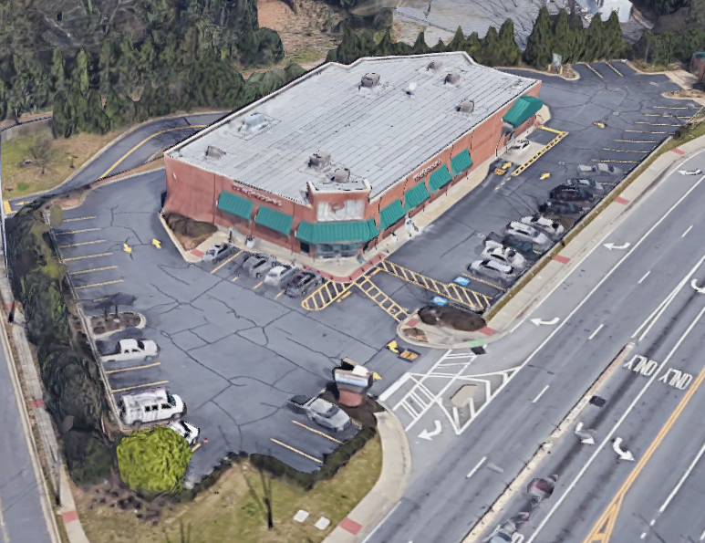
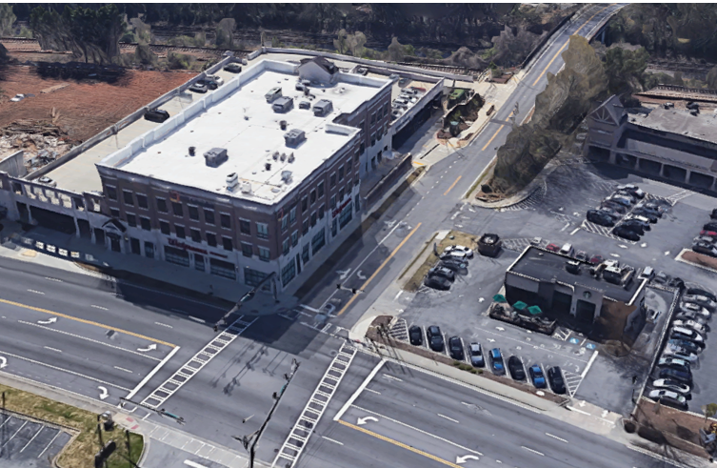
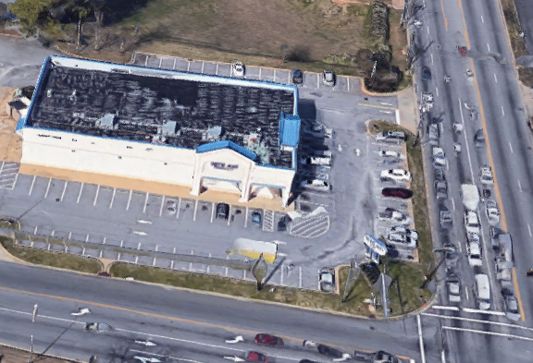
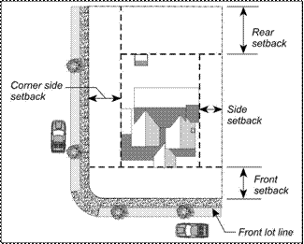
Community Design
Setbacks
Keep development consistent
Sets visual character of the street
Can encourage pedestrians- or deter them

Slide 8

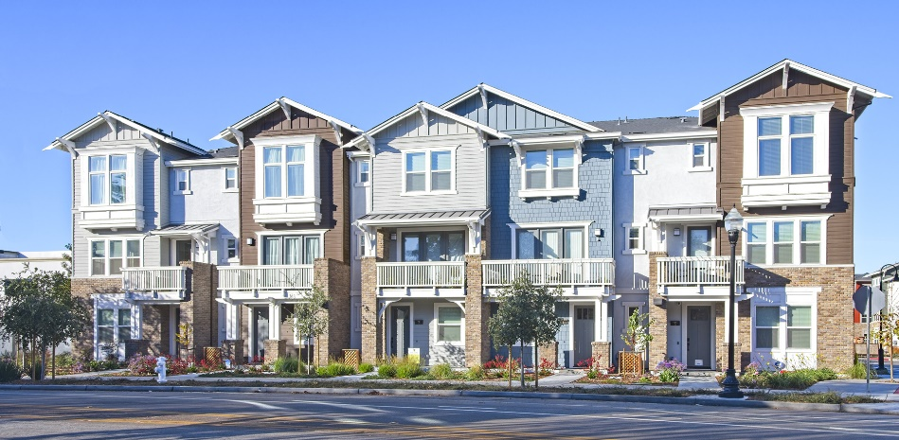
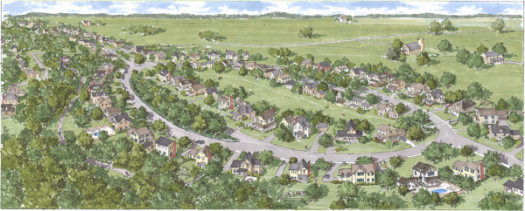
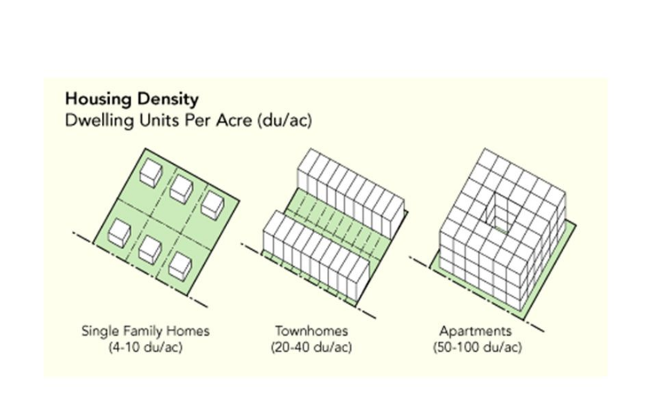
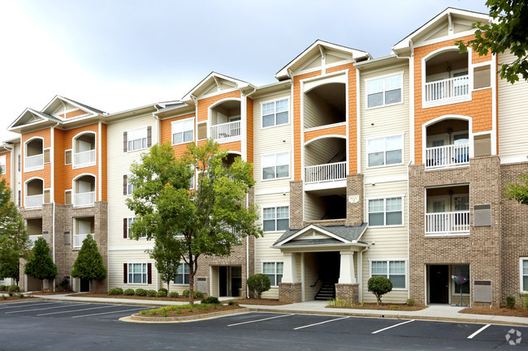
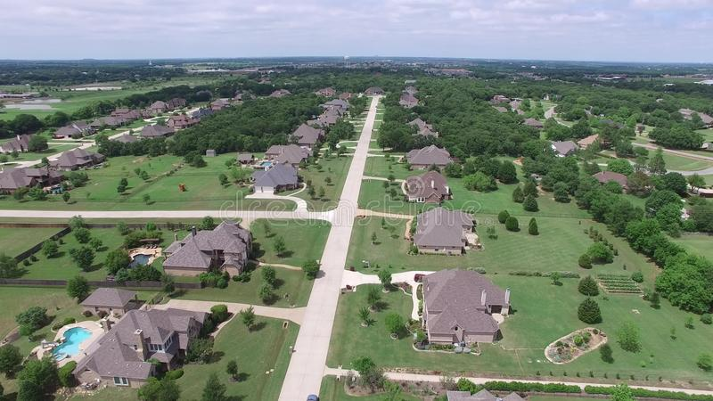
Community Design
Density
Number of units per acre. Higher density is often controversial but can be a better use of land and infrastructure. Provides housing options.

Slide 9
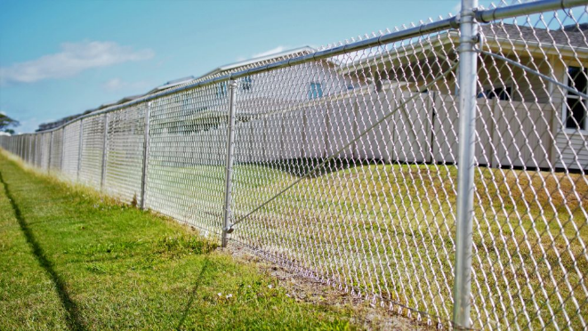
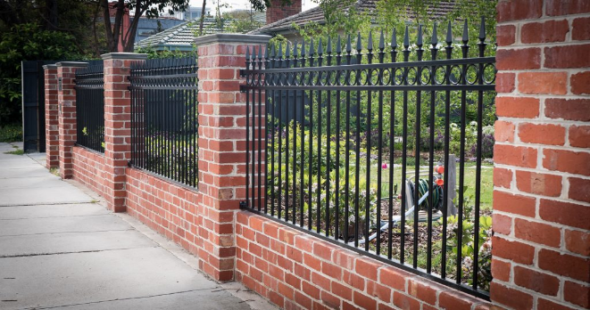
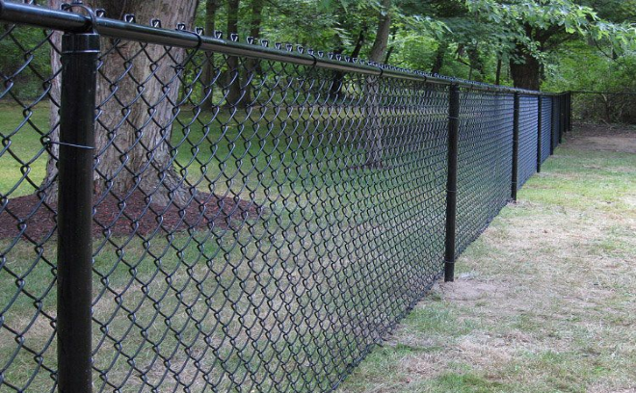
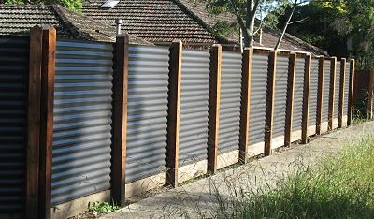
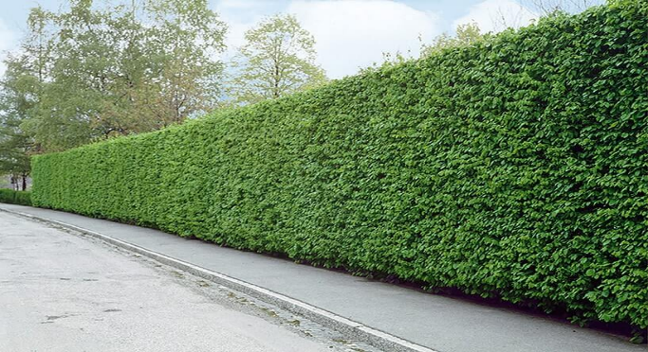
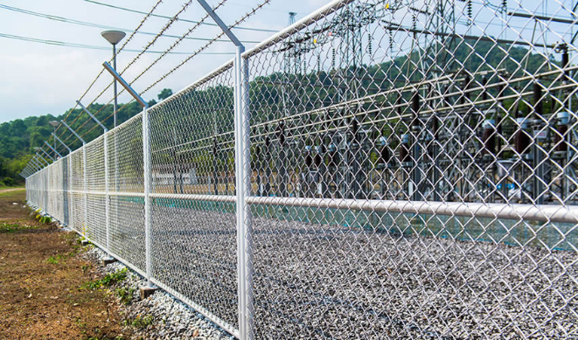
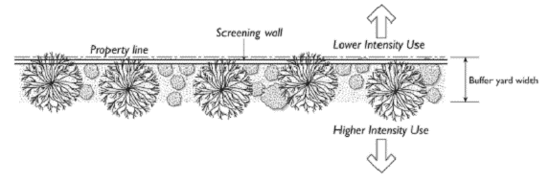
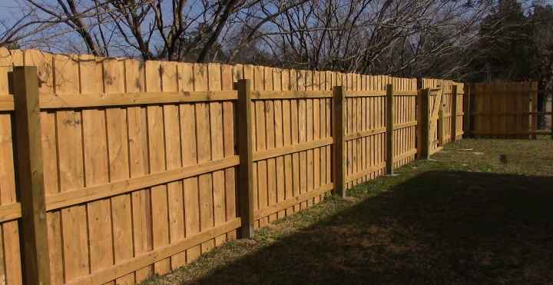
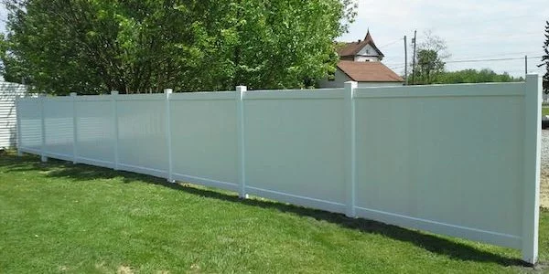
Community Design
Fencing and Screening
Provides privacy, definition of space. May be required to screen between different land uses

Slide 10
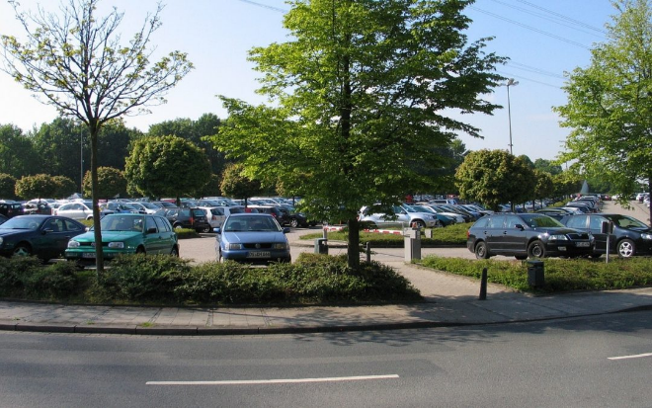
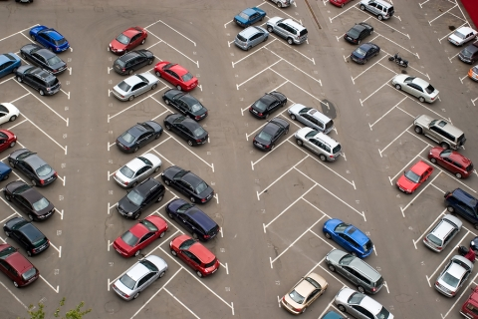
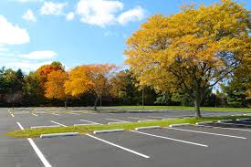
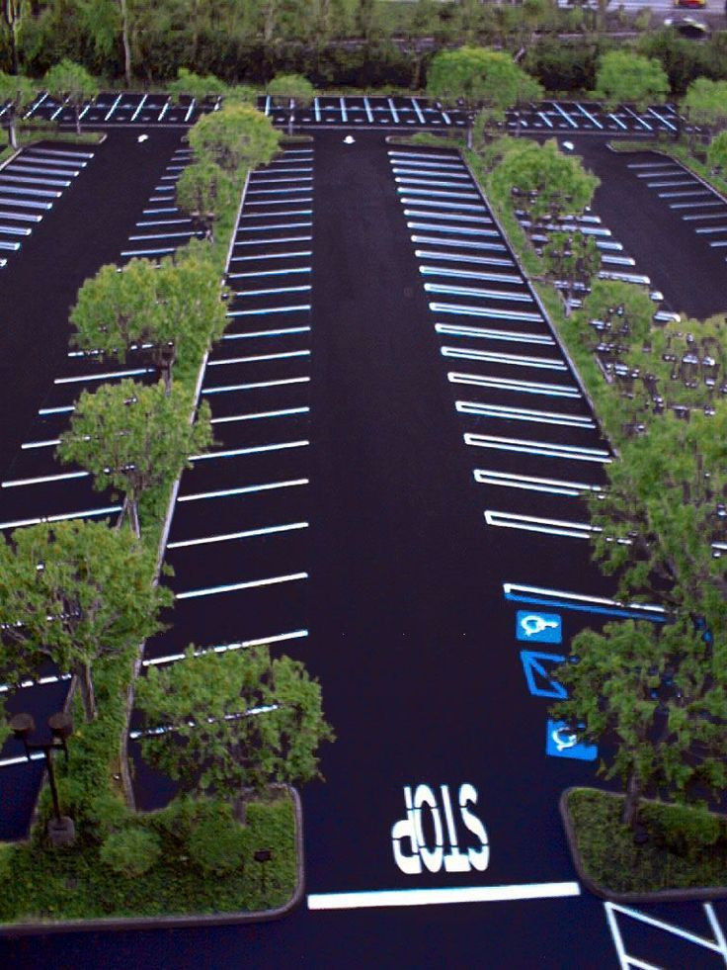
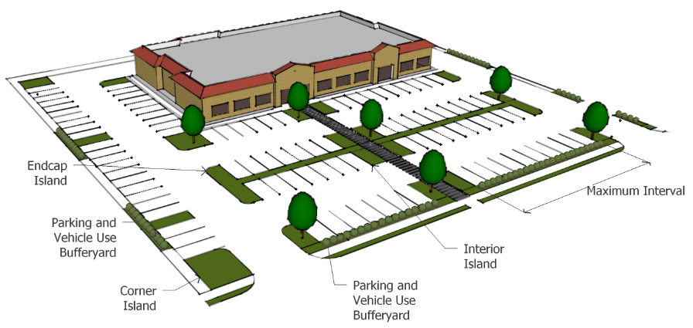
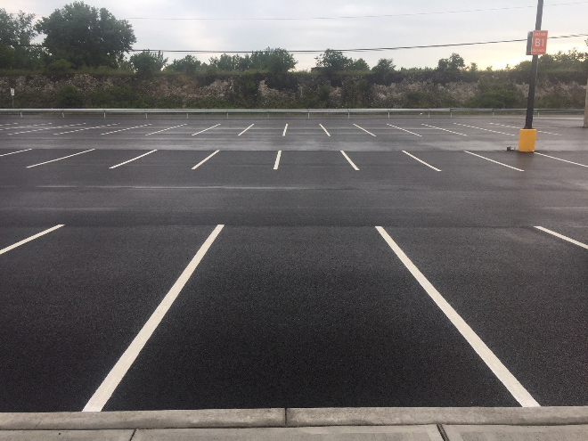
Community Design
Parking
Parking lot design and landscaping has a significant impact on the community. Can increase development cost

Slide 11
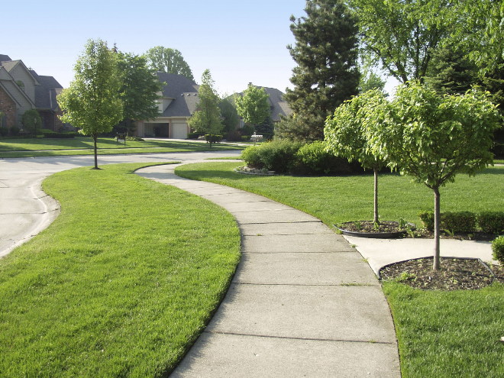
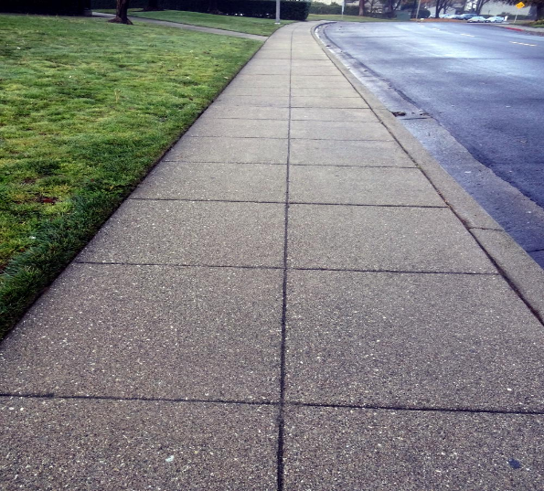
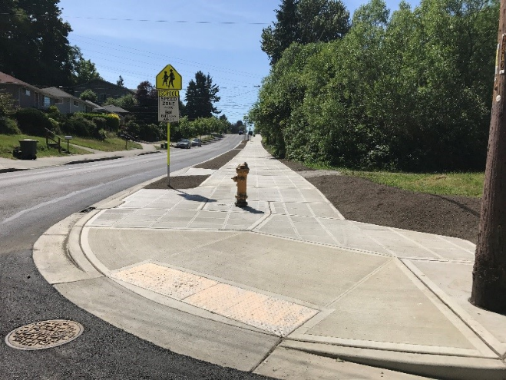
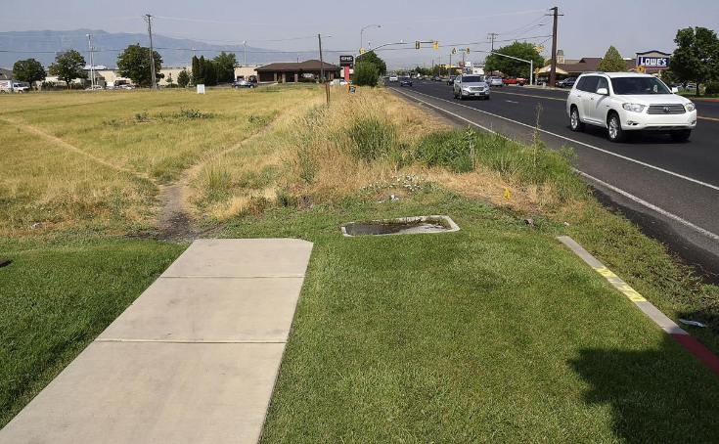
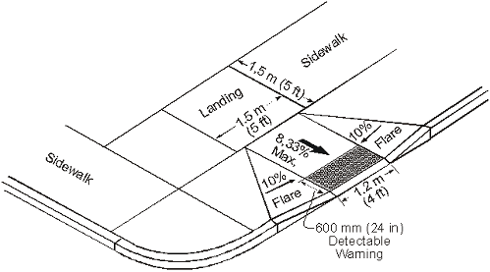
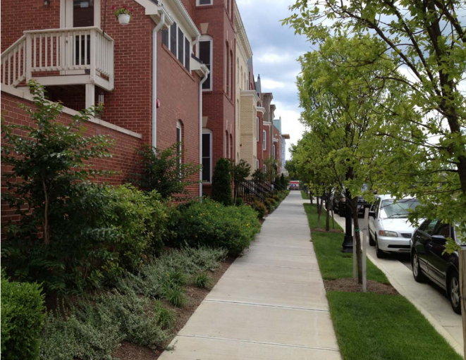
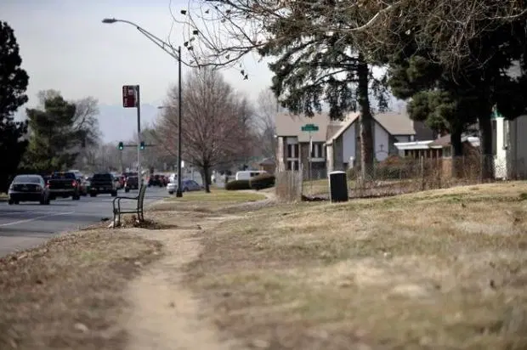
Community Design
Sidewalks
Keep development consistent
Can encourage pedestrians- or deter them
Sets visual character of the street.
Part of "complete streets"

Slide 12
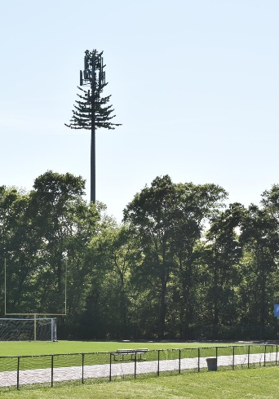
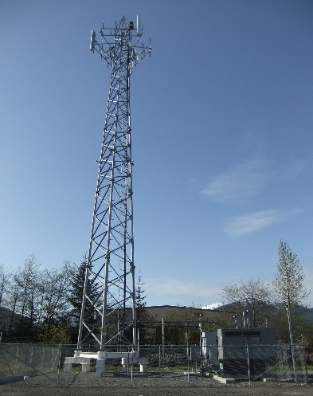
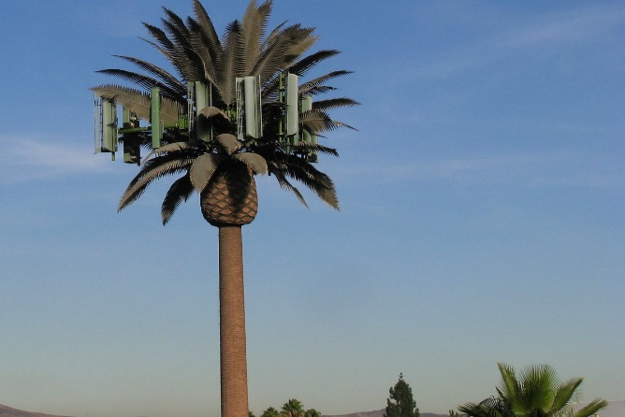


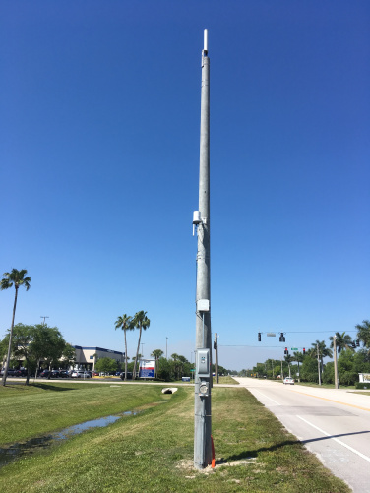
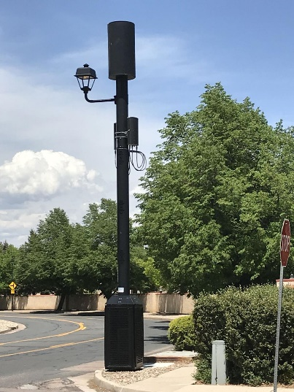
Misc.
Uses
Cell Towers
Have a process in place that complies with the Telecommunications Act of 1996 and 2015 FCC rules
Small Cells
Placed on rights-of-way, also federally regulated
Preemption…
Communications Towers

Slide 13
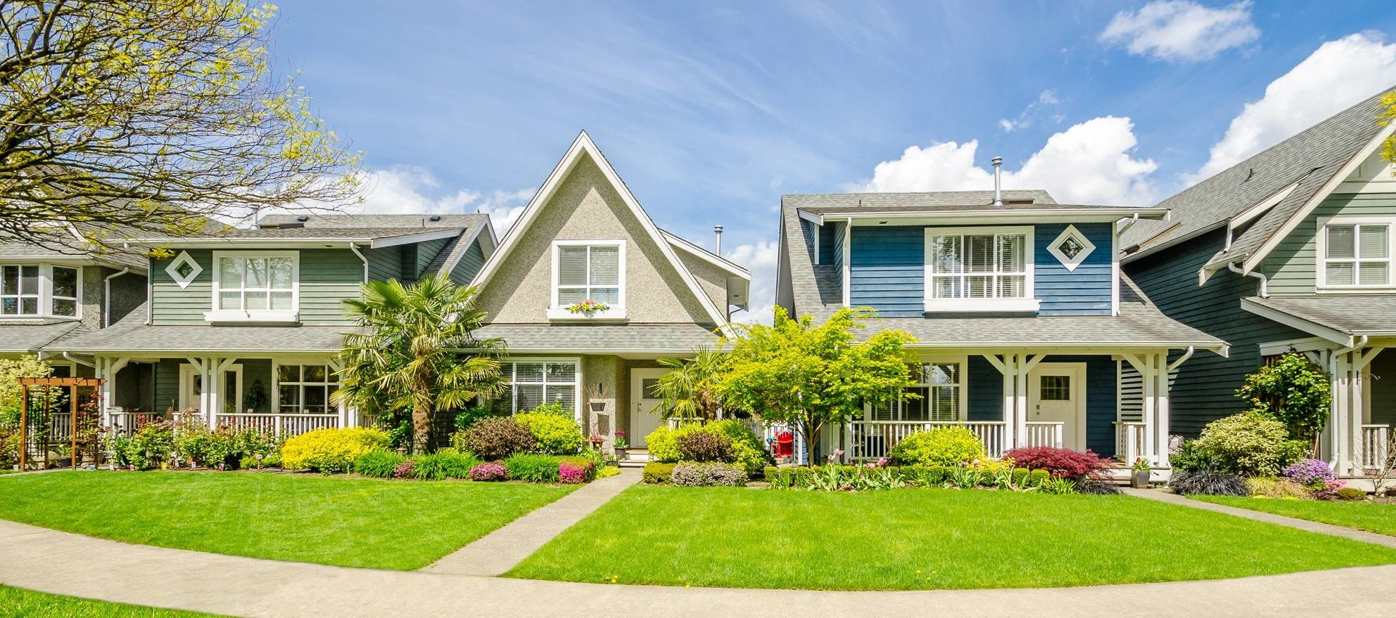

Misc.
Uses
Non-traditional housing
For people with disabilities
Personal care homes; Child-welfare facility; Treatment centers; Halfway houses; Re-entry programs; Boarding houses
Fair Housing and Americans with Disabilities Acts
Reasonable accommodation
Community Residences
Safe and decent housing for everyone vs. Not In My Back Yard

Slide 14




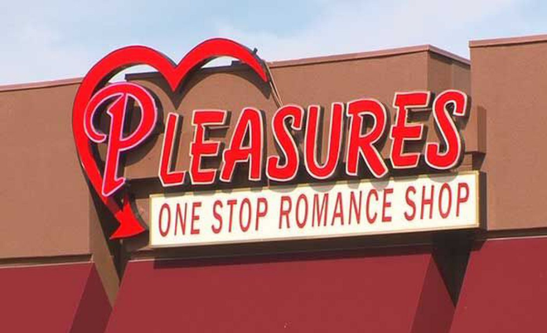
Misc.
Uses
Cannot completely regulate out of a community but can make difficult. Strip clubs, bookstores, massage parlors
.
Adult Entertainment
First Amendment: Freedom of speech

Slide 15


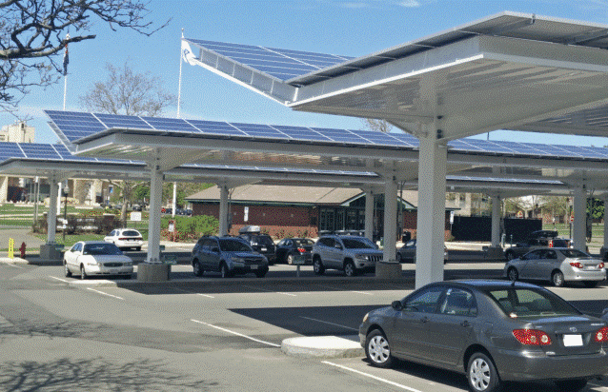
Misc.
Uses
On-site production
Off-site production
Where should it be allowed in your community?
Solar Power

Slide 16
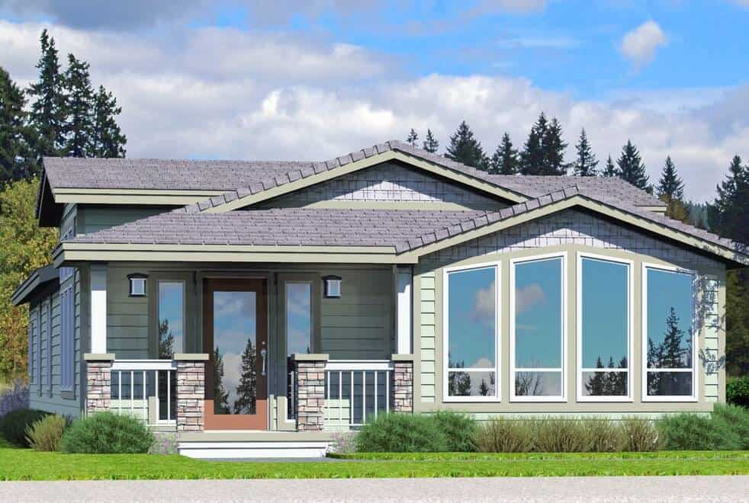
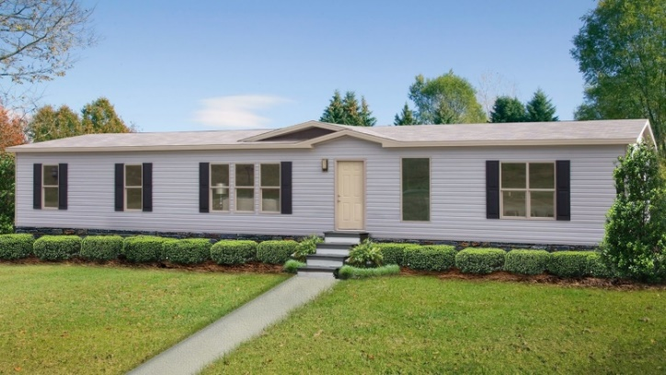
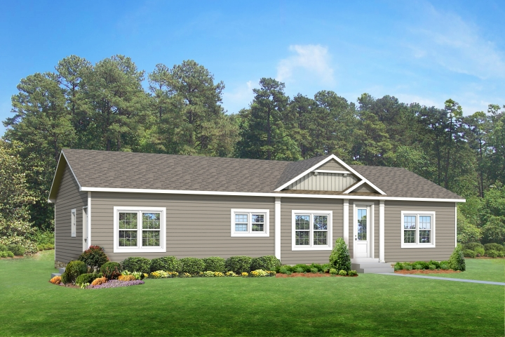
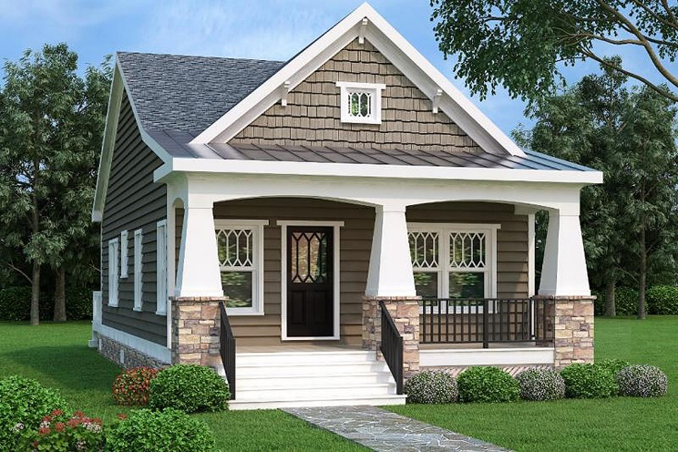
Misc.
Uses
May be excluded from all residential zones, provided they are allowed in manufactured home parks and subdivisions. Ordinance must have valid purpose-quality, safety, property value, aesthetics
Allowed anywhere stick-built homes allowed, but can be regulated through aesthetics
Manufactured and Modular Homes
Factory built housing
Potential for affordable options

Slide 17
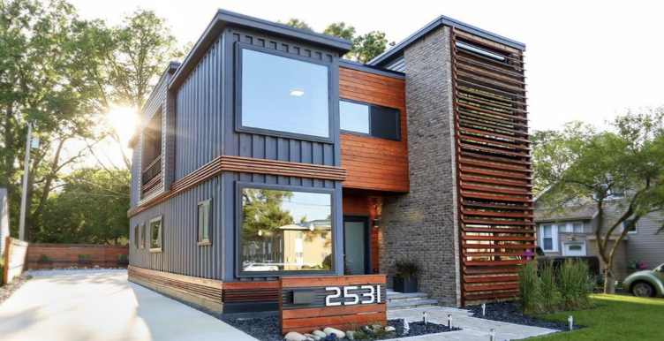
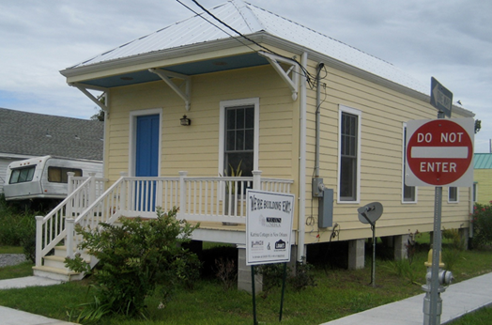
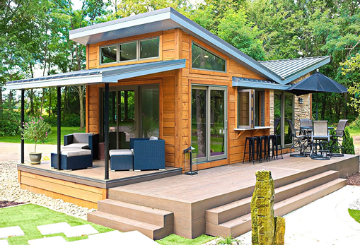
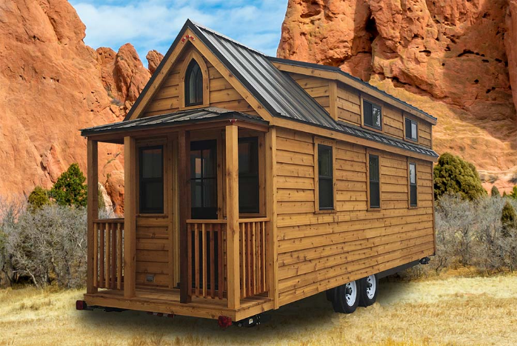
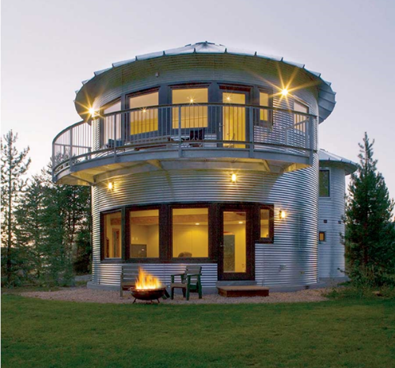

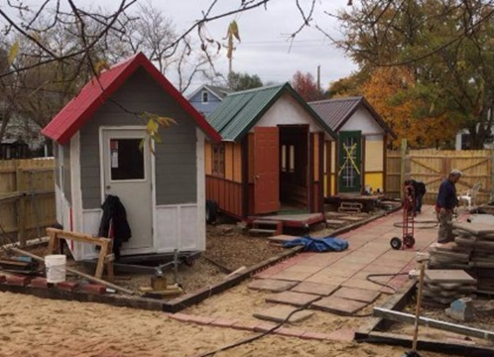
Misc.
Uses
Tiny homes and other design alternatives

Slide 18
Other Related Ordinances
Regulations beyond zoning
Overlay districts
  Historic Preservation
Parking commercial vehicles in residential areas
Parking in front yards
Floodplain
Signs

Slide 19





Other Related Ordinances
Overlay Districts

Slide 20







Other Related Ordinances
Commercial vehicles and parking in the front yard

Slide 21







Other Related Ordinances
Floodplain

Slide 22







Other Related Ordinances
Signs
First Amendment: Free speech

Slide 23
Enforcement
To be effective, regulations must be enforced
Jurisdiction must be prepared to address enforcement from the beginning

Slide 24
Plan
Implement
Enforce

Slide 25
The End
Paul Forgey, AICP, CFM, Director
Planning & Development Services
Albany/Dougherty County
pforgey@albanyga.gov
229.302.1848

