Slide 1
Successfully Implementing the Project: Public Facilities
Cindy Alligood

Slide 2
Next Steps After Award
The Role of the CDBG Representative
Start-Up Site Visit
Goal Sheet Schedule
Ongoing Monitoring Visits
Grant Amendments
Program Reminders and Updates
Administrative Guidelines

Slide 3
The Role of the CDBG Representative
  Provide Technical Assistance
  Keep Project Moving Forward
  Ensure Compliance with Applicable Regs
  Shepherd project to successful completion

Slide 4
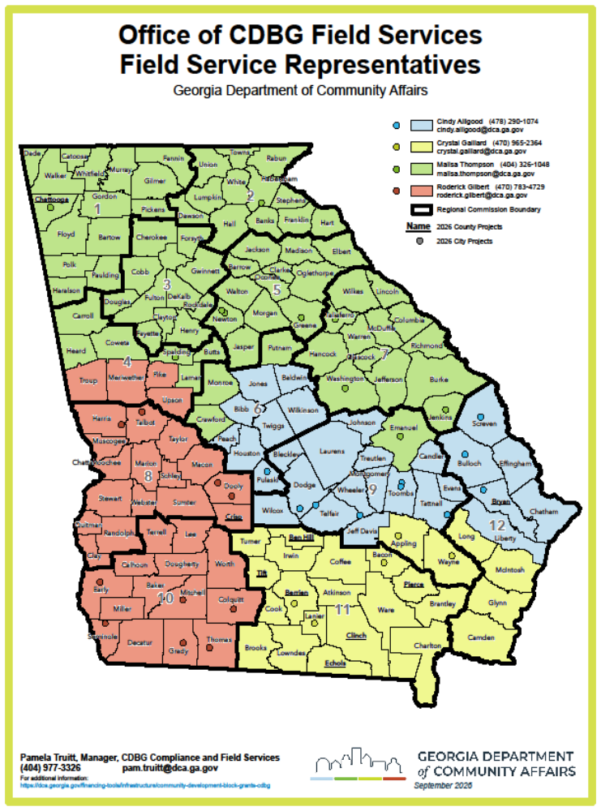

Slide 5

Monitoring Your Award
  Start Up Visit – Before October 28,2026
  Award Date – September 28, 2026

Slide 6
Who Should Attend the Start Up Meeting?
Chief Elected Official (or someone from his/her staff)​
City or County Clerk​
Finance Director​
Grant Administrator​
Engineer or Architect​
Program Director (building)​
Public Utilities Director (infrastructure)​
City or County Attorney (if acquisition is involved)

Slide 7
What to Expect at the Start-Up Meeting?
    Surveys of beneficiaries will be checked for accuracy - Please have them available and complete
    Roles of all involved will be discussed
    Start Up Checklist – Expectations from DCA
    Goal Sheet Schedule

Slide 8
Start Up Checklist
    Grant Award Package
    Financial Management/Audits
    Budget discussion
    General and Special Conditions
    Administration
    Environmental – Historic/Floodplains/Wetlands
    Beneficiaries/Fair Housing/Civil Rights/Section 3

Slide 9
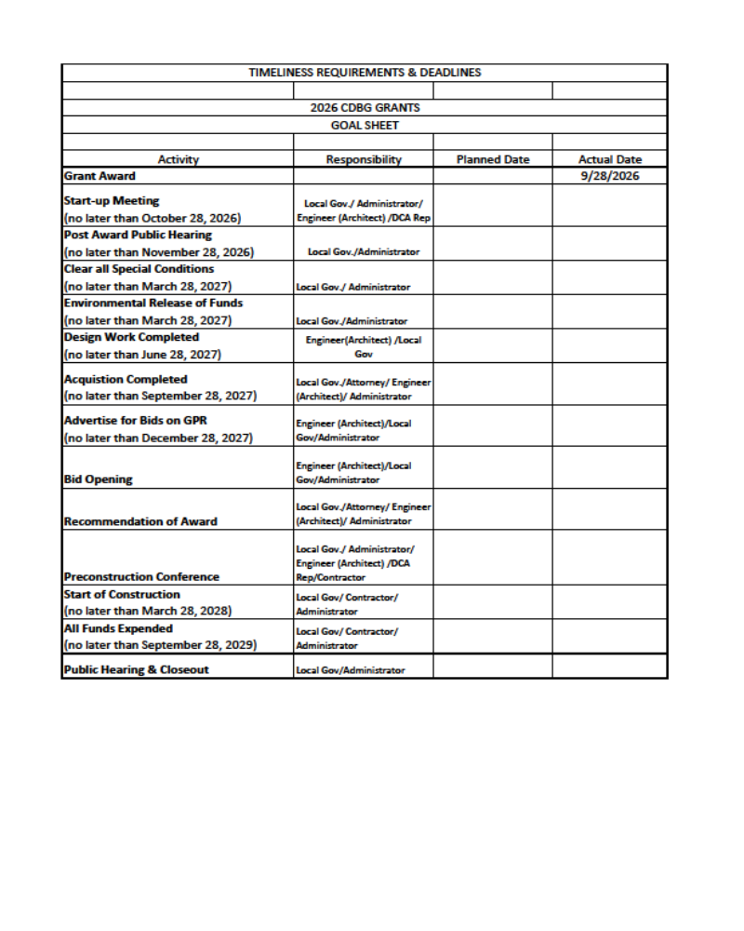
Goal Sheet
    Example of Goal Sheet Schedule

Slide 10
Goal Sheet Schedule
Start – Up Meeting (No later than October 28, 2026) City/Administrator/Engineer/DCA Rep
Post Award Public Hearing (no later than November 28, 2026) City/Administrator)
Clear all Grant Award Conditions (no later than March 28, 2027) City/Administrator
Environmental Release of Funds (no later than March 28, 2027) Administrator
Design Work Completed (no later than June 28, 2027) Engineer/City

Slide 11
Goal Sheet Schedule
Acquisition Completed (no later than September 28, 2027) City/City Attorney/Engineer/Administrator
Advertise for Bids on GPR (no later than December 28, 2027) Engineer/City/ Administrator
Bid Opening - Engineer/City/ Administrator
Recommendation of Award - City/Engineer/City Attorney/Administrator
Pre-construction Conference - City/Admin./DCA Rep/Eng./Contractor

Slide 12
Goal Sheet Schedule
Start of Construction (no later than March 28, 2028) City/Contractor/ Administrator
All Funds Expended (Three years from the date of award – September 28, 2029) City/Contractor/ Administrator
Public Hearing and Close Out - City/Administrator

Slide 13
Goal Sheet Schedule
Keep your Goal Sheet Schedule easily accessible for the life of the project
Update as needed
It’s a very easy way to determine whether your project may be falling behind

Slide 14

  Ongoing Monitoring – After Award
  CITIZEN PARTICIPATION - Public Hearings
    Prior to application submission (“pre-award PH”)
    Within 60 days of Grant Award Date (“post-award PH”)​
    At time of Project Completion (“close-out PH”)
    Plus a PH only if CDBG program is substantially amended
    If project is in LEP community, check for requirements.
​​

Slide 15
  Ongoing Monitoring – After Award
    LEP Requirements can be checked at the following website: Data.census.gov (form S1601)
​​

Slide 16
Ongoing Monitoring
  PROCUREMENT
      Administration
      Engineer / Architect
      Construction Contract – Requires advertisement in 3 locations (Section 3 & BABA verbiage)

Slide 17
Ongoing Monitoring
  Construction Contract Advertising
      Should be advertised on the local government web site and/or by publishing it in the applicant's “legal organ,” along with posting the opportunity at any of the following, for a total of 3 locations: A) city hall/county courthouse; B) most widely distributed newspaper; C) Local GA Department of Labor office and/or Local Workforce Board office; D) local DFCS office; E) local Public Health department; F) local Housing Authority management office. If the contract will be for more than $100,000 it must be advertised on the Georgia Procurement Registry
      Ensure BABA requirements are included

Slide 18
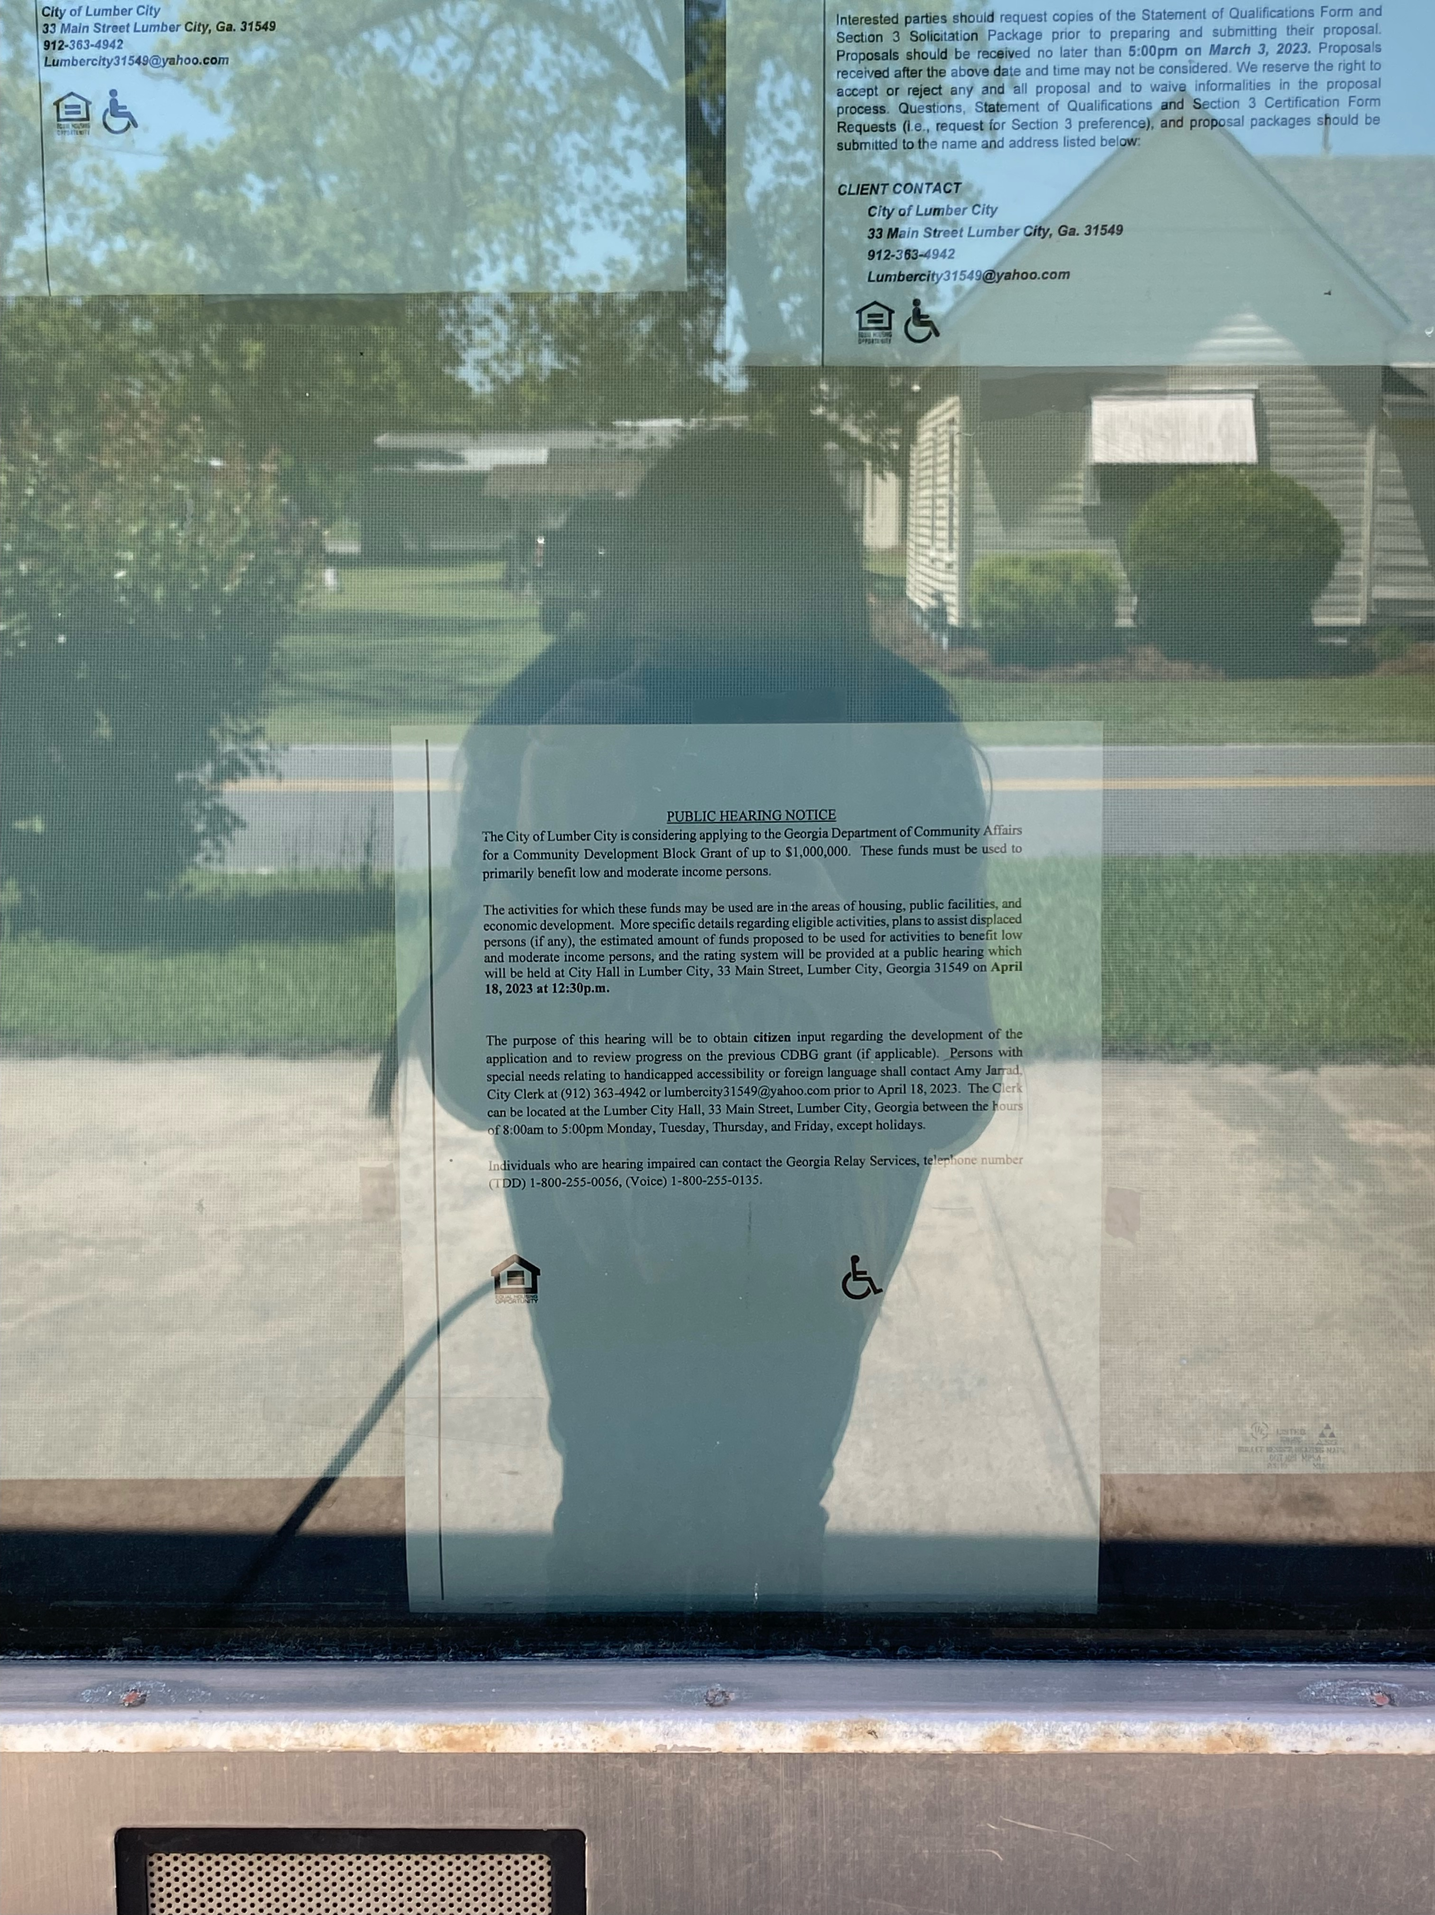
Ongoing Monitoring
  Example of Photo of Advertisement Posted at City Hall

Slide 19
Ongoing Monitoring
  FHEO
      Section 504 - Meeting Location Checklist
      Access to Services
      All Efforts to Affirmatively Further Fair Housing
  Section 3
      Be Sure to Request A List of Initial Employees
  Environmental Review

Slide 20
Ongoing Monitoring
    LABOR STANDARDS
        All Payrolls
        Other Deduction Forms
        Employee Interviews
        Authorized Signature Forms

Slide 21
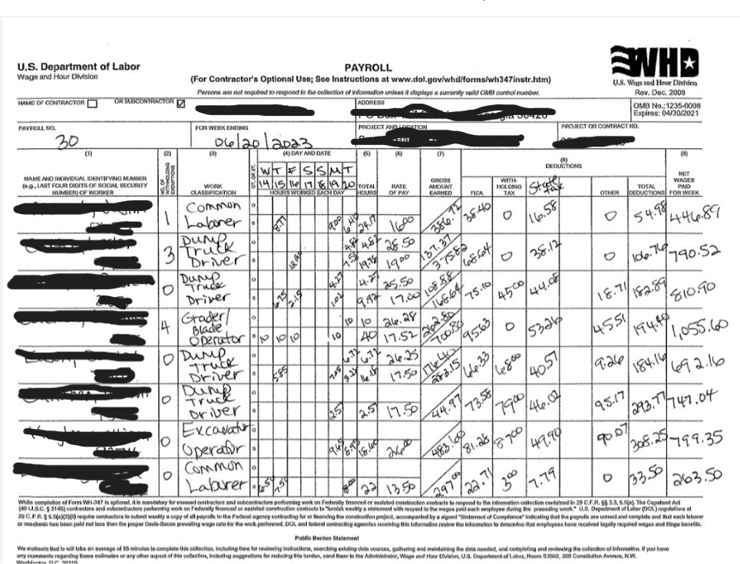
Ongoing Monitoring
    Attach payroll example

Slide 22
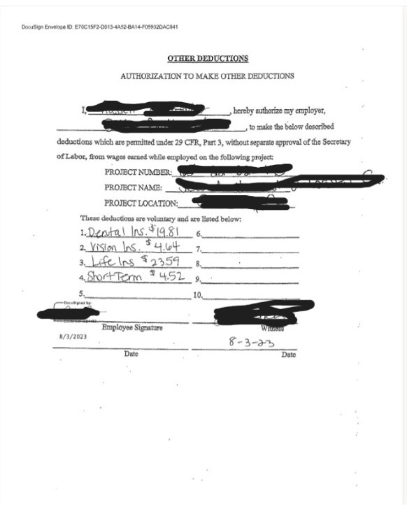
Ongoing Monitoring
    Example of Other Deductions Form

Slide 23
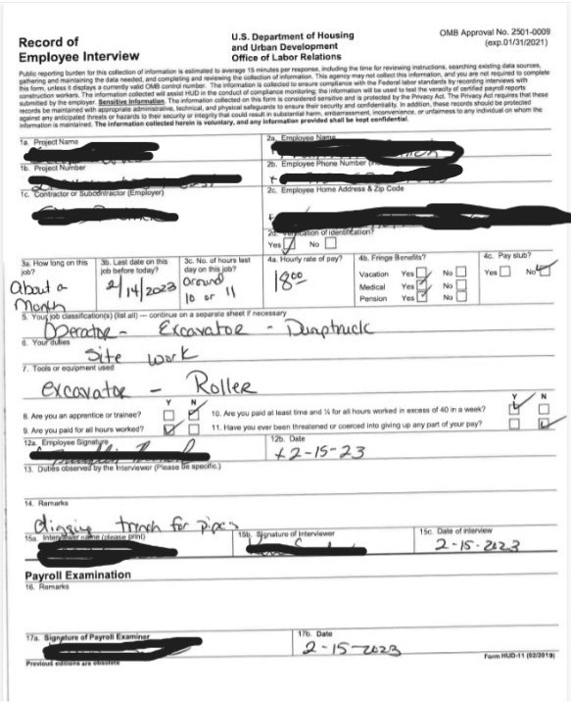
Ongoing Monitoring
    Example of Employee Interview
    Employee interview example

Slide 24
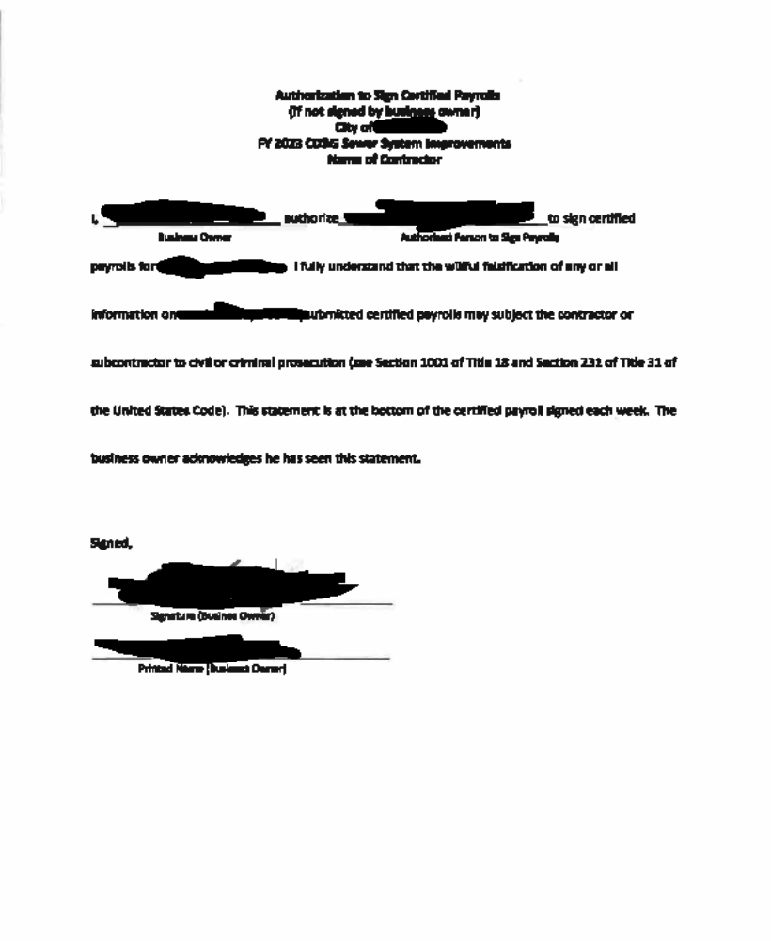
Ongoing Monitoring
  Example of Authorized Signature Form

Slide 25
Ongoing Monitoring
    FINANCIAL MANAGEMENT
        Quarterly Reports
        Bank Statements
        Invoices
        Bank Registry showing receipts and disbursements in chronological order (i.e. CDBG Checkbook)

Slide 26
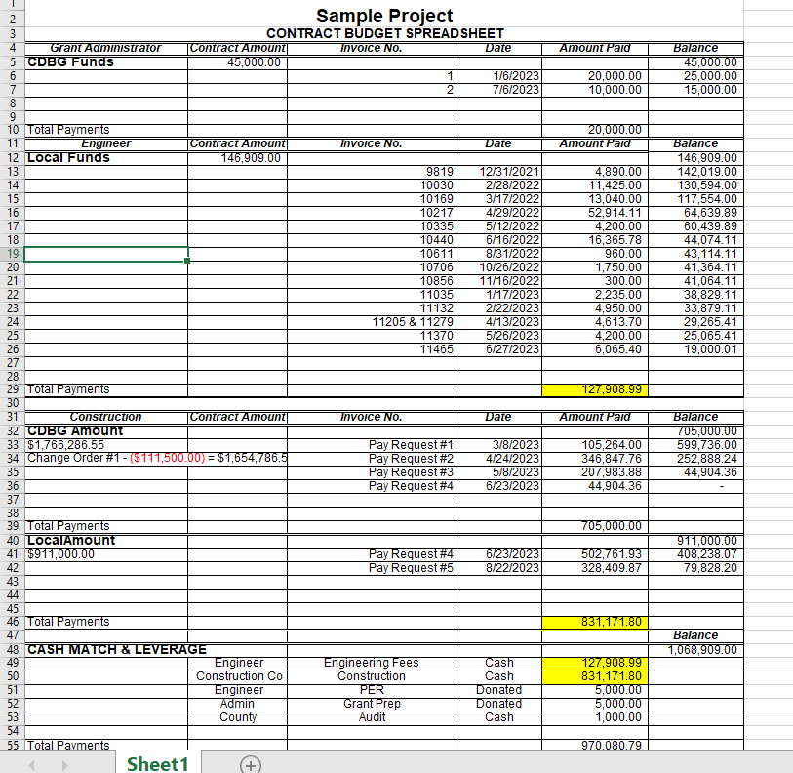

Slide 27
Ongoing Monitoring
  Uniform Act Compliance – If any Acquisition is required to complete the project
  Housing – If applicable
  Cash Match/Leverage – Completed prior to the final draw down or balance goes below 10%.

Slide 28
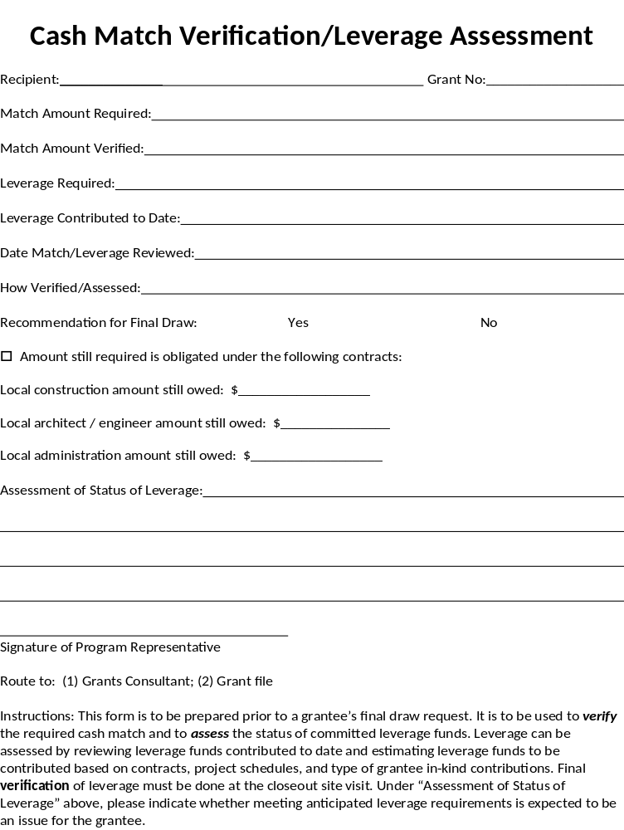
Ongoing Monitoring
  Example of Cash Match and Leverage Verification Form

Slide 29
Ongoing Monitoring
CLOSE OUT -​
      Final Public Hearing documentation​
      Final Quarterly Report ​
      Final Wage Compliance Report ​
      Actual Accomplishments form​
      Surveys & Beneficiary Data​
  ​

Slide 30
Ongoing Monitoring
Close out monitoring will result in “Conditional Closeout” Letter
After audit requirements satisfied, you will receive “Final Closeout Letter”​
​Retention of Records (Ch. 1, Section 10)​
Retain for at least 3 years after Final Closeout Letter

Slide 31

Managing the Award
GrAAM/ eCivis
Special Conditions
Financial Reports/Draws
Extensions/ Budget Amendments/ Scope Reductions
CDBG.Biz
Requests for Release of Funds
Wage Determinations & Add'l Classifications
Contractor Clearance
Activity Reports/
Accomplishments
De-obligation Requests
Notice of Contract Action
Sole Source Requests

Slide 32
Activity Reports
Used for Quarterly Reporting
The reporting period deadlines are:
  ​ January – March (due April 30)
  April – June (due July 31st)
  July – September (due October 31)
  October – December (due January 31)
​The first quarterly report for a grant should cover the first full quarter after the award date.
Attach the CDBG Contracts and Accomplishments Report form to report any contracting and Section 3 activity, leverage, and accomplishments.

Slide 33
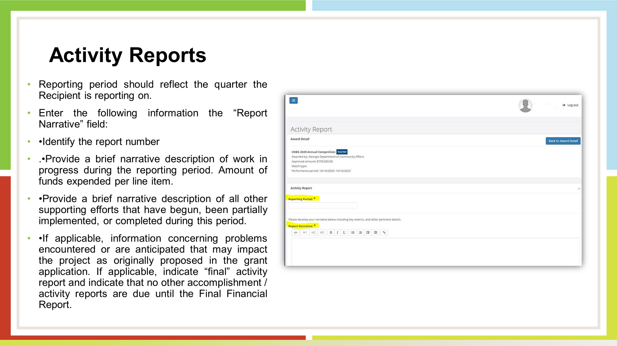

Slide 34
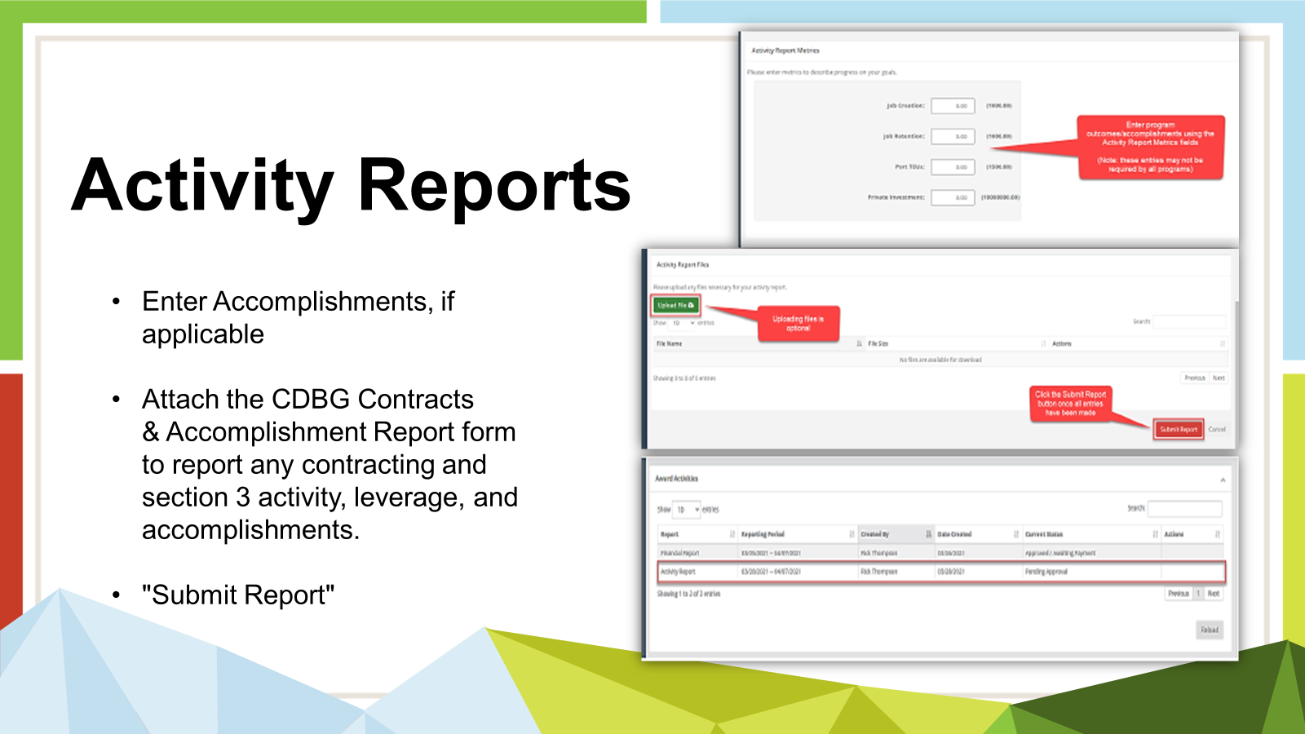

Slide 35
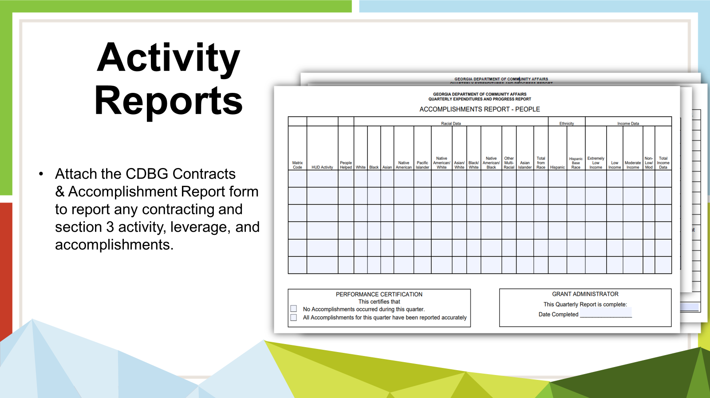

Slide 36
Important Notes!!!
With the exception of Housing, all projects meeting the LMA and LMC National Objective all required to report accomplishments on the people form once the project is completed.
Be sure to include all necessary information in your narrative.

Slide 37
Grant Amendments
​You must receive formal DCA Approval to…​
Add a new activity or delete an approved activity​
Increase/Decrease the scope of an activity by 10% or more​
Change of Scope may require a Public Hearing to ensure public awareness of the change.
Propose activity in area other than the approved CDBG​ Target Area
Transfer funds from one activity to another no matter the amount.​

Slide 38
Program Reminders and Updates
    When moving money between line items, you must submit a project amendment, no matter the amount being moved.
    When preparing your Language Access Plan (LAP), pay close attention to what you list as “Vital Documents”, especially if the project is in an LEP community. More details in later presentation.
    Concurrent Notice (Environmental) advertisements must be in LEP language if located in LEP community.

Slide 39
Program Reminders and Updates
    Stormwater monitoring (NPDES) must be available by the contractor to bid as a part of construction. Any entity (Engineer or contractor) that performs the service is subject to fair and open competition. See memo in Manual (Appendix O of Applicants' Manual).
    You must tabulate the number of hours that the General and subcontractors spent on the job site on your Quarterly Reports.

Slide 40
Grant Administrative Guidelines
“BE PREPARED!”:
  Check monitoring forms in the CDBG manual for items needed to answer monitoring questions – No Surprises
  Keep files up to date with documentation of project
  Check bank statements monthly.

Slide 41
Grant Administrative Guidelines
    Check with General and subcontractors on a regular basis to arrange for job site interviews.
    Be sure you have Environmental Clearance in hand before holding a bid opening.
Here is the link for the Analysis of Impediments: https://dca.georgia.gov/document/hud-planning/analysis-impediments-2016/download

Slide 42
Good Luck!
Call your Field Representative or DCA staff with questions.
Keeping us involved throughout the project can avoid or minimize problems.
We are truly here to help you with your CDBG.

Slide 43
CDBG Program Representatives
Cindy Alligood
478-290-1074
Cindy.Alligood@dca.ga.gov
Crystal Gaillard
229-733-7021
Crystal.Gaillard@dca.ga.gov
Roderick Gilbert
470-783-4729
Roderick.Gilbert@dca.ga.gov
Malisa Thompson
404-326-1048
Malisa.Thompson@dca.ga.gov

Slide 44
Thanks!
Cindy Alligood
cindy.alligood@dca.ga.gov
Direct/Cell: 478-290-1074
CDBG Field Representative
dca.ga.gov

