Slide 1
Successfully Implementing Housing & Neighborhood Revitalization
Malisa Thompson
CDBG Field Representative
Notes:
Good afternoon, I’m going to share some points that will help ensure that your housing project is successful.

Slide 2
Housing & Neighborhood Revitalization
Monitoring Requirements

Slide 3
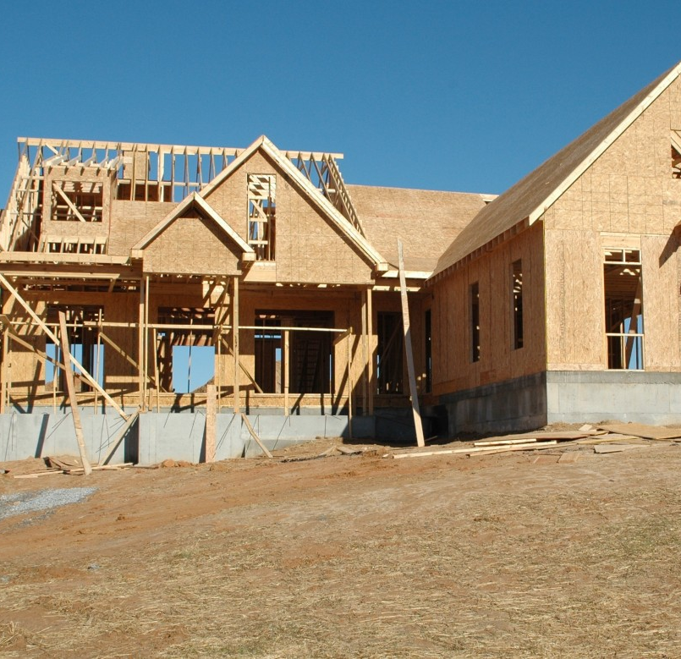
Before you begin.....
Clear Special Conditions
  Mobile Home costs exceeding $20,000
  Housing Policies and Procedures
Notes:
So before you begin, your project may have some special conditions that need to be cleared. Here are a couple of examples of potential special conditions and there may be others. Its important that the conditions are cleared within a timely manner.

Slide 4

DCA Monitoring for Compliance
  Monitoring visits are usually scheduled in advance, however, may be subject to review without notice
  The Local Government is responsible for organization and maintenance of all records
  A Contractual obligation between a recipient and a third party (i.e. Consultant) does not absolve the recipient of ultimate accountability for all aspects of the grant

Slide 5

DCA Monitoring for Compliance
File Organization
  Homeowner Files
  Application for assistance
  Documentation of income
  Proof of lawful presence
  Signed income calculation form
  Annual Income Limits used
  Contractor Clearance
  Detailed work-write up and cost estimate
  Contract for rehab or re-construction
  Include all Change Orders
  Release of Liens

Slide 6

Additional Requirements....
Submit a request to exceed 20%
Budget revisions
Timely Quarterly Reports
Grant extensions

Slide 7
Things to consider….
Revitalization Area Strategy (RAS Designation)
  Designation for 3 years.
  Can receive up to 20 points on CDBG Application that are proposed within the designated RAS area.
  Apply for CDBG annually, if current CDBG project meets timeliness criteria.
Georgia Initiative for Community Housing(GICH)
  Designation for 3 years or longer…
  Technical Assistance with developing a housing plan for your community.
  If designated, local Government can apply annually for CDBG for 3 years while participating in program and longer if local Government meet certification requirements every 2 years.
  For more information on how to apply for GICH, please contact Dr. Jermaine Durham at Jermaine.Durham@uga.edu or (912)687-5522.

Slide 8

QUESTIONS………..

Slide 9
Thanks!
Malisa Thompson
Cdbg Field Representative
Malisa.Thompson@dca.ga.gov
Direct: 404.326.1048
dca.georgia.gov

