Slide 1
General & Special Conditions Compliance
Roderick Gilbert

Slide 2
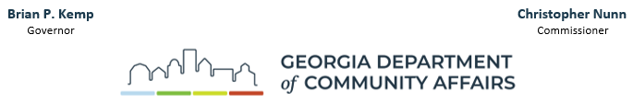
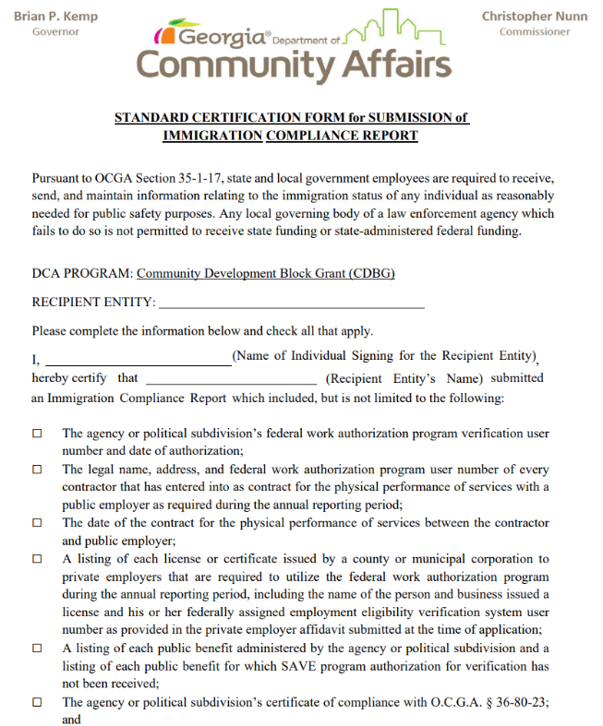
New General Condition
RETURN WITH AWARD PACKAGE IN ECIVIS
2024 Amendment to OCGA Section 35-1-17
As a condition of funding to a local governing body, the Department of Community Affairs, the Department of Transportation, or any other state agency that provides funding to local governing bodies shall require certification pursuant to Code Section 50-36-4 as proof of compliance with this Code section
Notes:
May 2024 update section f of the cited Official Georgia Code. Form issued by legal to comply.

Slide 3
Special Conditions
Special Conditions – generally specific to the local project and are usually cleared via Grant Adjustment Notice.
Must be cleared prior to the drawdown of funds.
All awards are subject to a Language Access Plan Special Condition & BABA

Slide 4
Language Access Plan (LAP))
Limited English Proficient (LEP) persons
  Do not speak English as their primary language as a result of national origin​
  Have a limited ability to speak, read, write, or understand English
All direct recipients and Subrecipients of federal funds must provide services to ensure that LEP persons have meaningful access to these federally funded programs. Title VI of the Civil Rights Act of 1964 & Executive Order (EO) 13166
  Conduct an analysis to determine what REASONABLE action is required to ensure meaningful access to all programs and activities assisted with federal funds​
  Develop an implementation plan (LAP) to provide appropriate language assistance
Notes:
Tables S1601 & ACS B16001.
Title VI of the Civil Rights Act of 1964: Protects individuals from discrimination on the basis of their race, color, or national origin ​
Executive Order (EO) 13166 signed on August 11, 2000: Programs receiving federal financial assistance must provide meaningful access to Limited English Proficient (LEP) persons

Slide 5
LAP: Contents
Template – Recipients’ Manual
General Information
Four-Factor Analysis
The name of the individual responsible for coordination of LEP compliance
A training plan on LEP requirements for all staff involved in programs and activities funded by the federal government and awarded by DCA
A list of vital documents to be translated (if necessary) and schedule for translating and disseminating vital documents
A plan for complaints and appeals. See the complaints and appeals requirement in the DCA policy (CDBG Recipients’ Manual Appendix 2, 2022 – 2027)
A policy for updating the Four-Factor Analysis and the LAP every five years.
  Updated LAPs include a revised general information and considering Factor 3
A plan to maintain records regarding its efforts to comply with Title VI LEP obligations.
Notes:
General Info: • Grantee • CDBG Grant Number • Target Area • Preparer’s name, phone number, email address
Factor 3. Nature & Importance of program - What is the nature of the program? e.g. Providing improved water and sewer services What is the importance of the program? Would denial or delay of access to services or information could serious or even life-threatening implications for the LEP individual?

Slide 6
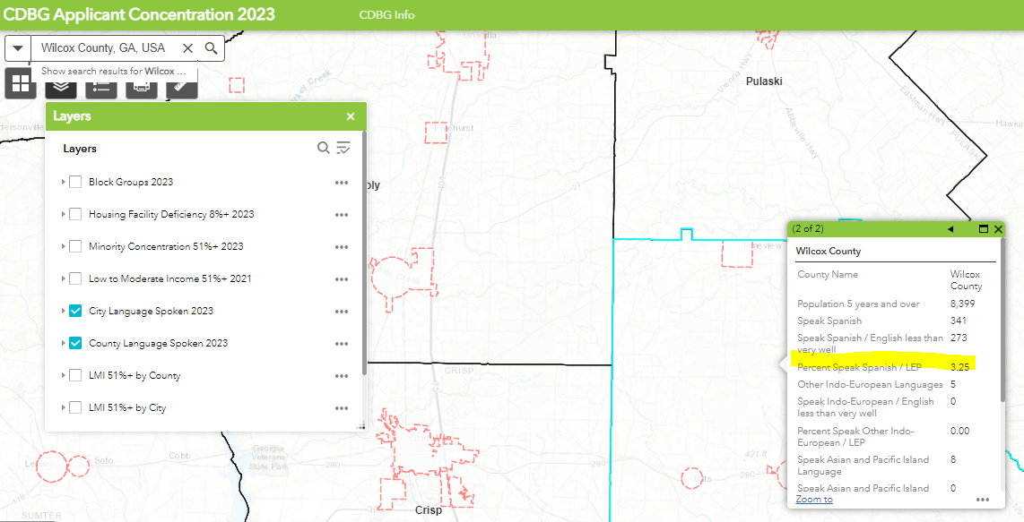
Four-Factor Analysis: Factor 1.
Number of LEP Persons in the Jurisdiction & Target Area
Threshold for Translation
Size of Language Group | Recommended Provision of Written Language Assistance
1,000 or more in the eligible population | Translated vital documents
More than 5% of the eligible population or beneficiaries and more than 50 in number | Translated vital documents
More than 5% of the eligible population or beneficiaries and 50 or less in number | Translated written notice of right to receive free oral interpretation of documents.
5% or less of the eligible population or beneficiaries and less than 1,000 in number | No written translation is required.
https://data.census.gov S1601
DCA’s CDBG Applicant Concentration Map
Notes:
ACS S1601 & sometimes ACS B16001.
Survey data in target area

Slide 7
Four-Factor Analysis: Factor 2.
Identify how your program engages with the public and how frequently does this occur:
  When notifying the public about a grant award application and its proposed activities
  When notifying the public about the grant award and its funded activities
  When seeking applicants to participate in the program (e.g., when seeking homeowners for rehabilitation assistance)
  When working with homeowners selected for assistance
  When notifying the public about the grant award closeout and its accomplishments

Slide 8
Four-Factor Analysis: Factors 3 & 4
Factor 3:
Answer the following questions:
  What is the nature of the program? e.g., Providing improved water and sewer services
  What is the importance of the program? Would denial or delay of access to services or information could serious or even life-threatening implications for the LEP individual?
Factor 4:
The resources available and costs to the recipient.
  Oral interpretation services;
  Bilingual staff;
  Telephone service lines interpreter;
  Written translation services;
  Notices to staff and sub recipients of the availability of LEP services;
  Referrals to community liaisons proficient in the language of LEP persons.
  Provide "I speak" card

Slide 9
Vital Documents
Definition:
A vital document is any document that is critical for ensuring meaningful access to the recipients' major activities and programs by beneficiaries generally and LEP persons specifically. Whether or not a document (or the information it solicits) is "vital" may depend upon the importance of the program, information, encounter, or service involved, and the consequence to the LEP person if the information in question is not provided accurately or in a timely manner.
A list of vital documents to be translated (if necessary) and schedule for translating and disseminating vital documents:
Sample verbiage:
The following list of Vital HUD/CDBG Documents will be translated into the Spanish language and made available:
  Pre-award Public Notice – Prior to award
  Post- Award Public Hearing Notice – within 60 days of award
  Environmental Notices – As required (traditional publications & online per FFRMS Final Rule)
  GA DCA/HUD Brochures, Posters, Fliers – On permanent display or as required
  Fair Housing Materials - On permanent display or as required
Notes:
A vital document is any document that is critical for ensuring meaningful access to the recipients' major activities and programs by beneficiaries generally and LEP persons specifically. Whether or not a document (or the information it solicits) is "vital" may depend upon the importance of the program, information, encounter, or service involved, and the consequence to the LEP person if the information in question is not provided accurately or in a timely manner.
Federal Flood Risk Management Standard​

Slide 10
Build America, Buy America
The Recipient must submit for DCA's review and written approval a certification, signed by the chief elected official, stating the Recipient will adhere to the requirements of the The Build America, Buy America Act (BABA), enacted in the Infrastructure Investment and Jobs Act on November 15, 2021. BABA requires products purchased in connection with infrastructure projects funded by Federal financial assistance programs to be produced in the United States, known as the “Buy America Preference (BAP)”. Specifically, this is a statutory requirement that Federal funding for infrastructure projects use “covered materials” that are “American-made.” The BAP applies to the following products: Iron and steel; Manufactured products; and Construction materials. For FY2024 awards, BAP will include Iron & Steel and Specifically Listed Construction Materials. Specifically Listed Construction materials consists of metals other than iron and steel (non-ferrous metals), lumber, composite building materials, and plastic and polymer-based pipe and tube (e.g., PVC pipe).
Housing Caveat CPD Notice 25-01
HUD found that single-family housing is not considered infrastructure
Notes:
HUD has expressed a written determination of the applicability of general waivers. This can be accomplished with a statement certifying each housing unit/ per contract does not exceed $250K.

Slide 11
State Reporting Compliance
State Audit
Report of Local Government Finances
Government Management Indicators (GOMI) Survey
“Within six (6) months of award, the local government must submit evidence of compliance with this requirement. The City will be prevented from drawing down funds whenever it is noncompliant with State reporting requirements.”
Notes:
Must not receive State Funding.

Slide 12
Water & Sewer Rate Survey
Water & Sewer Rate Survey
Provide survey data to DCA & University of Georgia’s Carl Vinson Institute of Government. Certify participation in survey throughout the award period.
Estimated number of connections
Estimated service population
Operating revenue
Operating expenses
Average Household size (ACS data)
Median Household Income (ACS data)
Poverty rate (ACS data)

Slide 13
Drainage Special Condition
The Recipient's engineer must certify conformance with the Georgia Stormwater Management Manual, Minimum Standard in its evaluation of potential downstream impacts.
Recommended by Engineer due to property damage complaints from downstream property owners.
Provide a certification statement from the project engineer.
Notes:
1.) reduce the possibility of funding a CDBG drainage project that causes downstream property damage and 2.) make the design engineer responsible for designing a project that does not result in downstream property damage.

Slide 14
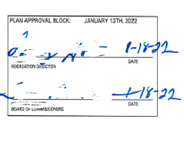
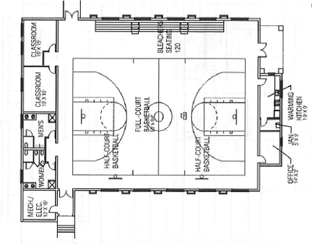
Building Special Conditions
Continued Use Statement (Change of Use of Real Property 24 CFR 570.489(j))
Provide statement with verbiage from Special Condition certified by CEO on letterhead
Floorplan
Provide final floorplan signed by all agencies involved in project.

Slide 15
Radon
In instances where radon testing cannot be conducted until after the environmental review record is certified, the Recipient must submit for DCA's review and written approval a certification, signed by the chief elected official, stating that required radon testing will be completed post environmental certification. Should radon testing determine indoor air radon levels are at or above 4 pCi/L, the Environmental Review Record (ERR) must include a mitigation plan compliant with HUD’s Notice CPD-23-103. When testing demonstrates that radon levels within the building are below 4 pCi/L, mitigation is not required. Subsequently, the ERR must then be updated with the radon evaluation and include proof of any required mitigation once completed.

Slide 16
Conflict of Interest
Recipients’ Manual, page 12 - 15
24 CFR Part 570.489 (h)
Exception request documentation
Description of how the potential COI was disclosed
Proof of Public Disclosure – agenda & meeting minutes
A map showing the location of any target area property indicated in the potential conflict of interest
A written opinion of the local government's attorney that the conflict of interest for which the exception is sought would not violate state or local law
An explanation of the extent of involvement of covered persons with any votes or discussion of the grant. Officials should abstain from any involvement as soon as any COI is foreseen.

Slide 17
COI Continued
Factors to be addressed:
Whether the exception would provide a significant cost benefit or an essential degree of expertise to the program or project which would otherwise not be available;
Whether the person affected is a member of a group or class of low-income persons intended to be the beneficiaries of the assisted activity, and the exception will permit such person to receive generally the same interests or benefits as are being made available or provided to the group or class;
Whether the affected person has withdrawn from his or her function or responsibilities, or the decision-making process with respect to the specific assisted activity in question;
Whether the interest or benefit was present before the affected person was in a position as described in a position to participate in the decision-making process or gain inside information with regard to CDBG activities
Whether undue hardship will result either to the participating jurisdiction or to the person affected when weighed against the public interest served by avoiding the prohibited conflict;
Any other relevant considerations presented to DCA.

Slide 18
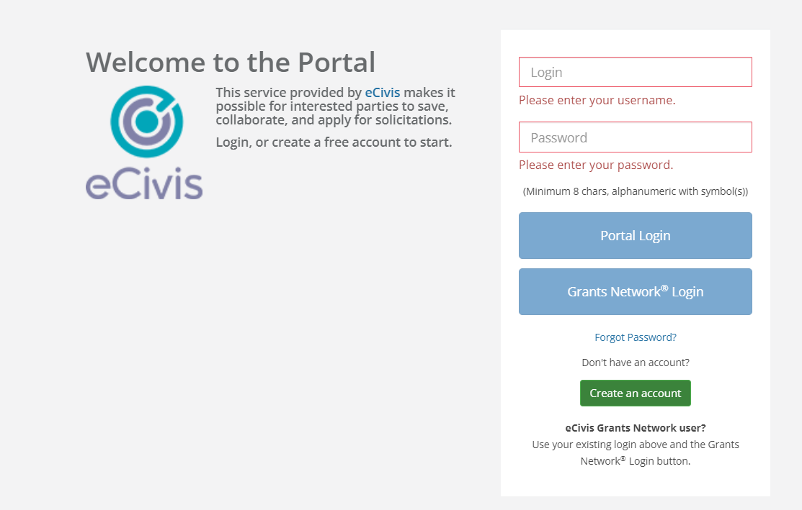
eCivis
Special conditions must be submitted in eCivis.
However, until the award package is returned and accepted. The award dashboard will not be available.

Slide 19
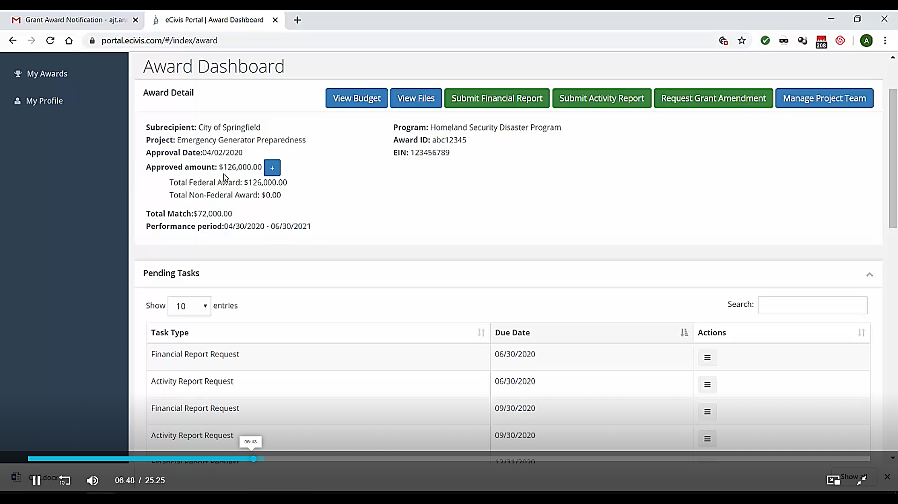
Recipient Award Dashboard
Draw Requests
Quarterly & Accomplishment
Extensions,
Amendments,
De-obligation
Assigned Tasks: Special Conditions

Slide 20
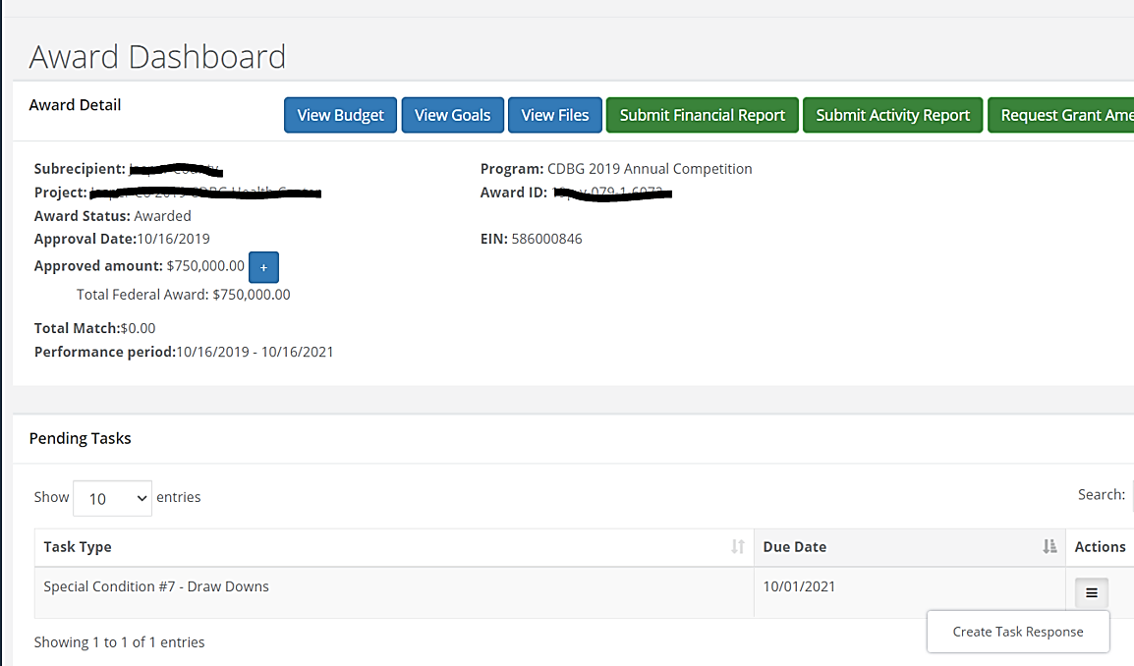
Pending Tasks
Special Conditions will appear under "Pending Tasks".
Use the "Actions" menu to respond and clear Special Condition

Slide 21
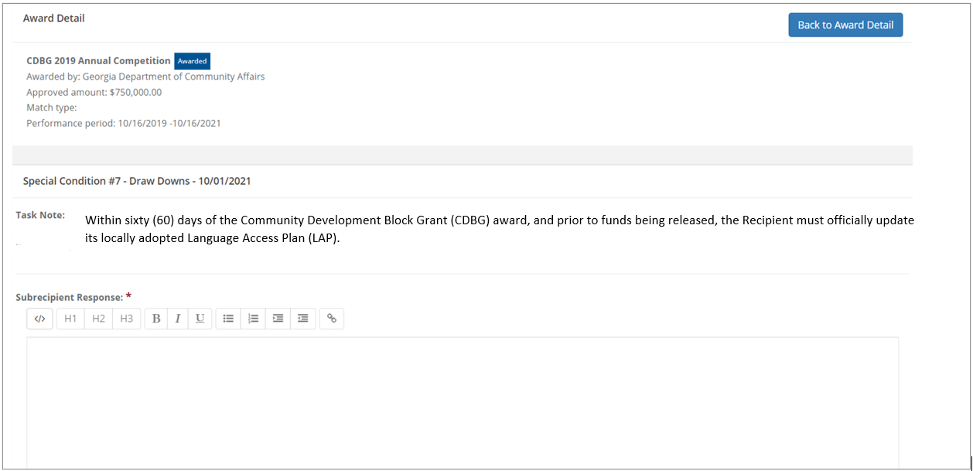
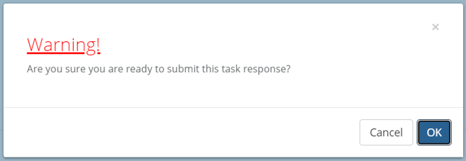
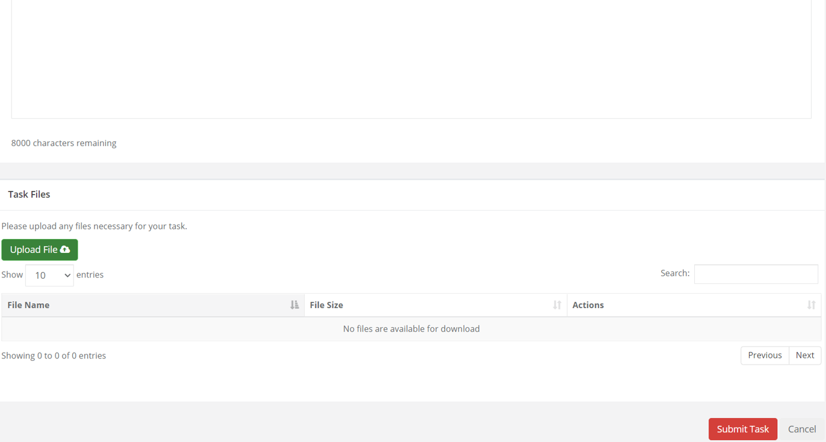
Pending Tasks/ Special Conditions

Slide 22
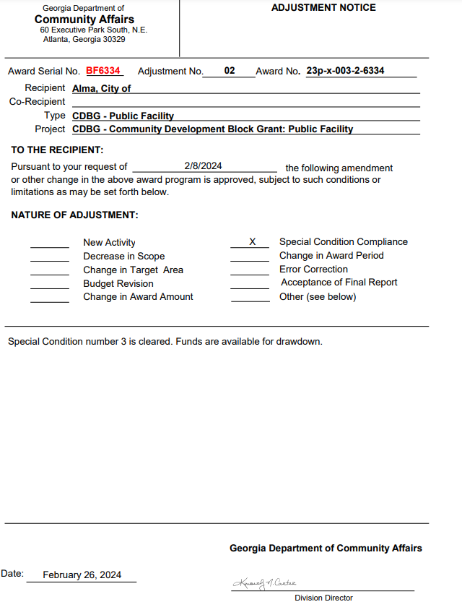
Special Condition Clearance
Grant Adjustment Notice (GAN)
Placed in external files section of the task

Slide 23

Resources:
Quarterly Reporting Instructions & Forms - https://dca.georgia.gov/financing-tools/infrastructure/community-development-block-grants-cdbg/compliance-administration
-Appendix III – GrAAM Job Aids
https://dca.georgia.gov/financing-tools/infrastructure/community-development-block-grants-cdbg/annual-cdbg-competition/cdbg
-ECivis Video Library:
https://www.gotostage.com/channel/ecivis
Kathleen Vaughn:
(404)679-0594
Kathleen.Vaughn@dca.ga.gov
Notes:
Funds cannot be drawn until all Special Conditions are cleared.

