Slide 1
Siting Solar is Getting Easier
Prepared for the Community Planning Institute
January 6, 2025 / Dublin, GA
Thatcher Young – VP of Business Development

Slide 2
Topics for Discussion
Location, location, location
Land Impact
Resources for Practioners

Slide 3
Why in my Community?
Solar is growing due to rising energy costs and greater corporate action to reduce carbon emissions – going Net Zero.
Economic development projects seeking renewables to meet customer needs.
Land availability – utility scale solar requires significant land area – a 500MW solar array requires 2,500 acres of land.
Follow the money – like all development, tax incentives often drive the location of these projects.
Locating solar closer to load – more projects are moving towards on-site placement.

Slide 4
Land Impacts
Moratoriums on the siting of solar
Proper Siting – Utility Infrastructure
Solar vs. Food
End of Life Considerations

Slide 5
Resources for Practioners
There are some new’ish tools to help community planners and zoning staff manage these projects.

Slide 6
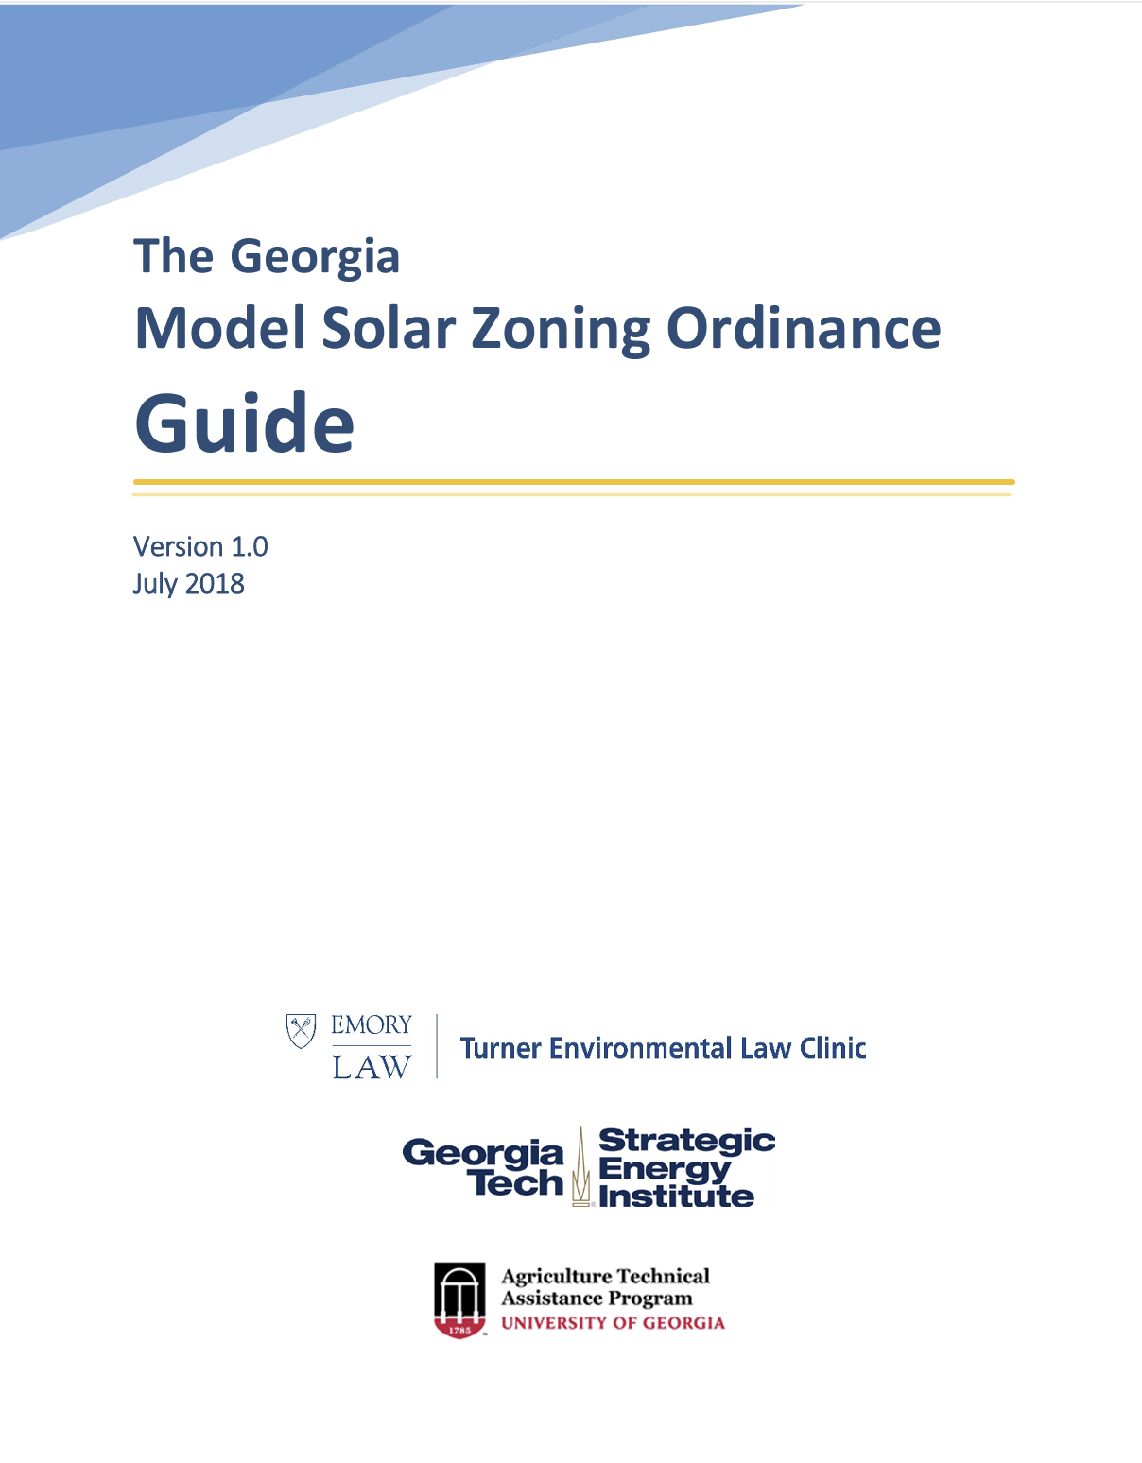
Model Solar Zoning Ordinance
The Georgia Model Solar Zoning Ordinance provides a comprehensive template to help cities and counties in Georgia draft regulations for various types and sizes of solar energy systems.
Collaboration: Developed by representatives from Emory Law School, Georgia Institute of Technology, and the University of Georgia.
Key aspects of the ordinance include:
Purpose and Definitions: Clarifies the intent and provides definitions for different solar energy systems.
Use Permissions: Specifies where and how solar energy systems can be installed.
Use-Specific Standards: Details standards for rooftop, building-integrated, and ground-mounted systems of different sizes³.
The ordinance is designed to be adaptable, allowing local governments to modify it to fit their specific requirements.
The guide can be found at - 2018-07-30_mso_guide_final.pdf (lpdd.org)

Slide 7
TNC Solar Siting Tool
Link to tool - The Georgia Low Impact Solar Siting Tool (GA LISST) (arcgis.com)

Slide 8
Questions?
Thatcher Young
tyoung@velosolar.com
M. 404-518-1116

