Slide 1
Section 3
and
Procurement Requirements

Slide 2

Section 3
Notes:
In this section we will reviewing the implementing regulations. Section 3 refers to Section 3 of the HUD Act of 1968 which was created to ensure employment (jobs) and other economic opportunities (contracts) generated by Federal Financial Assistance for housing and community development, to the greatest extent feasible, be directed towards low- and moderate-income individuals. For this presentation we will review the implementing regulations, definitions, and responsibilities and requirements of Section 3.

Slide 3
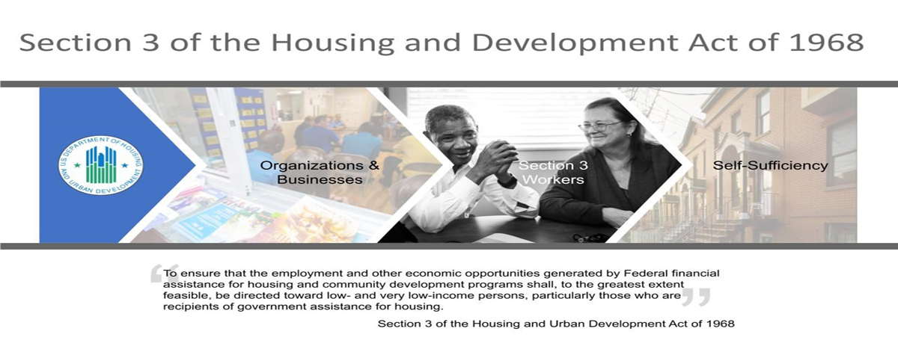
DCA Section 3 Policy
Notes:
The purpose of Section 3 is to ensure that economic opportunities, most importantly employment, generated by certain HUD financial assistance shall be directed to low- and very low-income persons.

Slide 4
Section 3 Final Rule
Requirement
Employment, training, and contracting opportunities generated by Federal financial assistance for housing and community development programs are, to the greatest extent feasible, directed toward low-and very low-income persons.
Final rule published September 29, 2020
24 CFR Part 75
Promotes sustained employment and career development
Focuses on labor hours instead of new hires
Aligns Section 3 reporting with standard business practices
Consistent labor-hour tracking mechanism (Davis-Bacon)
Notes:
Today we'll be focusing on the new rule that was published in 2020.

Slide 5
Applicability
Section 3 requirements apply to all housing rehabilitation, housing construction or other public construction projects
    Threshold is met if the total amount of CDBG assistance exceeds $300,000*
    Applies to an entire Section 3 project, regardless of whether the project is fully or partially assisted under HUD programs that provide housing and community development financial assistance.
A Project is defined as a site or sites together with any building(s) and improvements located on the site(s) that are under common ownership, management, and financing.
*Effective March 16, 2026, increased the funding threshold that trigger Section 3 requirements to account for rising construction costs.
Notes:
Most CBDG awards trigger Section 3 compliance. CDBG, disaster, mitigation and redevelopment
The recipient or sub recipient's responsibility includes awarding contracts, to the greatest extent feasible, to Section 3 business concerns.
The new regulation emphasizes compliance “project-wide”.

Slide 6
Procedures promoting outreach to Section 3 workers & Business Concerns
When hiring, contracting or job training opportunities arise in connection with housing rehabilitation, housing construction or other public construction.
Recruitment of Section 3 Workers & Business Concerns
Notes:
There are procedures to promoting outreach to Section 3 workers and business concerns

Slide 7
Definitions
Section 3 Worker
Any worker who currently fits, or when hired within the past five years fit, at least one of the following criteria:
  Low- or very low-income, as established by HUD’s income limits;
  Employed by a Section 3 business concern
  YouthBuild participant
Targeted Section 3 Worker
Worker employed by a Section 3 business concern
Low and very low-income workers residing within neighborhood or service area of the project (neighborhood service area – one-mile radius of project site, or if fewer than 5,000 people, radius on project containing 5,000 people).
YouthBuild participants
Notes:
Ok, let’s look at who we are providing outreach and job opportunities to. As you can see, HUD defines a section 3 worker as (READ the Left side) and Targeted Section 3 Worker as (READ the right slide)
DOL defines YouthBuild as a community-based pre-apprenticeship program that provides job training and educational opportunities for at-risk youth ages 16-24, who did not finish high school.
Service area will be defined in the following slide.
Reviewing the definitions in the regulations can be confusing because there is a different set of definitions for Public Housing projects. CDBG projects should comply with Subpart C of the regulations.

Slide 8
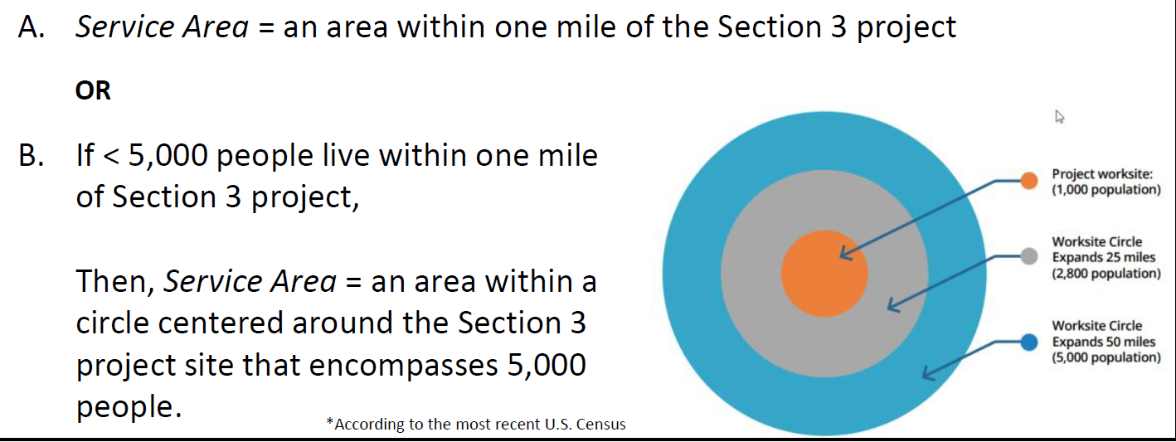
Service Area as Defined in 24 CFR 75.5
Notes:
More than likely for our projects, letter B will apply-It’s an area within one mile of the project site. For rural populations, the service area should be expanded radially beyond the 1-mile circumference, until it encompasses 5,000 people.
*The service area definition is based on the most recent US census.

Slide 9
Definitions
Section 3 Business Concern (meets criteria within the past 6 months)
51% or more owned by low- or very low-income persons
  OR
75% or more labor hours are performed by Section 3 workers who are low or very low-income persons or YouthBuild participants
      OR
51% or more owned by current residents of public housing
Notes:
As you can see the Concept of Section 3 prioritizes local employment *READ THE SLIDE*

Slide 10
Benchmarks
▪ Focuses Reporting on Key Outcome Metrics: New Benchmarks
▪ Safe Harbor Benchmarks
  ◦ 25% of all labor hours must be performed by a Section 3 Worker
  ◦ 5% of all labor hours must be performed by Targeted Section 3 Workers
  ◦ A labor hour = hours worked by all workers employed on a Section 3 project
  ◦ Set by Notice and amended periodically as necessary
https://www.federalregister.gov/documents/2020/09/29/2020-19183/section-3-benchmarks-for-creating-economic-opportunities-for-low--and-very-low-income-persons-and
Notes:
Ok, so what are the Safe Harbors? Which refers to efforts taken to comply with Section 3.
HUD is looking for us to meet 25% of total labor hours worked by Section 3 workers and 5% of total labor hours worked by “Targeted Section 3 workers”
HUD will update the benchmarks via Federal Register, subject to public comment, every 3 years.
*Professional hours are excluded from the total number of labor hours-basically our focus is on contract hours

Slide 11
How are benchmarks achieved?
Outreach to Section 3 workers and businesses​
Documentation of Outreach
Give a Preference in hiring and contracting to Section 3 workers and businesses
Notes:
Economic Opportunities - “Opportunity” involves reasonable access and fair notification, not a guarantee.
--Benchmarks are achieved through outreach.
--This affects advertising requirements for hiring and contracting.
a. Outreach to Section 3 workers and businesses
b. Documentation of Outreach
c. Preference is given to Section 3 Businesses and Workers, all things being equal among respondents and applicants.

Slide 12
Recipient Responsibilities
Employment & Training
Ensure employment and training opportunities arising in connection with Section 3 projects are provided to Section 3 workers within the metropolitan area (or nonmetropolitan county) where project is located
Priority of opportunities
  Section 3 workers residing within the service area or the neighborhood of the project, and
  Participants in YouthBuild programs.
Contracting
Ensure contracts for work awarded in connection with Section 3 projects are provided to business concerns that provide economic opportunities to Section 3 workers residing within the metropolitan area (or nonmetropolitan county) in which the project is located.
Priority of contracts awarded
  Section 3 business concerns that provide economic opportunities to Section 3 workers residing within the service area or the neighborhood of the project, and
  Youthbuild programs.
Document actions taken to comply
Reporting
Notes:
This is a very important slide, taken right out of Subpart C of Implementing Regulations. What you see here defines the responsibilities and order of preference of the recipients responsibilities.
*READ THE SLIDE*

Slide 13
Recipients also must implement at least one (1) of the following actions:
Facilitating an opportunity fair annually for contractors to meet interested low-income & very-low-income residents for possible employment.
When employment opportunities arise or are anticipated, posting at all job sites funded by DCA with a location or phone number of whom and how to apply for any opportunities for employment, training or contracting. The sign should be no smaller than 24” x 24” in Black ink and specifically read:
“This project is covered under Section 3 of the HUD Act of 1968 which requires that any new hiring opportunities first be directed to low- and very low-income persons in this community. Please contact (list the contact person name and number) for information on any employment, contracting and sub-contracting opportunities.”
Notes:
*READ THE SLIDE*Next the recipient must implement on of the following actions
Facilitate an opportunity fair annually for contractors to meet section 3 workers
Post all jobs opportunities as they arise at DCA funded project sites. As you can see there are some specifics to this
As always make sur the section 3 language is visible

Slide 14
Operating Procedures
Post positions in at least three community sources
  local community newspaper; widely distributed newspaper; local housing authority, or homeless agency, or/local low-income housing community; local workforce board; the local DFCS office; and the local GA Public Health County office
Use of temporary agencies​
  Placements must self-certify and be offered Preference​
Post contracting opportunities in at least three community sources
Contractor must convey history of compliance
Contract language regarding compliance for those that claim a Preference​
  Preference must be maintained or subject to penalties​
  Contractors may be banned from future participation
Notes:
Section 3 opportunities (positions or contracts) should be posted a Minimum of 3 community sources:
This could include but are not limited to the list included - the local community newspaper; widely distributed newspaper; local housing authority, or homeless agency, or/local low-income housing community; local workforce board; the local DFCS office; and the local GA Public Health County office
If using temp agencies, the posting must require placements to its recipient, or contractors to complete the Self Certification form (clarifying their qualifications as a qualified Section 3 Resident
The worker or contractor shall maintain status throughout the life of the contract.
Failure to meet this requirement will result in penalties up to and including contract termination.

Slide 15
Solicitation Package
Section 3 Self-Certification and Action Plan
Allows a contractor to claim preference or
Allows a contactor to decline preference
Previous Section 3 Compliance Certification
Allows a contractor to certify compliance on previous work
Assurance of Compliance Certification/Action Plan
List subcontractors (if known)
List of workforce
  Changes will constitute NEW hires
  Provides “Before and After” picture for compliance documentation
  Provides record keeping requirements
Self-Certifications – Business & Resident
Notes:
The solicitation package should contain the bolded areas as seen. This allows the contractor and subcontractors to claim preferences and/or certify to previous work

Slide 16
Solicitation Package
Contract award exceeding $300,000 & Claiming Preference
  Section 3 Self-Certification and Action Plan and the Section 3 Business Concern Self Certification portions at time of BID
Contract award exceeding $300,000
  Entire package completed and submitted prior to AWARD
Contract award less than $300,000
  Package is made available and submitted prior to AWARD
  If claiming a preference
    Section 3 Self-Certification and Action Plan and the Section 3 Business Concern Self Certification portions at time of BID/PROPOSAL
Notes:
The Section 3 solicitation package can be found on our website under the CDBG files under the Compliance and Administration section.
The Section 3 self certification allows the contractor to claim a claim a preference. If they are claiming a preference, they would submit the appropriate forms at the time of bid.
If they are not claiming a preference, they need to submit the appropriate forms prior to award or contract execution.
*To note, Section 3 is still required for procuring subcontracts of $100, 000 since the award itself is more than $200K.

Slide 17
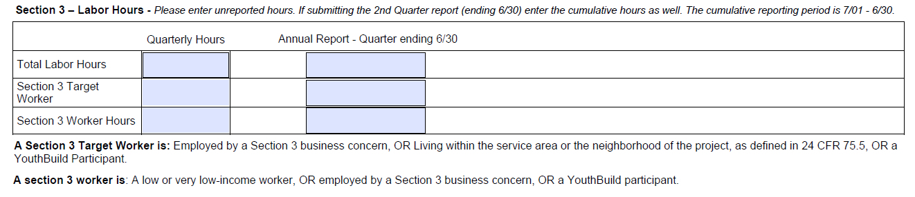
Reporting Requirements
Reporting of labor hours
(i) The total number of labor hours worked;
(ii) The total number of labor hours worked by Section 3 workers; and
(iii) The total number of labor hours worked by Targeted Section 3 workers.
Section 3 workers' and Targeted Section 3 workers' labor hours may be counted for five years from when their status as a Section 3 worker or Targeted Section 3 worker is established pursuant to § 75.31
QUARTERLY EXPENDITURES AND PROGRESS REPORT
Please enter unreported hours. If submitting the 2nd Quarter report (ending 6/30) enter the cumulative hours as well. The annual reporting period is 7/01 - 6/30.
Notes:
Points to be made:
DCA does have requirements for reporting.
Total labor hours should be reported quarterly along with the Section 3 worker hours and cumulatively in the annual report (July 1 – June 30)
Section 3 workers are required to re-certify every 5 years.

Slide 18
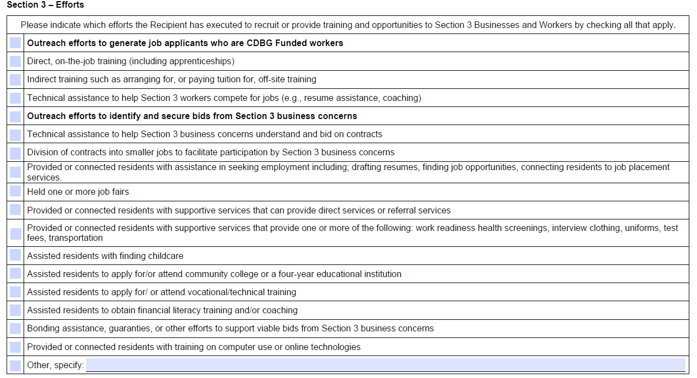
Qualitative Reporting
If unable to meet goals, must describe efforts taken to meet
Examples include:
Held job fairs
Conducted on-the job training
Outreach efforts to public housing residents
Connected residents with supportive services
Helped residence apply for technical training
Provided technical assistance to Section 3 Businesses
QUARTERLY EXPENDITURES AND PROGRESS REPORT
Notes:
As you can imagine, it’s not uncommon for us not to reach the benchmarks.
The efforts are especially important to State CDBG projects, because the benchmarks can be difficult to reach with rural populations.
Because of this we have a report of qualitative efforts.
If unable to meet goals, must describe efforts taken to meet the qualitative efforts
Examples include:
Held job fairs
Conducted on-the job training
Outreach efforts to public housing residents
Connected residents with supportive services
Helped residence apply for technical training
Provided technical assistance to Section 3 Businesses

Slide 19
Section 3 Resources
Section 3 Solicitation Package:
https://dca.georgia.gov/financing-tools/infrastructure/community-development-block-grants-cdbg/compliance-administration-0 & Appendix 2
Section 3 New Rule: Federal Register
HUD’s Website: https://www.hud.gov/
Section 3 Guidebook: https://www.hudexchange.info/programs/section-3/section-3-guidebook/welcome/
Income Limits: https://www.huduser.gov/portal/datasets/il.html
Notes:
Break for 15 min before procurement

Slide 20

Procurement
Standards
Methods
Sole Source Requirements
Contract Requirements
Notes:
We are going to look at DCA’s standards in addition to the 4 methods of procurement. We will also review the step-by-step process of competitive proposals for negotiation, competitive sealed bids and sole source requirements. Finally, we will discuss what you need to submit within the application to document the procurement.

Slide 21


Calling all Consultants
The CDBG consultants list is provided to local governments to assist in the procurement of professional services, such as; grant administration, grant writing, engineering, and architectural services. DCA would like to update its CDBG consultants list and is requesting updated contact information for grant writers and administrators, engineers, architects, and other services providers wishing to be solicited by potential applicants of CDBG funds. Please visit the Compliance & Administration section of our website to complete the survey or use the link and QR code below.
List of Consultants for Interested Applicants
Notes:
As some of you may know we are updating our consultants list. If you have not done so, please submit your information via the QR code or by clicking the compliance & admin link in the deck provided online.

Slide 22
Procurement Standards
DCA’s procurement policies and procedures implement the requirements of 24 CFR 570.489 (g), which says the State shall establish requirements for procurement policies and procedures for units of general local government, based on full and open competition.
Identification of Methods of Procurement and their applicability
Prohibition of cost plus a percentage of cost & percentage of construction costs methods of contracting
Assurance that all purchase orders and contracts include any clauses required by Federal statutes, Executive orders, and implementing regulations
Subrecipient and contractor determinations shall be made in accordance with the standards in 2 CFR 200.331.
Notes:
Instead of using part 200 DCA had the ability to implement its own procurement procedures per part 570. The bullet points are a recitation of that law.
In order to do this we must identify the method of procurement and their applicability. We do this by the dollar thresholds and the type of services you are procuring.
There is a prohibition of cost plus a percentage of cost and percentage of construction costs methods of contracting.
Assurances that all purchase orders and contracts include any clauses required by Federal statutes, executive orders and implementing regulations – these are usually contained in our recipient’s manual in the appendices section
And then of course subrecipient and contactor determinations should be made in accordance with the standards in part 200
The full text can be found in Chapter 3, Section 4 of the recipient’s manual. There are some things that we don’t provide a high-level view of here so it is worth looking at for further information.

Slide 23


Procurement transactions will be provided in a manner providing full & open competition
Avoid:
Unreasonable requirements
Noncompetitive pricing practices
Noncompetitive awards to consultants that are on retainer contracts
Organizational conflicts of interest
Specifying only a brand name product
Any arbitrary action in the procurement process
Notes:
The procurement methodology should promote full and open competition. As you can see on the slide, there are restrictive situations that should be avoided.
Unreasonable requirements – requirements such as excessive bonding
Noncompetitive pricing practices
Noncompetitive awards to consultants that are on retainer contracts – opposite of competitive competition
Organizational conflicts of interest – we’ll take a look at this later
Specifying only a brand name product
Any arbitrary action in the procurement process

Slide 24
Procurement
Standards
Documented Conflict of Interest Policy, which states:
  No employee, officer, or agent…
  “May participate in the selection, award, or administration of a contract supported by a Federal award if a real or apparent conflict of interest is present.”
Persons covered = Employees, agents, consultants, officers or elected/ appointed officials of state,
Local government and/or recipient and subrecipient.
Notes:
Each Local Government should have a documented Conflict Of Interest policy which states no employee, officer, or agent may participate in the selection, award, or administration of a contract supported by a Federal award if a real or apparent conflict of interest is present.

Slide 25
Prohibited Conflicts
Persons with CDBG responsibilities, decision-making power or information may NOT:
Obtain a financial interest or benefit from CDBG activity
Have any interest in contract or subcontract
  Applies to family members and business ties
  Applies during tenure and 1 year after
Example: Grant Administrator cannot assist grantee with drafting statements of work or RFPs for grant administration if they intend to submit proposal.
May explain process, discuss instructions/process publicly available on DCA website
Notes:
To be more detailed - persons with CDBG responsibilities, decision-making power, or information may NOT:
Obtain a financial interest or benefit from CDBG activity or
Have any interest in contract or subcontract
This applies to family members and business ties and applies during tenure and 1 year after tenure.
As an example: a Grant Administrator cannot assist a grantee with drafting statements of work or RFPs for grant administration if they intend to submit a proposal. However, they may explain the process, discuss the instructions/process that is publicly available on DCA’s website

Slide 26
Standards – Selection Procedures
Accurate description of the technical requirements for material, product, or service without restricting competition​
Clear requirements and evaluation factors​
The review of proposed procurement actions by Recipient officials to avoid purchasing unnecessary or duplicative items. ​
A cost or price analysis for every procurement action​
Consideration of contractor integrity, compliance with public policy, record of past performance, and financial and technical resources in the selection process​
Notes:
Let’s discuss the standards to selection procedures.
a. When selection procedures are carried our properly and correctly it will always reflect in the RFP’s score sheets, evaluation factors, recommendation of technical requirements.
b. The recommended selection will reflect contractor integrity, compliance with public policy, and record of past performance.
c. It’s not always about who is going to give the best price here. You do have flexibility to protect yourself according to risks of the responses depending on your assessment.
d. When done properly, these selection procedures will reflect in the process.

Slide 27
Methods of Procurement
Small purchase: Procurements under $250,000 (if allowed by local policy).
  Require that price or rate quotations be obtained at least three (3) sources.
  Not appropriate for procurement of administrative or professional services
Competitive Proposals: Professional Services
Competitive Sealed Bids: Public Works Construction
Sole Source: Requires DCA Approval
  The item or service is available from only one source;
  Urgent public need will not allow for the delay caused by advertising;
  Although a number of bids were solicited, only one response was received.
Notes:
Georgia has increased the small purchase threshold for public works contracts to $250,000, effective July 1, 2025

Slide 28

Professional Services Procurement
Competitive Proposals (pre-application)

Slide 29
Procurement – Competitive Negotiation
CDBG payments for Professional services are subject to the “competitive negotiation” requirements of 24 CFR 570.489 (g).
  Private grant writers/administrators
  Engineers and Architects
  Not applicable if contracting with Regional Commissions
Notes:
If your local government is going to procure for private consultants to complete grant writing and/or administrative services or engineering/architect services, the competitive negotiation or competitive proposal method must be used.
-Per Georgia law, Regional commissions can be contracted with without going through the procurement process.

Slide 30
Avoid the appearance of a conflict of interest:
Prior to application submission, both grant application services and grant administration services should be solicited using the same Request for Proposal (RFP).
Competitive Negotiation
For Engineering/Architectural services, preliminary reports and design and construction services should all be procured upfront using the appropriate RFP or Request for Qualification (RFQ) process.
Notes:
Regardless of who is paying for Grant Writing or Administrative services, the services should be procured at the same time in the same RFP to avoid the appearance of a conflict of interest. Same goes for Engineering/Architectural services. This will result in a single contract that is contingent upon award.

Slide 31
Step - by - Step Process
1
2
3
Establish or appoint a local Selection Review Committee
Determine the Selection Criteria
Prepare a Ratings Criteria Score Sheet
May choose Request for Qualifications (RFQ) for engineering/ architectural services
Include the evaluation factors, level of importance, deadlines, and contact information
Develop the Request for Proposals (RFP) Package
4
Publicize the RFP or RFQ.
Allow 30 days for responses
If equal to or greater than $100,000 place on Georgia’s Procurement Registry, (HB 322)

Slide 32
5
6
7
Distribute the RFP or RFQ to known providers
Review & Rate Proposals
Approve the Selection
8
Maintain Complete Records
Consultants/Administrators sent to at least seven (7) known providers
Engineering/architectural sent to at least ten (10) known providers
Email delivery – use Request Delivery Receipt & Request Read Receipt / Mail delivery – send Certified Return Receipt
Consult city or county attorney about recommendation and proposed contract
Obtain full council/commission approval and execute contract
Notify unsuccessful applicants in writing

Slide 33
Complete Records List
RFP/RFQ
Proof of Publication
Proof of Solicitation
Distribution List
Copies of Proposals Received
Scoring Sheets
Meeting Minutes – Council/Board Approval
Executed Contracts
Correspondence with Section 3 businesses (if applicable)

Slide 34
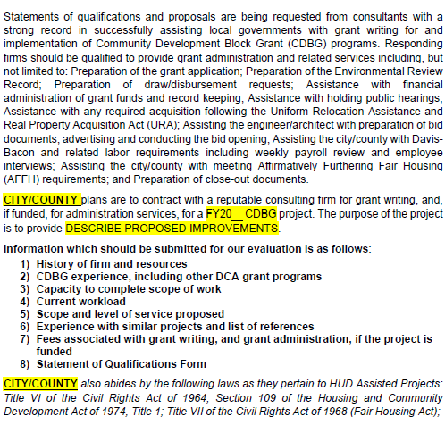
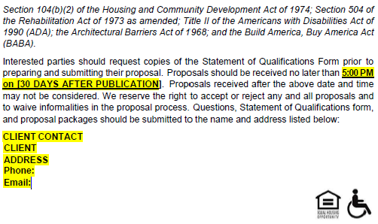
Notes:
RFP example, this can be tailored to whatever type of project you may have although this example is very specific to CDBG. What you see highlighted is very pertinent information that DCA will be looking for – items such as the type of service being procured, the funding program and year, project scope, appropriate dates and contact information
Refer to BABA being included in the advertisements.

Slide 35
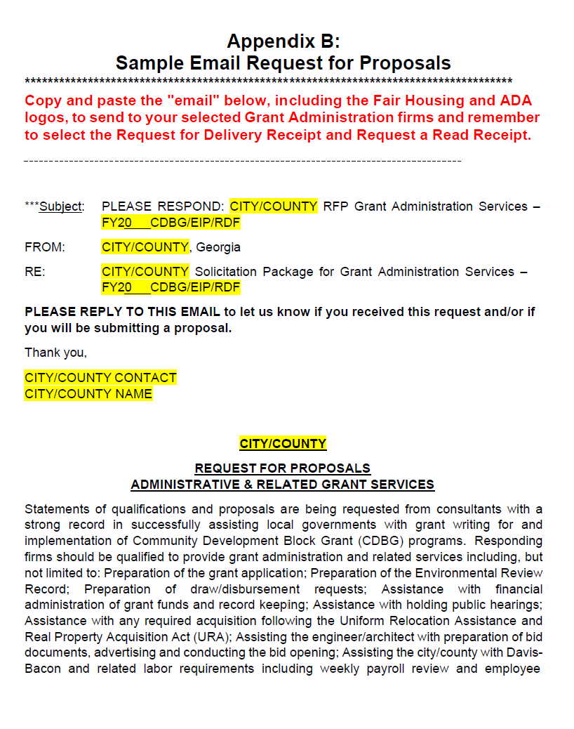
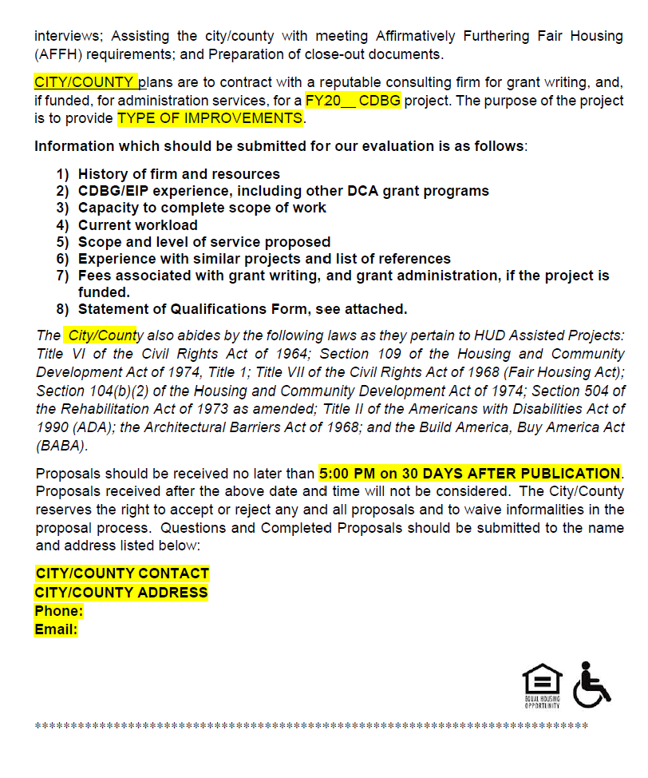
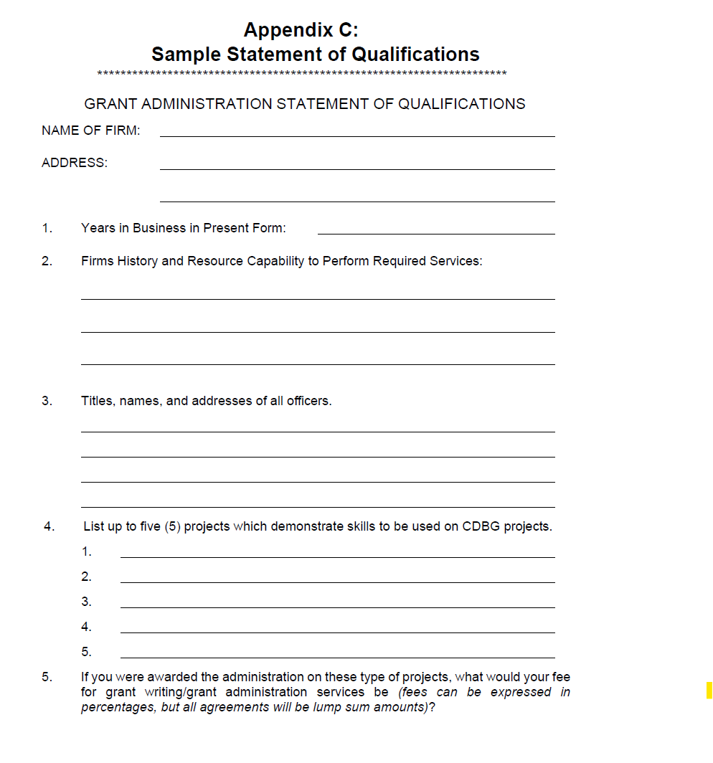
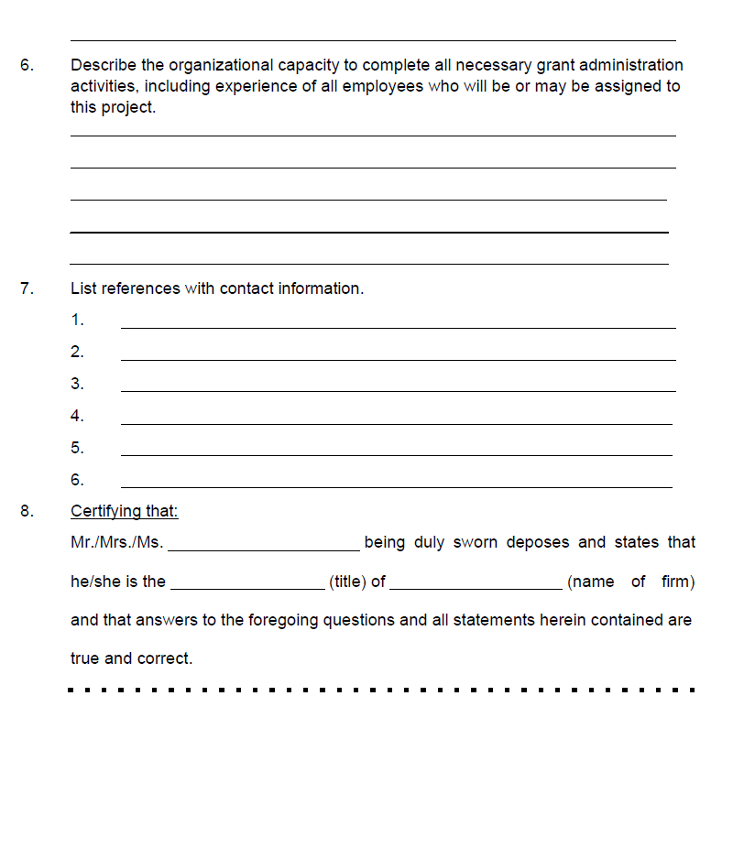
Notes:
Here we are looking at an RFP package example. The first two pages contains much of what I just mentioned DCA would be looking for. The next page includes a sample statement of qualifications form.

Slide 36


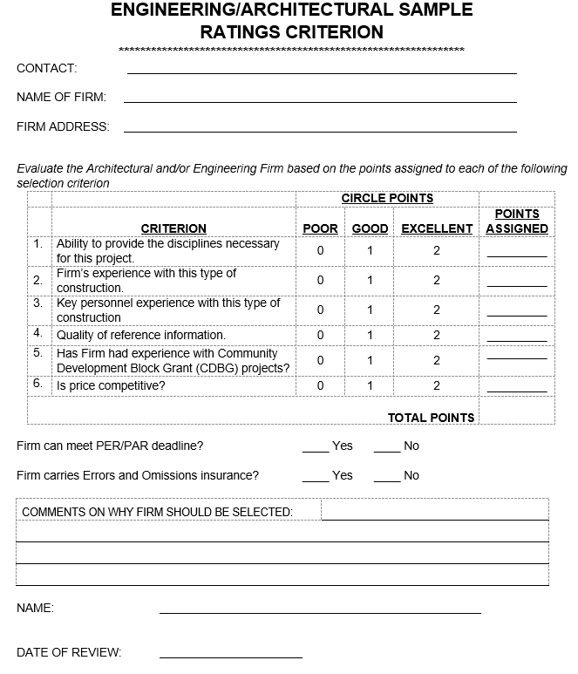
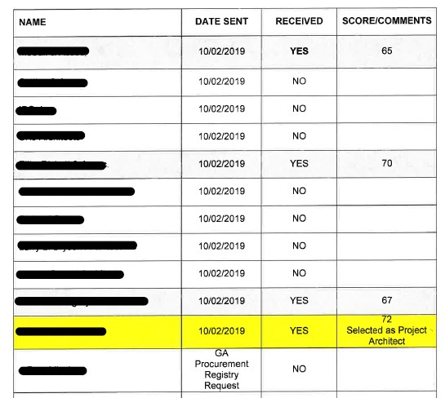
Notes:
Next, on the left you see a score sheet example which is also available online and an example of a summary of responses received. We do ask for a version of both of these to be a part of your application submission. All of these forms we just covered can be found by visiting the link at the end of the presentation.

Slide 37
Procurement – Other Considerations
Unsuccessful grant applicants from the previous year can use same grant administrator and engineer or architect:
  Must be for previous application cycle
  Any older procurements will not be valid, and a new advertisement and solicitation of RFPs is required
  Followed acceptable procurement process
Notes:
If you had a grant application from the previous year that was not funded and the procurement was valid, you may use the same procurement.
Anything older than two years MUST be solicited again.
This is only allowable for the same IMPROVED project.
*If you have a question regarding timing, please email me.

Slide 38
Phased Implementation
BAP now applies to:
  FY2023 CDBG Projects containing iron and steel with a costs greater than $250K
  FY2024 awards, BAP will include Iron & Steel and Specifically Listed Construction Materials. Specifically Listed Construction materials consists of metals other than iron and steel (non-ferrous metals), lumber, composite building materials, and plastic and polymer-based pipe and tube (e.g., PVC pipe).
  FY2025 and later awards, BAP will include the same material groups from FY2023 and FY2024 awards in addition to All Other Construction Materials and Manufactured Products. All Other Construction Materials consists of glass, drywall, and other construction materials. Manufactured Products include a material or supply used in an infrastructure project that is not iron or steel or a construction material.
  FY2026 and later awards, BAP will include the material groups from FY 2023, FY2024, and FY2025.
BAP does not apply to:
  Non-infrastructure funding.
  Infrastructure projects that do not contain steel
  Infrastructure projects with a total costs of $250K or less
  CDBG-DR, CDBG-MIT, CDBG –CV projects
  Projects qualifying under another HUD general waiver

Slide 39
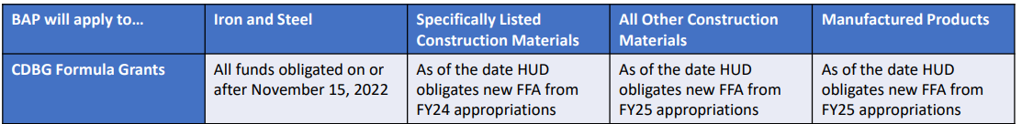
HUD Construction Materials Groups
HUD’s waiver breaks construction materials into two groups for the purposes of HUD’s phased implementation: “specifically listed” and “all other construction materials.”
Iron & Steel – 2023 Awards and beyond
Specifically Listed – 2024 Awards
  Metals other than iron or steel (non-ferrous metals)
  Lumber
  Composite building materials
  Plastic and polymer-based pipe and tube (e.g., PVC pipe)
All Other Construction Materials
  Glass
  Drywall
  Other construction materials
Manufactured Products
  A material or supply used in an infrastructure project that is not iron or steel or a construction material.
Notes:
2026 applicants, all four lists

Slide 40
BABA’s Impact
Pre-Award Considerations
Availability of products covered by the Buy America Preference (BAP)
Cost of products covered by the Buy America Preference (BAP)
Impact on PER/PAR cost estimates
Grant Administrator Knowledge

Slide 41

Post Award Procurement
Competitive Sealed Bids: Public Works Construction
Notes:
Now, let's assume you are being awarded for your project – this leads us to competitive sealed bids procurement process.

Slide 42
Competitive Sealed Bid
DCA, under the authority of 24 CFR 570.489(g), has adopted Title 36, Chapter 91 of the Official Code of Georgia, Georgia Public Works Construction Law
Traditional design–bid–construct method
  *Alternative methods require DCA approval
Advertising Requirements (including Section 3 & BABA)
Contract opportunity must be posted in the governing authority’s office
Contract opportunity must be advertised in either the legal organ of the government, or on an Internet website of the government entity or one identified by the entity
Place on Georgia’s Procurement Registry, if over $100,000 (HB 322)

Slide 43
Competitive Sealed Bid – Advertising Requirements
If advertised in newspaper, opportunity must be advertised at least two times:
  The first advertisement must be at least 4 weeks prior to the bid opening date; and
  The second advertisement must follow at least 2 weeks after the first advertisement
Advertisements placed on an Internet website should run continuously for at least four weeks.
Each advertisement shall include such details and specifications as will enable the public to know the extent and character of the bid or proposal opportunity
Notes:
sometimes we run into issues with GPR not providing enough detail or Section 3 not being noticeably included on the landing page. We are now expecting to see BABA written into the brief description also. Please just make sure you have a proper amount of detail in the posting.

Slide 44
Section 3 Advertising Requirements
Construction Contract Opportunities must be posted in at least
3 locations
GPR, your website, Dodge Room, newspaper, DOL, DFCS
Section 3 Policy
(page 11)
All ads must include this Section 3 language: “This is a Section 3 Covered Contract. Section 3 Business Concerns are encouraged to apply.”
Notes:
-Once again you must post the construction contract opportunity in 3 locations. The ads should always include the section 3 language and the list of locations is provided here also - GPR, your website, Dodge Room, newspaper, DOL, DFCS and several more.
-The section 3 policy, specifically page 11, lays these locations out in bullet point form, should you need a reference back to them.

Slide 45
BABA Bid Requirements
Advertisement for Bids
This agreement is for services related to a project that is subject to the Build America, Buy America Act (BABAA) requirements under Title IX of the Infrastructure Investment and Jobs Act (“IIJA”), Pub. L. 177-58. Absent an approved waiver, all iron, steel, manufactured products, and construction materials used in this project must be produced in the United States, as further outlined by the Office of Management and Budget’s Memorandum M-22-11, Initial Implementation Guidance on Application of Buy America Preference in Federal Financial Assistance Programs for Infrastructure, April 18, 2022.
Instructions to Bidders
Any request for substitute or “or equal” shall include the Manufacturer’s Certification of compliance with the Build America, Buy America Act (BABAA) requirements mandated by Title IX of the Infrastructure Investment and Jobs Act (“IIJA”), Pub. L. 177-58. If the Instructions include a Federal requirements section, include the following: BABAA requirements apply to this project.
Bid Form
Bidder’s representation section: Bidder is familiar with all laws and regulations that may affect cost, progress, and performance of the work, including BABAA requirements.
Notes:
When procuring for construction, there are BABA bid requirements
The advertisements must state the agreement for services is subject to BABA,
Provide instructions to bidders, and
The bid form should have a section related to the bidder being familiar with BABA

Slide 46
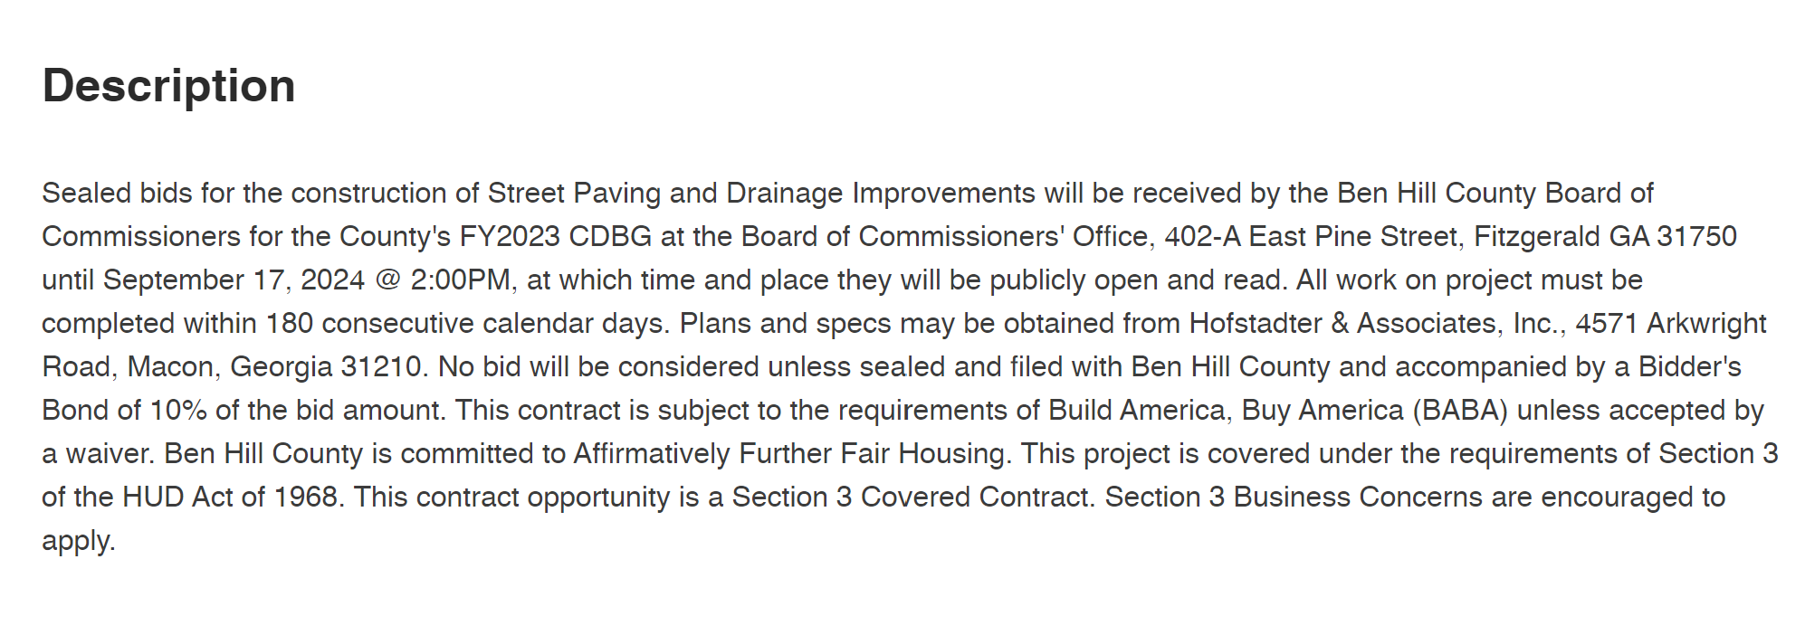
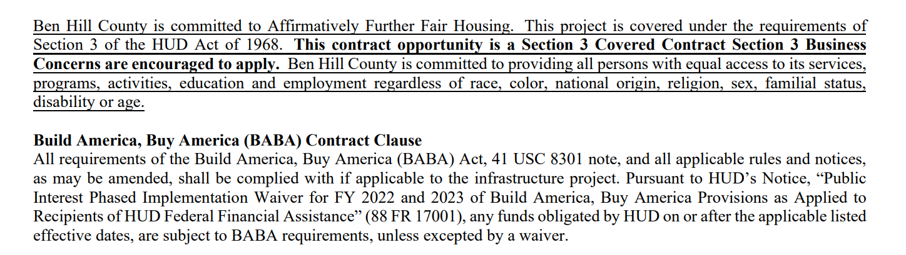
GPR landing page
Advertisement
for Bid
Notes:
Example of what we are looking for in bid advertisements online on the landing page of sites being utilized.

Slide 47
Competitive Sealed Bid- Bonding Requirements
State requirements (contracts $100,000+):
A performance bond from contractors executed in connection with each contract.
A payment bond on the part of the contractor for 100% of the contract price.
Federal requirements (contracts $100,000+):
A bid guarantee from each bidder equal to 5% of the bid price.
A performance bond from contractors for 100% of the contract shall be executed in connection with each contract.
A payment bond on the part of the contractor for 100% of the contract price.
DCA requirements:
adequate contractor’s liability insurance from all contractors
  $25,000 property and $50,000 bodily injury coverage
Notes:
Looking at the Competitive Sealed Bid Bonding Requirements, we have a deeper dive for what is required from a Federal, State and DCA standpoint.

Slide 48
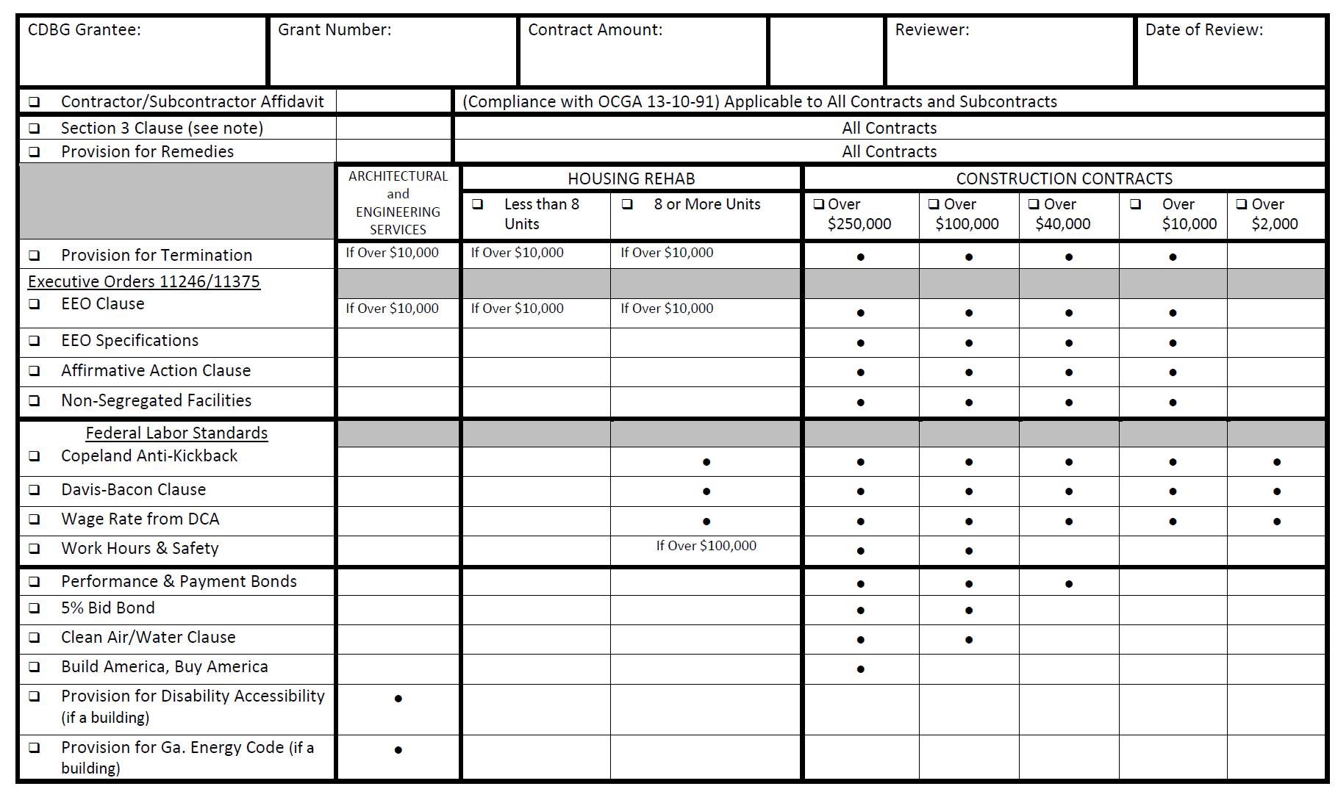
Section 3 Solicitation package is completed & submitted to Recipient prior to award for contracts $200,000+
Notes:
This is a matrix of the contract requirements; it is the same form that the reps use when they conduct their procurement check. As you can see the number of Contract Clauses increases as the number of construction contract amount increases. We do have this in the clauses referenced in the appendices of the recipient’s manual.
Matrix now inclusive of BABA

Slide 49
Sample CDBG Contract Conditions
Build America, Buy America (BABA) Contract Clause
Section 3 Clause
Provision for Remedies Clause
Termination Clause
Equal Employment Opportunity (EEO) Clause
Standard Federal EEO Specifications (E.O. 11246)
Notice of Requirement for Affirmative Action
Certification of Nonsegregated Facilities
Standard Federal Labor Standards Provision
Contractor Certification Regarding Debarment, etc.
Performance, Payment and Bid Bonds
Clean Air and Clean Water Act Compliance
Contractor and Subcontractor Affidavit and Agreement (For compliance with O.C.G.A. §13-10-91)
Debarment and Suspension (Executive Orders 12549 and 12689)
Byrd Anti-Lobbying Amendment (31 U.S.C. 1352)
Section 6002 of the Solid Waste Disposal Act
Rights to Inventions Made Under a Contract or Agreement
*The Local Government’s Attorney should review and approve all contract provisions.
Notes:
From page 418 of 493 in Recipients’ Appendix 2

Slide 50
BABA’s Impact
Post-Award Considerations
Documenting products country of origin
Bid Requirements – Advertising, Instructions, Bid Forms
Contract Requirements
Architect/ Engineer - obtaining and maintaining all BABA documentation (particularly manufacturers’ certifications) during construction, which shall be transferred to the recipient.
Construction Contract Clause

Slide 51
Build America, Buy American (BABA)
Demonstrating Compliance
Recipients will ensure the products delivered to the construction site are accompanied by proper documentation that demonstrate compliance with the law and made available to the funding authority upon request.
Signed certification letter from the manufacturer for the project is the most direct and effective form of compliance documentation for ensuring products used on site are BABA-compliant prior to their installation
Basic elements of sufficient documentation:
  Project name, project location, contract number, or project number
  Description of product(s) (simple explanation sufficient to identify the product(s)), or an attached purchase order, invoice, or bill of lading.
  Attestation statement referencing Infrastructure Investment and Jobs Act (“IIJA”) or the Bipartisan Infrastructure Law (BIL) and American Iron and Steel (AIS) requirements
  Manufacturing location (s)
  Signature of representative certifying knowledge of manufacturing processes.
Notes:
Link to Product
Attestation statement
Manufacturing location or locations
Representative’s signature certifying knowledge of manufacturing processes.

Slide 52
Demonstrating Compliance Cont’d
Architect/ Engineer contract should include, as a basic service, obtaining and maintaining all BABA documentation (particularly manufacturers’ certifications) during construction, which shall be transferred to the recipient. The architect or engineer will need to certify to this action at the project’s end.
At a minimum, the following must be included in all construction contract documents: All requirements of the Build America, Buy America (BABA) Act, 41 USC 8301 note, and all applicable rules and notices, as may be amended, shall be complied with if applicable to the infrastructure project. Pursuant to HUD’s Notice, “Public Interest Phased Implementation Waiver for FY 2022 and 2023 of Build America, Buy America Provisions as Applied to Recipients of HUD Federal Financial Assistance” (88 FR 17001), any funds obligated by HUD on or after the applicable listed effective dates, are subject to BABA requirements, unless excepted by a waiver.
Contractors must provide manufacturers’ certifications for all BABA compliant items to the responsible party before a request for reimbursement to the agency is made.
Notes:
contractor construction contract(s) must include a requirement to procure and install only items that comply with BABA or are subject to an approved waiver.

Slide 53
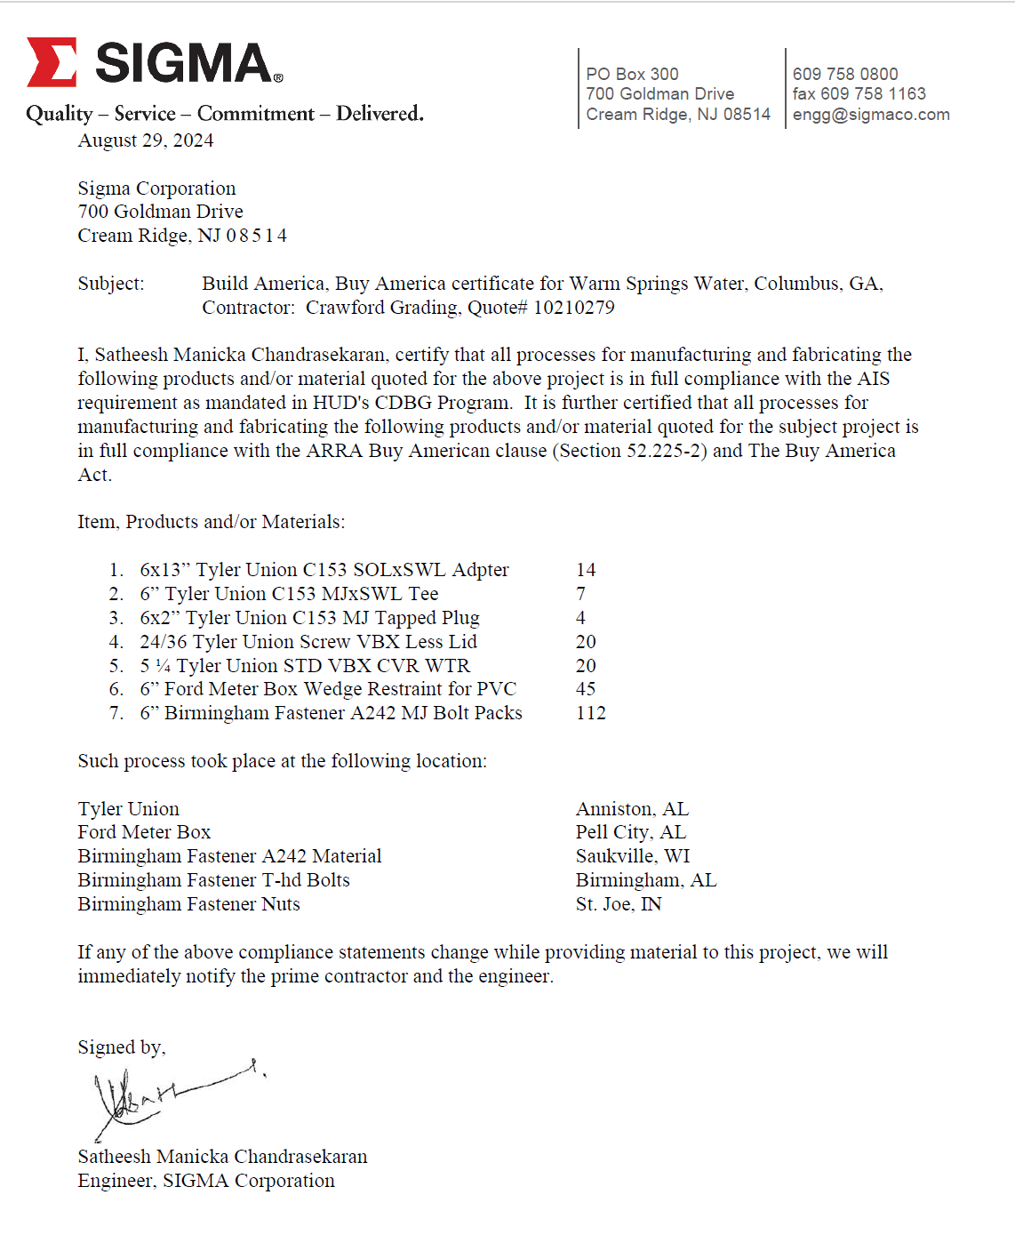
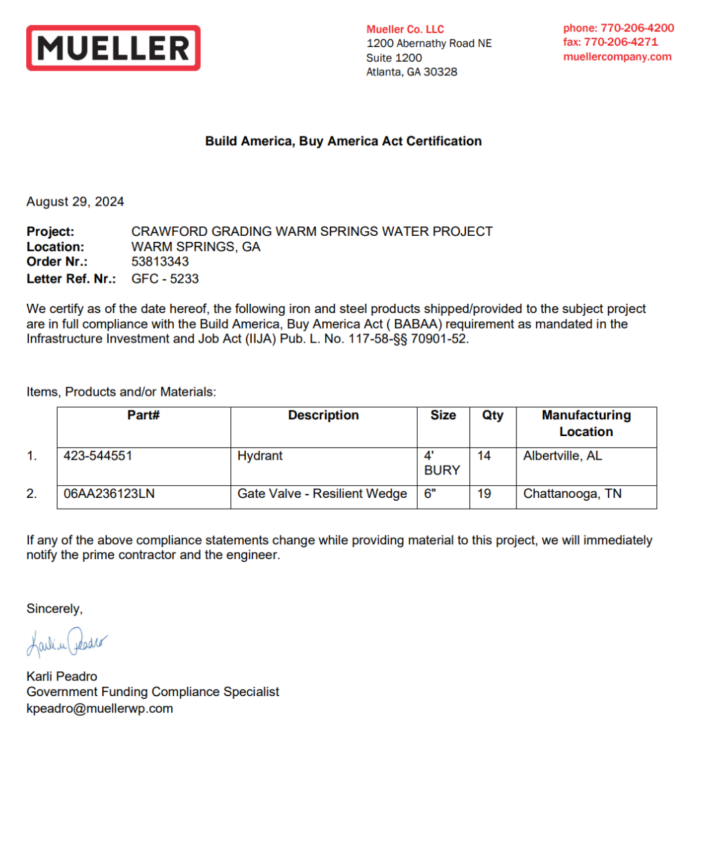
Notes:
Examples of acceptable BABA documentation

Slide 54
Ineligible Procurement Practices
National Pollutant Discharge Elimination System (NPDES)
When the NPDES inspection work is included in the construction contract, the general contractor must be allowed to bid this line Item without restrictions on price or inspection firm unless otherwise required by regulation. Keep in mind that ineligible procurement practices are subject to sanctions including repayment to DCA of disallowed costs. (Appendix O, Applicants Manual)
Notes:
Lastly, as mentioned by Cindy Alligood yesterday, additional engineering for National Pollutant Discharge Elimination System (NPDES) should be competitively procured as stated in Appendix O of the applicant’s manual (screen shot on slide). Veering any other route is contrary to the principle of promoting DCA’s Standard which is fair and open competition.

Slide 55
Sole Source Requests
Chief Elected or Authorized Official’s request letter
Description of Procurement Methodology
Tear Sheet of the Bid Advertisement or RFP/RFQ
Local Government’s Attorney Opinion; noting applicable laws, rules, and regulations.
Sealed Bid Procurements
  Local Government’s Engineer/Architect states that the one bid response’s prices were reasonable and appropriate based on independent cost estimates.
Professional Services Procurement
  list of the active, qualified consultants or engineers/architects that were mailed the RFPs/RFQs (7 for grant administrators and 10 for engineers/architects)
  certified return receipt documentation or adequate email documentation
This approval must be received prior to the application deadline for professional services.
Notes:
Attorney's Letter - letters submitted recently for competitive sole source reference the Ga Public Works Construction law but instead should reference 24 CFR 570.489(g)

Slide 56

Did not allow at least 3o days for responses
Common
Procurement
Mistakes
Failed to advertise the Competitive Sealed Bid at the Governing Authority’s office.
Did not retain proof of solicitation delivery (read receipts) or a memorandum of the process
Meeting minutes indicated the highest scored respondent was not selected without explanation
Sole Source (professional services) approval was not obtained prior to application submission

Slide 57
Procurement Resources
CDBG Manuals & Local Government Officials’ Handbook: https://dca.georgia.gov/financing-tools/infrastructure/community-development-block-grants-cdbg/annual-cdbg-competition/cdbg
DCA’s Professional Procurement Instructional Materials: https://dca.georgia.gov/financing-tools/infrastructure/community-development-block-grants-cdbg/compliance-administration-0

Slide 58
Thanks!
Brittney Hickom
Brittney.Hickom@dca.ga.gov
Direct: 470-698-8166
Compliance Officer
dca.georgia.gov

