Slide 1
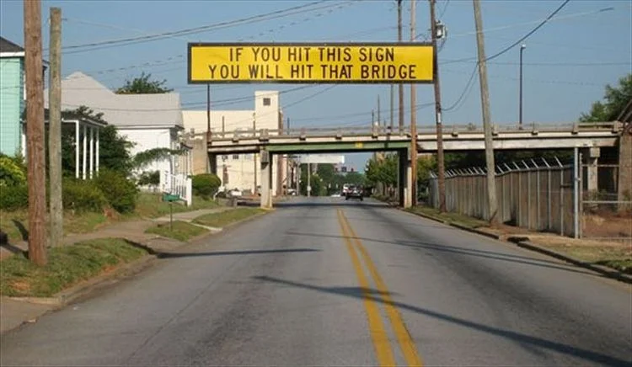

Slide 2
FY2027 CDBG Summit Revitalization Area Strategy

Slide 3
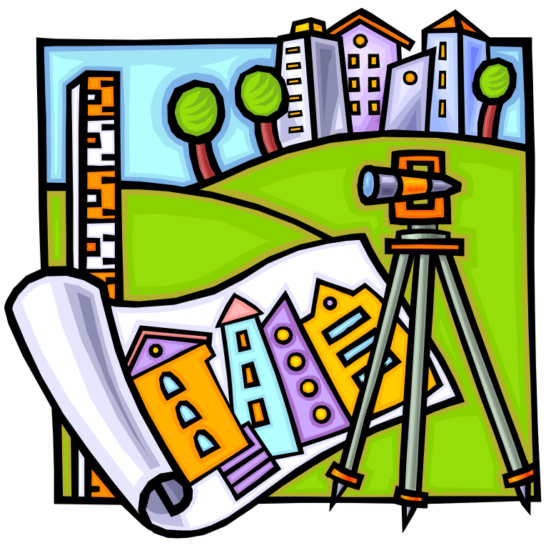
Revitalization Area Strategies
RAS designation is for 3 years
Successful applicants are rewarded for local efforts demonstrating:
Long-term vision for the area
Well-defined area that includes comprehensive revitalization activities
Grassroots involvement from area residents
Commitment from other funding partners
Documented commitment from funders and stakeholders

Slide 4

Revitalization Area Strategies
Planning for the future-when designing the RAS area, keep in mind:
DCA generally does not allow changes to the geography of the RAS Area during the 3 year designation term
Map your proposed area with future projects in mind!

Slide 5
Revitalization Area Strategies
Application process and requirements – See RAS Application Manual
For RAS applicants Who Are Applying for CDBG for FY27:
Electronic submission via the DCA’s GrAAM System is mandatory
Applications due April 2, 2027
  New or Recertification applicants complete RAS 1
  RAS Communities in year 2 or 3 must complete RAS 2
Both require significant narrative and documentation as part of the application process

Slide 6
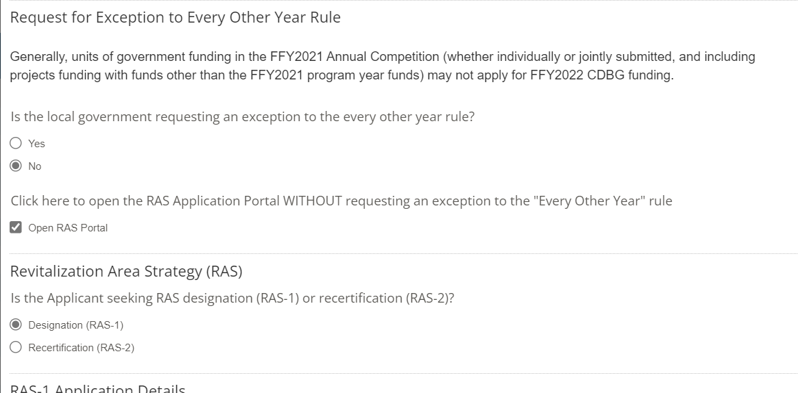
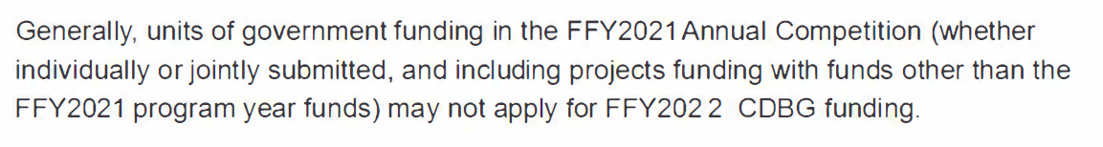
To Access the RAS Application in GrAAM:
Complete all information on subsequent pages

Slide 7
Active RAS Communities that do not apply for CDBG
For local governments that are not applying for CDBG funds in the 2027 Application Cycle, the RAS 2 information must be submitted though DCA’s WEB_GMS System.
Please Don’t Use The GrAAM System!!

Slide 8

CDBG Revitalization Area Strategies
RAS Application Scoring
Threshold – 5 points
Local Redevelopment Tools
– up to 5 points
Investment Partnerships
– up to 5 points
Collaboration
– up to 5 points

Slide 9
Threshold – 5 Points
Urban Redevelopment Plan – must be officially adopted by the local government and
The RAS area must be within Census Block Groups of 20% or Greater Poverty
Summary of Georgia’s Urban Redevelopment Act (O.C.G.A 36-61-1)
  Gives cities and counties broad powers to redevelop blighted or threatened areas of the community.
  Allows communities to use eminent domain to buy and assemble property for revitalization and resale.
  Does not require a referendum.
  Can be implemented by an authority appointed by the local government.

Slide 10
Threshold – 5 Points
Urban Redevelopment Plan
Summary of Georgia’s Urban Redevelopment Act (O.C.G.A 36-61-1) Cont.
  Encourages involvement of private enterprise/public private partnerships to redevelop neglected areas of the community.
  Permits use of tax-exempt bonds for redevelopment purposes. These may be secured by loans and grants.
  Lets the public know what is being planned for the redevelopment area.
  Guides investments in infrastructure to support redevelopment.
  Allows the City or County to negotiate variances and waive existing zoning and development requirements in order to achieve the optimum economic and aesthetic results in the redevelopment area.

Slide 11
Threshold – 5 Points
Urban Redevelopment Plan
Allows the imposition of conditions more specific than existing land use regulations. Conditions run with the property and control development above other land use regulations. Design standards may be included
Can waive or modify ordinance provisions that stand in the way of revitalization
Shows public what will replace blight
UR entity may issue tax exempt bonds to be repaid with profits from redevelopment project. May be secured by mortgages on property within the district

Slide 12
Threshold – 5 Points
Urban Redevelopment Plan O.C.G.A. 36-61
Checklist items
Citizen participation process
A Statement that the URP is consistent with the local government comprehensive plan
Clearly defined boundaries
Explanation of negative conditions in the area
Defines the city or county land use objectives for the area
Outlines possible exceptions to development regulations
Description of land parcels to be acquired

Slide 13
Threshold – 5 Points
Urban Redevelopment Plan O.C.G.A. 36-61
URP Checklist, cont’d.
Structures to be demolished or rehabilitated
Strategy for relocating any displaced residents
Any covenants/restrictions to be placed on properties in the redevelopment area
Public infrastructure to be provided (transportation, water, sewer, sidewalks, lighting, streetscapes, public recreational space, parking, etc.) to support redevelopment
Strategy for leveraging private resources
A workable strategy for implementing the plan

Slide 14

Threshold – 5 Points
  RAS must be within eligible Census Block Group(s) 20% or greater Poverty Rate (not AMI). Mapping tools are found on DCA’s website
  RAS must be within Urban Redevelopment Area with an adopted Urban Redevelopment Plan (O.C.G.A. 36-61)
  CDBG Public Participation process must be followed for RAS also – Hearings may be held consecutively
Note: The entire CDBG Target Area must be located within the RAS Area in order to receive RAS bonus points

Slide 15
Threshold – 5 Points
20% or greater poverty rate – may be determined by
  ACS Data – Any of the most recent 3 years of data available (DCA Mapping website)
    or
  Local Survey conducted in accordance with the “Guide to Acceptable Survey Methodology – November 2017” – Appendix C in the CDBG Applicants’ Manual
  A narrative describing the survey methodology, analysis of results, and copies of all survey instruments used for the survey must be included in the RAS application.
  Note – Poverty rate income is different than AMI income. 2027 rate table may be found in the RAS Manual when available

Slide 16
Threshold – 5 points
Map Requirements – map(s) must show
  Local government (city/county) limits
  Census Block Group(s)
  Urban Redevelopment Area
  RAS Area – including individual plats within the RAS boundary
  CDBG Target Area

Slide 17
Threshold – 5 points
Threshold
Census Block Group(s) with 20% Poverty
URA Area
RAS Area
CDBG Target Area
Note: Please show source of poverty data on the map legend

Slide 18
Threshold – 5 points
Property values for the RAS area are to be tracked each year.
The Tax valuation Spreadsheet must be submitted electronically as part of the application.
*Taxable value of property--Sample spreadsheet.
Tax Parcel | Street Address | Tax Value
A
B
C
D
etc.
Total tax value |  | Total MUST be included

Slide 19
Threshold – 5 points
  Application NARRATIVE Requirements
  RAS 1 – Detailed description of HOW the revitalization strategy will be implemented
    Activities that will be undertaken to revitalize the chosen area including a detailed description as to how these activities are tied to the urban redevelopment plan
    Local strategy that will be used to implement the plan;
    Property Values (described above)
    Number of business/occupational licenses issued.
    Number and value of building permits issued.
    Opportunities available for economic development improvement.
    Problems likely to be encountered.
    Photos illustrative of conditions in the RAS

Slide 20
Threshold – 5 points
  Application NARRATIVE Requirements
  RAS 2 – Detailed description of how the revitalization strategy is being implemented
    Activities the local government has undertaken to revitalize the chosen area including a detailed description as to how these activities are tied to the urban redevelopment plan - results must be documented
    Narrative describing what other developments have happened within the RAS that furthers the goals of the strategy. Supporting documentation of activities is required.

Slide 21
Threshold – 5 points
  Application DOCUMENTATION Requirements
  RAS 1
    Copy of Urban Redevelopment Plan
    Evidence of Citizens’ Participation including, but not limited to, advertisements of public meetings, attendance lists and minutes from the hearing
    A copy of all local government resolutions establishing urban redevelopment area(s), urban redevelopment plan(s) including amendments and related resolutions, must be submitted.
    A certification from the local government’s attorney that the public hearing requirements, resolutions and policies and the authorizing resolutions for the urban redevelopment plan were adopted in accordance with applicable law must be included. If URP has been amended, new atty. certification is required
    Maps

Slide 22
Threshold – 5 points
  Application DOCUMENTATION Requirements
  RAS 2
    Copy of any amendments to the Urban Redevelopment Plan (if applicable)
      Must also include attorney certification that plan was amended in accordance with 36-61
    Documentation of supporting activity undertaken as described in the narrative for this category
    Number of business/occupational licenses issued
    Number and value of building permits issued
    Updated property values for the RAS area
    Spreadsheet must be included with the application

Slide 23
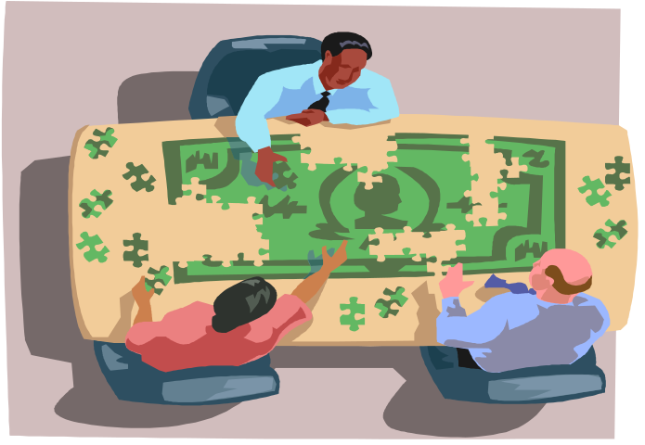
Local Redevelopment Tools – Up to 5 points
Locally adopted tools designed to target investment and/or redevelopment programs for the RAS area
Examples:
      Tax Allocation District (O.C.G.A. 36-44)
      Community Improvement District
      Business Improvement District
      Enterprise Zone (O.C.G.A. 36-88)
      Opportunity Zone
      Land Bank Authority
      Other locally designated, geographically targeted strategies/ordinances that further the goals of the strategy

Slide 24
Local Redevelopment Tools – Up to 5 points
  Application Requirements
  RAS 1
    Narrative requirement
      Narrative for this section of the RAS application must describe in detail how the tools will be used to benefit the RAS area.
    Documentation requirement
      Documentation of official adoption of all tools claimed (e.g., resolutions, ordinances, charters, etc.)

Slide 25
Local Redevelopment Tools – Up to 5 points
  Application Requirements
  RAS 2
    Narrative requirement
      Narrative for this section of the RAS application must describe what tools were used over the past year and details as to how those tools have contributed to the revitalization of the RAS area.
    Documentation requirement
      Documentation (where possible) of benefits derived from use of the claimed tool - Company/agency letters documenting benefits gained by use of the tool(s)
  Full narrative and documentation required for any NEW tools proposed

Slide 26
Investment Partnerships – Up to 5 points
Partnerships committed to monetary Investment into the area by revitalization, residential improvement, social service funding programs or job creation / retention programs applicable to the RAS area
Examples:
  Investment partnerships may be:
    Private developers
    Public programs chartered by the State of Georgia,
    Georgia Housing and Finance Authority,
    U.S. Department of Treasury
    SBA
    USDA

Slide 27
Investment Partnerships – Up to 5 points
Examples (con’t)
  Federal Home Loan Bank
  TVA
  HUD
  DOL
Habitat for Humanity,
Other non-profit organizations – CBDO’s, CHDO’s

Slide 28
Investment Partnerships – Up to 5 points
  Application Requirements
  RAS 1
    Narrative requirement
      Narrative for this section of the RAS application must describe in detail the roles of the investment partners and how the investment will be used to benefit the RAS area.
    Documentation requirement
      Documentation (correspondence from the proposed partners) must be provided showing a firm, long-term commitment by the investment partner or a long-term commitment by the applicant to use investment partners as part of their RAS strategy.

Slide 29
Investment Partnerships – Up to 5 points
  Application Requirements
  RAS 2
    Narrative requirement
      Narrative for this section of the RAS application must describe in detail the roles of the investment partners over the past year and how their investments have been used to benefit the RAS area.
    Documentation requirement
      Documentation (correspondence from the partners) must be provided confirming their investment in the RAS area. This section may also identify new partners who began (or will begin) participation in the RAS strategy. Documentation from newly identified partners must also be included.

Slide 30
Collaboration – Up to 5 points
Application must demonstrate that initiatives will be created and/or undertaken within the eligible area by private for-profit and/or not-for-profit community stakeholders.
Examples:
Local lending institutions
Community or Neighborhood housing organizations
Community development organizations or groups that will carry out some aspect of the Revitalization Area Strategy.
  GICH
  Housing or other task forces
  City/County code enforcement efforts

Slide 31
Collaboration – Up to 5 points
Examples (con’t.)
Credit counseling, Homebuyers Classes
Housing Expo, Senior Expo
Cleanup campaigns, junk appliance roundup
Formation of Neighborhood Associations and Neighborhood Watch
Church outreach: Food Pantry, Boys and Girls Club, After-school programs
Summer youth mission group builds handicap ramps and trim shrubbery
“Hands-On” projects: paint elderly houses, help build park

Slide 32
Collaboration – Up to 5 points
  Application Requirements
  RAS 1
    Narrative requirement
      Narrative for this section of the RAS application must describe in detail the roles of the collaborative partners and how the initiatives undertaken by each partner will be used to benefit the RAS area.
    Documentation Requirement
      Documentation (correspondence from the proposed partners) must be provided indicating commitment by the collaborative partners describing the initiatives they will undertake as part of the overall RAS strategy.

Slide 33
Specific Documentation
Points for Collaboration / Investment Partnerships are based on the DOCUMENTATION submitted (in addition to narrative):
Before and after photos
Newspaper clippings, newsletters
Letters from partners, with specific details
Minutes from council meetings
Code enforcement logs
Agreements, deeds, etc.
Grant award letters, etc.

Slide 34

RAS Rewards:
  Can apply for CDBG every year, provided that current CDBG project meets timeliness criteria
  Provides up to 20 bonus points on CDBG Annual Competition applications that are proposed within the RAS area
  Designation is effective for 3 years, then can re-apply
Note: Generally, DCA will only allow geographic amendments to RAS boundaries every three years upon application for renewal status - Plan Ahead

Slide 35
RAS Application Submission:
Electronic submission of RAS Applications through GrAAM is mandatory if applying for CDBG in this round.
Submission of RAS 2 information for those active RAS communities not applying for CDBG --- DCA’s WEB_GMS
Deadline April 2, 2027

Slide 36
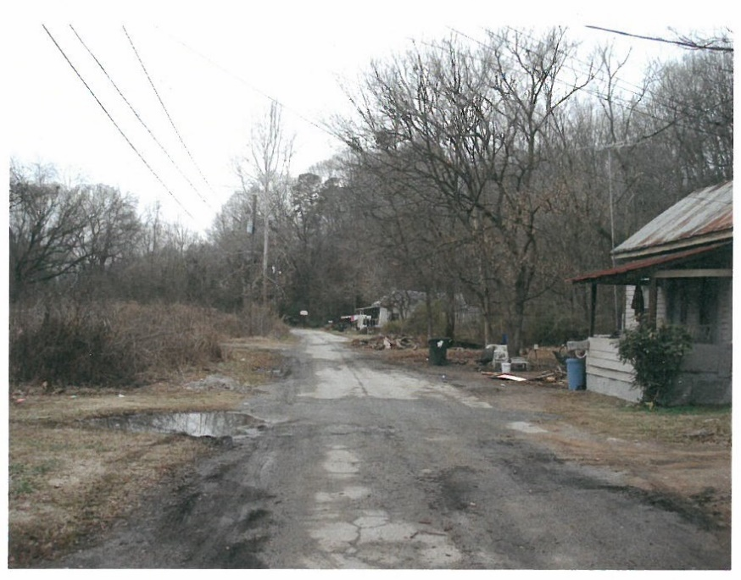
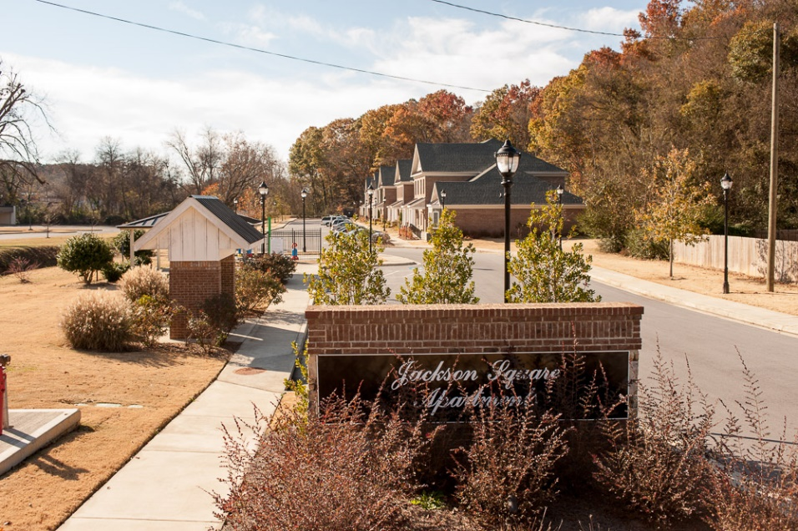
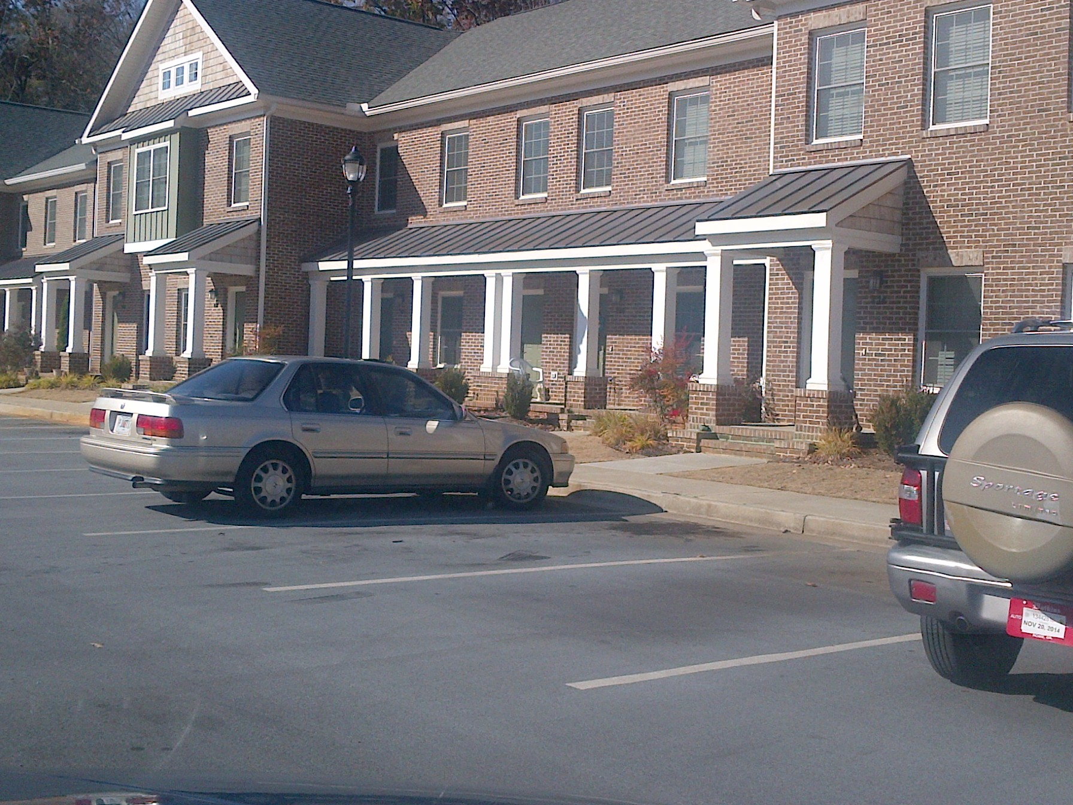
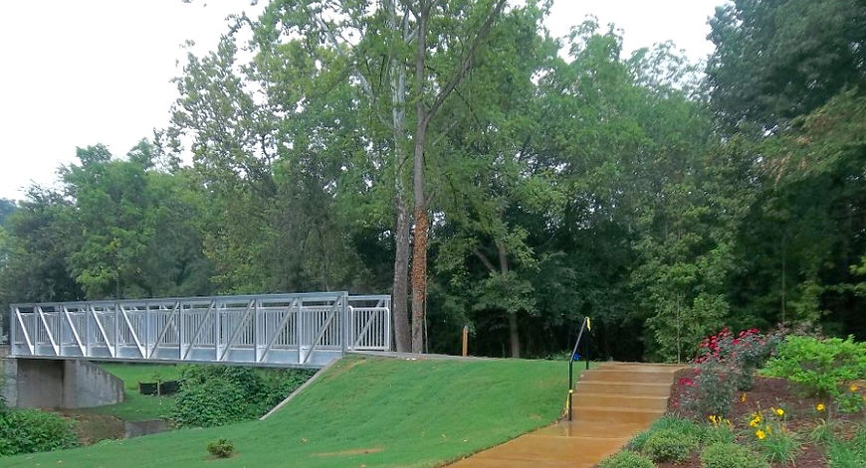
Results…………
Rockmart:
Jackson Square Apts.

Slide 37
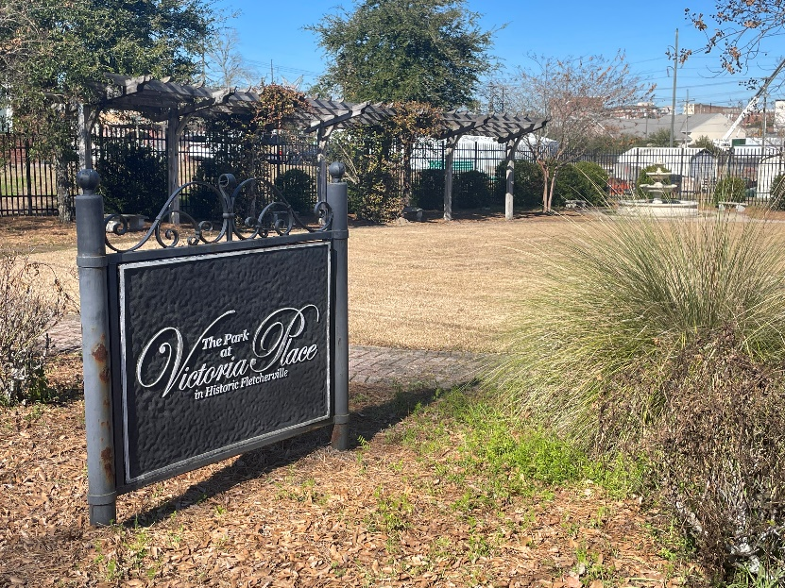
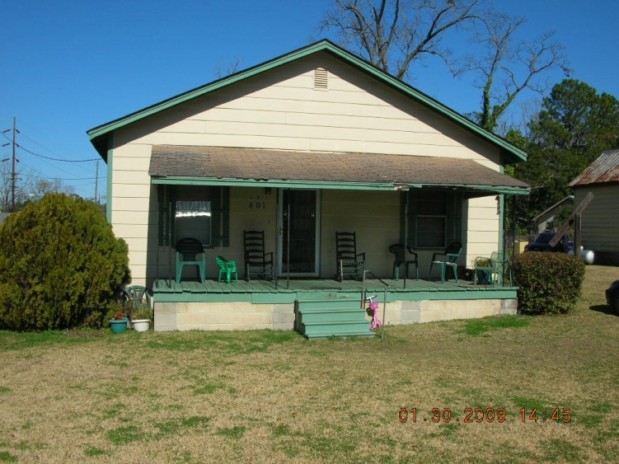
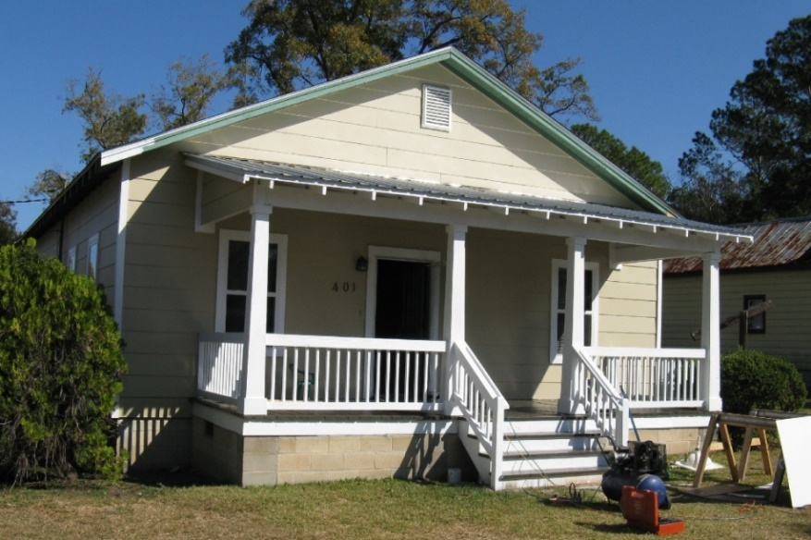
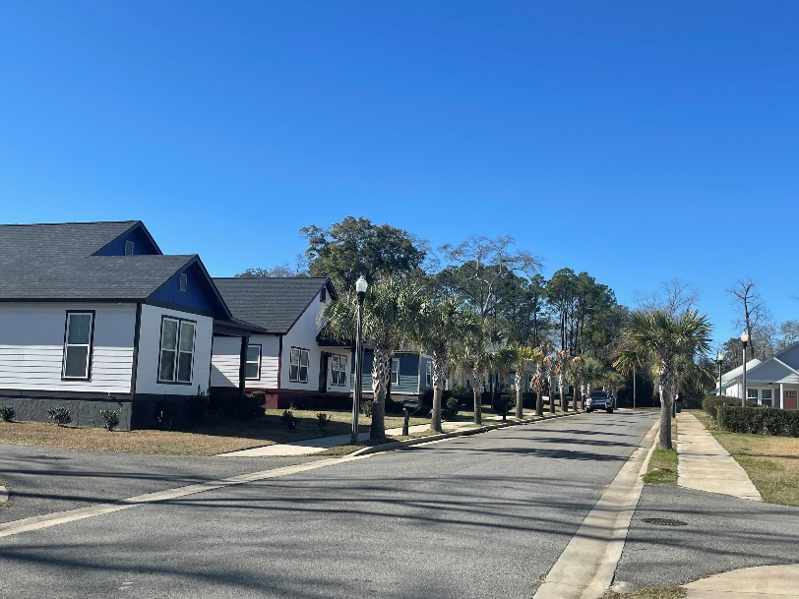
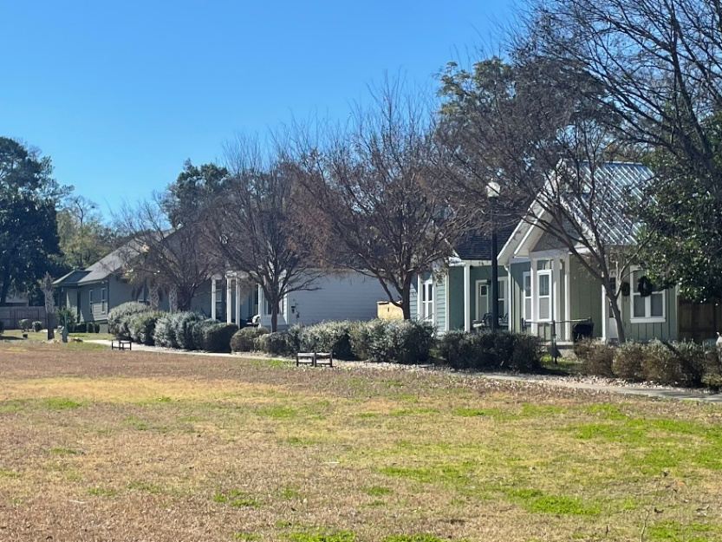
Thomasville: Victoria Place

Slide 38
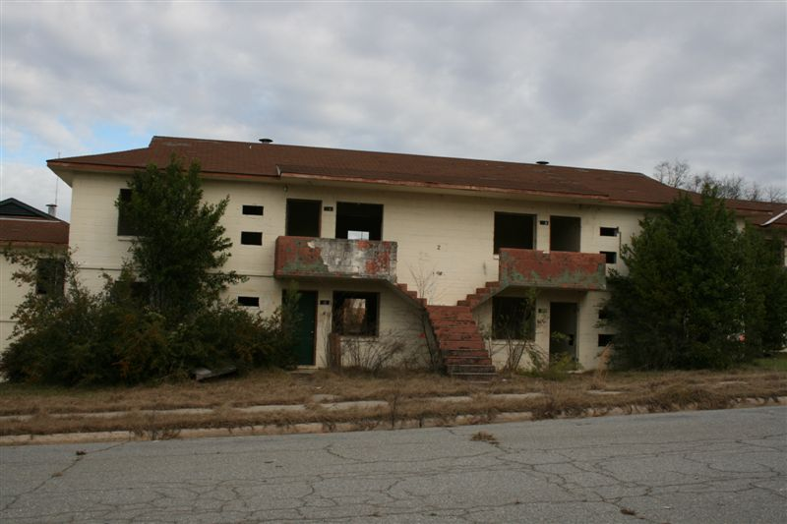
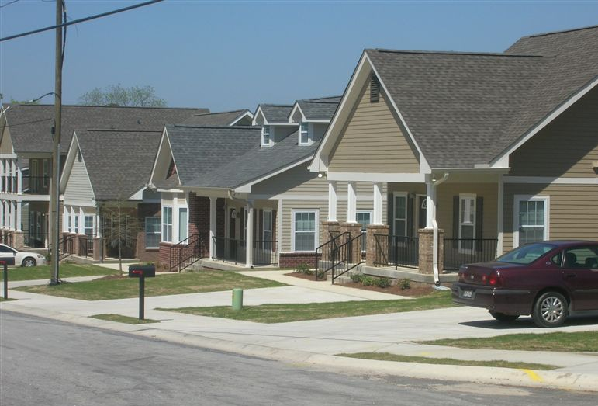
The former Macon Homes—now Bartlett’s Crossing

Slide 39
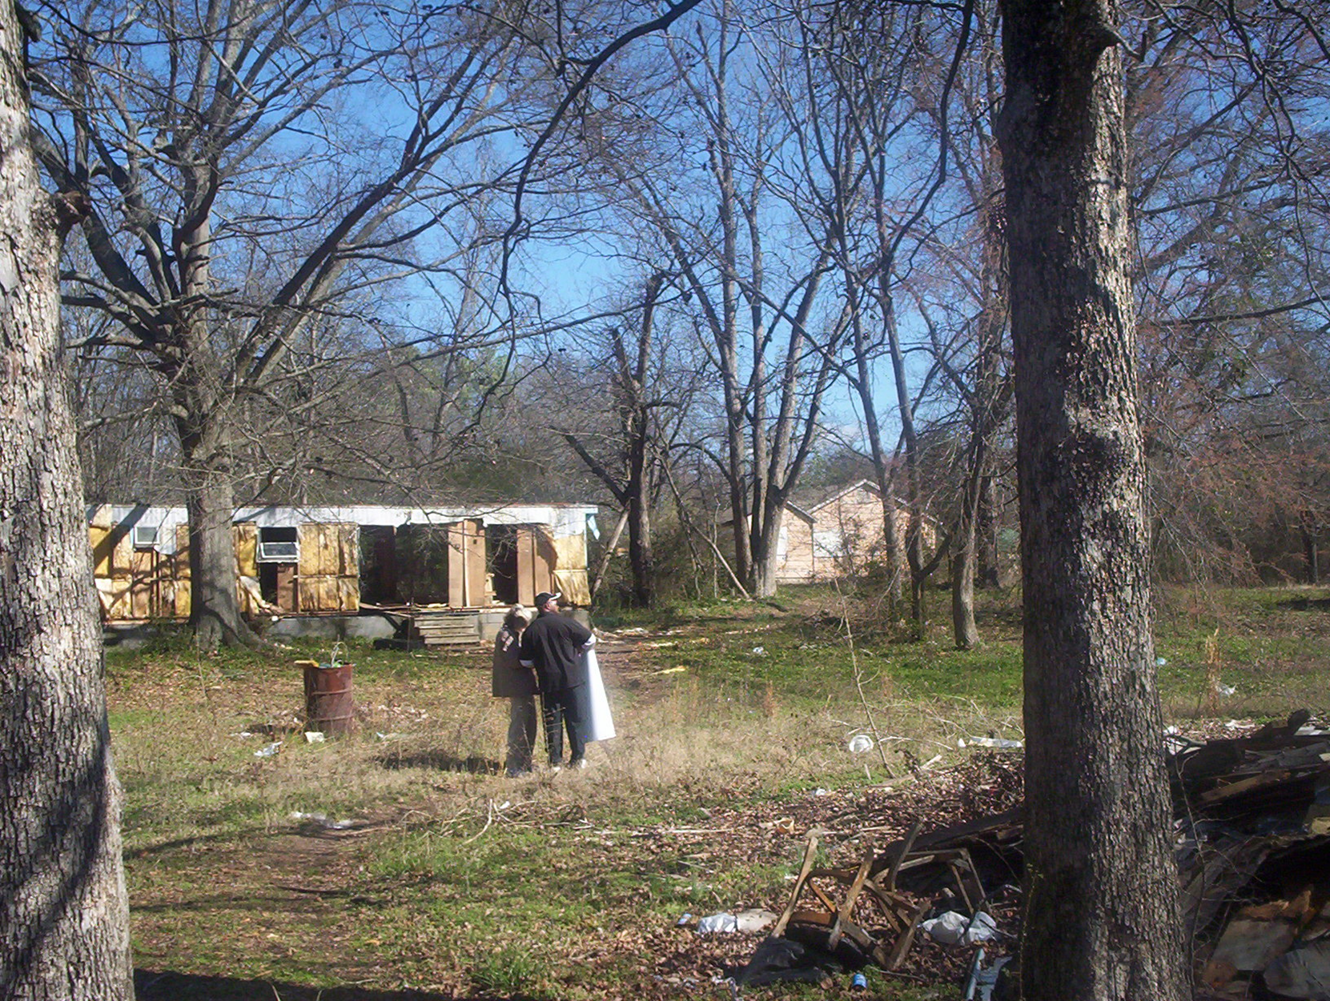
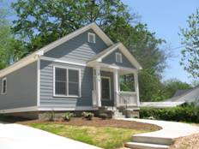
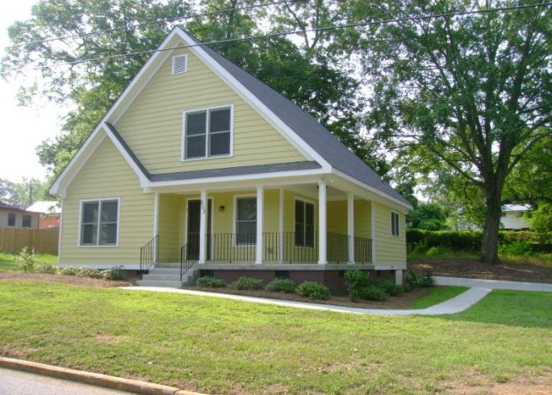
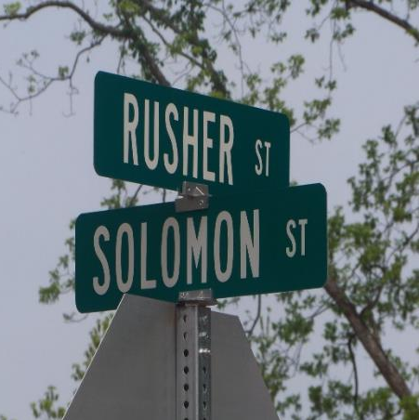
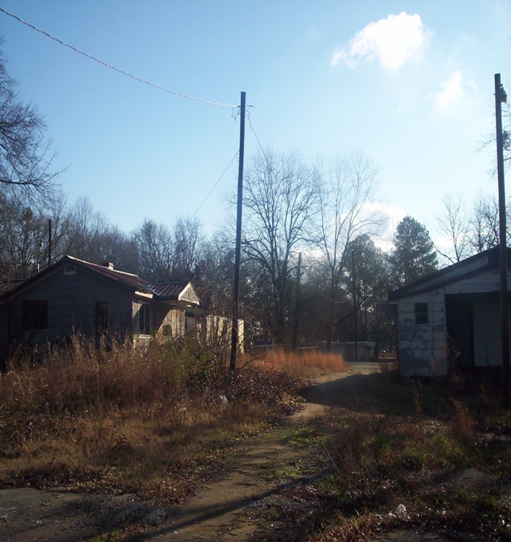
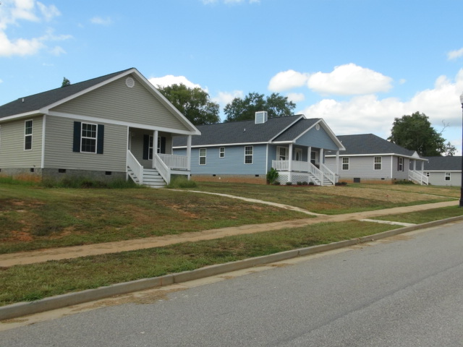
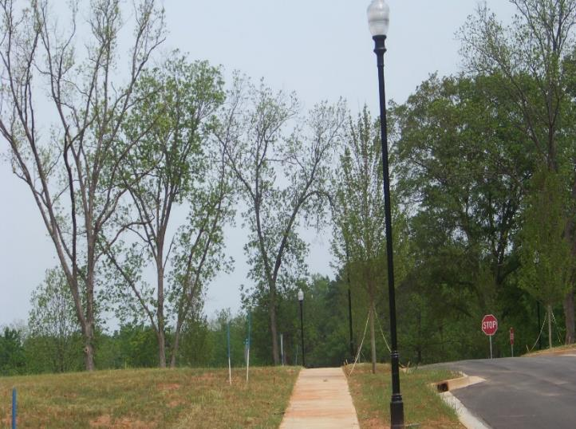
City of Washington - Rusher Street

Slide 40
For more info:
Revitalization Area Strategies, contact:
  Glenn Misner(404) 679-3138
  glenn.misner@dca.ga.gov

Slide 41
Questions?

