Slide 1

Regional Planning
Community Planning Institute
March 8, 2024
Carrollton, GA

Slide 2
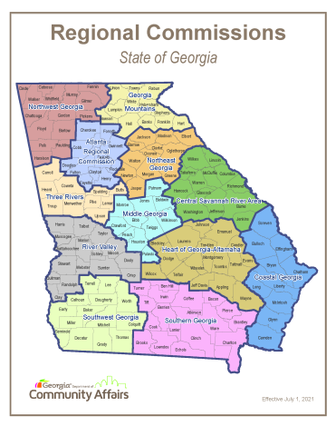
What is regional Planning?
Established by state law – GA Planning Act
  12 regional commissions in GA
  Guided by DCA Regional Planning Standards
Empowered by shared needs and common goals
  Basis established quality community objectives
  Building and strengthening capacity
Supported by partnerships with Federal and State agencies, local governments, and other regional commissions

Slide 3







Partnerships
Department of Community Affairs
  Local and Regional Planning
  Developments of Regional Impact
  Historic Preservation
  Local plan implementation
Department of Transportation
  Transit Planning
  Bike/Pedestrian Planning
U.S. Economic Development Administration
Appalachian Regional Commission
Southeast Crescent Regional Commission – new!
Local Governments

Slide 4
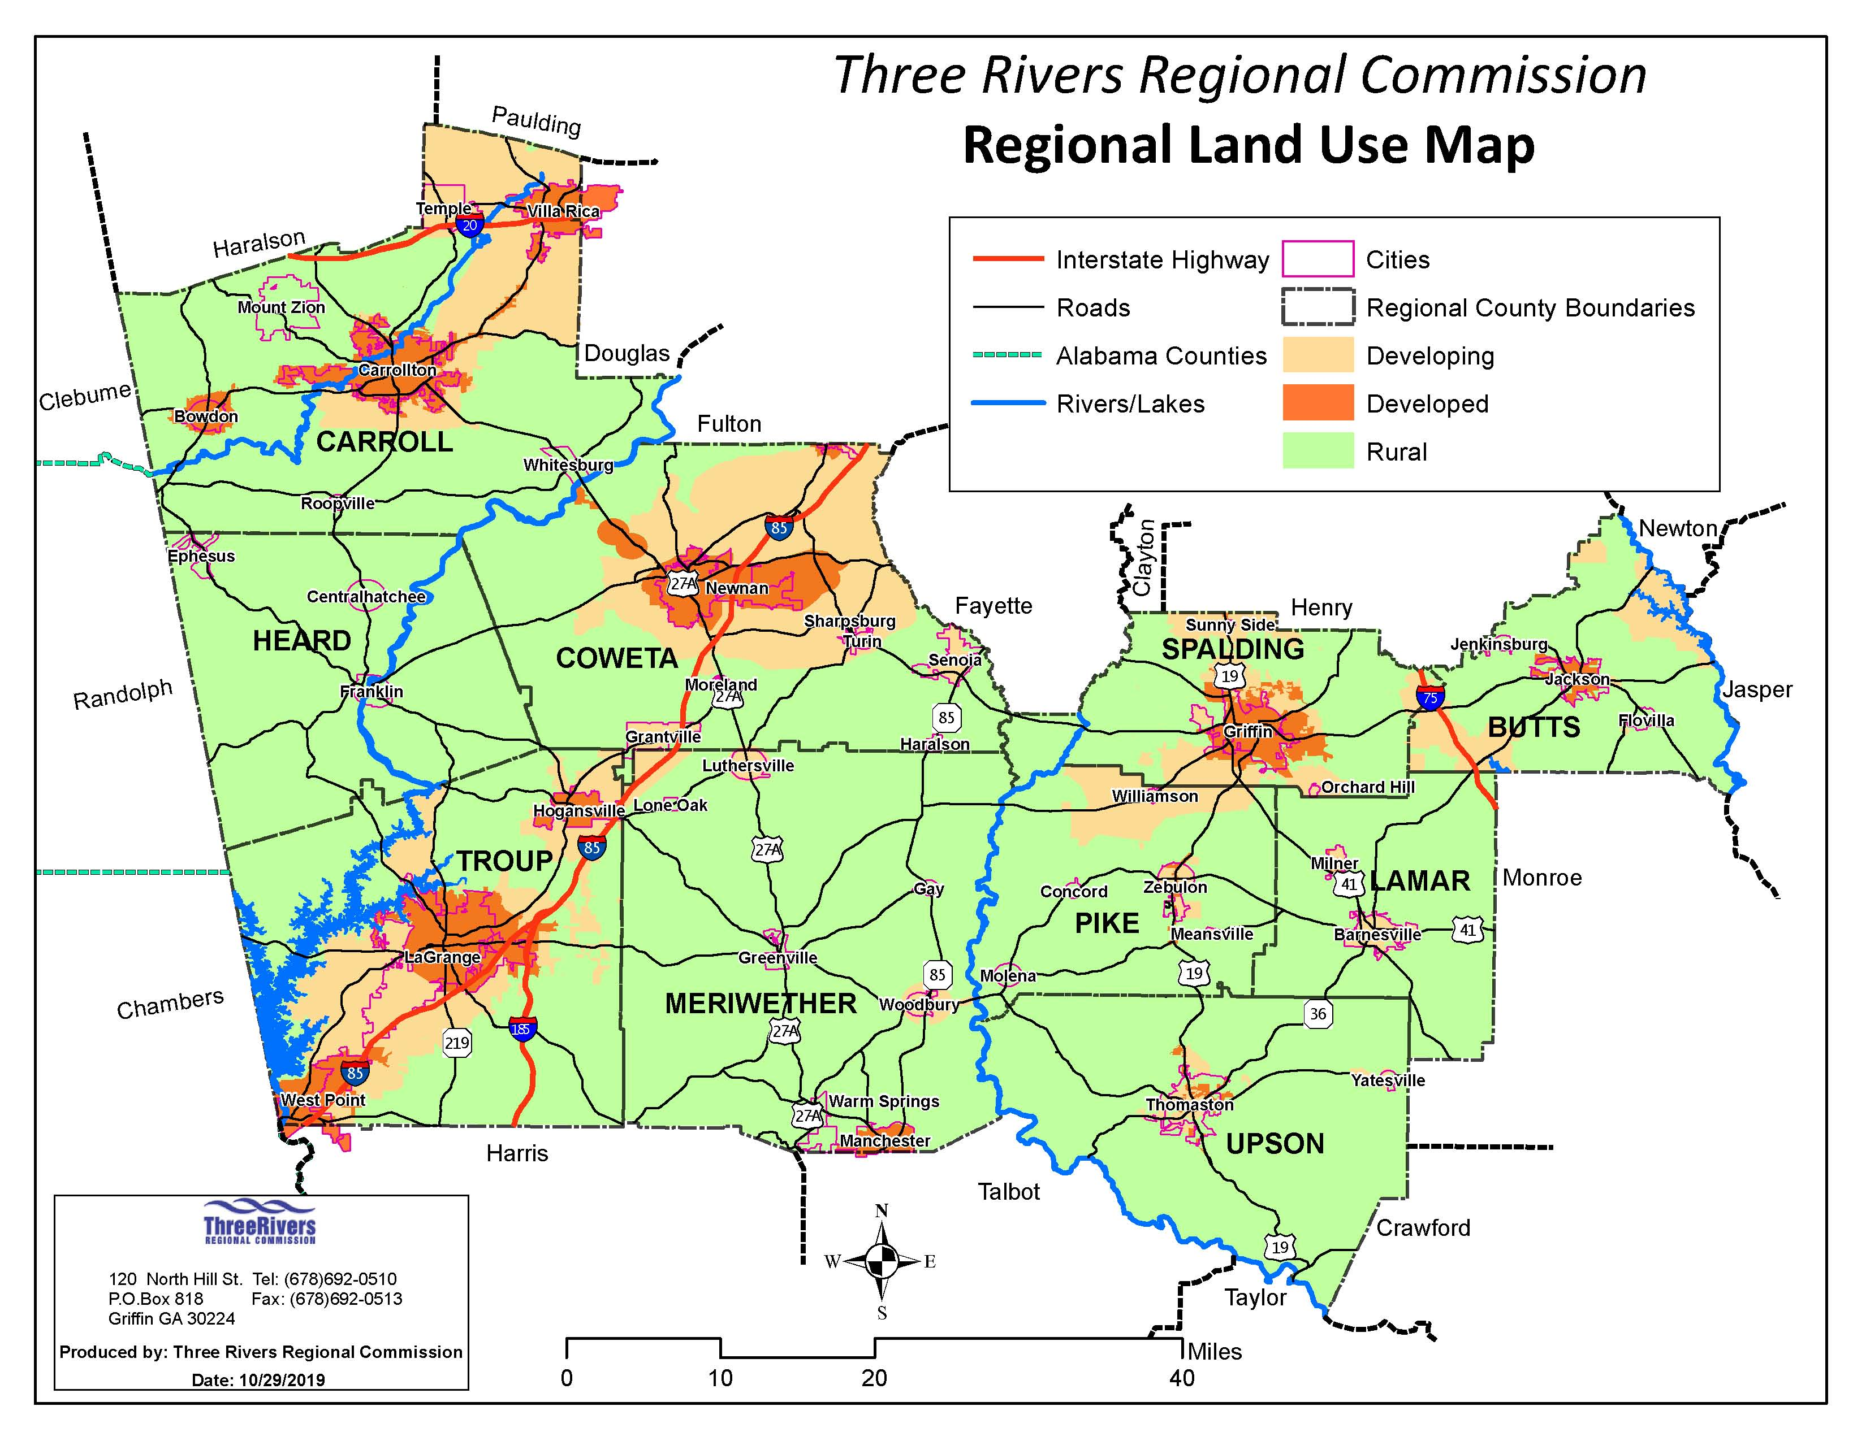
Regional plan
Align with State Planning Goals
Quality Community Objectives
Regional Needs and Priorities
Regional Land Use Map
  Larger picture and development trends
Regionally Important Resources Plan
  Heritage and natural resources and state vital areas
  Potential conflicts with conservation and development
  DRI Reviews
Notes:
Regional plan – similar to the local comprehensive plan but region wide. Support state and regional goals and align with QCOs (which we will dive into deeper and use as the basis of our regional needs/themes discussion).

Slide 5
DRI Activity in our Region & State
Purpose of DRI Reviews
Requirement: of Georgia Department of Community Affairs (DCA) Code 110-12-3-.01
Intent of rules: “improved local, regional and state level communication about new growth in the state. Communication of this nature will aid in maximizing the positive benefits of new development projects while minimizing their adverse effects. The end result should improve development outcomes for the host jurisdiction, neighboring jurisdictions, the region, and the state.”
Advisory in nature: the information that is transmitted from affected parties is not binding and does not infringe on host jurisdiction’s right to determine appropriate development within its boundaries.
Process
Project determined to be a DRI by the regional commission based on development thresholds and population tiers
  project packet assembled
  A traffic study is required for jurisdictions within the GRTA boundaries
15 day public comment period for affected parties
Report of findings issued to be used for local decision-makers
Notes:
Intergovernmental Coordination example
Regional and intra and inter county and inter-regional information sharing
One of the few ways of regular communication between governments i.e. mandated communication

Slide 6
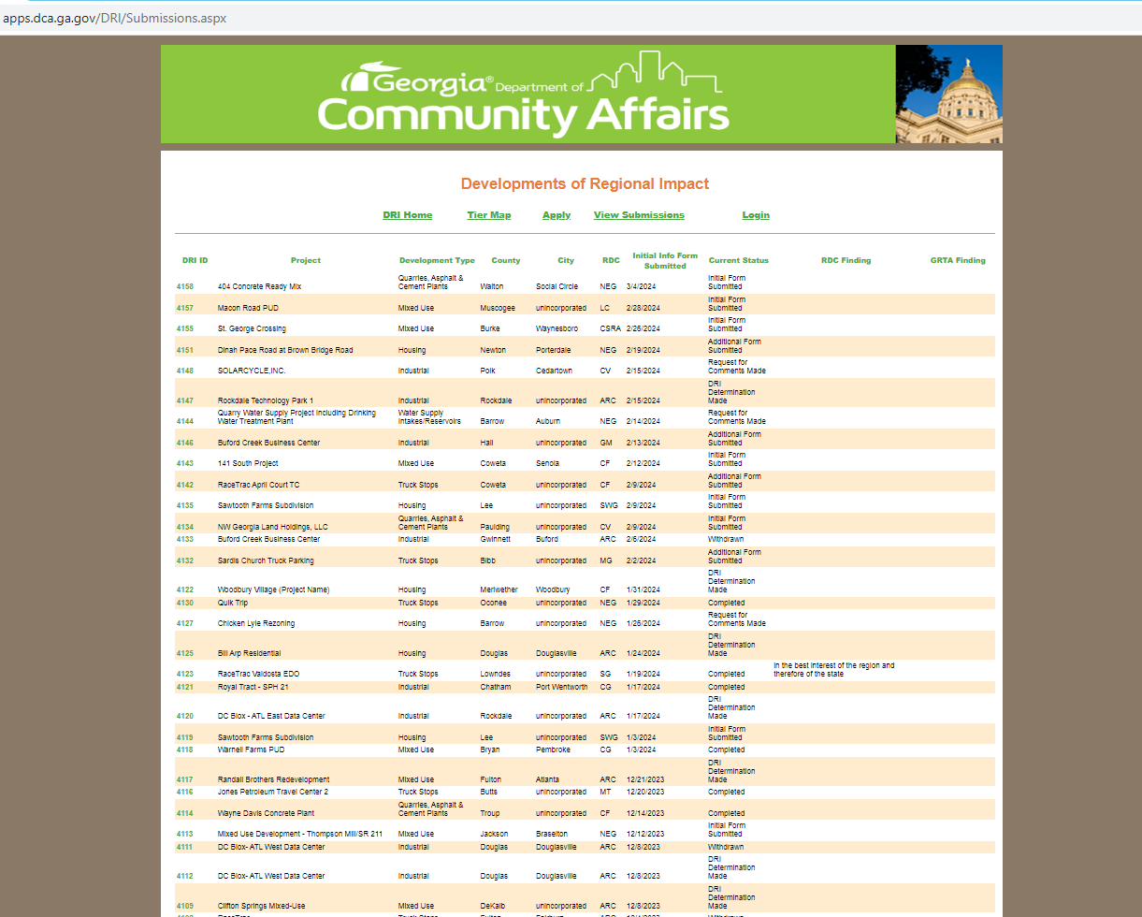
DRI Activity in our Region & State
DCA DRI Website*
Archive of all DRIs, including reviews underway
  Since 2001: approximately 4,000 DRI reviews
  About 150 – 200 per year for the state recently
Searchable by county
  Three Rivers Region: 199 reviews (about 5% of state total)
  Highest paced counties: Coweta, Troup, Butts, Carroll, Lamar
Trending DRI Development Types/Land Uses
  Mixed Use, Truck Stops, Quarries/Asphalt/Cement Plants, Industrial, Housing, Warehousing
  Specifically: travel centers, truck parking, data centers, warehouses, subdivisions
*https://www.dca.ga.gov/local-government-assistance/planning/regional-planning/developments-regional-impact
Notes:
Highest paced DRI counties are higher in population, located along major highways and interstates and more urbanized areas.
Warehouses and large square footage structures in Coweta County. Changing the landscape along SR 16 corridor.
Quarries/Cement plants can affect more rural areas (Johnstonville HD in Lamar County and quarry in Carroll County).

Slide 7
Shared needs and Goals
State Planning Goals and Objectives – Regional Targets and Guidance
Economic Development Goal: To achieve a growing and balanced economy, consistent with the prudent management of the state's resources, that equitably benefits all segments of the population.
Natural and Cultural Resources Goal: To conserve and protect the environmental, natural and cultural resources of Georgia's communities, regions and the state.
Community Facilities and Services Goal: To ensure the provision of community facilities
and services throughout the state to support efficient growth and development patterns that will protect and enhance the quality of life of Georgia's residents.
Notes:
Since this is a DCA led training, I hope they appreciate the alignment with their state goals and objectives! ☺
These goals support regional goals and objectives.
These are further outlines in the following QCOs.

Slide 8
Shared needs and Goals
State Planning Goals and Objectives – Regional Targets and Guidance Cont…
Housing Goal: To ensure that all residents of the state have access to adequate and
affordable housing.
Land Use and Transportation Goal: To ensure the coordination of land use planning and transportation planning throughout the state in support of efficient growth and development patterns that will promote sustainable economic development, protection of natural and cultural resources and provision of adequate and affordable housing.
Intergovernmental Coordination: To ensure the coordination of local planning efforts with other local service providers and authorities, with neighboring communities and with state and regional plans and programs.
Notes:
Land Use, Transportation, and Intergovernmental Coordination tie directly back to the benefit of the DRI review process.

Slide 9
Shared needs and goals
State Quality community objectives
Economic Prosperity:
Encourage development or expansion of businesses and industries that are suitable for the community.
Factors to consider when determining suitability include job skills required; long-term sustainability; linkages to other economic activities in the region; impact on the resources of the area; or prospects for creating job opportunities that meet the needs of a diverse local workforce.
Considerations:
DRI Reviews
Industry hubs and suppliers
Workforce development and training and partnerships with colleges and universities
Infrastructure availability
Rural Zone
Notes:
Local example: KIA cluster and related suppliers in surrounding counties.

Slide 10
Shared needs and goals
State Quality community objectives
Resource Management: Promote the efficient use of natural resources and identify and protect environmentally sensitive areas of the community.
This may be achieved by promoting energy efficiency and renewable energy generation; encouraging green building construction and renovation; utilizing appropriate waste management techniques; fostering water conservation and reuse; or setting environmentally sensitive areas aside as green space or conservation reserves.
Considerations:
Conservation techniques
Historic preservation
Part 5 Environmental Criteria and Ordinances
Floodplain mapping
Park/Greenspace expansion
  Trust for Public Land
  GOSP – Ga Outdoor Stewardship Program
River corridor and watershed planning
  Regional Water Plans
EV Charging

Slide 11
Shared needs and goals
State Quality community objectives
Efficient Land Use: Maximize the use of existing infrastructure and minimize the costly conversion of undeveloped land at the periphery of the community.
This may be achieved by encouraging development or redevelopment of sites closer to the traditional core of the community; designing new development to minimize the amount of land consumed; carefully planning expansion of public infrastructure; or maintaining open space in agricultural, forestry, or conservation uses.
Considerations:
Zoning and comprehensive planning
Transfer of Development Rights
Conservation techniques
  Ga Ag Land Trust
  State Conservation/Tax Programs (CUVA)
Park/Greenspace expansion
  Trust for Public Land
  GOSP – Ga Outdoor Stewardship Program
Infrastructure planning
Infill development
Tax Allocation Districts
Notes:
Zoning – increase in minimum acreage in rural areas?
Consideration of urban growth boundaries
TDR continues to serve Chatt Hills well. Best practices workshop?
Infrastructure planning – expansion needed or keep it reigned in to encourage growth closer to core of community (infill)
Park expansion – McIntosh Reserve
TAD – VR and Carrollton
Many examples of infill in Carrollton, Newnan, etc

Slide 12
Shared needs and goals
State Quality community objectives
Local Preparedness: Identify and put in place the prerequisites for the type of future the community seeks to achieve.
These prerequisites might include infrastructure (roads, water, sewer) to support or direct new growth; ordinances and regulations to manage growth as desired; leadership and staff capable of responding to opportunities and managing new challenges; or undertaking an all-hazards approach to disaster preparedness and response.
Considerations:
Zoning and comprehensive planning
Signage
Corridor planning
Hazard Mitigation Planning
GDOT Plans

Slide 13
Shared needs and goals
State Quality community objectives
Sense of Place: Protect and enhance the community’s unique qualities.
This may be achieved by maintaining the downtown as focal point of the community; fostering compact, walkable, mixed-use development; protecting and revitalizing historic areas of the community; encouraging new development that is compatible with the traditional features of the community; or protecting scenic and natural features that are important to defining the community's character.
Considerations:
Downtown master planning
Historic preservation ordinances
Redevelopment planning
Streetscapes
Zoning and comprehensive planning
Signage
Corridor planning such as Bankhead and Maple Streets in Carrollton
Tools: TA and GTIB, Rural Zone, DDA
Community Improvement Districts

Slide 14
Shared needs and goals
State Quality community objectives
Regional Cooperation: Cooperate with neighboring jurisdictions to address shared needs.
This may be achieved by actively participating in regional organizations; identifying joint
projects that will result in greater efficiency and less cost to the taxpayer; or developing collaborative solutions for regional issues such as protection of shared natural resources, development of the transportation network, or creation of a tourism plan.
Considerations:
Zoning and comprehensive planning
DRI Review process
Multi-jurisdictional transportation master planning
Corridor planning – GDOT
River corridor and watershed planning
  Regional Water Plans
Heritage and Eco-tourism
Notes:
Local example – Troup County Strategic Planning
Regular meetings of the regional water planning districts
Flint River Trail in Meriwether County and Ocmulgee River Trail in Butts County/Jasper/etc, Chatt River trail in Heard
SR 16 corridor planning
Update comprehensive transportation plans
Implementation of tourism resource team plans
All comprehensive plans shared with neighboring regions and local governments as part of regional review

Slide 15
Shared needs and goals
State Quality community objectives
Housing Options: Promote an adequate range of safe, affordable, inclusive, and resource efficient housing in the community.
This may be achieved by encouraging development of a variety of housing types, sizes, costs, and densities in each neighborhood; promoting programs to provide housing for residents of all socio- economic backgrounds, including affordable mortgage finance options; instituting programs to address homelessness issues in the community; or coordinating with local economic development programs to ensure availability of adequate workforce housing in the community.
Considerations:
Zoning and comprehensive planning
Housing assessments and plans
State Workforce Housing Initiative
Zoning and development codes
Public/private partnerships
Georgia Initiative for Community Housing (GICH)
Community Development Block Grants/CHIP
Homeowner education programs
Notes:
CHIP – Community Home Investment Program
GICH – VR, Troup County, Thomaston

Slide 16
Shared needs and goals
State Quality community objectives
Transportation Options: Address the transportation needs, challenges and opportunities of all community residents.
This may be achieved by fostering alternatives to transportation by automobile, including walking, cycling, and transit; employing traffic calming measures throughout the community; requiring adequate connectivity between adjoining developments; or coordinating transportation and land use decision-making within the community.
Considerations:
Zoning and comprehensive planning
GDOT Plans – Bike and pedestrian improvements, Vulnerable Road Users, Safety Action Plans
Transit Planning
Complete Streets
Corridor Planning
  SR 16, US 27
  The Ray – Troup County
Safe Routes to School
Notes:
Carrollton – only TRRC community with complete streets policy.
TRRC – local transit development plans, Carroll, Troup, Coweta recent. Upcoming Heard County.
Regional Transit plan underway. Survey still open?

Slide 17
Shared needs and goals
State Quality community objectives
Educational Opportunities: Make educational and training opportunities readily available to enable all community residents to improve their job skills, adapt to technological advances, manage their finances, or pursue life ambitions.
This can be achieved by expanding and improving local educational institutions or programs; providing access to other institutions in the region; instituting programs to improve local graduation rates; expanding vocational
education programs; or coordinating with local economic development programs to ensure an
adequately trained and skilled workforce.
Considerations:
K-12 Education
Pre-schools
School readiness
Adult literacy
Colleges and Universities
Workforce development and training – Work Source Three Rivers
Chambers of Commerce

Slide 18
Shared needs and goals
State Quality community objectives
Community Health: Ensure that all community residents, regardless of age, ability, or income, have access to critical goods and services, safe and clean neighborhoods, and good work opportunities.
This may be achieved by providing services to support the basic needs of disadvantaged residents, including the disabled; instituting programs to improve public safety; promoting programs that foster better health and fitness; or otherwise providing all residents the opportunity to improve their circumstances in life and to fully participate in the community.
Considerations:
Zoning and comprehensive planning
Recreation, parks, trails
Sidewalk extensions and maintenance
Transit program planning
Complete Streets policy
Safe Routes to School
Workforce development and training programs
Local farms and agriculture programs
  Carroll County Agriculture Advisory Committee
Notes:
SRTS programs and resources, Walk Audits, Funding for infrastructure
Carrollton Elementary School
GA Ag Land Trust

Slide 19
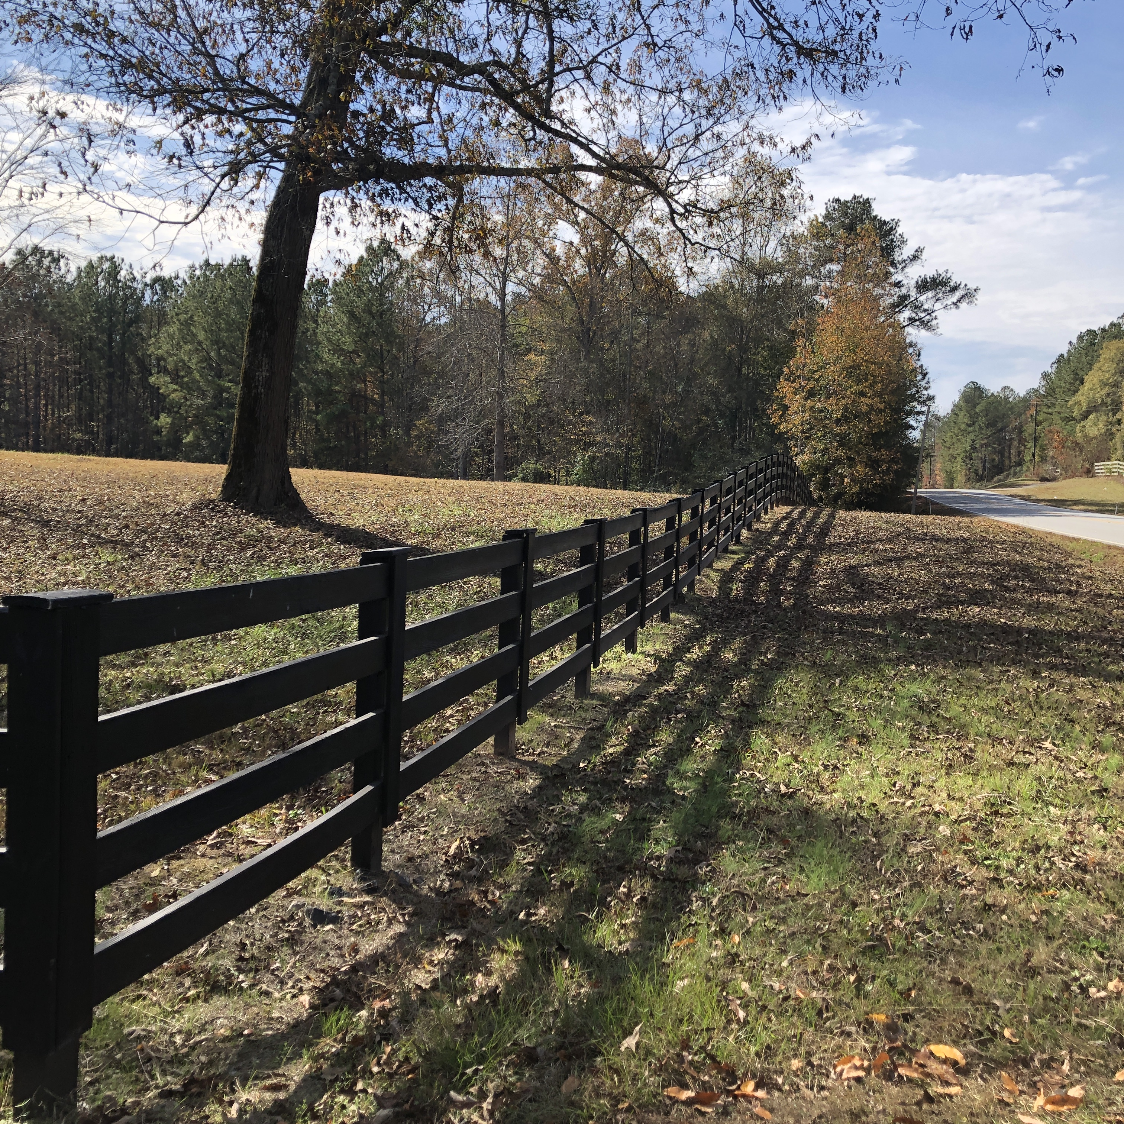
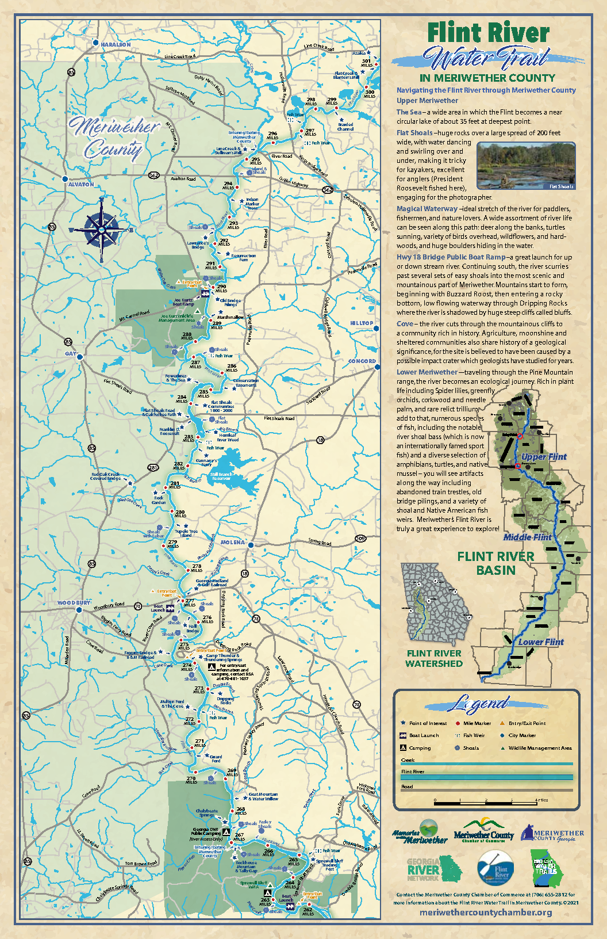
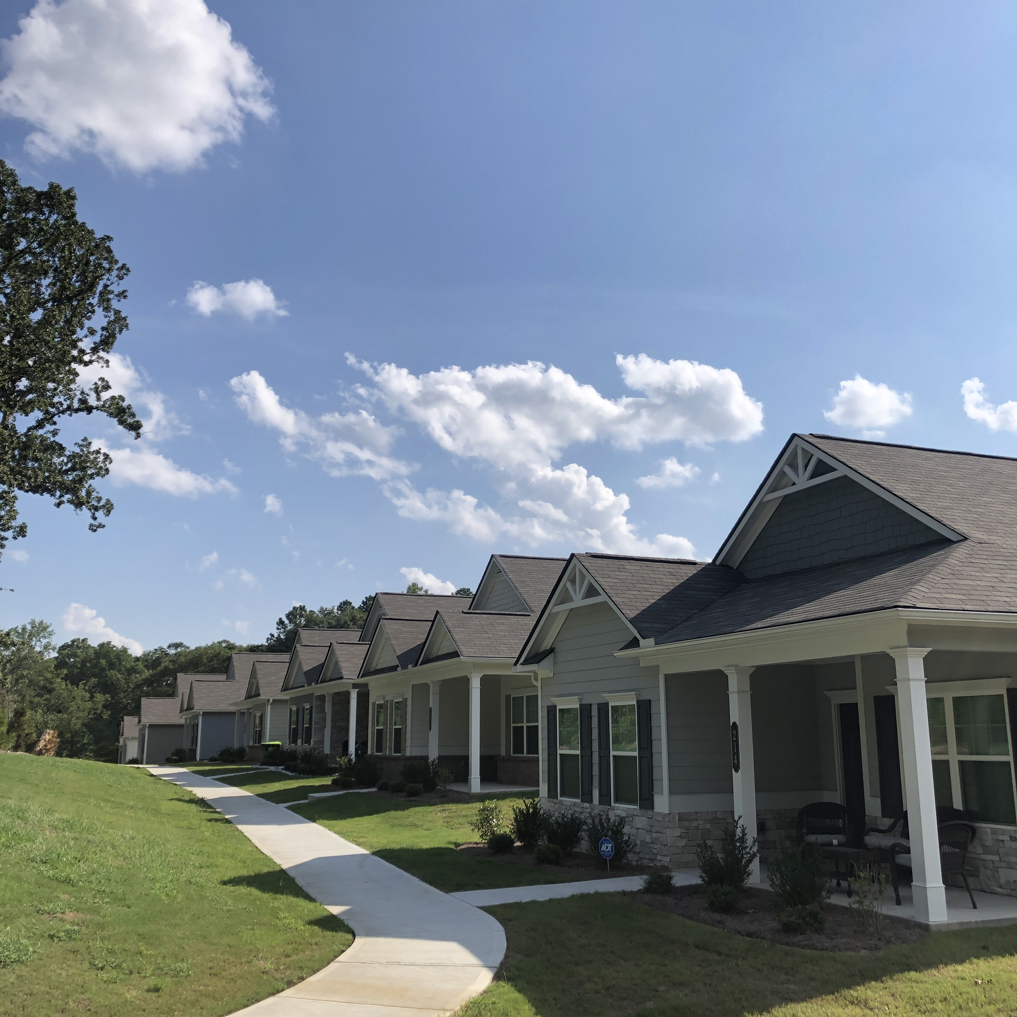
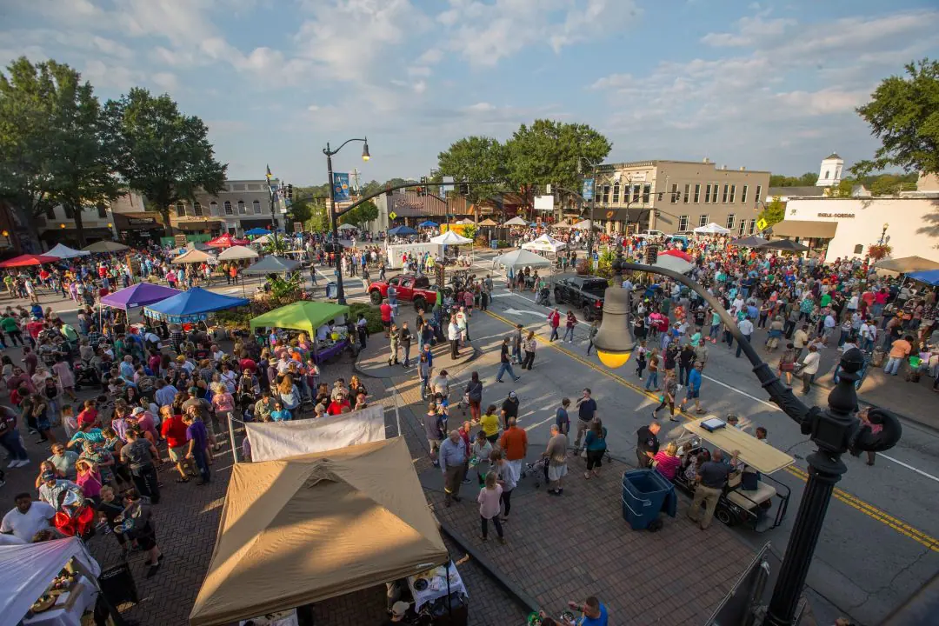
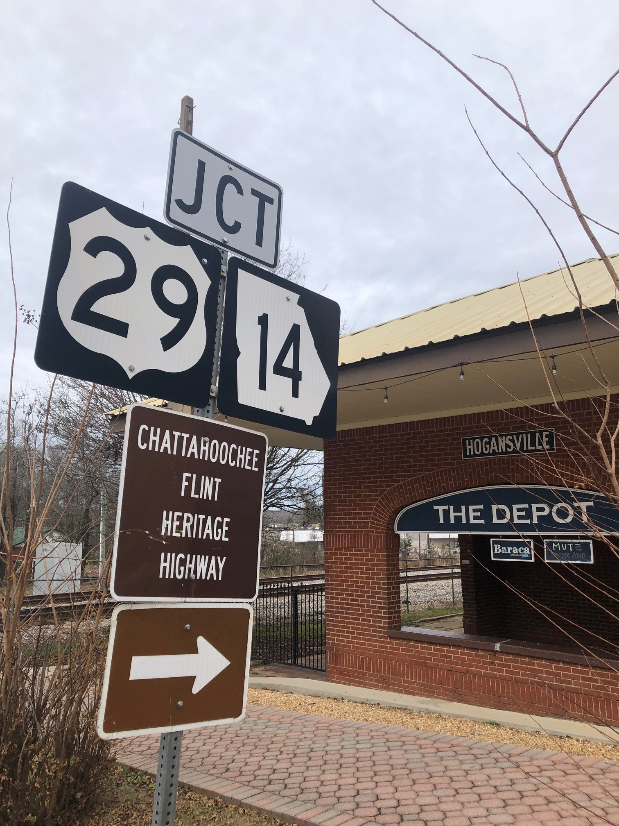
Regional identity
Built upon shared assets
  Strong downtowns
  Heritage and eco-tourism
  Industry and infrastructure
  Sense of place
  Not typical metro Atlanta
Shared concerns/opportunities/themes
  Housing
  Broadband
  Coordinated land use planning
  Quality growth
  Interstate corridors
  East/West corridors – SR 16
  Regional convening of shared interests
Notes:
Vibrant downtowns spread throughout the region with redevelopment and revitalization opportunities. Not just centered on one regional hub i.e. Rome, Columbus, Macon.
Housing remains a statewide topic – GARC Economic Development Committee focus
Regional commissions want to be conveners of topics of interest to multiple governments

