Slide 1
Public Facilities Application Development
Cindy Alligood & Roderick Gilbert

Slide 2
Public Facilities Projects
Meet the needs of low- and moderate-income people in the community, using bricks & mortar, concrete & paving and piping and plumbing.

Slide 3
Eligible Activities
Water & Sewer
Street & Drainage
Boys & Girls Club
Senior Centers
Health Care Facilities
Battered Women’s Shelters
Mental/Physical Health Department
Head Start Program Facility
Food Banks
Acquisition for Public Facilities

Slide 4

PROHIBITED!!
“...the renovation or construction of new space where the primary purpose is the provision of general-purpose local government”
City Hall
County Commission
Courthouse
Police/Fire Dept

Slide 5
Key Players
Grant writer
Administrator (may also be your Grant Writer)
Architect / Engineer
City Manager
Public Works
Decide if local funds or CDBG funds will be used to pay these fees.

Slide 6
Figure out how much the project is going to cost.
Determine the Budget and the Source of Funds
Administration fee (6%)
Architect/Engineering fee (12%)
Line items:
Construction estimate
Acquisition

Slide 7
Budget - Revenue
Sources of income:
CDBG Grant – Up to $1,000,000
Matching funds
Local Leverage funds
In-Kind Contributions- force account
Other Funding Agencies (USDA, etc…)

Slide 8

Cash Match
Must be Cash!
Not required for grant amounts up to $500,000
5% of Grant amount $500,001 to $750,000
10% of Grant amount $750,001 to $1,000,00
15% of Grant amount
$1,000,001 or more (multi-activity)

Slide 9
Cash Match Amounts
Less than $500,000 $0
$750,000 $12,500
$1,000,000 $37,500
Keep in mind that this is just the minimum that is required. The more leverage the Local Government injects into the project, the more competitive the application will be.

Slide 10
Leverage = Bonus Points!
Additional funds, land and NEW materials above the required Cash Match are counted.
In-Kind work should be tabulated for leverage, including fuel, equipment usage, employee costs and materials. The GEMA forms are acceptable.
Operating budgets & salaries, already owned furnishings & equipment DO NOT count.
Leverage will be monitored – must be realistic and achievable, or penalties may apply.

Slide 11
Document your sources for cash match and leverage with signed, original commitment letters.
Match & Leverage
For a new program, document sources of operational funding (staff salaries, equipment, etc.) Like a business plan.

Slide 12
Infrastructure projects – survey as Area Benefit.
Conduct door-to-door survey to count the number of people benefiting, and their low-mod status.
90% or more of households must be surveyed or conduct a statistically valid random sample.
Vacant units are not households, cannot be surveyed.
Determine the Beneficiaries

Slide 13
DCA 6
DCA 6 must include:
  The dates and times of when the surveys were completed.
  The percentage of residents surveyed.
  The summary table must be attached.

Slide 14
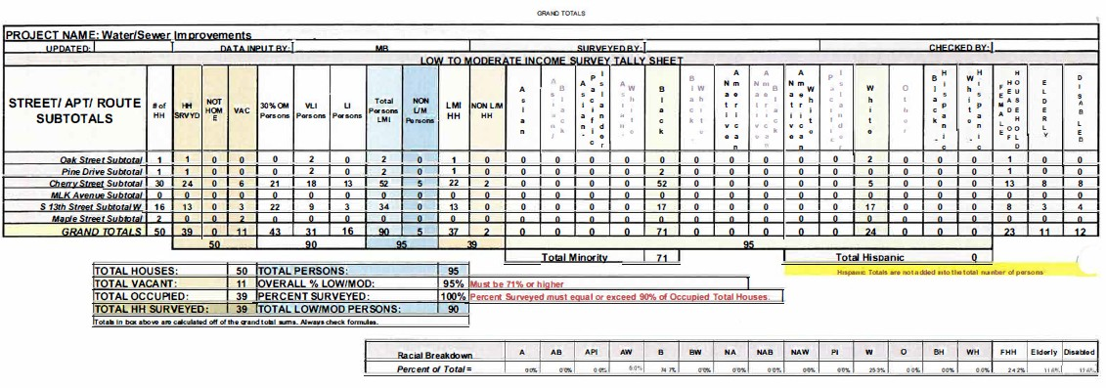
DCA-6 Survey Table
Infrastructure projects
Include a Survey Summary (by street) Table

Slide 15
Determine the Beneficiaries
For a Building – survey the user group using Limited Clientele benefit. Include letter from Director.
Seniors at a Senior Center are categorically low-mod.
Nursing home residents are NOT categorically low-mod
Low-mod percentage can not be less than 70%.
For infrastructure projects with multiple TA’s, each must meet the 70% threshold.

Slide 16
Keep the focus on the needs of the residents.
State how the identified need impacts LMI persons
Problems created by developers will not be viewed as a high severity of need.
Municipal issues are not considered a priority.
Description of Needs to be Addressed DCA-4

Slide 17
DCA-5
Detailed description of each activity to address the needs identified in DCA-4
Project Overview
The impact the project will have on the problem.
Most importantly, the impact the project will have on the residents.

Slide 18
DCA-5 – Be sure to cover:
Need for household plumbing
Abandonment of well and/or septic tanks
Design configuration must make sense
Drainage projects -Downstream impact
Acquisition
Permits
# of Tap-ons and Tap on fees
Wetlands/Floodplain
Utility relocation
Maintenance or operation
Capacity
Site location and conditions
Implementation schedule
Identify design standards and justify their usage

Slide 19
MAPS
Scale, north arrow, legend
All street names - correct and legible
Proposed and existing activity location and conditions.
Identify all houses in project area - all applications, not just Housing Applications
Show and identify vacant housing units and commercial buildings/churches
Include a street address in the target area that can be located on a GPS.

Slide 20
Concentrations Maps
Produce 3 separate concentration maps. Must be DCA maps.
Maps of entire local government, not just the target area
Identify Target Area(s) and current/proposed building sites on the maps.
Three different maps for concentrations:
  Concentrations of minorities
  Concentrations of substandard housing
  Concentrations of low-mod persons

Slide 21
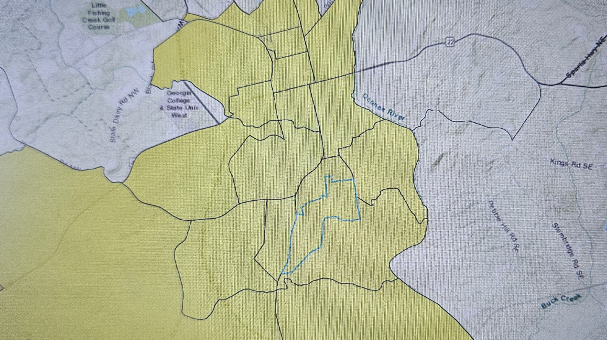
Be sure your map shows the entire jurisdiction and outlines the target area.

Slide 22
Concentration Maps
Use DCA Mapping Source, Map Atlas
  https://georgia-dca.maps.arcgis.com/home/index.html
  (DCA Main page, Resources, Maps)
For help, contact Lisa Westin
  GIS@dca.ga.gov
  404-679-3135

Slide 23
Concentration Maps
If there aren’t any concentrations for one or more of the three criteria, print the map and add the text “there are no concentrations, the minorities (or low-mod persons or substandard housing) are scattered.”

Slide 24
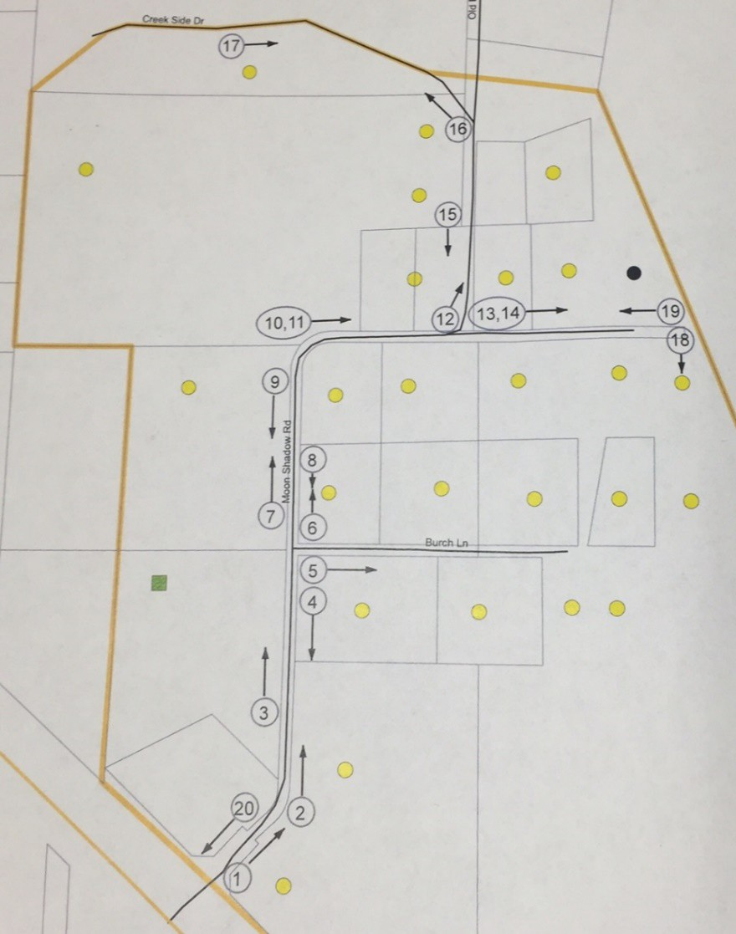
Maps – Photo Location
Location of photos
Numbered photos
Direction arrows
Show all Target Areas

Slide 25
Preliminary Engineering / Architectural Report
Engineer/Architect signature & stamp required
Include professional cost estimate
Unusual site conditions / higher costs
Preliminary Hydrologic / Hydraulic Calculations
  Scores will be reduced if calculations not provided.
Existing and Proposed Conditions maps
Viable alternatives with general cost estimates

Slide 26
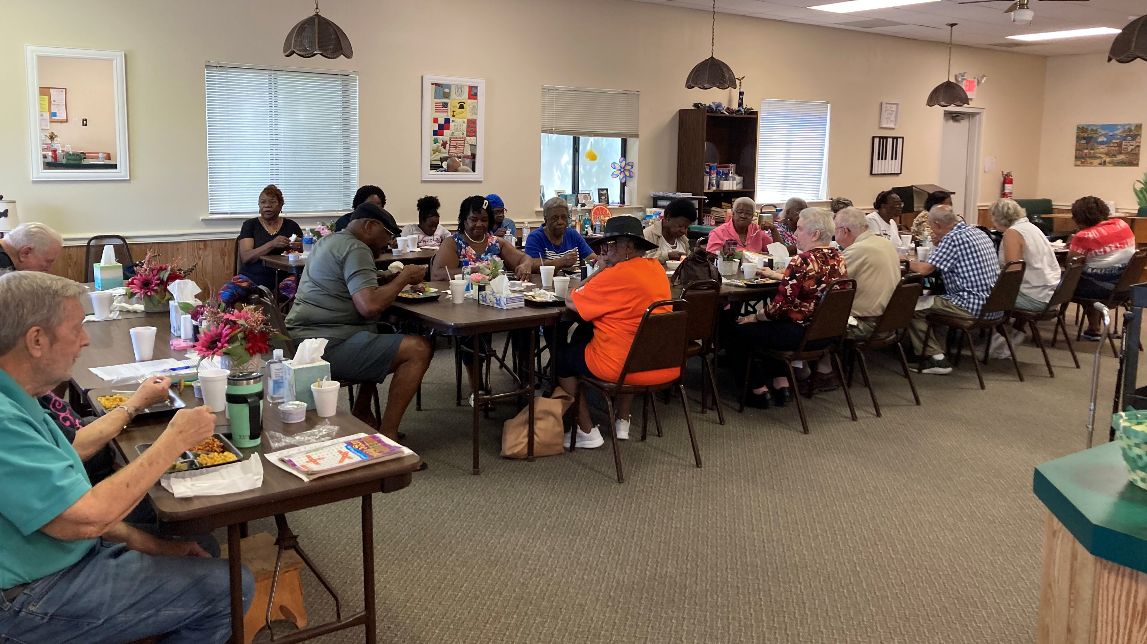
Telling The Story

Slide 27

Telling The Story
Keep the focus on the people
State how the identified need impacts LMI persons
The proposed improvements should
address identified resident needs
If a community has cracked sewer lines
and the treatment plant is over capacity
due to infiltration, how does this affect
the residents?

Slide 28
Telling The Story
When describing the problem, quantify the need to the greatest extent possible
“There are 46 households in the target area whose septic tanks are malfunctioning because of poor soil conditions and small lot sizes.”

Slide 29
Use information easy to understand and sufficiently documented
“According to the local Health Department, the coliform counts in these wells have been measured X,
which is an indication of contamination.”
Telling The Story

Slide 30
Telling The Story
Give a clear rationale for the proposed solution.
“...the average household income is X, and the high cost of drilling a well prevents residents from correcting problems.
Lot sizes are so small that even if there were funds available to replace the septic tanks, it would not be feasible to work .”

Slide 31
Telling The Story
ALWAYS DOCUMENT YOUR NEED
Letters from Residents
Form letters or pre-typed letters not best practice.
Include name and street address
Third Party Letters
Letter from the Fire Chief
Letter from the Health Dept.
Mental Health Directors
AAA Directors
Building Inspectors
Know the difference between letters of documentation and letters of support

Slide 32
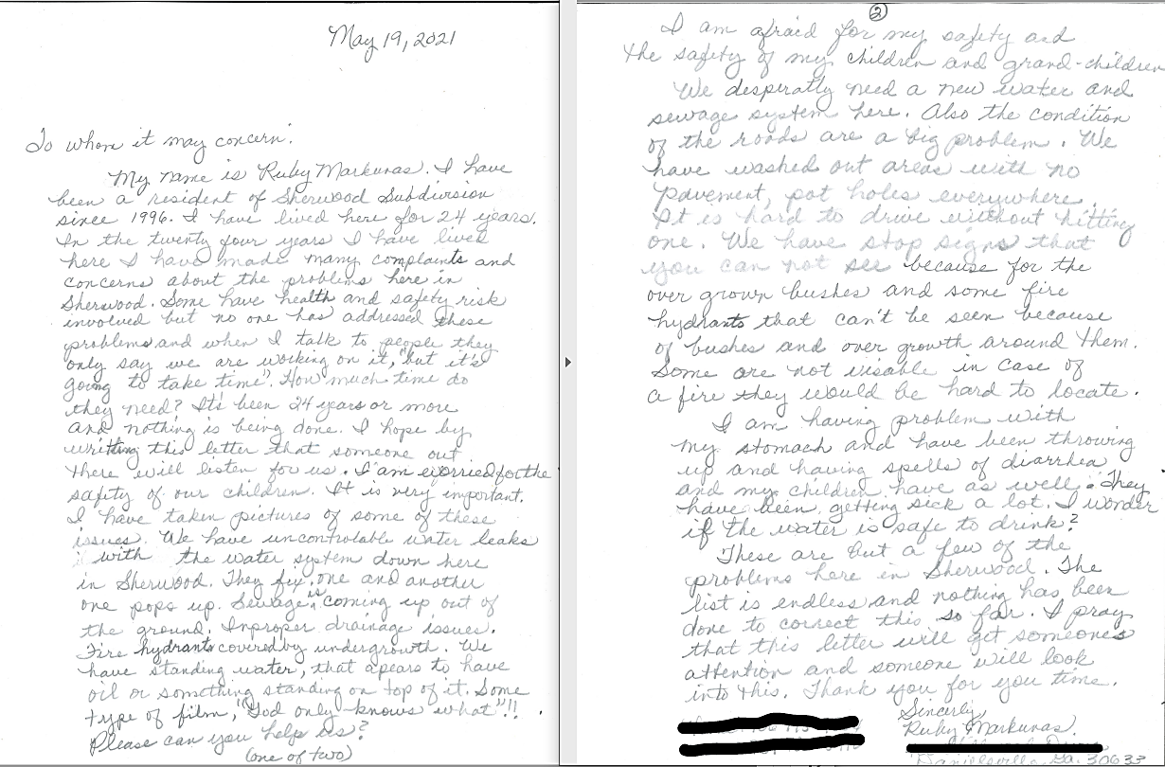
Resident
Letter of Documentation

Slide 33
Telling The Story
Proposing new sewer or water services to residents who are currently served only by private wells or septic tanks
Get documentation from as many residents as possible who are willing and able to pay a new utility bill.
A sign-up sheet would be an ideal form of documentation.

Slide 34
Fire Department Letter of Documentation
The letter from the Fire Chief should express:
Detailed knowledge of the target area,
Any fires that have occurred,
Any problems encountered while responding to calls,
Results from hydrant pressure tests,
The letter should be supported by a fire coverage map.

Slide 35
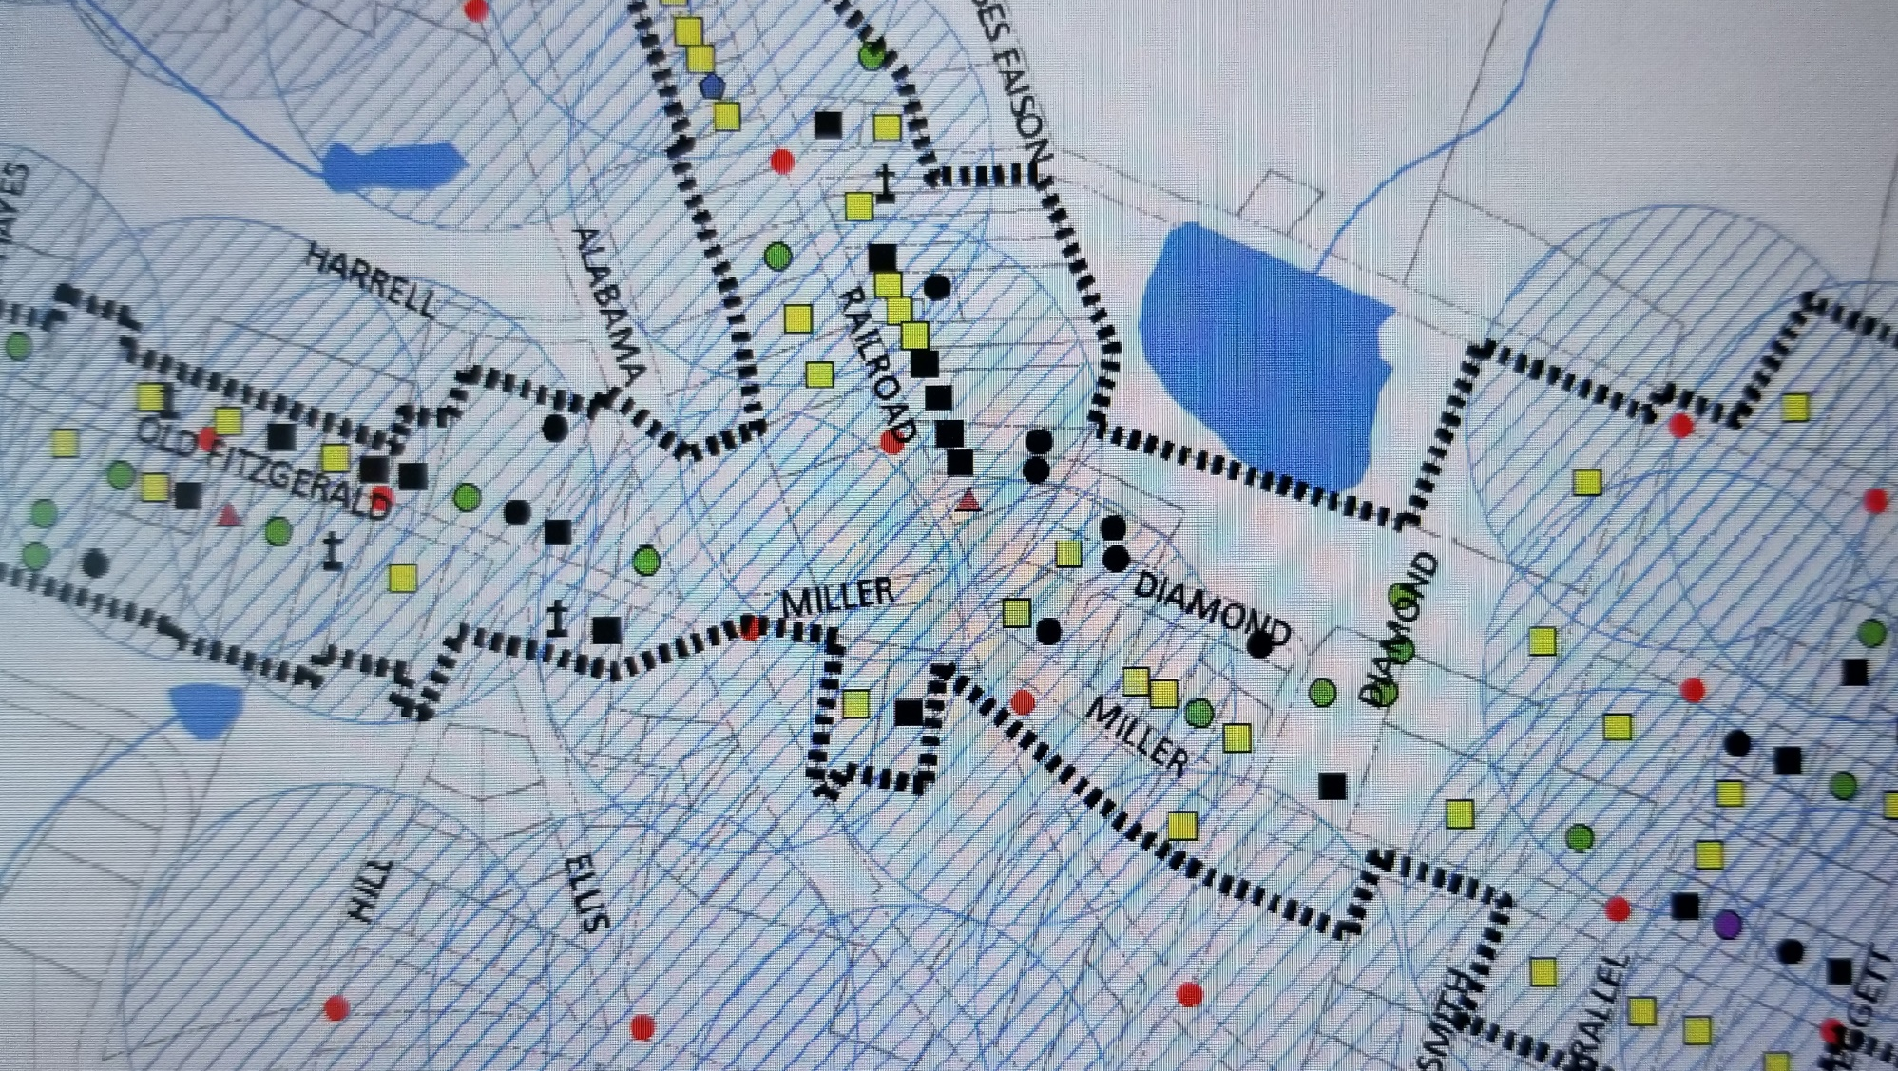
Fire Coverage Map

Slide 36
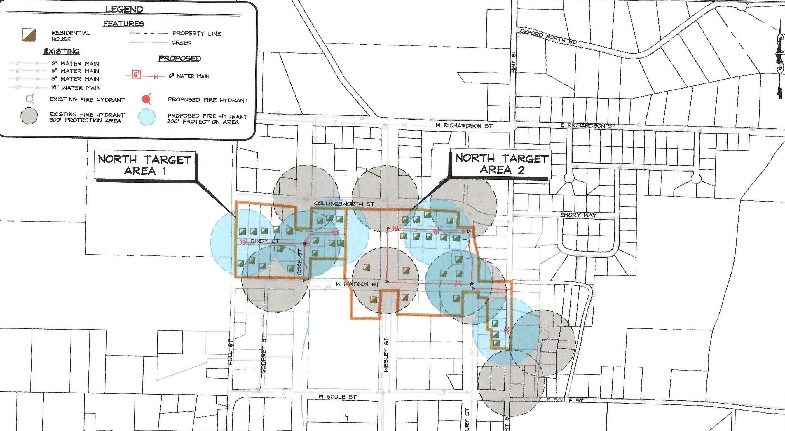

Slide 37
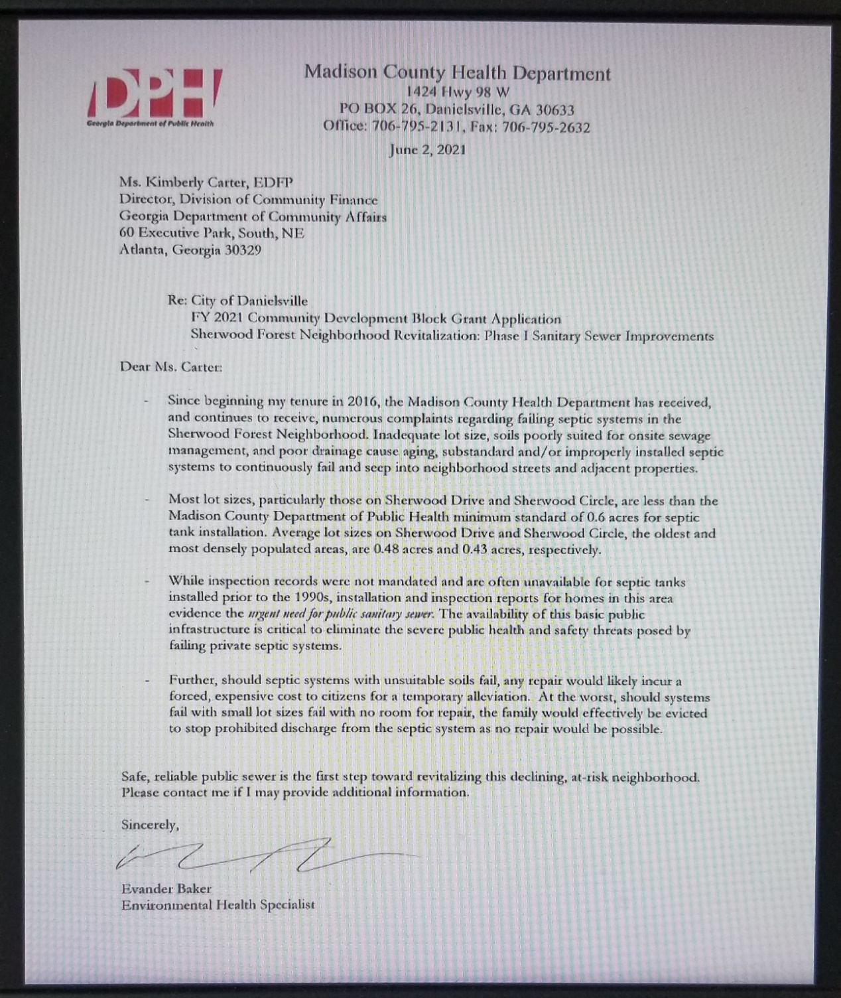
Health Department Letter of Documentation

Slide 38
Telling The Story
Photos
Quality photos are your best seller!
Identify location of photos (address, map)
Get your residents and public works to take photos.
Supplemental Documentation
News Reports
Work Orders
Pressure Tests
Third Party Testing
Reports and/or Consent orders from EPD
Make sure the documentation is relevant to the project!

Slide 39
Water & Sewer Work Orders
Work orders should include addresses, dates, and a brief description of the problem.
The work order should identify the location of the problem.
Work orders stating “water work completed” or “sewer work completed” are not sufficient to document the need.

Slide 40
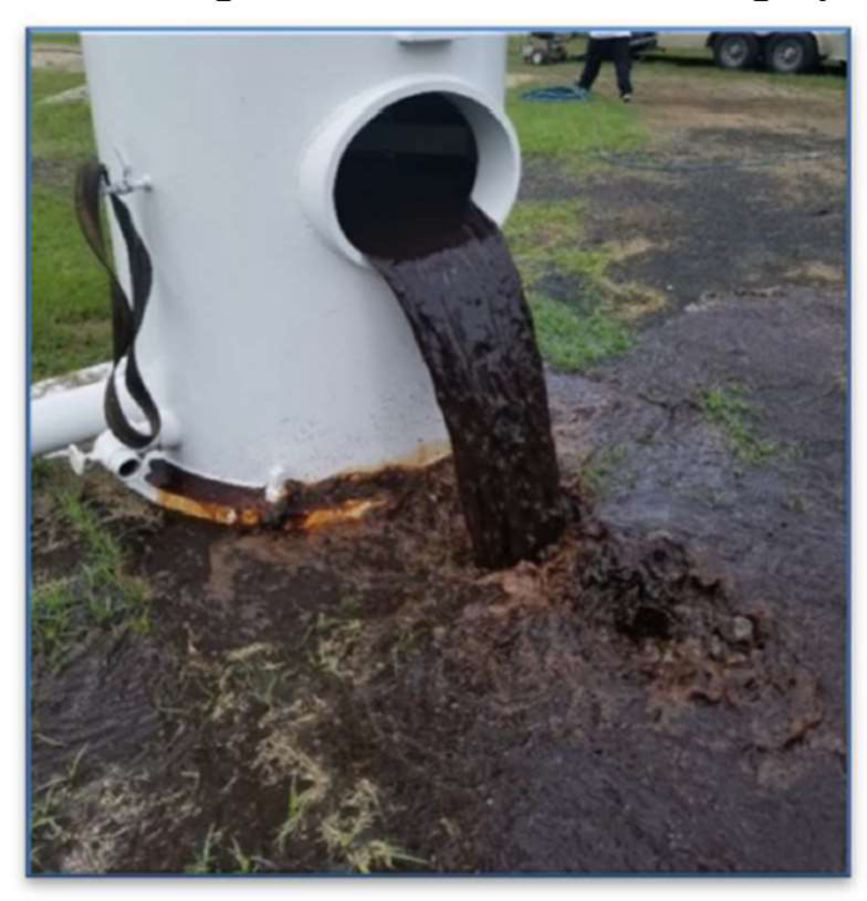
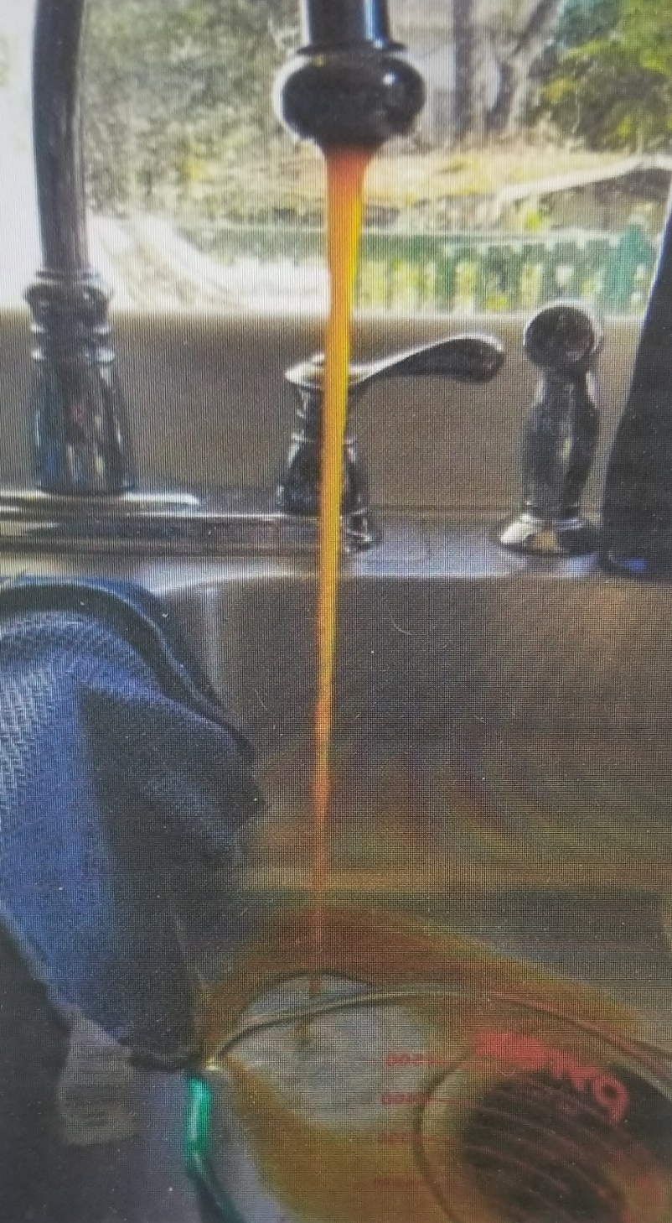
Water Photo Documenting Need

Slide 41
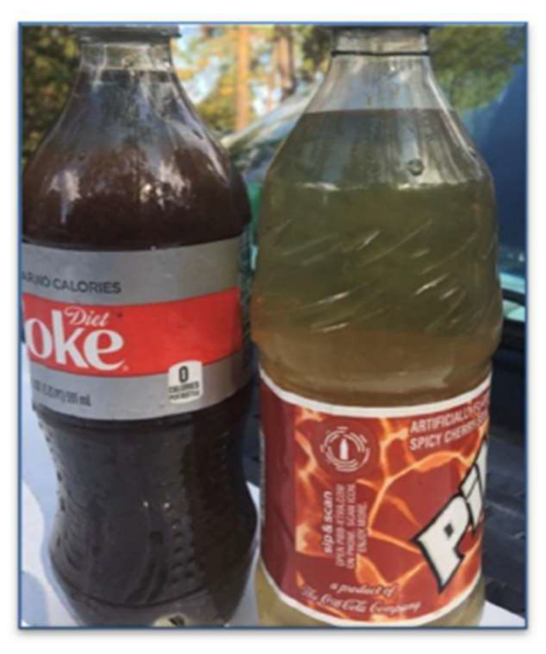
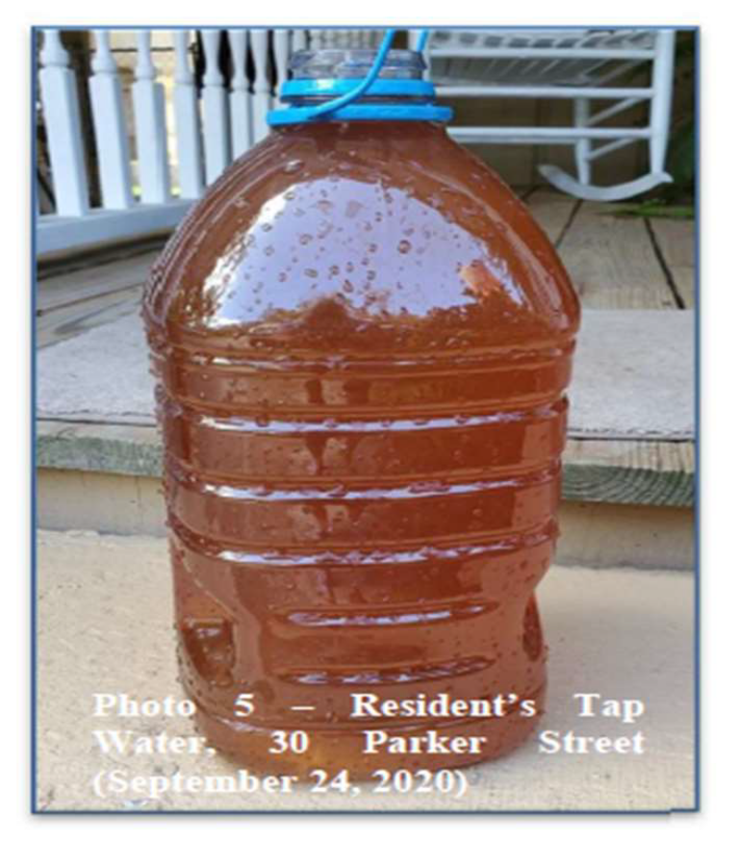
Water Photo Documenting Need

Slide 42
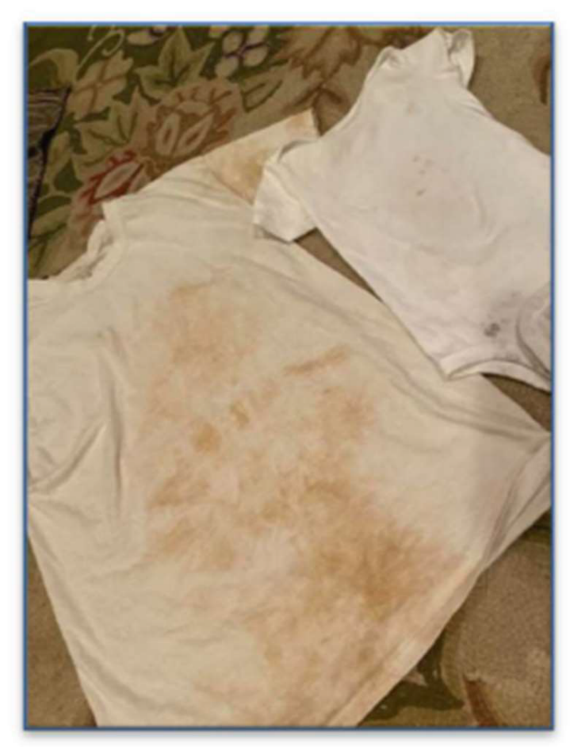
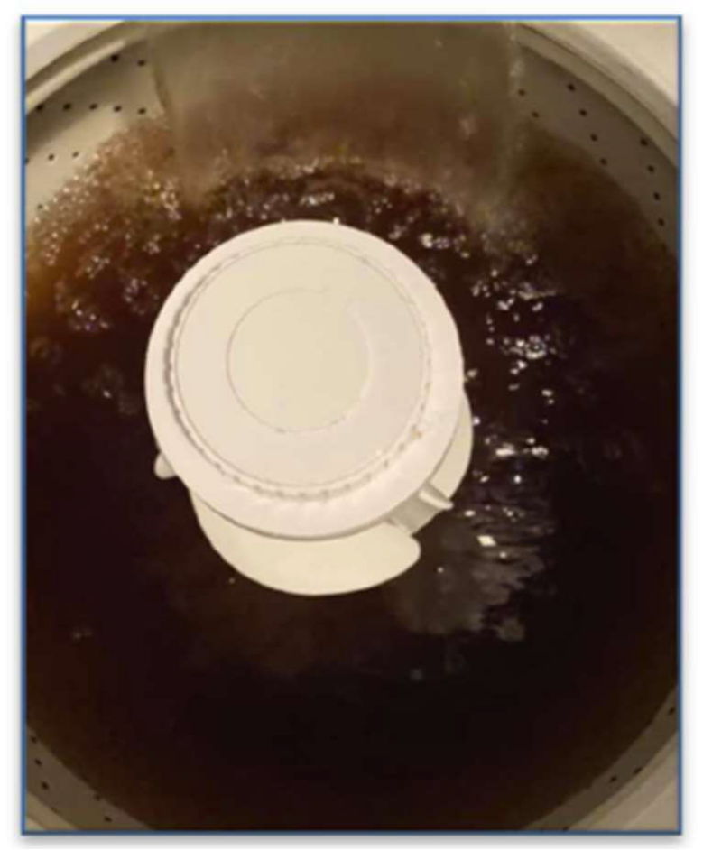
Water Photo Documenting Need

Slide 43
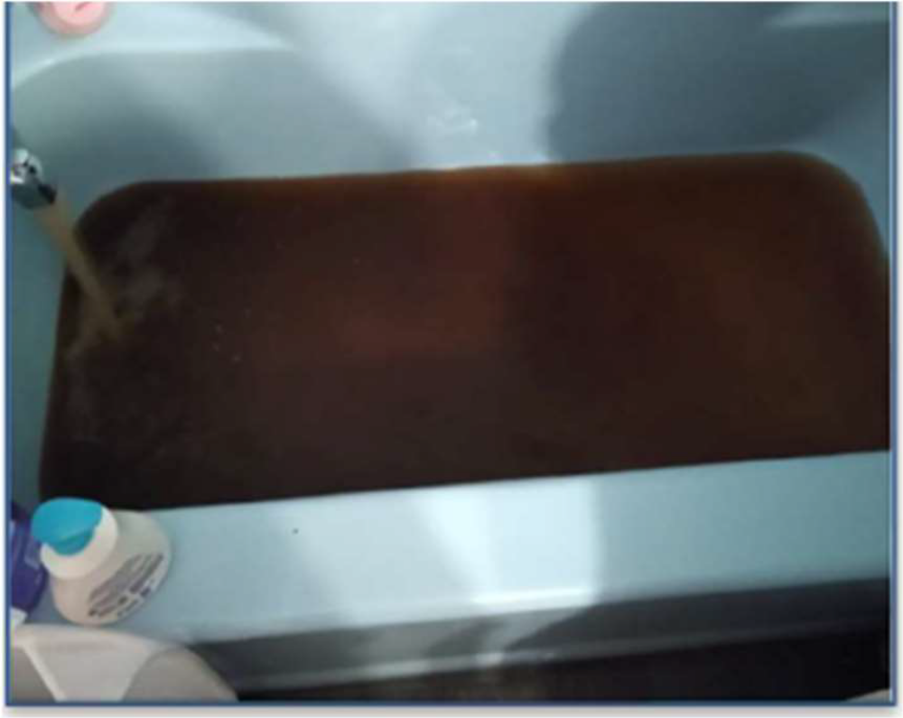
Water Photo Documenting Need

Slide 44
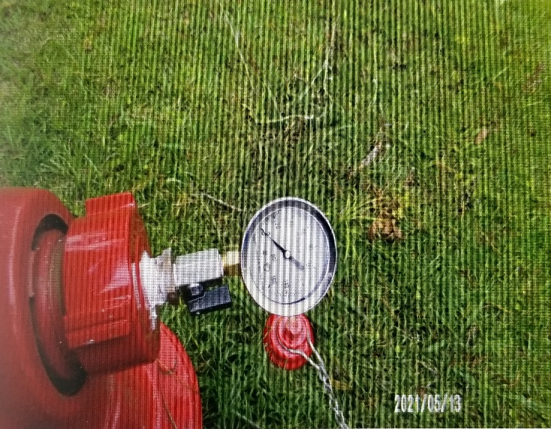
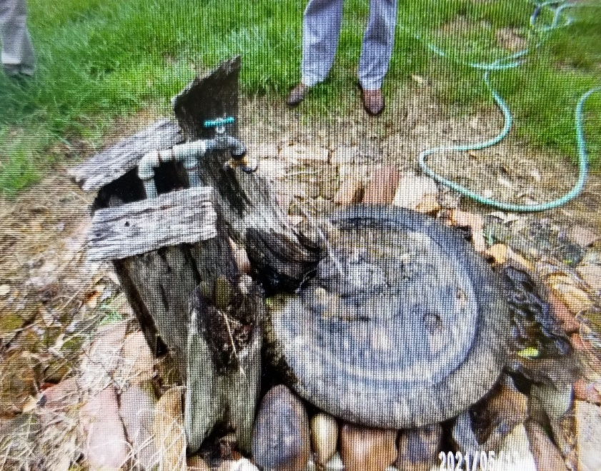
Low pressure at hydrants for fire protection
Low pressure at homes

Slide 45
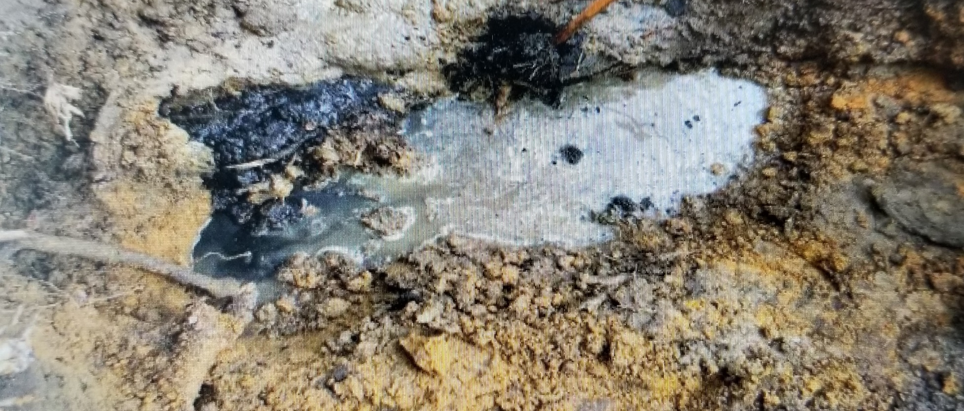
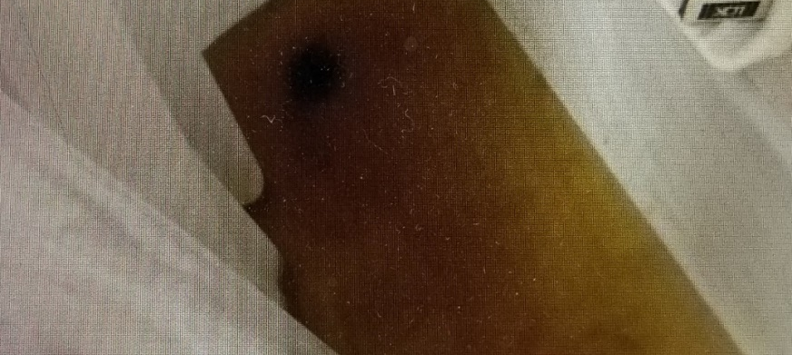
Sewer Photo Documenting Need

Slide 46
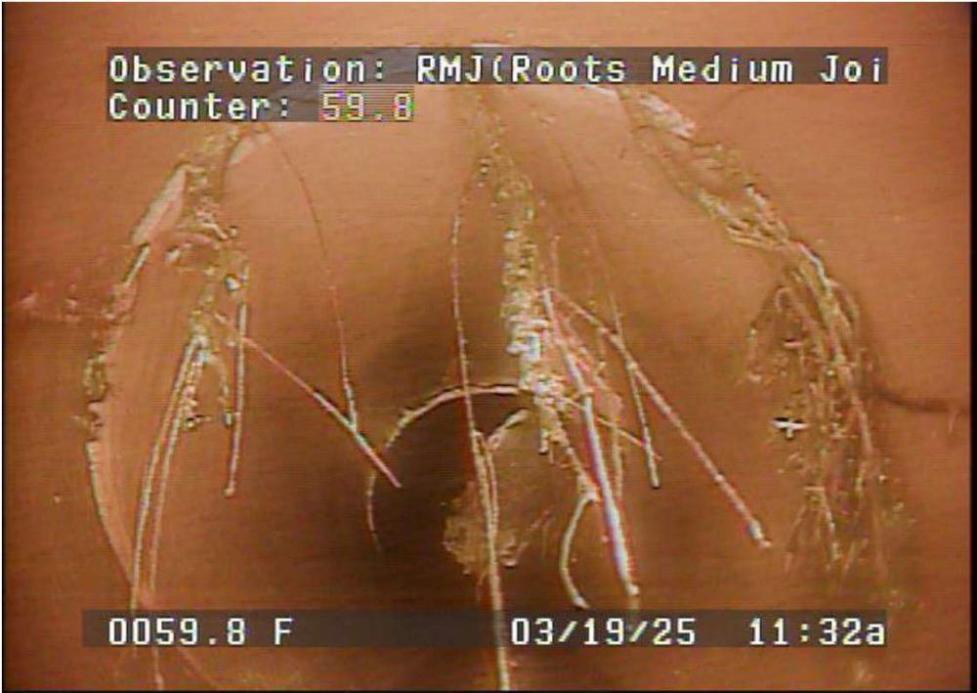
Sewer Photo
Notes:
Roots and Infiltration in joint of sewer main

Slide 47
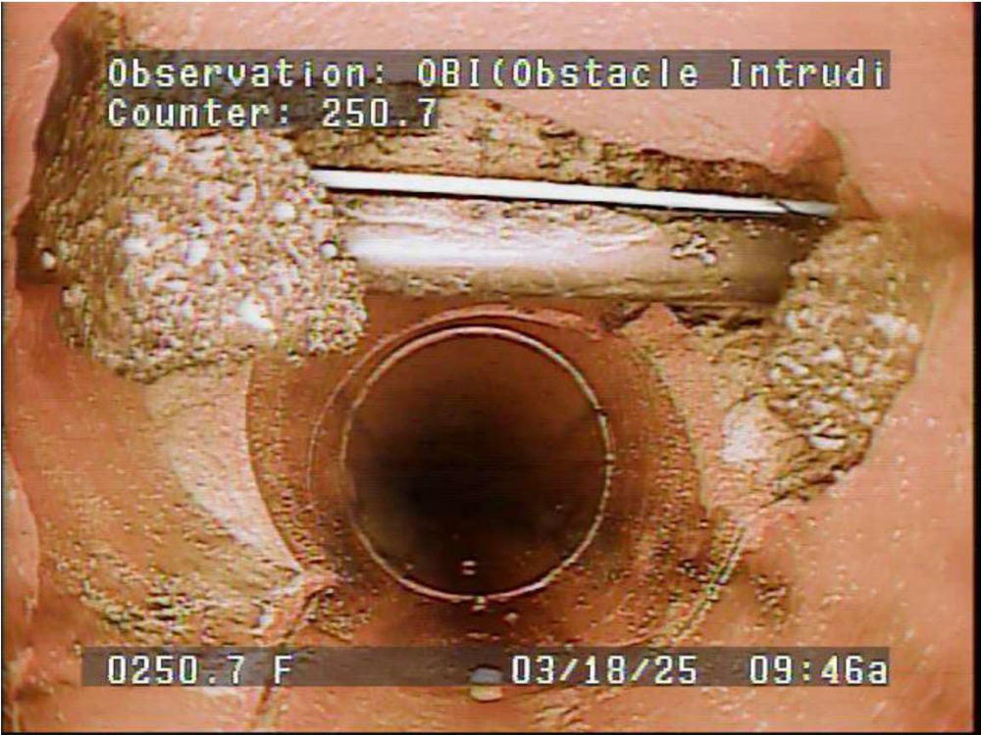
Sewer Photo

Slide 48
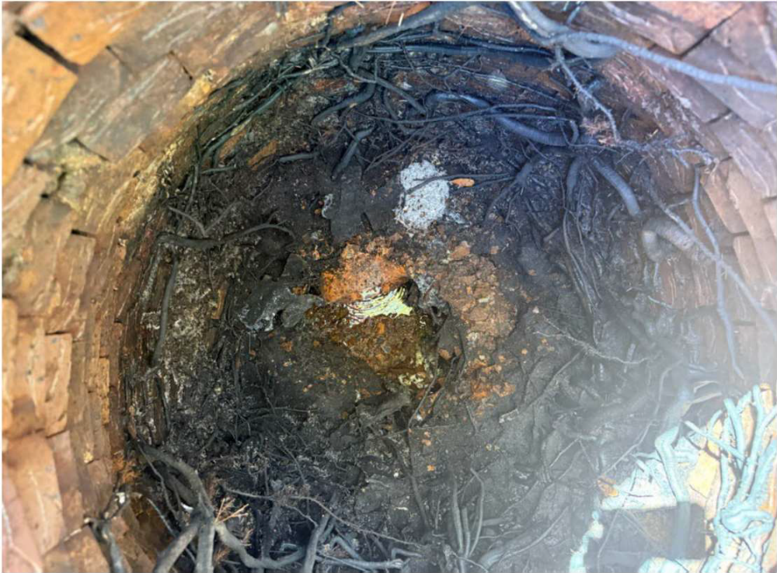
Sewer Photo

Slide 49
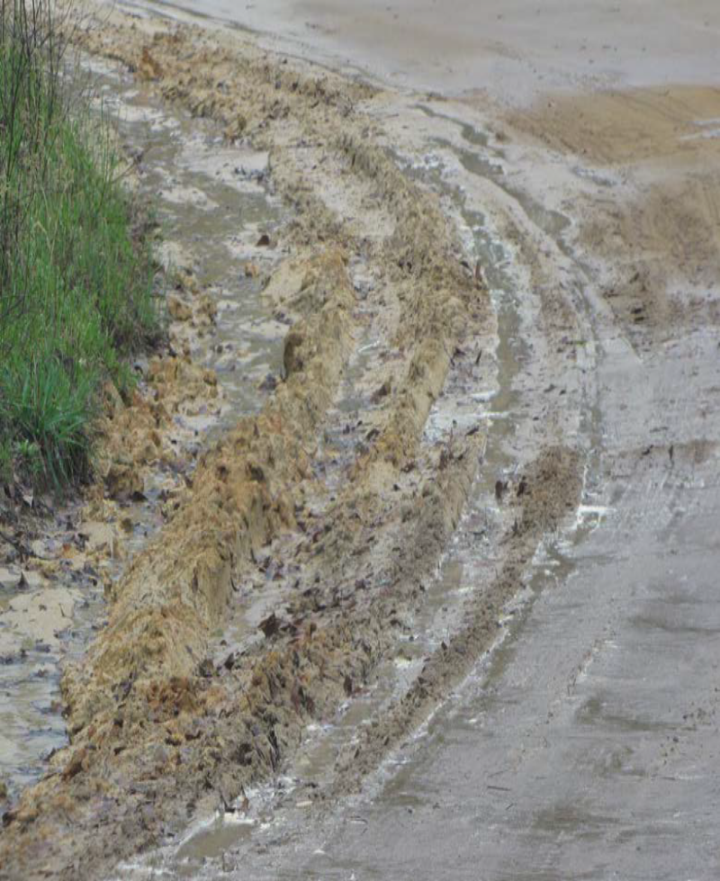
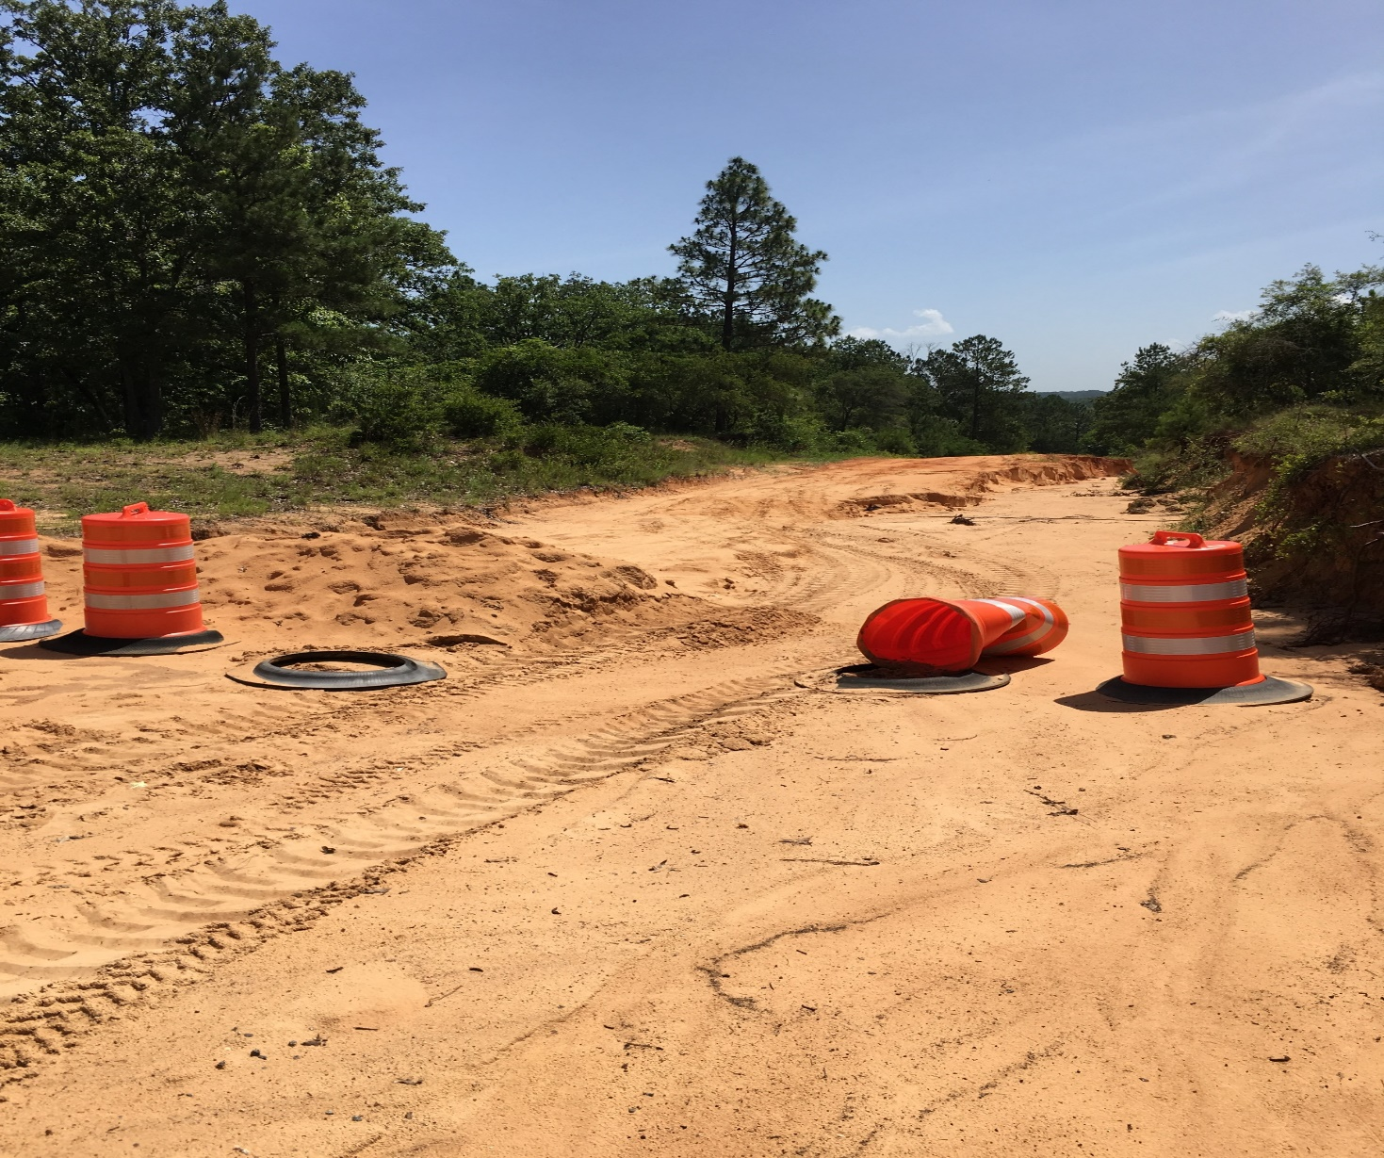
Streets and Drainage Photo Documenting Need

Slide 50
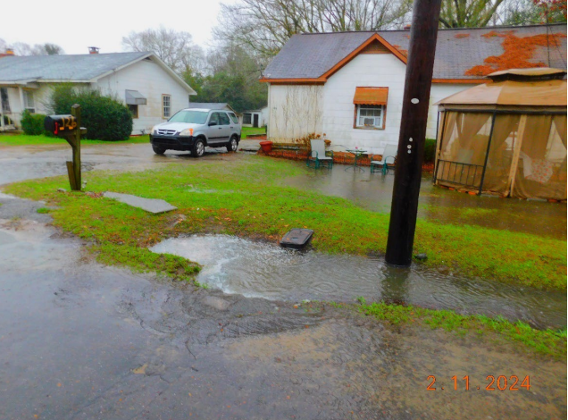
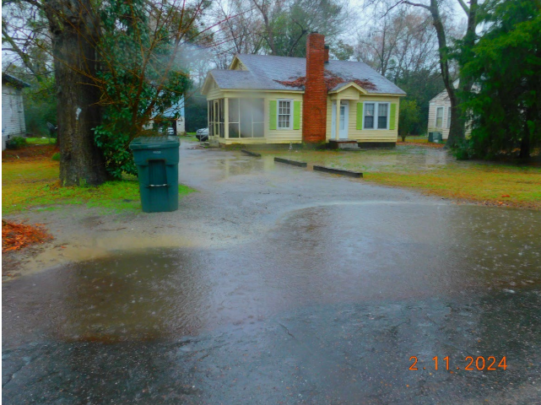
Streets and Drainage Photos Documenting Need

Slide 51
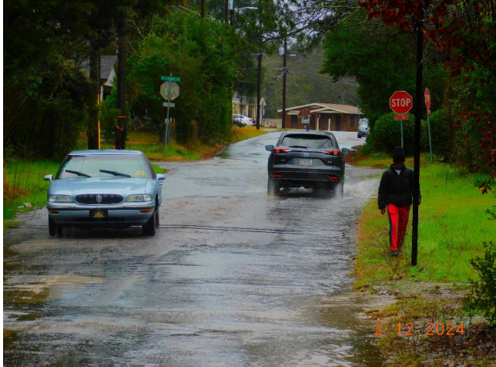
Streets and Drainage Photo Documenting Need

Slide 52
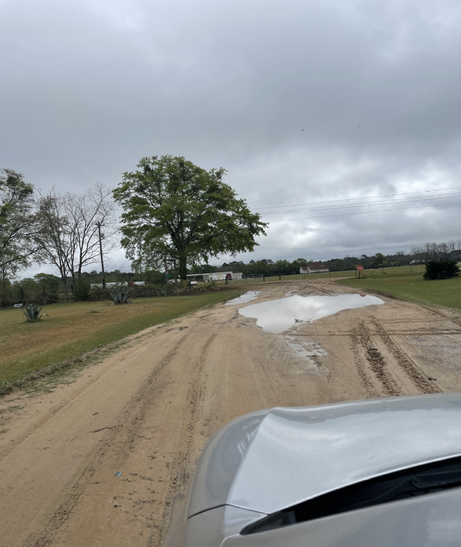
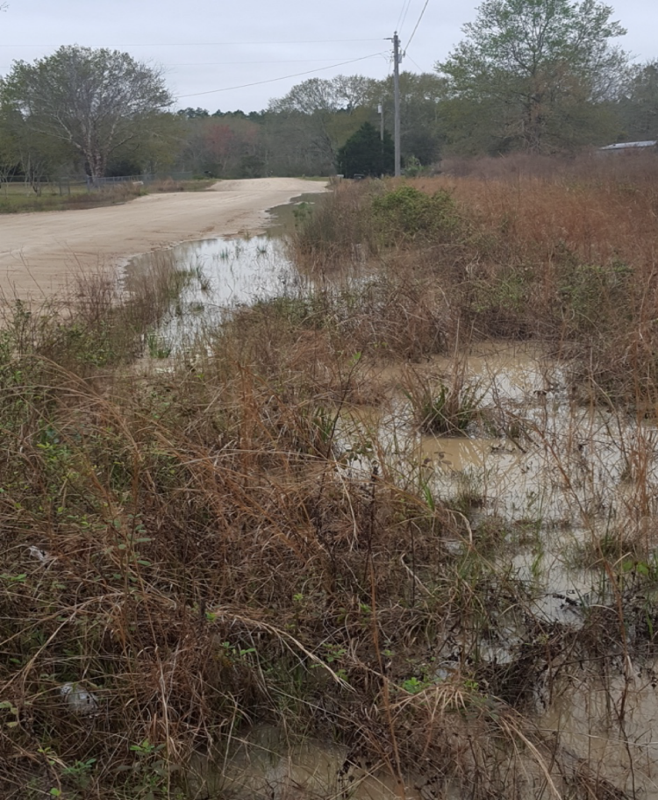
Streets and Drainage Photos Documenting Need

Slide 53
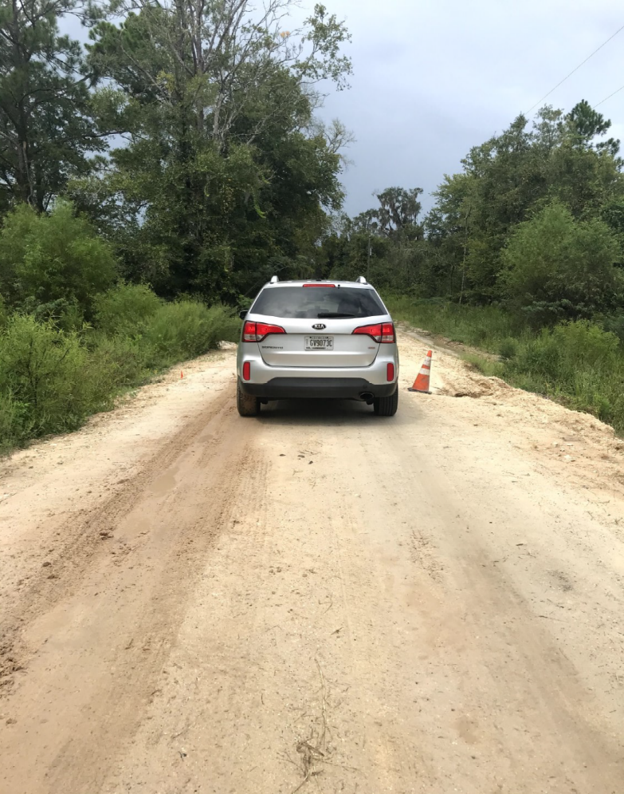
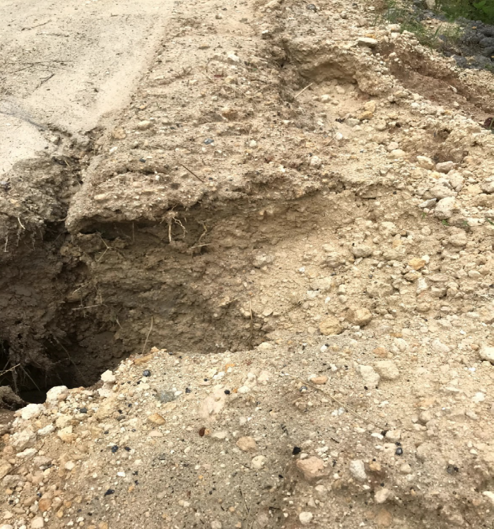
Streets and Drainage Photos Documenting Need

Slide 54

Building Photo Documenting Need

Slide 55
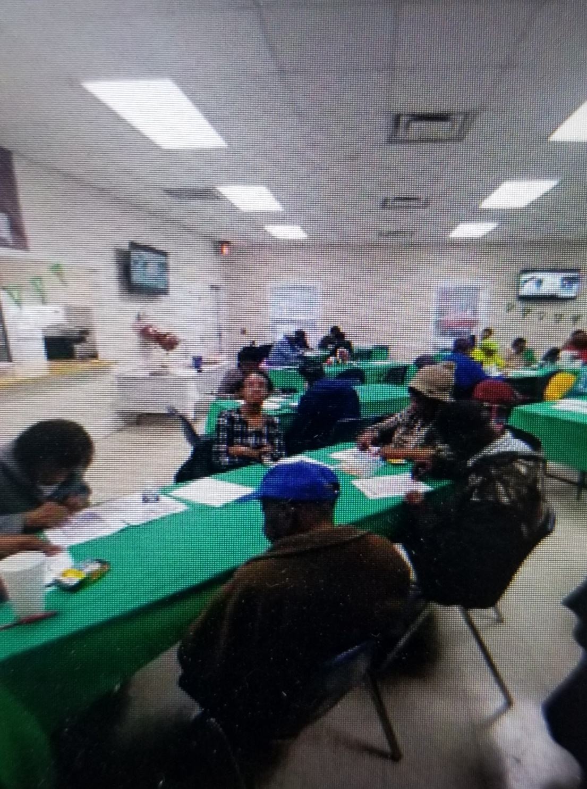
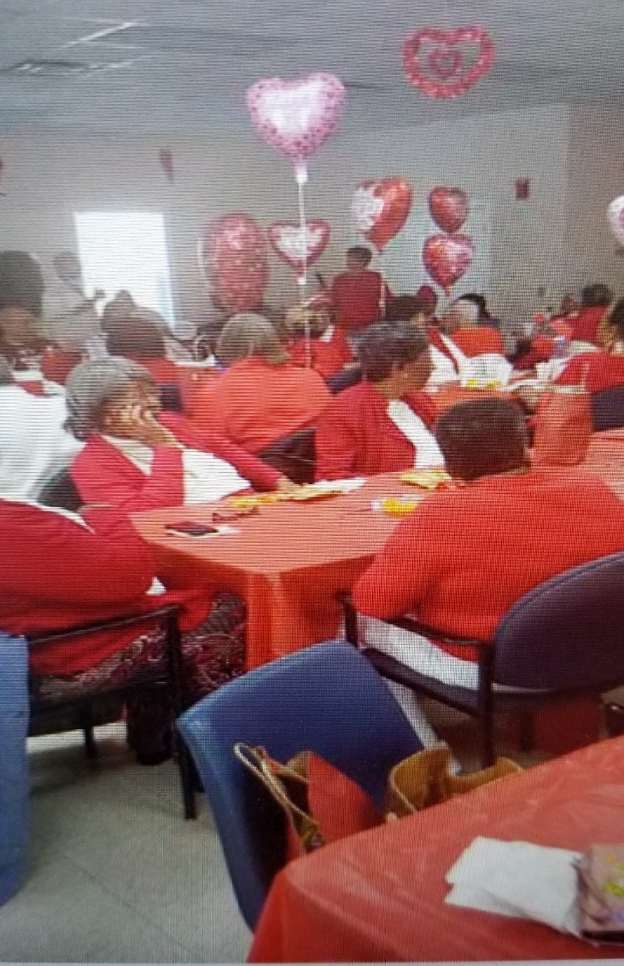
Building Photo Documenting Need

Slide 56
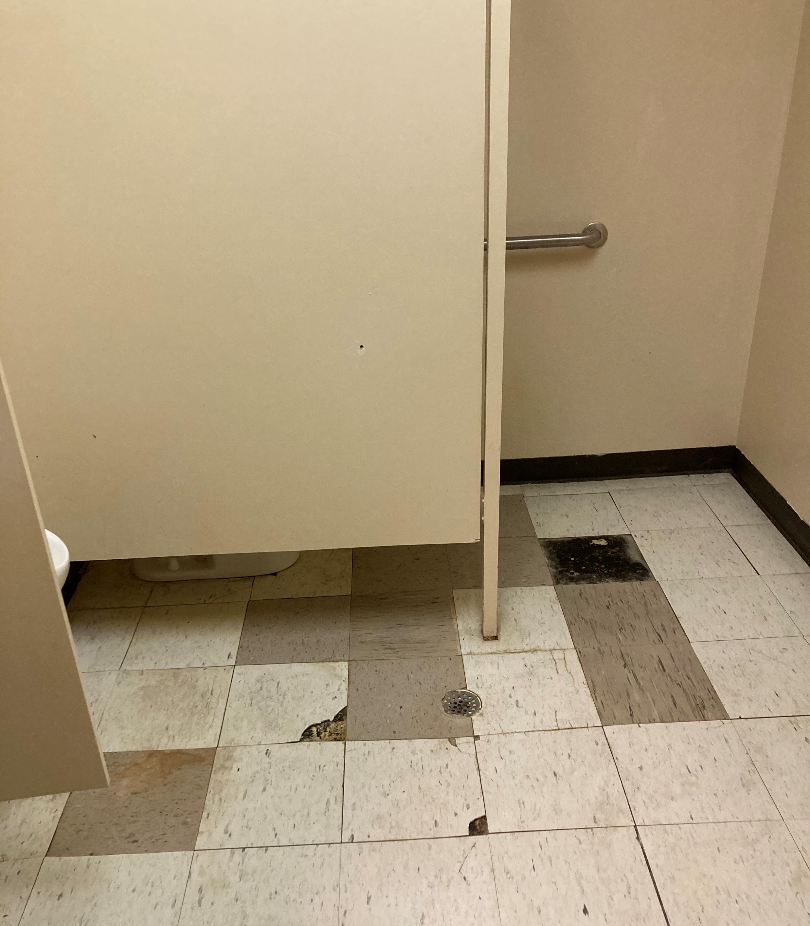
Building
Photo Documenting Need

Slide 57


Building Photos Documenting Need

Slide 58
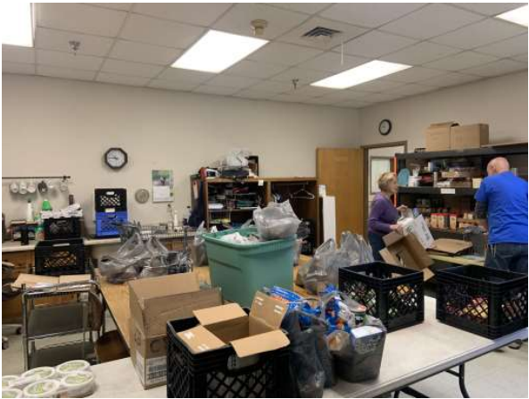
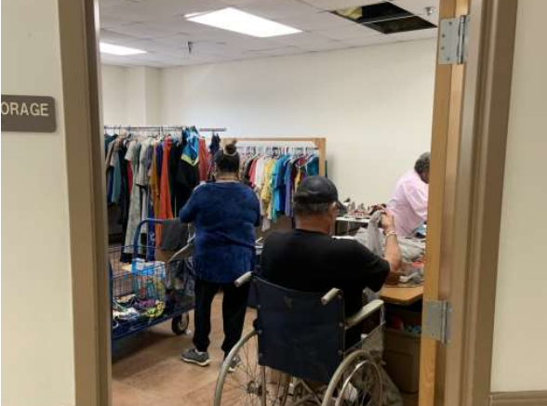
Building Photos Documenting Need

Slide 59

Telling The Story
Avoid political pitfalls
If the project overlaps jurisdictions, all sides must agree in writing to the application.

Slide 60
Telling The Story
Avoid political pitfalls
If the project overlaps jurisdictions, all sides must agree in writing to the application.

Slide 61
Case Study #1 – Booville, GA

Slide 62
Introduction
The City of Booville, GA was established in 1921. Booville is known for its annual Halloween Festival which has been held each year since 1924. Each year at the festival, the local Boys and Girls Club holds a can food drive and a trick or treat event which is held outside in the parking lot of the current facility. This one event serves all children in attendance.
Each year after the outdoor event, the Boys and Girls Club is approached by many families who would like to participate in other events held throughout the year. However, due to its current indoor capacity, the current building cannot safely accommodate any additional children. The Club always has a long waiting list.
Due to its limited capacity and ongoing waiting list, the Boys and Girls Club approached the City Council and asked them for help to build a new facility that will provide enough space to serve all children in need of assistance. After several discussions regarding available funding sources and alternatives, the City voted to apply for CDBG funds for a new building to benefit the local Boys and Girls Club. The new building will be constructed on a vacant lot owned by the City.

Slide 63
Exercise
1.) There are a variety of ways to document need for the proposed building. What should documentation photos show? Who should letters come from and what details are needed? What other types of documentation could be used to prove the need for the new building and additional space?
2.) What types of documentation should be included for any new types of services proposed? For example – a summer meal program?
3.) What details should be included for the proposed building site
4.)The ownership and operational structure should be identified. What documentation could be included for each option? Govt. Own/Operate; Govt. Own/Lease; or Non Profit Own/Operate?
5.) What should be used to determine the income for the Boys and Girls Club beneficiaries?
6.) What are some opportunities for Robust Citizen Participation with this application?

Slide 64
Case Study #1 – Question Review

Slide 65
1.) There are a variety of ways to document need for the proposed building. What should documentation photos show? Who should letters come from and what details are needed? What other types of documentation could be used to prove the need for the new building and additional space?

Slide 66
What should documentation photos show?
Any ongoing events/activities at the facility during regular operating hours
Crowded and/or overcrowded rooms full of people/clients
Deteriorated conditions
Any areas of concern noted in narrative

Slide 67
Who should letters come from and what details are needed?
Director – Letter should indicate the number of registered attendees, (possibly breaking out the after-schooler and summer attendees), approximate number of inquiries they receive, and the services they provide.
Volunteers/Employees – Letter should note what services they assist with and any issues affecting delivery of services.
Parents of Children on the Wait-List – Letter should discuss the activities offered, why they wish for their children to participate, and why they are not currently able to.
Children – Letter should discuss the activities offered and how the center has benefited them.
School Principal/BOE - Letter from schools should discuss the facility’s ability to accommodate all of the kids requiring after-school care (if they have to turn away kids because of a lack of space and relate it to the club’s bigger facility accommodating those kids).
Law Enforcement - Letter should note if they have trouble from kids with nothing to do in the summer.

Slide 68
What other types of documentation could be used to prove the need for the new building and additional space?
Work Orders (if any maintenance has been performed on the building)
Videos from the children (with parental consent)
A copy of the wait-list over multiple years (with personally identifiable information redacted)
Detailed comparison of current floor plan vs. new building floor plan
A call log of inquiries for participation

Slide 69
2. What types of documentation should be included for any new types of services proposed? For example – a summer meal program?

Slide 70
2. What types of documentation should be included for any new types of services proposed? For example – a summer meal program?
Sign-Up sheet from interested families
Letters from parents requesting or needing services that the center currently does not provide
Letters from the school with the number of kids receiving free lunch and/or census information to show poverty information
The application needs to address if other programs in the area offer the new services that is being proposed
Operational Details about the New Service
  How often will meals be provided and for what time frame
  How many clients the service is expected to serve
  Eligibility Requirements of New Service
  How will new services be paid for

Slide 71
3. What details should be included for the proposed building site??

Slide 72
3. What details should be included for the proposed building site?
Photos/Videos of Proposed Site
Details of Surrounding Area – Businesses, Schools, Low Mod Areas
Ease of Parking and Accessibility
Comparison between Existing Site and Proposed Site
Site History

Slide 73
4. The ownership and operational structure should be identified. What documentation could be included for each option? Govt. Own/Operate; Govt. Own/Lease; or Non Profit Own/Operate?

Slide 74
4. The ownership and operational structure should be identified. What documentation could be included for each option? Govt. Own/Operate; Govt. Own/Lease; or Non Profit Own/Operate?
All applications should document who the owner of the building is, include a copy of all lease agreements, rental fees, and who is/will be responsible for maintaining and operating the building.

Slide 75
5. What should be used to determine the income for the Boys and Girls Club beneficiaries?

Slide 76
5. What should be used to determine the income for the Boys and Girls Club beneficiaries?
The club should survey attendees, and the director can indicate the number in his/her letter. The proposed number of beneficiaries can be projected based on the interest in the program and the number of children in the area that’s not currently a member of the club.

Slide 77
6. What are some opportunities for Robust Citizen Participation with this application?

Slide 78
6. What are some opportunities for Robust Citizen Participation with this application?
Additional citizen participation meetings in current facility or proposed facility site (instead of or in addition to the traditional PH at City Hall)
Have a public meeting with the architect to get input on building design or floorplan
Send home a survey/flier for current and potential kids at the boys and girls club or local school system
Survey wait-listed families

Slide 79
More Opportunities For Robust Citizen Participation
Have a representative speak at PTA meetings (if allowed)
Have a website campaign (Boys and Girls Club website, local government website and any social media sites used by either party)
Place flyers in places utilized by area residents
Host an information session about the CDBG application

Slide 80
Case Study #2 – Gobble-Gobble, GA

Slide 81
Introduction
The City of Gobble-Gobble, GA was established in 1872. Residents are happy to be from the city that hosts the largest Thanksgiving festival in the state. However, residents are not so happy with the current state of the City’s infrastructure. Most of the City’s infrastructure was installed in the late 1950s and 1960s. Residents have a long list of complaints including sewer backups in their homes, sewer backups in their yards, poor water quality, poor water pressure, and there is a lack of fire protection in a large part of the city. In addition, there are 3 streets that are currently unpaved within the city limits of Gobble-Gobble and residents on these streets frequently experience flooding in their yards.
With so many issues needing to be addressed, it became evident that the City would need to take a phased approach to address all needs. The city held several public hearings to determine what the phase one target area should be. One area had the most citizen complaints, and the city knew, from previous planning efforts, that the area was at least 70% LMI.
The Turkey Hollow subdivision, with two (2) of five (5) unpaved streets, no fire hydrants, and residents with numerous incidences of water and sewer issues became the phase 1 target area. The City voted to apply for CDBG funds for water, sewer, streets, and drainage infrastructure to serve residents of this target area.

Slide 82
Exercise
What documentation can be included in the application to document efforts made by the city to prevent reoccurrence of the problems?
What types of documentation could be used to back up each claim noted below? Remember: Each claim must be documented individually, and documentation should directly document the need claimed. For example: Any photos included to document drainage issues would logically need to be taken after a rain event.
What issues should be considered when including the two unpaved streets within the larger target area?
What happens if sufficient documentation cannot be provided for all claims made?

Slide 83
Case Study #2 – Question Review

Slide 84
1. What documentation can be included in the application to document efforts made by the City to prevent reoccurrence of the problems?

Slide 85
1. What documentation can be included in the application to document efforts made by the City to prevent reoccurrence of the problems?
Local policies
Local Practices
Local ordinances
Local programs
Be sure to include specific dates and frequencies to receive full points.

Slide 86
2. What types of documentation could be used to back up each claim?
The review panel looks at each claim individually.

Slide 87
2. What types of documentation could be used to document back ups in homes?

Slide 88
Sewer Back Ups In Homes
Photos showing back ups in showers, sinks, tubs, toilets
Resident letters specifically noting back ups in homes and where back ups are occurring
Work orders specifically stating that the resident had a sewer back up inside home
Health Department letter noting firsthand knowledge of sewer back ups in the target area in the homes
Housing Authority Letter noting firsthand knowledge of backups in residents' homes
Any Insurance claims filed due to severe backups in homes

Slide 89
2. What types of documentation could be used to document back ups in yards?

Slide 90
Sewer Backups in Yards
Photos of raw sewage on the ground in resident’s yard
Work orders specifically stating that the resident had a sewer back up in yard
Health Department letter noting firsthand knowledge of sewer back ups in the target area in yards
Housing Authority Letter noting firsthand knowledge of backups in resident's yards
Resident letters specifically noting backups in yards

Slide 91
2. What types of documentation could be used to document poor water quality?

Slide 92
Poor Water Quality
Photos showing dirty, rusty, discolored water from a resident’s home
Resident’s letter noting specific water issues and how it is affecting them in their daily lives
Test for contamination of the water supply
Health department or other third-party letter noting health risk to residents from water supply
Work orders specifically noting poor water quality issues affecting residents

Slide 93
2. What types of documentation could be used to document poor water pressure at homes?

Slide 94
Poor Water Pressure at Homes
Pressure test conducted on home pipes
Resident letters specifically describing low pressure issues affecting them in their home on a daily basis
Photos showing differences in pressure with more than one faucet running in home
Video showing low pressure in homes
Work orders that specifically note low pressure issues affecting residents in homes

Slide 95
2. What types of documentation could be used to document the need for additional fire protection?

Slide 96
Fire Protection
Fire Coverage Map showing that all homes are in need of fire protection and that all homes will be covered with adequate fire protection – Be sure to include fire coverage rings on existing and proposed maps, as applicable.
Letter from fire chief describing current issues fighting fires in the proposed target area
Resident letters noting the need for fire protection
List of fire calls in the target area

Slide 97
2. What types of documentation could be used to document unpaved and narrow streets?

Slide 98
Unpaved and Narrow Streets
Photos showing width of street as well as street conditions
Photos taken after rain events
Resident letters noting personal issues with current road conditions
Third party letters from bus drivers, emergency personnel, or others who have to travel down the street in order to serve residents

Slide 99
2. What types of documentation could be used to document poor drainage?

Slide 100
Poor Drainage
Photos showing wet conditions, damage to homes including mold or other issues related to poor drainage conditions
Letters from residents noting specific issues caused by poor drainage
Any insurance claims filed due to damage from poor drainage conditions

Slide 101
3. What issues should be considered when including the two unpaved streets within the target area?

Slide 102
3. What issues should be considered when including the two unpaved streets within the target area?
Would the streets qualify as stand-alone projects?
Who lives on these streets?
Is there any conflict of interest associated with anyone on the specific streets?

Slide 103
4. What happens if sufficient documentation cannot be provided for all claims?

Slide 104
4. What happens if sufficient documentation cannot be provided for all claims?
Each claim is evaluated on its own. If there is not sufficient documentation for each claim, your score is reduced for each claim undocumented.
When deciding what to apply for, make sure you can document each claim individually. If you cannot, it would be best to remove the undocumented claim from the application.

Slide 105
Thanks!
dca.georgia.gov

Slide 106
CDBG Program Representatives
Cindy Alligood
478-290-1074
Cindy.Alligood@dca.ga.gov
Crystal Gaillard
229-733-7021
Crystal.Gaillard@dca.ga.gov
Roderick Gilbert
470-783-4729
Roderick.Gilbert@dca.ga.gov
Malisa Thompson
404-326-1048
Malisa.Thompson@dca.ga.gov

