Slide 1
What’s in my plan? An overview of the Minimum Standards for Local Comprehensive Planning
Jon A. West, AICP | Director, Community Development Division

Slide 2
Obligatory Warm-Fuzzy Quote
“…When we build, let us think that we build for ever. Let it not be for the present delight, nor for present use alone; let it be such work as our descendants will thank us for, and let us think as we lay stone on stone, that a time is to come when those stones will be held sacred because our hands have touched them, and that the people will say when they see them,
“See! This is our parents did for us.”
John Ruskin, The Seven Lamps of Architecture

Slide 3
Regulatory Framework
Georgia Planning Act of 1989
Minimum Standards for Local Comprehensive Plans
Local Comprehensive Plans
Local Zoning & Development Regulations

Slide 4
The Standards: Overview
Menu of Plan Elements (Community Chooses)
Each Element Has Only Brief, Flexible Guidance
Only Three Elements are Required of All
Five Elements are Required for Some Communities (depending on local conditions)
Substitution of Existing Plans/Elements Encouraged
No Update Required for Some Plan Elements
Other Elements Updated Every Five Years
RCs and communities can adapt the rules to fit local needs (e.g. plans may be significantly scaled-down for very small communities)
Notes:
“Required” elements will be explained in a moment, when we begin to overview the draft standards.
“Normal” plan update deadline is the one assigned to each government by DCA (otherwise called the Recertification Schedule - some type of update is required every five years).

Slide 5
Menu of Plan Elements
REQUIRED
for all
COMMUNITY
GOALS
NEEDS &
OPPORTUNITIES
BROADBAND SERVICES ELEMENT
COMMUNITY
WORK PROGRAM
REQUIRED for some communities
CAPITAL IMPROVEMENTS ELEMENT
LAND USE
ECONOMIC DEVELOP-MENT
TRANSPOR-
TATION
HOUSING
OPTIONAL
Elements (Examples)
TARGET AREAS
PUBLIC SAFETY
GREENSPACE
EDUCATION
RECREATION
HUMAN SVCS
NATURAL RESOURCES
INTER-GOVERNMENT
COORDINAT’N
SOLID WASTE
MANAGE-MENT
INFRA-STRUCTURE & FACILITIES
COMMUNITY
SUSTAIN-ABILITY
HISTORIC & CULTURAL RESOURCES
DISASTER RESILIENCE
**Visual Concept by Ozgur Basak Alkan, Perkins+Will
Notes:
Explain graphic (required for all, required for some, always optional)
Briefly describe what each plan element is about – more depth for the required elements, very brief for the optional elements.
5

Slide 6
Menu of Plan Elements
REQUIRED
for all
REQUIRED
for all
COMMUNITY
GOALS
NEEDS &
OPPORTUNITIES
BROADBAND SERVICES ELEMENT
COMMUNITY
WORK PROGRAM
REQUIRED for some communities
CAPITAL IMPROVEMENTS ELEMENT
ECONOMIC DEVELOP-MENT
OPTIONAL
Elements (Examples)
LAND USE
TRANSPOR-
TATION
HOUSING
TARGET AREAS
PUBLIC SAFETY
GREENSPACE
EDUCATION
RECREATION
HUMAN SVCS
NATURAL RESOURCES
INTER-GOVERNMENT
COORDINAT’N
SOLID WASTE
MANAGE-MENT
INFRA-STRUCTURE & FACILITIES
COMMUNITY
SUSTAIN-ABILITY
HISTORIC & CULTURAL RESOURCES
DISASTER RESILIENCE
**Visual Concept by Ozgur Basak Alkan, Perkins+Will
Notes:
Explain graphic (required for all, required for some, always optional)
Briefly describe what each plan element is about – more depth for the required elements, very brief for the optional elements.
6

Slide 7
Standards & Examples
REQUIRED
for all
COMMUNITY
GOALS
NEEDS &
OPPORTUNITIES
BROADBAND SERVICES ELEMENT
COMMUNITY
WORK PROGRAM
Notes:
Explain graphic (required for all, required for some, always optional)
Briefly describe what each plan element is about – more depth for the required elements, very brief for the optional elements.
7

Slide 8
DCA Provides Tools
Statistical and demographic data provided by DCA for FREE, upon request
QCOs provide useful “conversation starters”
Use to educate the public and fact-check their input
No requirement that it be included in the final document—if it is (typically as an appendix), it can be an excellent source of data and stats about your community to aid continued decision-making

Slide 9
Standards & Examples
REQUIRED
for all
COMMUNITY
GOALS
NEEDS &
OPPORTUNITIES
BROADBAND SERVICES ELEMENT
COMMUNITY
WORK PROGRAM
COMMUNITY
GOALS
REQUIRED FOR ALL communities
1 or a Combination of any of the following:
General Vision Statement
List of Community Goals
Community Policies
Character Areas & Defining Narrative
This element is created ONCE potentially drawing from previous plans.
Updated at the discretion of the local government.
Notes:
Explain graphic (required for all, required for some, always optional)
Briefly describe what each plan element is about – more depth for the required elements, very brief for the optional elements.
9

Slide 10
Vision Statement
FROM THE RULES
“General Vision Statement. Include a general statement that paints a picture of what the community desires to become, providing a complete description of the development patterns to be encouraged within the jurisdiction.”

Slide 11
Vision Statement
“We want our community to be a happy, friendly place where people want to live, play, and do business.”
This is useless to the community.

Slide 12
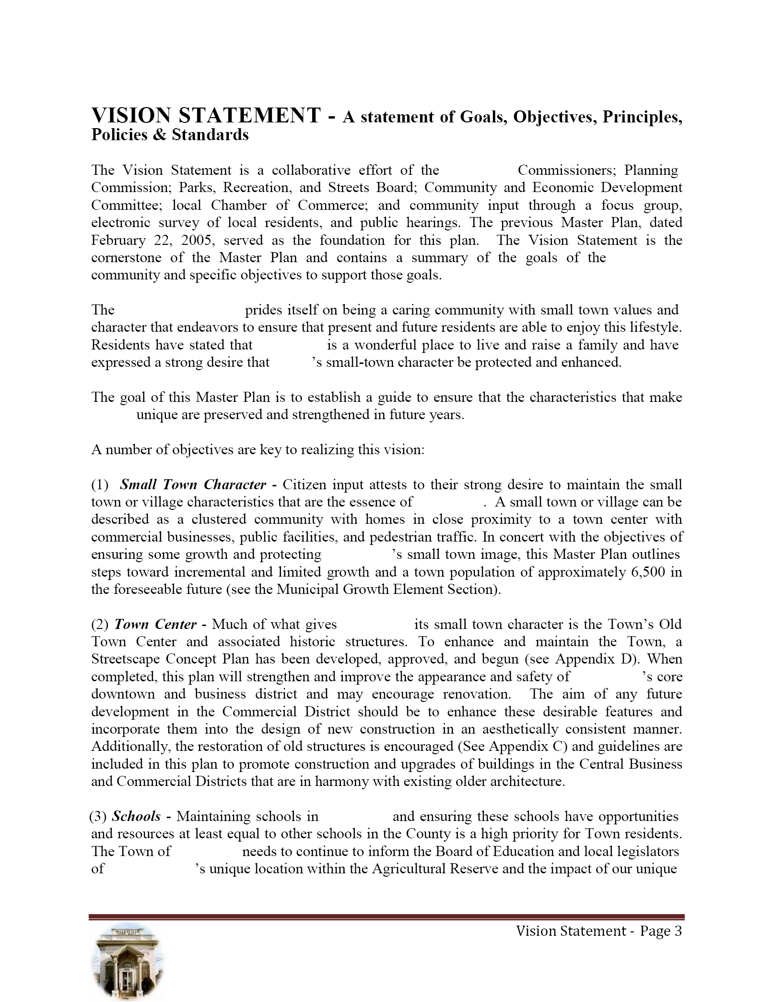
Vision Statement
**From Whitfield County
Or, you can provide a much more detailed narrative like this.

Slide 13
Vision Statement
Or, you can provide a much more detailed narrative like this.

Slide 14
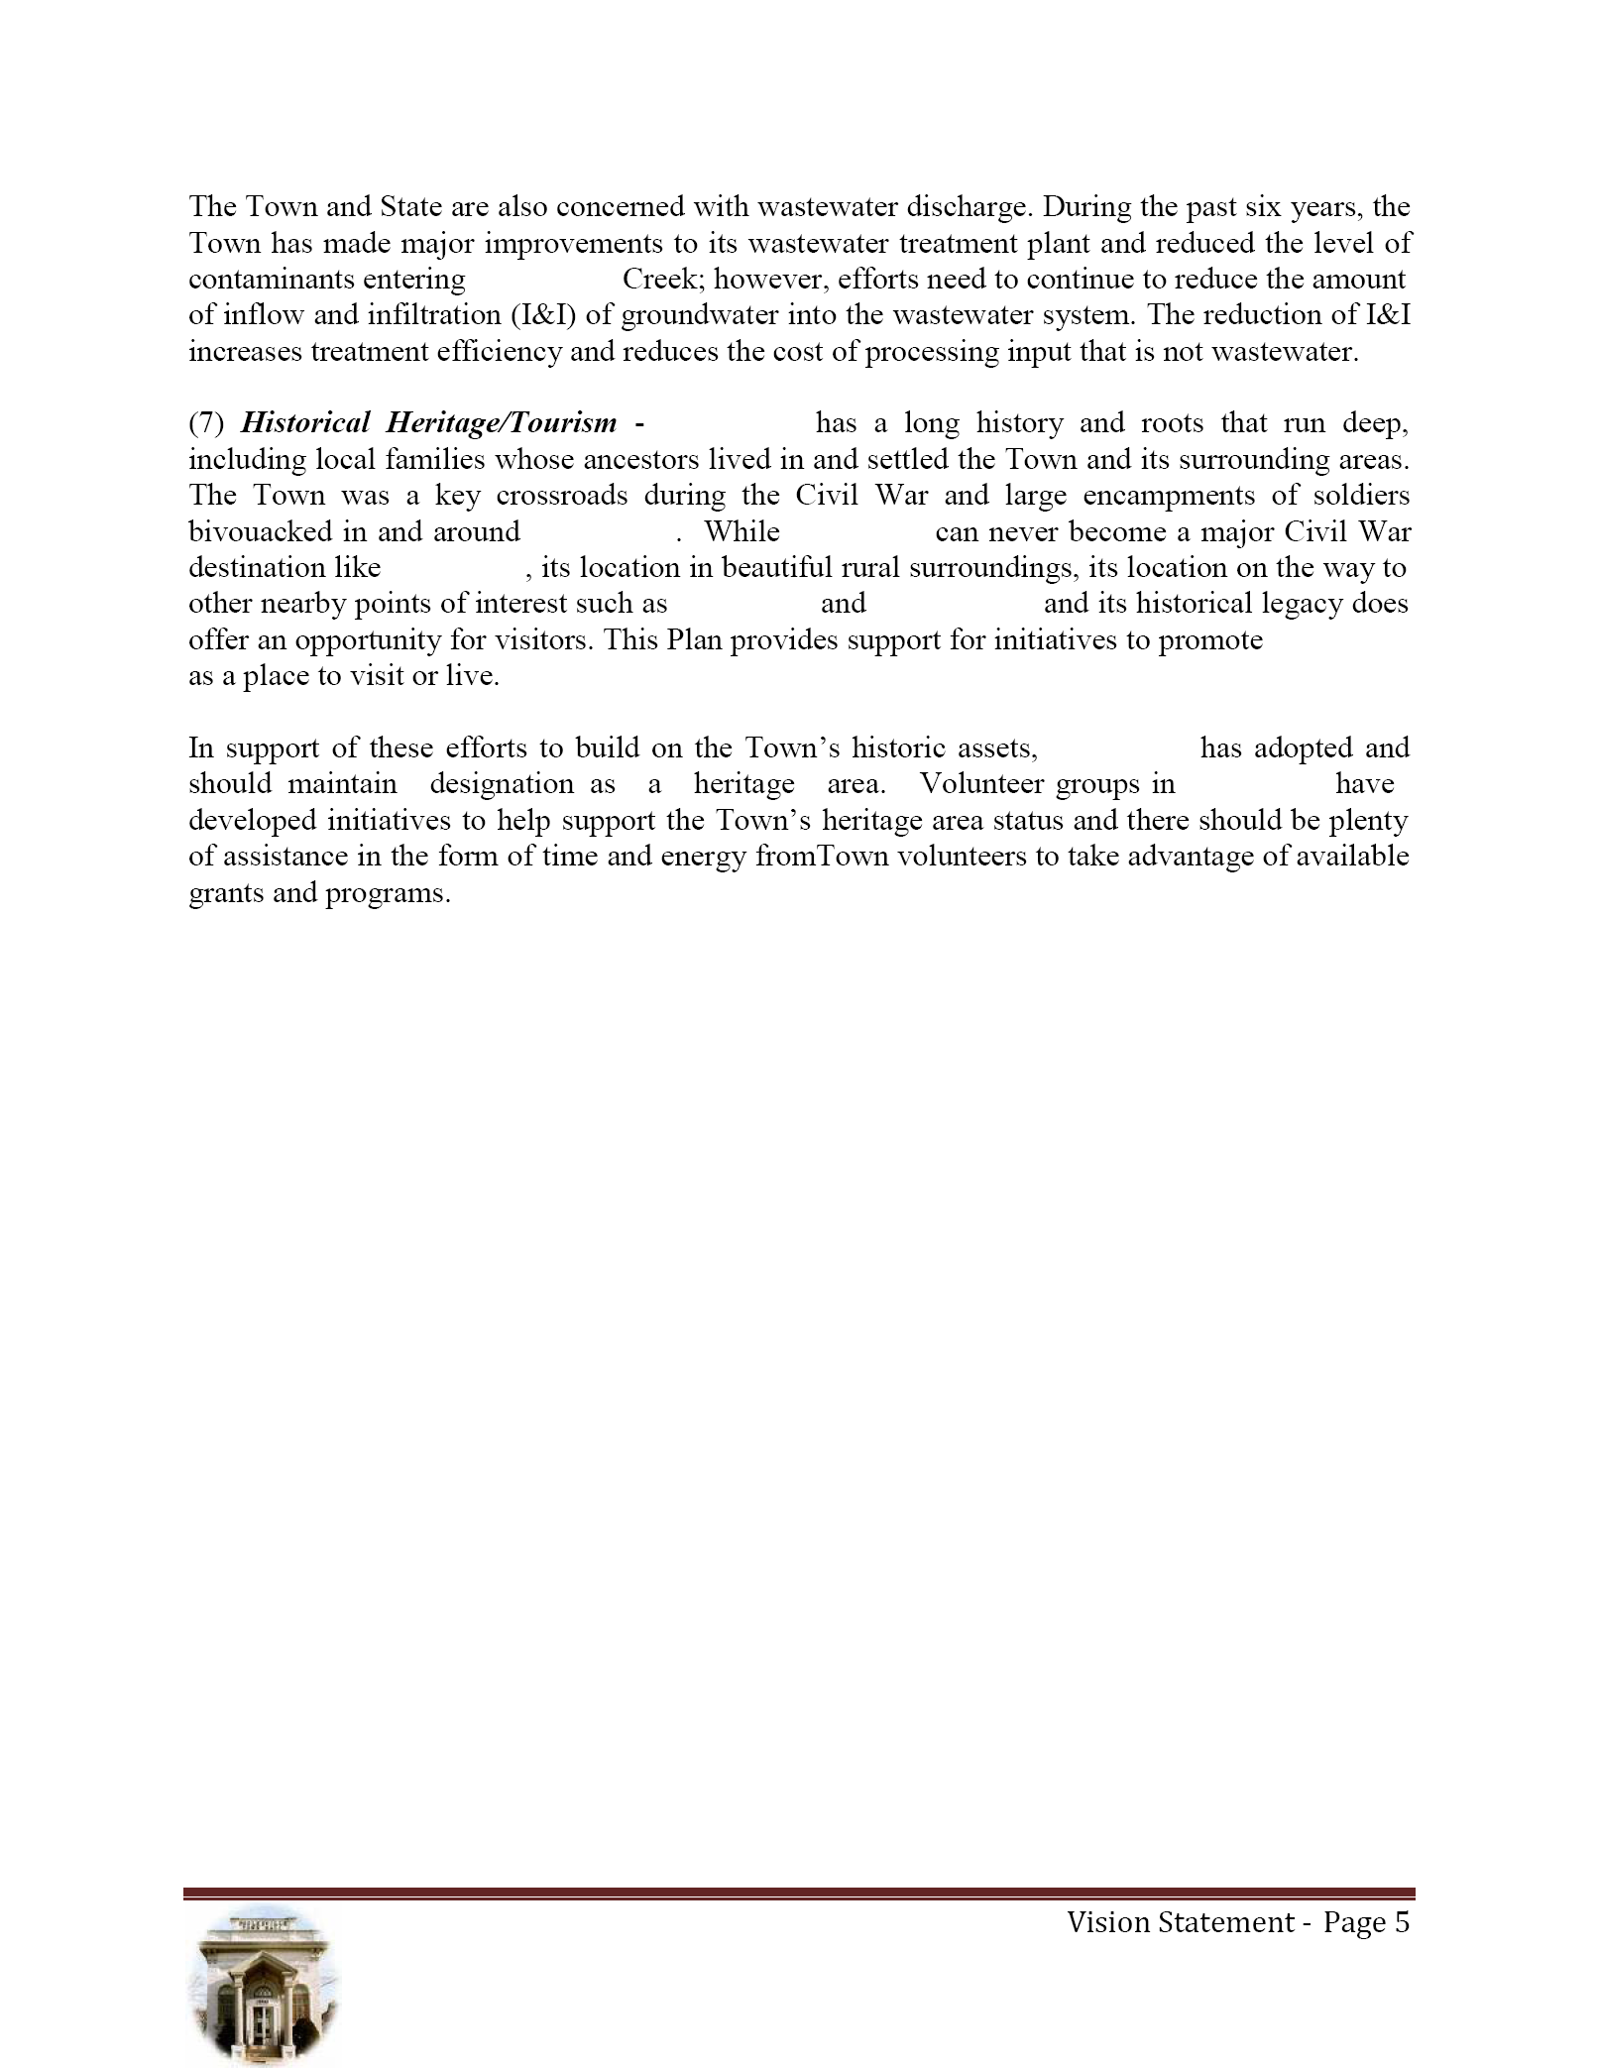
Vision Statement
Or, you can provide a much more detailed narrative like this.

Slide 15
Structuring the Comp Plan Goals – Policies - Activities
Goals articulate a set of broad, overarching ideals for which the community is working.
Policies provide ongoing guidance and direction to local officials for making decisions that support achieving the community’s vision/goals.
Implementation Activities specific activities the community plans to undertake (e.g. activities, initiatives, programs, ordinances, administrative systems) in order to implement policies and achieve goals

Slide 16
Structuring the Comp Plan Goals – Policies - Activities
Goal 1: Our community will employ innovative tools and processes to attract new businesses that complement our Vision and retain existing ones.
Policy 1:A → Collaborate with the development authority to provide financial incentives to local businesses.
Activity 1:A(1) Increase funding to existing façade restoration program by at least 5%.
Policy 1:B → Ensure that review processes do not unnecessarily hamper (re)development.
Activity 1:B(1) Develop a simple process flowchart that the lay public can understand and provide it to each applicant at the beginning of every review process
Activity 1:B(2) Revise our zoning ordinance to provide an “expedited review” path for projects that meet a set of specified “Excellence” criteria.

Slide 17
List of Community Goals
FROM THE RULES
List of Community Goals. Include a listing of the goals the community seeks to achieve.

Slide 18
List of Community Goals: Examples
Economic Prosperity: We encourage development or expansion of businesses and industries that are suitable for the community.
Resource Management: We ensure the efficient use of natural resources and we identify and protect environmentally sensitive areas.
Efficient Land Use: We maximize the use of existing infrastructure and minimize the costly conversion of undeveloped land at the periphery of the community.
Local Preparedness: We identify and put in place the prerequisites for the type of future the community seeks to achieve.
Sense of Place: We protect and enhance our community’s unique qualities.
Regional Cooperation: We cooperate with neighboring jurisdictions to address shared needs.
Housing Options: We provide an adequate range of safe, affordable, inclusive, and resource-efficient housing in the community.
Transportation Options: We address the transportation needs, challenges and opportunities of all community residents.
Educational Opportunities: We make educational and training opportunities readily available to enable all community residents to improve their job skills, adapt to technological advances, and pursue their life ambitions.
Community Health: We ensure that all community residents, regardless of age, ability, or income, have access to critical goods and services, safe and clean neighborhoods, and good work opportunities.
Notes:
USEFUL NOTE: These are actually drawn straight from DCA’s QCOs (I have no idea why they’re called “objectives”—they’re really not objectives). The first sentence of each QCO lays out a broad “goal” statement. The following sentences provide policy-oriented guidance that can help achieve the goal.

Slide 19
List of Community Goals: Using the QCOs as a resource
Economic Prosperity: Encourage development or expansion of businesses and industries that are suitable for the community. Factors to consider when determining suitability include job skills required; long-term sustainability; linkages to other economic activities in the region; impact on the resources of the area; or prospects for creating job opportunities that meet the needs of a diverse local workforce.
Local Preparedness: Identify and put in place the prerequisites for the type of future the community seeks to achieve. These prerequisites might include infrastructure (roads, water, sewer) to support or direct new growth; ordinances and regulations to manage growth as desired; leadership and staff capable of responding to opportunities and managing new challenges; or undertaking an all-hazards approach to disaster preparedness and response.
Notes:
USEFUL NOTE: These are actually drawn straight from DCA’s QCOs (I have no idea why they’re called “objectives”—they’re really not objectives). The first sentence of each QCO lays out a broad “goal” statement. The following sentences point communities toward policy-oriented guidance that can help achieve the goal.

Slide 20
Community Policies
FROM THE RULES
Community Policies. …provide ongoing guidance and direction to local government officials for making decisions consistent with achieving the Community Goals. These are general, guiding principles that you want to help define your community.

Slide 21
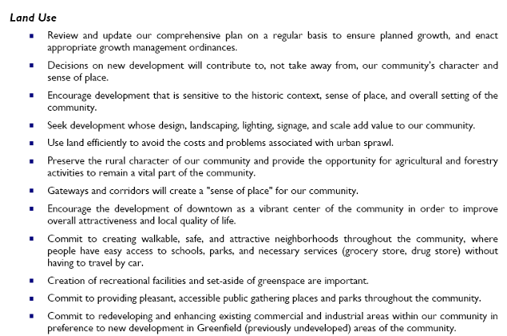
Community Policies: Good Example
**From Whitfield County

Slide 22
Character Areas
FROM THE RULES
‘Character Area’ means a specific geographic area or district within the community that:
has unique or special characteristics to be preserved or enhanced (such as a downtown, a historic district, and arts district, a neighborhood, or a transportation corridor);
has potential to evolve into a unique area with more intentional guidance of future development through adequate planning and implementation (such as a strip commercial corridor that could be revitalized into a more attractive village development pattern); or
requires special attention due to unique development issues (rapid change of development patterns, economic decline, etc.).
Each character area is a planning sub-area within the community where more detailed, small-area planning and implementation of certain policies, investments, incentives, or regulations may be applied in order to preserve, improve, or otherwise influence its future development patterns in a manner consistent with the Community Goals.

Slide 23
The Character Area Map
FROM THE RULES
Character Areas Map and Defining Narrative. Identify and map the boundaries of existing or potential character areas (see definition in Chapter 110-12-1-.05) covering the entire community, including existing community sub-areas, districts, or neighborhoods. …Community improvement districts, tax allocation districts, Livable Centers Initiative planning areas, designated redevelopment areas and the like are good candidates for delineation as character areas.

Slide 24
The Character Area Map
It’s a map—it should reflect basic, cartographic, common sense
No blank spots,
Map & Legend should match,
Map and Text (Defining Narrative) should match.
At a high enough resolution to be easily read, not blurry
*A properly oriented North-arrow is always handy
A high-quality map can do more than simply illustrate boundaries . . .

Slide 25
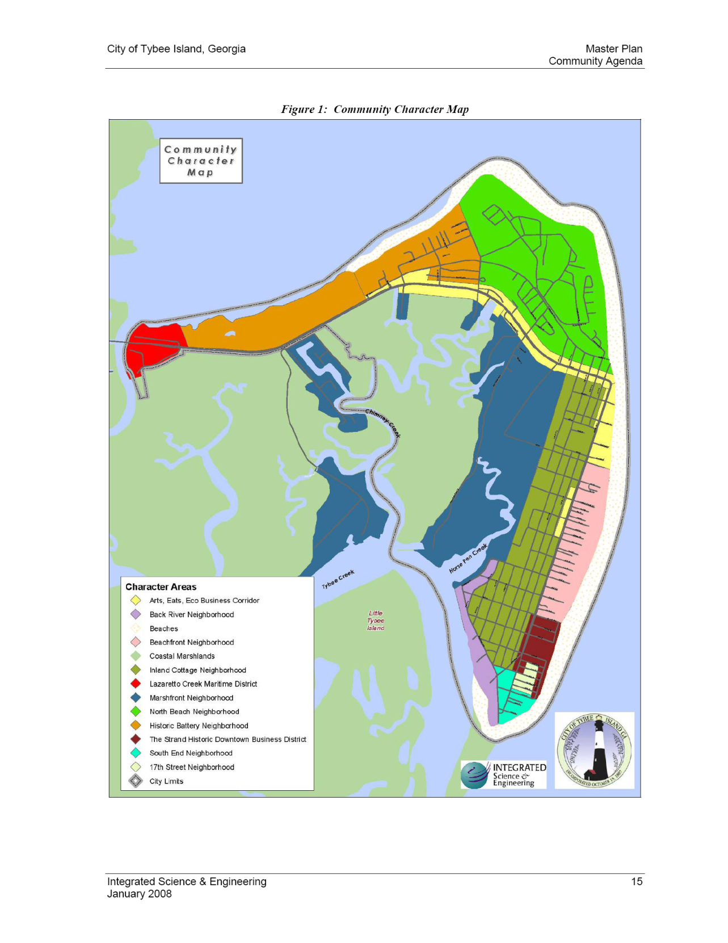
Character Area Maps Good Examples
**From the City of Tybee Island

Slide 26
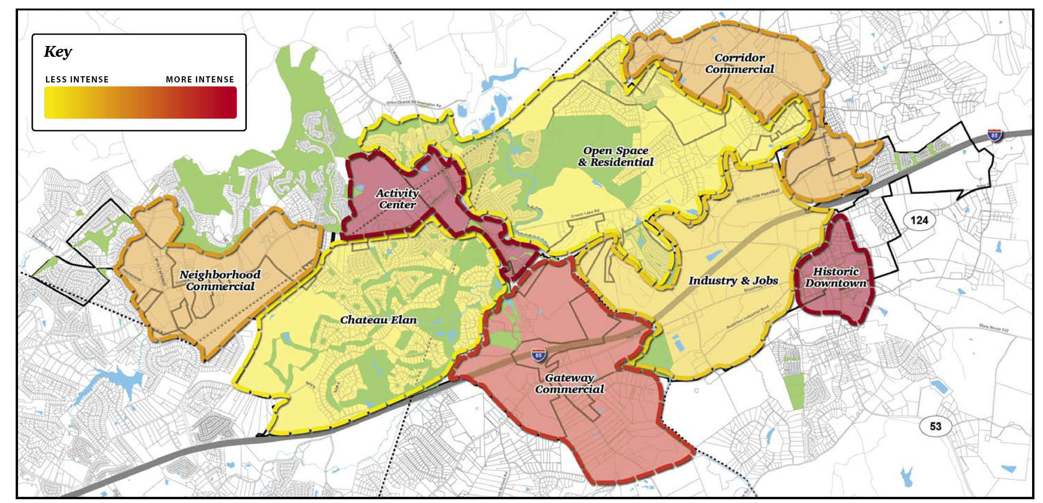
**From the Town of Braselton
Character Area Maps Good Examples

Slide 27
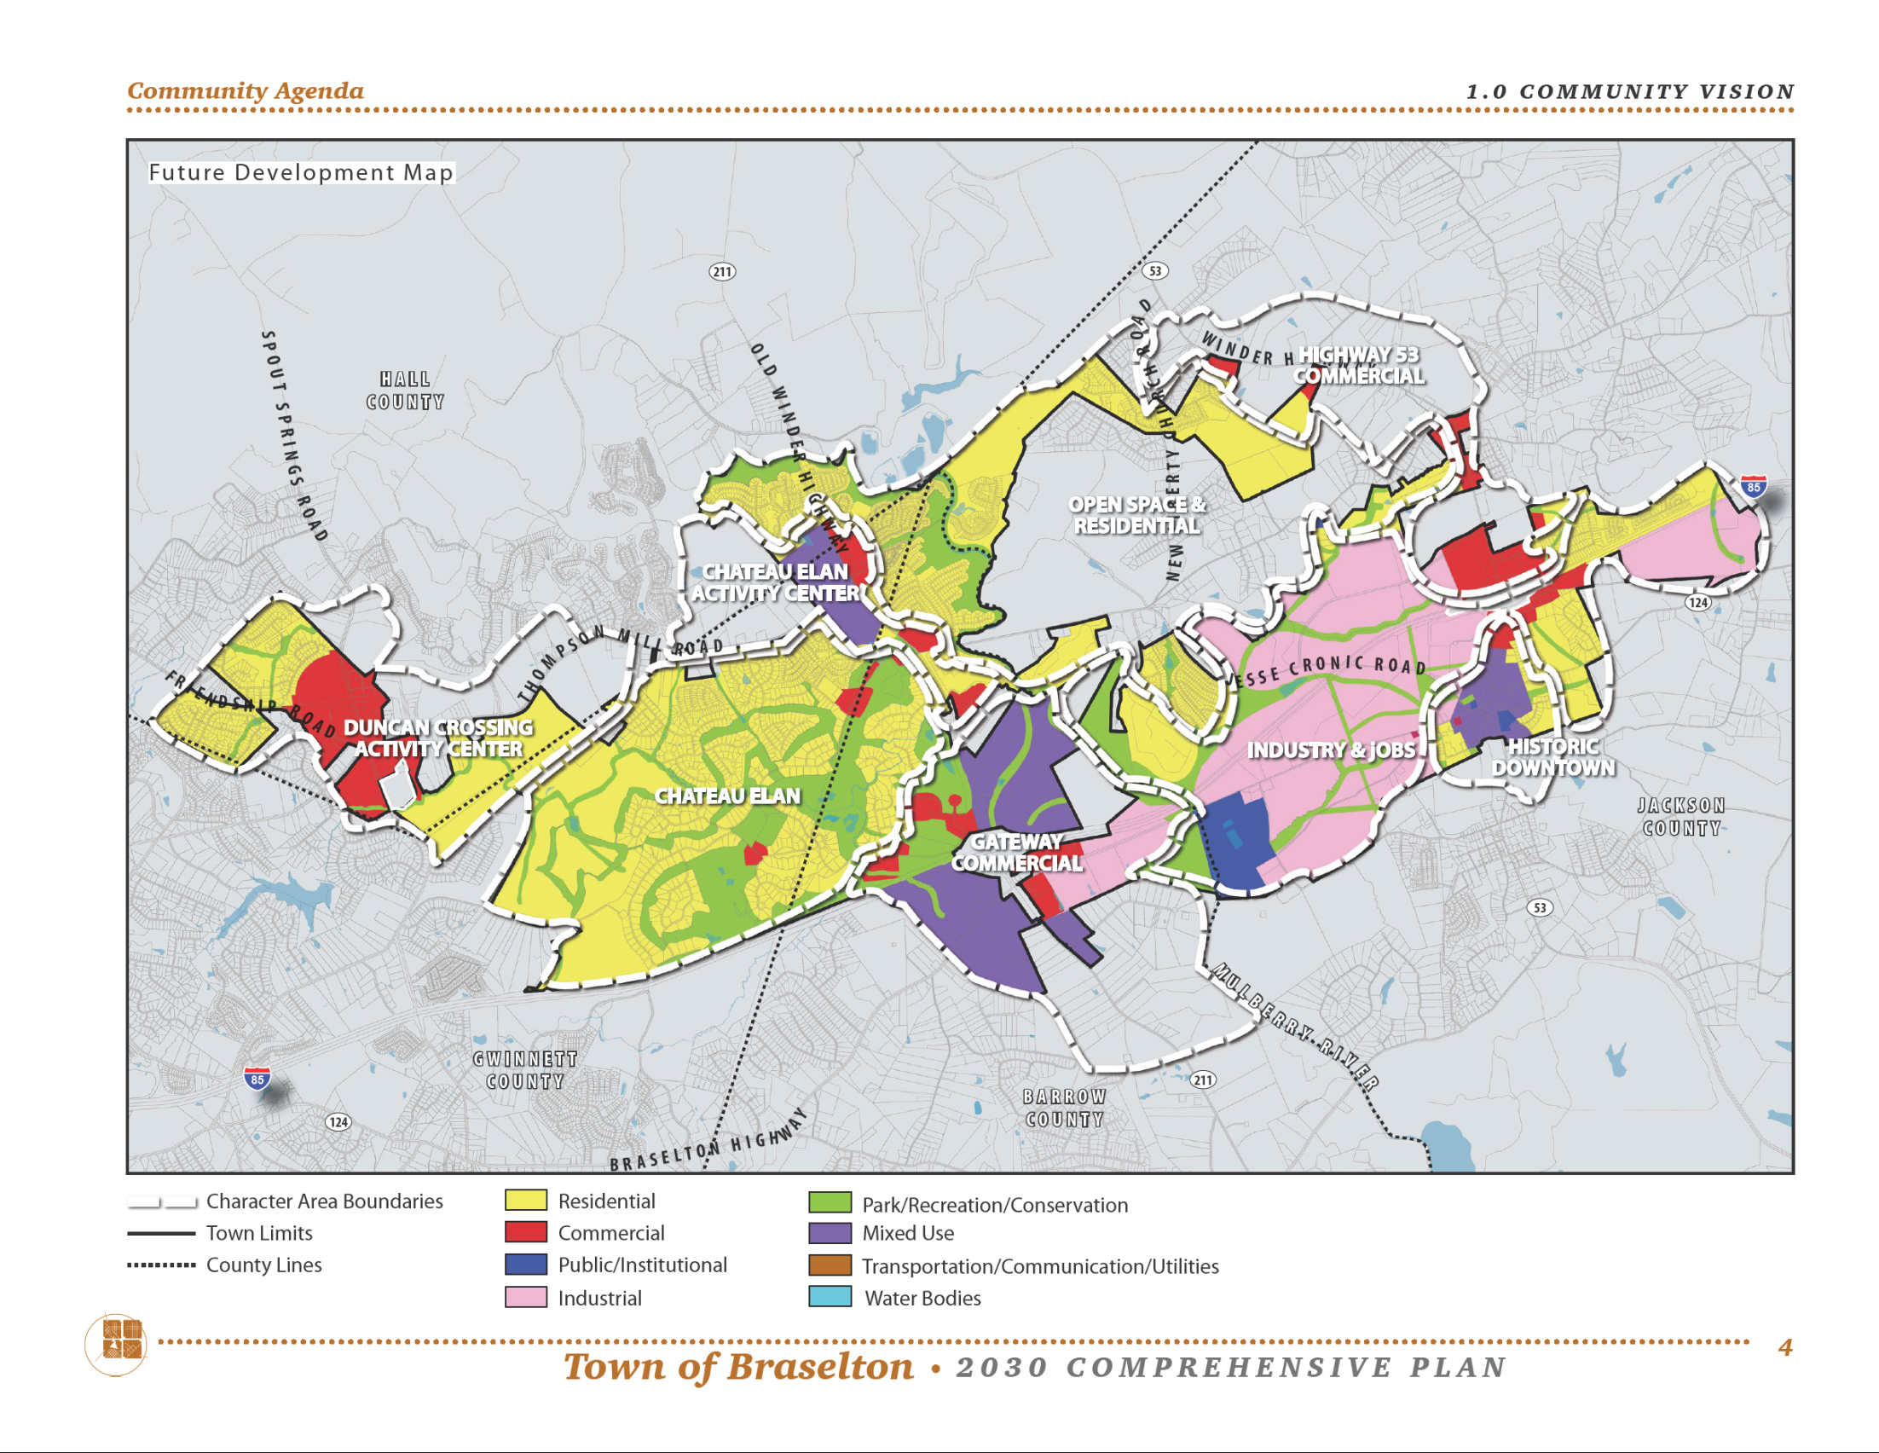
**From the Town of Braselton
Character Area Maps Good Examples
Final Draft

Slide 28
Character Area Defining Narrative
Detailed discussion of EACH character area presented on the map
Required to Include
Basic description with text and Illustrations/photos/etc.
Allowable land uses
Implementation measures
Notes:
The rules actually have too many words for a slide. I’ve distilled them, here.
For each identified character area, carefully define a specific vision or plan that includes the following information:
Written description and pictures or illustrations that make it clear what types, forms, styles, and patterns of development are to be encouraged in the area. Refer to recommended development patterns listed in the Supplemental Planning Recommendations for suggestions.
Listing of specific land uses and/or (if appropriate for the jurisdiction) zoning categories to be allowed in the area.
Identification of implementation measures to achieve the desired development patterns for the area, including more detailed sub-area planning, new or revised local development regulations, incentives, public investments, and infrastructure improvements. Refer to recommended plan implementation measures listed in the Supplemental Planning Recommendations for suggestions.

Slide 29
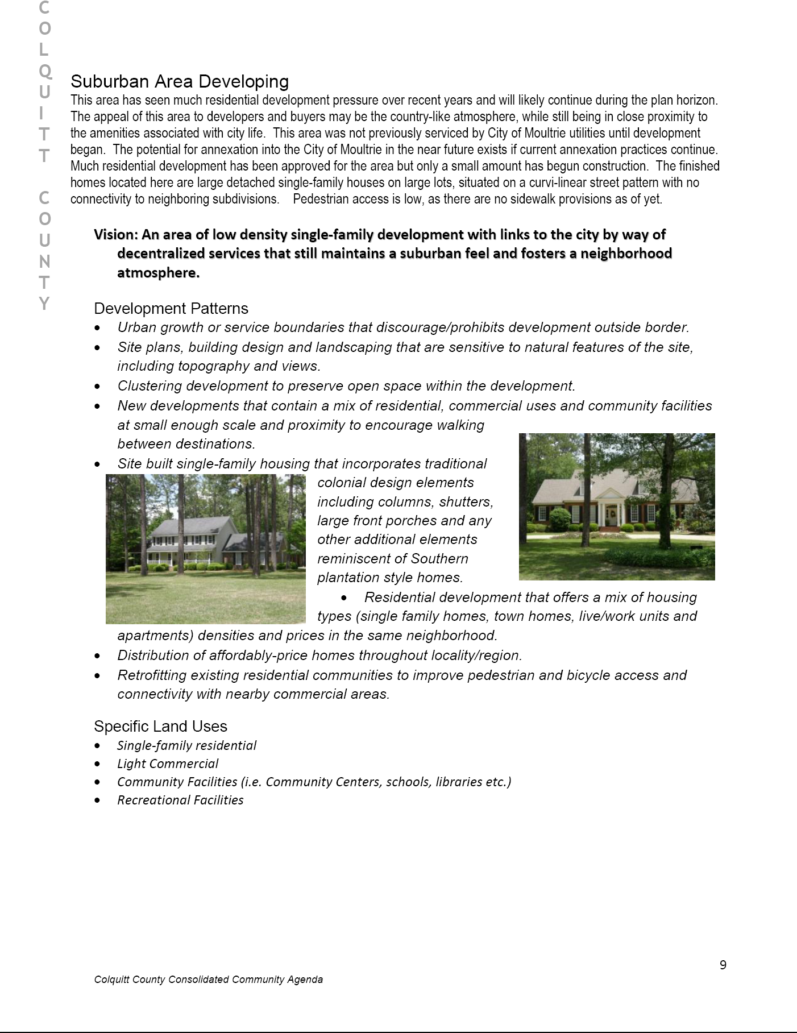
**From Colquitt County
Defining Narrative Good Example

Slide 30
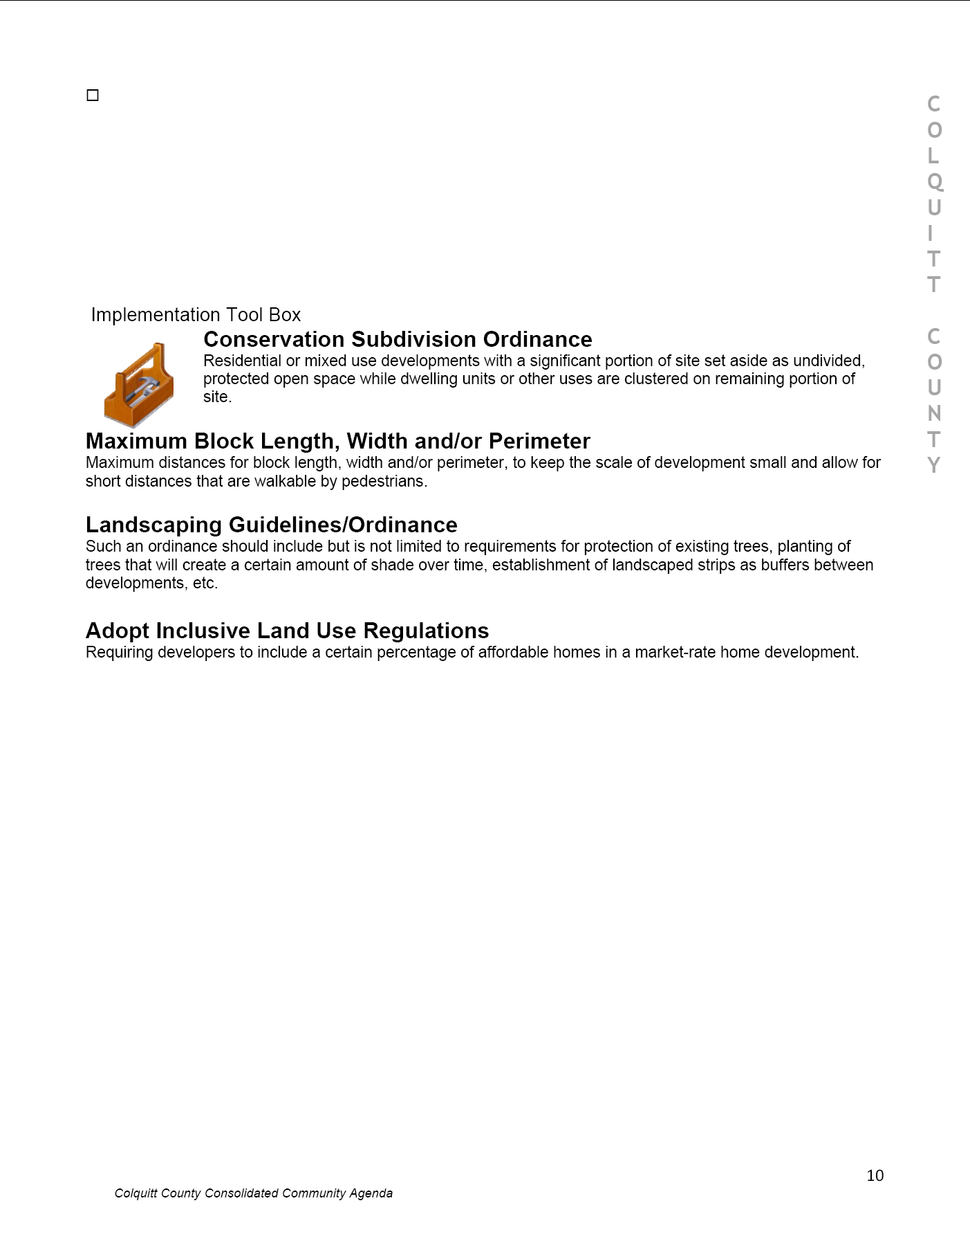
Defining Narrative Good Example
**From Colquitt County

Slide 31
Standards & Examples
REQUIRED
for all
NEEDS &
OPPORTUNITIES
BROADBAND SERVICES ELEMENT
COMMUNITY
WORK PROGRAM
COMMUNITY
GOALS
NEEDS &
OPPORTUNITIES
REQUIRED FOR ALL communities
Update EVERY 5 YEARS with in-depth community involvement
Previous plan’s Needs & Opportunities, current statistical and demographic data, and the QCOs are typically used as starting points.
Like a SWOT Analysis.
Notes:
Explain graphic (required for all, required for some, always optional)
Briefly describe what each plan element is about – more depth for the required elements, very brief for the optional elements.
31

Slide 32
Needs and Opportunities
FROM THE RULES
Needs and Opportunities. (Required for all local governments, updates required every five years.) … locally agreed upon list of Needs and Opportunities the community intends to address. …The list must be developed by involving community stakeholders in carrying out a SWOT (strengths, weaknesses, opportunities, threats) or similar analysis of the community.
Notes:
ADDITIONALLY: The community may prioritize this list, in which case “high-priority items” can line up with very specific activities listed, later, in the Community Work Program.

Slide 33
SWOT Strengths
Consider this from the community’s point of view. Involve the citizens and organizations that make up your community. Don't be modest. Be realistic.
What are your advantages?
What do you do well?
What relevant resources are available to you?
What do other people see as your strengths?

Slide 34
SWOT Weaknesses
Consider these questions from internal and external viewpoints: Do other people/organizations seem to perceive weaknesses that you do not see? Are other communities doing better than you? It is best to be realistic now, and face any unpleasant truths as soon as possible.
What could your community improve?
What do you do poorly?
What should you avoid?

Slide 35
SWOT Opportunities
Look at your strengths and ask yourself whether these open up any opportunities. Alternatively, look at your weaknesses and ask yourself whether you could open up opportunities by eliminating them.
Where are the positive opportunities for your community?
What are the promising trends?
Useful opportunities can come from such things as:
Changes in technology and markets on both broad and narrow scales
Changes in government policy
Changes in social patterns, population profiles, life styles, etc.
Local conditions

Slide 36
SWOT Threats
Carrying out this analysis will often be illuminating - both in terms of pointing out what needs to be done, and in putting problems into perspective.
What obstacles do you face?
Are the threats facing your community undergoing change (more or less threatening)?
Is changing technology threatening your position?
Could any of your weaknesses seriously threaten your community?

Slide 37
Needs and Opportunities
Should be comprehensive
A simple list is common and totally acceptable—but some are more creative
It should make sense for the community
NOT a “to-do” list (that comes later)

Slide 38
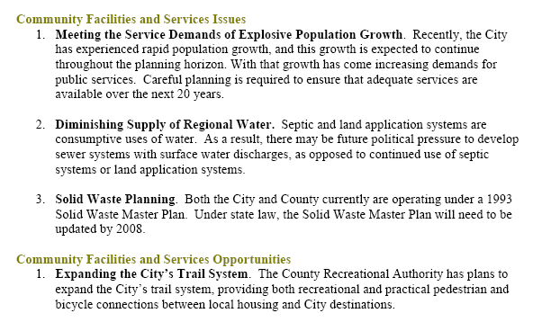
Needs and Opportunities Good Example
**From the City of Covington
Good Example (City of Covington)

Slide 39
Needs and Opportunities Other Techniques…
Identify observed trends or events then explain the specific needs and opportunities that may result. For example:
TREND→ Eleven percent increase in retired population since the last census.
NEEDS: ~Increased access to medical services
~Greater variety in senior-oriented recreational activities
OPPORTUNITIES: ~Expanded volunteer base for local nonprofits
~More potential daytime “neighborhood watch” members

Slide 40
Standards & Examples
REQUIRED
for all
BROADBAND SERVICES ELEMENT
COMMUNITY
GOALS
NEEDS &
OPPORTUNITIES
BROADBAND SERVICES ELEMENT
COMMUNITY
WORK PROGRAM
REQUIRED FOR ALL communities
Updates at the discretion of local government
Can be very simple, some work has already been done
Notes:
Explain graphic (required for all, required for some, always optional)
Briefly describe what each plan element is about – more depth for the required elements, very brief for the optional elements.
40

Slide 41
Achieving Connectivity Everywhere

Slide 42
Achieving Connectivity Everywhere
2017’s Achieving Connectivity Everywhere (ACE) Act. Established a framework for expanding broadband internet access throughout the state.
Georgia’s communities and its citizens will not be able to thrive in the future without access to broadband internet service. Citizens without access are likely to face significant hardship.
Access to reliable, affordable broadband internet service is critical to public health, safety, and welfare.
The internet is now the primary tool used by citizens to access goods, services, and information (and the primary tool used by providers to deliver those goods, services, and information)
This the not unlike rural electrification efforts in the early 21st Century.

Slide 43
Broadband Services Element
FROM THE RULES
Broadband Services Element. (Required for all local governments, updates at local discretion.) …an action plan for the promotion of the deployment of broadband services by broadband service providers into unserved areas within its jurisdiction. The action plan must describe steps for the promotion of reasonable and cost-effective access to broadband to parts of the local government's jurisdiction designated by the Department as unserved areas. The local action plan required pursuant to this element may include, but shall not be limited to, any assessments, studies, ordinances, and/or goals to achieve certification as a Broadband Ready Community or designation of facilities and developments as Georgia Broadband Ready Community Sites. Each local comprehensive plan should contemplate and seek to implement this element in a manner which stresses the importance of broadband deployment across this state, and that broadband services should be considered as important as other necessary utilities.

Slide 44
Broadband Services Element
Examples (“Baby Steps”
Goal: Our citizens will have ready, reliable, and affordable access to broadband internet service.
Need/Opportunity: Citizens in a number of areas in our community are unable to take advantage of a variety of goods, services, and information due to lack of access to broadband internet service.
Project/Activity: Review our development regulations to identify (and eliminate) unnecessary obstacles to the expansion of broadband internet infrastructure.

Slide 45
Standards & Examples
REQUIRED
for all
BROADBAND SERVICES ELEMENT
COMMUNITY
WORK PROGRAM
COMMUNITY
GOALS
NEEDS &
OPPORTUNITIES
COMMUNITY
WORK PROGRAM
REQUIRED FOR ALL communities
Update EVERY 5 YEARS with in-depth community involvement.
A Report of Accomplishments and a new Five-Year Work Program.
Report of Accomplishments = Status Report
Work Program = “To Do” List
Use previous Work Program as a starting point.
Notes:
Explain graphic (required for all, required for some, always optional)
Briefly describe what each plan element is about – more depth for the required elements, very brief for the optional elements.
45

Slide 46
Planning as Priority-Setting
Long Term Immediate
Plans deal with both the immediate and the long term but pull it all together in the Work Program
Community Goals
Needs & Opportunities
Community Work Program

Slide 47
Community Work Program
FROM THE RULES
Community Work Program. (Required for all local governments, updates required every five years.) …the specific activities the community plans to undertake during the next five years …This includes any activities, initiatives, programs, ordinances, administrative systems …(Note that general policy statements should not be included in the Community Work Program, but instead should be included in the Policies section of the Community Goals.) …

Slide 48
Community Work Program
FROM THE RULES, cont’d.
The Community Work Program must include the following information for each listed activity:
Brief description of the activity;
Legal authorization for the activity, if applicable;
Timeframe for initiating and completing the activity;
Responsible party for implementing the activity;
Estimated cost (if any) of implementing the activity; and
Funding source(s), if applicable.

Slide 49
Community Work Program
Focuses both on the projects that will incrementally move you toward your vision over the long-term—AND– the projects that are necessary to meet the community’s immediate needs
This is simple. There’s a basic template that most communities use—it’s just a matter of filling in blanks.
This is the place where you will find specific projects/activities. Hopefully it avoids inclusion of “projects” that begin with words like “encourage”, “promote” and “consider.”
No clear responsible party, cost estimate, funding source, and/or start and end dates →Probably a policy statement or a non-specific project that shouldn’t have been included in the CWP

Slide 50
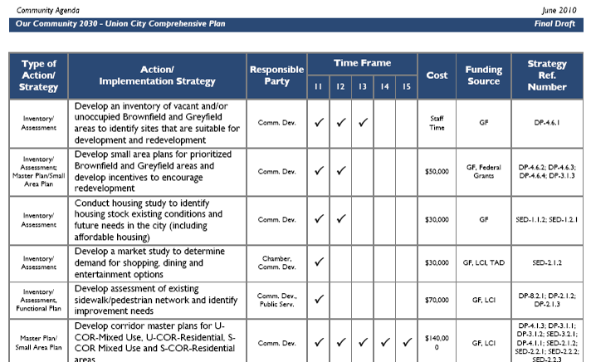
Community Work Program Good Example
**From the City of Union City

Slide 51
Community Work Program Other Ideas…
**From the City of Union City
Description | Responsible Party | 2014 | 2015 | 2016 | 2017 | 2018 | Reference
Install Trees in Historic District (authority: 2011 Street Enhancement Program, adopted 10/10/2011) | PWks, Cdev, Hist |  | 10 Trees/year, 3, years, $150/per tree; $4500 total |  |  |  | Goals: 1-3 Pols: 3a, 4b N/O: 13-15
Construct New City Hall (authority: CIE / Impact Fee Program, adopted 04/05/2012) | See below | Max = $1.55M |  |  |  |  | Goals: 5 Pols: 3b-f, 8a-b N/O: 4, 5-7, 16, 21
Property Acquisition | Commission, Fin | $300
Design | Consultant TBD, Cdev, Hist | ~$100K
Build | Consultant TBD, Wks, Cdev |  |  | ~$1.15M
Buffer / Contingency | As needed |  |  |  |  | X

Slide 52
Community Work Program Report of Accomplishments
A Report on the status of all the projects that were included in the previous work program
It looks just like an STWP. Addition of columns for “Completed”, “In-Progress”, “Postponed”, “Not Accomplished/Cancelled” Try to use the standard terms:
Completed = the project is finished, the program is established
Ongoing = the project is started, work to complete it will continue
Postponed = work did not start at the expected time, but will in the future
Not Accomplished = cancelled, will not be carried forward
Any item noted “Postponed/Cancelled” should include an explanation
Anything “In-Progress” or “Postponed” should also be carried over into the new Work Program. Items postponed beyond five years are sometimes added in a new section for “Long-Term Projects”.

Slide 53
Menu of Plan Elements
REQUIRED
for all
COMMUNITY
GOALS
NEEDS &
OPPORTUNITIES
COMMUNITY
WORK PROGRAM
REQUIRED for some communities
CAPITAL IMPROVEMENTS ELEMENT
LAND USE
ECONOMIC DEVELOP-MENT
TRANSPOR-
TATION
HOUSING
OPTIONAL
elements
TARGET AREAS
PUBLIC SAFETY
GREENSPACE
EDUCATION
RECREATION
HUMAN SVCS
NATURAL RESOURCES
INTER-GOVERNMENT
COORDINAT’N
SOLID WASTE
MANAGE-MENT
INFRA-STRUCTURE & FACILITIES
COMMUNITY
SUSTAIN-ABILITY
HISTORIC & CULTURAL RESOURCES
DISASTER RESILIENCE
Notes:
Explain graphic (required for all, required for some, always optional)
Briefly describe what each plan element is about – more depth for the required elements, very brief for the optional elements.
53

Slide 54
Standards & Examples
REQUIRED for some communities
CAPITAL IMPROVEMENTS ELEMENT
LAND
USE
ECONOMIC DEVELOPMENT
TRANSPORT-ATION
HOUSING
Notes:
Explain graphic (required for all, required for some, always optional)
Briefly describe what each plan element is about – more depth for the required elements, very brief for the optional elements.
54

Slide 55
Standards & Examples
REQUIRED for qualifying communities
CAPITAL IMPROVEMENTS ELEMENT
LAND
USE
ECONOMIC DEVELOPMENT
TRANSPORT-ATION
HOUSING
REQUIRED FOR SOME: communities charging impact fees
Updates required annually. SEPARATE RULES provide more detailed guidance.
Notes:
Explain graphic (required for all, required for some, always optional)
Briefly describe what each plan element is about – more depth for the required elements, very brief for the optional elements.
55

Slide 56
Standards & Examples
REQUIRED for qualifying communities
LAND USE ELEMENT
CAPITAL IMPROVEMENTS ELEMENT
ECONOMIC DEVELOPMENT
TRANSPORT-ATION
HOUSING
REQUIRED FOR SOME: communities with zoning and similar development regs
Updated every Five Years
Options:
Traditional Land Use Map, and/or
Character Area Map & Defining Narrative
 (also satisfies requirement for Community Goals element)
Notes:
Explain graphic (required for all, required for some, always optional)
Briefly describe what each plan element is about – more depth for the required elements, very brief for the optional elements.
56

Slide 57
Land-Use Map & Narrative
No blank spots—entire community covered
Parcel-specific
May use insets to provide better detail in dense areas
A properly oriented North Arrow always helps
Narrative simply explains what each land-use category is within the context of your community

Slide 58
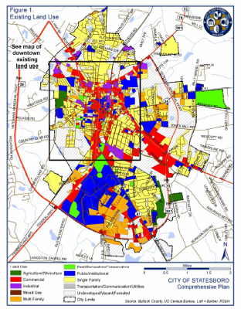
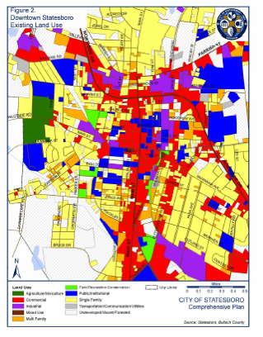
Land-Use Map Good Example
**From the City of Statesboro

Slide 59
Standards & Examples
REQUIRED for some communities
CAPITAL IMPROVEMENTS ELEMENT
LAND
USE
ECONOMIC DEVELOPMENT
TRANSPORT-ATION
HOUSING
Notes:
Explain graphic (required for all, required for some, always optional)
Briefly describe what each plan element is about – more depth for the required elements, very brief for the optional elements.
59

Slide 60
Standards & Examples
REQUIRED for some communities
CAPITAL IMPROVEMENTS ELEMENT
LAND
USE
ECONOMIC DEVELOPMENT
TRANSPORT-ATION
HOUSING
These three have additional analytical requirements—specific items that must be considered when planning
Work draws from previous planning efforts and existing plans:
CEDSs
MPO Transportation Plans
Consolidated Plans
The priorities from these plans are extracted and built into the comp plan into the appropriate sections of the comp plan (like the Broadband Services Element)
Updated when the underlying plan has changed since the last Comp Plan Update

Slide 61
Standards & Examples
REQUIRED for qualifying communities
ECONOMIC DEVELOPMENT ELEMENT
CAPITAL IMPROVEMENTS ELEMENT
LAND
USE
TRANSPORT-ATION
HOUSING
REQUIRED for communities in Job Tax Credit Tier 1
Notes:
Explain graphic (required for all, required for some, always optional)
Briefly describe what each plan element is about – more depth for the required elements, very brief for the optional elements.
61

Slide 62
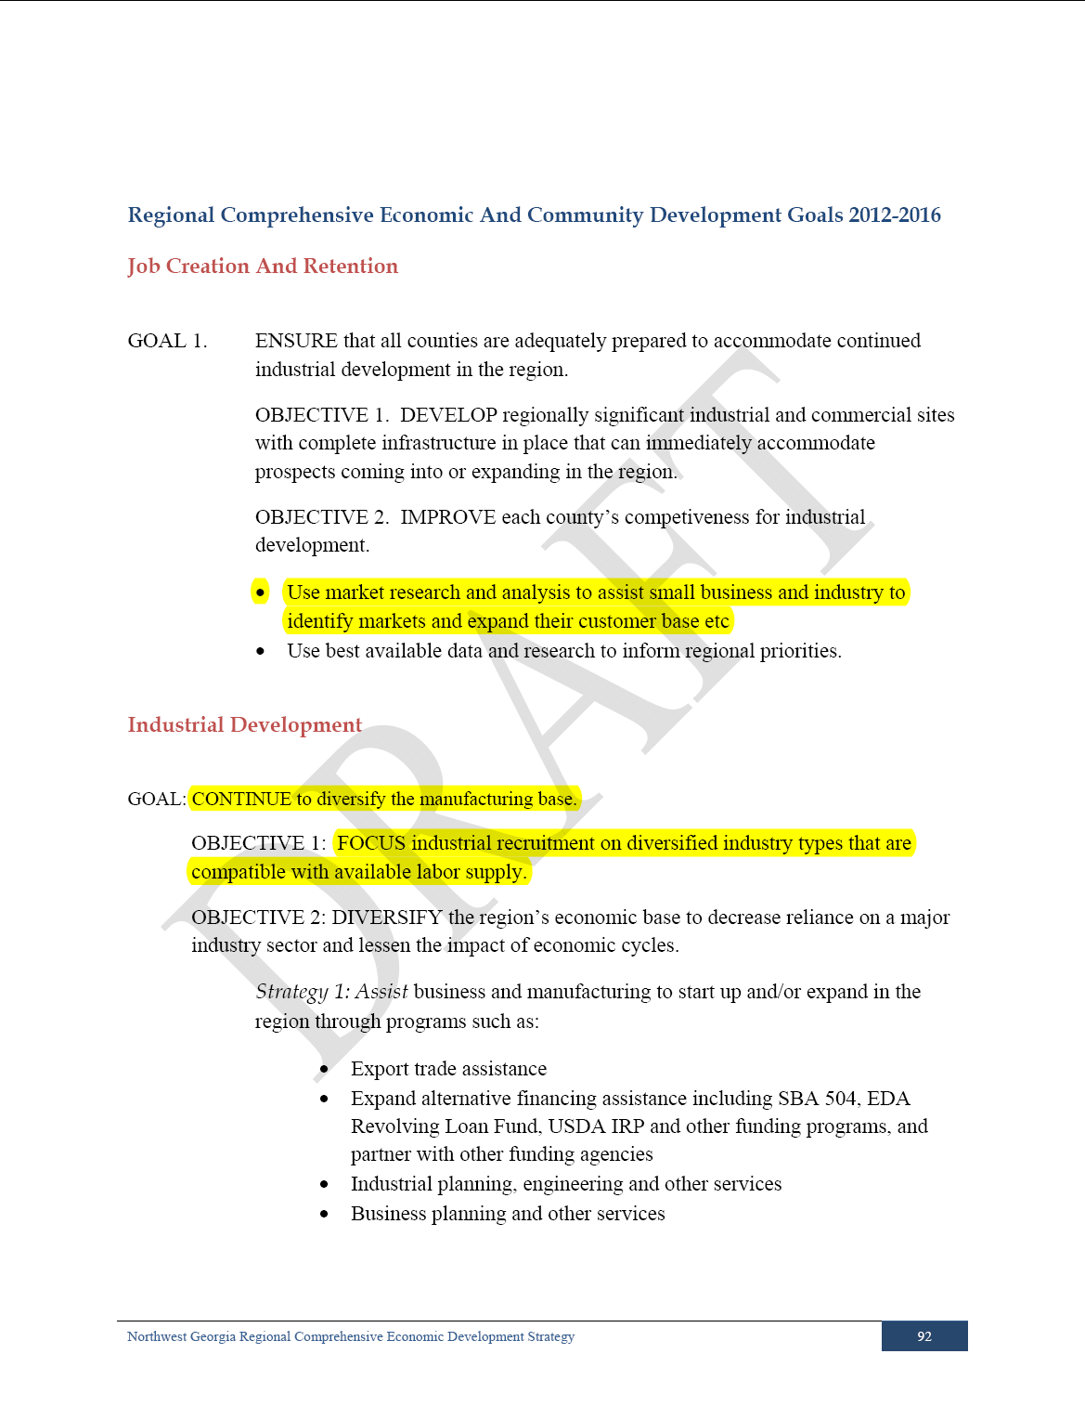
Economic Development
**From the NWGRC CEDS
High-Priority items from stand-alone Economic Development Plan are pulled into the Comprehensive Plan.
Goals & Policies→

Slide 63
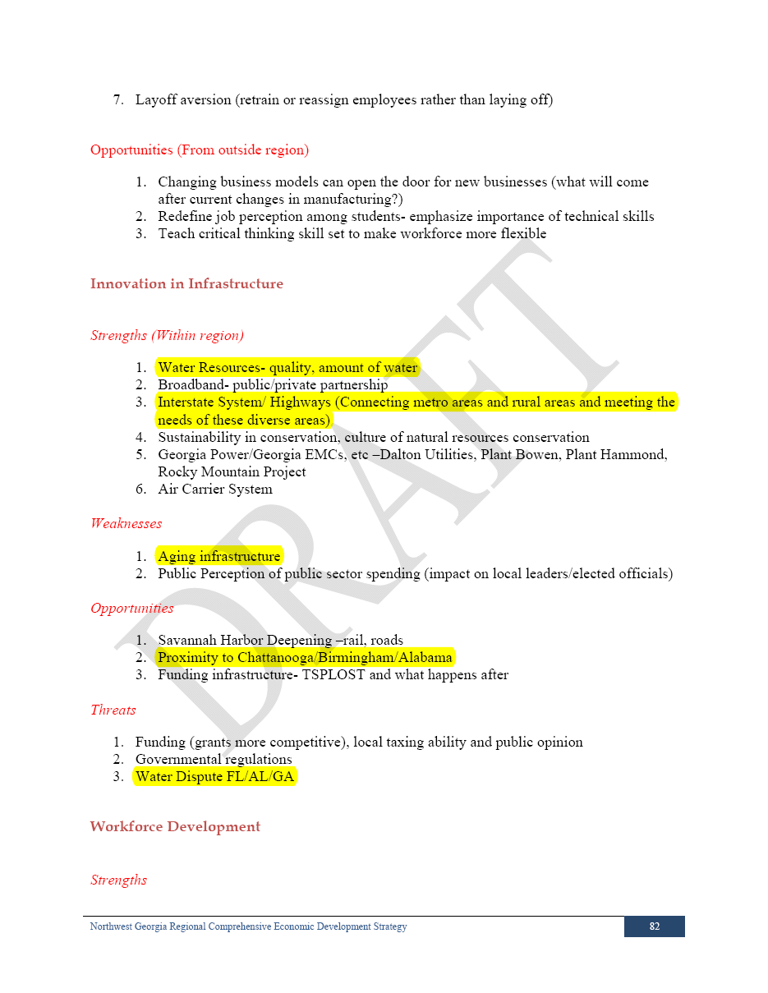
Economic Development
**From the NWGRC CEDS
High-Priority items from stand-alone Economic Development Plan are pulled into the Comprehensive Plan.
Needs & Opportunities →

Slide 64
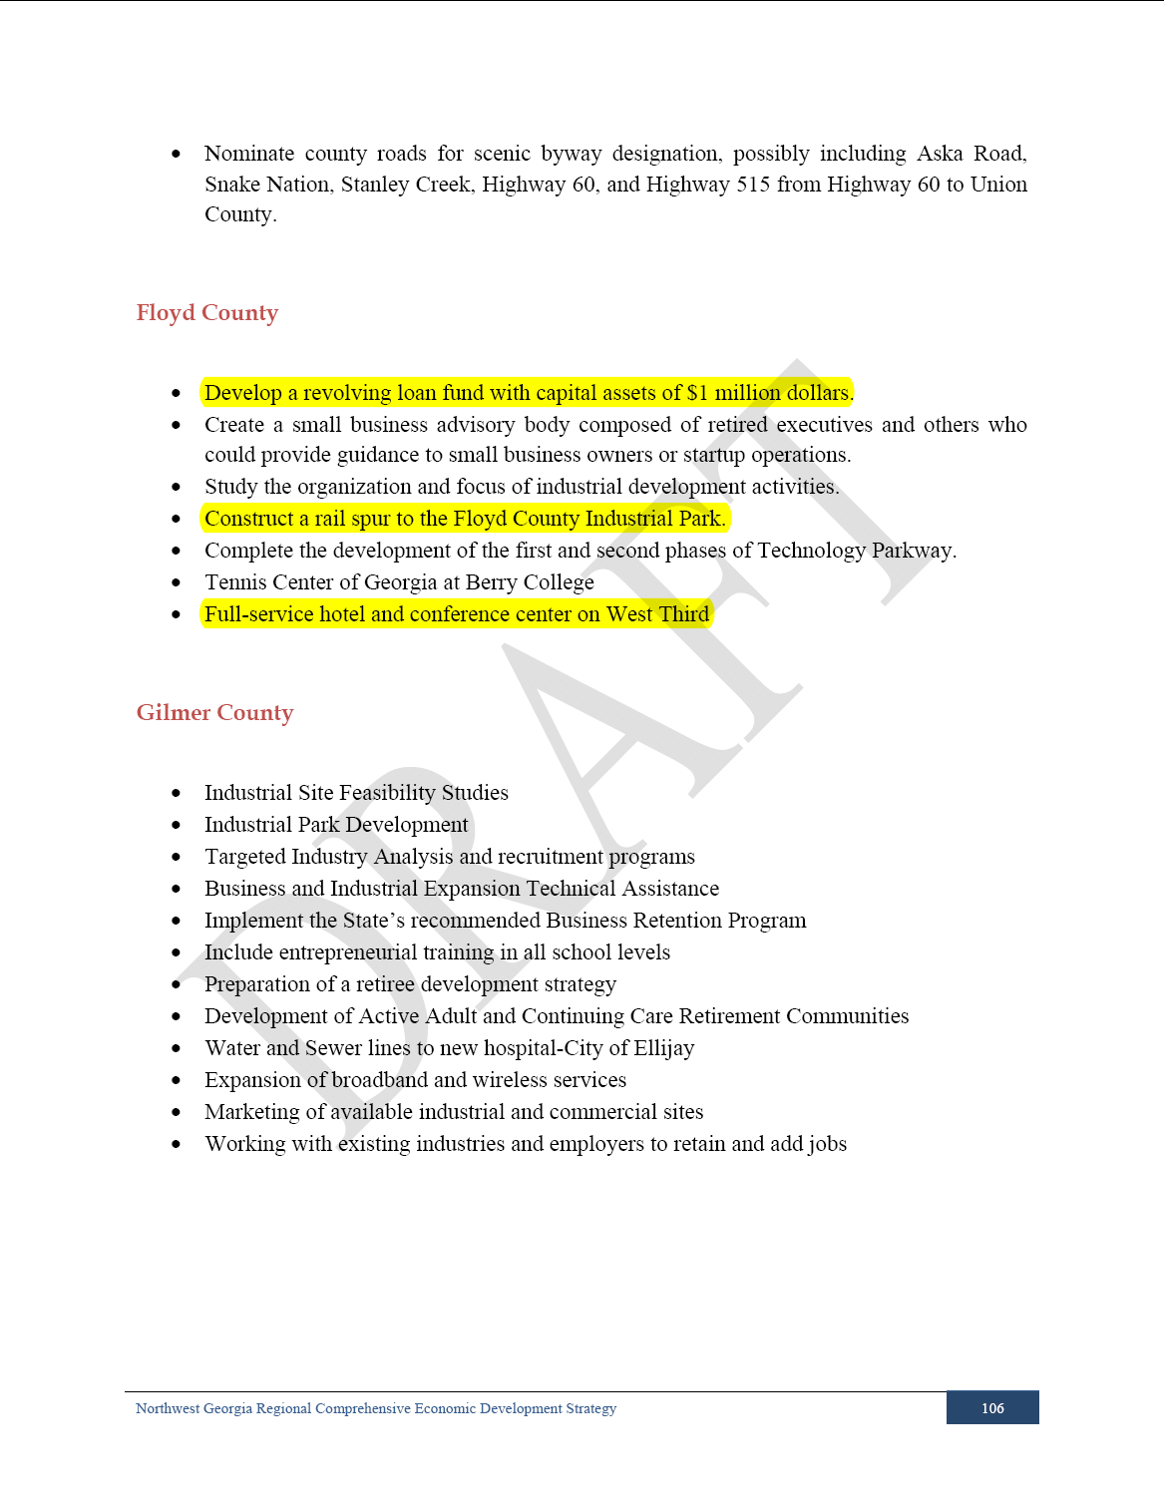
Economic Development
**From the NWGRC CEDS
High-Priority items from stand-alone Economic Development Plan are pulled into the Comprehensive Plan.
Specific Projects→

Slide 65
Standards & Examples
REQUIRED for qualifying communities
TRANSPORTATION ELEMENT
ECONOMIC DEVELOPMENT
LAND
USE
HOUSING
REQUIRED for communities in an MPO
Notes:
Explain graphic (required for all, required for some, always optional)
Briefly describe what each plan element is about – more depth for the required elements, very brief for the optional elements.
65

Slide 66
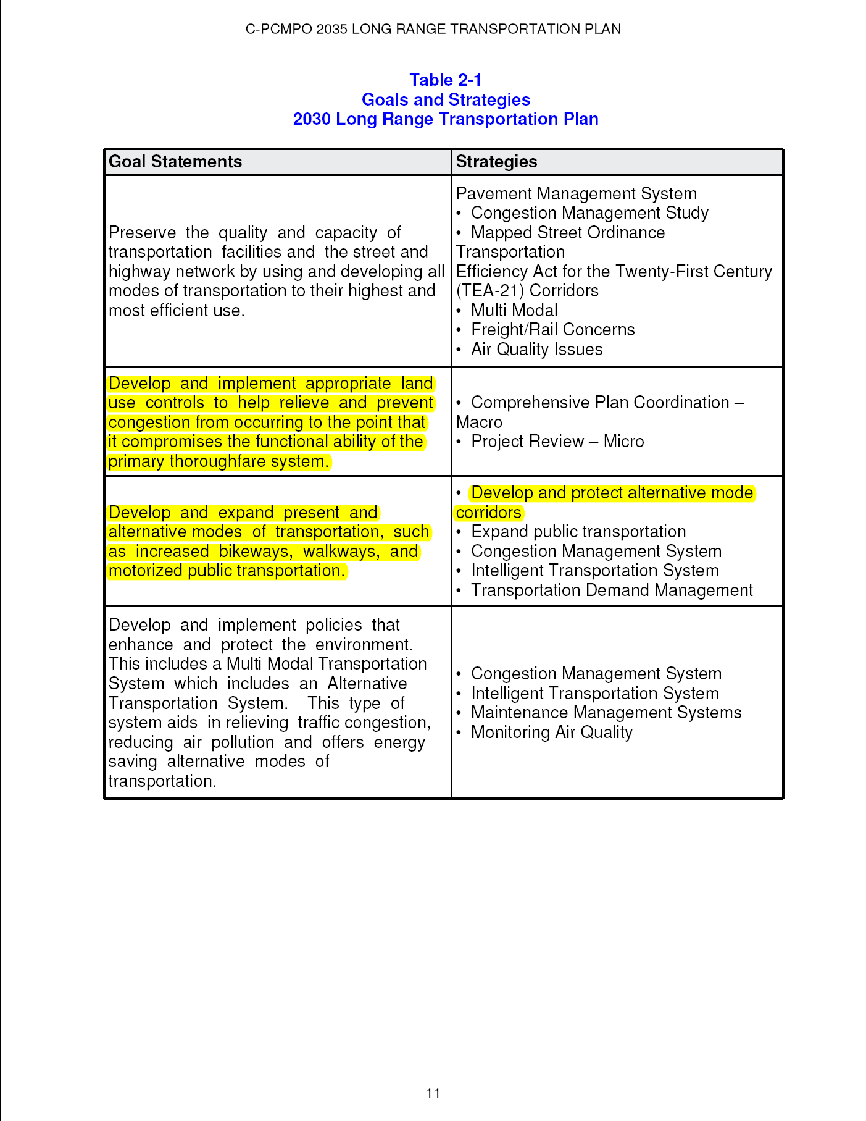
Transportation
**From the Columbus-Phenix City Long Range Transportation Plan
High-Priority items from stand-alone Regional Transportation Plan are pulled into the Comprehensive Plan.
Goals & Policies→

Slide 67
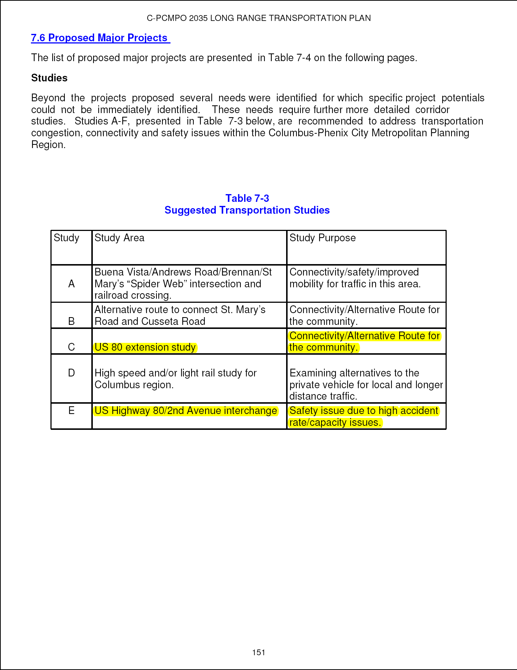
Transportation
**From the Columbus-Phenix City Long Range Transportation Plan
High-Priority items from stand-alone Regional Transportation Plan are pulled into the Comprehensive Plan.
Specific Projects→

Slide 68
Standards & Examples
REQUIRED for qualifying communities
HOUSING ELEMENT
CAPITAL IMPROVEMENTS ELEMENT
ECONOMIC DEVELOPMENT
LAND
USE
TRANSPORT-ATION
REQUIRED for HUD Entitlement communities
Notes:
Explain graphic (required for all, required for some, always optional)
Briefly describe what each plan element is about – more depth for the required elements, very brief for the optional elements.
68

Slide 69
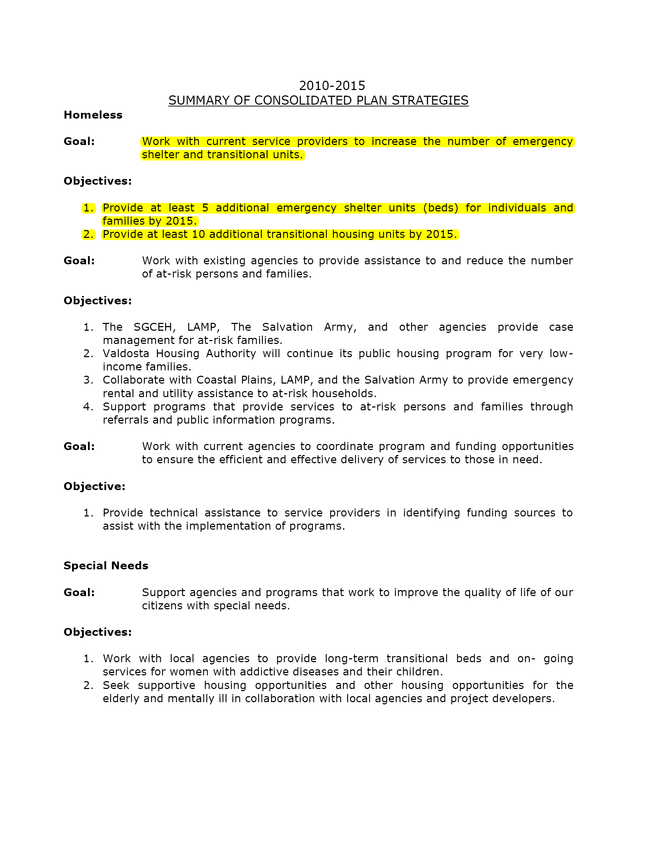
Housing
**From the City of Valdosta Consolidated Plan
High-Priority items from stand-alone Local Consolidated Plan are pulled into the Comprehensive Plan.
Goals, Policies, Specific Projects→

Slide 70
Menu of Plan Elements
REQUIRED
for all
COMMUNITY
GOALS
NEEDS &
OPPORTUNITIES
BROADBAND SERVICES ELEMENT
COMMUNITY
WORK PROGRAM
REQUIRED for some communities
CAPITAL IMPROVEMENTS ELEMENT
ECONOMIC DEVELOP-MENT
LAND USE
TRANSPOR-
TATION
HOUSING
OPTIONAL
elements
TARGET AREAS
PUBLIC SAFETY
GREENSPACE
EDUCATION
RECREATION
HUMAN SVCS
NATURAL RESOURCES
INTER-GOVERNMENT
COORDINAT’N
SOLID WASTE
MANAGE-MENT
INFRA-STRUCTURE & FACILITIES
COMMUNITY
SUSTAIN-ABILITY
HISTORIC & CULTURAL RESOURCES
DISASTER RESILIENCE
Notes:
Explain graphic (required for all, required for some, always optional)
Briefly describe what each plan element is about – more depth for the required elements, very brief for the optional elements.
70

Slide 71
Optional Elements
Any of the 5 “Required for Some” elements may have been used as “Optional” elements in building your plan
The same approach used to incorporate transportation, housing, and economic development plans can be used for all of your other free-standing plans, as well. Greenspace Plans, Rec Plans, Hazard Mitigation Plans, LCIs, Water/Sewer Plans, etc.
If you don’t have a free-standing, special purpose plan, your next comprehensive plan update might be a good segue into that!

Slide 72
Then, What?
PlanFirst is DCA’s program to recognize and reward communities that clearly demonstrate an established pattern of successfully implementing their Local Comprehensive Plans.
Reputational Incentives
Statewide recognition for community achievement
Use of the PlanFirst logo
Highlighted on the PlanFirst webpage
PlanFirst plaque/trophy indicating dates of designation
Free slots for attendance at any Community Planning Institute event
Financial Incentives
Eligibility to apply for State CDBG funding every year rather than every other year
Employment Incentive Program, the Redevelopment Fund Program, and the Downtown Development Revolving Loan Fund Program
½ percent interest rate reduction in GEFA loans.

Slide 73
Like Potato Chips, You Can’t Have Just one
“A man has made at least a start on discovering the meaning of human life when he plants shade trees under which he knows full well he will never sit.”
Elton Trueblood, The Life We Prize
These plans are our shade trees.

Slide 74
QUESTIONS?

