Slide 1
Georgia
Planning & Financial Resources for
Affordable Housing

Slide 2
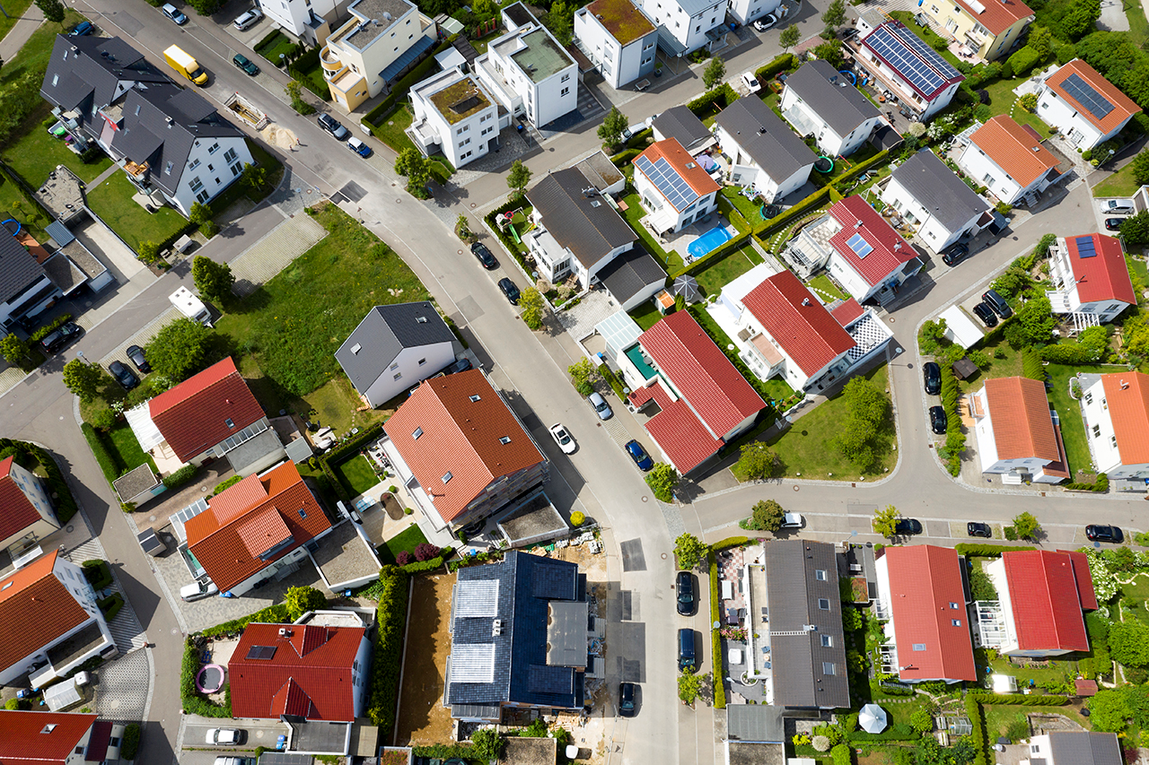
Why is Planning for Housing Important?

Slide 3
Housing is an
Economic Development Issue
Housing availability and affordability are essential in attracting new businesses
When workers spend more on housing, they spend less on goods and services in the local economy
Housing is a
Transportation Issue
Rising housing costs = longer commutes

Slide 4
2008 Housing Market Crisis
Homeowners lost $16 trillion in net worth
10 million people who lost their homes to foreclosure
2009-2020
Privately-owned housing starts dropped 60% in 2009 and recovered slowly during the 2010s.
Many small banks and construction companies left the market
65% of homeowners who lost their housing are still renting
Since the 2020 Pandemic
Home sales and construction froze, then migration (higher priced & denser markets to lower-priced markets)
The National Home Price Index increased 6.6% from November 2022 to November 2023.
HUD Fair Market Rents rose 24% in Georgia from 2019-2023
We’re short
138,000 homes in Georgia
Sources: Up For Growth | 2023 Housing Underproduction™ in the U.S. - Up For Growth; https://www.washingtonpost.com/news/business/wp/2018/10/04/feature/10-years-later-how-the-housing-market-has-changed-since-the-crash/; FHFA House Price Index | Federal Housing Finance Agency

Slide 5
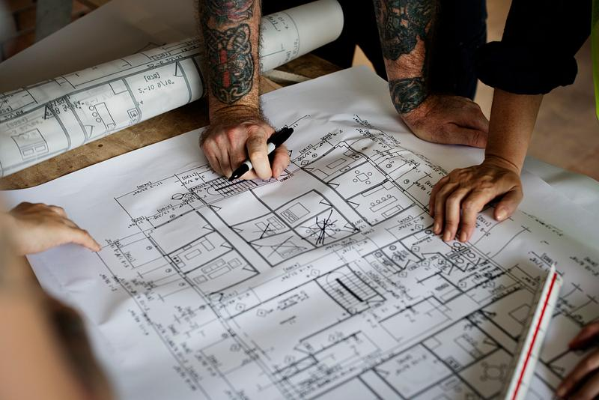
How do Planners Play a Role?
Land Use Planning
Transportation Planning
Zoning and Ordinances Decisions

Slide 6
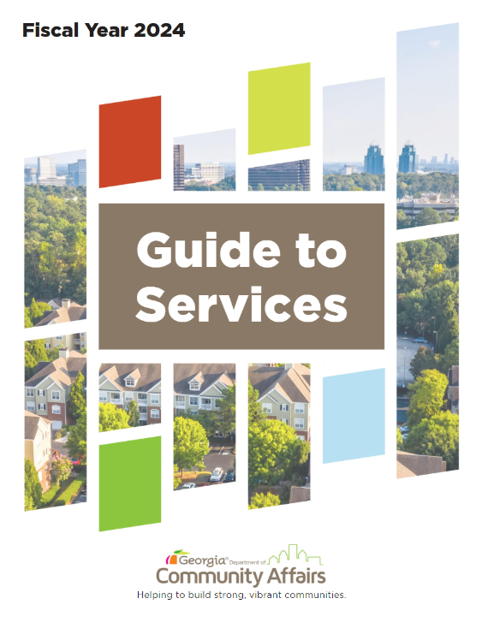
Georgia DCA Resources
60+ Programs
Local Reps in 12 GA Regions
Planning Resources for Local Governments
13 Affordable Housing Programs
26 Community & Economic Development Programs

Slide 7
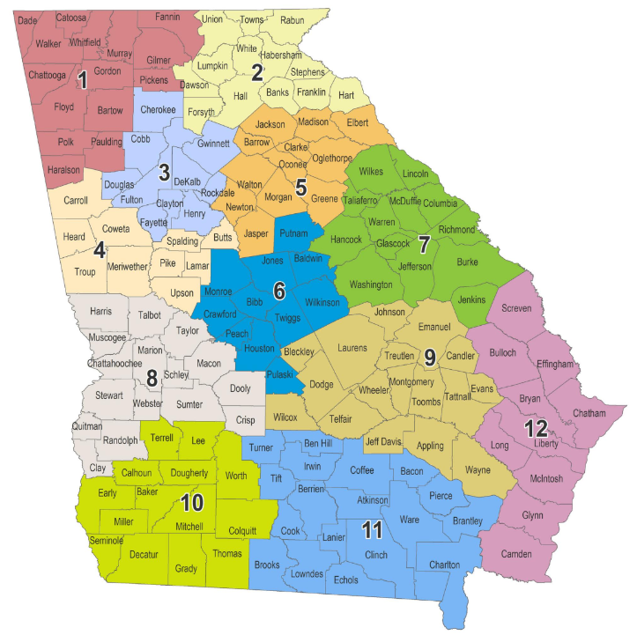
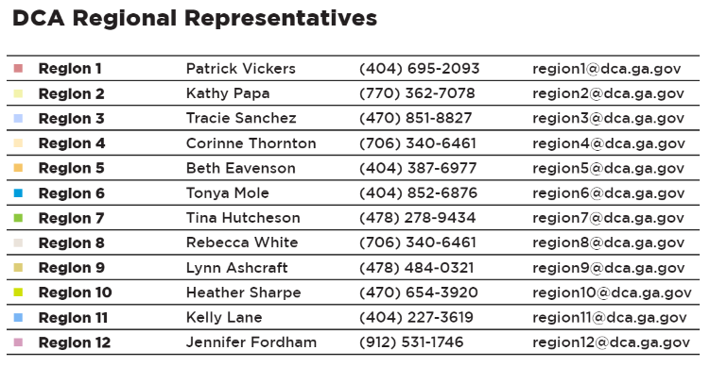
DCA Regional Representatives
Contact: Corinne Thornton, Director Corinne.Thornton@dca.ga.gov
706-340-6461

Slide 8
Planning
Resources for Affordable Housing

Slide 9
Housing Elements in Comprehensive Plan
Evaluate:
Current housing stock
(age, tenancy, affordability)
Need for new housing
Develop shared vision
View other communities plans here:
https://www.dca.ga.gov/node/2511/documents/2088
How many companies
are passing you up because you don’t have enough housing?

Slide 10
GA Housing Planning Resources
Create a Housing Market Study
DCA LIHTC Guide Link
Presentation on Planning & Zoning for Affordable Housing from DCA 2020 Fall Conference Link
Georgia Initiative for Community Housing (GICH)

Slide 11
GICH
Georgia Initiative for Community Housing

Slide 12
Homeownership Award Winner:
GICH
3-year program
2 retreats per year
5 teams are added annually
90+ communities have participated to date

Slide 13
GICH
Application Release | May 1st
Informational Webinars | Webinars May 19th (10:00AM -11:30AM) Register here June 16th (10:00AM -11:30AM) Register here Application Q&A July 21st (10:00AM - 11:00AM) No registration required
Letter of Intent Due | July 7th
Application Due | July 31st by 5:00 pm EST
Site Visits to Finalist Communities | Late August & Early September
Selection Announcement | During Fall GICH Retreat
Pre-retreat Orientation Meeting | Early December
First Retreat | TBD

Slide 14
Home Ownership Programs

Slide 15
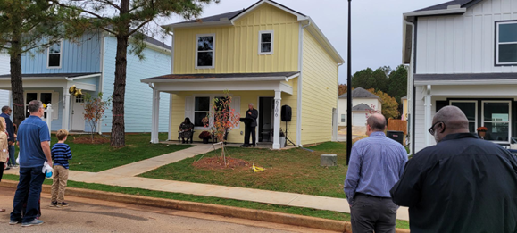
CHIP Grants
Community HOME Investment Program
Annual grant application due in January
$1.5 MM to build for-sale homes
$500,000 for home repairs
Homeowners/buyers must make under 80% Area Median Income
CHIP neighborhood built by Covington Housing Authority

Slide 16
Owner-Occupied Rehab Baldwin County

Slide 17
Rural Workforce Housing Initiative
Vidalia house plan
(Region 9)
$35.7M in State funds for $25M Infrastructure Grants & $10M Construction Loans
Quarterly applications are due on the 2nd Friday in January, April, July, and October.
For additional information, please view the GA Rural Workforce Housing Initiative Webinar here: Georgia Rural Workforce Housing Initiative Webinar #1 (youtube.com)

Slide 18
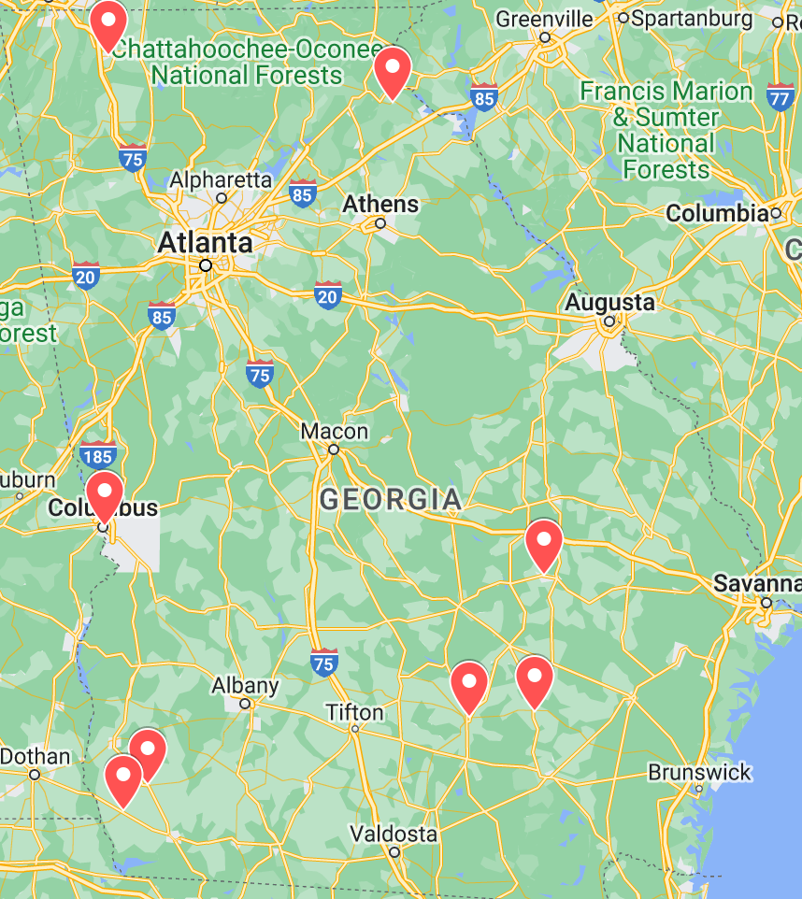
Awardees to Date
Grant Recipient | Amount | Homes
City of Albany | $925,513 | 29
City of Alma | $2,498,218 | 60
City of Colquitt | $2,400,000 | 93
City of Vidalia | $2,500,000 | 70
Columbus Consolidated Government | $2,300,000 | 24
Dalton Whitfield County Development Authority | $1,500,000 | 39
Donaldsonville & Seminole County Development Authority | $2,500,000 | 53
Douglas-Coffee County Industrial Authority | $2,300,000 | 65
Stephens County Development Authority | $478,400 | 318

Slide 19
CDBG Community Development Block Grant
Annual competitive grant program for local governments for infrastructure improvements.
$1,000,000 for neighborhood revitalization activities
Application due in June

Slide 20
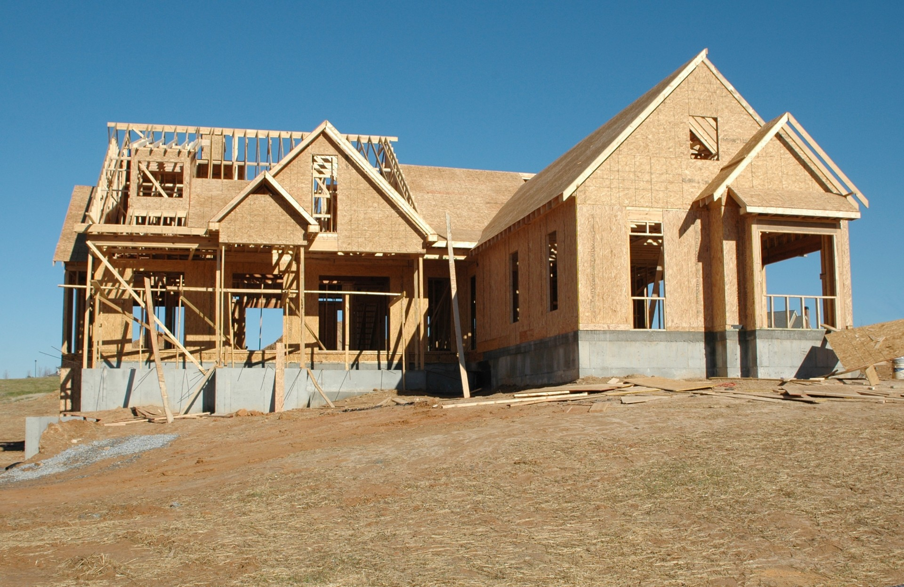
Housing Development Programs

Slide 21
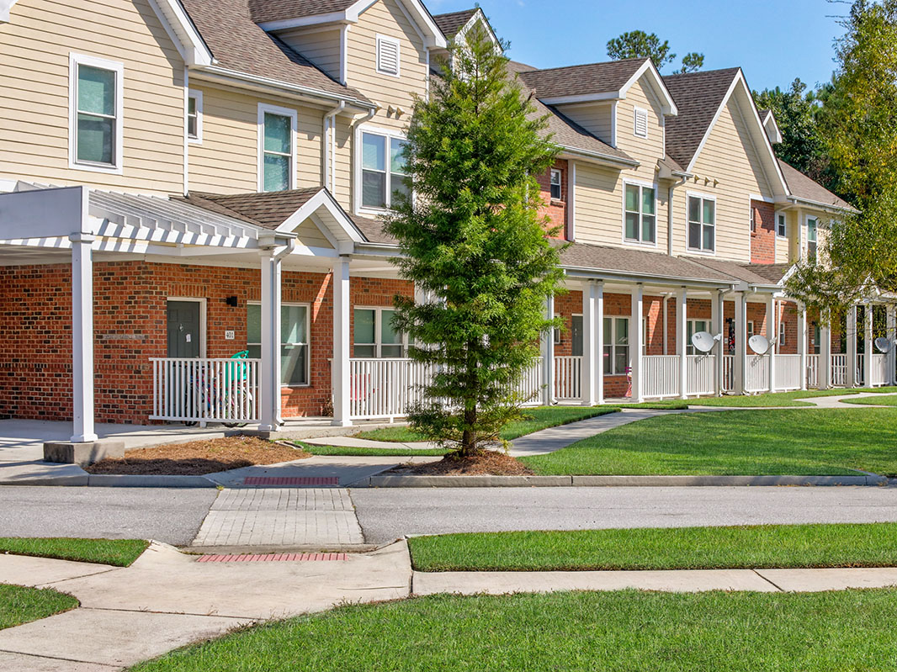
Housing Tax Credits
Income Restricted
Rental Housing Developments
Tenure: Family or Seniors
New Construction or
Acquisition/Rehab
Stay Affordable for 20+ Years
Housing Developers Apply
in March & October
Harmony Greene
Pooler, Chatham County

Slide 22
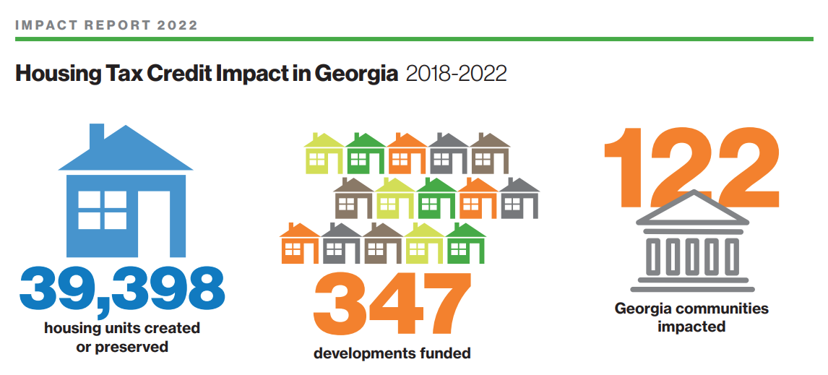

Slide 23
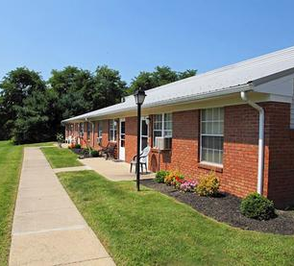
Expectations

Slide 24
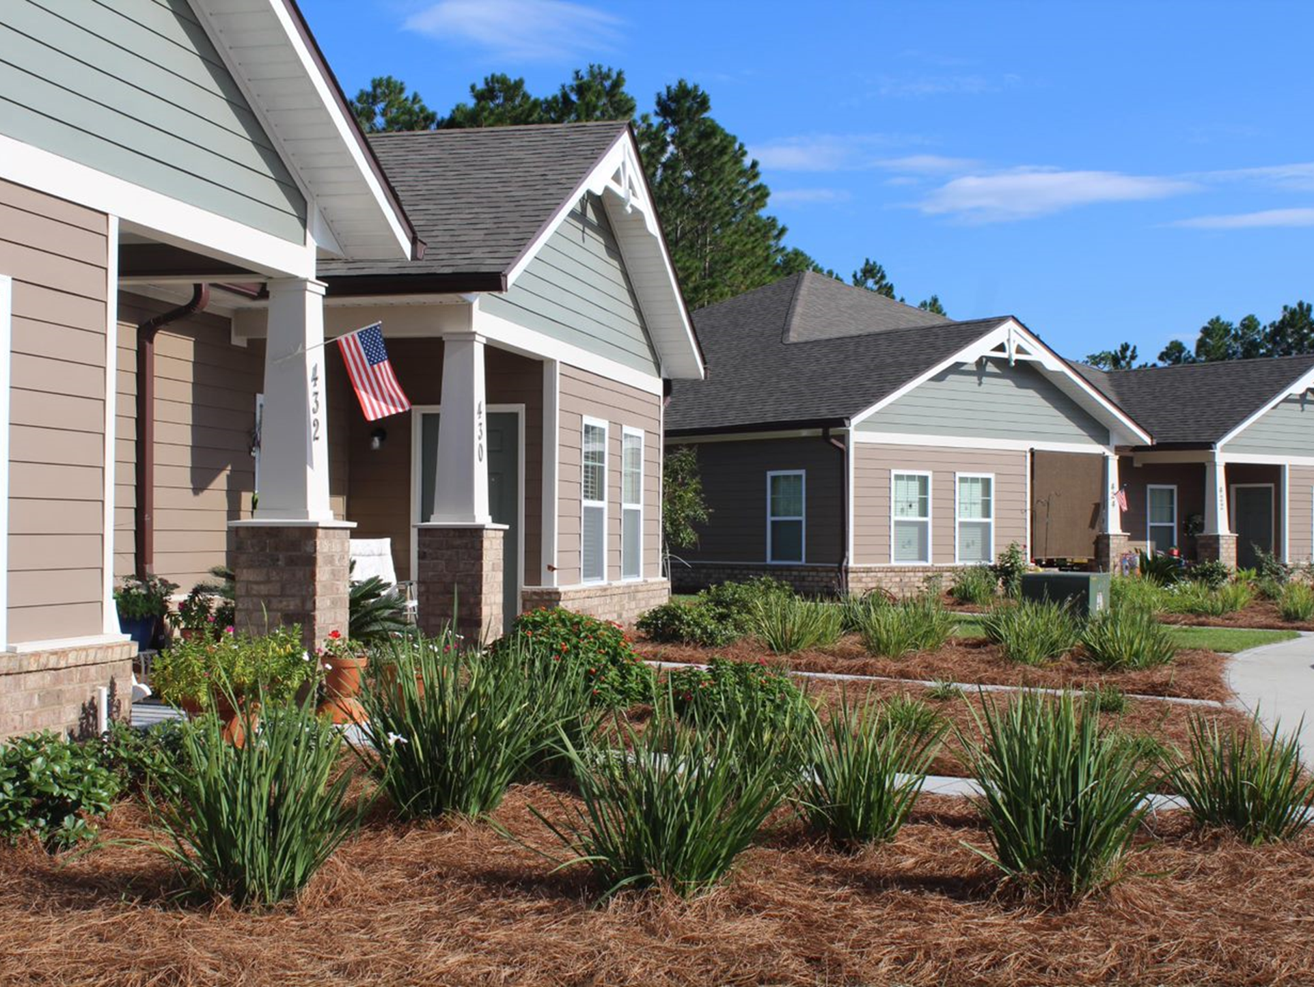
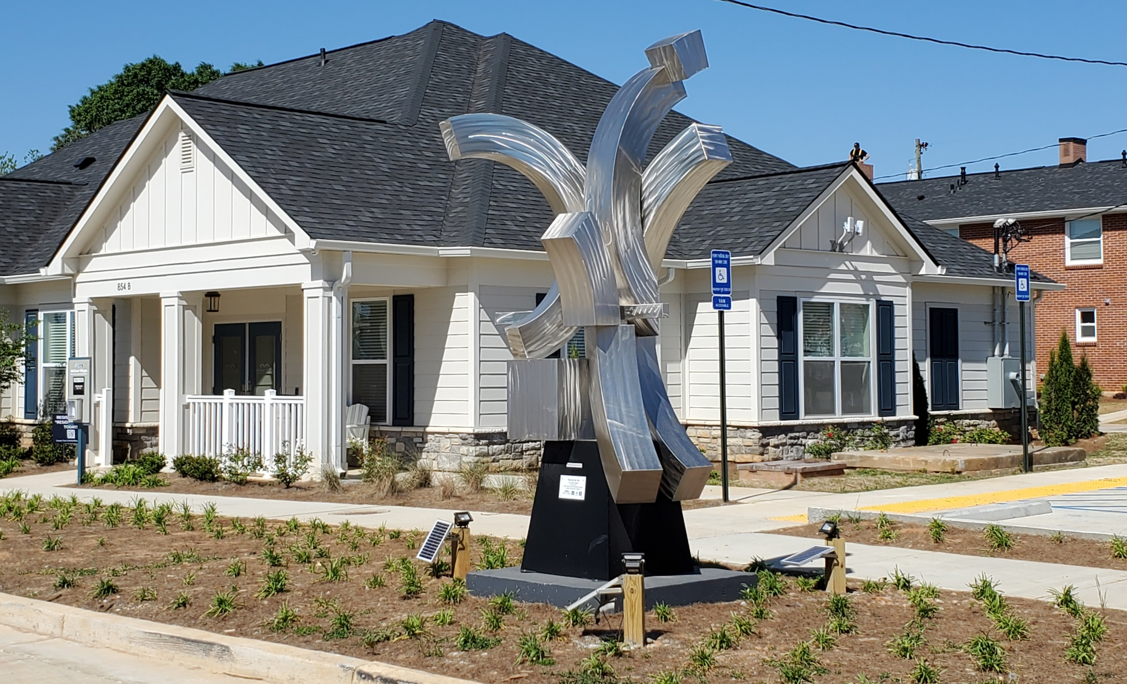
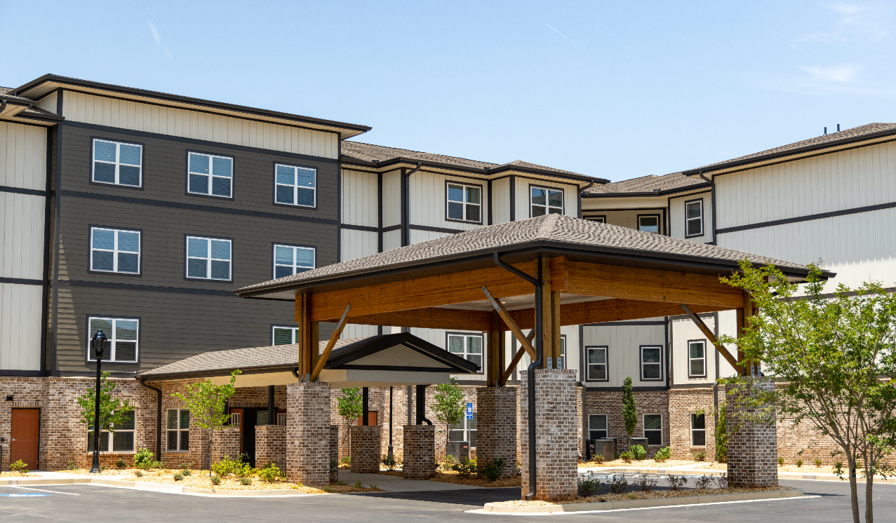
Midtown Village
Gainesville
The Villages at Winding Road
St. Marys
Versus Reality
Villas at Mount Zion
Stockbridge

Slide 25
HOME-ARP
Funded through the American Rescue Plan Act
$87.6 Million allocated for Georgia for activities to be funded through 2030
Combines HOME Regulations with McKinney Vento (Homeless) Regulations
What is HOME-ARP?
New Beneficiaries
Households who are Homeless and at Risk of Homeless
New Activities
Non-Congregate Shelters and Supportive Services

Slide 26
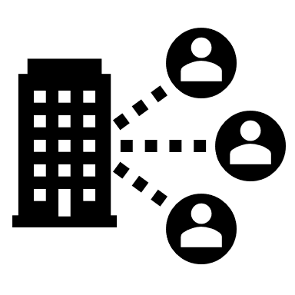
HOME-ARP Eligible Activities
Non-Congregant Shelters
A room for each household with a door that locks and a bathroom
Rental Housing (Multi-Family)
One Household per Apartment for Qualified or Low-Income Populations
Tenant-Based Rental Assistance
Subsidy-based housing support
Supportive Services
McKinney-Vento Supportive Services, Homelessness Prevention Services, and Housing Counseling Services
Agency Capacity Building Developing the capacity of eligible nonprofit organizations to successfully carry out HOME-ARP eligible activities

Slide 27
Qualifying Populations
Households that are experiencing homelessness
24 CFR §91.5
Households at Risk of Being
Homeless with incomes below 30% Area Median Income (AMI), or up to 50% AMI with waiver
24 CFR §91.5
CPD 21-10
Households fleeing or
attempting
to flee domestic violence,
dating violence, sexual assault, stalking, or
human trafficking
HUD 24 CFR §5.2003
Other households requiring services or housing assistance to prevent
returning to homelessness
CPD 21-10
Households at 30% AMI with severe housing cost burden defined as paying more than 50% of monthly household income
CPD 21-10

Slide 28
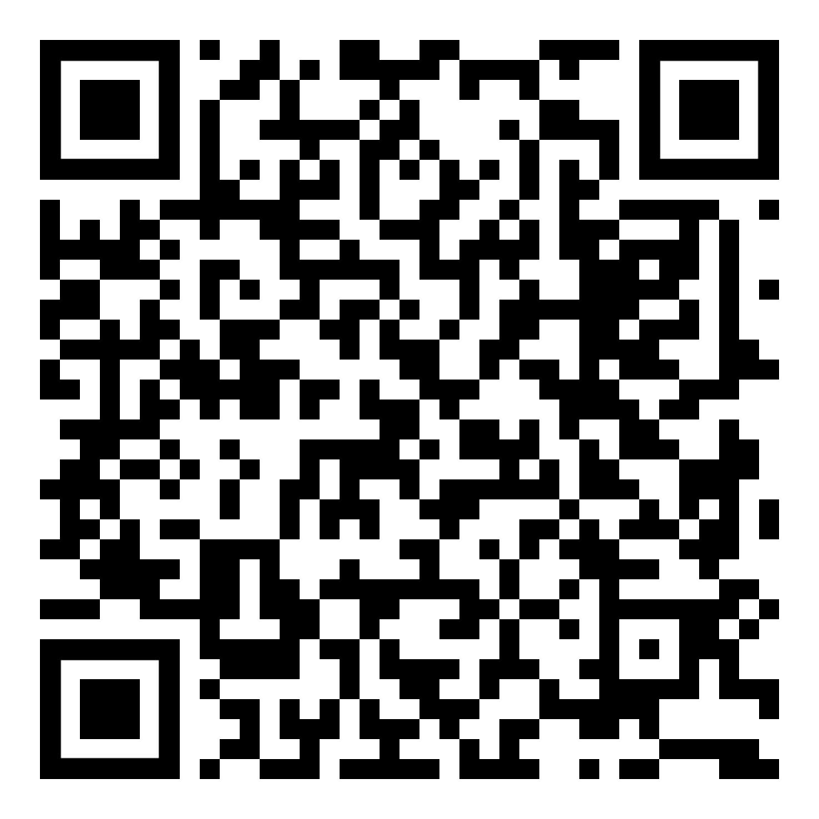
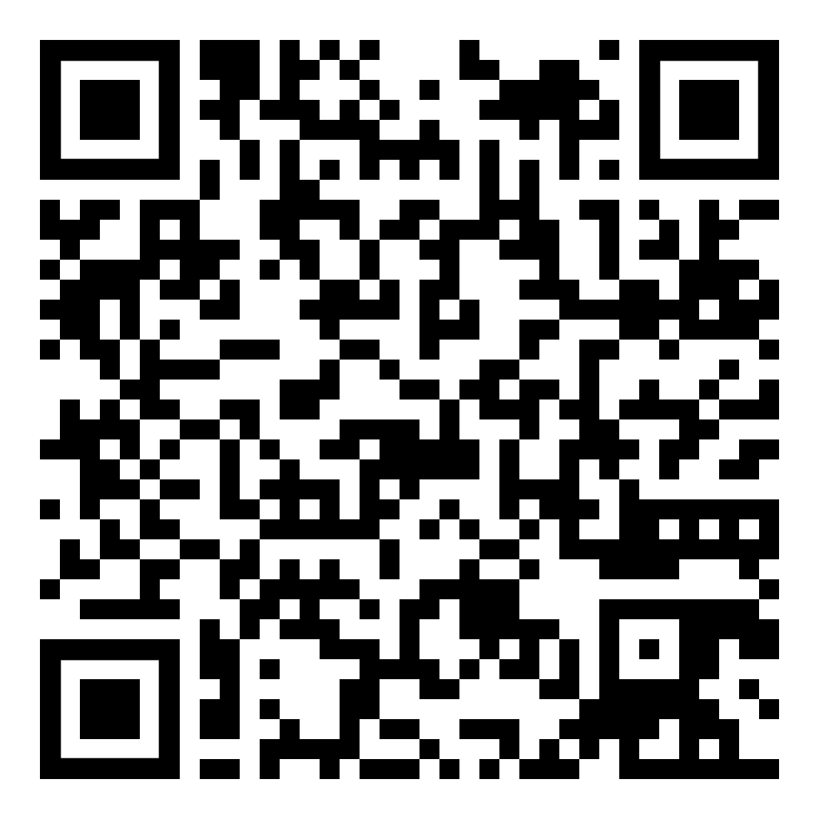
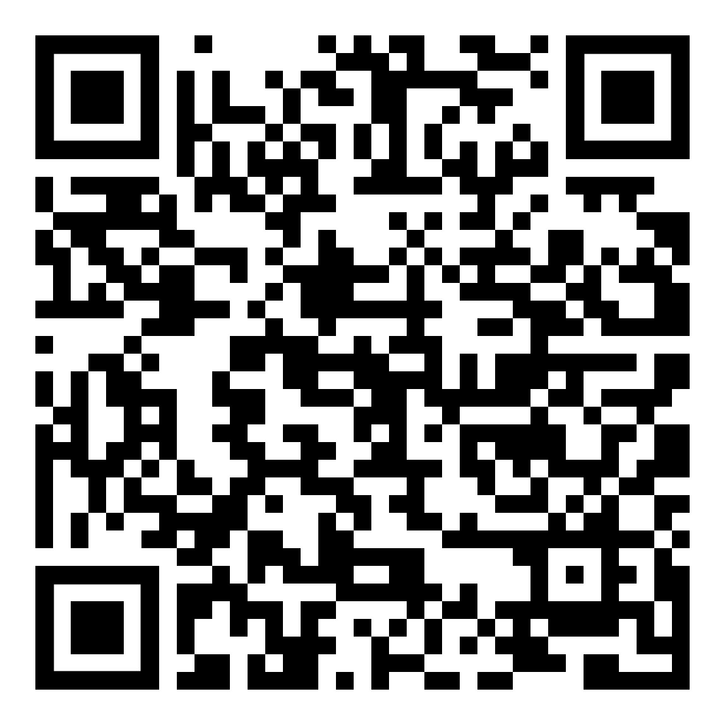
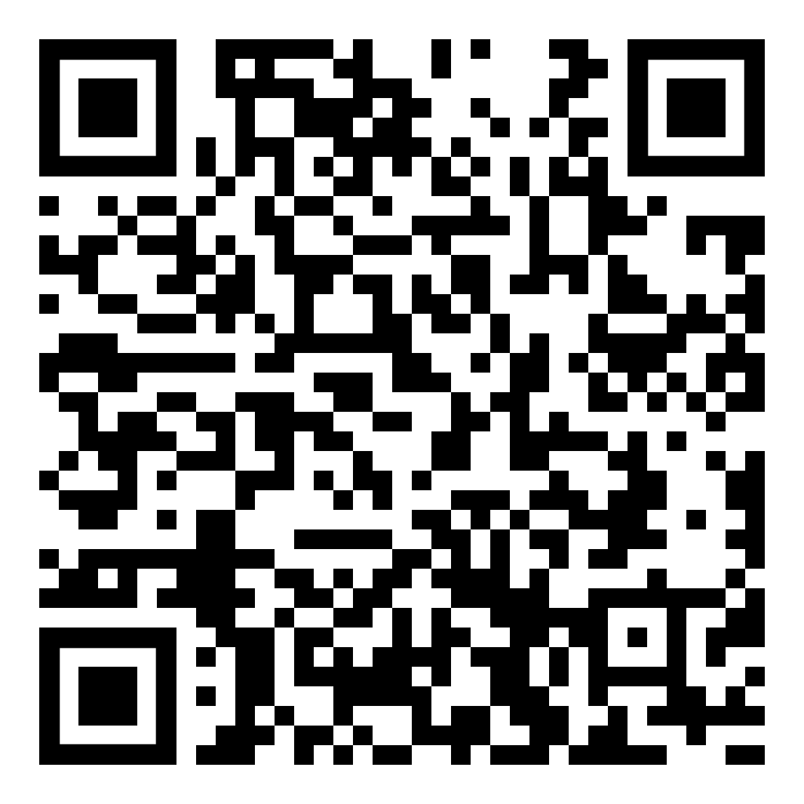
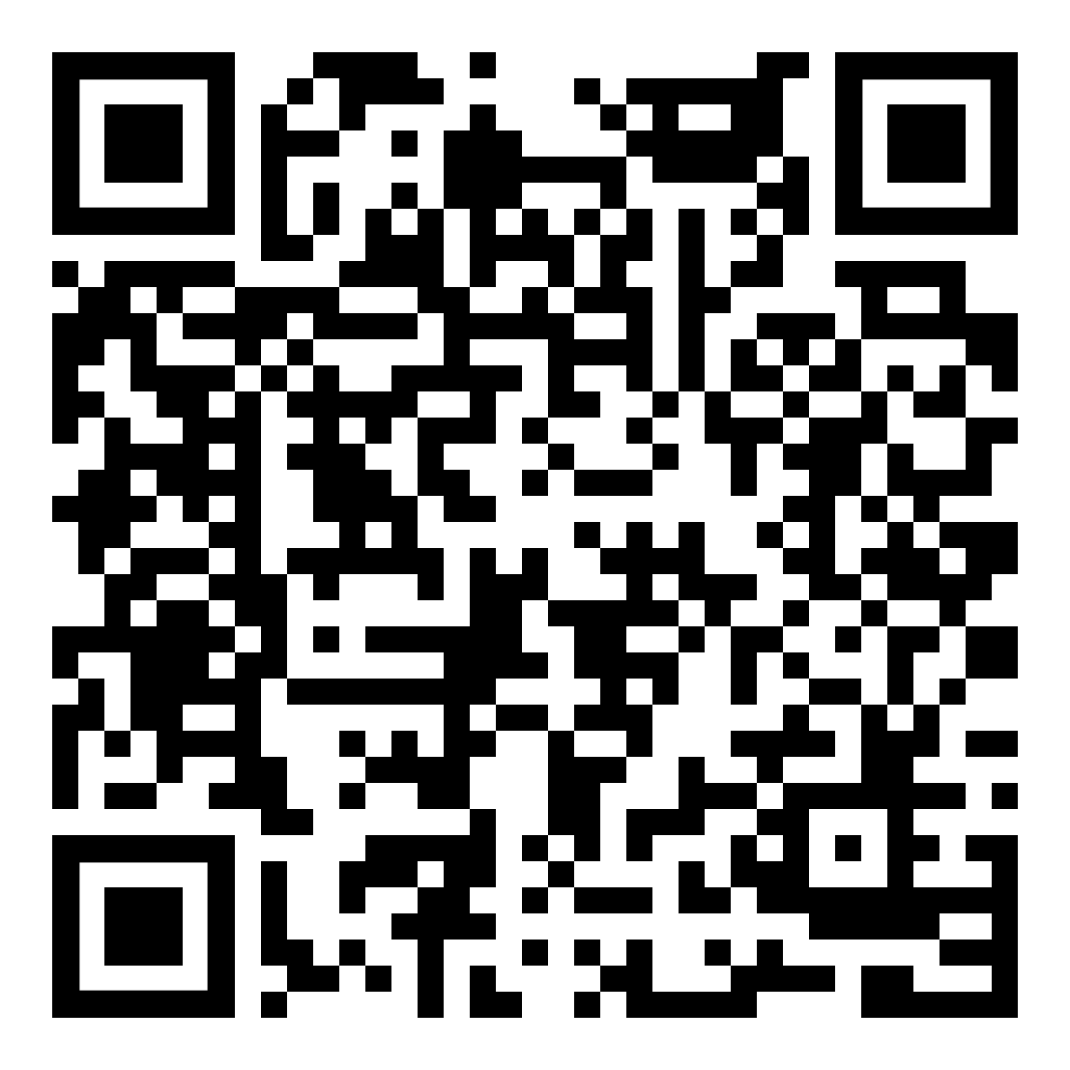
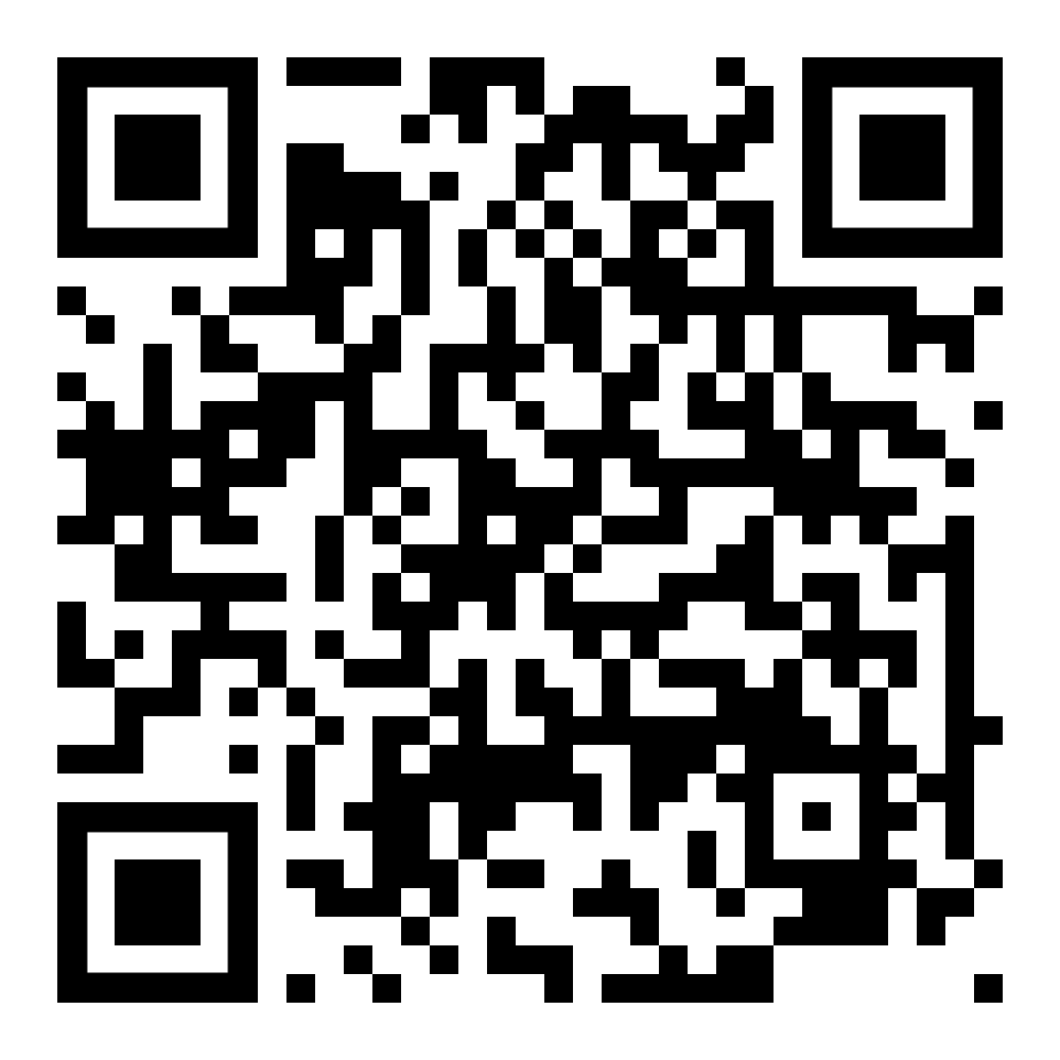
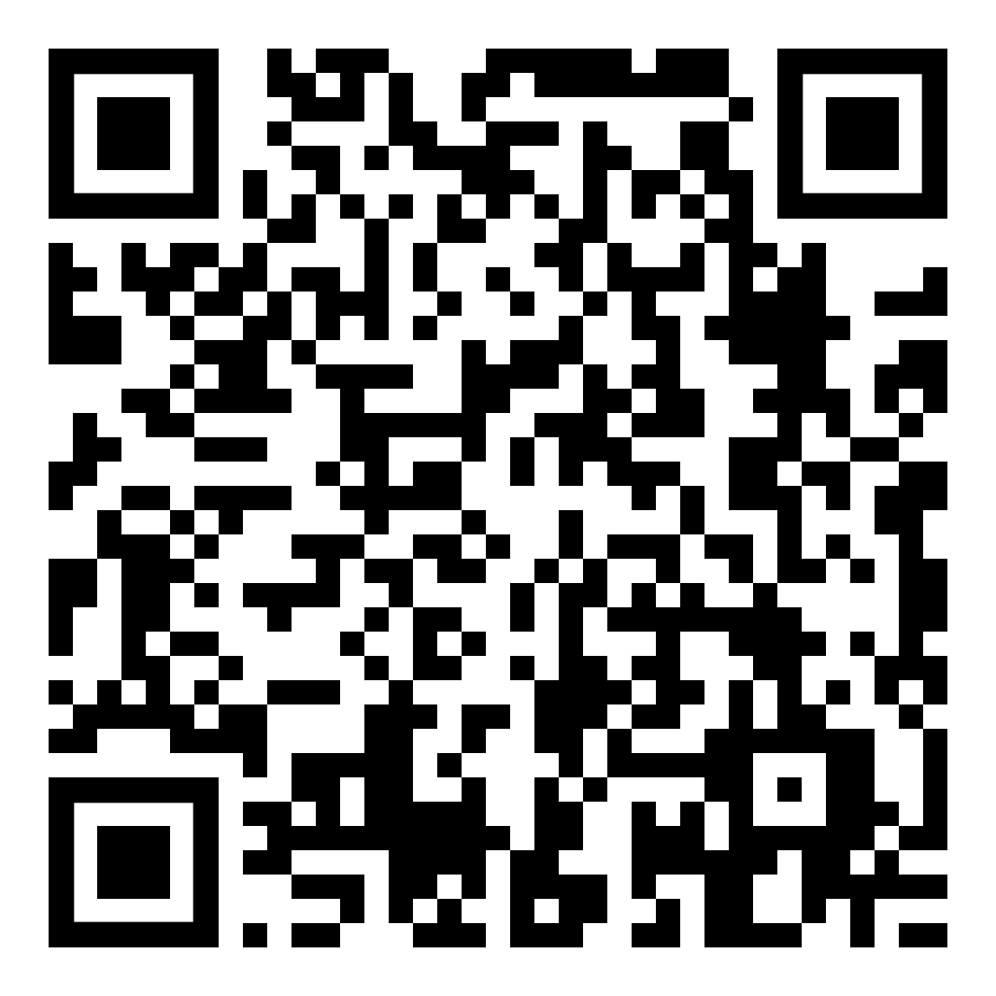
Questions & Resources
HOME-ARP Questions
CHIP Questions
CDBG Questions
LIHTC Questions
RWHI Questions
Please scan the appropriate QR Code to email a team member or access resources.
DCA Guide to Services
Housing Georgia’s Workforce

Slide 29
Chris Hurley
Community Housing Outreach Coordinator
Office of Community Housing Development

