Slide 1
Georgia
Planning & Financial Resources for
Affordable Housing

Slide 2
“Our American values are not luxuries, but necessities – not the salt in the bread, but the bread itself.” – Jimmy Carter

Slide 3
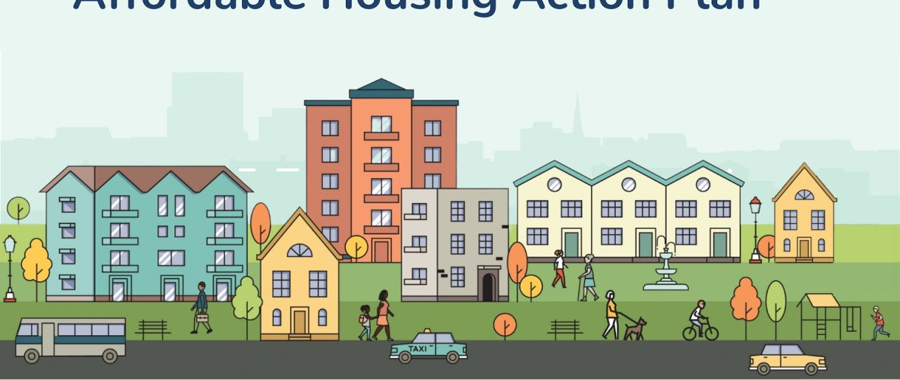
Why is Planning for Housing Important?

Slide 4

Housing is an
Economic Development Issue
Housing availability and affordability are essential in attracting new businesses
When workers spend more on housing, they spend less on goods and services in the local economy
Housing is a
Transportation Issue
Rising housing costs = longer commutes
Notes:
Did you know that the shortage of affordable housing costs the American economy an estimated $12 trillion a year in lower wages and productivity?

Slide 5


Over the last five years, Georgia has witnessed record-breaking economic development, with over 2,000 new or expanded site locations and 268,000 jobs added to the economy.
“In the same five years, we’ve experienced unprecedented economic growth in every corner of the state, housing inventory has decreased by over 60%, making the dream of homeownership unattainable for nearly four million Georgians,” said Daniela Perry, vice president of the Georgia Chamber Foundation.

Slide 6




Fast Facts
Georgia's housing inventory has decreased by 60% over the last 5 years.
29% of children live in high housing cost-burdened households.
The number of first-time home buyers has declined by 8% over the last year.
The average county in Georgia has seen a 53.6% increase in monthly housing payments.
SOURCE: State of Housing Report, GA Chamber of Commerce, State of Housing Report | Georgia Chamber of Commerce

Slide 7
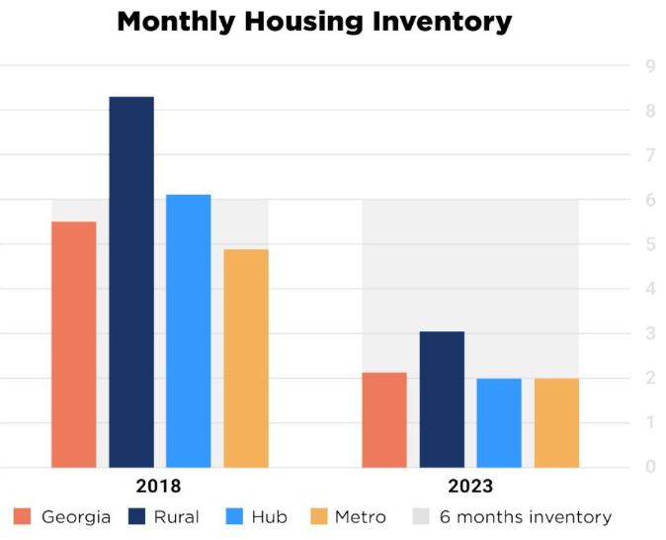
Housing Inventory
A healthy community housing stock level is around 6 months of supply. From November 2018 to November 2023, the number of Georgia counties with at least a 6-month supply of housing dropped from 75 to only 9 counties. This indicates that the rate at which new housing is being developed is not adequate to accommodate our state’s population growth rate.
SOURCE: State of Housing Report, GA Chamber of Commerce, State of Housing Report | Georgia Chamber of Commerce

Slide 8


Slide 9
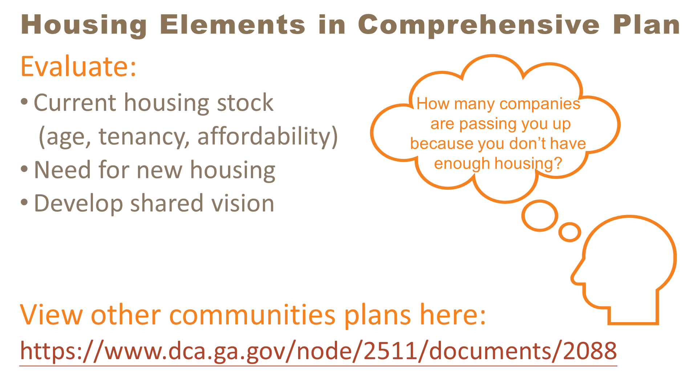

Slide 10
Create a Housing Market Study
DCA LIHTC Guide Link
Presentation on Planning & Zoning for Affordable Housing from DCA 2020 Fall Conference Link
Georgia Initiative for Community Housing (GICH)
Georgia Housing Planning Resources

Slide 11
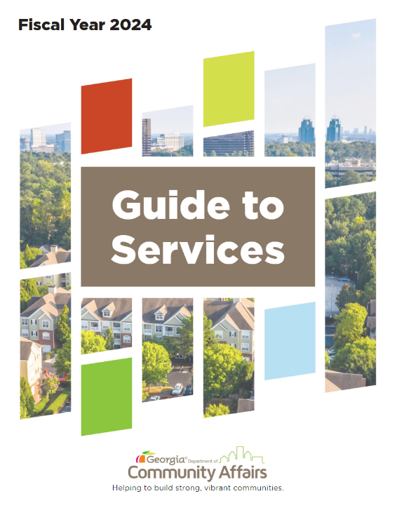

Georgia DCA Resources
60+ Programs
Local Reps in 12 GA Regions
Planning Resources for Local Governments
13 Affordable Housing Programs
26 Community & Economic Development Programs

Slide 12
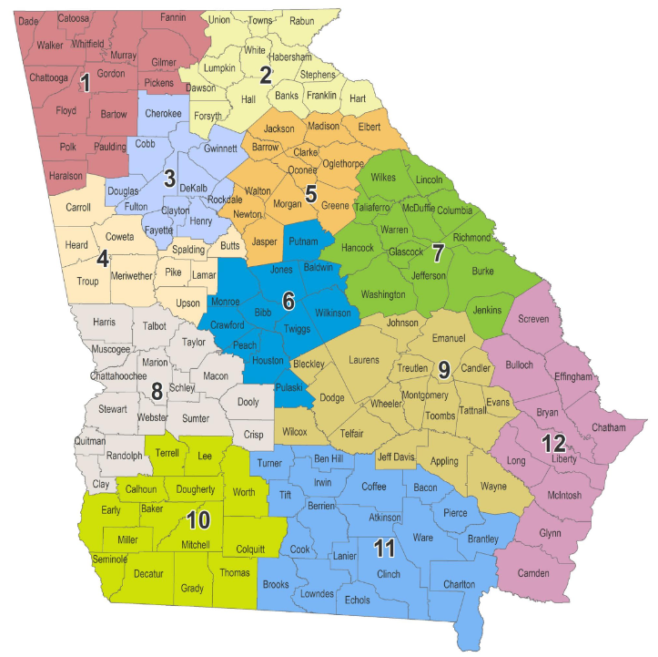
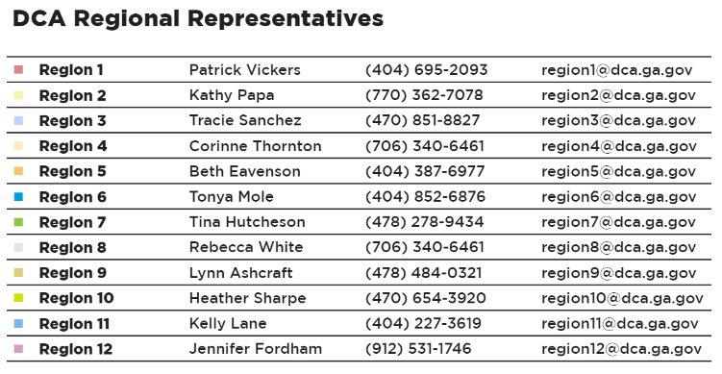
DCA Regional Representatives
Contact: Corinne Thornton, Director Corinne.Thornton@dca.ga.gov
706-340-6461

Slide 13
Planning Resources for Affordable Housing

Slide 14





Georgia Initiative for Community Housing
GICH
GICH helps communities improve their quality of life and economic vitality through the development of locally-driven housing and revitalization strategies. This is achieved through:
Technical assistance
Collaboration
Expert presenters
Training
Facilitation
Consensus building
Networking
Mentoring

Slide 15
Home Ownership
Programs

Slide 16

Community HOME Investment Program
CHIP
Available to local governments, housing authorities, and non-profits
$1.5 Million for Single-Family Construction
$500K for Owner-Occupied Rehabilitation
Homeowners/homebuyers income must be under 80% AMI

Slide 17
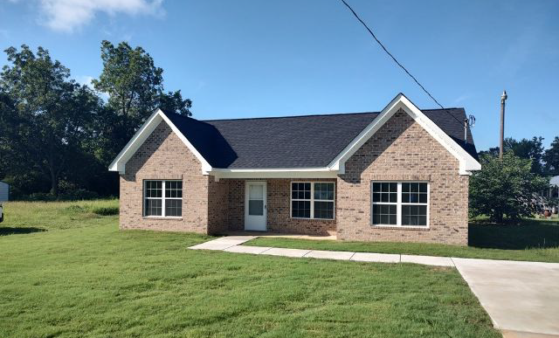
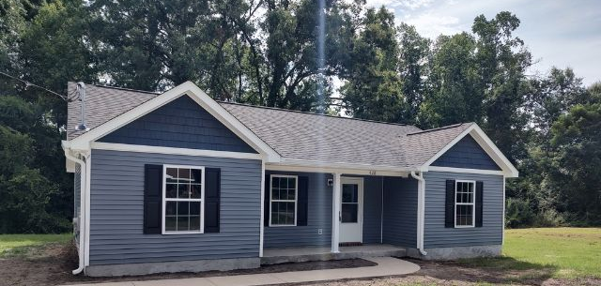
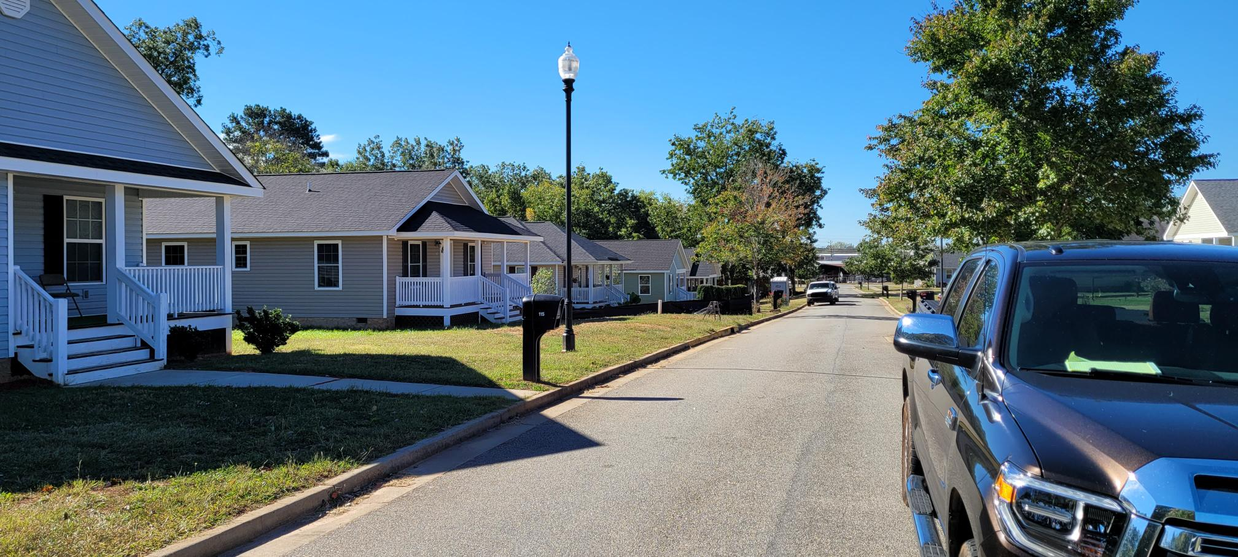
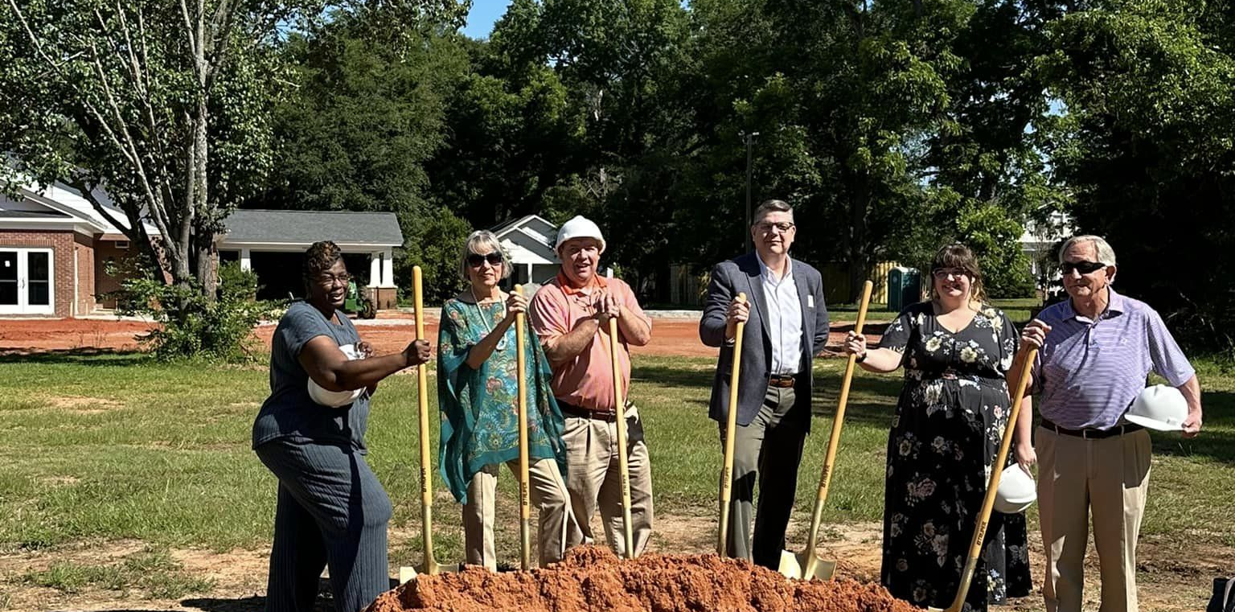
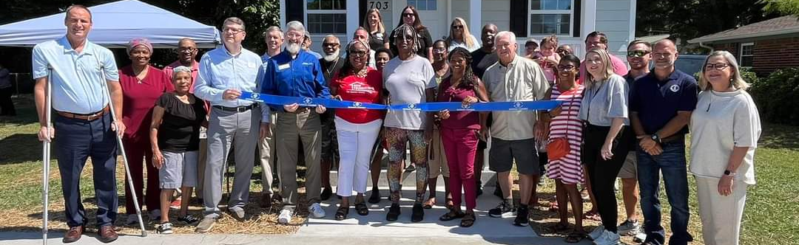

Slide 18
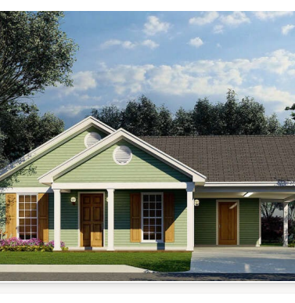
Rural Workforce Housing Initiative
Single-family homes for use as a primary residence with a sale price of between $125,000- 290,000.
Maximum $1 million loan (Loan Term – 2 years from Award date)
The project must be completed, the Home must be sold to an owner-occupied Homebuyer, and the loan must be repaid to DCA within two years.
Applications will be accepted quarterly. (The second Friday of the following months: January, April, July, and October.) Prior to submitting the pre-application, an initial project assessment meeting must be held with the DCA Regional Representative. Pre-applications are due 30 days before the full application.

Slide 19
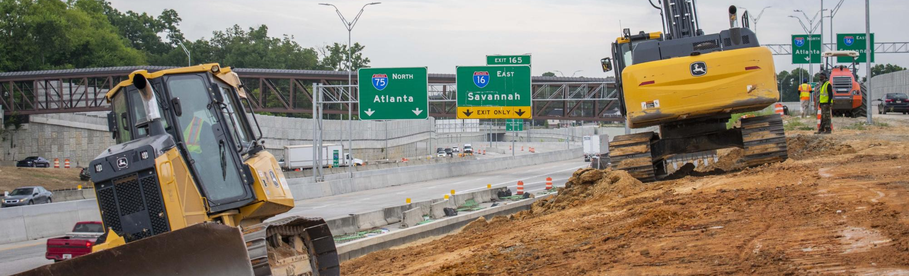
Community Development Block Grant
CDBG
The Community Development Block Grant Program (CDBG) provides funding to assist a wide range of eligible activities, including housing improvement projects, public facilities such as water and sewer lines, buildings such as local health centers or head start centers, and economic development projects. All projects must substantially benefit low—and moderate-income persons.
The maximum amount available per applicant is $1,000,000 for a Single Activity during regular competition and $1,250,000 for a Multi-Activity during regular competition.

Slide 20
Housing Development
Programs

Slide 21
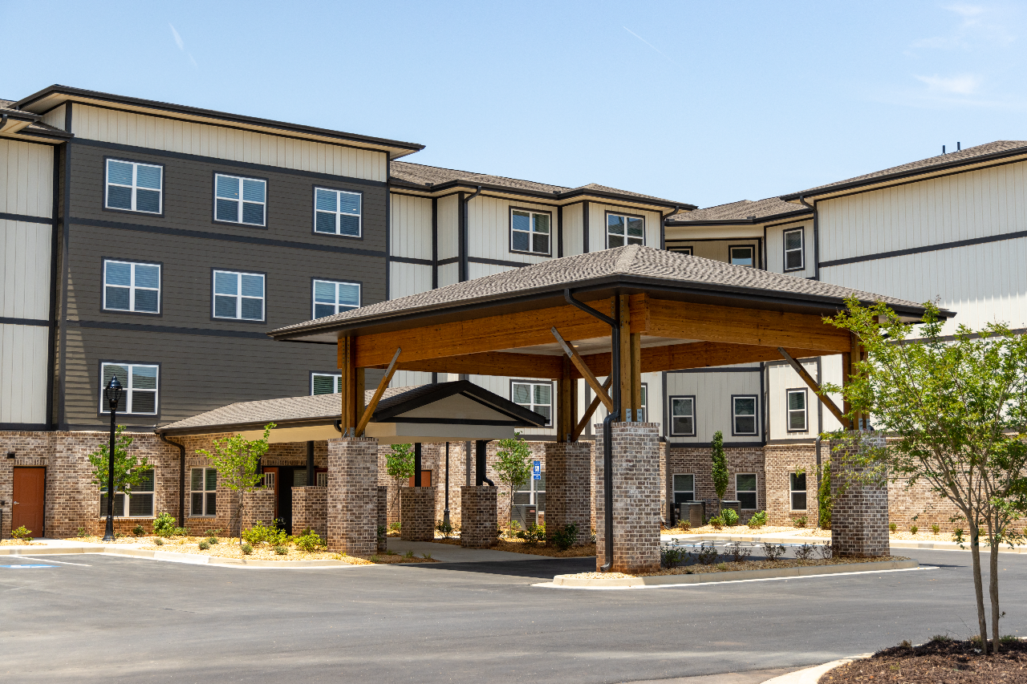
Housing Tax Credits
The Housing Tax Credit Program produces rental housing for households with incomes between 20% and 80% of the Area Median Income.
Provides tax credits for new construction or acquisition/rehab
Must remain affordability for 20+ years
Housing provided for families or senior citizens

Slide 22

HOME-ARP
Funded through the American Rescue Plan Act
  $87.6 Million allocated for Georgia for activities to be funded through 2030
  Combines HOME Regulations with McKinney Vento (Homeless) Regulations
What is HOME-ARP?
New Beneficiaries
  Households who are Homeless and at Risk of Homeless
New Activities
  Non-Congregate Shelters and Supportive Services

Slide 23


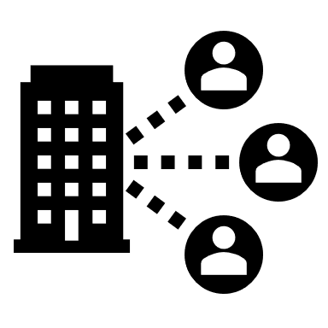


HOME-ARP Eligible Activities
Non-Congregant Shelters
A room for each household with a door that locks and a bathroom
Rental Housing (Multi-Family)
One Household per Apartment for Qualified or Low-Income Populations
Tenant-Based Rental Assistance
Subsidy-based housing support
Supportive Services
McKinney-Vento Supportive Services, Homelessness Prevention Services, and Housing Counseling Services
Agency Capacity Building
Developing the capacity of eligible nonprofit organizations to successfully carry out HOME-ARP-eligible activities

Slide 24



Qualifying Populations
Households that are experiencing homelessness
24 CFR §91.5
Households at Risk of Being
Homeless with incomes below 30% Area Median Income (AMI), or up to 50% AMI with waiver
24 CFR §91.5
CPD 21-10
Households fleeing or
attempting
to flee domestic violence,
dating violence, sexual assault, stalking, or
human trafficking
HUD 24 CFR §5.2003
Other households requiring services or housing assistance to prevent
returning to homelessness
CPD 21-10
Households at 30% AMI with severe housing cost burden defined as paying more than 50% of monthly household income
CPD 21-10

Slide 25
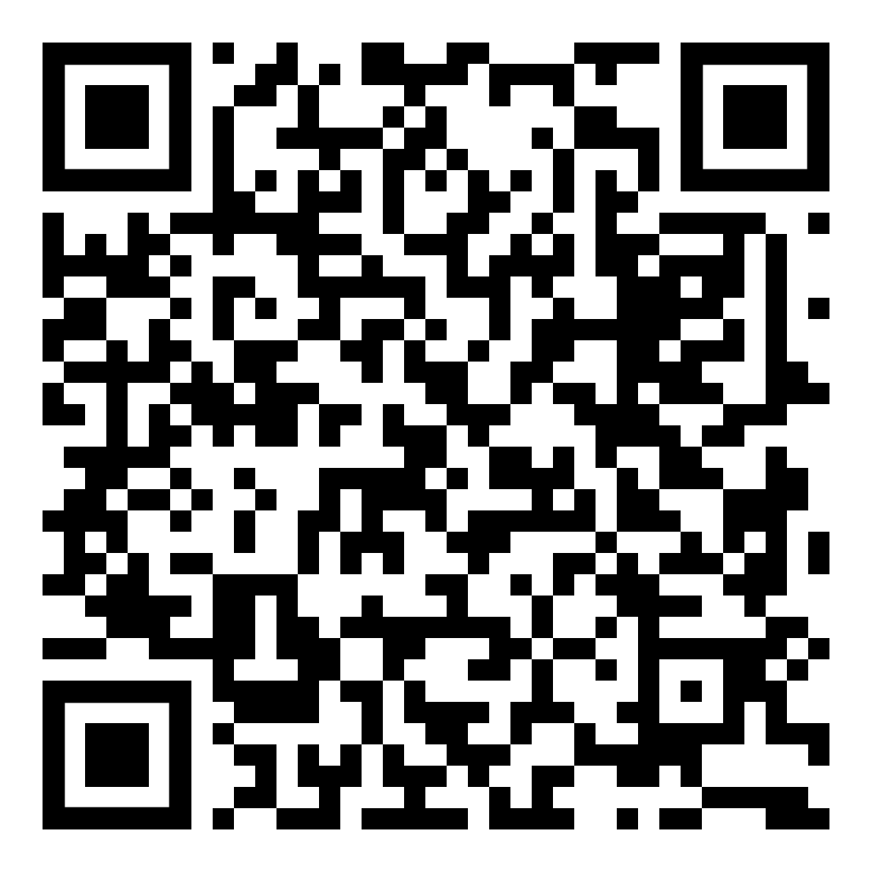
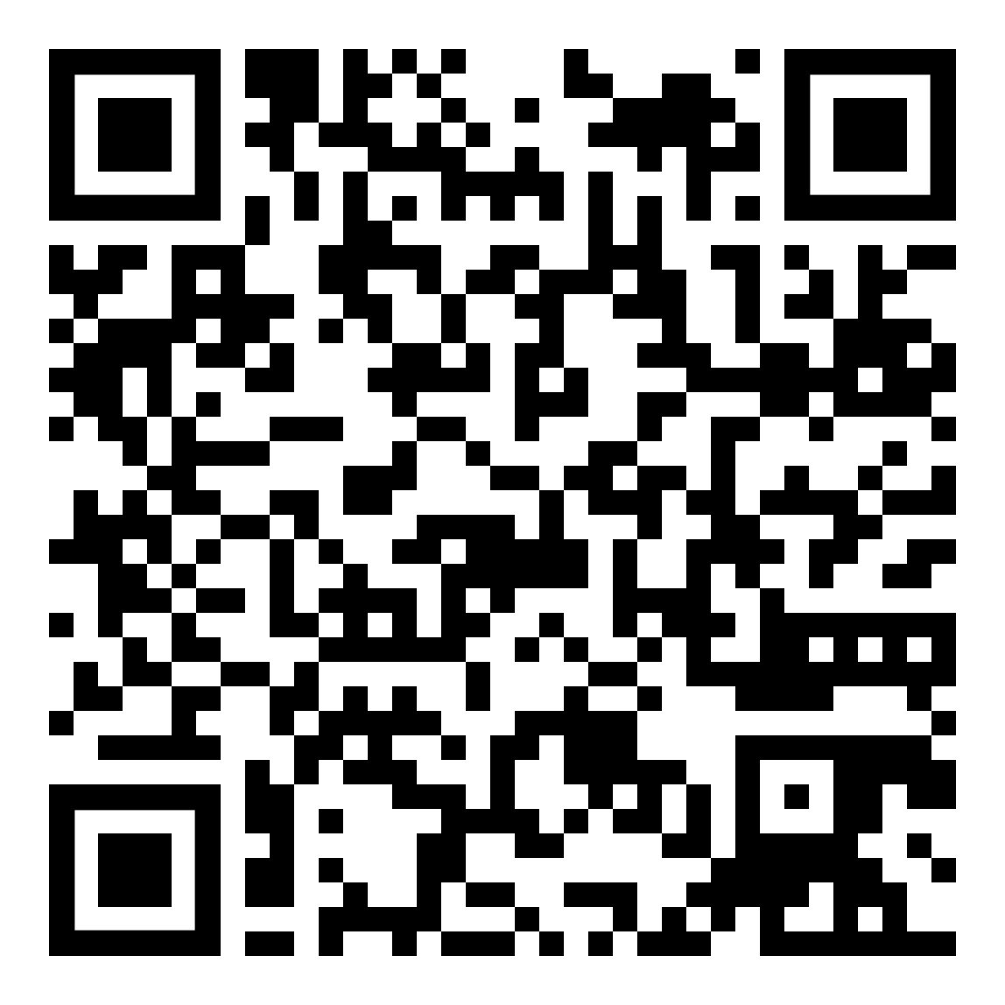
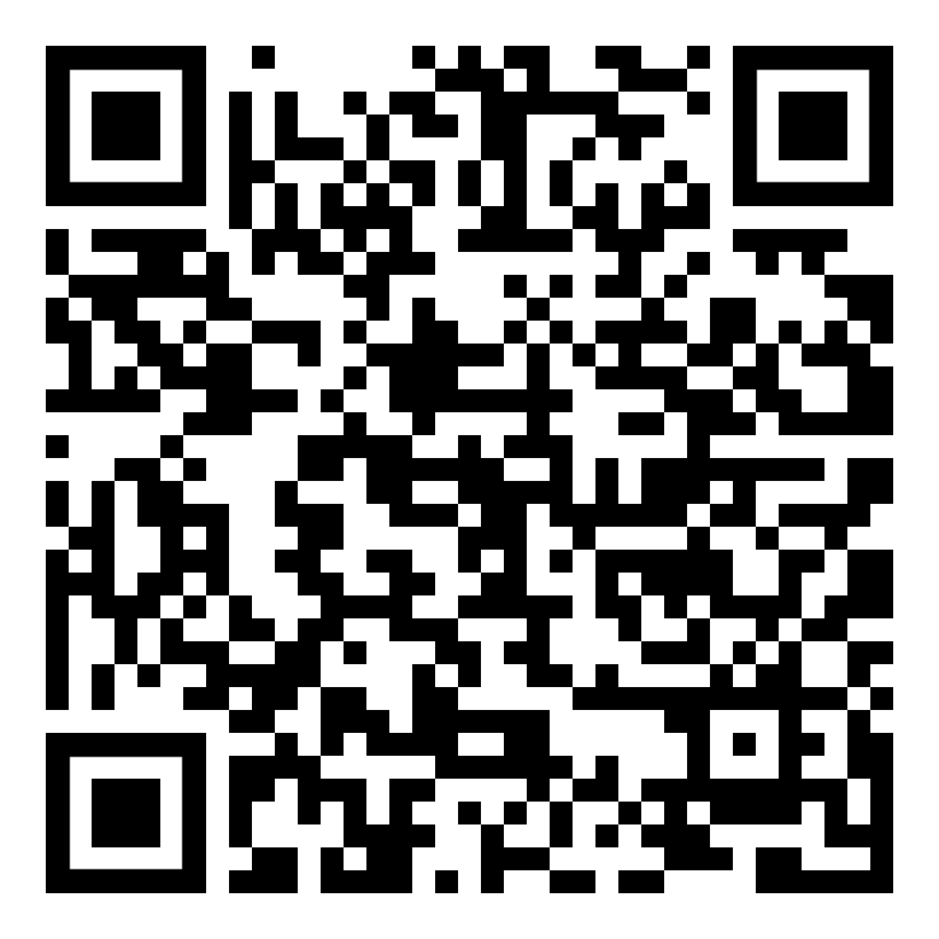
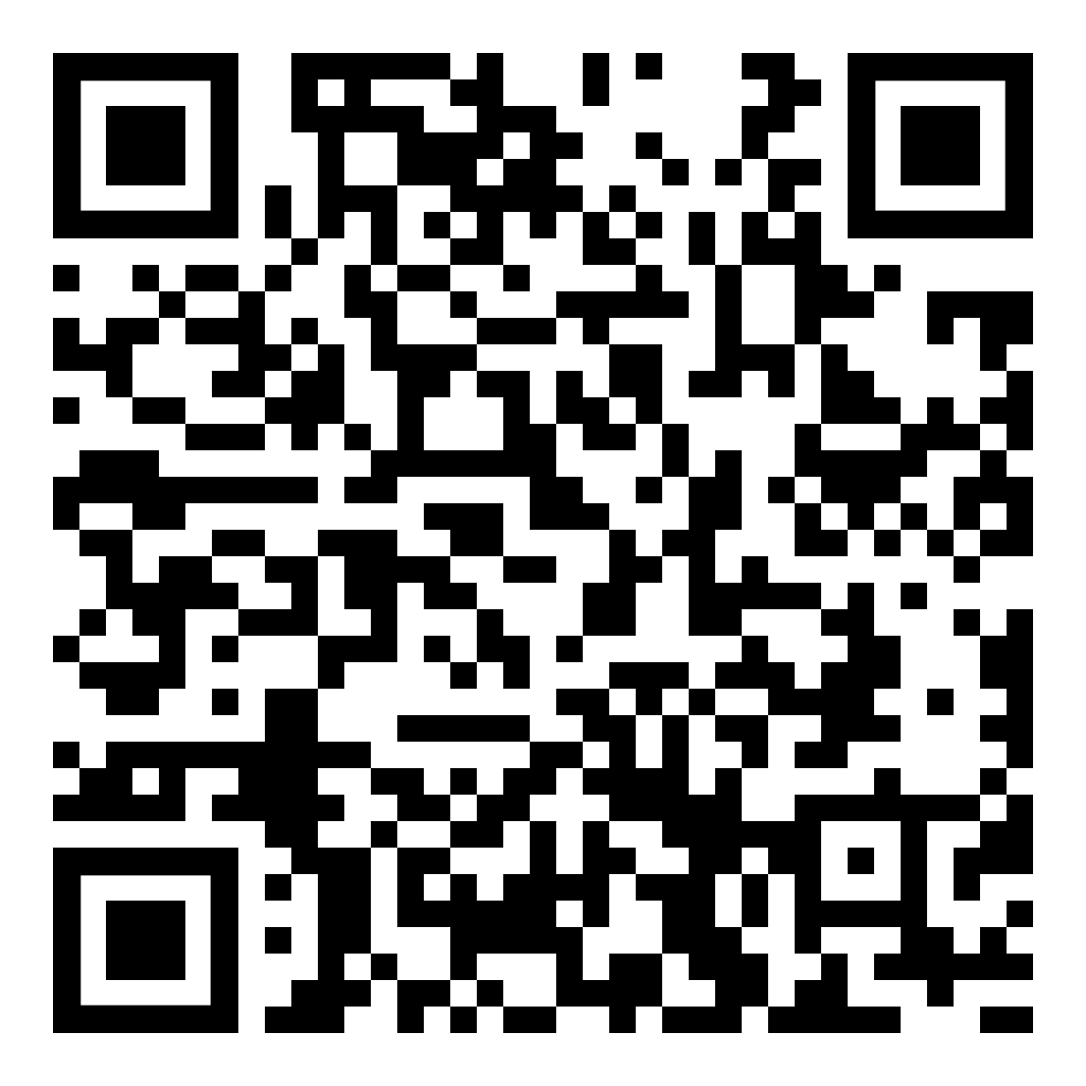
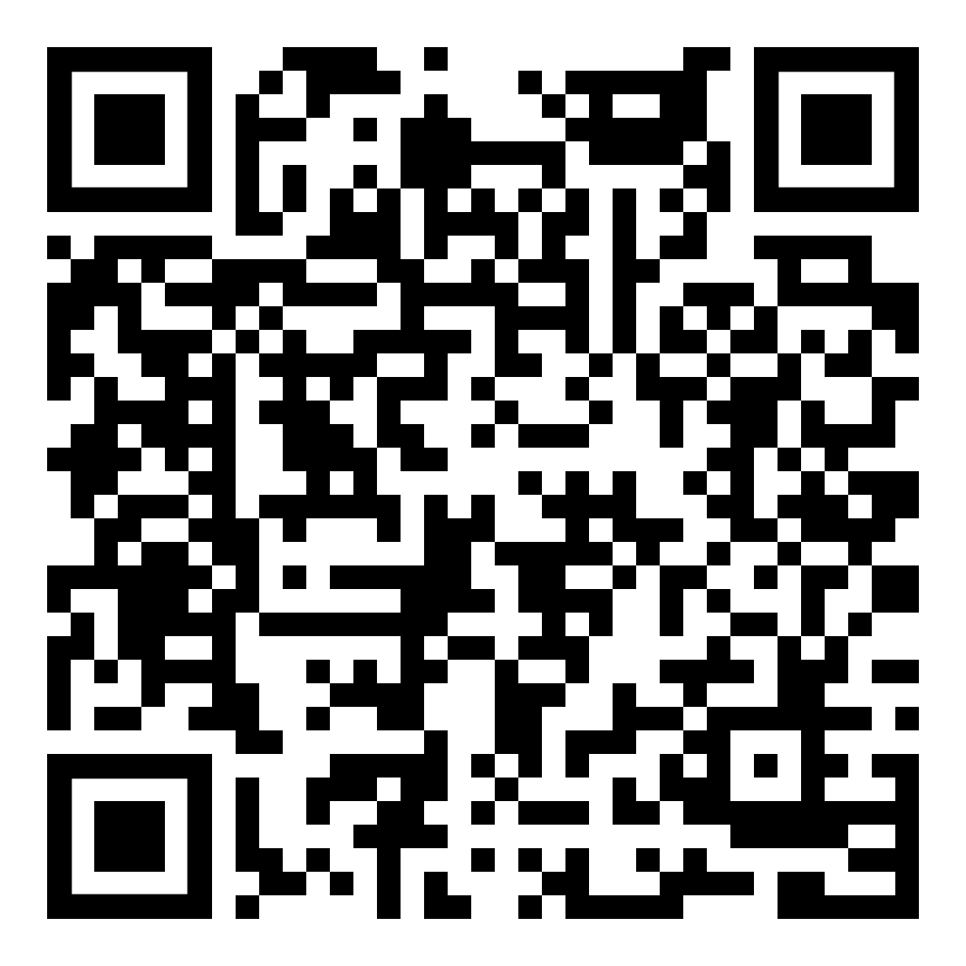
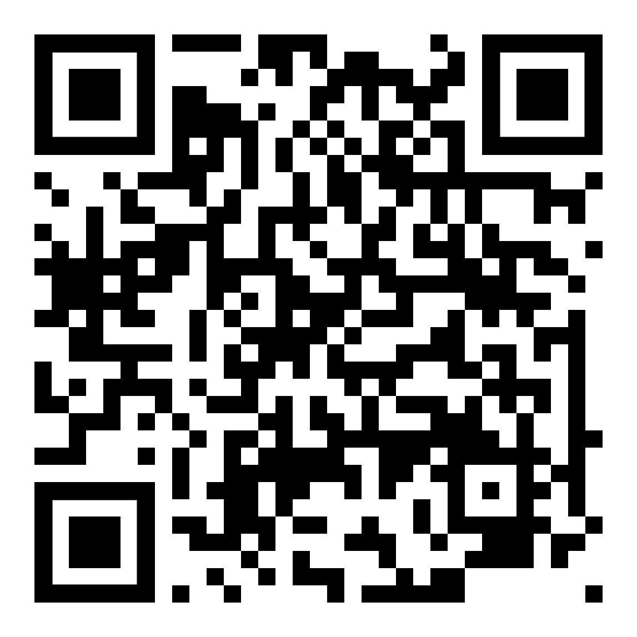
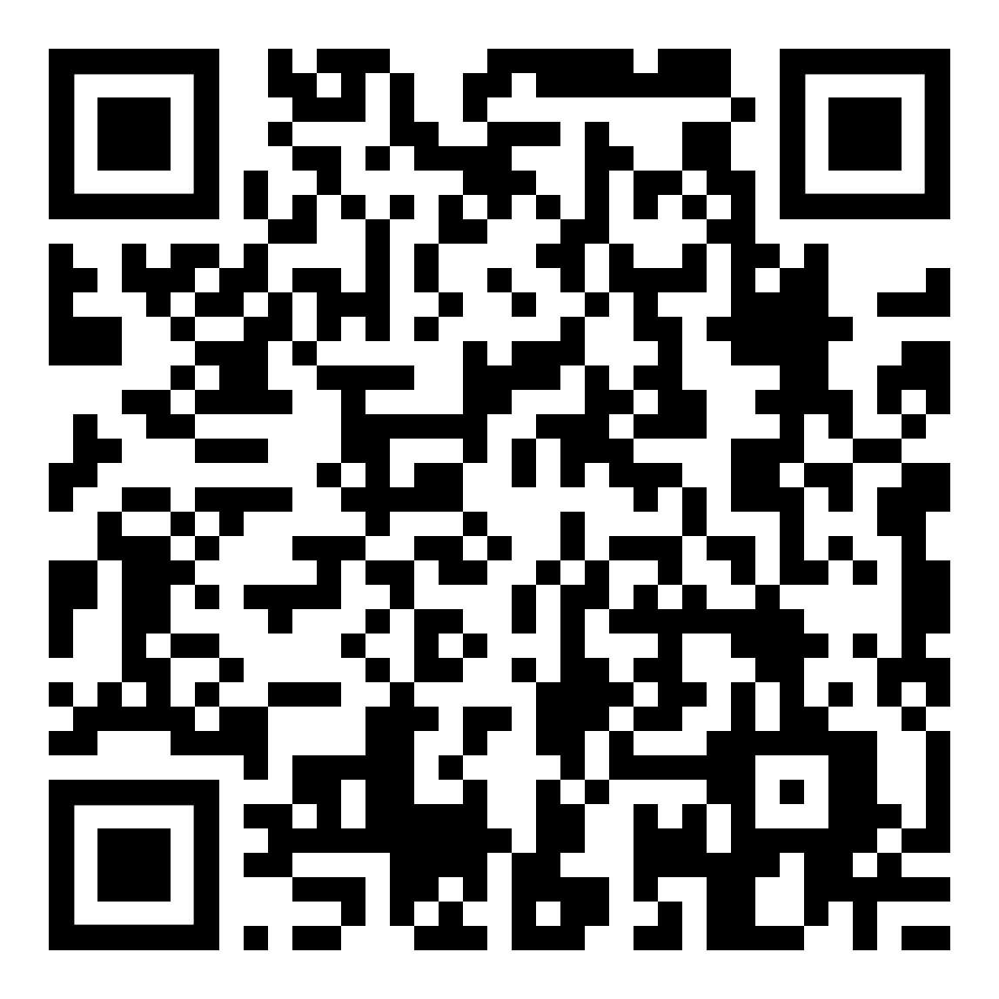
Questions & Resources
HOME-ARP Questions
CHIP Questions
CDBG Questions
LIHTC Questions
RWHI Questions
Please scan the appropriate QR Code to email a team member or access resources.
DCA Guide to Services
Housing Georgia’s Workforce

Slide 26

Thanks!
Chris Hurley
Chris.hurley@dca.ga.gov
Direct: 470-773-8892
Community Housing Outreach Coordinator
dca.ga.gov

