Slide 1
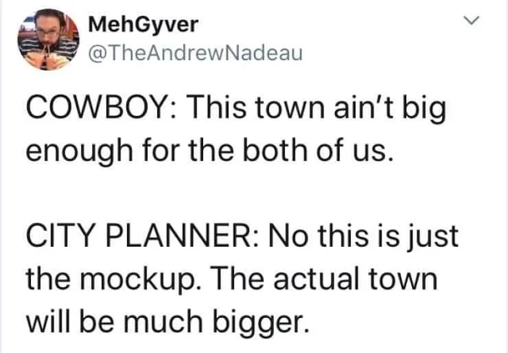
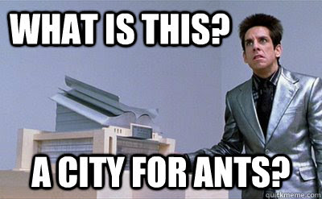
Planning Essentials
January 7th, 2025
Office of Planning - Juli Yoder, AICP

Slide 2
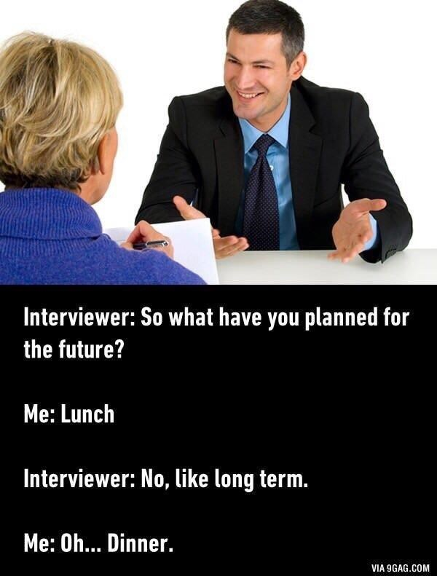
TO PLAN OR NOT TO PLAN…
WHAT is it?
WHY do we do it?
WHO does it?
HOW do you do it?
WHAT do you do with it when you’ve got it?

Slide 3
TO PLAN OR NOT TO PLAN…
Plan - Verb
Definition:
to arrange the parts of
to devise or project the realization or achievement of
To think in advance about a method
Plan - Noun
Definition:
a detailed formulation of a program of action;
a method devised for doing something or achieving an end, involving a series of actions

Slide 4
TO PLAN OR NOT TO PLAN…
Plan - Verb
Definition:
to arrange the parts of
to devise or project the realization or achievement of
To think in advance about a method
Plan - Noun
Definition:
a detailed formulation of a program of action;
a method devised for doing something or achieving an end, involving a series of actions

Slide 5
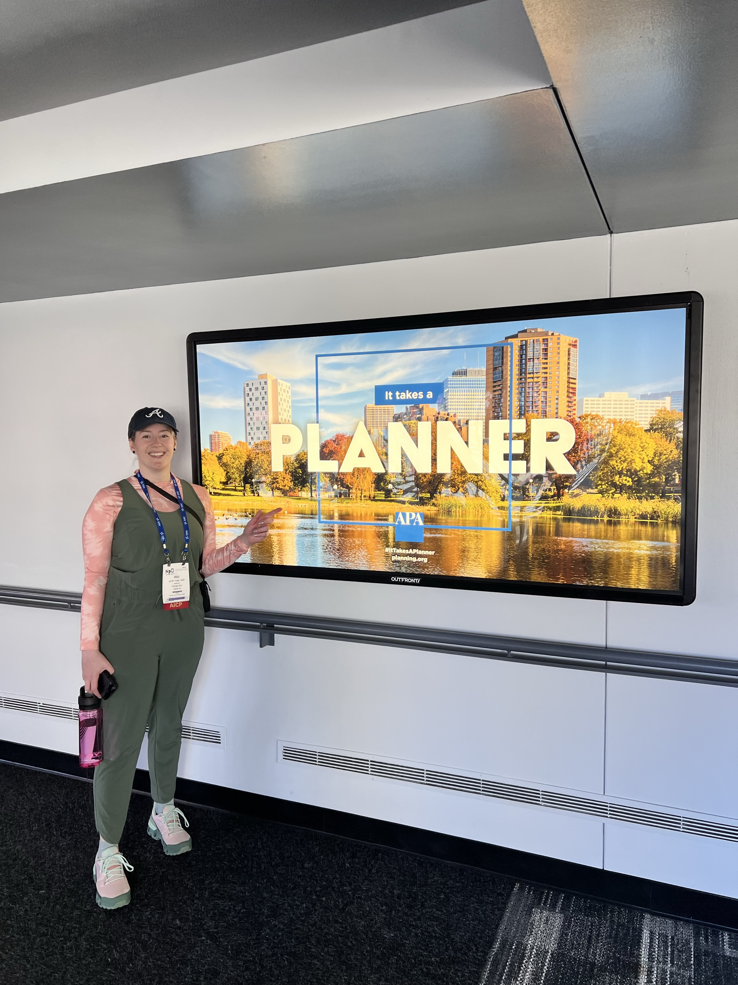
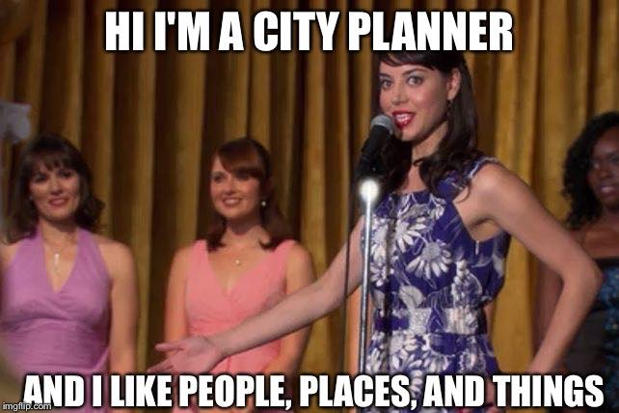
WHAT IS PLANNING?

Slide 6
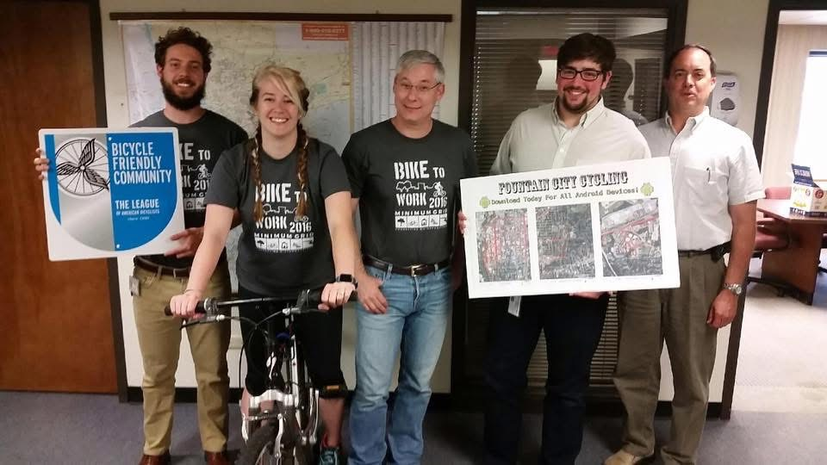
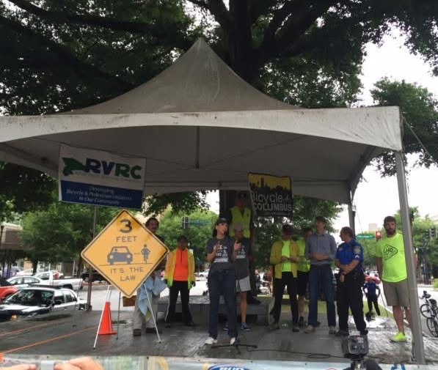
WHAT IS PLANNING?

Slide 7
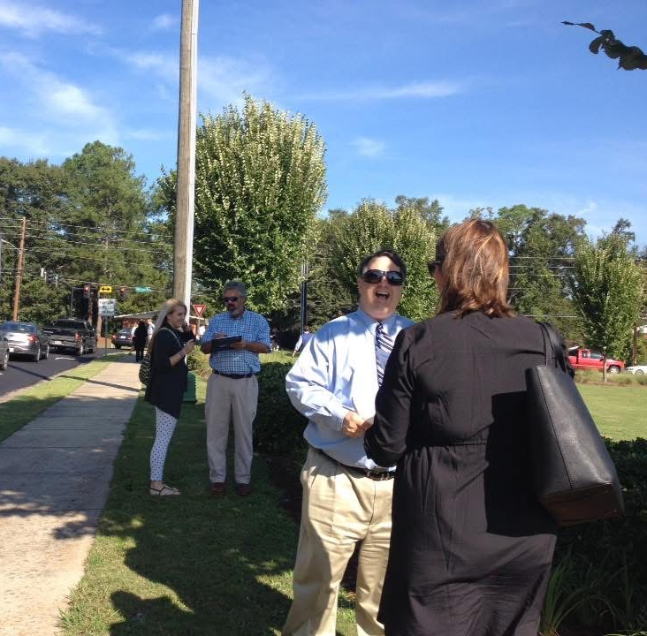
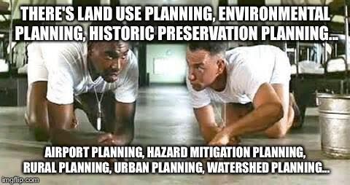
WHAT IS PLANNING?

Slide 8
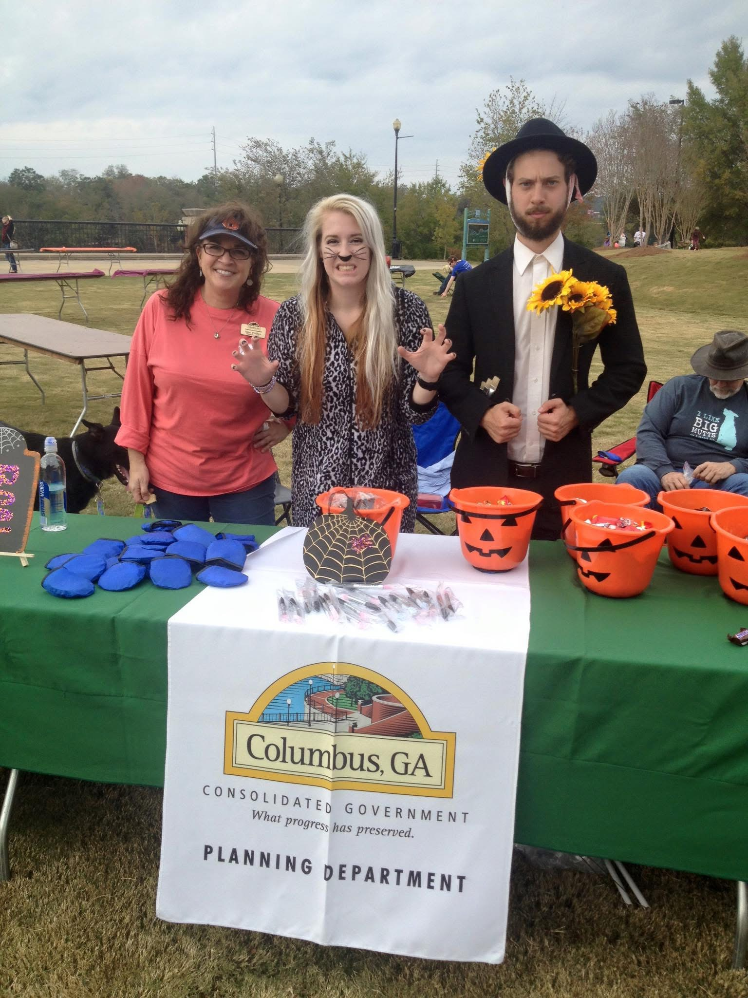
WHY PLAN?
Planning for YOUR Community:
Helps protect property rights/values
Certainty is good for economic development
Helps maintain and improve your quality of life
Protect public investments: It’s your money, after all
Provides a forum to reach consensus

Slide 9
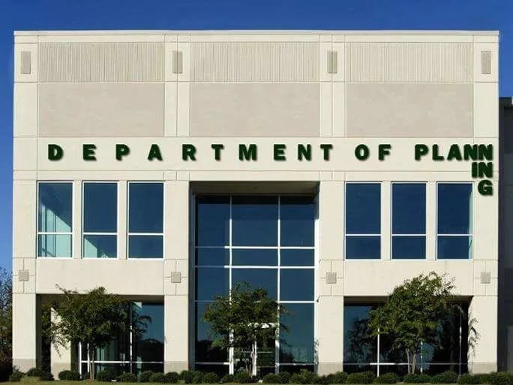
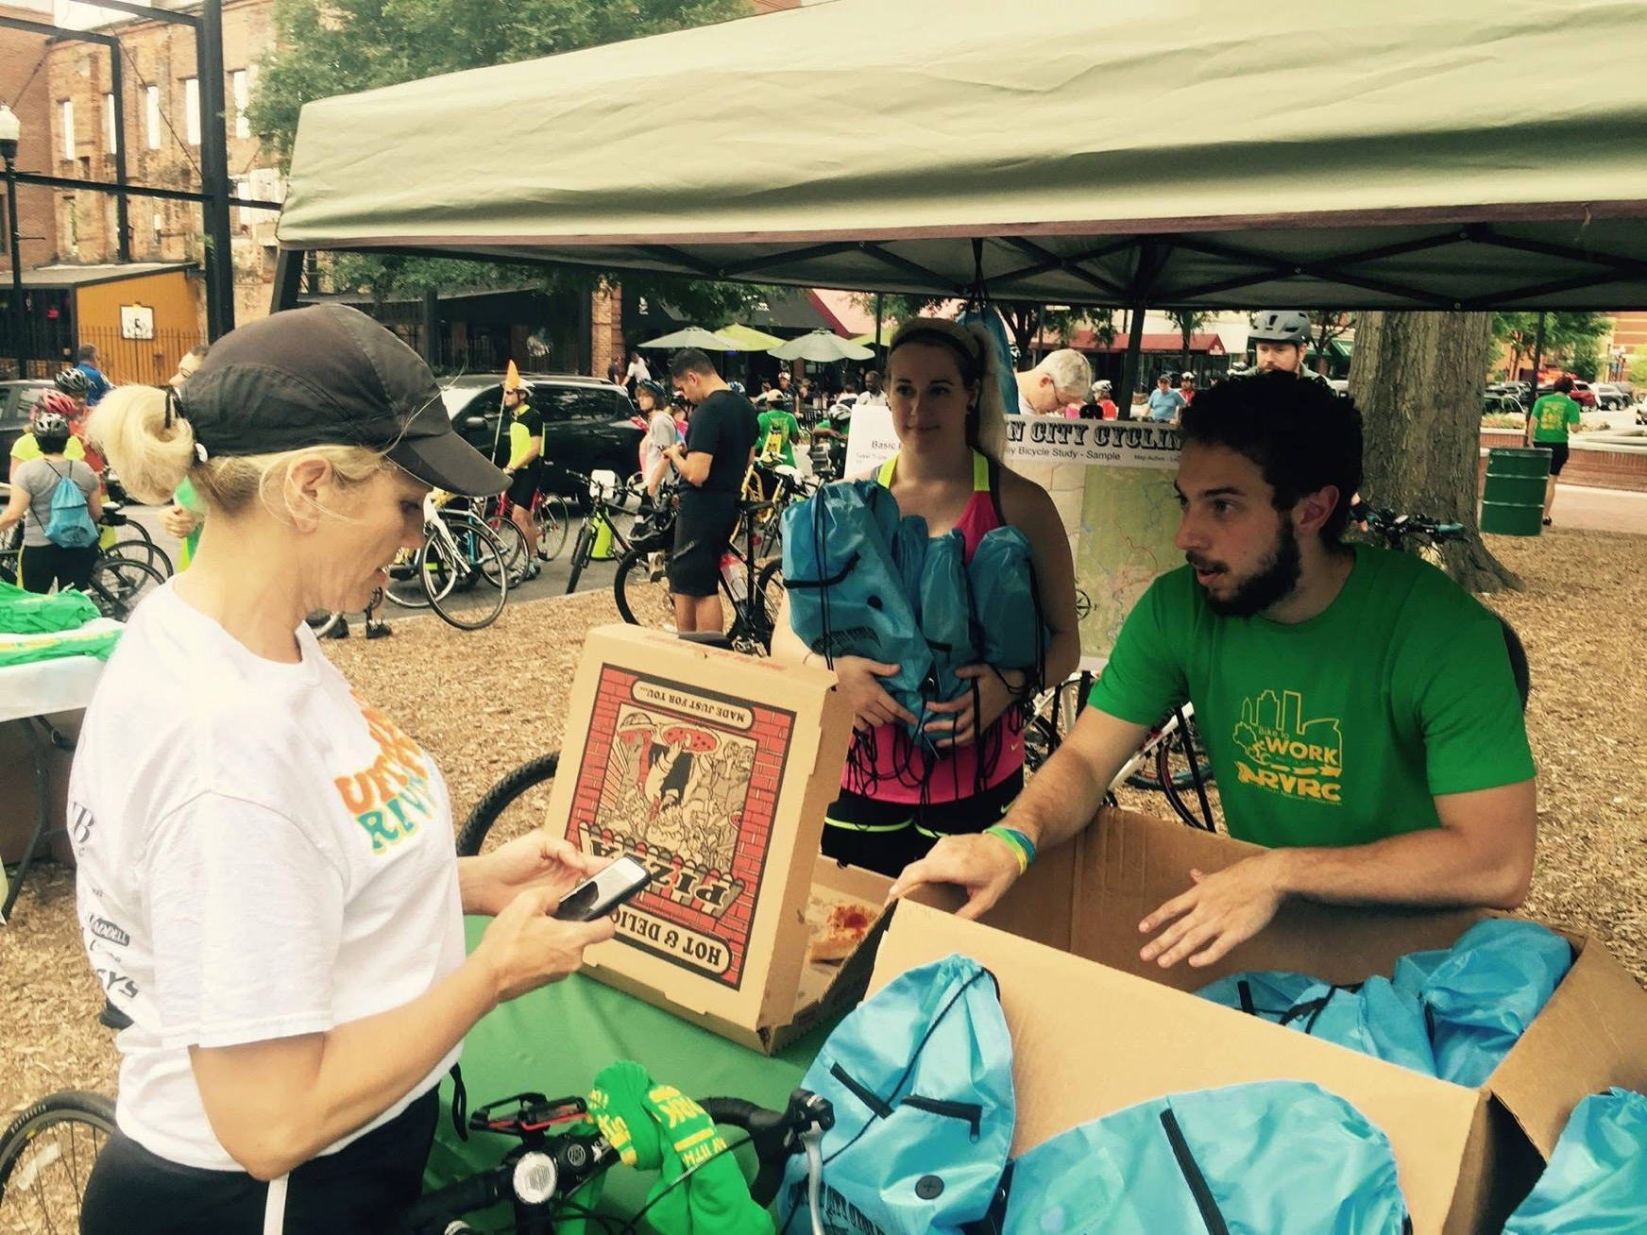
WHY PLAN?
Planning for YOUR Community:
Helps protect property rights/values
Certainty is good for economic development
Helps maintain and improve your quality of life
Protect public investments: It’s your money, after all
Provides a forum to reach consensus

Slide 10
WHY PLAN? Social Benefits

Slide 11
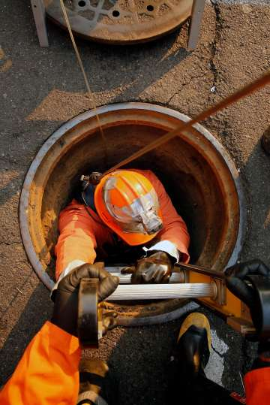
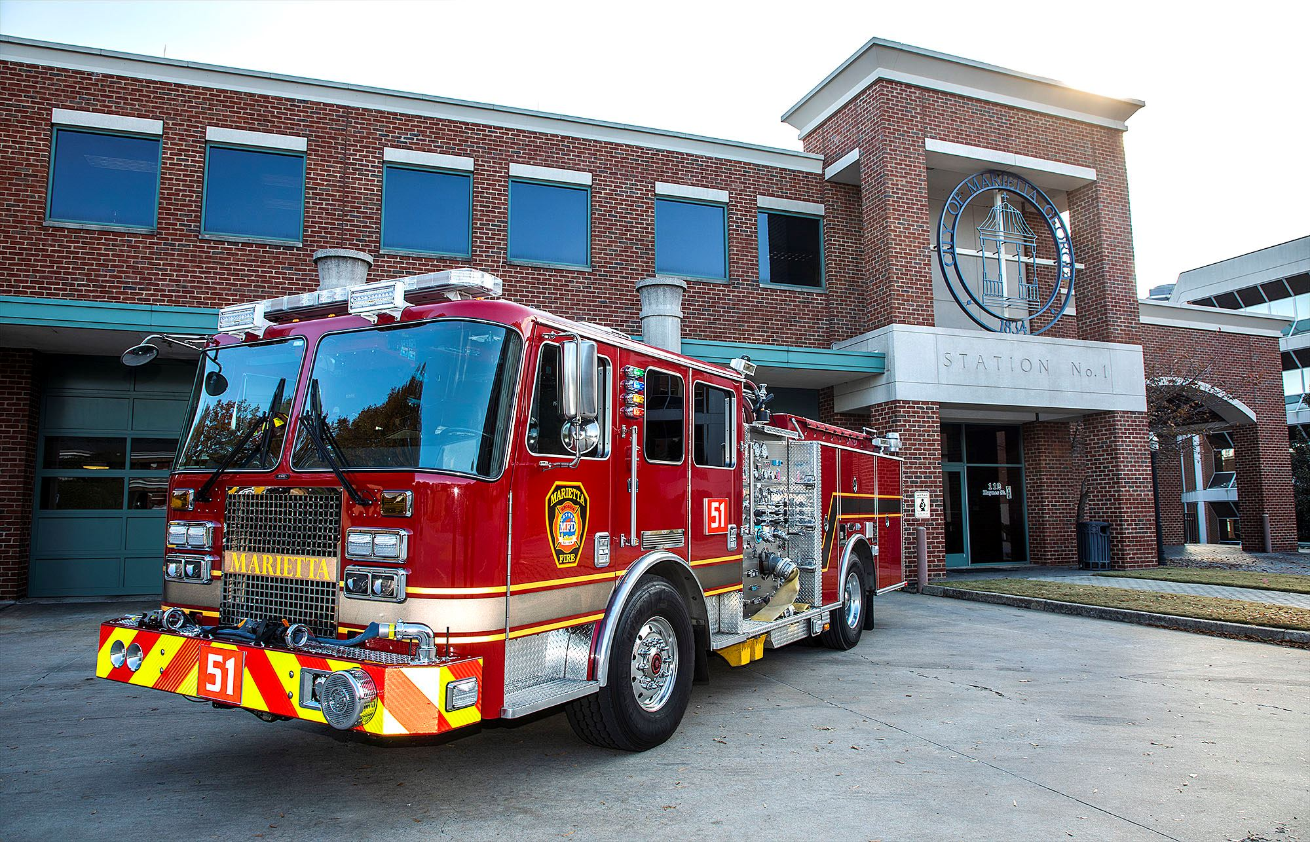
WHY PLAN? Economic Benefits

Slide 12
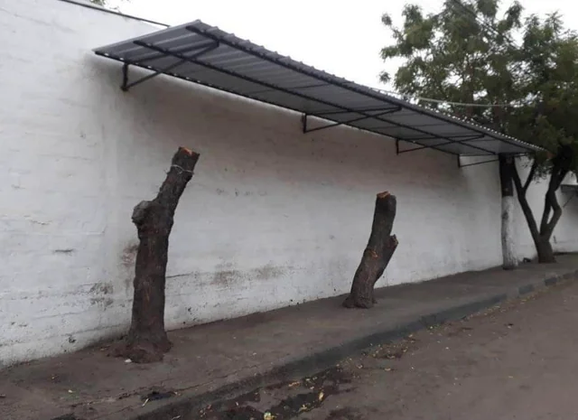
WHY PLAN? Environmental Benefits

Slide 13
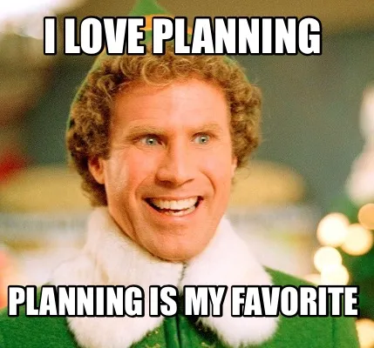
WHO PLANS?
EVERYONE – the plan should involve the entire community
Elected Officials
Local Government Staff
Consultants, Developers
Appointed Officials
Regional Commissions
State of Georgia

Slide 14
PLAN MAKING

Slide 15
WHAT COMMUNITY PLANS DO
Predict future population, housing, and employment trends
Protect and preserve future land needs
Assure adequate public facilities and services
Protect existing and future public investment
Protect environment
Reflect community values
Don’t you want to know how many houses you will need? New jobs?
Don’t you want to make sure you have enough land available to grow?
Don’t you want to have enough water for the community?
Don’t you want to save money by continuing to use what you already have paid for?
Don’t you want to make sure your natural and historic resources are protected?
Don’t you want your community to be what YOU want it to be?

Slide 16
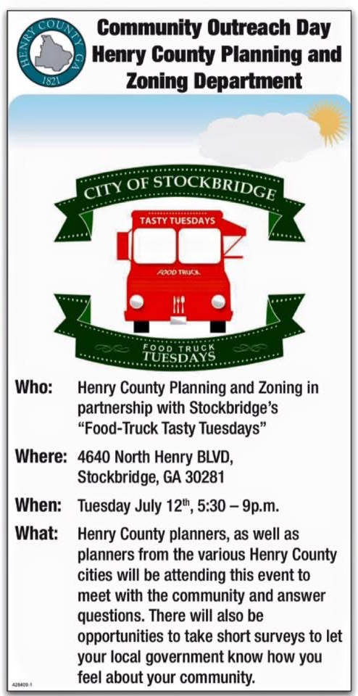
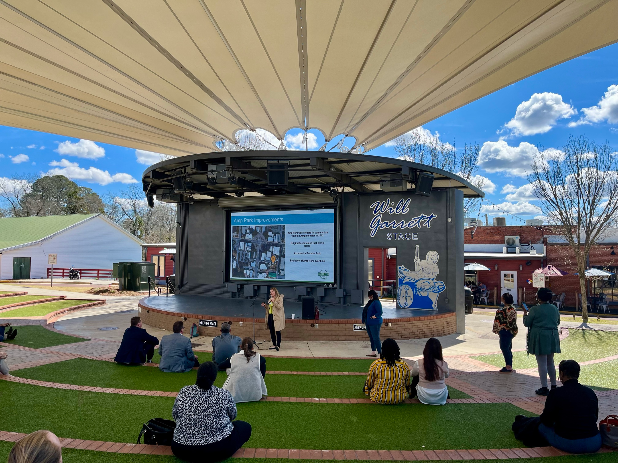
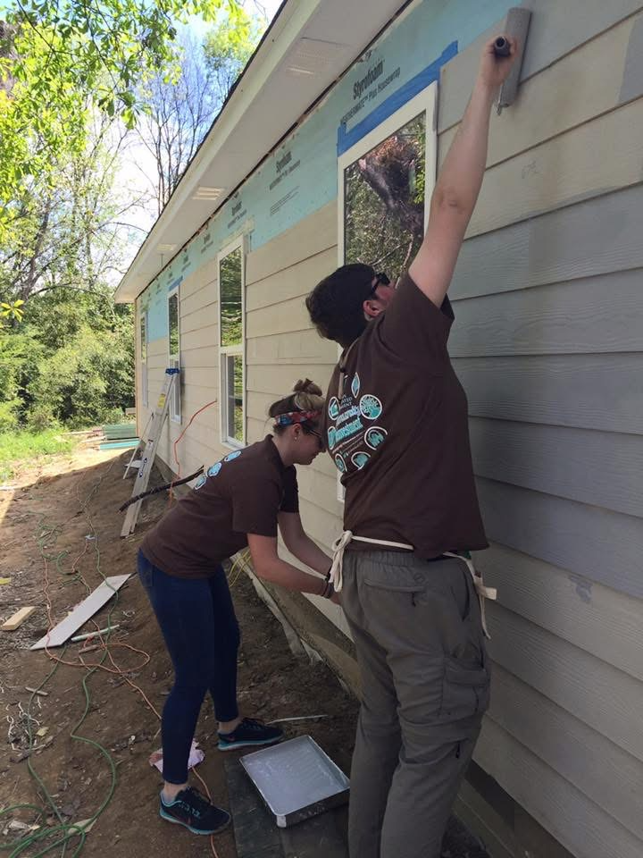
WHAT COMMUNITY PLANS DO

Slide 17
DO PLANS MATTER?

Slide 18
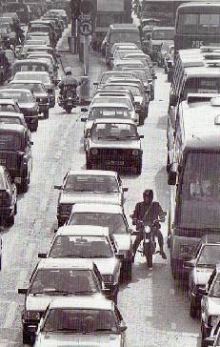
IF WE DON’T PLAN!

Slide 19
IT ISN’T JUST DCA

Slide 20
HOW WE DO IT IN GEORGIA
1st passed in 1989
DCA administers the Local Planning Rules
Rules revised several times
Provides eligibility for state funds, QLG
Georgia Planning Act is the foundation for community planning across the State

Slide 21
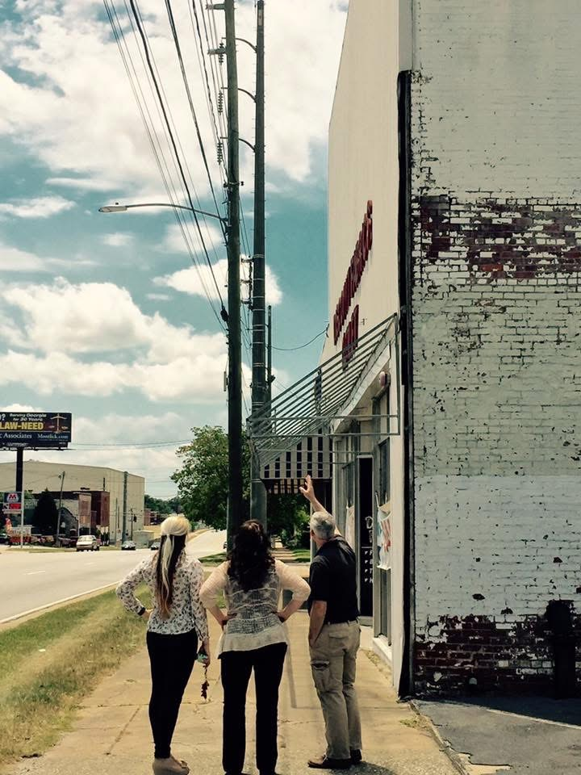
LOCAL COMPREHENSIVE PLANS
Help develop & support policies
Direct capital improvements
Help set the budget
Evaluate future development
See the future
Set the future
Guide economic growth
Guide land development

Slide 22
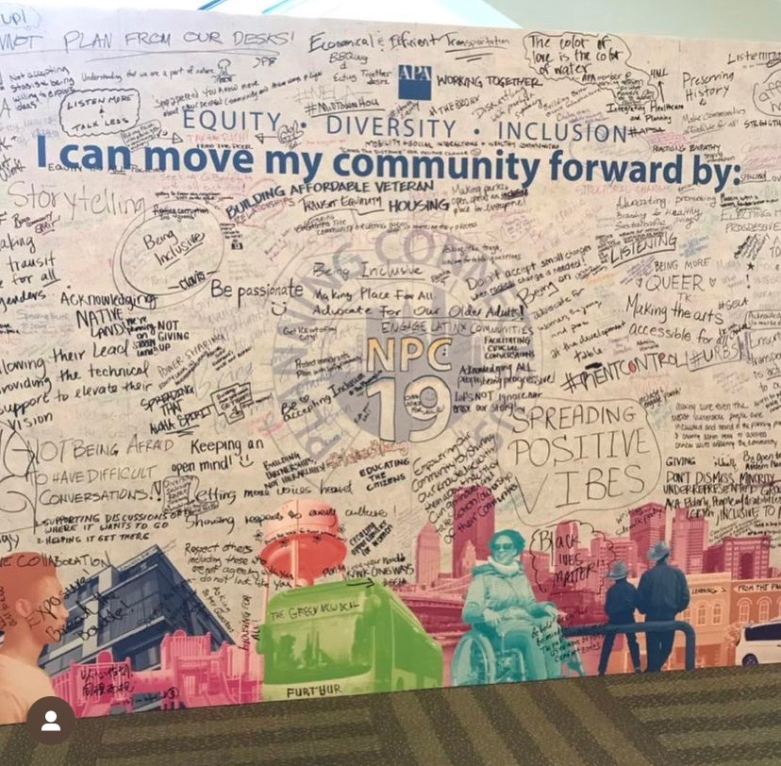
LOCAL COMPREHENSIVE PLANS
Celebrate the community
Improve community health
Address housing issues
Upgrade local infrastructure
Gives the public a voice
Represents everybody
See opportunities not just issues
Provide solutions

Slide 23
LOCAL PLANNING TOOLS
Future Development Map in the comp plan
Zoning Ordinance and Map
Unified Development Code
Special ordinances for trees, signs, etc.
Design Guidelines (historic districts, etc.)
Others specific to your local government

Slide 24
ZONING DEFINED

Slide 25
ZONING ORDINANCE
Zoning Map
Administrative Procedure
District Requirements
Site Design

Slide 26
WHO’S INVOLVED?
On the local level:
Elected Officials: State, County, City
Appointed Boards and Commissions
Planning Staff
Development Community
Public

Slide 27
ELECTED OFFICIALS
Legislative Actions
Responsibilities

Slide 28
ACTIONS
Legislative (elected officials)
Such things as:
Adopting the zoning ordinance
Adoption of amendments to the ordinance that change the text
Rezoning of property
Special use permits
Administrative
Anything else

Slide 29
LEGISLATIVE RESPONSIBILITIES
Set plan in motion
Create a capable board
Establish policy
Change policies/ordinances
Give sense of direction
Make final decisions

Slide 30
PLANNING COMMISSION AUTHORIZATION
Contained in your ordinance - Administration (the commission as well as the elected body and staff)
Planning Commission
Creation, Appointment, Terms
Organization, Rules, Staff
Functions and Duties
Role and responsibilities of the elected body
All procedures and standards

Slide 31
PLANNING COMMISSION
FIVE GOALS OF PLANNING COMMISSION
Remember what the purpose of “zoning” really is
Carry out development review process within the legal framework and requirements of state and local law
Effectively deal with the local political will
Act as an arbiter between government staff, applicant, citizens, land owners, and other parties
Review projects in view of standards and technical criteria which are applicable

Slide 32
PLANNING COMMISSION
QUALIFICATIONS
Be a resident
Willingness and dedication
Interest in community planning
Desire to assist in implementation
Willingness to encourage and accept input
Ability to maintain an objective approach

Slide 33
PLANNING COMMISSION
ROLES
Prepare comprehensive plan
Advise on planning
Work within established policies/codes
Recommend changes to policies/codes
Implement plan with local government

Slide 34
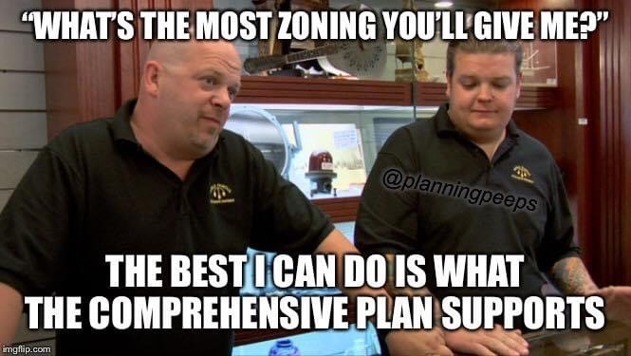
PLANNING COMMISSION: TIPS
Are environmental impacts reduced or eliminated by conditions or are there overriding considerations?
Is decision supported by findings of fact based on substantial evidence in the record?
Anything else?
Does it meet all applicable zoning and subdivision requirements?
Is the proposal consistent with the Comp Plan?
FOLLOWING THE LAW - ASK THESE QUESTIONS

Slide 35
PLANNING COMMISSION: MEMBERS
BEING EFFECTIVE
Learn meeting procedures (Robert’s Rules of Order)
Stay informed
Keep communication open
Be an effective leader
Follow the law

Slide 36
PLANNING COMMISSION: MEETING BASICS

Slide 37
AGENDA
Introduction of reports/documents
Approval of minutes
Old business
New business
Other business
Adjournment

Slide 38
ACTIONS: What are your choices?
Approve
Deny
Postpone
Approve with Conditions

Slide 39
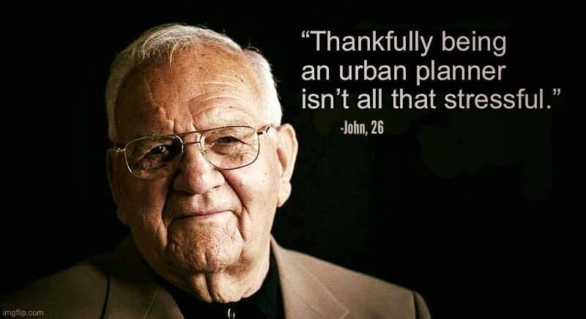
LOCAL STAFF RESPONSIBILTIES
Administer code
Provide full and accurate information and background to applicant, developers, boards, commissions, and landowners
Reports/recommendations based on fact (plan/code)
Administrative permits

Slide 40
DEVELOPMENT COMMUNITY
Acts as agents for property owners or neighborhood
Professional wisdom and experience

Slide 41
WHO IS THE DEVELOPMENT COMMUNITY?
Real estate agents/brokers
Land developers/speculators
Residential and commercial builders
Apartment developers and landlords
Lawyers
Engineers, architects, surveyors
Bankers
Consultants
Trade groups/special interest groups

Slide 42
THE PUBLIC
Plans belong to the community
Publishing hearing agenda in various media outlets is good tool
Handouts and visuals can help individuals understand in process

Slide 43
FINAL WORDS

Slide 44
Juli Yoder, AICP
Principal Planner/ Planning Manager
planning@dca.ga.gov

