Slide 1
2026 CDBG
Grant Award and Financial Management

Slide 2
Agenda
Grant Award Package Contents
Common Award Package Issues
Financial Management
Audits

Slide 3
Communication is Key
City/County
Grant Administrator
DCA
Bonita Chapman
DCA Accounting Office
SAO
State Accounting Office

Slide 4

Grant Award Package
1. Statement of CDBG Award
2. Budget Summary
3. General & Special Conditions
4. Statement of Revisions
5. Authorized Signature Card
6. Supplier Change Request Form (SCR)
7. Banking Letter
8. Drawdown Form
9. Form W-9
(Chapter 1)
$?$?$?

Slide 5
Two Parts of the Award Package
Part 1 (return in eCivis)
Statement of Award
General and Special Conditions
Statement of Revisions (if needed)
Part 2 (register with Ga@Work and send copies to CDBG.biz)
Supplier Change Request Form
Bank Letter
W-9 Form
Signature Card
Notes:
Next two slides cover:
Register as a prospective supplier
Add and Update Supplier Contacts and Users
*explain why they are sending the copies to CDBG.biz

Slide 6
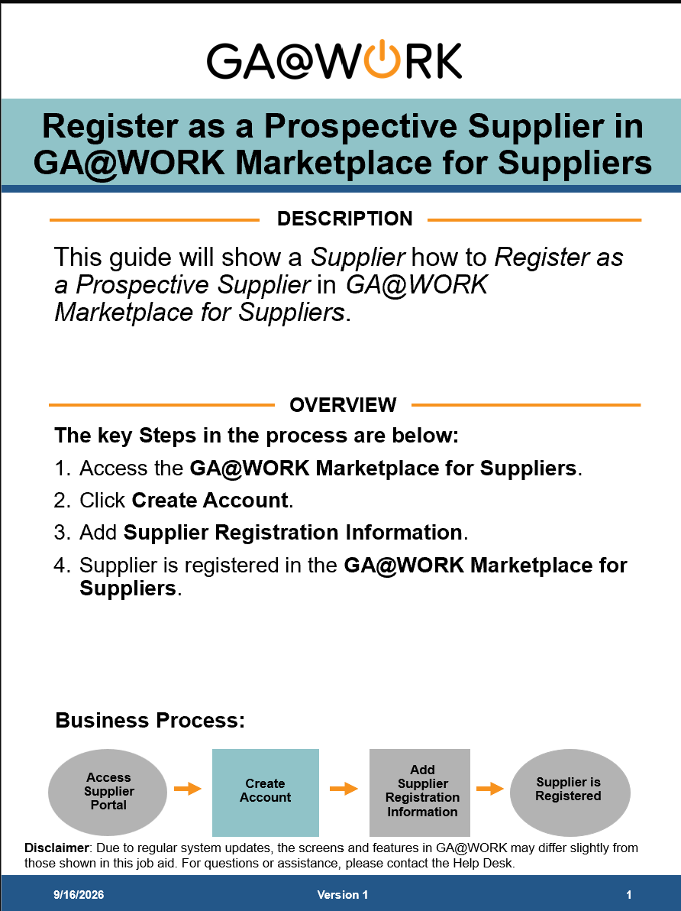
Step 1:
Register as a Prospective Supplier in Ga@Work https://doas.ga.gov/sites/default/files/2026-06/Job%20Aid_PROC%20Suppliers_Register%20as%20a%20Prospective%20Supplier%20in%20GA%40WORK%20Marketplace%20for%20Suppliers_Complete.pptx

Slide 7
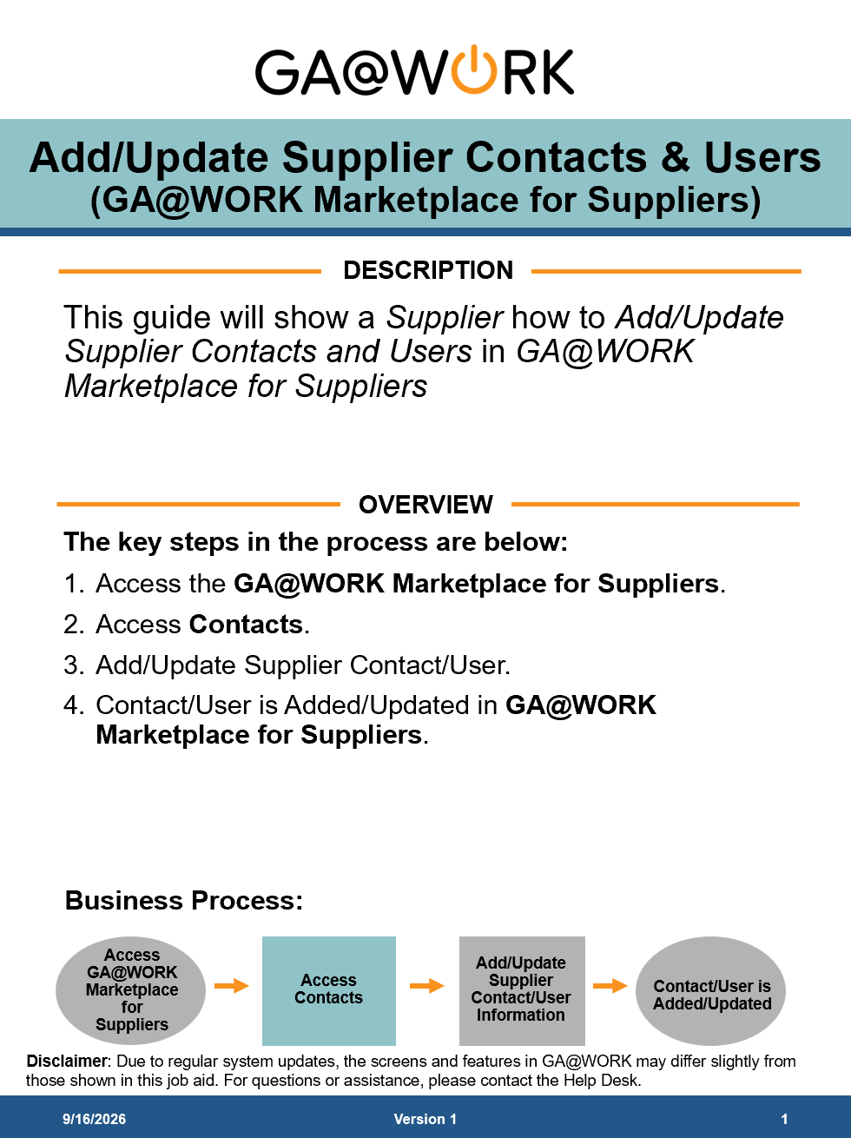
Step 2:
Add/Update Supplier Contacts & Users in Ga@Work https://doas.ga.gov/sites/default/files/2026-06/Job%20Aid_PROC%20Suppliers_Add%20and%20Update%20Supplier%20Contacts%20and%20Users%20%20%28GA%40WORK%20Marketplace%20for%20Suppliers%29_Complete.pptx

Slide 8
1. Statement of CDBG Award
Your Contract with DCA
Your unique Grant #. Include Grant # on all forms & correspondence to DCA
Grant Period: An important timeline to keep
Sign & return to DCA.
Keep a copy for you files.
Notes:
First Bullet: “in accordance with the plan set forth in the application
Second Bullet: on ALL correspondences submitted to DCA
Third Bullet: If an extension is needed, request in advance of the grant expiration.

Slide 9
1A. State of Award
Signature Required of the Chief Elected Official
Unless appointed otherwise in meeting minutes or in a Resolution
Include a copy of the meeting minutes or a Resolution that applies with award package

Slide 10
2. Budget Summary
Your Official Budget
Use THIS budget (not application’s) to create your ledger, accounting records
Local match/leverage is listed at bottom; keep documentation of it – it will be monitored
DO NOT SIGN & RETURN this form with the award package

Slide 11
3a. General Conditions
For ALL CDBG awards
Includes standard, mandatory CDBG compliance responsibilities (Environmental, Section 3, Conflict of Interest, BABA, etc.)
Must be signed & returned in award package
Notes:
Second bullet: this goes back to that contract idea: by signing, you are agreeing to these General Conditions.

Slide 12
3b. Special Conditions
Specific to each CDBG Award
Elected Official’s Signature = “I agree to clear these conditions ASAP.” (See General Conditions)
Not cleared until you receive a “Grant Adjustment Notice” (no clearance, no $$$)
Must be signed & returned in award package
Notes:
First Bullet: you may not have any SC’s

Slide 13
4. Statement of Revisions
Your Statement of Award might say, “This award is subject to revisions” →
Changes to proposal were made (usually budget, but some project scope changes for 2025)
Review thoroughly, sign & return with award package

Slide 14
5. Authorized Signature Card
Local authorization to sign & submit draws
Gives option of 1 or 2 signatures on draws
At least one local government signature is required
(employee or official)

Slide 15
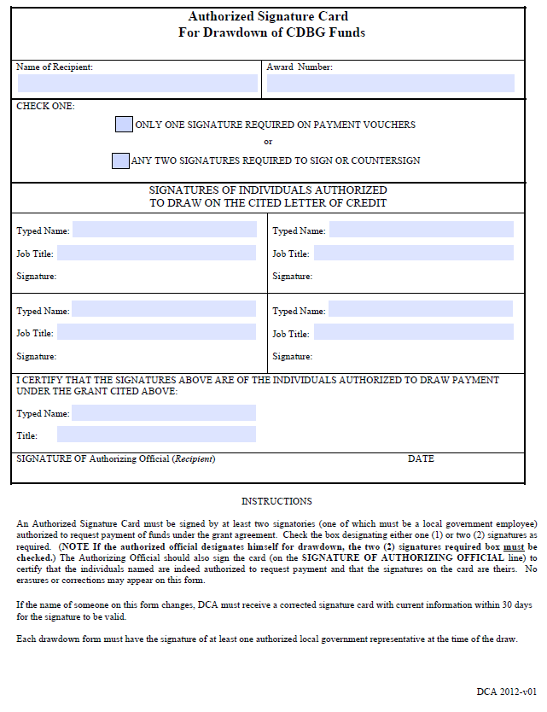
Notes:
Even though this is being uploaded to Marketplace, please also forward to CDBG.biz for internal drawdown records.

Slide 16
Your CDBG Bank Account
Separate, non-interest bearing bank account for each CDBG award
Account is for CDBG $$$ ONLY (no match or any other project funds!!!!!!!!)
Tips:
  Check with bank for minimum balance; if local $ is used to open, it can be reimbursed later
  CDBG will not pay insufficient fund charges
  CDBG funds-on-hand for over three-business days should be limited to $5,000 or less. If more than $5,000….you must send it back to DCA.
Notes:
*except, of course, when you draw down funds. Drawn down funds should leave account within 3 days of arrival

Slide 17
6. Supplier Change Form (SCR)
Drawn funds deposited electronically to your CDBG bank account
Must be signed & returned with award package
Attach an approved Bank Letter

Slide 18
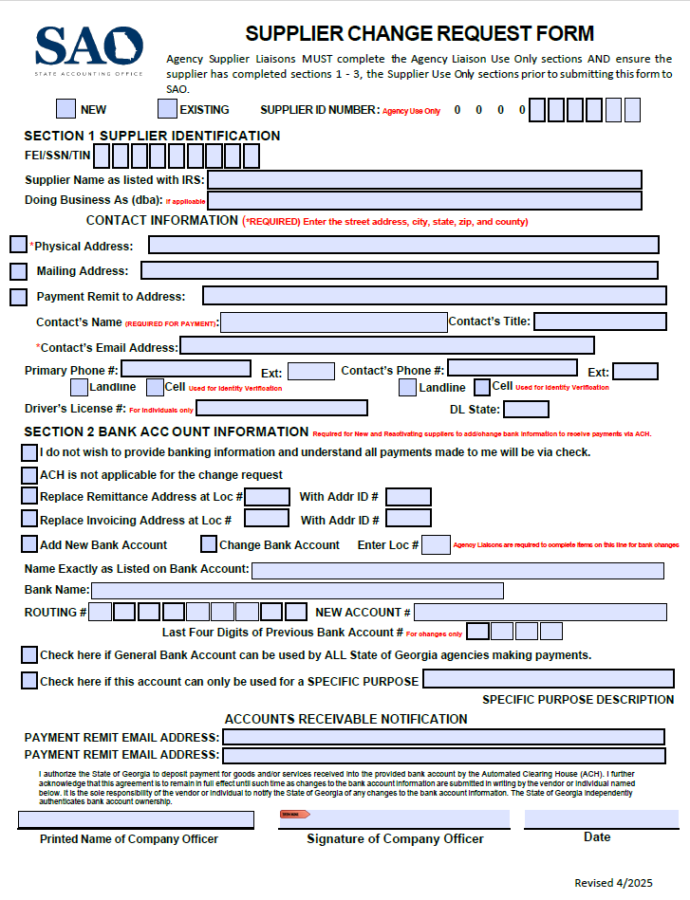
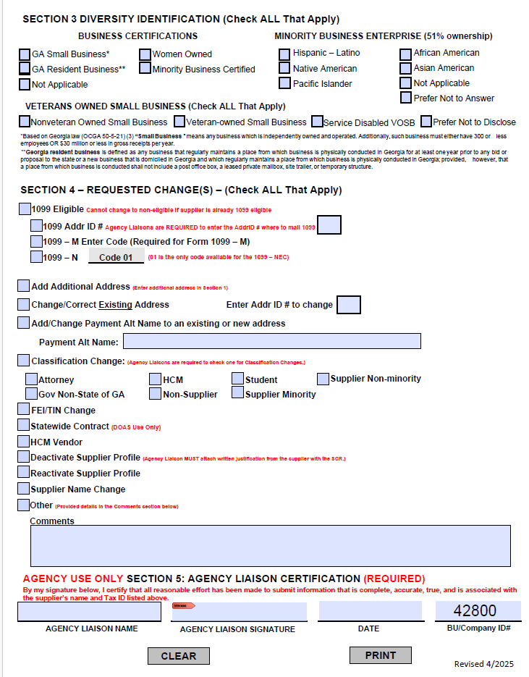
New Supplier Change Form
Notes:
Instructions for completion are in appendices 1

Slide 19
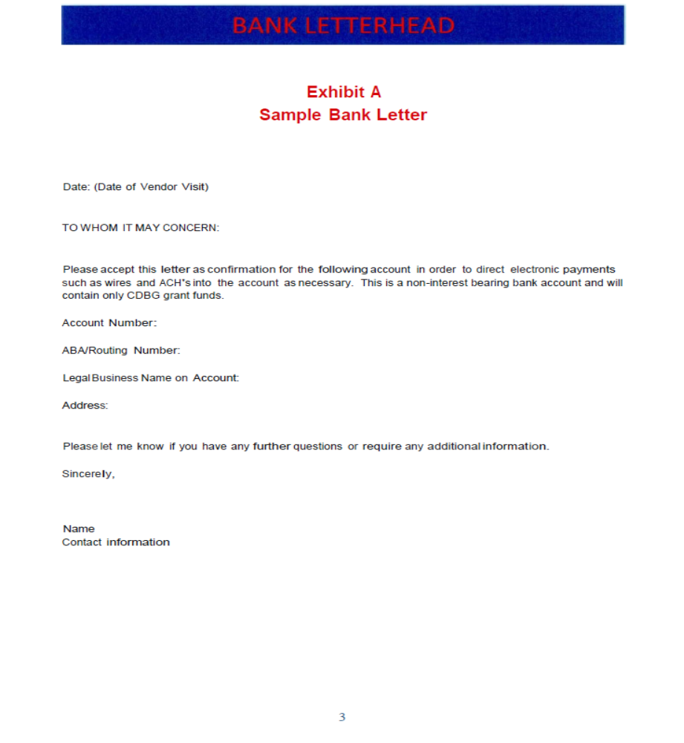
7. Banking Letter

Slide 20
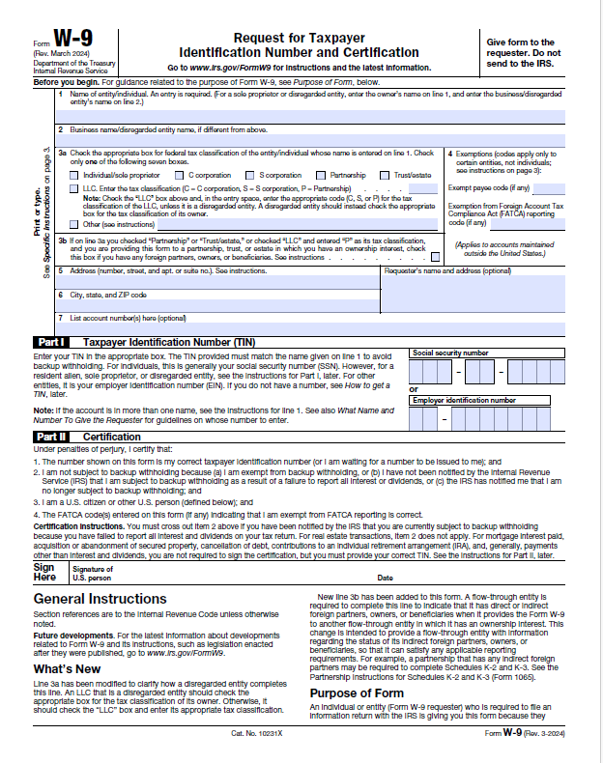

Slide 21
Common Award Package Issues
Supplier Change Request Form – Correct Way
Section 1 - Complete Address 1, if adding an Address 2, that must be done on a separate SCR form. No need to complete the Drivers License and DL State.
Section 2 –Complete - Content must match W-9 and the Banking Letter
Section 3 – Mark Not Applicable for both Business and Minority sections
Section 4 – Only use Comments section - enter the contact name, phone number and days of the week/hours available
Notes:
*except, of course, when you draw down funds. Drawn down funds should leave account within 3 days of arrival

Slide 22
Common Award Package Issues
Banking Letter – Correct Way
All content must match Supplier Change Form and W-9
Use DCA sample letter
Need:
  Account #
  Routing #
  Business Name on Account
  Business Address, Signed and Dated
Notes:
*except, of course, when you draw down funds. Drawn down funds should leave account within 3 days of arrival

Slide 23
Common Award Package Issues
W-9 – Correct Way
Lines 1-7 Business Name and address – must match Supplier Change Form and Bank Letter
Part I - EIN# must be accurate and must match Supplier Change Form
Part II – Must be signed and dated
Notes:
*except, of course, when you draw down funds. Drawn down funds should leave account within 3 days of arrival

Slide 24
Important Reminders
Keep copies of your entire award package
Sign & return award package within 30 days of award, October 28, 2026
Remember: No signed award package = No $$$
Notes:
*Not the budget summary

Slide 25
Financial Management

Slide 26
Financial Management
“…financial records should be established & maintained in such a manner as to facilitate the reporting and monitoring of expenditures and obligations by activity.”
--Ch. 3, Financial Management & Administration
Bottom Line:
You need a good ledger and financial filing system for your project – please review Chapter 3 carefully.
You will be monitored for Financial Management
Notes:
What will you need when we monitor you for FM? Bank Statements. QR’s. Drawdown files and accompanying invoices. All match/leverage source & use documentation.

Slide 27
You Cannot Draw Down Funds
Until You…
Complete and submit grant award package
Clear your special conditions through GAN’s
Receive DCA environmental clearance for non-exempt activities
…are caught up on Quarterly Reports
Verify required cash match/leverage (for final draw down)

Slide 28
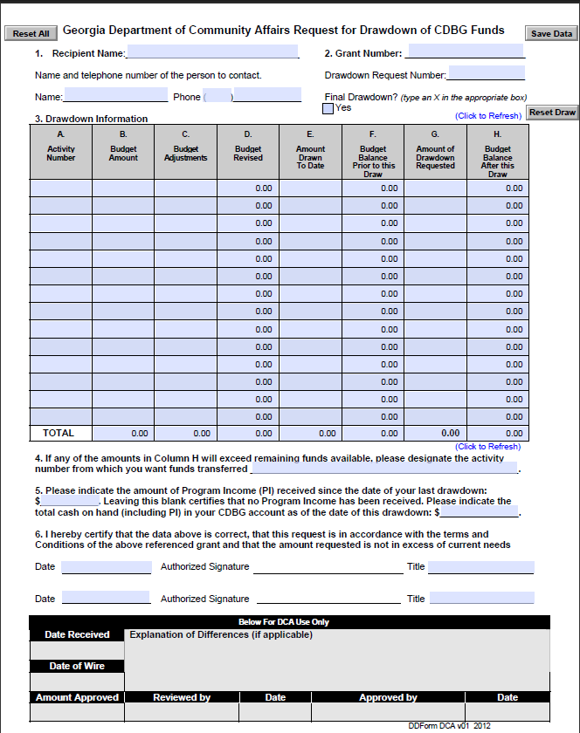
8. Drawdown Form

Slide 29
Draw Downs
DCA processes draws on Tuesdays & Thursdays
Time your draw-downs accordingly; “funds should be in your bank 10 days from the day DCA processes request”
Match signatures to those on Authorized Signature Card
Invoices must total at least the draw amount and signed by local government official
Funds should be paid out of your account no later than 3 business days after they are deposited (if not, it will result in an unresolvable finding)

Slide 30
Common Draw Errors
Missing authorized signatures
Incorrect activity codes
Incorrect amounts – eCivis and draw form do not match
Invoices not signed by Local Government
Dates missing on the forms
eCivis is our main communication for draws

Slide 31

DCA Mailing Address
& Email Address
Office of Community Development
Georgia Department of Community Affairs
60 Executive Park South, NE
Atlanta, GA 30329-2231
CDBG.BIZ@DCA.GA.GOV

Slide 32
eCivis Portal
Award Acceptance

Slide 33

You’ve Been Awarded!
Wait for the email with link for your community’s award
Use Portal account associated with application
Ensure “support@eCivis” is added to your approved sender list (“Whitelist”)
Notes:
All awardees should have received their email from eCivis for their awards.

Slide 34
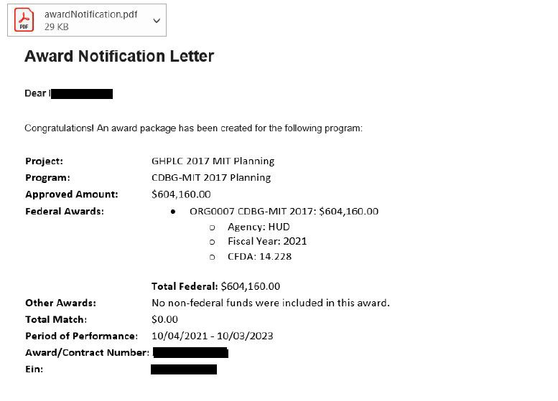
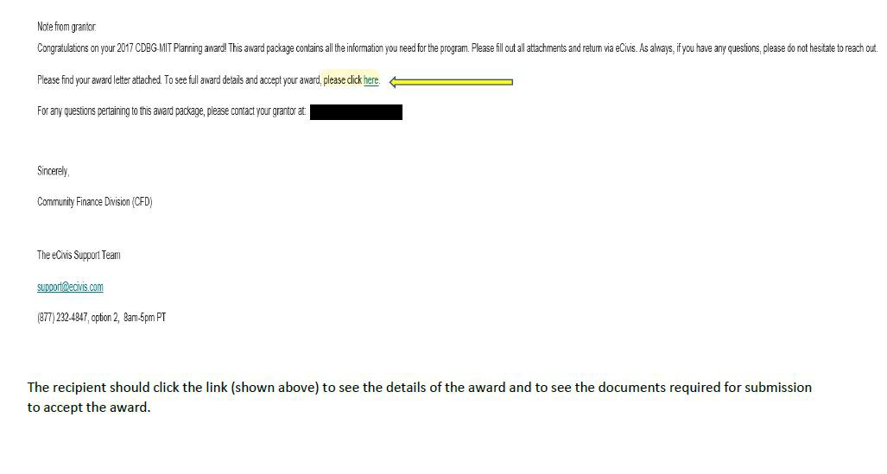
The Award Notification Email

Slide 35
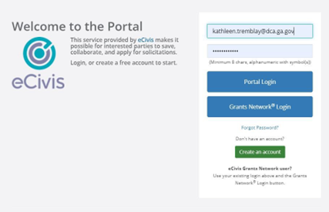
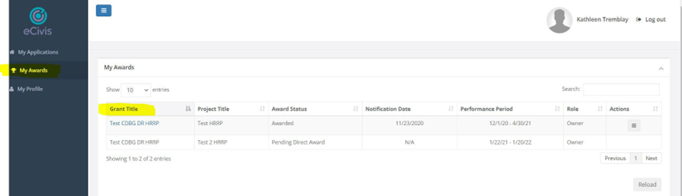

Slide 36
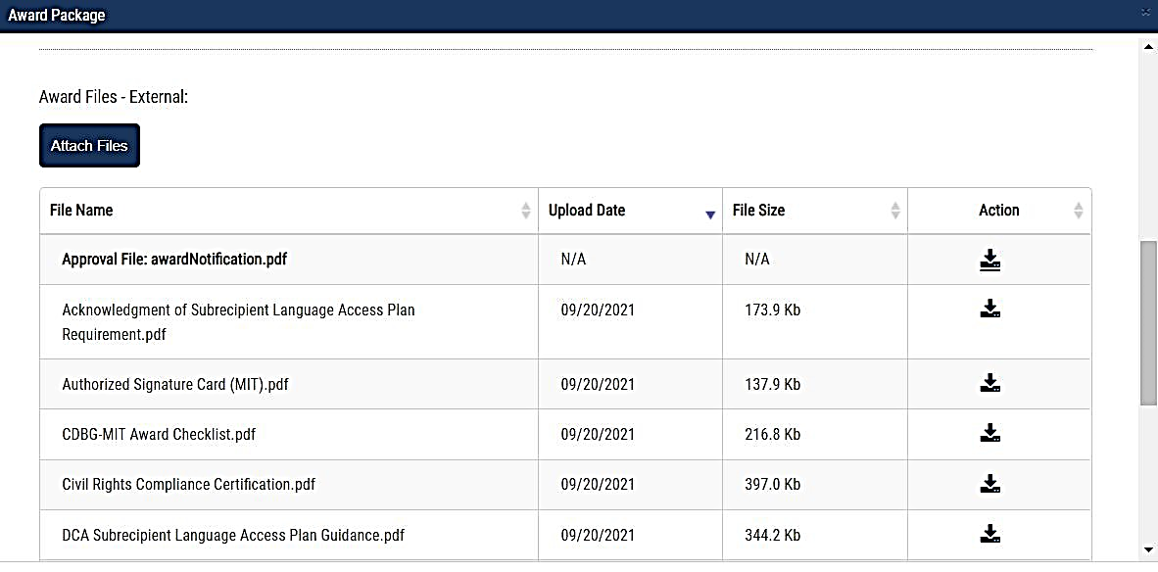
In the award package you will find all documents necessary to execute your award
  Award documents will require you to download for completion and/or signature(s)
  Additional documents may be samples to assist with completing the required documents
  You can upload documents as they are completed BUT do not submit until all required documents are uploaded

Slide 37
The ONLY award documents to be returned thru eCivis are listed below:
The Statement of Award
General Conditions
Special Conditions
Revisions to the Grant Award if needed
All other forms (Signature Card, Supplier Change Form, W9 and the Banking Letter should be uploaded to Georgia Marketplace and later emailed to CDBG.BIZ@DCA.GA.GOV
Contact Bonita Chapman if you have any questions, Bonita.Chapman@dca.ga.gov

Slide 38

Things to Remember
If there are errors in any document, the entire award package will be returned to you
When resubmitting please ensure you have deleted the erroneous document and only uploaded the revised version
If you need assistance with completing the required documents, please reach out to Bonita Chapman

Slide 39
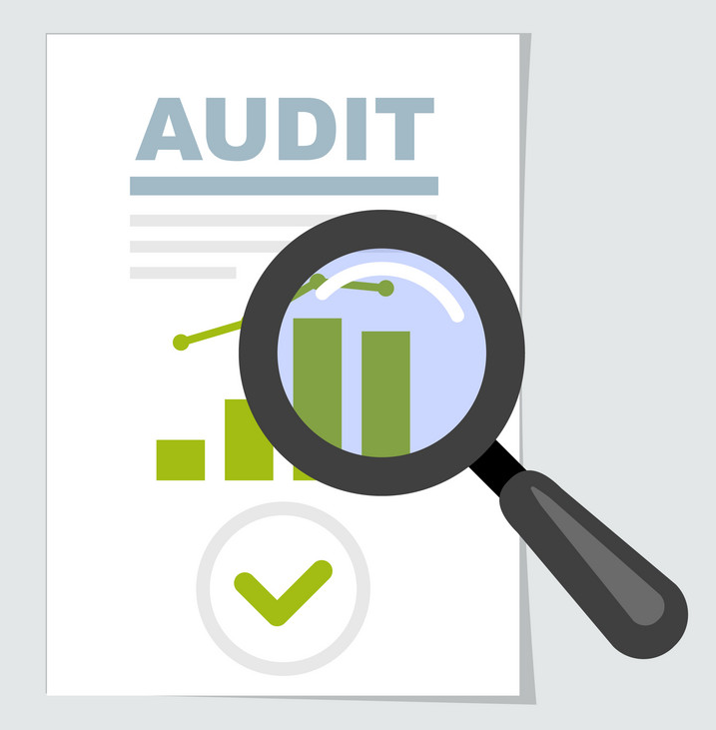
Audits
Forms and Requirements

Slide 40
Audits
For every fiscal year in which funds are drawn, audit must be submitted to DCA for review
  Electronic copy preferred
  CDBG.Biz@dca.ga.gov
Must include Source and Application of Funds - notify your auditor
  (or substitute w/Federal Schedule of Financial Assistance if total
  expenditures are $1 million or more & upload to FAC at https://app.fac.gov/)
  CDBG Project Cost Schedule
Grant Conditionally Closed - until all audits reviewed along with meeting other conditions
Formally closed - after all audits received and issues resolved

Slide 41
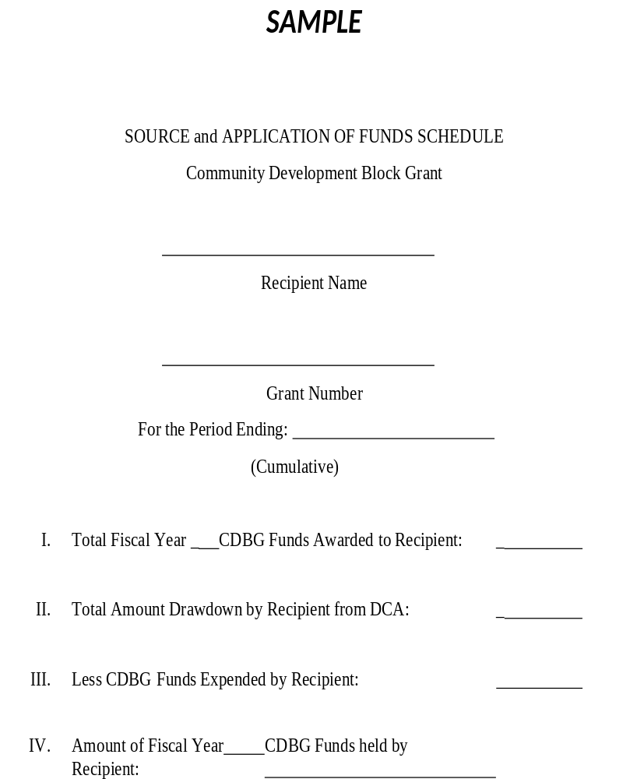
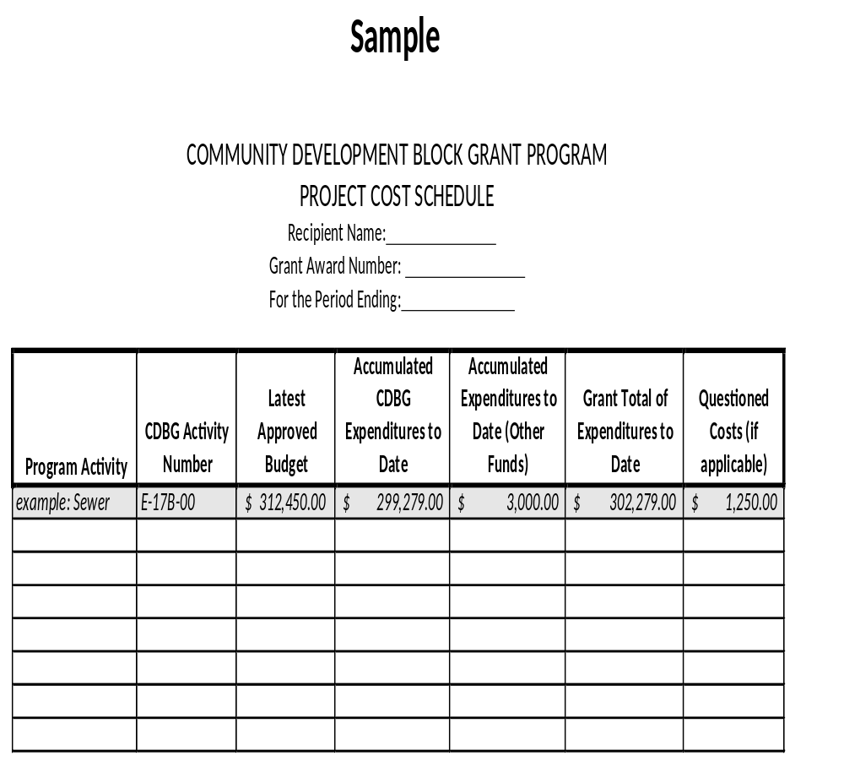

Slide 42

RLF Projects - Audits
Audit Reports - include a Balance Sheet and Income Statement
Required for each FY

Slide 43
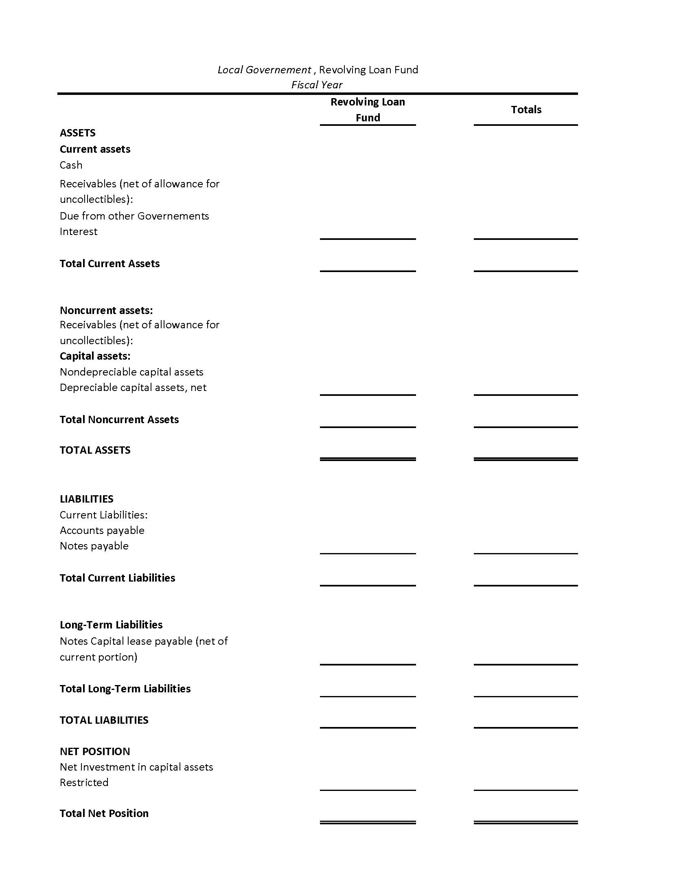

Slide 44
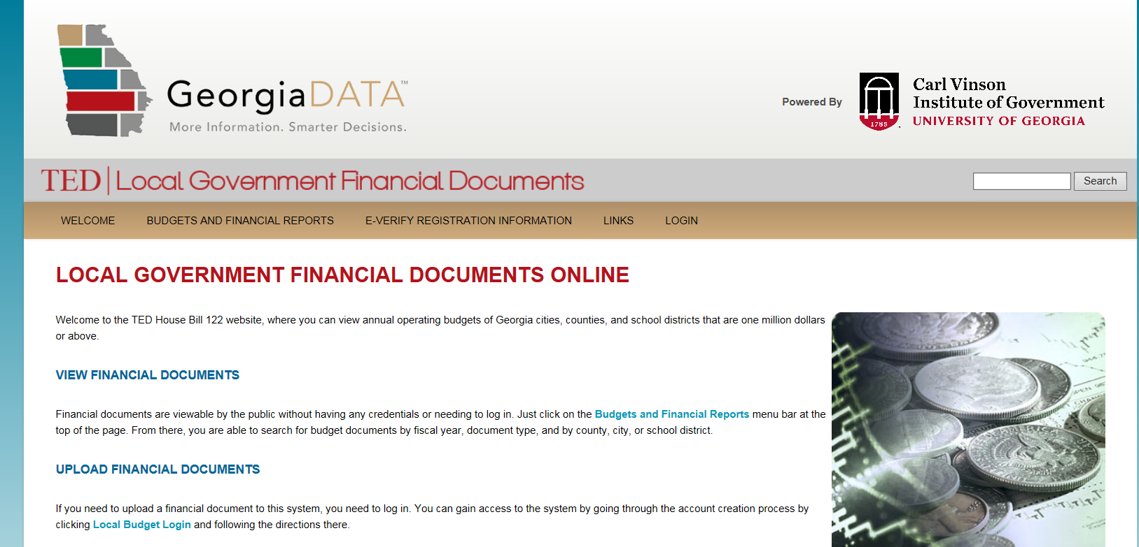
Audits
Send all audits to GA Department of Audits and Accounts
(Future CDBG applications are not eligible if audits are delinquent)
Send to:
  TED / Carl Vinson Institute of Government,
Local Government Finance Documents
  Web site maintaining audits for cities, counties, others
  https://ted.cviog.uga.edu/financial-documents/

Slide 45


Slide 46
Thanks!
Should you have questions, contact:
Bonita Chapman
Bonita.Chapman@dca.ga.gov
Grants Consultant
dca.georgia.gov

