Slide 1
Neighborhood Revitalization / Housing Scoring
Malisa Thompson
Notes:
Good afternoon. I'm going to cover the Scoring Criteria and what information and documentation you should include before submitting your application.

Slide 2
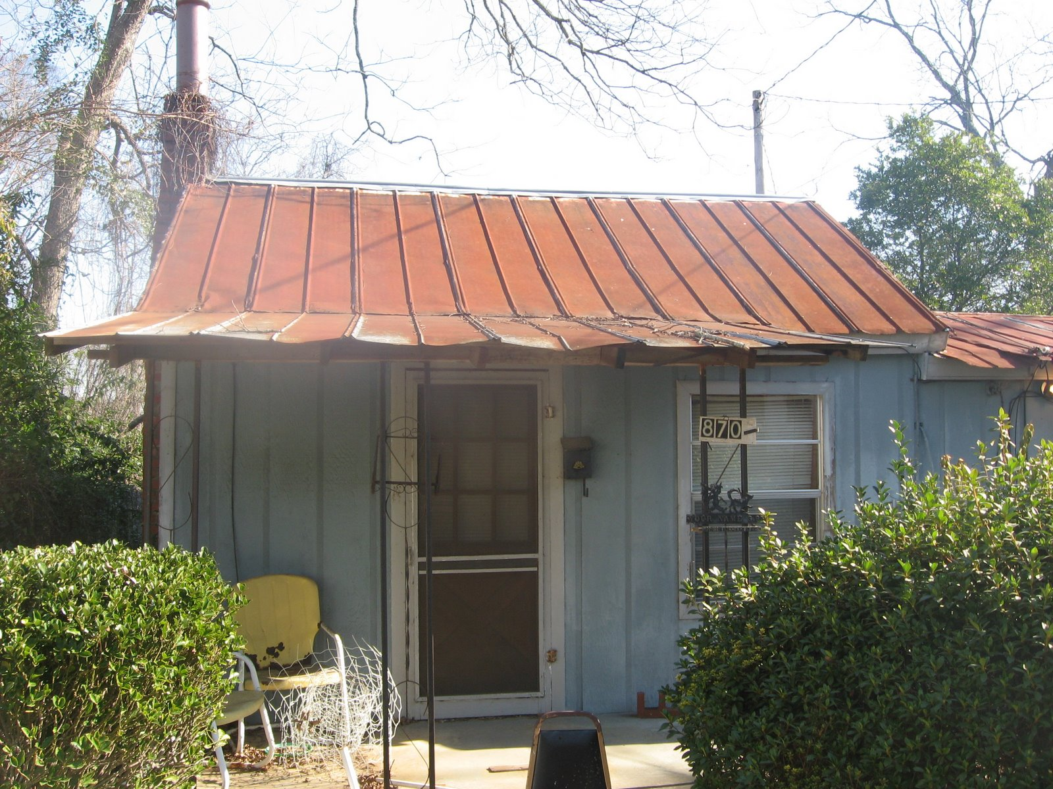
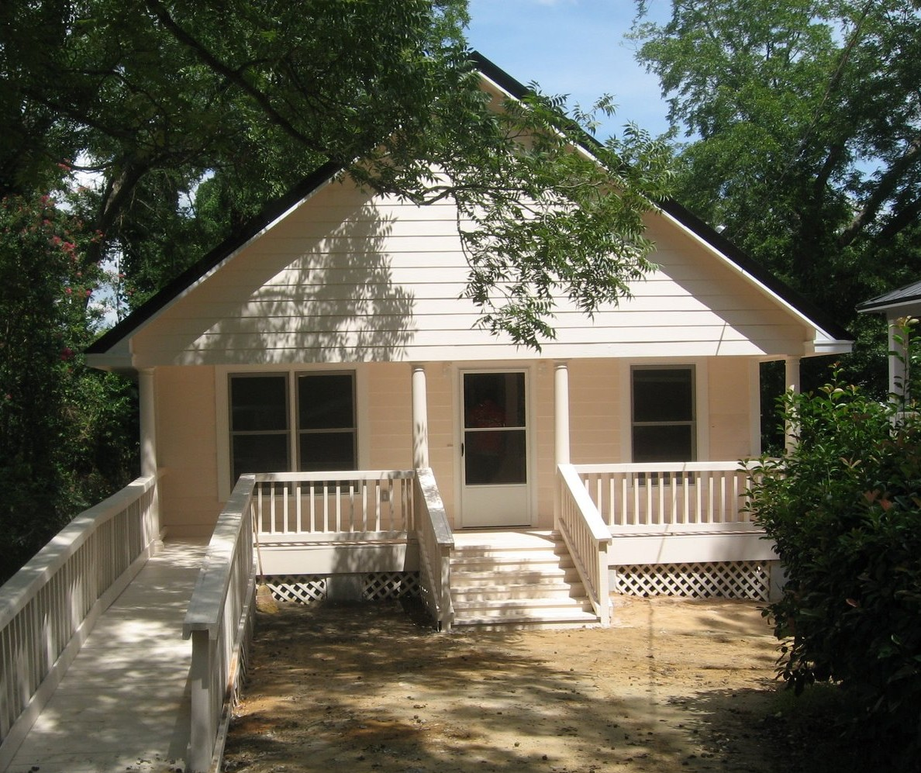
Neighborhood Revitalization
BEFORE
Applications should address:
  Decent
  Safe
  Sanitary
  Correct deficient conditions caused by deferred maintenance & lack of other financial resources
AFTER
Notes:
Applications for Neighborhood Revitalization should address Decent, Safe and Sanitary housing. The needed repairs should correct deficient conditions caused by deferred maintenance and demonstrate that the homeowner lack of financial resources to correct the deficiencies.

Slide 3

Neighborhood Revitalization
Not designed for maintenance or housekeeping
Homeowner responsible for maintaining home
Notes:
Funding for NR is not designed for maintenance or housekeeping. That should always be the homeowners’ responsibility.

Slide 4
Scoring Criteria
Strategy
Feasibility
Need
Impact
Notes:
The four scoring criteria for the application include Strategy, Feasibility, Need and Impact.

Slide 5
Strategy
Considerations

Slide 6
Strategy
How and why the project was chosen
  Provide a compelling narrative that describes the process used to choose the project – Including the required Citizen Participation process
  DCA required concentration maps AND the Community Needs Assessment should be the basis for this discussion
  Use DCA 4 for this discussion

Slide 7
Strategy
Describe and document severity of problems
Demonstrate needs in Narrative AND with Pictures
Alternatives to Strategy
  Especially true for Multi-Activity infrastructure activities
Discuss other possible strategies and why the proposed strategy is best for problems described. Inclusion of cost of alternative strategies can demonstrate why the chosen strategy is the best.

Slide 8

Strategy
Describe
Describe what steps the community has, or will take, to prevent reoccurrence of the described needs. Be specific!
Include
Include copies of current ordinances and enforcement policies that govern community blight (e.g., Code Enforcement). Include examples of actions taken and results.
Discuss
Discuss other detrimental conditions to which the community is exposed, and efforts being taken to resolve these issues.

Slide 9
Strategy
Discuss the financial commitments that the applicant has, or will make, to support and maintain continued area improvements.
Describe how CDBG funds will augment and support other efforts within the community to improve the “livability” of both the target area, as well as the community at large.

Slide 10
Strategy
Marketing of Program….
  Who has expressed interest in Program?
  How will community interest be generated?
  Are residents supportive of the program?
  Document Commitment from Owner Occupants and Investor Owners!
    Resident letters
    Written commitment of participation amounts
Notes:
1. If there has been ongoing interest from the community include that information in the narrative and/or any documentation you have that supports this claim. Such as an ongoing list, phone log, meetings etc.

Slide 11
Feasability
Considerations

Slide 12
Feasibility
Housing Unit Details
Property Standards
Lead Based Paint (LBP) fully addressed
Document Outside Funding Sources and Homeowner Commitments
Program operational Oversight / Experience
Maps and Overview
Selling Your Project
Reconstruction and/or Rehab Costs

Slide 13
Feasibility
Housing Unit Detail
  Document ownership of EACH unit
  Provide details on Household Composition i.e., how many persons, children, elderly and/or disabled
  Code Violations and any Documentation to support violations
  Priority should be given to Health, Safety, and ADA accommodation.

Slide 14
Feasibility
  Minimum Property Standards: Realistic Local Minimum Property Standards – Local Government should determine what standards to use in your community.
  Code Violations and Incipient Violations.
  Priority should be given to Health, Safety, and ADA accommodation.

Slide 15
Feasibility
  Lead Based Paint (LBP)
  Lead hazard evaluation is required on any structure built before 1978.
  Evaluation services must be performed by an inspector/risk assessor licensed and certified by the State of Georgia.
  Lead hazard control work must be performed by certified contractors who have passed the EPA Renovation, Repair and Painting (RRP) rule safe work practice training.

Slide 16
Feasibility
  Lead Based Paint (cont’d)
    Be prepared to seek services outside your local area.
    Demonstrate understanding of LBP regulation requirements.
    Lead hazard control can be costly. Budget 25% of estimated rehab hard cost on ALL budget forms.

Slide 17
Feasibility
Funding, Partnerships, Other Resources
  Provide reasonable justification for all costs, and the basis of those costs
  Obtain firm, specific commitment letters from all partners and homeowners
    Commitments may be conditional on grant award and present income
  Ensure that the commitment letters are issued and signed by authorized individuals
  Pledges of support without firm commitment letters will not be considered.

Slide 18
Feasibility
Funding, Partnerships, Other Resources (cont’d)
  Indicate how each will be applied, at what point will these funds be released
  Contractor pay schedule
  General Property Improvements (GPI) are not funded by CDBG
  Secure firm, convincing documentation of participation from investor-owners

Slide 19
Feasibility
Schedules and Timetables
  Who will provide project oversight?
  What are their credentials?
  Demonstrate capacity to undertake the project.
  Develop and show a schedule of start and completion dates. Indicate milestones and inspection points.

Slide 20
Feasibility
Contracting and Construction
The Application must demonstrate understanding of the Rehab process
Beneficiary eligibility
“Work Write-Up” and “Scope of Work”
  Maximum value rehabilitation!!!!
  MHU Rehab Limit of $20,000 – including owner match
Qualifying contractors: establish guidelines and criteria
Bidding process and bid acceptance protocol
Contract negotiations
Change Orders protocol
Draw Request and approval process

Slide 21
Feasibility
MAPS
**Request TA if you cannot access the DCA Mapping tools**
  DCA Form 12 instructions spells out what is required for Concentration Maps of the entire community – not just the TA
  You must include the required concentration maps from DCA’s website
  SDS map requirement must be met for housing and infrastructure projects (MA apps), if applicable

Slide 22
Feasibility
  Maps should be in common scale
  Show details in the Target Area(s): ALL existing structures (unit number), street names, schools, commercial, etc.
  Indicate occupancy status of all structures (e.g. Owner occupied, vacant, investor owner/rental, non targeted structure, non-residential, etc.)
  Indicate type of construction (Stick built/modular or MHU)

Slide 23
Feasibility
  MAPS
  Indicate condition of all residential structures – Three Classifications
    Standard
    Substandard
    Dilapidated

Slide 24
Feasibility
  MAPS (cont’d)
  Indicate Proposed Activity such as:
    No activity – standard or otherwise explained - Unaddressed need will not get full points available
    Rehab
    Reconstruction
    Acquisition and/or Clearance
  Include Financial Plan Form (Exhibit H)

Slide 25
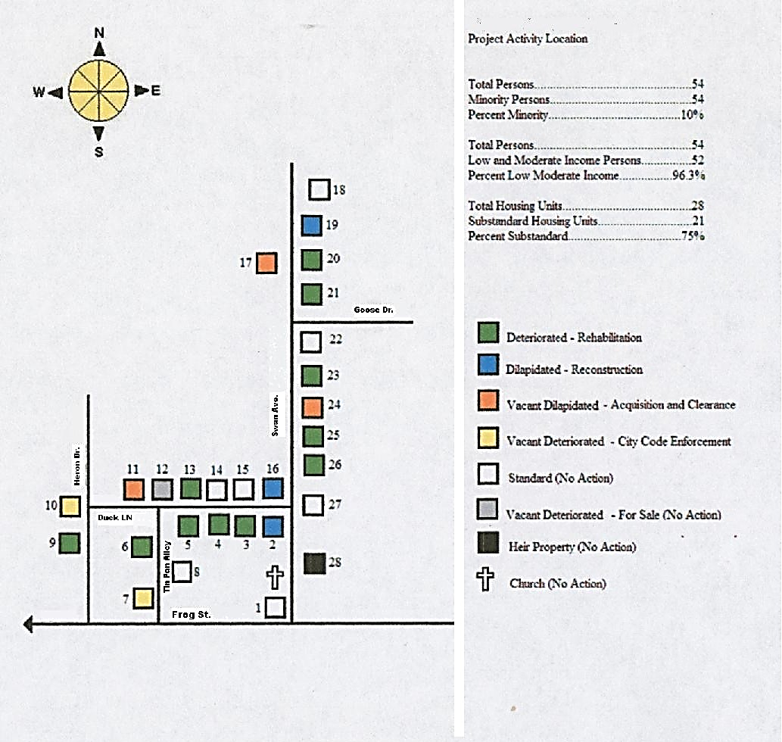
Unit Map Numbers
Street Names
Substandard
Substandard
Substandard
Stickbuilt
30
MHU
31
Type of Construction

Slide 26
Feasibility
Selling it to DCA
Exactly WHERE the target area(s) is/are located in the community (map).
Exactly HOW this project was chosen.
  Describe process for choosing this TA (See mapping Req.)
Exactly WHAT will this project achieve.
Exactly WHO will the project impact.
Exactly HOW you will successfully complete the project.
BE SPECIFIC!

Slide 27
Feasibility
Financing Technique(s) BE SPECIFIC
Deferred Payment Loans – discuss terms
Leveraged Loans/Interest Buy Downs
Who are your partners
Include participation formula
Know your community! Be realistic with participation formula – Get owner commitments in writing

Slide 28
Feasibility
Documented confirmation of proposed resources and partners
Compliance with Applicable Laws
  Be sure to address:
    Sec 3
    FHEO – AFFH Efforts
    LEP
    URA- Acquisition/Relocation/Displacement
    NEPA- Historic Preservation (SHPO)

Slide 29
Feasibility
Investor Owner Eligibility
  Financing: 50%, DPL at full term (no forgiveness)
  Rent Regulatory Agreement
Timetable for proposed accomplishments

Slide 30
Feasibility
Unit by Unit Analysis of Proposed Activity:
  Include per unit cost estimate.
  A Comprehensive Work Write-up for each unit
  Include description of proposed work needed with pictures illustrating problems (exterior and interior).
  Feasibility Test Forms – if applicable
  Complete “Financial Plan” Form (Appendix H)

Slide 31
NEED
Considerations

Slide 32
Need
  Document the severity of need.
    Photos of all problems described
    Must support the budget for the proposed activity
  Describe the effect the proposed project will have on the identified needs as well as the community as a whole.
  DCA 4 should describe the need for the chosen Target Area as well as the needs the project will address

Slide 33
Need
Housing units compared by severity of need for:
  Roof/ceiling damage
  Exterior damage (including windows & doors)
  Structural/Floors damage
  Electrical
  Plumbing
  HVAC

Slide 34
Need
Include copy of qPublic.net report, copy of deed, etc. to document ownership
If occupant and owner name discrepancy, explain
Reconstruction for owner-occupants only
If water/electricity has been disconnected for long period of time, the unit isn’t occupied

Slide 35
Need
Photos should include:
  Show all 4 elevations
  Interior and exterior photos should clearly represent condition of structure and problems described in narrative
  Photos should illustrate problems that will be addressed in the scope of work/cost estimate
  Photos should be captioned describing what the photo is illustrating
  Be sure to include dilapidated vacant units, usually proposed for acquisition and clearance – if unsafe to enter, be sure to describe conditions in full, and document ownership and owner commitment

Slide 36
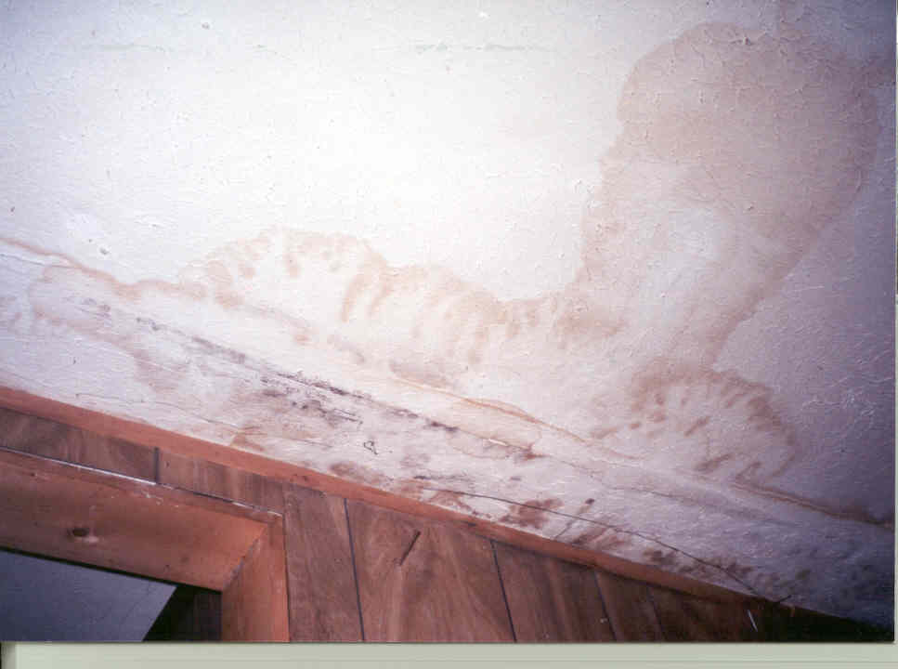
Photo Example: A

Slide 37
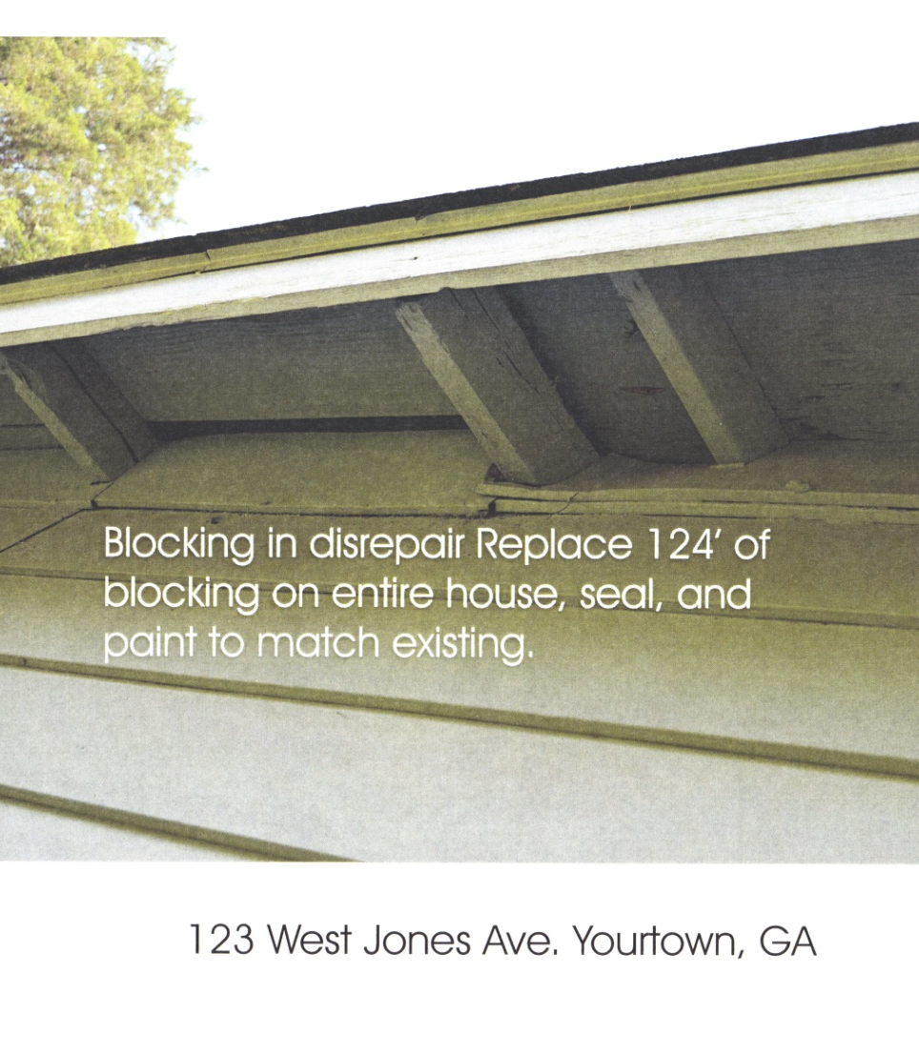
Photo Example: B
Describes the repairs that are needed
Describes the repairs that will be completed
Identifies the property address
Date photo was taken
6/15/2022

Slide 38
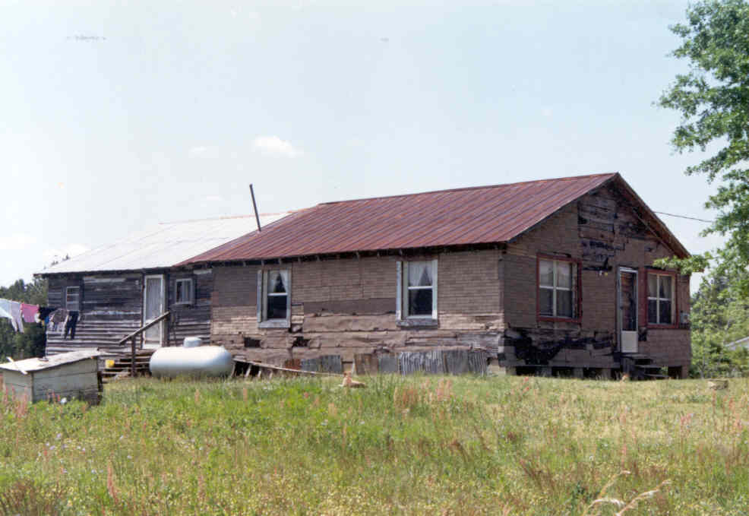
Left Front View
Unit #10

Slide 39
Impact Considerations

Slide 40
Impact
Describe the effect a successful project will have on the Target Area and entire community.​
100% of the described need must be addressed – with CDBG funds or with other resources – to gain maximum points​
Other resources/strategies to address needs unmet by CDBG funds must be identified and documented in detail​
Concentration of activity in as small a target area as funding will allow is the ideal, in order to achieve maximum impact in the chosen TA​

Slide 41
Impact
Cost per person
Percentage of need met
  Larger target areas more difficult to meet 100% of need than smaller target areas
  Phasing should be explained and justified in detail, not just a simple sentence
  Explain how other units will be addressed

Slide 42
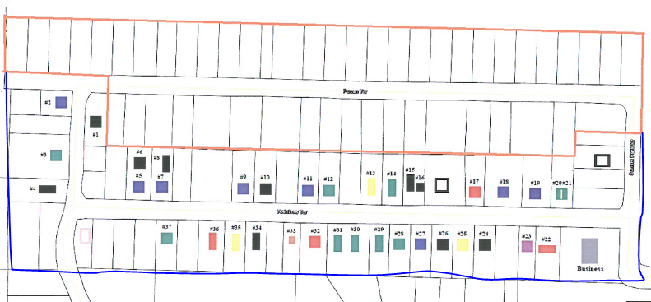
Impact
Example of a Smaller Target Area, concentrated impact

Slide 43
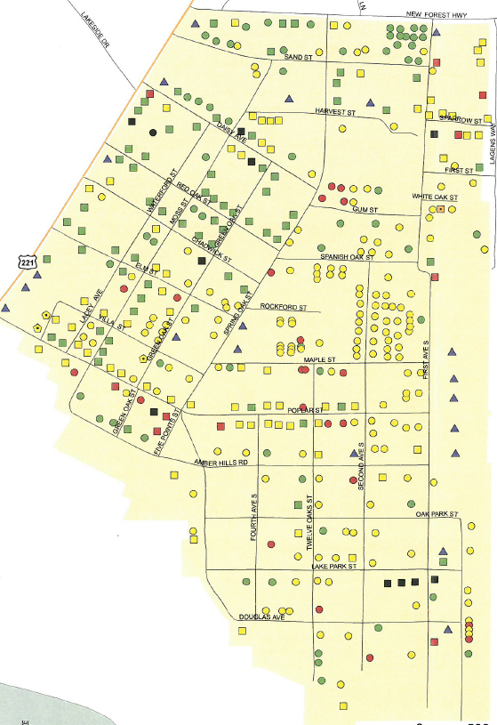
Example - Larger Target Area, concentrated impact
Impact

Slide 44
Successful Strategies
Financial Participation
Owner Participation as Fixed Percentage of Annual Income based on Income Level.
Examples:
“Participants whose income is below 30% of AMI are required to pay X% of their annual income”……
“Participants whose income is between 30% and 50% of AMI are required to pay X% of their annual income”…..
“Participants whose income is between 50% and 80% of AMI are required to pay X% of their income”

Slide 45
Successful Strategies
Mandatory Homebuyer Counseling for projects that propose Homebuyer Assistance
Mandatory Homeowner Maintenance Counseling for Rehab & Reconstruction projects
Credit Counseling (must be documented)
Employment training
Holistic approach to neighborhood revitalization
  Address issues and concerns along with housing/infrastructure problems
  Discuss how identified problems not addressed with CDBG funds will be addressed – document efforts by other partners or the local government

Slide 46
Problems With Previous Applications
100% grants/DPLs.
Proposed Unit Deficiencies not adequately described.
Per Unit cost estimates not included or too high.
Flat Participation amounts for all Participants regardless of income level.
Failure to present clear financial plan and Owner Participation formula AND written commitment from owners

Slide 47
Problems With Previous Applications
Rental Properties proposed without convincing commitment to participate by Landlord.
Lack of consistency throughout application.
  Numbers do not add up or differ from one section to another.
  Numbers on DCA 8 does not reconcile with numbers projected in DCA 5.
Failure to describe who will play key roles in program administration.
Failure to address Lead Hazard Control.

Slide 48

Provide
If rehab of vacant units is proposed, provide plausible explanation – and need for this activity
Provide
Provide clear and understandable Owner participation formula – that cover ALL circumstances (even if there are no TA families currently in a particular L/M Income Range)
Provide
Provide written commitment of funds from owners
Address
Address all described needs

Slide 49
Include House by House Analysis:
  Units keyed to map
  Provide CLEAR photos along with description of needed repairs (Exterior & Interior)
  Cost Estimate by Unit
  List of Deficiencies
  Feasibility Test Forms (for Reconstruction)

Slide 50
LASTLY………
If you have questions or concerns, discuss potential project with DCA staff:
Glenn Misner
404-679-3138
glenn.misner@dca.ga.gov
Malisa Thompson
404-326-1048
Malisa.Thompson@dca.ga.gov

Slide 51
Thanks!
Any questions?

