Slide 1
National Environmental Policy Act (NEPA) Review Process
Shelli Lockwood

Slide 2
Statutory & Regulatory Structure
National Environmental Policy Act (NEPA) and implementing regulations of the Council on Environmental Quality (40 CFR Parts 1500-1508).
HUD Regulations (24 CFR Part 58) - “Environmental Review Procedures for Entities Assuming HUD Environmental Responsibilities”
NEPA-Related Laws and Authorities (List at 24 CFR 58.5).
    https://www.hudexchange.info/environmental-review/federal-related-laws-and-authorities/
  Refer to Recipients’ Manual, Chapter 2: Section 2
Notes:
Procedures for the environmental review process on all CDBG projects are determined by NEPA, implementing regulations of the Council on Environmental Quality (CEQ), and of HUD at 24 CFR Part 58. Part 58 has over 12 NEPA-related environmental laws/authorities.
Link provides guidance to comply with each law and regulation at 58.5

Slide 3
Who Is Responsible for the Environmental Review?
Chief Elected Official (CEO)
Part 58 allows local units of government to perform NEPA responsibilities, with States reviewing documentation in place of HUD
  Assumes responsibility for environmental review
  Must sign the Finding of No Significant Impact (FONSI) and the Request for Release of Funds/Certification
  Accepts the jurisdiction of the Federal Courts as the responsible entity in environmental matters for this certification
Notes:
Under the terms of the certification required by 24 CFR Part 58.71, a responsible entity’s certifying officer is the “Responsible Federal Official” as that term is used in Section 102 of NEPA. The certifying officer is therefore responsible for all the requirements of Section 102 of NEPA and the related provisions.
The certifying officer represents the local government in Federal court - and in this process, there is no passing the buck.
Everything the grant administrator does should support all of these processes.

Slide 4
When should the Environmental Review start?
Before making choice limiting actions, including acquisition and signing construction contracts
  Must be able to reject the site
Before commitment of funds – 24 CFR Part 58.22 (a)
  Neither a recipient nor any participant, including a private, non-profit, or for-profit entity, may commit federal funds before approval of the RROF
  Neither a recipient nor any participant may commit non-HUD funds if the project has the potential to have an adverse impact or limit the choice of reasonable alternatives.
Notes:
DO NOT SPEND ANY AMOUNT OF MONEY ON THIS PROJECT UNTIL YOU HAVE COMPLETED THE APPLICABLE ENVIRONMENTAL REVIEW PROCESS AND RECEIVED AUTHORIZATION FROM THE STATE TO PROCEED VIA THE ROF AUTHORIZATION. UNTIL THIS IS DONE, YOU DO NOT HAVE CLEARANCE TO PROCEED.
It doesn’t matter if you plan to use local funds or CDBG funds. Once an application for CDBG funds has been made for this project, commitment of HUD or even non-HUD funds prior to approval of the environmental review inherently diminishes and biases objective consideration of alternative locations for the proposed project (including a no-action alternative).
Local funds mean public or private funds
HUD considers that consideration of alternatives is fundamental to the environmental review process.
Consideration of alternatives is the “heart of NEPA”.
Option agreements are allowed on a proposed site or property prior to completion of environmental review. The agreement should contain stipulations that ensure the project participant does not have a legal claim to any amount of CDBG funds to be used for the specific project or site until the environmental review process is satisfactorily completed.

Slide 5
Importance of Early Start
Begin environmental review process as soon as possible.
Typical time required to complete review ranges from 1 to 120+ days.
Notes:
You should begin the environmental review process as soon as you have identified the scope of the project and the project area. Here is where you would determine the level of review needed for the activities in the project.
The review times can take anywhere from one day up to 3-4 months depending on the project. If a project is exempt or categorically excluded from the NEPA related laws and authorities, it may take only one day to process the review and document the exemption, but for other types of projects and levels of environmental review, the review time can take up to 3-4 months depending on the project and the environmental notices requesting public comment.
HUD funds cannot be committed on an activity prior to the approval of the Request for Release of Funds/Certification. (RROF/C).
NOTE: State may add its own specifics here to this slide about its own schedules and deadlines.

Slide 6
Environmental Review Process High Level Overview
Determine the Level of Environmental Review required
Applies to the project as a whole, NOT just CDBG funds
Create the Environmental Review Record
  Must be available to the public at the local government
Complete the Environmental Review and document compliance with the related laws
Publish required notices according to the level of review
Notes:
Each responsible entity must prepare and maintain a written record of the environmental review undertaken for each project. This written record or file is called the Environmental Review Record (ERR), and it must be available for public review upon request.
The ERR shall contain all the environmental review documents, public notices (and proof of their publication), and written determinations or environmental findings required by 24 CFR Part 58 as evidence of review, decision making and actions pertaining to a particular project.

Slide 7

Steps in the Environmental Review Process
Determine
Determine the Level of Environmental Review Required
(Applies to the entire project, not just CDBG funds)
Create
Create the Environmental Review Record
(Must be Available to the Public)
Complete
Complete the Environmental Review and document compliance with the related laws
Publish
Publish required notices according to Level of Review
Submit
Submit the Request for Release of Funds and supporting documentation to DCA
(DCA issues “release” letter)
Maintain
Maintain Documentation of Compliance (Including mitigation) in the ERR
Notes:
Project Description
Sets the Foundation of the Review
Should include
All contemplated actions regardless of funding
A description of all physical aspects (phases of development, number of buildings, activities to be undertaken)
A description of all physical impacts (e.g. ground disturbance)
Each responsible entity must prepare and maintain a written record of the environmental review undertaken for each project. This written record or file is called the Environmental Review Record (ERR), and it must be available for public review upon request.
The ERR shall contain all the environmental review documents, public notices (and proof of their publication), and written determinations or environmental findings required by 24 CFR Part 58 as evidence of review, decision making and actions pertaining to a particular project.
Sec. 58.38: The Responsible Entity (RE) must maintain a written record of the environmental review undertaken for each project.
The ERR is to be available for public review.
The ERR may be posted on the Responsible Entity’s website.
Again, good recordkeeping is CRITICAL.

Slide 8
HUD’s Project Description Instructions
The Project description is the foundation of the environmental review.
Capture the maximum anticipated scope of the project:
Overall objective of the project
List of all activities
List of all funding sources (both HUD and non-HUD)
Time frame of project (max of five years)
Provide maps showing clearly defined site project boundaries
  Project boundaries are not limited to the site owned/controlled by the recipient/sub-recipient

Slide 9
Levels of Environmental Review
  24 CFR Part 58.34(a) Exempt
  24 CFR Part 58.35 Categorically Excluded
    Categorical exclusions SUBJECT to laws and authorities at 24 CFR Part 58.5
    Categorical exclusions NOT subject to laws and authorities at 24 CFR Part 58.5
  24 CFR Part 58.36 Environmental Assessment
  24 CFR Part 58.37 Environmental Impact Statement
Notes:
Examples of activities falling into each category are listed in Chapter 2 of the Manual.
An Environmental Impact Statement (EIS) details the recipient’s final analyses and conclusions, according to NEPA, related to potential significant environmental impact of the project. Recipients must follow prescribed steps in the course of preparation, filing and review of an Environmental Impact Statement
Ex: Any project to remove, destroy, convert or substantially rehabilitate at least 2,500 existing housing units.

Slide 10
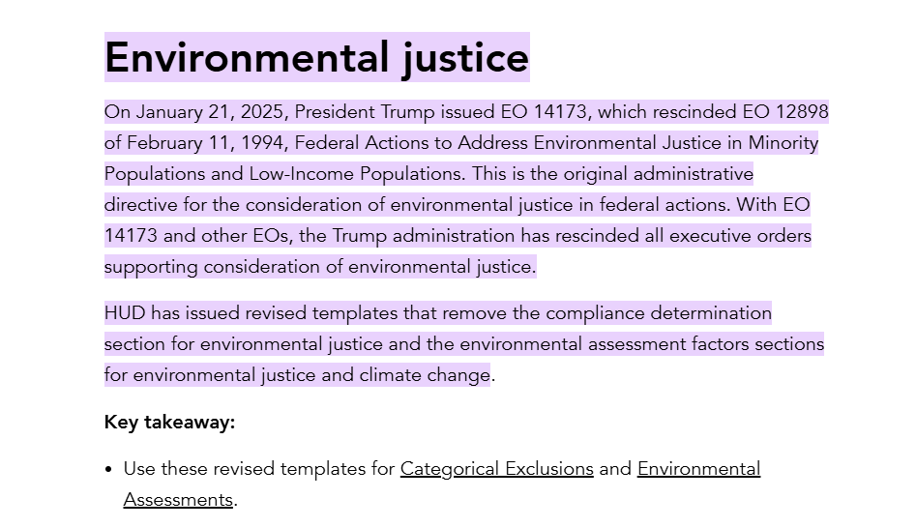
Environmental Statutory Updates
https://www.hudexchange.info/resource/3139/part-58-environmental-review-cest-format/
https://www.hudexchange.info/resource/3140/part-58-environmental-assessment-form/
Notes:
You’ll notice the Environmental Justice piece has been removed. The links above are the updated environmental statutory checklists.

Slide 11
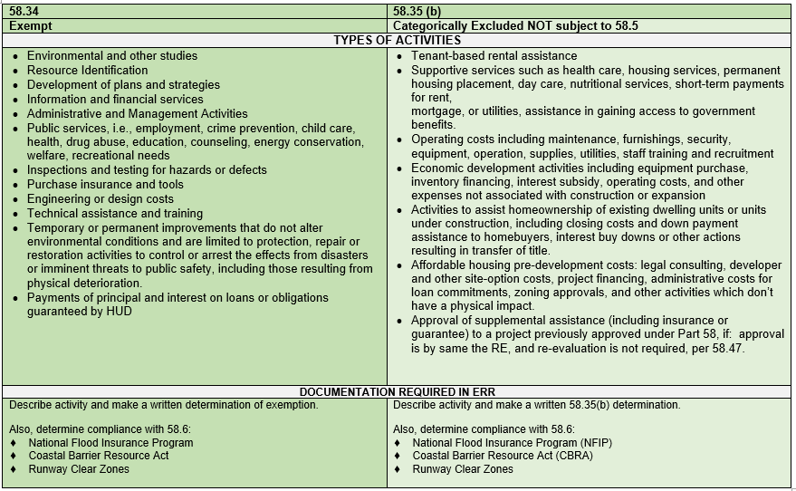
Notes:
This chart can help determine the level of review. The top provides the regulation and level of review, then types of activities, and finally documentation required to note compliance or determinations. As you can see Exempt and CENST activities have no physical impacts and require no publication of notices.

Slide 12
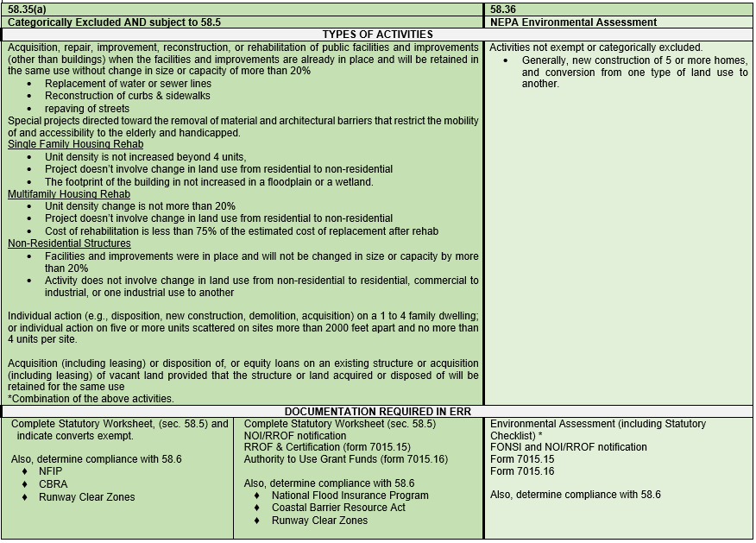
Notes:
“Subject to” activities - Acquisition, repair, improvement, reconstruction or rehabilitation of public facilities and improvements (other than buildings) when facilities and improvements are in place and will be retained in the same use without change in size or capacity by more than 20%. Special projects directed to the removal of barriers in ADA projects or the acquisition of land or buildings retained for the same use.
“ Not subject to” activities - working capital or equipment in ED projects, housing down payment assistance or housing supportive services.
If the project converts to Exempt, you still need to submit the form and the statutory checklist to our office. If it does not convert to exempt, a Notice of Intent is required to be published once the seven-day comment period has passed and the ROF form is submitted to DCA.

Slide 13
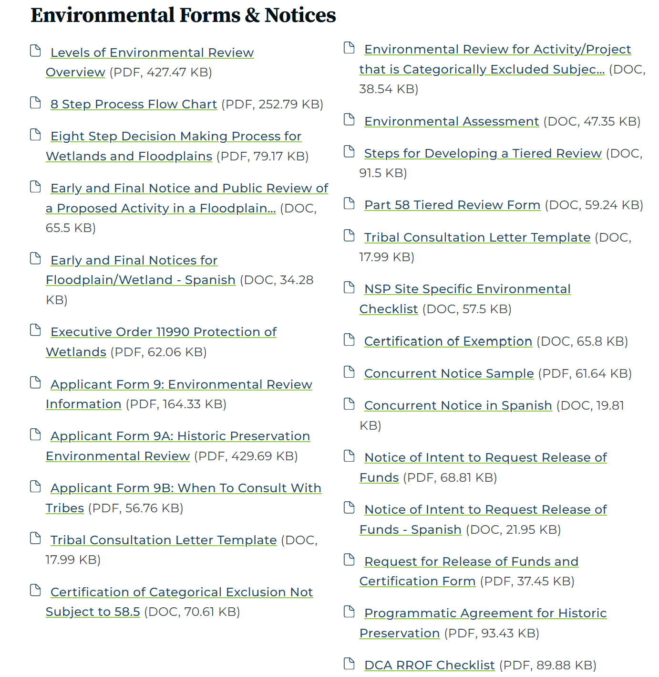
Environmental Assessment
Use current forms on DCA Website
Cite Authoritative Sources of Info
  See HUD tool (https://www.hudexchange.info/environmental-review/federal-related-laws-and-authorities )
Describe mitigation measures for any identified negative impacts
Evaluate all alternatives
Certifying Officer must sign FONSI
Notes:
HUD has updated the assessment and it is on our website

Slide 14
Environmental Impact Statement (EIS)
EIS required if Finding of Significant Impact (FOSI) is found as a result of completing an environmental assessment for the project
Most CDBG projects do not trigger
Contact DCA immediately for assistance

Slide 15
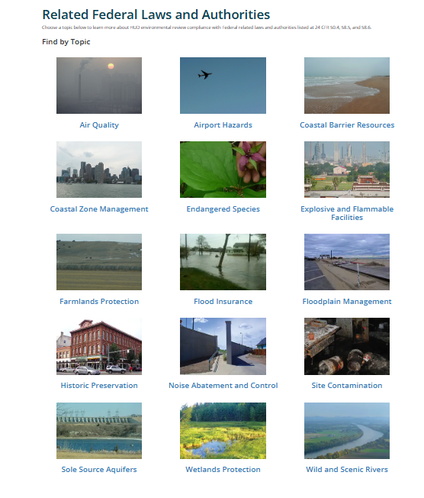
Compliance Factors
HUD’s Laws and Authorities Web Page
https://www.hudexchange.info/programs/environmental-review/federal-related-laws-and-authorities/
Notes:
The partner worksheets have not been added back to the HUD exchange website; it is unknown when the worksheets will be back online.

Slide 16
How Do I Clear Each Compliance Factor?
Consult HUD’s Laws and Authorities Web Page
Incorporate the HUD worksheets in review
  Partner worksheets if completed by Regional Commission or Private Consultant
Each factor must have documentation, including items like Sole Source Aquifers that do not apply to Georgia
A map or report from a qualified expert or the appropriate government agency is the most common documentation
Fish and Wildlife online Endangered Species tool: https://ecos.fws.gov/ipac/

Slide 17
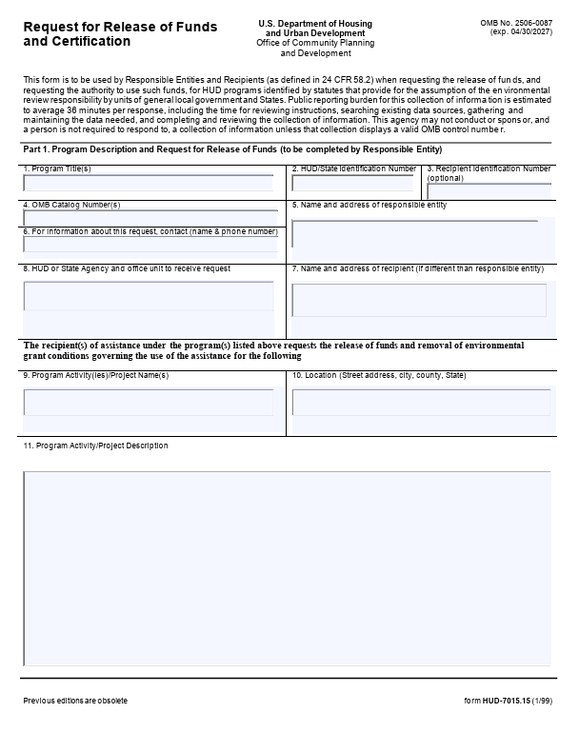
Request for Release of Funds
Form HUD-7015-15
Grant # or Pending year
Enough description that a HUD auditor or member of the general public would be able to understand the basics of the project. We do NOT need information on what CDBG is, this should be about the project.
Please provide us with a list of the activities and a brief summary of the project in a few sentences. This should not be a generic set of sentences for the type of project, but a description of the particular project. Indicate the problem you are trying to solve.
The description should include the location of work and beneficiaries, including street/neighborhood names or similar details. How many people are being helped? Add other pertinent details.
Notes:
The project description should provide details of the project. For example, if existing water lines are 2”, but will be replaced with 6” water lines. For buildings, specify the change in square footage.

Slide 18
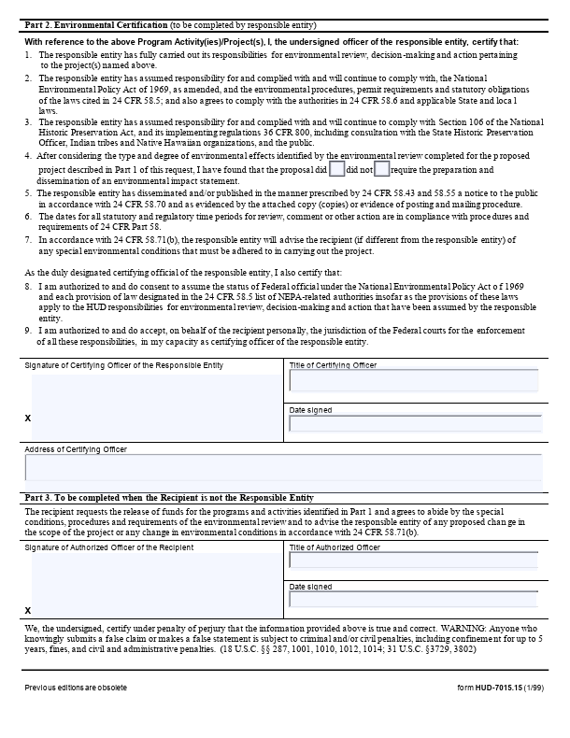
Request for Release of Funds Form HUD-7015-15
Notes:
The recipient's Certifying Official is responsible for ensuring that all the project’s environmental requirements are met. The Certifying Official must sign any official environmental documents.
The Certifying Official must be the Chief Elected Official or a person designated as the Certifying Official by resolution of the Recipient’s governing body.
If someone other than the Certifying Official is signing the RROF, a letter of certification from the local government indicating designation should be submitted with the RROF.

Slide 19
Environmental Notices Period
Local Comment Period
Publish in local newspaper of general circulation.
    Legal or non-legal section
Notice of Intent to Request Release of Funds (NOI): 7 days
FONSI and NOI (Combined/Concurrent notice): 15 days
Notice includes an additional 15 days for public objection of RROF to DCA.
    Begins the day after DCA receives the RROF.
Notes:
Publish combined notice - FONSI – Finding of No Significant Impact and NOI/RROF – Notice of Intent to Request Release of Funds.
Submit notices to the agencies determined by your state CDBG staff. Observe at least 15 day local comment period and respond to all written comments in writing. Provide copies of all correspondence to your state CDBG staff.
After the 15 day comment period submit copy of publication(s), affidavit(s) of publication and Request Release of Funds and Certification to state CDBG staff.
Upon receipt, the State begins a 15 day time for receiving objections on the recipient’s certification and request for release of funds. Permissible bases for objections are listed in § 58.75.
Funds released 16 days after DCA receives the RROF and notices or the date given in the notice whichever is later.

Slide 20
Local Period – Objections
Basis for Objections
  Anything
Local Government must consider comments
  If you get a comment, you must respond
  Acknowledge and respond in writing
Tell DCA about any comments and include your response

Slide 21
Objections to DCA
Basis for Objections
  RROF not signed by Certifying Officer
  Omission of a required decision, finding, or step applicable to the environmental process
  Committed funds prior to release of funds

Slide 22
Waiting Period Details
All Waiting period days must be full 24-hour periods
The day of publication DOES NOT COUNT toward the waiting period
The DCA public comment period does not start until the day after receipt of the RROF
Each part of the process must be separate, no overlapping days

Slide 23
Example Fastest Concurrent Notice and RROF
Day1: Concurrent Notice Published
Day 2-16: 15-day comment period
Day 17: RROF signed and dated by certifying official, emailed to and received by DCA. DCA comment period does not start on the day we receive it.
Day 18-32: State 15-day comment period
Day 33: RROF letter prepared by DCA
Weekends and any delay usually increases this by a few days
If you have the time, allow for slightly more than 15 days. If you use the minimum and the newspaper runs it a day late you will have to re-publish.

Slide 24
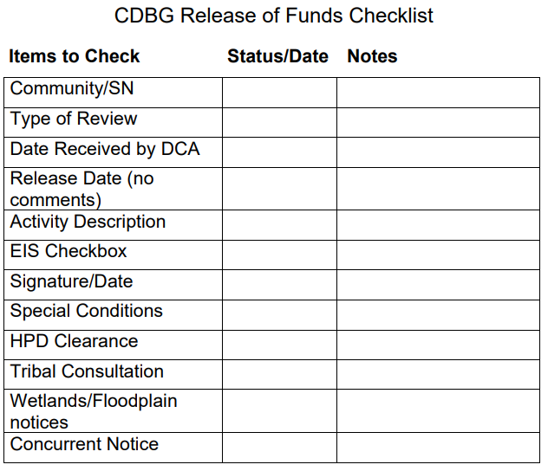
Items to send when Requesting Release of Funds
CEO Signed and Dated Request for Release of Funds
    HUD wants an actual description not just the budget line item
    Make sure to select the appropriate EIS check box on page 2
    Must be signed and dated after the end of the public comment period
  All Newspaper Notices (Concurrent in most cases, and Floodplain/Wetlands if necessary) – Scans or actual notices, make sure the date of the paper (not just in the notice) is visible.
HPD clearance letter unless it is not subject to 58.5
Proof of Tribal Consultation signed by a certifying officer of the local government if subject to 58.5 and the activity requires it.
If you received an objection or comment, include it and your response.
*If the project is a building or Multi-Family residential, provide Phase I results*

Slide 25
Required Items for your Application
Applicant forms listed in the manual and available on our website:
  DCA 9 Environmental Review Information
  DCA 9A Historic Preservation Environmental Review Form
  DCA 9B When to Consult With Tribes Under Section 106
    Proof of tribal consultation – Generally, this should be a scan of the letters, any responses, and a memo letting us know that the others did not respond during the review period.
    The Chief Local Official should sign letters, or if she/he cannot because of a conflict of interest or some other reason, by the next highest certifying official.
Floodplain and Wetland Maps
Any other environmental review paperwork from stages that are complete when submitted.

Slide 26
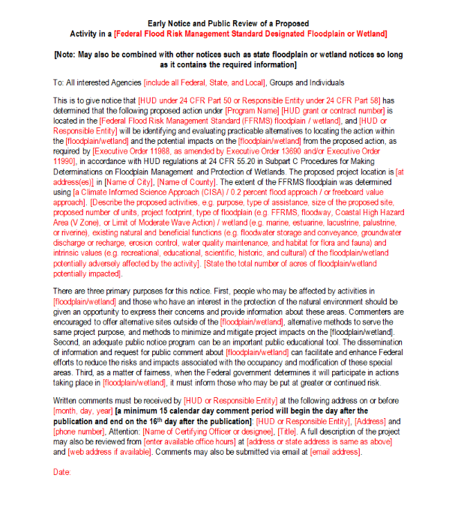
FFRMS – Federal Flood Risk Management Standard
English
https://dca.georgia.gov/document/document/early-and-final-notice-and-public-review-proposed-activity-floodplain-or-wetland/download
Spanish
https://dca.georgia.gov/document/forms/early-and-final-notices-floodplainwetland-spanish/download

Slide 27
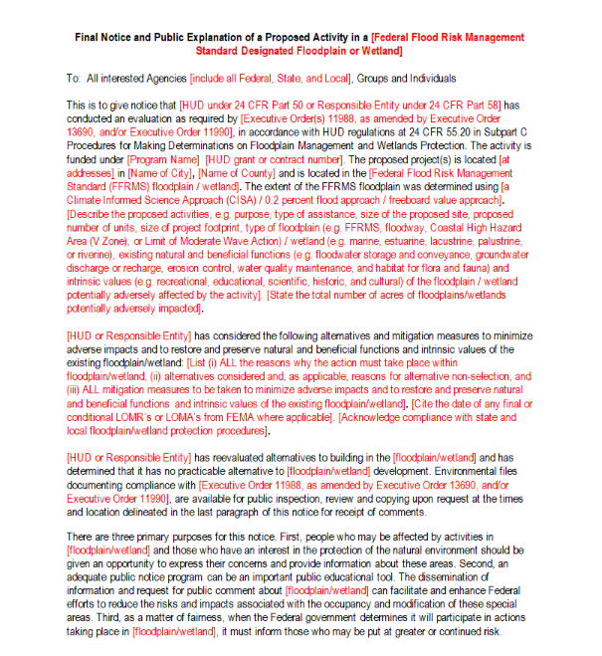
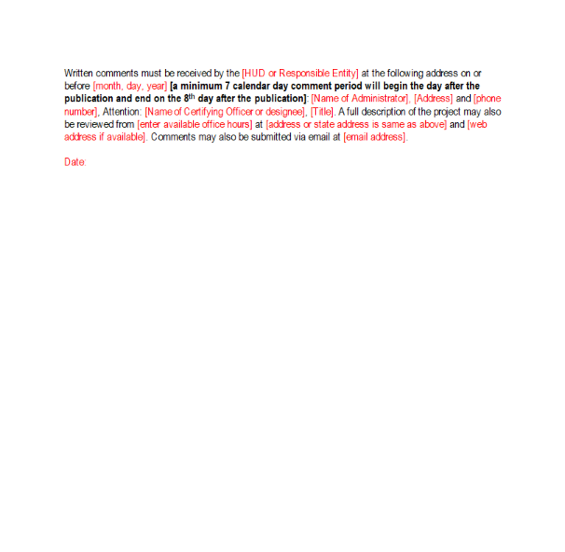
FFRMS – Federal Flood Risk Management Standard
Note: 100-year templates are no longer permissible
Notes:
Notices can be found in the Applicant’s Appendix I.

Slide 28
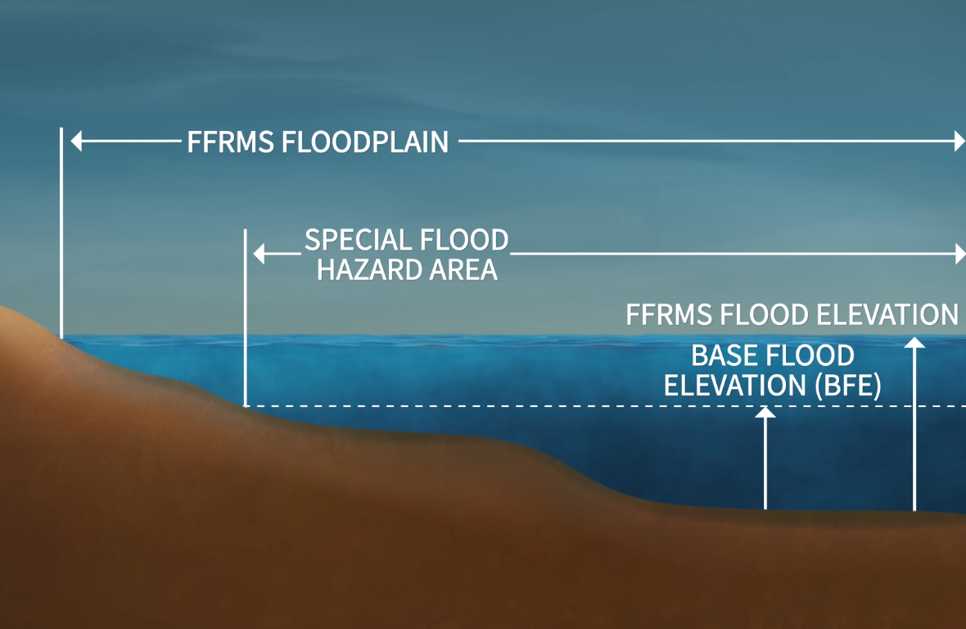
Federal Flood Risk Management Standard
Published April 23, 2024, amends existing floodplain regulations – effective June 24, 2024.
Expands 100-year floodplain to newly defined “FFRMS floodplain” (expanded area).
  E.O.13690 January 2015
New construction or substantially improved structures within FFRMS floodplain must be elevated or floodproofed.
Projects within FFRMS floodplain required to complete 8-step/ 5-step
Added 24 CFR 55.7 - 3-Tiered Approach to FFRMS
Allows for public notices required for environmental reviews to be published online on appropriate government websites.
https://www.ecfr.gov/current/title-44/chapter-I/subchapter-A/part-9
https://www.ecfr.gov/current/title-24/subtitle-A/part-55/subpart-B/section-55.7
Notes:
This Rule amends HUD’s existing floodplain regulations to require a greater level of flood protection for new construction and substantial rehabilitation projects. Building to this standard will increase the Nation’s resilience to flooding, reduce the risk of flood loss to human life and property, and minimize the direct impact of floods on households across the country. *"HUD Published Proposed Rule Revising Regulations Governing Floodplain Management and the Protection of Wetlands , and the comment deadline was 9/8, we are waiting on further guidance to be issued*

Slide 29
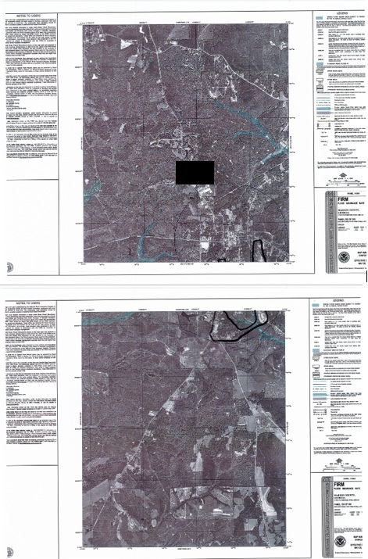
Insufficient Floodplain Map
Notes:
Illegible, unable to determine the streets included in the project area, the map is separated into multiple pages

Slide 30
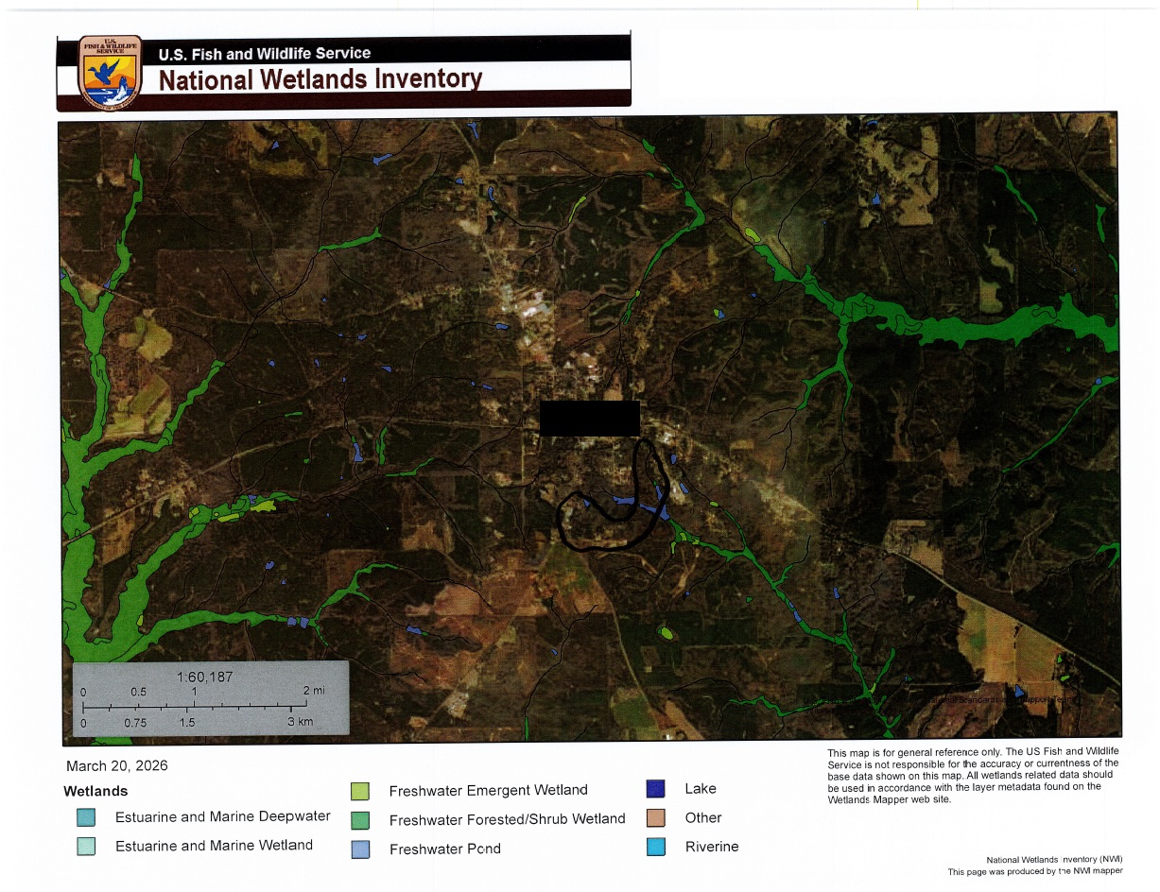
Insufficient Wetlands Map
Notes:
Even though the target area is outlined, the map is zoomed out

Slide 31
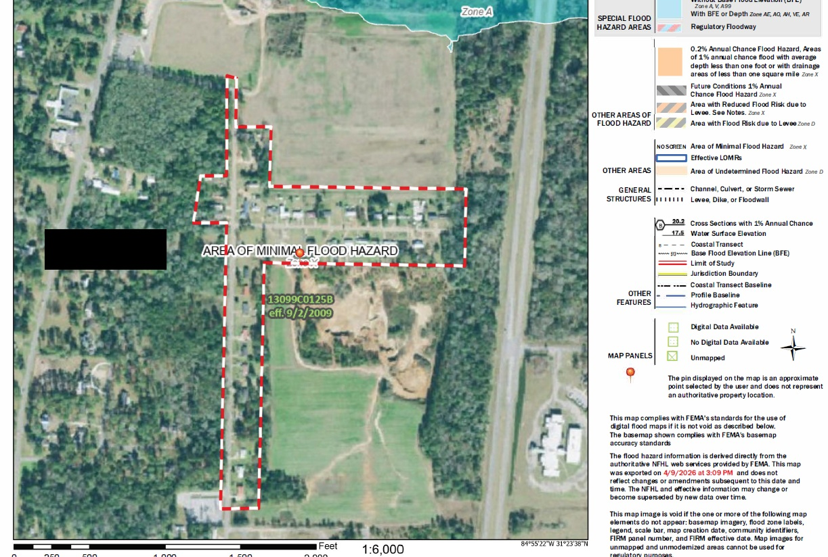
Floodplain Map with Target Area

Slide 32
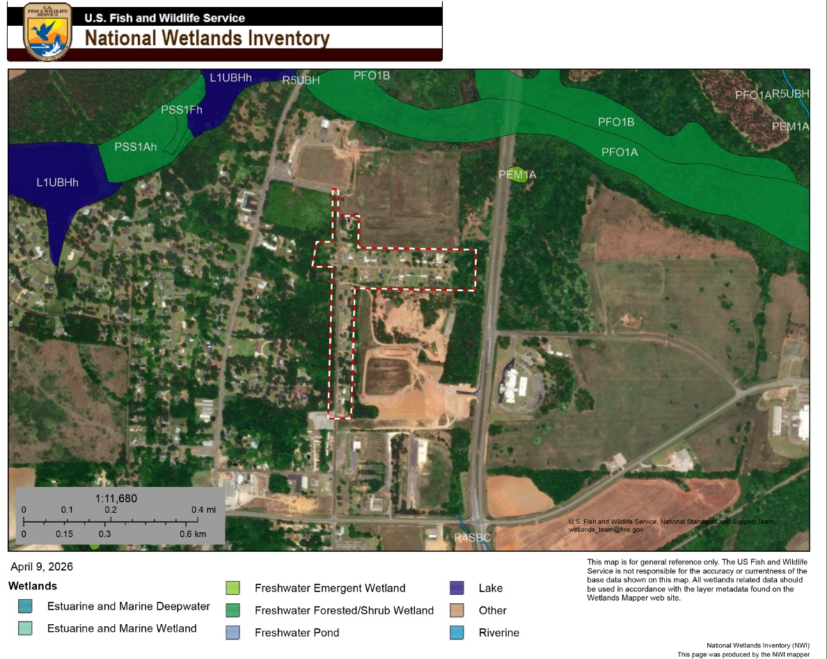
Wetland Map with Target Area

Slide 33


Application Requirements & Bonus Points
2 April 2027
Tribal Consultation must be completed by the Application Deadline
30 June 2027
If you complete the process and have a Release of Funds by Wednesday, June 30, 2027, your application will receive 5 bonus points.

Slide 34
Environmental Review Optional Advice for RROFs
A memo listing items submitted with the RROF and items previously sent to DCA will make it faster and easier to review.
Grouping paperwork with the RROF instead of each item submitted separately will make it easier for anything that is not bonus point-related.
Only submit the requested documents.

Slide 35

Important Tips
Change of scope in the project (grant amendments) might require additional review.
DON’T SPEND A DIME – until your ER is complete and you have received Release of Funds from DCA
  Exception for Admin and Design Costs
When in doubt – contact DCA/CDBG staff!
Notes:
Be aware that if you change the scope of the project (location, size of lines, etc.) it can affect the level of review that is required for that project.
Also note that if federal funds are being used for any “part” of a project, environmental review must be done on the entire project and at the most stringent classification that the project includes. Environmental Review or approvals from other federal agencies do not supplant the ER process required by the CDBG program.
DO NOT spend any money on the project until after you have received a ROF from your CDBG staff.
Any CDBG money invested in the projects holds the entire project to the regulations – not just the “parts” that are being paid for with CDBG funds.
Cannot take project apart to avoid the requirement, concept of aggregation.
When you are unsure, keep in mind your state staff can help you and your ERO whenever necessary. Again,
Project tiering is allowed BUT a subsequent action could change the level of review required for the project from when you started it. This could be a real problem.
Project tiering is not allowed but if a subsequent action would have changed level of review required for the project when you started it so don’t even try it!
When you are unsure, keep in mind your state staff can help you and your ERO whenever necessary.

Slide 36
Current Issues
Everything must be complete, including the response from Historic Preservation, before you publish the FONSI/Concurrent Notice
The Environmental Review lasts 5 years from the release date. If construction is still taking place, you must stop and perform a completely new review
Any Historic Preservation condition stops a conversion to Exempt
Incidental Floodplain and Wetlands – Do 8 Step, or Deed Restrict
Tribal Consultation should be Government-to-Government, and signed by the CEO
Hazardous Waste: Check 300’ radius
Radon determination should be included in projects where required
For Buildings or Multi-Family residential housing with 5 or more units, provide Phase I results with the RROF.
Please Note: For a Phase 1 to be presumed valid, it must be less than 180 days since preparation.

Slide 37
Phase One Assessment Requirements
Standards should be referenced (American Society for Testing and Materials (ASTM) E1527-21 Standard)
Professionals’ resumes for Engineer/Geologist
Documentation indicating “No Findings of Impact”
The environmental review of multi-family housing with five or more dwelling units (including leasing) or the development of non-residential property (buildings such as
Head Start Centers, Senior Centers, etc.) must include a Phase One Assessment.
Notes:
A Phase One Assessment is an evaluation of previous uses of the site or other evidence of contamination on or near the site to ensure that the occupants of proposed sites are not adversely affected by hazardous materials, contamination,
toxic chemicals and gases, and radioactive substances.

Slide 38

HUD Policy Updates

Slide 39

HUD’s Departmentwide Radon Policy Notice

Slide 40
HUD Departmental Radon Policy Notice
On January 11, 2024, HUD published its departmentwide radon policy notice, “Departmental Policy for Addressing Radon in the Environmental Review Process” addressing the risk of radon exposure.
This policy falls under HUD’s contamination regulations at 24 CFR 50.3(i) & 58.5(i)(2), which is part of the environmental (NEPA) review of proposed HUD supported projects
The Policy requires consideration of radon gas for projects:
  With a CEST, EA, or EIS level of review
  Structures occupied or intended to be occupied at least four (4) hours a day
Radon testing is not required, but mitigation is required if the method used to consider radon shows levels at 4.0 pCi/L or greater.

Slide 41

Radon Policy Notice: Implementation
11 Jan. 2024
The final policy was published as CPD Notice CPD-23-103 on January 11, 2024.
11 Apr. 2024
Policy became effective on April 11, 2024, for all non-tribal and recipients.
11 Apr. 2024
On April 11, 2024, Responsible Entities must consider radon as part of any non- tiered Environmental Review (ER) that were not yet certified, regardless of where they are in the ER process.

Slide 42
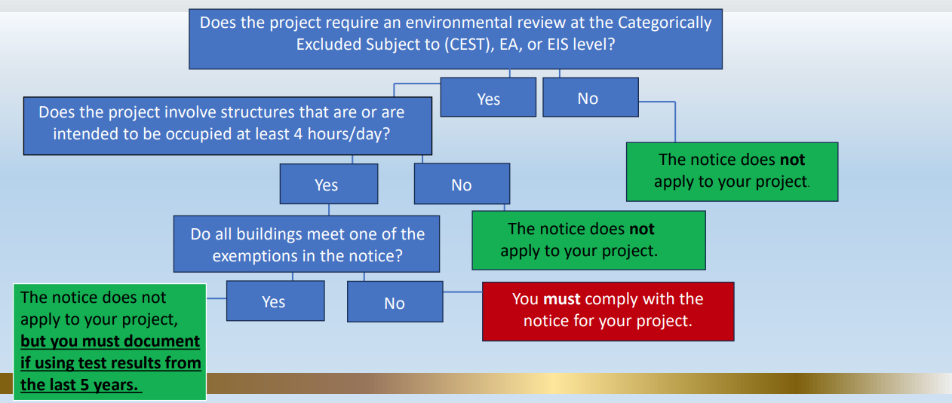
Exemptions
Buildings with no enclosed areas having ground contact
  For example, buildings built on piers
Non-residential buildings which will not be occupied for more than four (4) hours per day
Buildings with existing radon mitigation systems - document radon levels are below 4 pCi/L with test results dated within two years ( of application or certification)
Buildings tested within five (5) years with test results below 4 pCi/L

Slide 43
HUD’s Preferred, Best Practice: The American National Standards Institute (ANSI) and American Association of Radon Scientists and Technologists (AARST) radon testing and mitigation standards.
Alternative strategies that can be used (if testing not otherwise required by law/reg):
  Do-It-Yourself (DIY) Testing: Use of individual DIY home radon test kits
  Continuous Radon Monitoring Devices: for use by trained local government staff in remote areas
  Review of science-based data on radon in the area where the project site is located: state/tribal geologic data, CDC radon test data
If use of any of the above methods determines that indoor radon levels are or may be above 4 pCi/L, then the Responsible Entity (RE) must document and implement a mitigation plan.
How To Consider Radon
Under the Policy Notice

Slide 44

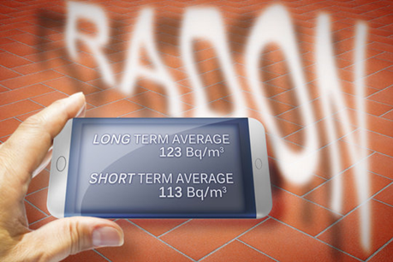
DIY Testing
Do-it-yourself (DIY) test kits allowed in single-family dwelling units for “single-family” homes, buildings that feature 1-4 dwelling units
Tests should ideally be approved by the National Radon Safety Board (NRSB) or the National Radon Proficiency Program (NRPP)
Continuous Radon Monitors
  In remote areas where other types of testing is not possible or feasible, the use of continuous radon monitors (CRMs) by the local government is allowed to measure radon levels
  Devices should be approved by the NRSB or NRPP
  Contact your state or the National Radon Program Services at KSU for recommendations and assistance

Slide 45
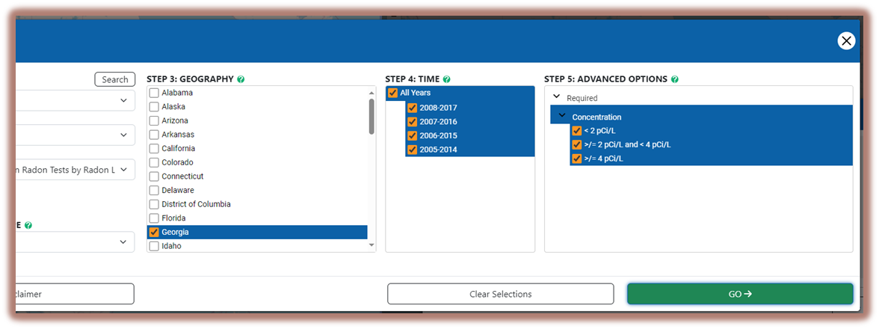
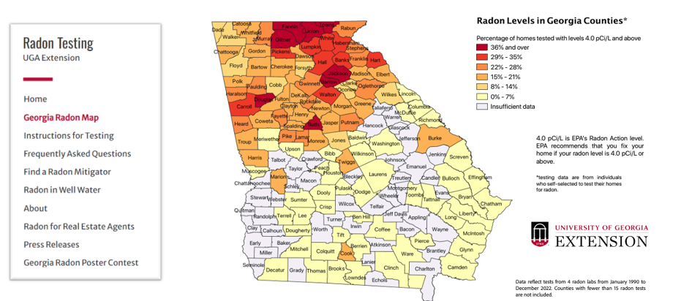
Review of Science-Based Data: Examples of Data Sources
https://www.cdc.gov/environmental-health-tracking/php/data-research/radon-testing.html
https://extension.uga.edu/programs-services/radon-testing.html
Notes:
These are the only acceptable data sources for radon.

Slide 46
Mitigation under the Notice functions just as other mitigation under 24 CFR 50.3(i) and 58.5(i)
If radon testing or a review of science-based data shows a radon level for a building at or above 4 pCi/L, then the Environmental Review Record (ERR) must include a mitigation plan
If using a review of science-based data radon testing can be done prior to initiation of mitigation to determine if mitigation is necessary for a building
  If a review of science-based data shows levels at or above 4.0 pCi/L but subsequent testing shows levels in the building below 4.0, no mitigation is needed
  By electing to test, Environmental Review preparers and recipients may ultimately save funds by avoiding unnecessary radon mitigation
Mitigation plans must: identify the radon level; consider the risk to occupants’ health; describe the radon reduction system that will be installed; whenever possible, establish an ongoing maintenance plan to ensure the system is operating as intended; establish a reasonable timeframe for implementation; and require post-installation testing.
  Post-installation testing should be conducted by a licensed radon professional where feasible.
Mitigation

Slide 47

Getting Technical Assistance and Useful Resources
HUD Policy for Addressing Radon in the Environmental Review Process
https://www.hudexchange.info/trainings/courses/hud-policy-for-addressing-radon-in-the-environmental-review-process/
For assistance with selecting a test or monitoring device, industry standards, and becoming certified in testing or mitigation, and other educational information, check out the National Radon Program Services at Kansas State University:
https://sosradon.org/
Phone number - 800-767-7236
To view the ANSI/AARST standards online for free:
https://standards.aarst.org/

Slide 48
Contact Information
Shelli Lockwood
470-883-1063
Shelli.Lockwood@dca.ga.gov
Send Environmental documents to cdbg.biz@dca.ga.gov

Slide 49
Resources
https://www.hudexchange.info/environmental-review/orientation-to-environmental-reviews/
https://egis.hud.gov/tdat/
https://www.hudexchange.info/environmental-review/federal-related-laws-and-authorities/
https://www.hudexchange.info/resource/4707/environmental-review-record-related-federal-laws-and-authorities-worksheets/
https://dca.georgia.gov/financing-tools/infrastructure/community-development-block-grants-cdbg/compliance-administration-0
https://nepassisttool.epa.gov/nepassist/nepamap.aspx

