Slide 1

Historic Preservation 101
Sandra Hall
Notes:
Hi everyone! My name is Sandra Hall, and I am the current Certified Local Government Coordinator with the Historic Preservation Division (HPD for short) at the Department of Community Affairs.
BREATH 1
In this presentation, I will give a bit of background on who we are and what we do, with more focus on the Certified Local Government (CLG) Program, which is the area I cover.

Slide 2

Who We Are
A division of the Georgia Department of Community Affairs, we are the Georgia State Historic Preservation Office, known as HPD
25+ dedicated staff with academic backgrounds and professional expertise in Archaeology, Architecture, History, Historic Preservation, Planning, Education, Geography and other related academic fields
Federally funded by the National Park Service
Matching budget appropriations from the Georgia State Legislature
Notes:
The State Historic Preservation Office (SHPO) was formerly a division under the Georgia Department of Natural Resources but moved to the Georgia Department of Community Affairs in 2020.
BREATH 1
In total, we have about 25 staff members with backgrounds in ……. architecture, history, historic preservation, planning, education, archeology, and geography.
BREATH 2
Our office was created through the passing of the National Historic Preservation Act in 1966, which is why we are both federally funded by the National Park Service and through the GA state legislature.

Slide 3

What We Do
Carry out all federal and state mandated historic preservation activities
Provide preservation education, training, and local technical assistance, and statewide support
Notes:
Our office handles a few different programs including National Register, Georgia Register, Environmental Review, Tax Incentives, Community Assistance and Outreach but to sum up exactly what our office does on a day-to-day basis, we…..
BREATH 1
Carry out all federal and state mandated historic preservation activities
BREATH 2
Provide preservation education, training, and local technical assistance, and statewide support

Slide 4
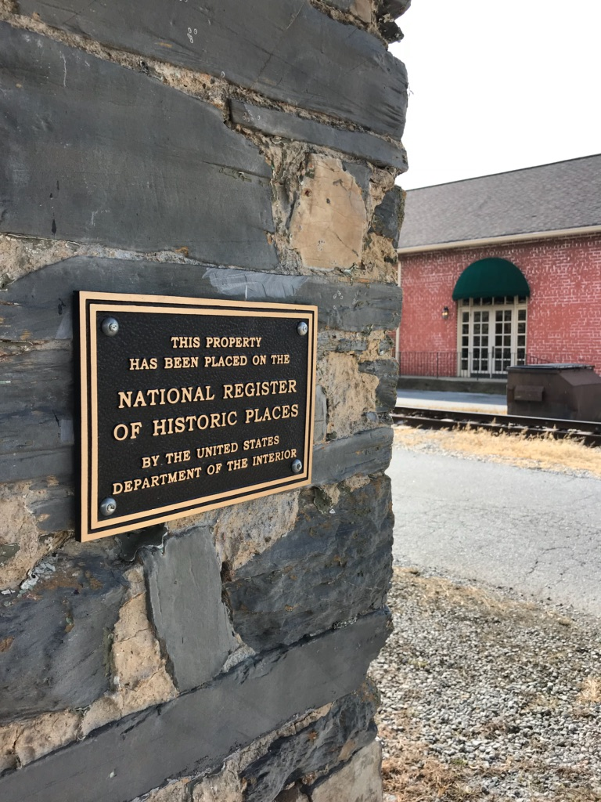
Program Overview
National Register of Historic Places & GA Register of Historic Places
Official lists of historic properties
Includes buildings, sites, structures, objects, and districts
National Register is managed by the National Park Service
HPD administers both the National Register & GA Register programs for the state
Properties listed are not protected
Notes:
A quick overview on what each of our programs offer and do.
BREATH 1
The National Register of Historic Places and Georgia Register of Historic Places are official lists of historic properties that are worthy of preservation. Properties listed in the National Register include buildings, sites, structures, objects, and districts that are significant in American history, architecture, archaeology, engineering, and culture.
BREATH 2
While the National Register of Historic Places is managed at the federal level by the National Park Service, as Georgia’s state historic preservation office (SHPO), the Historic Preservation Division (HPD) administers the National Register of Historic Places program in Georgia as well as the Georgia Register of Historic Places.
BREATH 3
An important thing to remember: Being listed does not provide protections for the properties, but it does offer benefits such as eligibility for Tax Incentives.

Slide 5
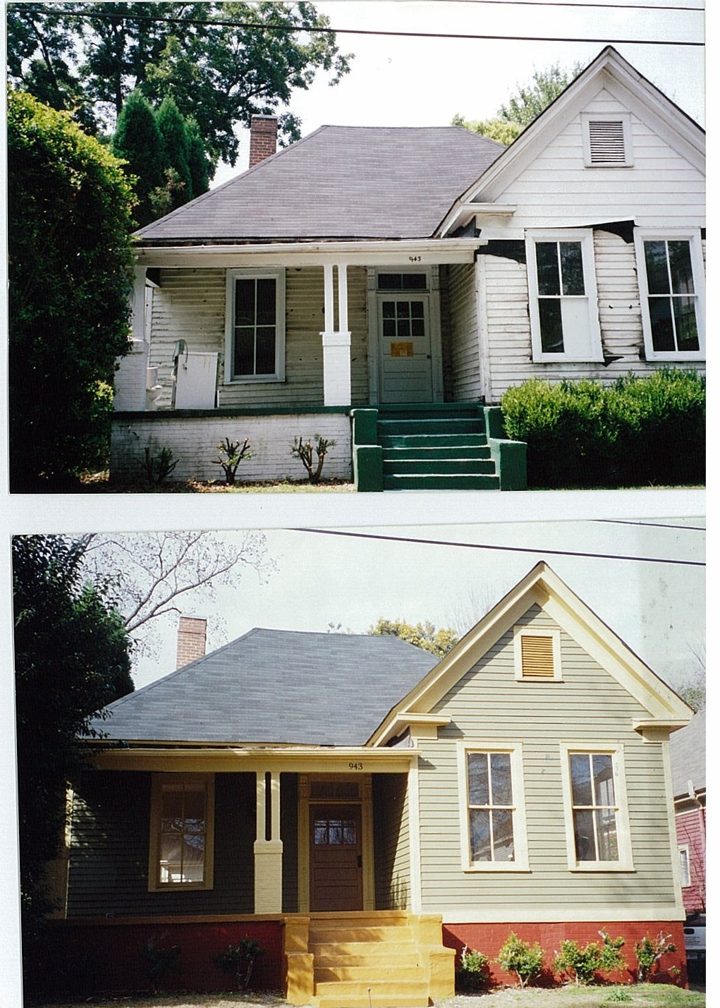
Program Overview
Tax Incentives
Team manages 3 Tax Programs
Preferential Property Tax Assessment for Rehabilitated Buildings
  Freezes property taxes for 8 years
State Income Tax Credit
  Equal to 25% of qualified rehab expenses
Federal Income Tax Credit
  Equal to 20% of qualified rehab expenses
Notes:
The Tax Incentives team manages three tax programs:
BREATH 1
a Preferential Property Tax Assessment for Rehabilitated Buildings (which freezes property taxes for about 8 years);
BREATH 2
a state income tax credit (this is equal to 25% of qualified rehabilitation expenses for the rehabilitation of certified historic structure );
BREATH 3
and a federal income tax credit (which is equal to 20% of qualified rehabilitation expenses).
BREATH 4
Tax incentives and the overall process is a separate presentation, so I won’t get too into the weeds, but if you’d like to know more, information about all three programs, as well as contact info for the Tax Incentives Team are on our website.

Slide 6
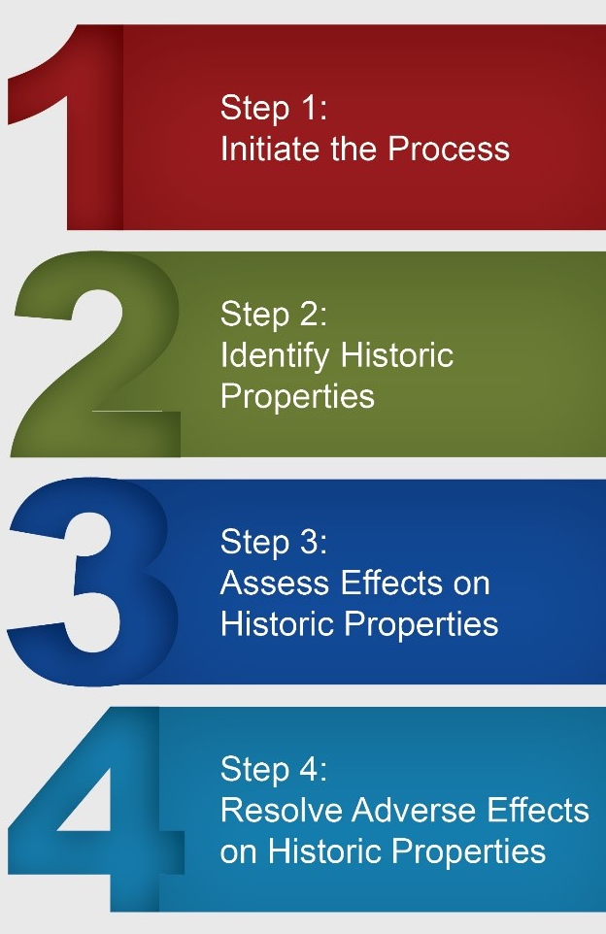
Program Overview
Environmental Review
Section 106 Review Process
Dictated by the National Historic Preservation Act (1966)
Mandates projects to be assessed for adverse effects to historic resources
Process must be completed prior to the approval of the expenditure of federal funds for the project, or prior to the issuance of any federal license or permit
Notes:
Our Environmental Review team tackles the massive Section 106 process.
BREATH 1
This process was dictated by the National Historic Preservation Act of 1966, which mandated that any project funded by or requiring permits or licenses from the federal government…be assessed for potential adverse impacts to historic resources (This being any resource over 50 years old, and not just those on the National Register).

Slide 7
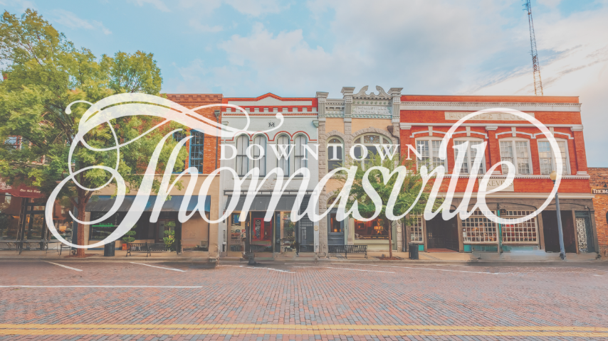
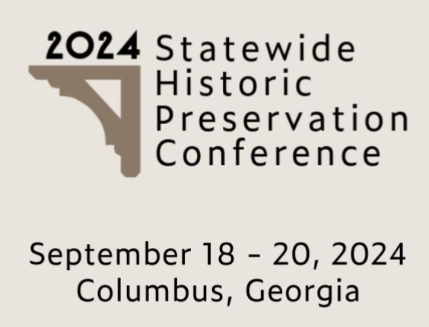
Program Overview
Community Assistance/Outreach
African American Programs
Centennial Farms Program
  560 farms listed
Certified Local Government Program
Statewide Historic Preservation Conference
Preservation Planning
Historic Preservation Ordinances
2024
GA Downtown Conference
August 26 - 29, 2024
Thomasville, Georgia
Notes:
The Community Assistance and Outreach team includes our African American Programs, Centennial Farms Program, and Certified Local Government Program.
BREATH 1
We also provide guidance to communities regarding their Preservation Ordinances and Preservation Planning and conduct training sessions through the Statewide Historic Preservation Conference, GA Downtown Conference, and so forth.

Slide 8
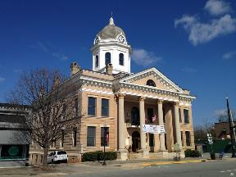


Certified Local Government Program
Partnership program between the local government, HPD, and the National Park Service
Opportunities for technical assistance in historic preservation are available in the form of training sessions, information material, statewide meetings, workshops and conferences
Certified Local Governments are eligible for preservation grants from HPD
Notes:
Let’s dive into the Certified Local Government (CLG) Program!
BREATH 1
The CLG Program is an elective partnership program for communities that have a historic preservation commission. The partners in this partnership are the local governments, our office, and the National Park Service, as our federal partner.
BREATH 2
The intent of this program is for the state and federal government to support local historic preservation planning efforts by providing a framework for historic preservation planning, technical assistance, and funding. Each year, governments that have gone through the certification process are eligible to apply for annual historic preservation grants.

Slide 9

Certified Local Government Program
Federal Program Requirements:
Establish Historic Preservation Commission
Enforce State and Local Legislation for Designation and Protection of Historic Properties
Maintain a System for Survey and Inventory
Provide for Public Participation
Notes:
The requirements at the federal level are outlined by the legislation which passed in 1980 and created the CLG program. In order to become a Certified Local Government, there are a few requirements.
BREATH 1
The first is that you must create a local historic preservation commission by passing a historic preservation ordinance.
BREATH 2
The second is that the commission must enforce any local and state legislation that designates or protects historic properties. The local historic preservation commission has the authority to create local historic districts and landmarks if they choose. If a local district and landmark is designated, that creates a review process for any future development or changes to the designated buildings.
BREATH 3
It’s important to remember that it is not a requirement in Georgia for historic preservation commissions to create local historic districts, that is a local planning decision. But this is where a lot of confusion around historic preservation happens. If there is regulation around what can or cannot be done to a historic building, it is typically related to this local process, and not listing in the National Register of Historic Places and not by naming it a historic site.
BREATH 4
The third requirement is for the HPC to continually survey and take inventory of the historic properties in their jurisdiction, as they are the body responsible for planning for those resources.
BREATH 5
And finally, we require that the local government provide for adequate public participation. Preservation should be an open and transparent process, and the historic preservation commission is bound to all open meeting requirements

Slide 10
Certified Local Government Program
Additional State Program Requirements:
City Staff Contact
Commission Training
Evaluation
Reporting Commission or Ordinance Changes
Notes:
CLGs are also expected to meet the state requirements, which include….
BREATH 1
Having a city staff contact
Training for members of the Historic Preservation Commission. This being at least 1x per term.
Having an evaluation performed every 4 years.
Reporting changes that occur within the historic preservation commission or ordinance.

Slide 11
Certified Local Government Program
Georgia has 100 CLG Communities
Recent additions to the program include Woodbury, Winterville, Adairsville, and Trenton-Dade County
Georgia ranks first nationally in the highest number of CLG Communities
Notes:
Currently in Georgia we have 150 communities that have a historic preservation commission.
BREATH 1
Of those 155 communities, 100 have chosen to become Certified Local Governments.
BREATH 2
Our most recent additions are Woodbury, Winterville, Adairsville, and Trenton-Dade County.
BREATH 3
With 100 communities, we have the largest CLG program in the country, which I think speaks volumes to how much we value our history and historic buildings here in Georgia.

Slide 12
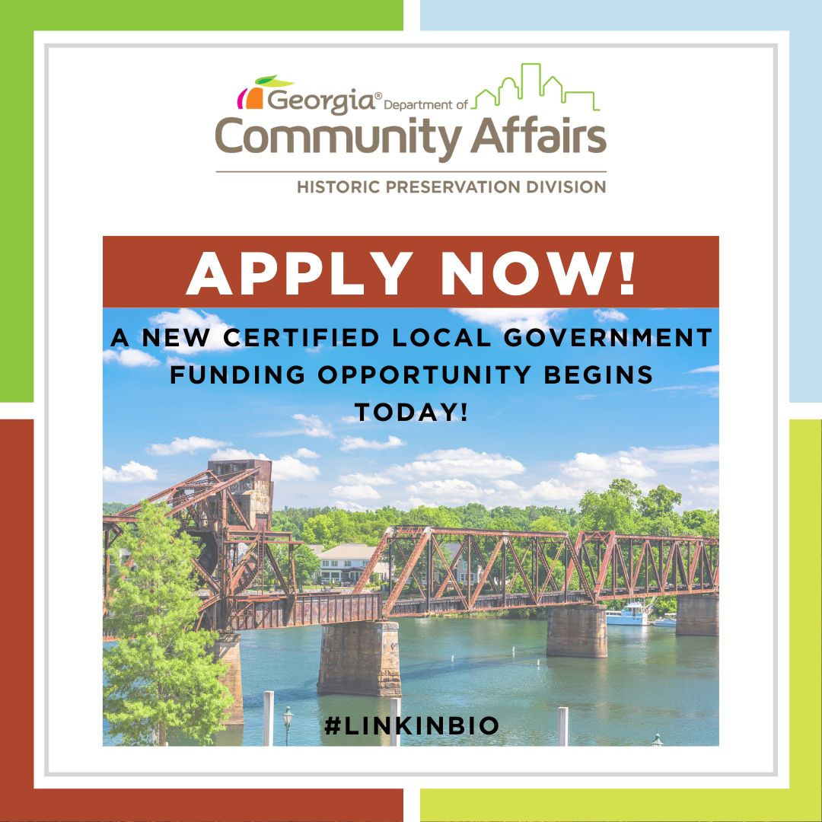
Certified Local Government Program
A local government is eligible to apply for HPF/CLG federal historic preservation grant funds that are available only to communities certified as CLGs.
In FFY2020, more than $103,000 in federal funds were awarded to CLG’s across Georgia
The HPF/CLG grants are 60/40 percent matching grant and some of the 40 percent can be “in kind” match
Notes:
The main benefit in becoming a Certified local government is that you have access to annual federal pass-through grants.
BREATH 1
We channel about $100,000 annually to CLGs for seed preservation projects.
BREATH 2
Our grants are 60/40 matching grants, but we do not require a cash-match. We allow in kind labor and donations to reduce the financial burden of some of these projects.

Slide 13
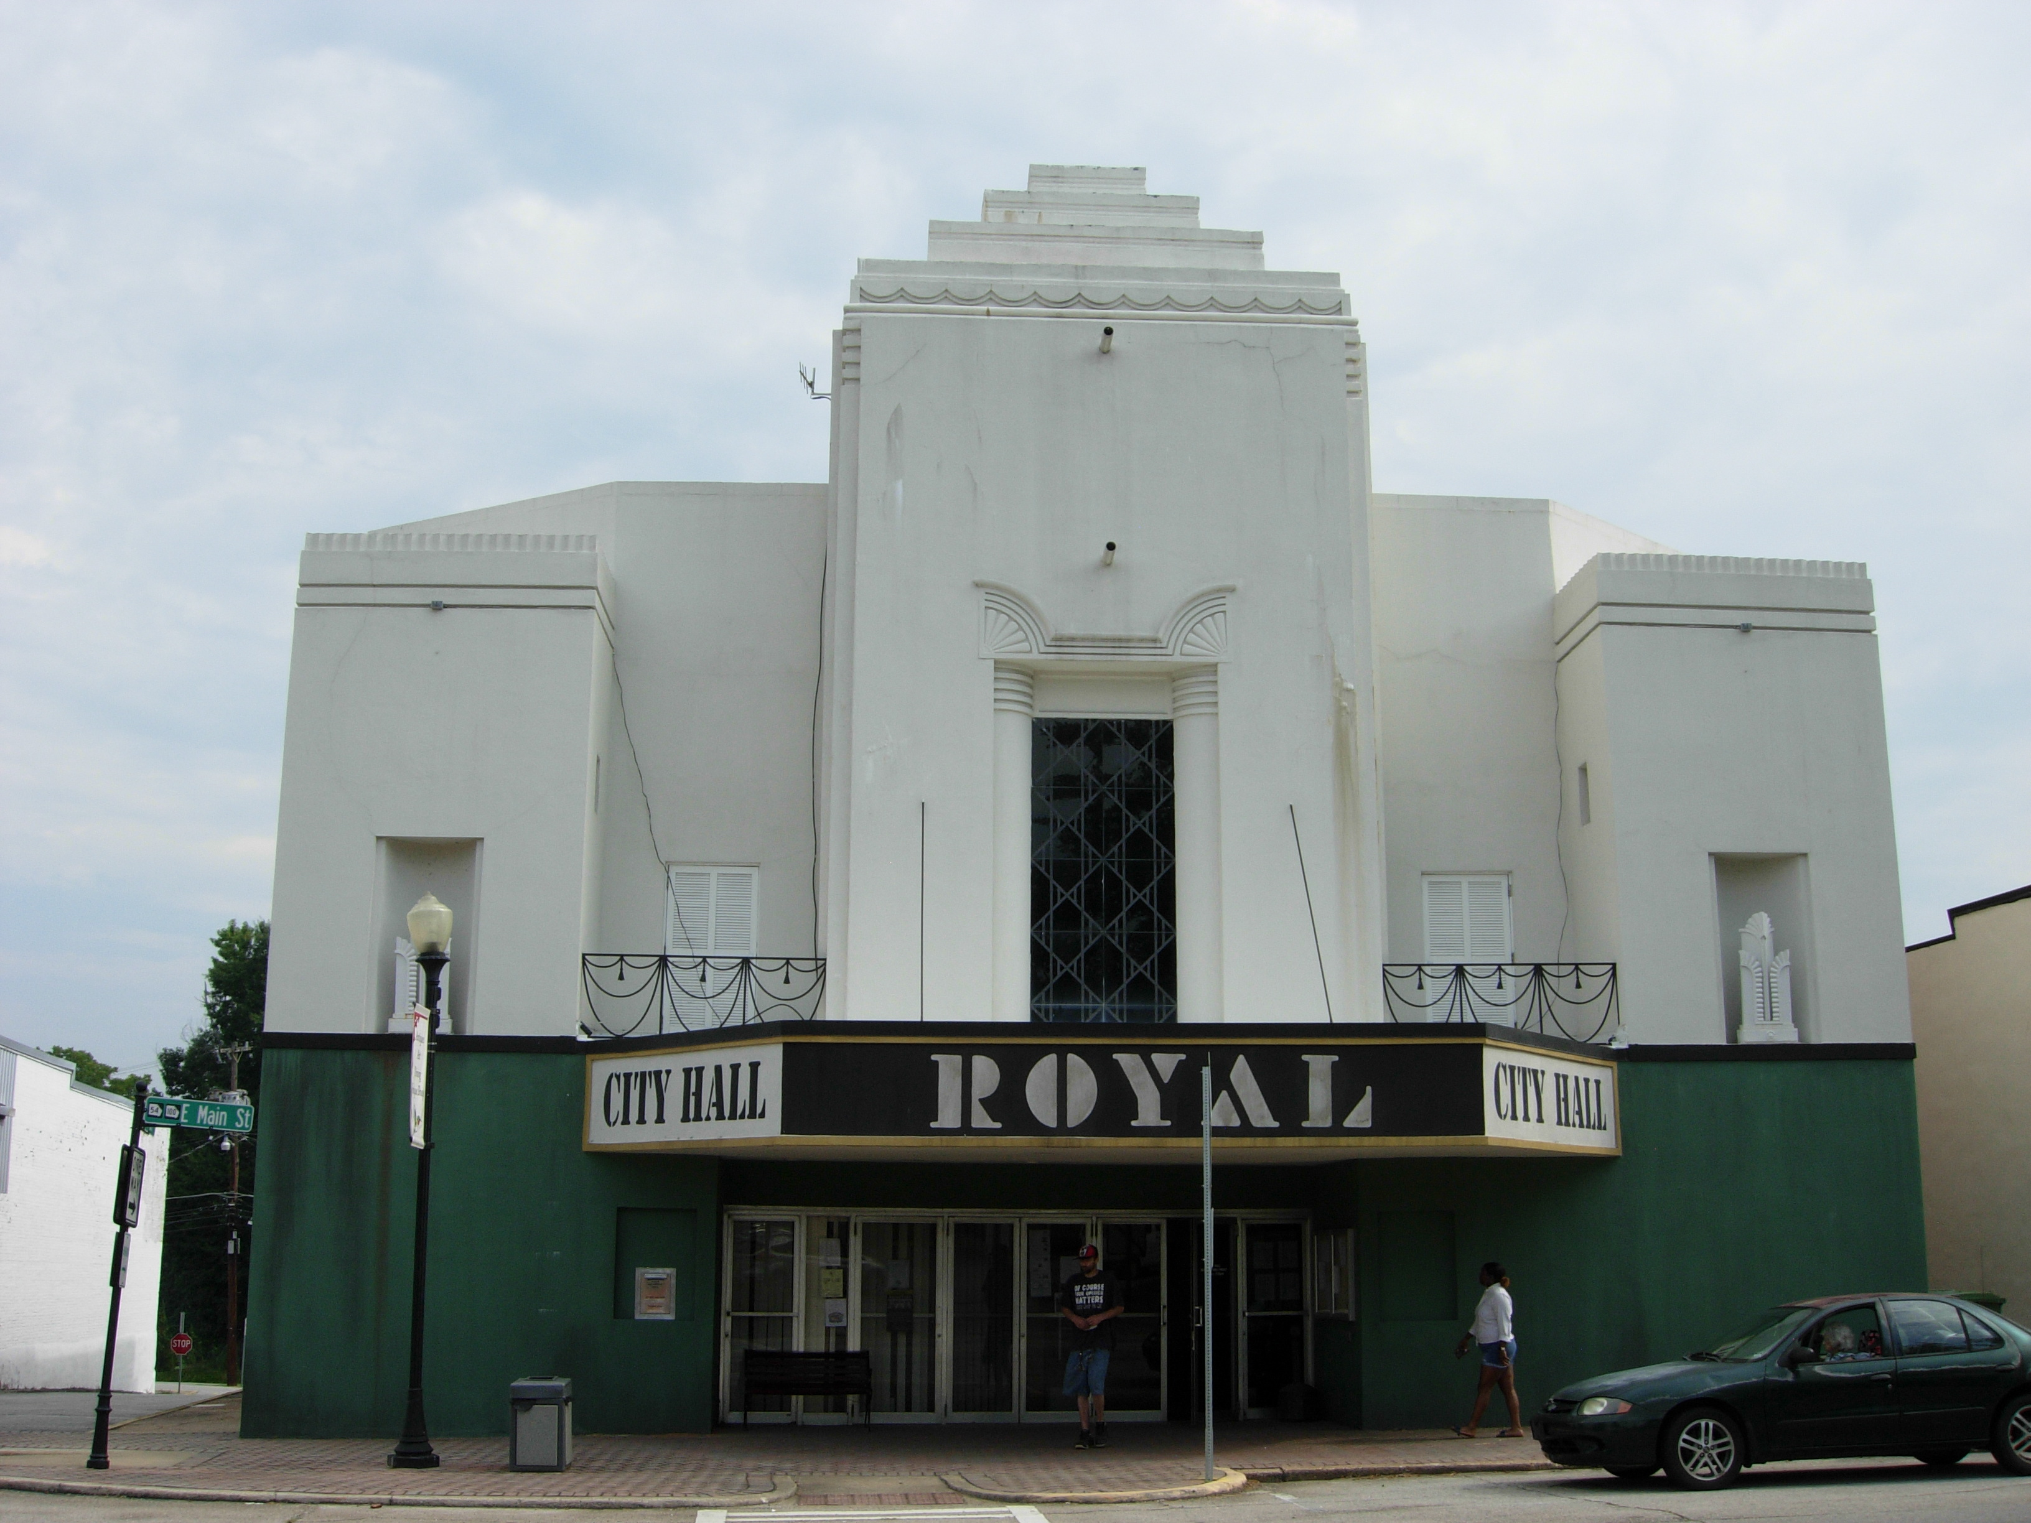
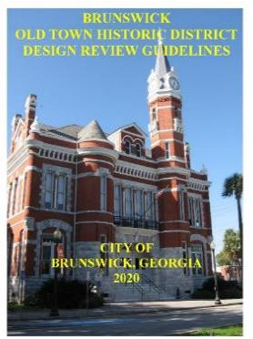
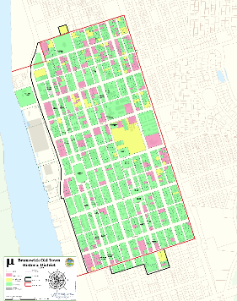
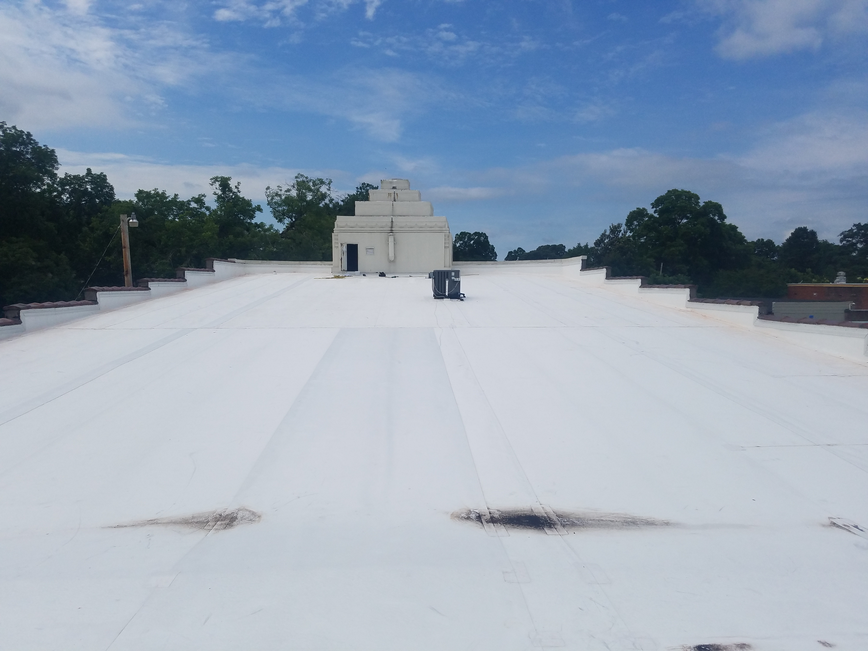
Certified Local Government Program
City of Brunswick
Updated design guidelines for Old Town Historic District
City of Hogansville
Roof repair for the Historic Royal Theatre
City of Greensboro
Historic audio stations tour
Notes:
With this grant funding, we can finance a variety of projects. Here are a few examples of some past CLG Grant funded projects.
BREATH 1
In 2019, the City of Brunswick received a $13,000 grant to assist in updating the 20-year-old design guidelines for the Old Town Historic District.
BREATH 2
Another example is a roof repair project that the City of Hogansville conducted in 2018. Although the program is unable to fund a full restoration project, we were able to award them with a $20,000 grant that year to assist in their efforts.
BREATH 3
The historic audio stations tour project in Greensboro, is a fun project to talk about because it’s a great example of HPCs, local planning departments, and MainStreet programs working together to preserve a community’s shared history.
BREATH 4
The City of Greensboro wanted to expand an interactive audio-walking tour that engaged visitors. With funding from two CLG grants awarded 2020 and 2021 (totaling approximately $10,000,) the City created seven Solar powered audio interpretive stations to place at designated sites throughout the City.

Slide 15
HPD Grant Opportunities
Torrey Long
Certified Local Government Grant
Georgia Heritage Grant
Notes:
For this presentation, I’m going to focus on our two main historic preservation grants. I’m going to cover the most important aspects of each grant: namely, when do applications open, where to find those applications, and what are the eligibility requirements.

Slide 16
Certified Local Government Grants
Annual (first Friday in December)
3 year cycle
Available only to Certified Local Governments (CLG)
60/40 matching grant ($25,000 max award)
Survey/Planning
Predevelopment/Development
Grant assisted project work must meet the applicable Secretary of the Interior’s Standards for Archaeology and Rehabilitation of Historic Properties
Notes:
A Certified Local Government is different than being a local government. A CLG is a special status that local governments can apply for.

Slide 17
CLG Requirements
Who and Where
Requirements include:
  Establishing a Historic Preservation Ordinance
  Establishing a Historic Preservation Commission
  Maintaining a system for survey and inventory of historic properties.
  Maintaining adequate public participation in local historic preservation process
For more information on becoming a CLG.
  Sandra.hall@dca.ga.gov
For more information on CLG Grants.
  Torrey.long@dca.ga.gov
How to find CLG Grant Application.
  Certified Local Government Grants | Georgia Department of Community Affairs (ga.gov)
Notes:
Also, I want to beat y’all to the punch and answer the most important questions of how do I find the grant application and who do I contact when catastrophe, crisis, and/or curveballs find you. Me is the answer.

Slide 18
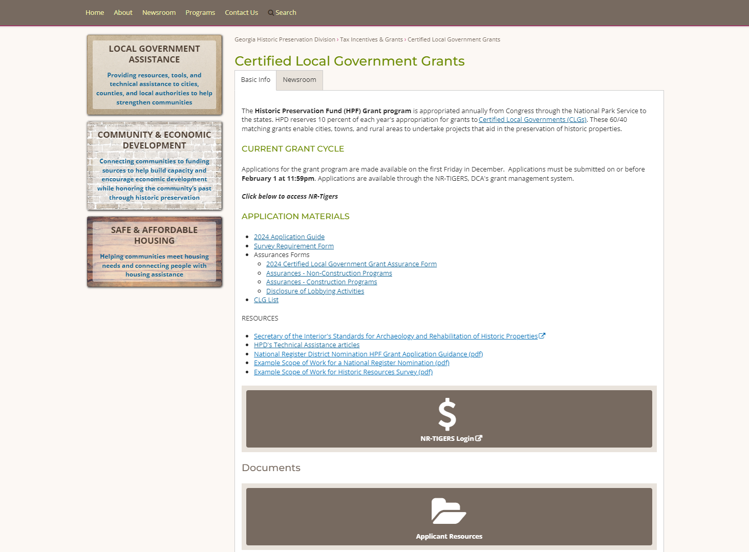
Notes:
This is what the CLG Grants webpage currently looks like.
Talk a bit about NR TIGERS.

Slide 19
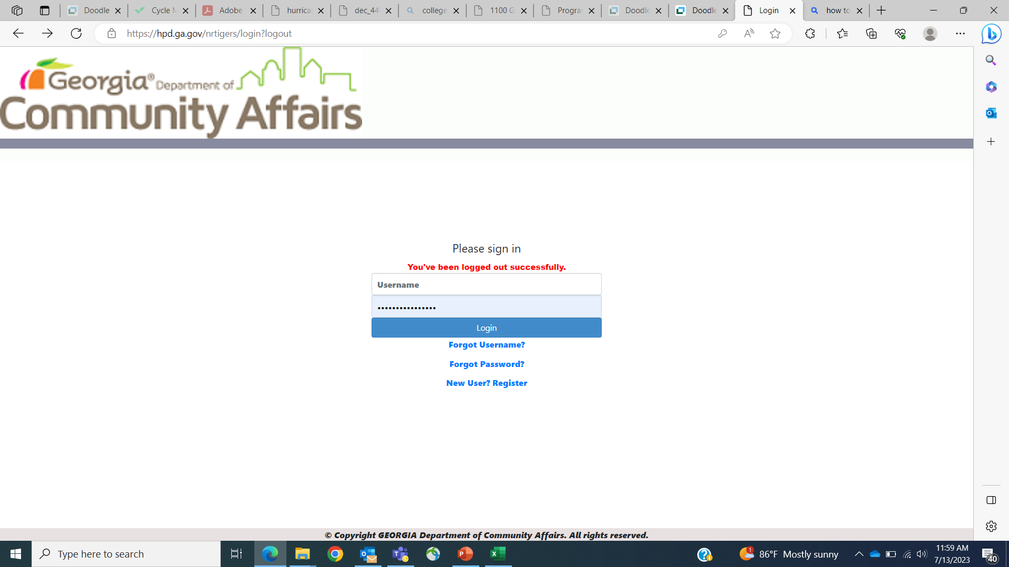
Government Representative
Choose your local government
Notes:
Talk a bit about NR TIGERS.

Slide 20
Project Types
Survey/Planning
Historic Resource Survey (500 max)
Archeological Survey & Report
Design Guidelines
Information/Education Projects
Master Plans
NR Nominations
Preservation Plan
Predev/Dev
Bricks and Mortar
Conditions Assessment
Historic Structure Report
Construction Drawings
Master Plans
Notes:
This slide is not comprehensive, but it includes the main project types for each category. Historic resource surveys are the most common project for the CLG grant, followed by design guidelines.
Many of the projects have a lot of overlap. Conditions Assessment Reports and Historic Structure Reports are similar projects. They both describe the existing condition of a historic structure along with its material elements. HSR also documents the history of a building and provides recommendations on how to deal with existing issues with the site or building. A Preservation Plan also outlines how to deal with existing issues, but it also integrates all other preservation planning activities, which may include CA and HSRs. Preservation plans guide the development of rehabilitation and restoration projects for a site and outline its continued maintenance. Master Plans also provide guidance on long term preservation of a building in its historic context.
As you can see, there’s a lot of overlap, so if you have a project you’re interested in, please email me. We’ll make sure one of our grants is a good fit first, then we’ll find out exactly what you want your project to achieve, then we can help you apply to do the appropriate project.
Predev is generally property specific. Planning projects are generally more for an area. If you have a project you’re interested in pursuing and you’re curious what project type it would fall under, feel free to catch me after the presentation or send me an email. I’d be happy to answer.

Slide 21
Georgia Heritage Grant
Not annual
18-month cycle
Funded by Georgia Historic Preservation License Plates
Available to local governments and 501(c)3 non-profit organizations
60/40 matching grant ($25,000 max)
Predevelopment/Development
Grant assisted project work must meet the applicable Secretary of the Interior’s Standards for Archaeology and Rehabilitation of Historic Properties
Georgia Heritage Grant | Georgia Department of Community Affairs (ga.gov)
Notes:
Also, you can apply for and be awarded both a CLG Grant and Ga Heritage Grant in the same year, even if they’re for very similar projects. The Georgia Heritage Grant is very similar to the CLG Grant in its requirements. The main difference is that it’s open to all Georgia local governments, as well as 501c3 non-profit organizations. Also, only predevelopment/development projects are eligible.
We run a Georgia Heritage Grant cycle when we have enough money in the pot from the Historic Preservation license plates and when we have capacity. We would like to have a cycle next year, but this is not confirmed yet. By early 2025, we will have a firm determination on whether we will run a Georgia Heritage Grant cycle for 2025 or wait until 2026.

Slide 22
Scoring Criteria: Survey/Planning
Project is appropriate in relation to previous and/or future preservation activities
Project design is consistent with SOI Standards
Project fills demonstrated preservation need
Project provides a public benefit
Project is of a type identified by HPD as having high priority*
Urgency or need/degree to which historic resource is threatened
Project is an ongoing, recurring, or concluding project that is identified by HPD as also beneficial to HPD programs/outreach activities
Notes:
These criteria, and the ones on the following slide for predev/dev, are consistent for every application scorer. Most importantly, make sure you describe the public benefit for your project, the need and urgency, any prior work related to this project, and what your next steps are after completing this project. Also, make sure you include all the required attachments. All the required attachments will be listed on our website, from that link from earlier.
For the blue highlighted criteria, if HPD intends to identify a specific type of project as having high priority, we will state that in the grant announcement. It will be on our website, in our newsletter, etc. If we don’t identify a specific project type as having priority, every applicant gets zero for this part, so it doesn’t come into play.

Slide 23
Scoring Criteria: Predev/Dev
Meets eligibility requirements
Project concept is appropriate for resources
Project design is consistent with SOI Standards
Project fills demonstrated preservation need
Project provides a public benefit
Significance of resource
Urgency or need/degree to which historic resource is threatened

Slide 24
Other Grant Opportunities
National Trust for Historic Preservation
Georgia Trust for Historic Preservation
National Park Service
Grants.gov
Notes:
I won’t go into a lot of detail here, since I want to focus on the grants that HPD has to offer, but I keep a list of other grant opportunities that would also be worth exploring in conjunction with the CLG Grant and Georgia Heritage Grant. If you would like that list, feel free to email me and I’d be happy to pass that along.

Slide 25
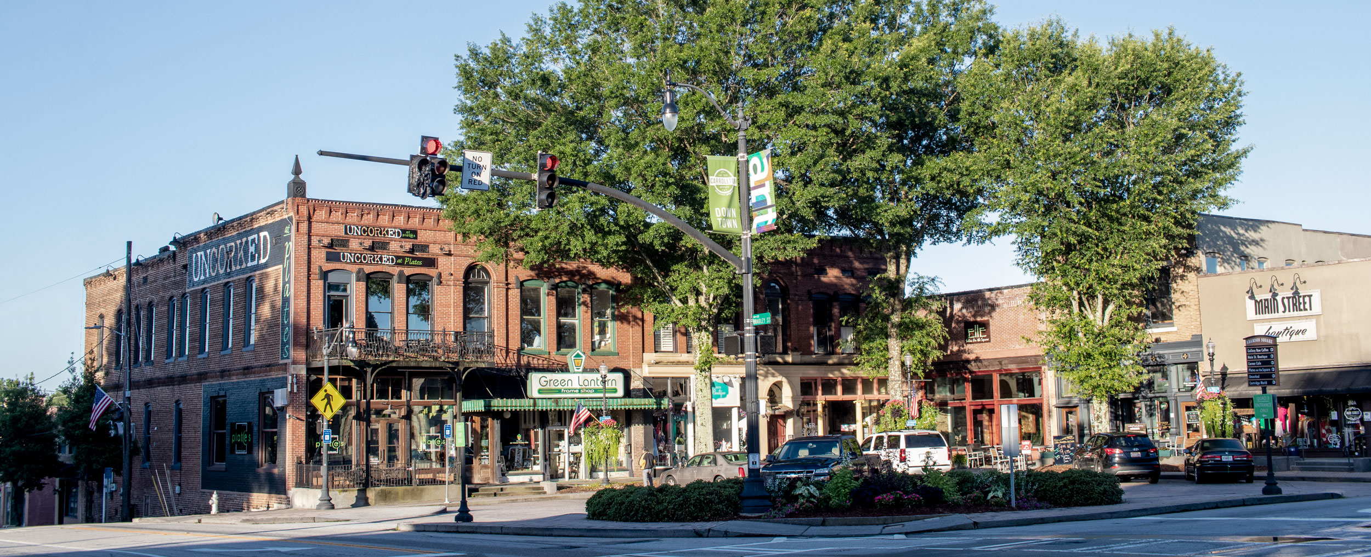
Will I Be Notified?
Website
Newsletter
Instagram
Email
Notes:
Will I be notified when the CLG Grant and Ga Heritage Grant become open for applications? Yes. We will announce it on our website, in our newsletters, on our social medias, and via email blasts.

Slide 26
Thanks!
Sandra Hall
sandra.hall@dca.ga.gov
404.679.4850
Certified Local Government Coordinator
Torrey Long
torrey.long@dca.ga.gov
470.757.2551
Grant Coordinator
dca.ga.gov

