Slide 1
Federal Labor Standards

Slide 2
Key Regulations & Statues
Copeland Act (Anti-kickback Act)
  Prohibits kickback of pay
  Requires certified weekly payrolls
  Regulates payroll deductions
Davis-Bacon Act
  Outlines labor standards for federal projects
  Applicable to all contracts over $2,000 involving federal funds
  Provides minimum wages by position
  Applies to all laborers and mechanics
  Applies to entire project, not just CDBG funded portion
Contract Work Hours & Safety Act
  Overtime pay for working over 40 hours (cannot get comp time in lieu of)
  Applies to contracts over $100,000
  Requires liquidated damages of $10 per day/per violation

Slide 3
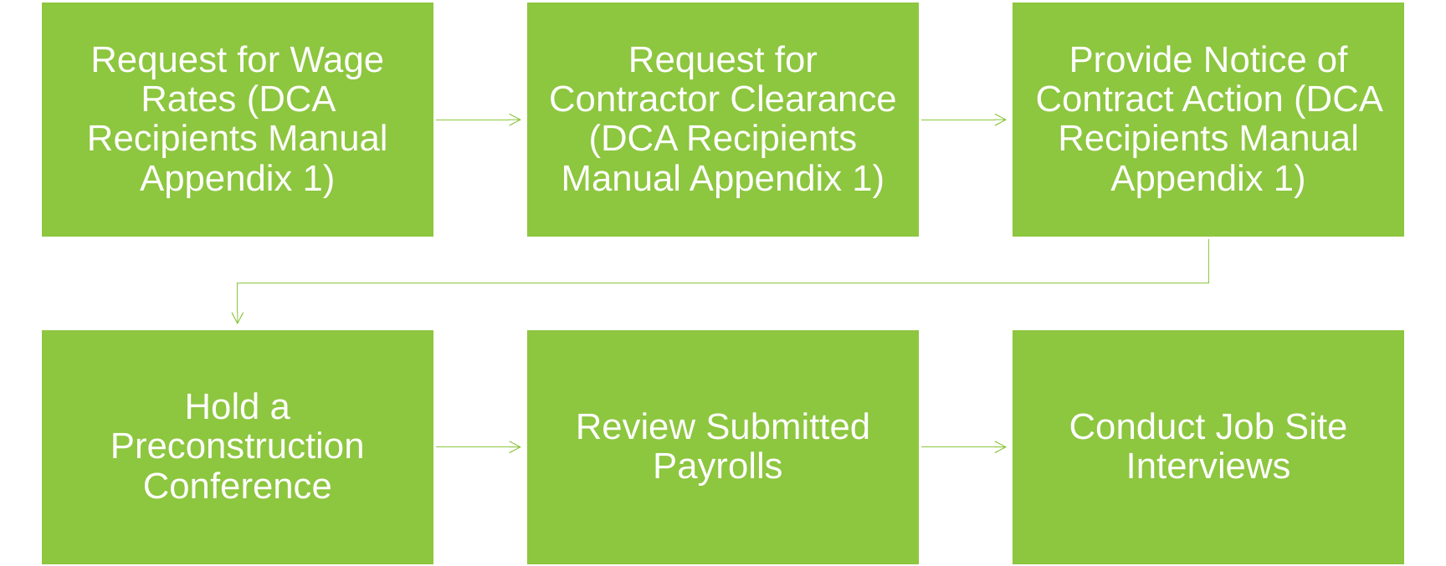
Steps to Complying with Davis-Bacon & Related Acts

Slide 4
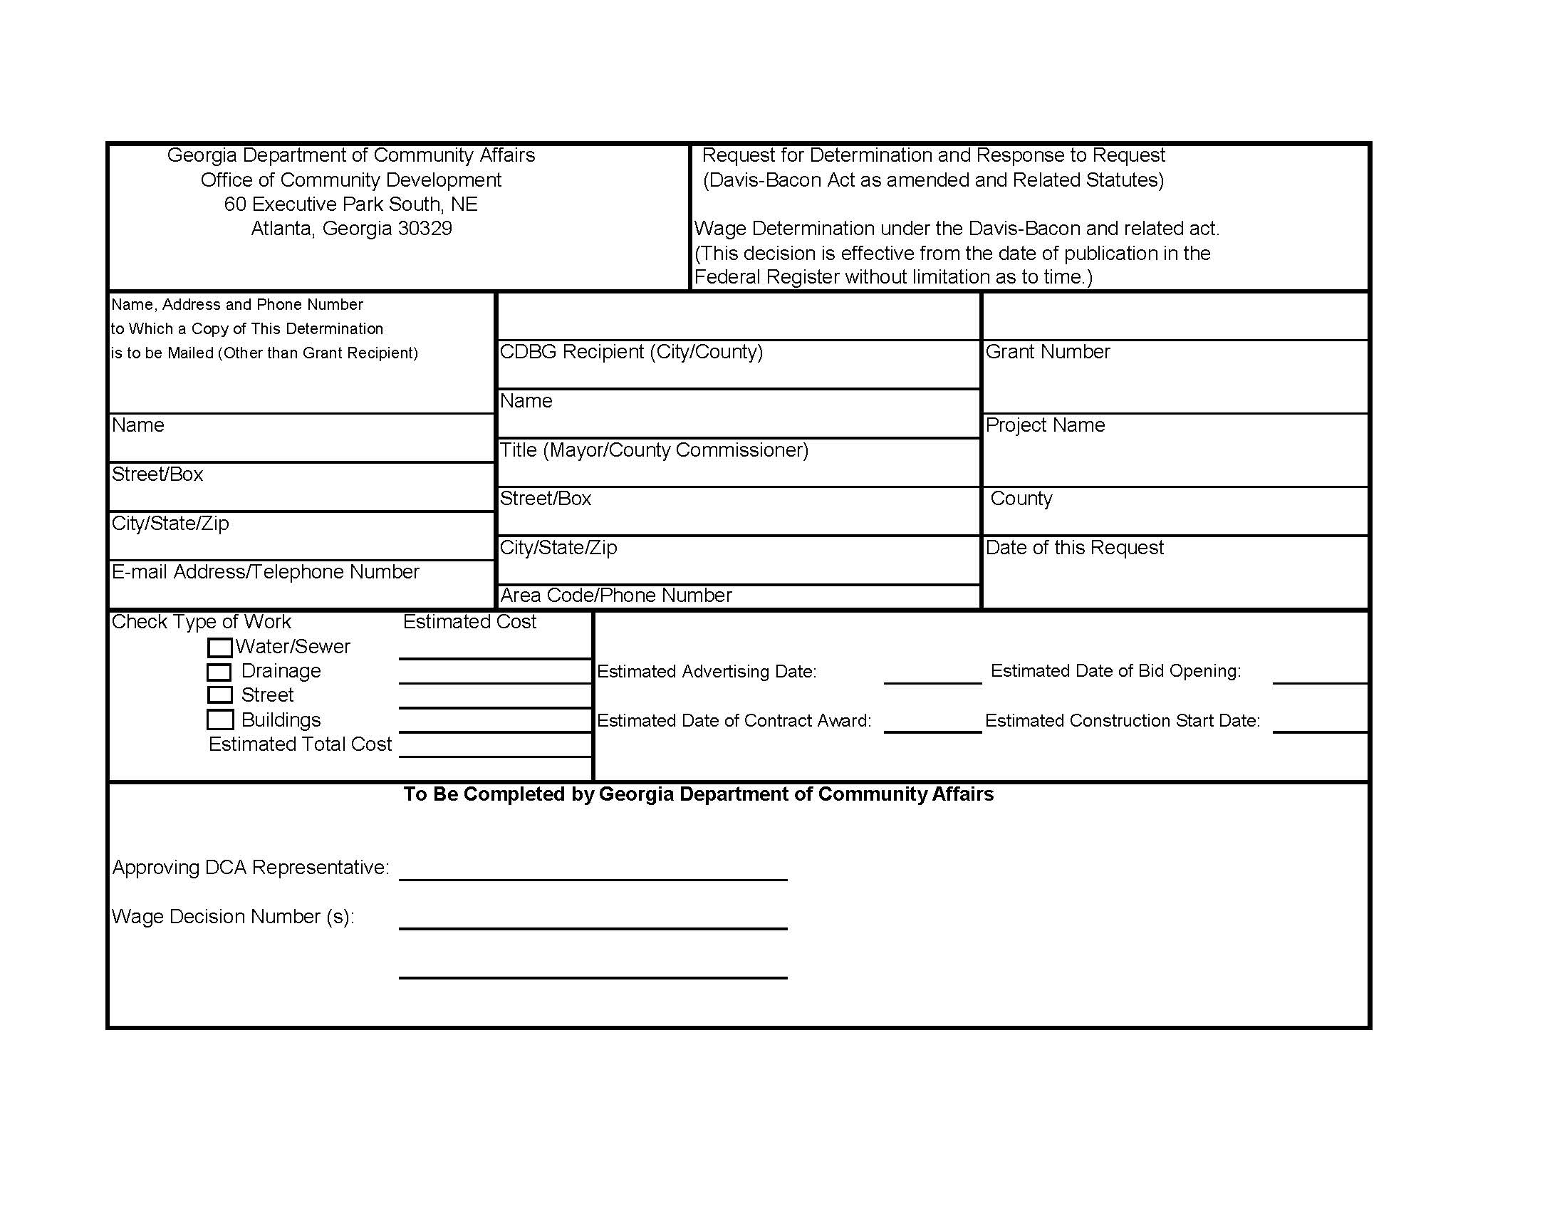
Step 1: Request for Wage Determination
Submit request to DCA (cdbg.biz@dca.ga.gov)
  30 days prior to advertising for contract bids
Check 10 days before bid opening
  10-day wage check form
Wage rates must be included in bid package and contracts.
Include the estimated cost of each activity and the percentage of each activity on the form.

Slide 5
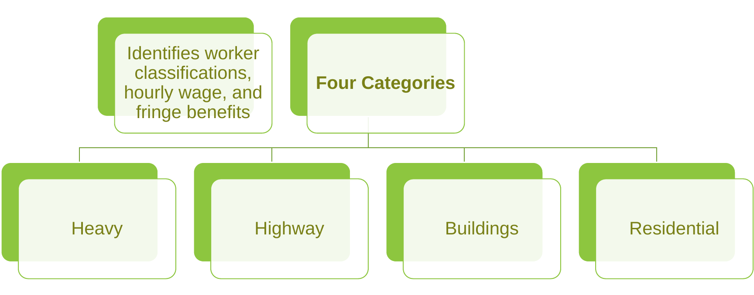
Wage Decision

Slide 6
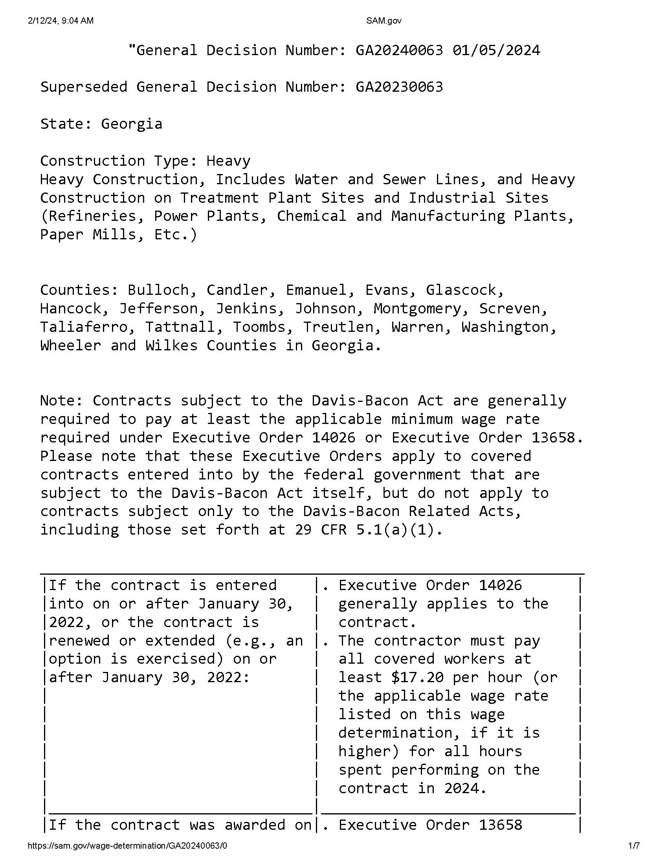
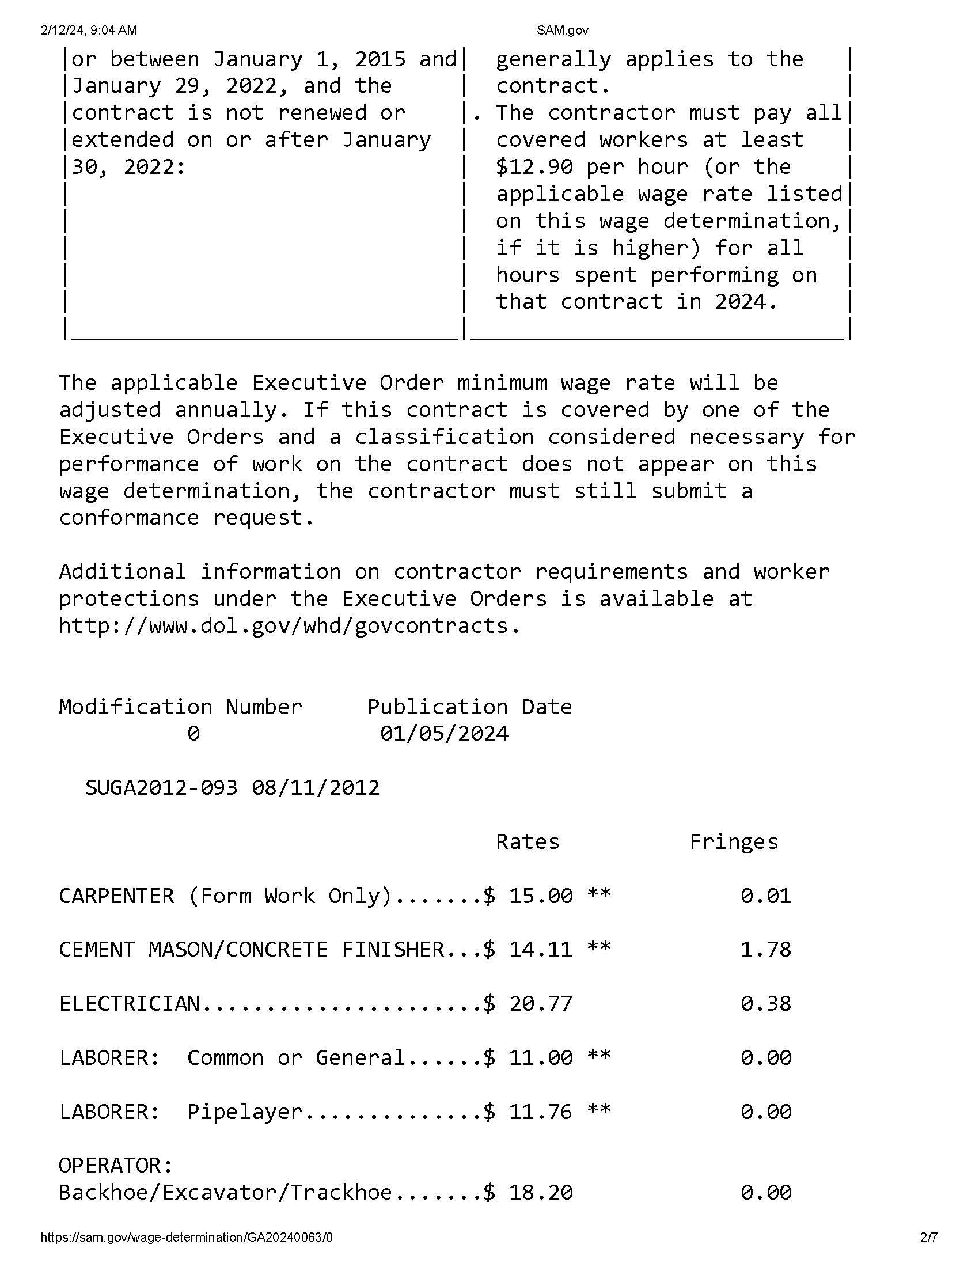
Wage Decision

Slide 7
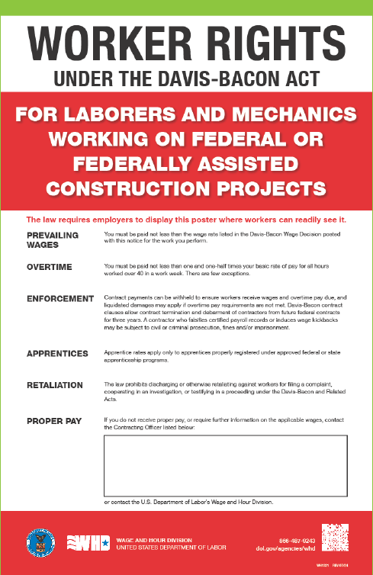
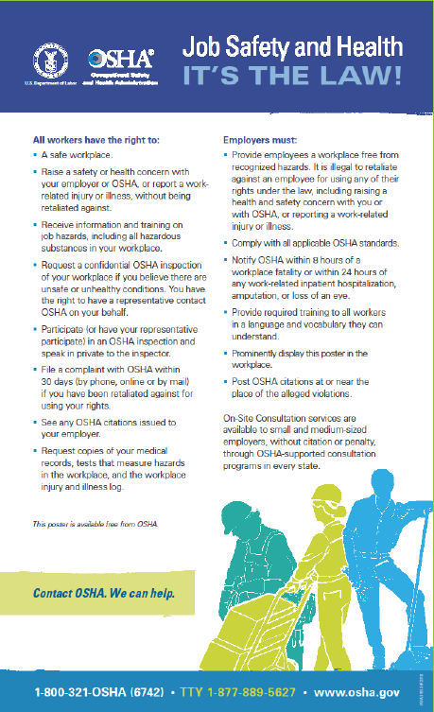
Posters

Slide 8
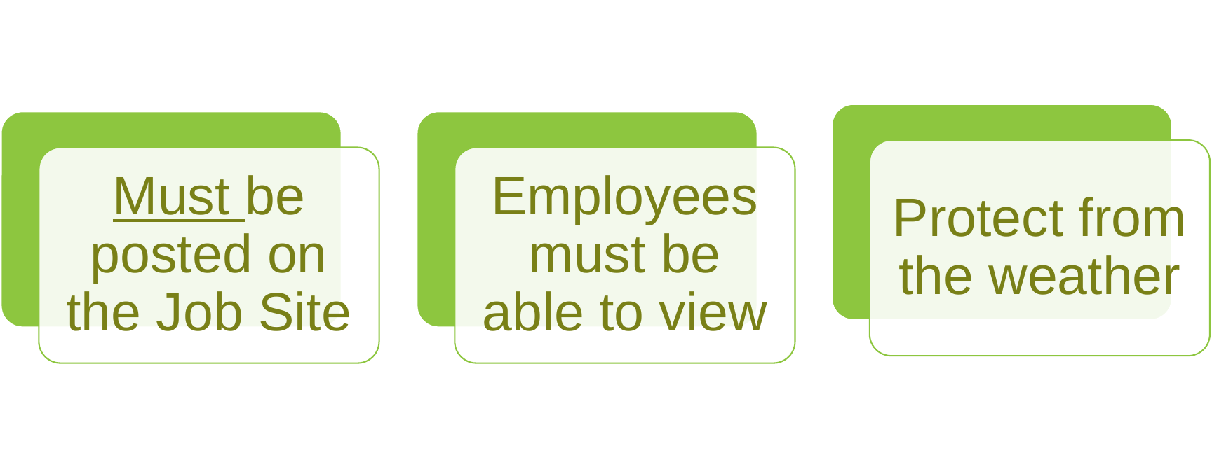
Wage Decision & Posters

Slide 9
Wage Decision Lock-in
Competitively Bid
At bid opening if contract is executed within 90 days of bid opening
If contract is not executed within 90 days, resubmit 10-day wage check form 10 days prior to contract execution and wage decision will be locked in at contract execution
Negotiated Contracts
  At contract execution
If a contract is modified to add additional work not within the scope of work in the original contract, the most recent applicable wage determination modification must be incorporated into the contract.

Slide 10
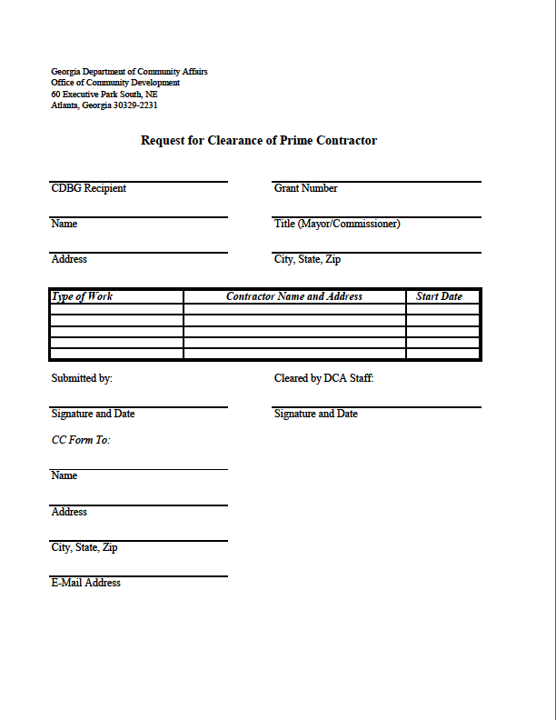
Step 2: Request for Contractor Clearance
Ensures contractor is not on Federal Debarred list
Must be cleared before entering into a contract
Email form to DCA (cdbg.biz@dca.ga.gov)

Slide 11
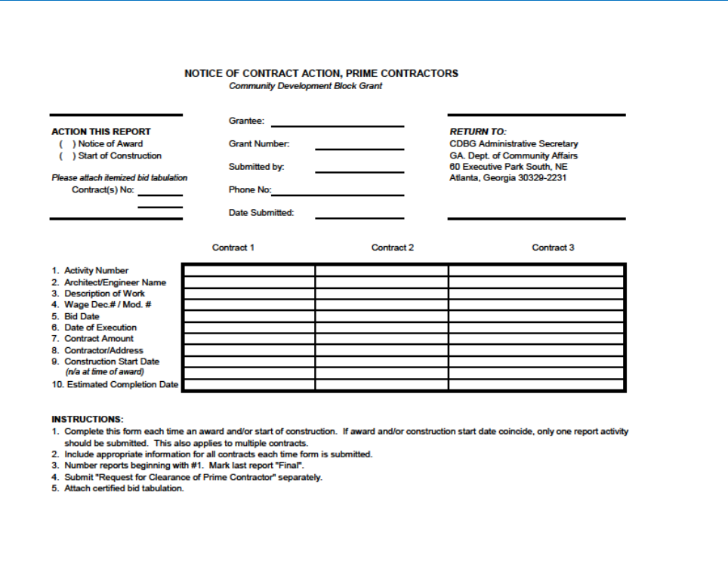
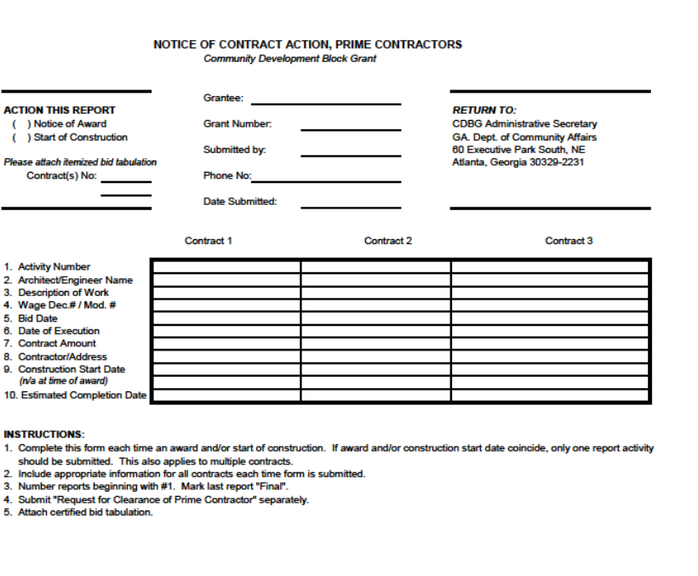
Step 3: Notice of Contract Action
Must be submitted to DCA
Include certified and itemized bid tabulation with form
Construction drawdowns will be withheld if not submitted

Slide 12
Step 4: Pre-construction Conference - Mandatory
Attended by the architect/engineer, grant administrator, the contractor and representatives of the local government.
Outlines contractor & subcontractor responsibilities, project timelines, logistics, etc.
Explain Davis-Bacon, other applicable laws & contract provisions, and Section 3
Include CDBG Reps when planning of the conference

Slide 13
CDBG Rep Contact Information
  Cindy Alligood: (478) 290-1074, Cindy.Alligood@dca.ga.gov
  Crystal Gaillard: (470) 965-2364, Crystal.Gaillard@dca.ga.gov
  Roderick Gilbert: (470) 783-4729, Roderick.Gilbert@dca.ga.gov
  Malisa Thompson: (404) 326-1048, Malisa.Thompson@dca.ga.gov

Slide 14
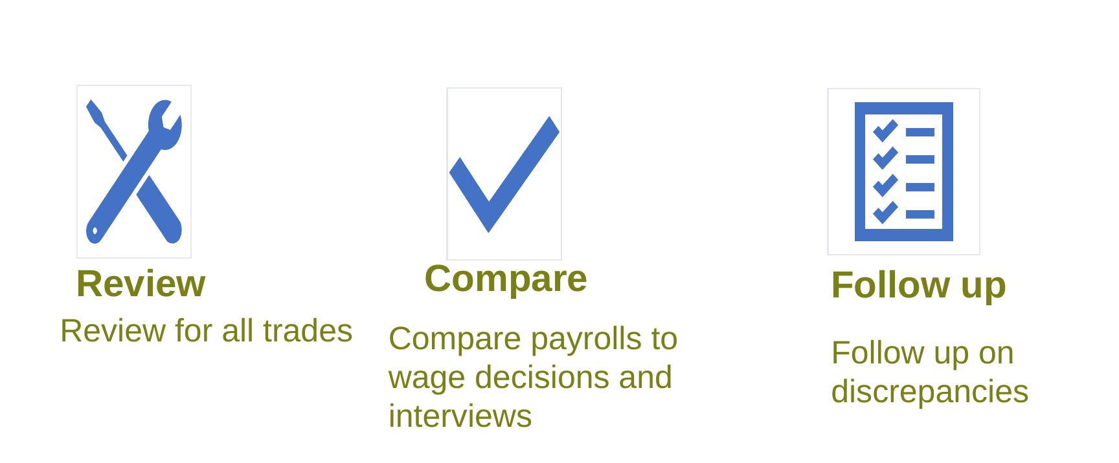
Step 5: Review Payrolls

Slide 15
Payrolls
Contractors must submit all payrolls to grant recipient​
Must include the name and identifying number of each worker the first time they appear​
  Contractor must provide address and social security number upon request​
  Contractor records must include each workers classification, last known telephone number, and email address.
Every contractor on the project must maintain records for three years after completion of the project.
The prime contractor must maintain a complete set of payrolls from every sub- contractor, subcontracts, and related documents on the project for three years after completion of the project.

Slide 16
DOL Davis-Bacon Payroll: Form WH-347
Contractor's Optional Use | Rev. Jan. 2025
DCA review: check the payroll
Project & payroll header
Project name/number, contractor or subcontractor, location, wage determination, payroll number, and week ending date.
Classification: Does the work performed match the wage decision classification?
Rate + fringe: Does the wage/fringe paid meet the applicable wage determination?
Worker information
Worker entry number, name, identifying number, and labor classification actually performed.
Hours: Do daily and weekly hours agree with time records and site interviews?
Hours & pay
Daily hours, straight-time/overtime, total weekly hours, hourly wage rate, fringe benefit credit/payment, and gross wages.
Overtime: When applicable, are hours over 40 paid at the required overtime rate?
Deductions & net pay
Tax withholdings, FICA, other specified deductions, total deductions, and net pay.
Deductions: Are deductions permissible and properly documented?
Certification: Is the Statement of Compliance signed by the contractor or authorized person?
Statement of Compliance
Each certified payroll must be accompanied by the signed Statement of Compliance on page 2 or identical wording.
Source: U.S. Department of Labor, Form WH-347 (Rev. Jan. 2025). WH-347 is optional; weekly certified payroll information and the Statement of Compliance are required.
DOL WH-347 + Instructions

Slide 17
Payrolls
Sole proprietors and self-employed mechanics
  Cannot self-certify to wages without a crew
  Must be reported on “responsible employer” payroll
  Can certify to hours when working with a crew
  Only report hours worked and list owner as classification

Slide 18
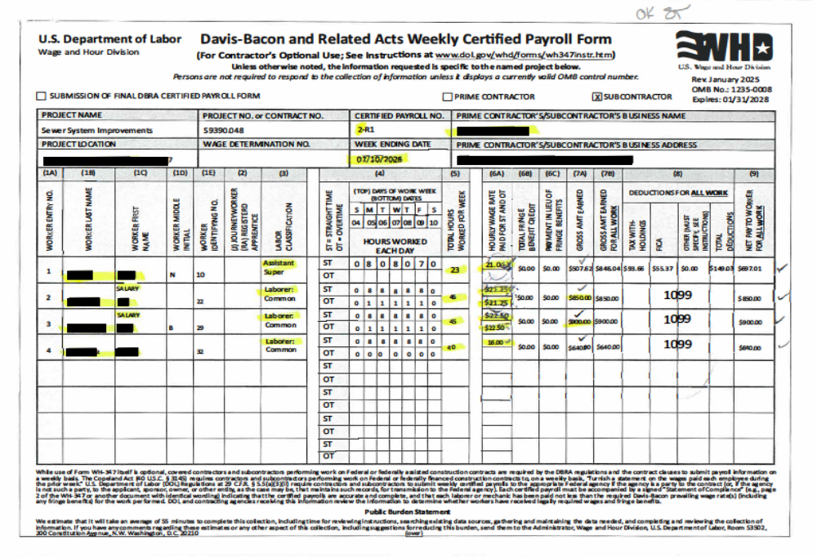

Slide 19
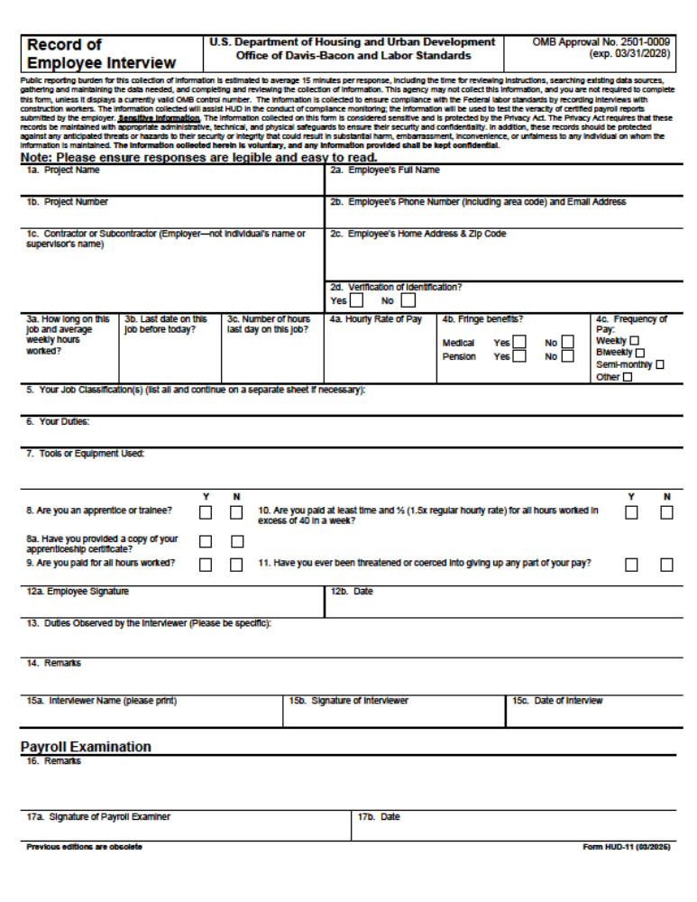

Slide 20
Conformance Request (Additional Classification)
Required when wage determination does not contain a classification that is applicable to the project.
The work that will be performed by the requested classification cannot be performed by another classification contained within the wage decision
The classification cannot come from another wage decision when multiple wage decisions are used in the contract.
The requested wage rate and fringe benefit, if any, must bear a “reasonable” relationship to the existing wage rates contained in the wage decision.

Slide 21
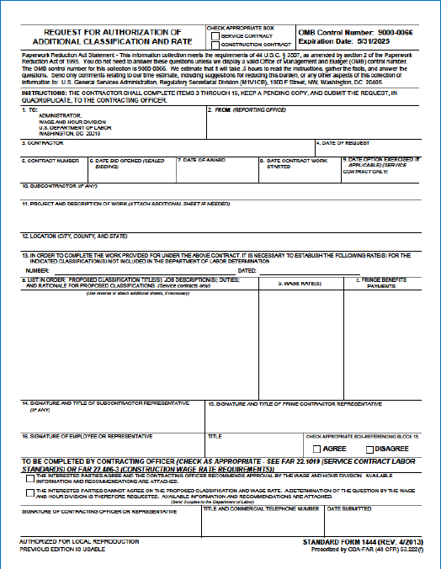
Submitting a Conformance Request
Request is submitted to DCA through CDBG.biz@dca.ga.gov
Signed letter from the grantee requesting the additional classification;
Applicable wage decision;
Prime contractor must complete the SF-1444 and submit a written letter with a description of the work to be performed by the requested classification;
And any related documentation or recommendations

Slide 22
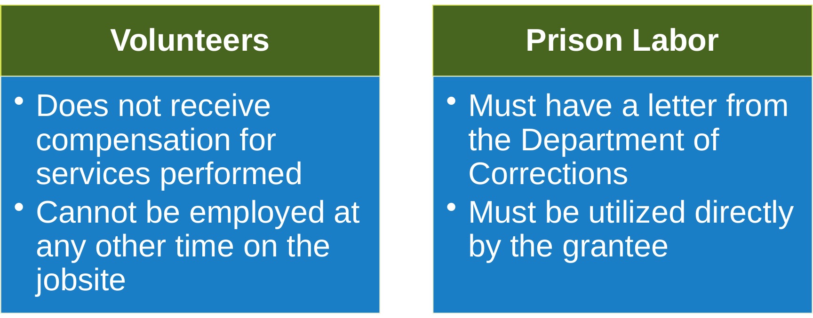
Exemptions

Slide 23

Prime Contractor Responsibilities
Responsible for compliance of all contractors
Include contract clauses and applicable wage rates in all sub-contracts
Review wage rates for additional classifications
Provide sub-contractors with guidance
Prepare and submit certified payrolls for employees
Maintain a complete set of payrolls from every sub- contractor, subcontracts, and related documents on the project for three years after completion of the project.

Slide 24
Sub-contractor Responsibilities
Prepare and submit certified weekly payrolls
Review wage rates and request additional classifications, if necessary
Ensure access to employees for on-site interviews
Maintain records for three years after completion of the project.

Slide 25
RECAP
Request wage rates
Request contractor clearance
Ensure submission of weekly payrolls
Conduct on-site interviews
Review payrolls and compare to interviews
Ensure correction of underpayments
Maintain records

Slide 26
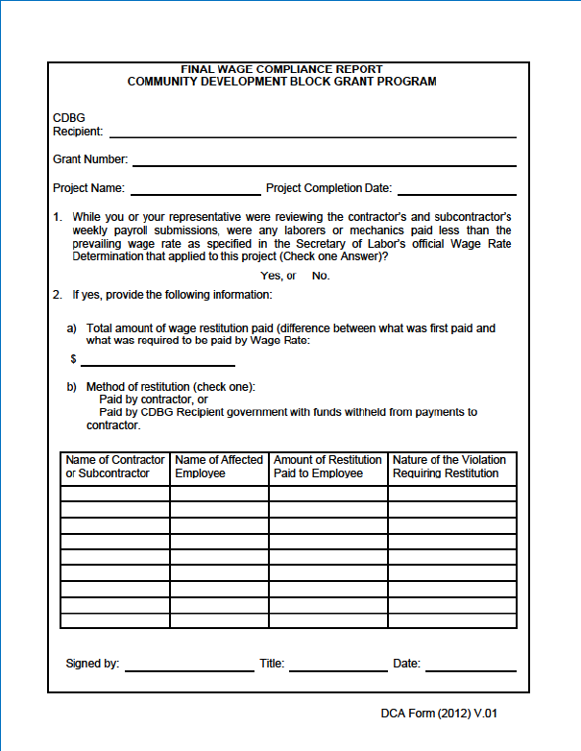
Final Wage Compliance Report
Complete at end of project
Captures restitution information
Required in closeout package

Slide 27
Resources
Davis-Bacon and Labor Standards, Contractor Guide Addendum
  https://files.hudexchange.info/resources/documents/Davis-Bacon-and-Labor-Standards-Contractor-Guide-Addendum.pdf/
Davis-Bacon and Labor Standards Agency/Contractor Guide
  https://files.hudexchange.info/resources/documents/Davis-Bacon-and-Labor-Standards-Agency-and-Contractor-Guide.pdf
Department of Labor, Davis-Bacon & Related Acts
  https://www.dol.gov/whd/govcontracts/dbra.htm

Slide 28
Thanks!
Pam Truitt
Pam.Truitt@dca.ga.gov
Direct: (404) 977-3326
Manager, CDBG Compliance & Field Services
dca.georgia.gov

