Slide 1
Economic Development Application Development & Revolving Loan Funds (RLF)
Faith Kae

Slide 2
Point of Contacts:
Faith Kae, Economic Development Consultant
DCA-Office of Community Development
Faith.Kae@dca.ga.gov
Kathleen Vaughn, Office Director, Community Development
DCA-Office of Community Development
Kathleen.Vaughn@dca.ga.gov
Corinne Thornton, Office Director, Regional Community Services or your local region rep
DCA-Office of Community Development
Corinne.Thornton@dca.ga.gov

Slide 3



The DCA Team
Regional & Field Representatives
Project identification, assessment & development
Monitoring
Managers
Review overall project
Ensure program objectives can be met
Craft award documents
Project oversight
Credit Underwriters
Credit analysis, underwriting
Financing options

Slide 4
Overview
Community Development Block Grant (CDBG) enacted by Congress as Title I of Housing and Community Development Act of 1974.
The primary objective of CDBG is to ensure “the development of viable communities through improvement of living conditions, housing and the expansion of economic opportunities in cities and counties, principally for persons of low and moderate income.”

Slide 5
Set-Aside Programs
Georgia Department of Community Affairs​
CDBG Economic Development ​
CDBG Programs:
Employment Incentive Program (EIP), Redevelopment Funds(RDF), Immediate Threat and Danger (ITAD), and Revolving Loan Fund (RLF)

Slide 6
Available Funding: Georgia
CDBG Funds from U.S. Housing and Urban
Development (HUD)
HUD Authorization​ | Approx. $40M
EIP​ | $4,000,000 set-aside​
RDF​ | $1,500,000 set-aside​
Immediate Threat​ | $500,000 set-aside​

Slide 7
Local governments can implement a broad range of activities as long as they further the National Objectives of the Act.
Three National Objectives are:
  Majority benefit to low- and moderate-income persons through services and job creation;
  Prevention or elimination of slum and blight; and
  Urgent Need
Set-Asides Overview

Slide 8
Maximum Award Amounts
EIP​ | $1,000,000 set-aside​
RDF​ | $1,000,000 set-aside​
Immediate Threat​ | $200,000 set-aside​
Primary Purpose​ | EIP - Expand employment opportunities for L/M income people​ RDF – Eliminate Slum and Blight​ ITAD- Immediate and Urgent Disaster Relief
Low/Moderate Income Benefit​ | At least 51% of jobs created and/or retained​
Eligible Uses​ | Public facilities, infrastructure, business loans, elimination of Slum and Blight​, Relocation Assistance

Slide 9
Organizational Processes
Potential Project
Initial Project Assessments
Market Successful Concepts
Local Community & Economic Development Needs
Application Development & Submission
Monitor & Audit
Manage Projects
Award / Denial
Final Structure of Assistance
Review & Underwrite Application

Slide 10
Review & Underwrite Application Timeline
IPA Received
PACA Letter Issued
Program Application Submitted
90 days
Completeness Checklist
10 days
Completeness items resubmitted, if not complete
Staff Review Panel
45 days
30 days
10 days

Slide 11
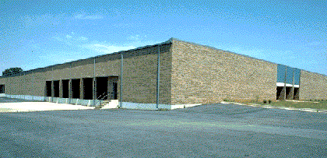
What exactly is this IPA?
Initial Project Assessment (DCA)
The Who, What, Why, When and Where of a Project;
Determines and Preserves Eligibility of activities and costs;
Enables Pre-Agreement Cost Approval (PACA) which is
especially important for federal funds;
Ensures all available funding sources are considered; and
Provides an idea how competitive your project might be.

Slide 12
What is PACA?
CDBG/EIP and DCA regulations allow potential applicants to request “pre-agreement cost approval” (PACA) from DCA that authorizes the potential applicant and beneficiary business to commence project activities and maintain project timetables while applying for EIP assistance.
Upon DCA’s issuance of pre-agreement cost approval, a project may move forward prior to submission of an application or award of funds while maintaining the eligibility of the job-creation and private investment that takes place prior to submission of an application and receipt of a grant award.

Slide 13
In other words, this is how it works:
Community contacts DCA Regional Representative about a potential project.
DCA conducts an Initial Project Assessment or Pre-Application visit to assist a potential applicant in understanding process & programs.
DCA reviews IPA Pre-App and recommends eligible financing strategy in written response.
Community prepares and submits application for DCA review. If the application is incomplete, the applicant is notified in writing of items needed to allow for a competitive application.

Slide 14
How it works, continued:
Application reviewed based on rating and selection criteria.
Award or denial of application.
Grant/loan management processes start – technical assistance provided through site visits.
Monitors project at intervals to ensure compliance with Award.

Slide 15
Let’s break down the EIP program!

Slide 16
Employment Incentive Program
Purpose
Facilitate and enhance job creation and/or retention, principally for low- and moderate-income persons, by providing funding cycle that is more responsive to expanding or retaining economic opportunities at the local level.
To Be Considered For Funding
Potential projects must address the creation and/or retention of jobs or employment opportunities, a minimum of 51% of which must be for persons of low and moderate income

Slide 17
Employment Incentive Program
Eligible Program Applicants
Units of general-purpose local government that are not metropolitan cities, urban counties and other units of government eligible to participate in HUD's urban counties, or metropolitan cities program.

Slide 18
Eligibility Restrictions
Georgia Planning Act
The Service Delivery Strategy Act
The Solid Waste Management Act ( Sewer Projects)
DCA Local Government Finance Report requirements
Local Government Audit Act

Slide 19
Compliance
Status Check
For information on a community’s Qualified Local Government Status (QLG), i.e., the status of a community’s compliance with the first four requirements listed in the previous slide, please go to the following web site: https://www.audits2.ga.gov/resources/orgs/local-government.
For information on a community’s compliance with the Local Government Audit Act, please visit : https://www.audits2.ga.gov/resources/orgs/local-government/. (Applicant should report status of conformance with the reporting requirements in the EIP application ).
It should also be emphasized, that to be eligible as a sub-recipient of EIP funding, the business and principals must not appear on the Georgia Department of Revenue’s delinquent tax list.

Slide 20
Employment Incentive Program
The program can be utilized to:
A financing mechanism which seeks to create employment opportunities for rural Georgia’s low- and moderate-income population ;
A method of assisting those businesses that cannot raise all of their financing needs through conventional private sources; and
A provider of infrastructure funding to local governments with projects that will create the necessary job opportunities , but cannot proceed because of a lack of sufficient infrastructure funding

Slide 21
Employment Incentive Program
Eligible Activities
Activities carried out by units of general local government and/or other local public authorities including:
  a) Acquisition of real property;
  b) Construction, reconstruction, rehabilitation, or installation of public facilities (except for buildings for the general conduct of government), site improvements, and utilities, and
  c) Commercial or industrial buildings, structures and other real property improvements.

Slide 22
Employment Incentive Program
Eligible Activities
Direct assistance to private for-profit entities, when the assistance is appropriate to carry out an economic development project
*Assistance can not be in the form of a grant, guarantees, or technical assistance.
*Financial assistance to private for-profit entities must be made upon firm commitments of financial participation from other private sources such as banks or the private for-profit entities themselves.
*Assistance must also create or retain permanent jobs principally for low- and moderate-income persons.

Slide 23
Employment Incentive Program
Eligible Activities
Assistance to local governments and/or other local public authorities to fund facilities that assist low- and moderate-income persons to acquire employment, the employment skills, and/or basic educational training to become more effective participants in the local economy.
*Eligibility for activities will be limited to "new" activities that have not previously been undertaken by the local government or local development entity

Slide 24
CDBG ED Grants - Examples Eligible Activities
Public water and sewer systems (E.G. Distribution and/or collection lines), wastewater treatment projects, rail spurs, and various other types of public facilities.
Financing for fixed assets including land, new facilities, rehabilitation of existing facilities, machinery, equipment, etc.
Notes:
For-profit facility construction or rehabilitation, machinery and equipment, and limited soft costs are eligible for loan assistance

Slide 25
Ineligible CDBG-ED/EIP/RDF Activities
Working Capital
Refinancing
Speculative Projects
Capacity Building
General Conduct of Government
Project Not Meeting Federal Guidelines
Using Federal Funds to relocate businesses (Piracy - There are Restrictions)

Slide 26
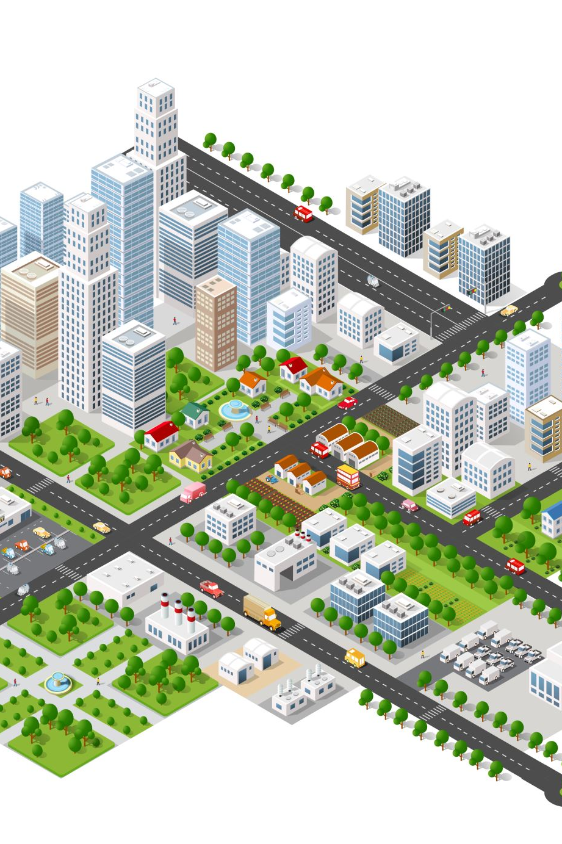
Pre-application Reminders
Whenever a local government recipient of CDBG/EIP needs to acquire property, such as land for a building, easements, Right-of-Way (ROW) for public infrastructure such as water or sewer lines, street paving, or drainage improvements the Uniform Relocation Assistance (URA) and Real Property Acquisition Act requirements must be satisfied
URA procedures must be followed for CDBG/EIP projects even if the local government recipient is using other federal funds, its own non-federal funds, or other non-federal funds to pay for the property.

Slide 27

Pre-application Reminders
All CDBG/EIP projects must take certain actions to comply with the National Environmental Policies Act of 1969 (NEPA) and HUD regulations implementing NEPA titled “Environmental Review Procedures for Entities Assuming HUD Environmental Responsibilities before committing funds for acquisition or construction. This includes any RLF projects.

Slide 28

Pre-application Reminders
Applicants must consult with tribes to determine whether a project may adversely affect historic properties of religious and cultural significance, and if so, how the adverse effect could be avoided, minimized or mitigated.” This is applicable to projects on and off tribal lands and to many of Georgia’s CDBG/EIP Recipients.
The HUD Notice (CPD-12-006) and the HUD Assessment Tool describe in detail the required protocol. Note that the revised Request for Release of Funds and Certification (form HUD 7015.15) includes a certification that this protocol was followed.

Slide 29
What defines Low and Moderate Income?

Slide 30
Definition of Low-and Moderate-Income
A low- and moderate-income person is defined as a member of a family having a combined gross family income (i.e., the full amount of gross income, before deductions, of all family members residing in the household) equal to or less than the Section 8 Housing Assistance Program “lower income limit” established by the U.S. Department of Housing and Urban Development (HUD). Unrelated individuals are considered as separate families.
The CDBG Income Limits (same as Adjusted HOME Income Limits, but not the same as Section 8 Income Limits) are available for each county and are based on 80 percent of the county's median income or 80 percent of the statewide non-metropolitan median income, whichever is greater, with adjustments for family size. Income guidelines are published each spring and are distributed by HUD. Copies of the guidelines for your county are located on HUD’s website

Slide 31
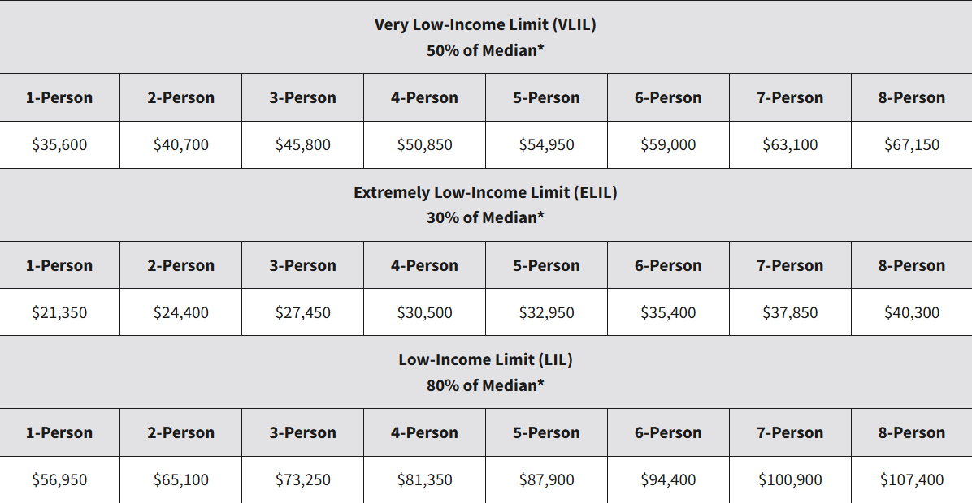
HUD Income Guidelines
Notes:
CDBG Applicants' Manual Appendix – current income guidelines can be found there.

Slide 32

Low- and Moderate-Income Jobs Criteria
For each activity funded under the Employment Incentive Program, at least 51% of all jobs to be created or retained as a result of the EIP project must be documented to be created for and/or retained by persons defined as low and moderate income by DCA.
For the purposes of determining whether a job is held by or made available to a low- or moderate-income person, the person may be presumed to be low- and moderate-income if the assisted business is located within a census tract that has a poverty rate of at least 20 percent (20%) as determined by the most recently available decennial census information.
For an activity or project that retains jobs, the unit of local government and proposed subrecipient(s) must document that jobs would actually be lost without the EIP assistance and that at least 51% of the total existing jobs are currently held by low- and moderate-income persons.

Slide 33
Low- and Moderate-Income Jobs Criteria Continued
For employment skill enhancement and/or basic educational training activities/services, at least 51% of the recipients of such services must be documented to have been low- and moderate-income persons at the time such services were provided.
The application is required to contain a list of prospective full-time permanent jobs along with a breakout of those positions that involve the employment of low- and moderate- income persons. The jobs to be created or retained should be listed by job title, salary or wage scale, and skill requirements.

Slide 34
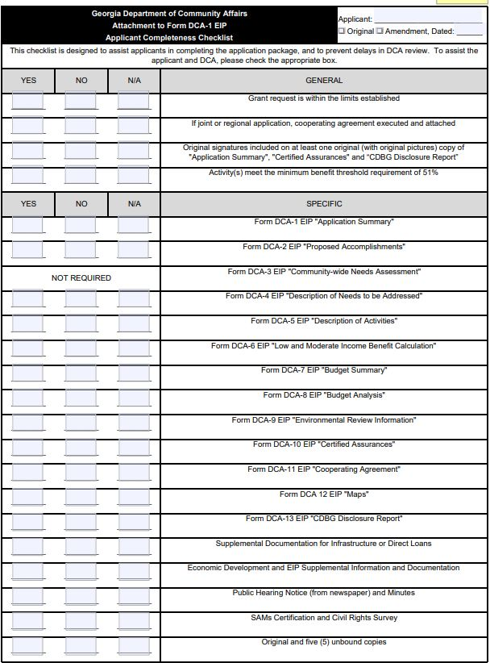
EIP Checklist

Slide 35
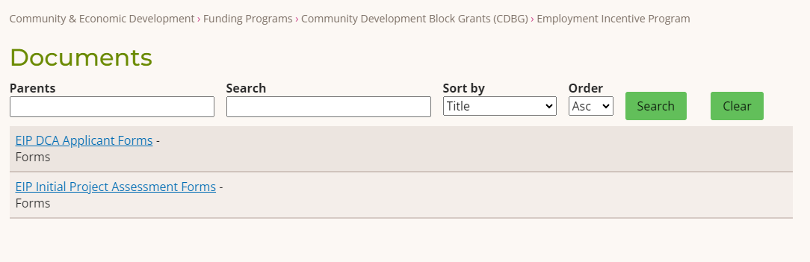
DCA Forms
Complete list of DCA forms can be found here:
EIP DCA Applicant Forms | Georgia Department of Community Affairs (ga.gov)

Slide 36
EIP Loan Disbursement
Loan Disbursement
  Disbursement agreement included in the EIP/RDF loan agreement.
  The Borrower’s other public and/or private financing will be disbursed on a pro-rata basis with the EIP/RDF loan proceeds.
GRANT TO APPLICANT
LOAN TO
LOCAL DEVELOPMENT AUTHORITY
LOAN TO
SUB-RECIPIENT BUSINESS

Slide 37
HUD Guidelines on EIP/RDF loans
According to HUD guidelines, program income must be utilized prior to granting additional funds to a community with the same project activity. Since the County retains program revenue generated by an economic development loan made with EIP/ CDBG grant monies, its RLF cash on hand must be used toward the creation of LMI jobs.

Slide 38
EIP Direct Loan Program
Loan Terms
  Up to 20 years for financed real estate
  Up to 10 years for financed machinery/equipment
  The interest rate is fixed at or below market rates determined at local level
Security/Collateral
  1st or shared 1st priority mortgage and/or lien position on project costs/uses financed
  Personal guaranties from owners (>20% ownership)
  Corporate guaranties from related companies
Repayment
  EIP,RDF Loan repayments must capitalize or be placed into a local Revolving Loan Fund (RLF)

Slide 39
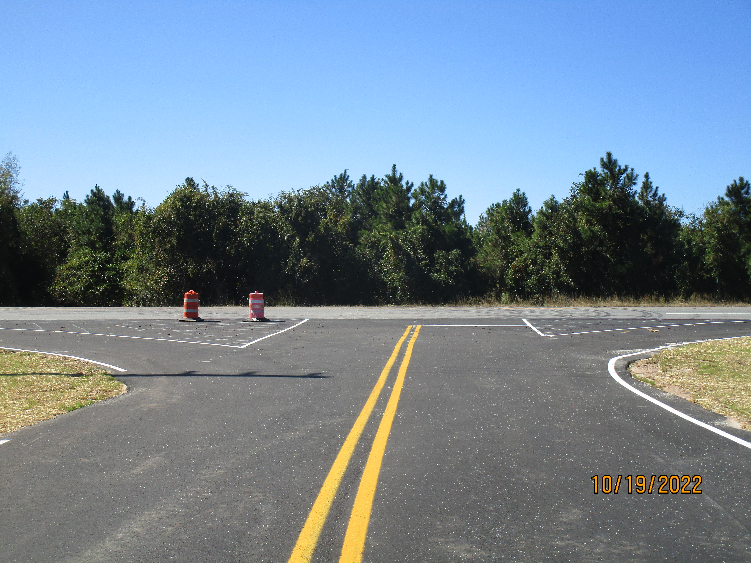
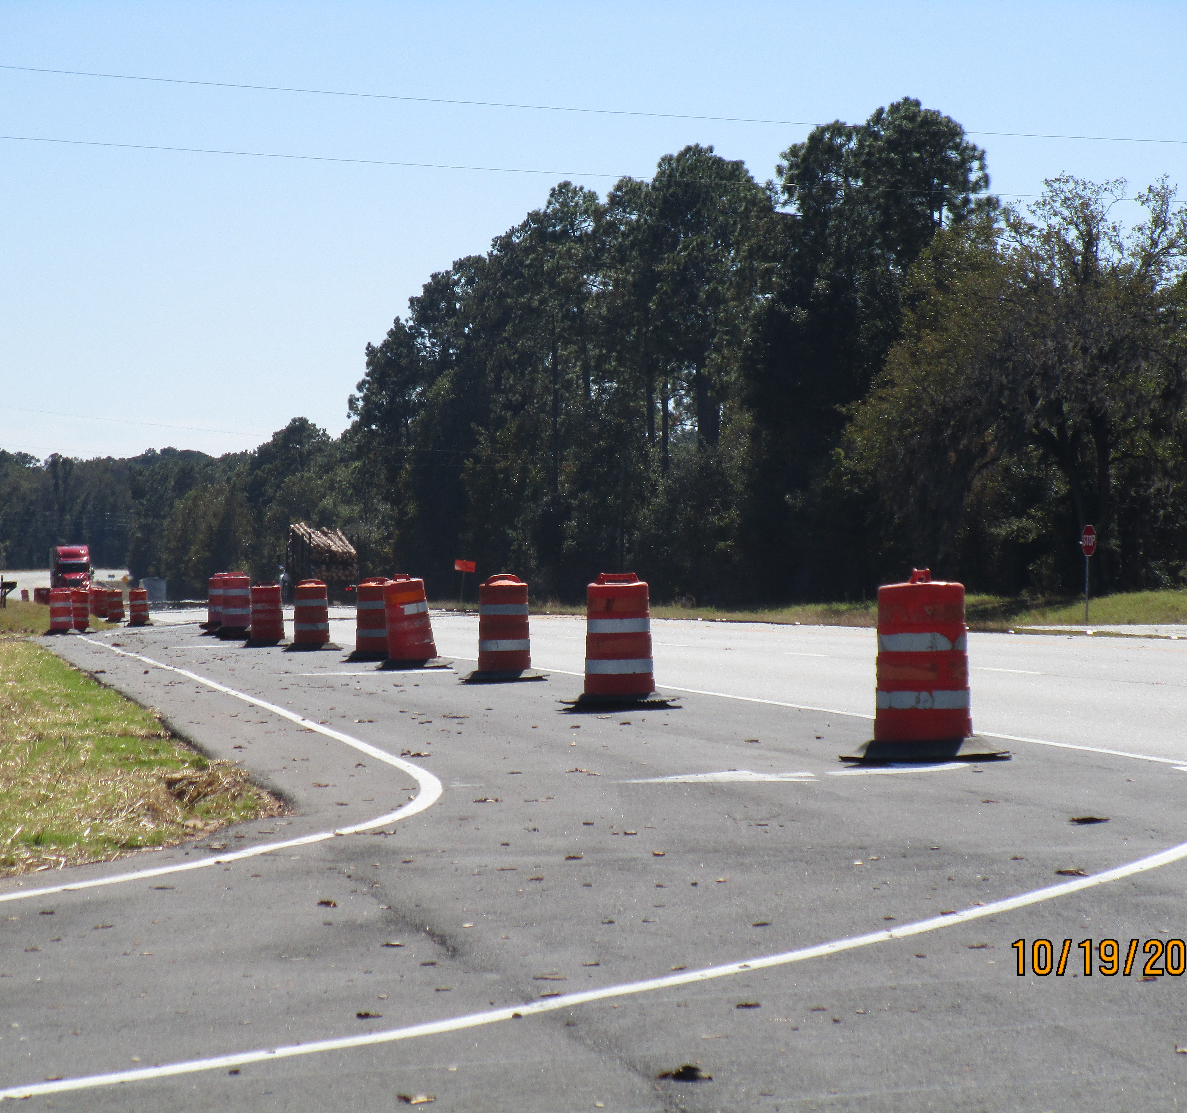
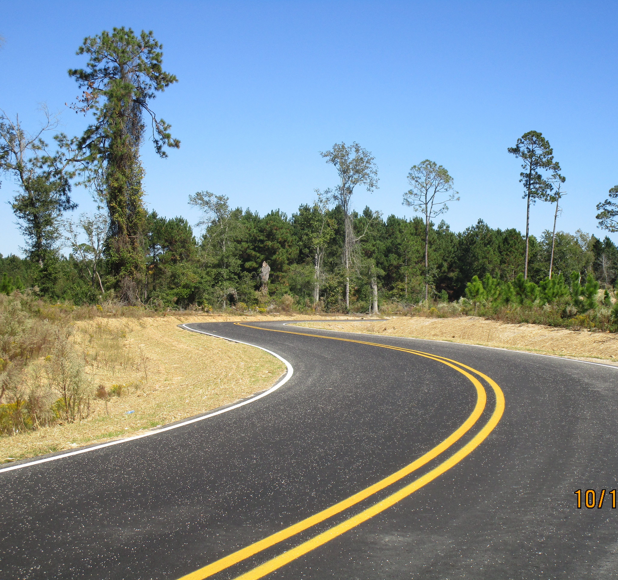
Bacon County– Street Paving and Drainage Improvements
Recipient – Bacon County
Sub-Recipient- Beach Timber
Grant Amount - $750,000
Project – Street Paving and drainage improvements
Private Investment - $1,875,254
Jobs – Create 34, 100% L/M

Slide 40
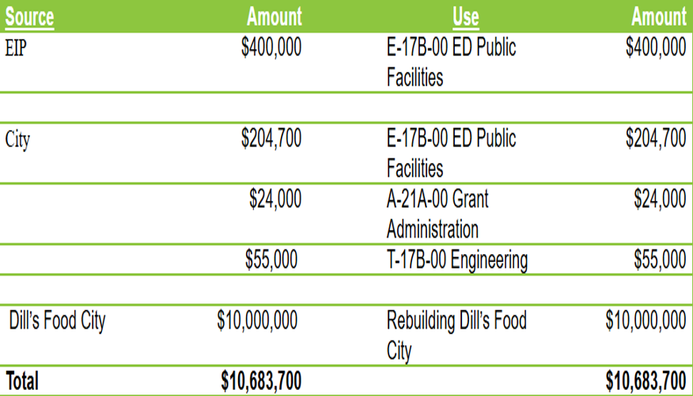
Source and Use – City of Royston

Slide 41
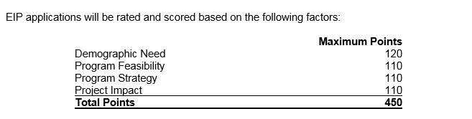
Employment Incentive Program Ranking System
Must score a minimum of 300 points for eligibility

Slide 42
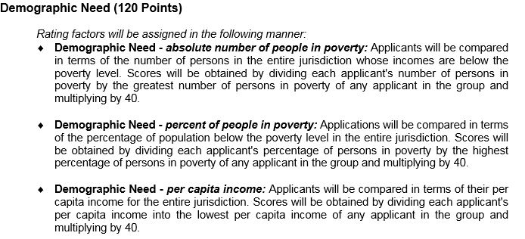
Demographic (120 points)

Slide 43
Feasibility (110 points)
The organizational status of the development agency or sub-recipient business:
  Reputable history for business and all related entities
  Credit history
  Litigation
  Government findings, sanctions, etc.
The proposed business or development concept/product/service is proven and does not represent an untried business model.
As applicable, the development agency’s or sub-recipient business’ historical performance and standing is secure in the following areas: capital management, debt capacity, management character and experience, collateral value, economic and market conditions.
As applicable, the development agency’s or sub-recipient business’ proposed development or business plan is reasonable and uses reasonable assumptions in the following areas: capital investment, debt service capacity, management ability, collateral value, industry analysis, response to future economic and market conditions.

Slide 44
Feasibility continued
For real–estate projects, the proposed development team has a successful record of accomplishment. (i.e. Developer, Contractor, Architect, Leasing Agent, Property Manager, Syndicator, Construction Manager, Interim and Permanent Lenders)
As applicable, the proposed project complies with the CDBG/EIP regulations and guidelines for “appropriateness”, underwriting, and public benefit which may not be more than $10,000 per job.
All project costs are reasonable and verified through original source documents, architectural and engineering reports, or a MAI or other certified appraisal acceptable to DCA.
The balance of all financing sources is verified and committed in writing, with supporting documentation.
As applicable, all required real estate is available, has clear title, and is under proper option or control.
The development agency and sub-recipient’s investment and job commitment letter is in the proper format.
All needed architectural plans, engineering reports, plans and specifications are completed and approved by appropriate authorities in support of the proposed project.
The project can be carried out in accordance with all applicable federal, state, and local law, regulation and permitting requirements.

Slide 45
Feasibility continued
Where applicable, review of any proposed recipient’s or subrecipient’s ability to provide administrative capacity or to undertake an approved activity.
If all project timetables for completion are reasonable.
Wetland and floodplain maps should be included with the application to assist DCA in determining project feasibility
All Preliminary Engineering Reports and Preliminary Architectural Reports should include an original signature and the appropriate professional stamp. Points may be deducted for feasibility without these features

Slide 46
Strategy (110 Points)
The ratio of private funds to EIP funds (To receive maximum points a minimum ratio of at least 1 to 1 is generally required);
As applicable, the local government’s financial condition and ability to participate in project costs;
Documentation illustrating the public benefits to be achieved are reasonable and to the extent practicable EIP funds will not substitute for other available funds;
As applicable, the reasonableness of financing strategy (adequacy of equity injection, collateral, and loan terms);
As applicable, the relationship between the sub-recipient’s infrastructure needs and the size and capacity of any infrastructure to be provided;
The validity of sub-recipient’s commitment to fulfill hiring and investment commitments (has sub-recipient agreed to provide acceptable surety to "bond" its performance);
As applicable for direct loans, the severity of the business’ or subrecipient’s need for financial assistance;

Slide 47
Strategy continued
As applicable, project’s utilization of existing land and/or buildings already served by public infrastructure;
The utilization of available funds within local revolving loan funds capitalized by CDBG/EIP;
A project's conformance to federal, state, and local laws and regulations
The relationship to overall objectives of the EIP and CDBG Program, including the extent of benefit to persons of low and moderate income.

Slide 48
Impact (110 points)
The number of jobs/beneficiaries created and/or retained;
The EIP/CDBG cost per job/beneficiary; no more than 50,000 per job
The availability of jobs or benefit to low/mod income persons;
The project’s impact on the benefiting population’s quality of life, living environment or opportunities for economic advancement;
An analysis of the documented severity of need;
As applicable, the quality of jobs and employee benefits (health insurance, retirement, leave, etc.);
The project's impact on local unemployment rates and other needs of the community; and
As applicable, the project’s impact on blighting conditions that threaten public health and safety or impede economic development

Slide 49
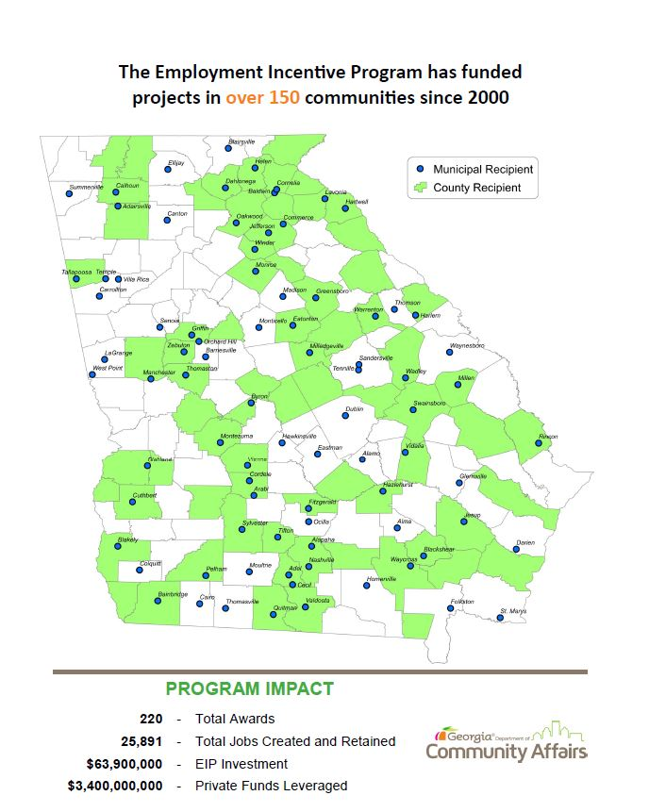
EIP Outcomes

Slide 50
Let’s discuss the RDF program!

Slide 51

Redevelopment Fund (RDF)
Purpose
The RDF program is designed to help finance acquisition and real property improvement projects aimed to meet the Slums/Blight National Objective
Uses CDBG funds to benefit low-and moderate-income persons through the prevention or elimination of blight and to alleviate serious and immediate threats to the health and welfare of community residents

Slide 52
Ineligible CDBG-ED/EIP/RDF Activities
Working Capital
Refinancing
Speculative Projects
Capacity Building
General Conduct of Government
Project Not Meeting Federal Guidelines
Using Federal Funds to relocate businesses (Piracy - There are Restrictions)
New housing construction except under certain conditions
Acquisition of furnishings, movable equipment, machinery, land write-downs

Slide 53
What exactly does “blight” mean?
Blight is more than just long-term vacancy of a building.
Blight should include easily identifiable deficiencies for internal staff to identify: deterioration of structure (roof holes, wall stability, etc.), outdated/non-compliant code issues, unsafe conditions (flooring, stairs, etc.), external threat to public safety (crumbling façade, falling brickwork, unsound overhang structure, etc.).
If the pictures do not tell the story of blight, the application may not score high enough for consideration or may not be viewed as eligible (unless strong supporting documentation is included).

Slide 54
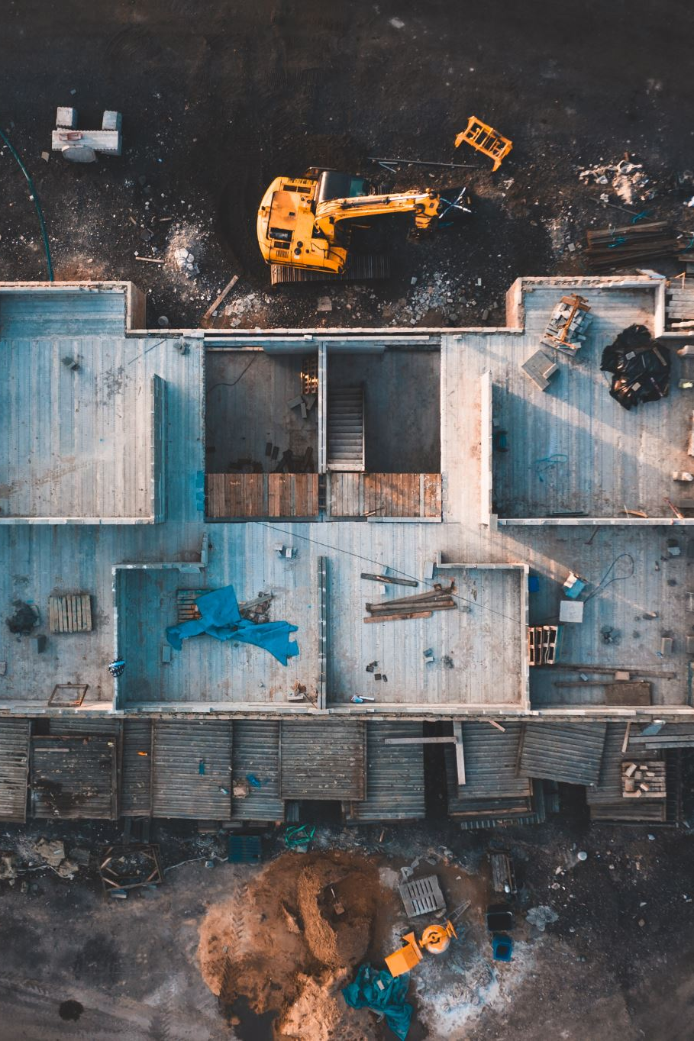
Elimination of Slum and Blight
“Spot Basis” vs “Area Basis”
Spot Basis
  Spot basis activities are limited to the extent necessary to eliminate specific conditions detrimental to the public health and safety
Area Basis
  Area basis activities are delineated by a unit of local government, meets a definition of a blighted, deteriorated, deteriorating, or slum area under State of Local law.

Slide 55
Spot Basis
Activities that eliminate conditions of blight or physical decay on a spot basis and are not located in a slum or blighted area.
Activities under this category are limited to :
  Acquisition
  Clearance
  Relocation
  Historic preservation
  Building rehabilitation activities*
* Rehabilitation is limited to the extent necessary to eliminate a specific condition detrimental to public health and safety.

Slide 56
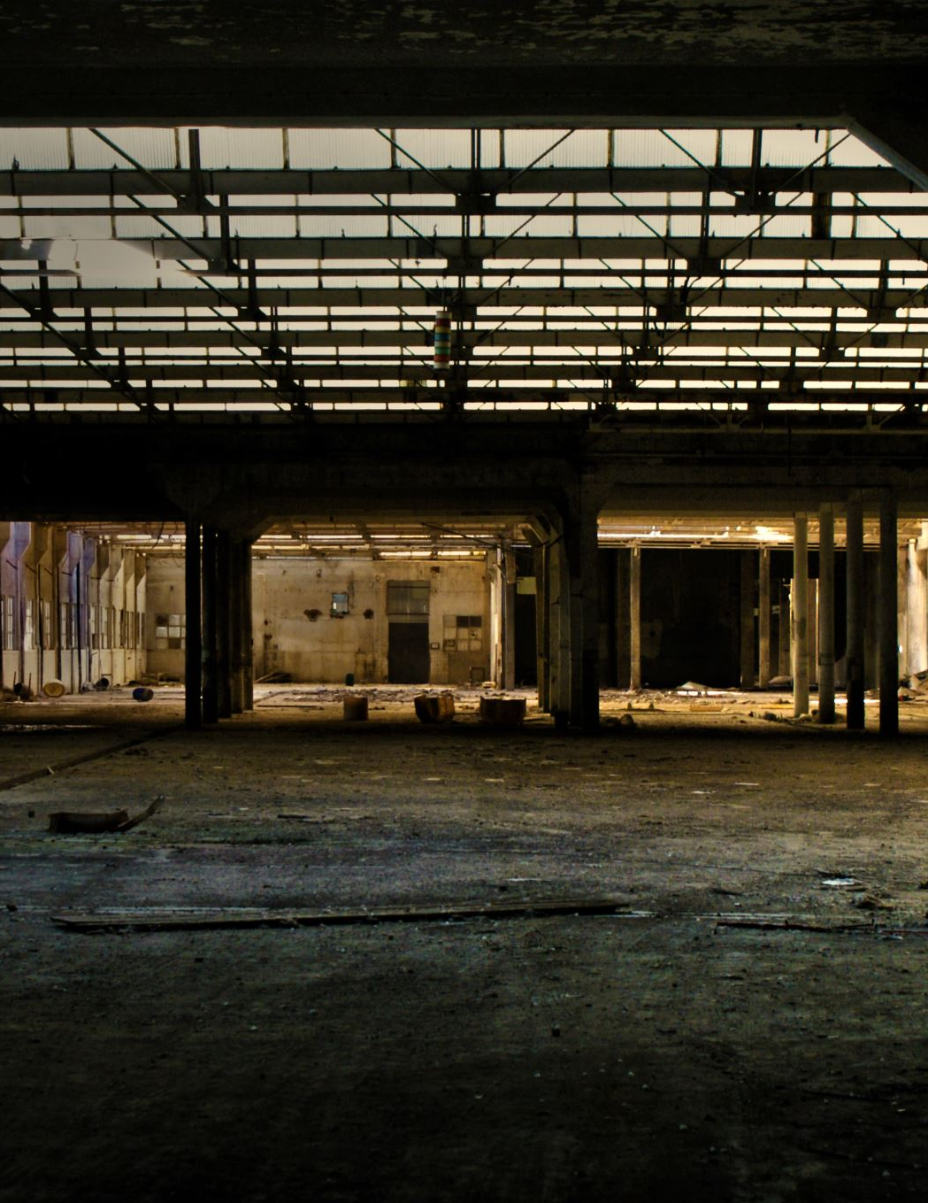
Spot Basis
Rehabilitation
  Rehabilitation which promotes energy efficiency of buildings and improvements
  Reconstruction or rehabilitation of privately owned properties including the renovation of closed school buildings

Slide 57
Spot Basis Documentation Needed
The records maintained must include:
A description of the specific condition of blight or physical decay treated and
A description of the assisted activity showing that it falls under one of the activity types that are eligible to be carried out under this subcategory.
A resolution declaring the property slum/blight
Where rehabilitation of a building is carried out under this category, information showing how the activity eliminates conditions detrimental to public health and safety must be included.

Slide 58
Spot Basis
Types of buildings and improvements eligible for rehabilitation assistance
Publicly or privately owned commercial or industrial buildings, except that the rehabilitation of such buildings owned by a private for-profit business is limited to
  Improvement to the exterior of the building, abatement of asbestos hazards, lead-based paint hazard evaluation and reduction, and the correction of code violations;
  Nonprofit-owned nonresidential buildings and improvements not eligible under Public Facilities Improvements

Slide 59
Direct Assistance to For-Profit Entity
Loans, grants, or other direct financial assistance to pay for the expansion of a factory or commercial business, or the establishment of a new facility or business
CDBG funds could be provided to for-profit company through a loan to:
  Purchase land;
  Construct a building or other improvements;
  Renovate an existing building to accommodate the business;
  Construct tenant improvements/finishes;
  Lease space in or purchase an existing building;
  Purchase capital equipment
The direct assistance to for-profit entities requires compliance with the requirements of the Low-to Moderate-Income requirements for job creation and the application of the public benefits standard of the CDBG program

Slide 60
Area Basis
Activities that aid in the prevention or elimination of slums or blight in a designated area.
The focus of activities is a change in the environment of a deteriorating area.
The area in which the activity occurs must be designated as slum or blighted.
Documentation must be maintained by the municipality on the boundaries of the area and the conditions that qualified the area at the time of its designation.

Slide 61
Area Basis Condition Determination
At least 25 percent of properties throughout the area experience one or more of the following conditions:
Physical deterioration of buildings or improvements;
Abandonment of properties;
Chronic high occupancy turnover rates or chronic high vacancy rates in commercial or industrial buildings;
Significant declines in property values or abnormally low property values relative to other areas in the community; or
Known or suspected environmental contamination.
- OR -
The public improvements throughout the area are in a general state of deterioration

Slide 62
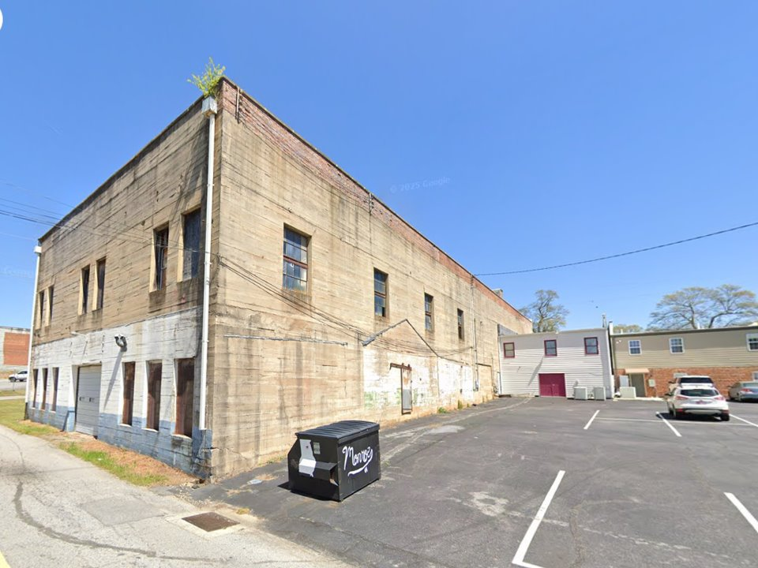
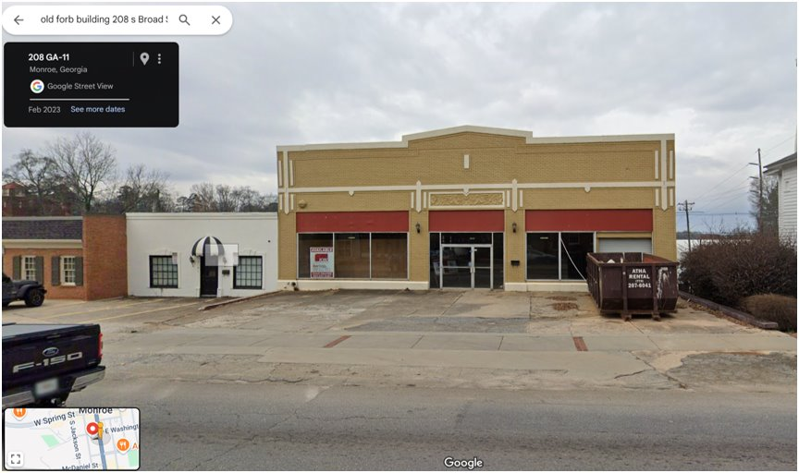
Successful Spot Basis Project
Former Ford Building
208 South Broad Street Monroe, Ga 30655

Slide 63
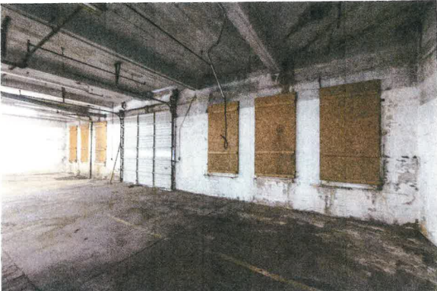
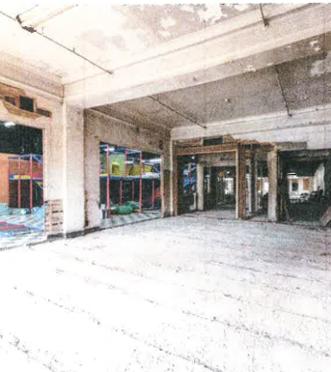
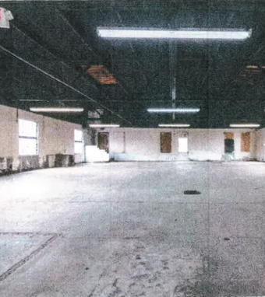
Building Interior-Before Renovation

Slide 64
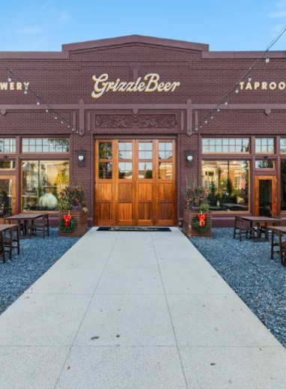
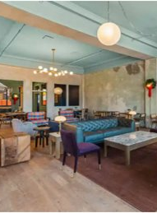
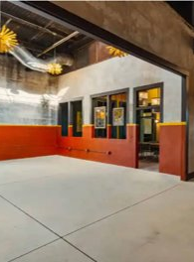
After Renovations
Grizzle Beer Brewery

Slide 65
Monroe RDF Award
RDF Grant to the City of Monroe to rehabilitate and preserve the former Ford building, a blighted structure located in Historic downtown Monroe to be repurposed as a new two-story microbrewery and a full-service seafood restaurant.
Owner and operator: JEC Development, Inc.
Award Amount: $1,000,000
Total Project Cost $3,146,277

Slide 66
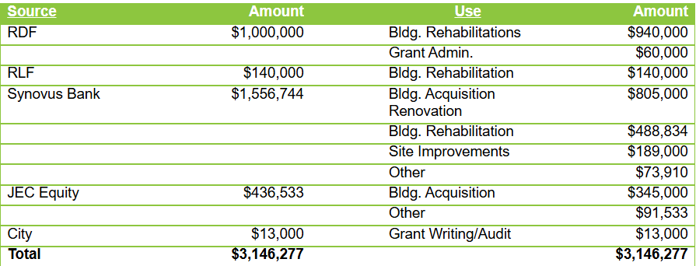
City of Monroe: Source and Use

Slide 67
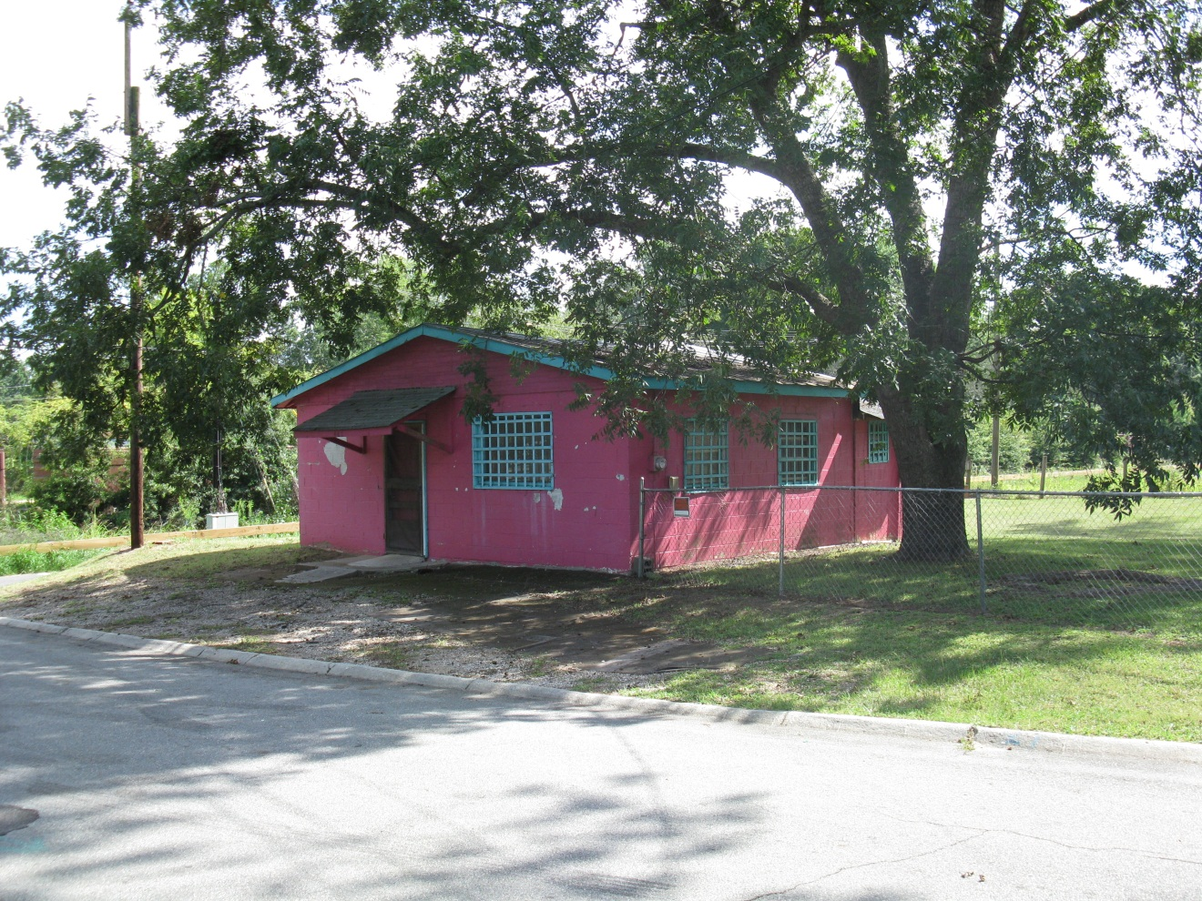
Successful Area Basis Project
City of Madison –
Canaan Corner Store

Slide 68
City of Madison RDF Award
RDF Grant to the City of Madison for clearance, site development and new construction of a blighted structure in the Downtown Redevelopment Area to be used as the new Canaan Corner Store
Grant Amount $100,912
City will invest $92,000 and create 2 jobs
Private entity will invest $46,000 for tenant build-out, inventory and equipment.

Slide 69
Madison RDF Source and Use
Source Use Amount
RDF Clearance, Construction $100,912
City Acquisition/Grant Admin. $ 92,139
DDA Construction, Legal/ Eng. $ 22,427
Private Entity Inventory & Equipment $ 46,346
Total Project Cost $261,824

Slide 70

Things to Remember
Qualify your project as “Spot Basis” or “Area Basis”
Verify that your activities are eligible
Document need, costs and support of organizations, banks & businesses
Debt – credit underwriting and terms

Slide 71
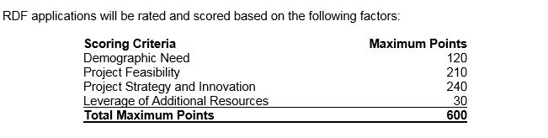
RDF Ranking System
Must score a minimum of 375 points for eligibility

Slide 72
Demographic Need ( 120 points)
Demographic Need ‑ absolute number of people in poverty: Applicants will be compared in terms of the number of persons in the entire jurisdiction whose incomes are below the poverty level. Scores will be obtained by dividing each applicant's number of persons in poverty by the greatest number of persons in poverty of any applicant in the group and multiplying by 40.
Demographic Need ‑ percent of people in poverty: Applications will be compared in terms of the percentage of population below the poverty level in the entire jurisdiction. Scores will be obtained by dividing each applicant's percentage of persons in poverty by the highest percentage of persons in poverty of any applicant in the group and multiplying by 40.
Demographic Need – median household income: Applicants will be compared in terms of their median household income for the entire jurisdiction. Scores will be obtained by dividing each applicant's median household income into the lowest median household income of any applicant in the group and multiplying by 40.

Slide 73
Feasibility (210 points)
Eligibility of proposed activity under either “spot basis” or “area basis” criteria;
All project costs are reasonable and verified through original source documents, architectural and engineering reports, or a MAI or other certified appraisal acceptable to DCA;
The project can be carried out in accordance with all applicable federal, state, and local law, regulation and permitting requirements;
If all project timetables for completion are reasonable;
The balance of all financing sources is verified and committed in writing, with supporting documentation;
All needed architectural plans, engineering reports, plans and specifications are completed and approved by appropriate authorities in support of the proposed project;
As applicable, all required real estate is available, has clear title, and is under proper option or control;
The reasonableness of any site contamination clean-up proposal and plan;

Slide 74
Feasibility (210 points)
As applicable, the proposed project complies with the CDBG/RDF regulations and guidelines for “appropriateness”, underwriting, and public benefit;
For real–estate projects, the proposed development team has a successful record of accomplishment. (i.e. Developer, Contractor, Architect, Leasing Agent, Property Manager, Syndicator, Construction Manager, Interim and Permanent Lenders);
As applicable, the development agency’s or sub-recipient business’ proposed development or business plan is reasonable and uses reasonable assumptions in the following areas: capital investment, debt service capacity, management ability, collateral value, industry analysis, response to future economic and market conditions;
A brief, thorough description of plans for implementing Section 3 requirements will enhance an applicant’s chances of receiving the maximum score on Feasibility. Note: Pre-Funding procurement requires Section 3 compliance.

Slide 75
Strategy(110 points)
The severity of the subrecipient’s need for financial assistance;
Documentation illustrating the public benefits to be achieved are reasonable and to the extent practicable RDF funds will not substitute for other available funds;
As applicable, the reasonableness of financing strategy (adequacy of equity injection, collateral, and loan terms);
The utilization of available funds within local revolving loan funds capitalized by CDBG/RDF;
The relationship to overall objectives of the RDF and CDBG Program, including the extent to which funds will address conditions of slum and blight; and
A project's conformance to federal, state, and local laws and regulations.

Slide 76
Project Leverage ( 30 points)
Leverage points are awarded based on a firm commitment of additional resources directly related to the project, including capital costs and new funds for operation of any proposed program(s).
The “leverage ratio” of other private or public funds will be the criterion considered. A reasonable value must be assigned to donated and in-kind items. The leverage score will be calculated based on the total value of leverage for each applicant
Ratio’s exceeding 3:1 receives maximum points
  1:1 means , if an applicant is asking for $200,000 in funding from program, then $200,000 should be matched from applicant private and leverage source and funds.

Slide 77
Application Forms
CDBG DCA forms for RDF application are the same as EIP.

Slide 78
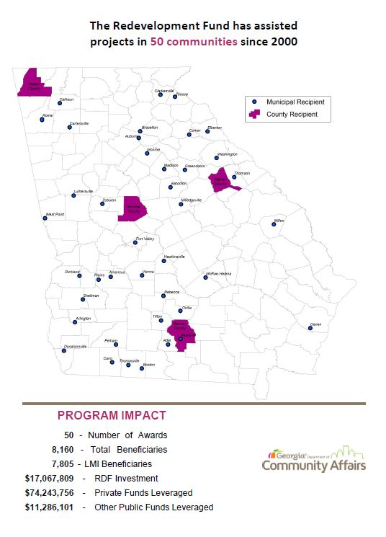
RDF Program Impact

Slide 79
Give me the 411 on the ITAD program!

Slide 80
Immediate Threat and Danger (ITAD)
Purpose
The ITAD Program is intended to respond to events or situations which have a particular urgency and uniqueness which adversely affect or impact the health or welfare of the community and its citizens and where other financial resources are not available to meet such need
The Immediate Threat and Danger Program provides grant funding for community development activities having a particular urgency when existing conditions pose a serious and immediate threat to the health or welfare of the community.“ The grant may fund up to 90% of the total project costs.
The program requires a minimum local match of 10% of the total project cost.

Slide 81
Eligible Activities
The construction or reconstruction of public facilities such as water, sewer, street or drainage system facilities or other community facilities
Housing rehabilitation, and
Relocation assistance

Slide 82
ITAD Circumstance
Intended to address situations that are urgent and unique, typically resulting from state or federally declared disasters, while also now allowing consideration of eligible projects outside of declared disaster areas when the required conditions are demonstrated.
Funds are not available for repairs of public infrastructure that are failing due age and lack of maintenance or the general “wear and tear” on existing infrastructure.
A certification from a licensed engineer, public health official, or other qualified third party is required to confirm that a direct threat to the health, safety, or welfare of the community exists, rather than an indirect or downstream impact, and that immediate action is required to address the threat.

Slide 83
Examples of Eligible Activity
Acquisition of property located in a flood plain that was severely damaged by a recent flood
Demolition of structures that were severely damaged by a major earthquake or tornado

Slide 84
Application Process
Applications can be submitted at any time and funds will be awarded to eligible applicants which meet the threshold
Applications must be submitted to DCA on the forms. Note that this includes a certification that other financial resources are not available to meet the identified need and that the situation poses a serious and immediate threat
After staff review and recommendations, the Department of Community Affairs will approve or deny the request and transmit the decision to the local government
Apply for ITAD here : https://gn.ecivis.com/GO/gn_redir/T/wbxttv6vohdf.

Slide 85
Minimum Information Needed For Determination
A narrative description of the problem which describes, in detail, the causes of the problem and the ramifications and threats to health or welfare if the problem is not resolved.
A copy of the applicant government’s most recent financial audit report, a current budget and revenue summary, and account balances, including all investments
A budget summarizing the amount of funds requested and the use of the funds plus an identification of the sources and uses of the required matching funding.
Other data which may be pertinent to a funding decision, such as an engineering analysis/EPD approvals, evidence of additional funding, etc.
Additional documentation for reimbursement-based projects as outlined in the Supplemental Guide in Appendix B.

Slide 86
Application Time!

Slide 87
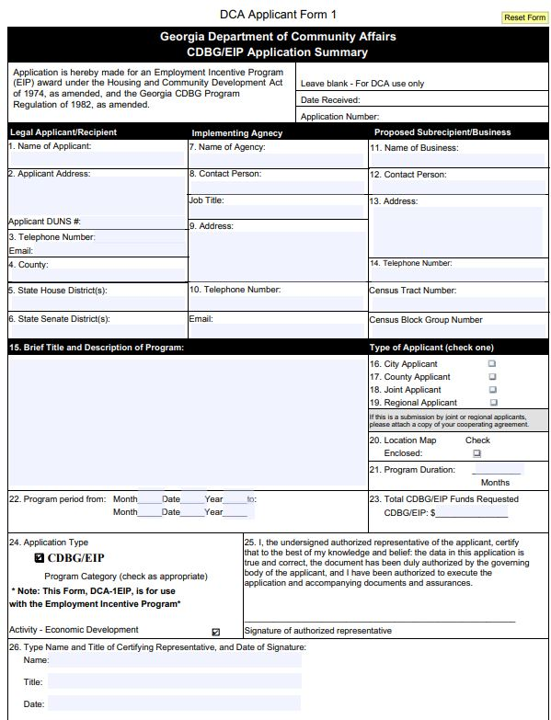
DCA Forms
Form 1-Purpose is to briefly describe the project activities and briefly quantify activities
Widget, Inc. Expansion Project - Timbuktu County requests $200,000 in EIP funds to provide a loan to Widget, Inc. The loan funds will be used along with a private investment of $800,000 to add a 15,000 square foot facility and purchase new machinery and equipment to add two new production lines. The project will support the creation of 100 new jobs at the facility, 83 of which will be available to low and moderate income persons. The loan will be secured by a second lien on the new facility and a first lien on the machinery and equipment and repaid to Timbuktu County.

Slide 88
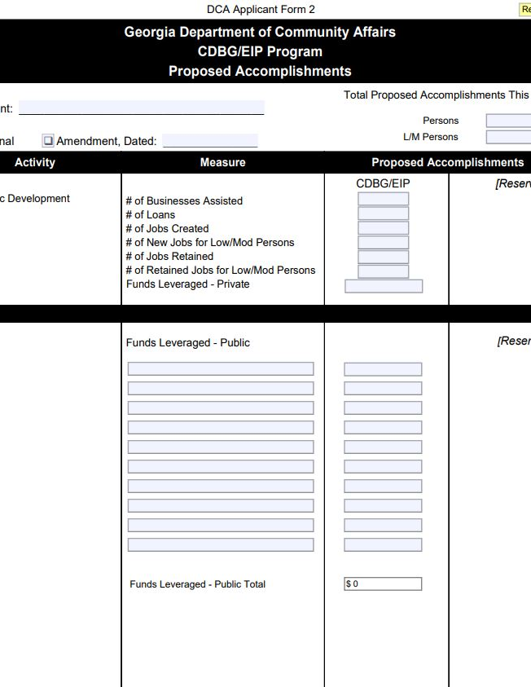
DCA Forms
Form 2-The purpose of this form is to provide a quantified summary of the accomplishments proposed by the applicant to be undertaken with CDBG/EIP funds. Note that a similar form will be used at project completion to collect data on actual accomplishments.

Slide 89
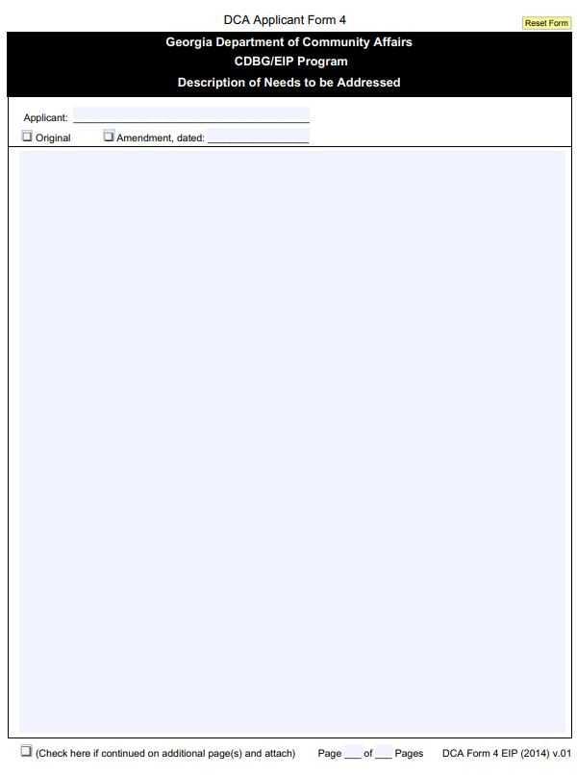
DCA Forms
Form 4-This form asks you to describe the target area’s overall community development needs and the needs being addressed by your grant request.
Describe the documentation economic development needs being addressed by your grant
This form should include:
Community description (location of project, demographics, economic conditions, etc.)
Proposed business information (history, products, other locations/offices/facilities, etc.)
Brief justification of the work which will be described in DCA-5

Slide 90
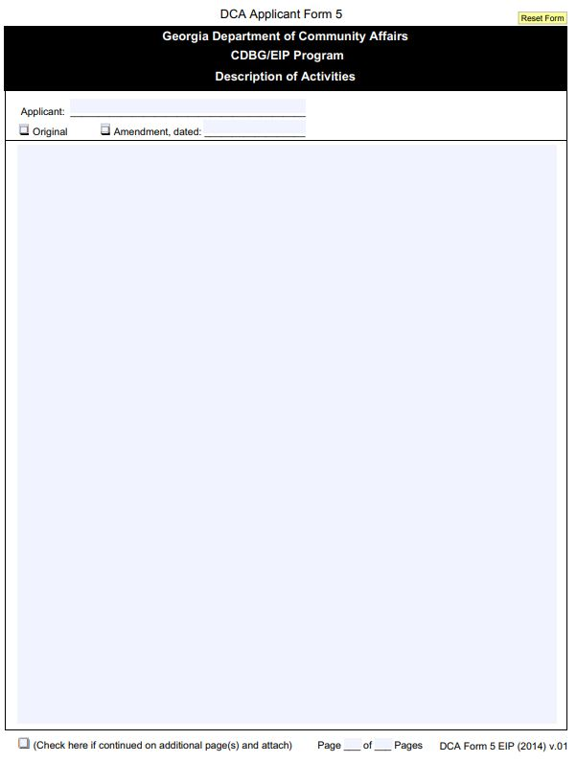
DCA Forms
Form 5- is where you describe how those needs will be addressed through the activities funded by the grant and through other local efforts
Applicants are encouraged to include information (including dates accomplished) related to some of the following items: Identify each activity by name and number to be undertaken with CDBG EIP funds
Procurement, public hearings, environmental compliance, Historic Preservation consultation, other financial assistance, right-of-way acquisition, general property acquisition and permits required/received.

Slide 91
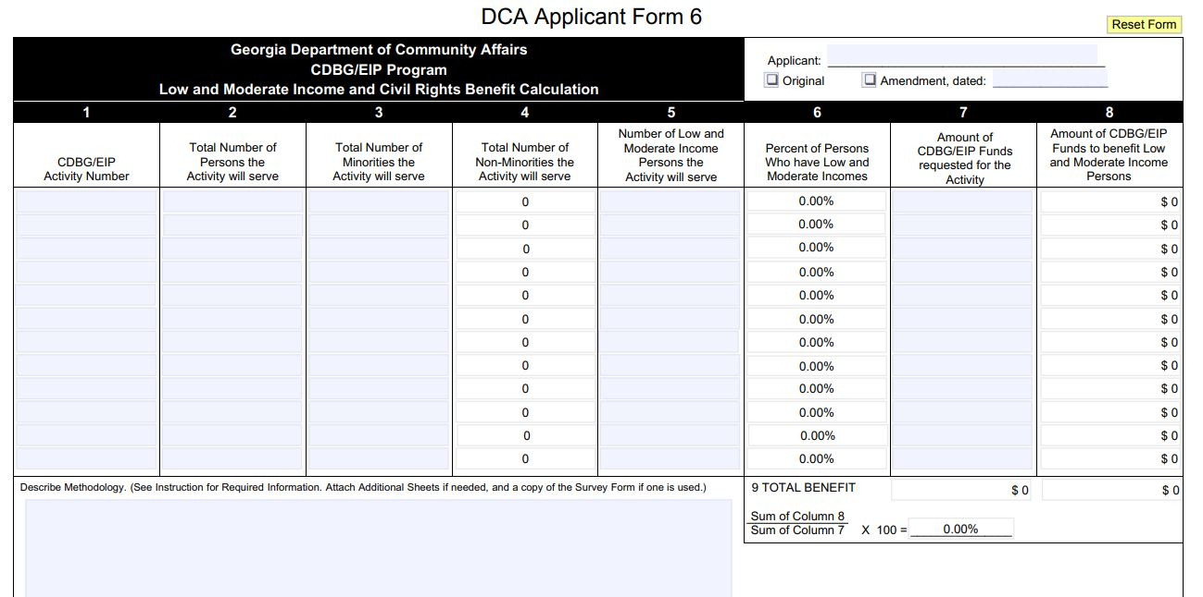
DCA Forms
Form 6-All EIP applications are required to have at least a 51% benefit to low- and moderate-income persons for each activity (administrative and contingency budgets are excluded). ( demographic survey)
Describe the methodology used to determine the number of minorities/ non-minorities and the number of low and moderate-income persons to be served by each activity.

Slide 92
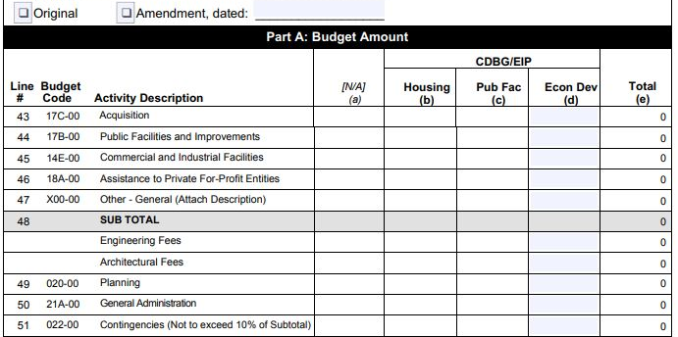
DCA Forms
Form 7-Part A of this form should include an assessment of CDBG/EIP funds budgeted for the project.
Part B of this form is used to identify the total funds available (including in-kind contributions) to complete the program

Slide 93
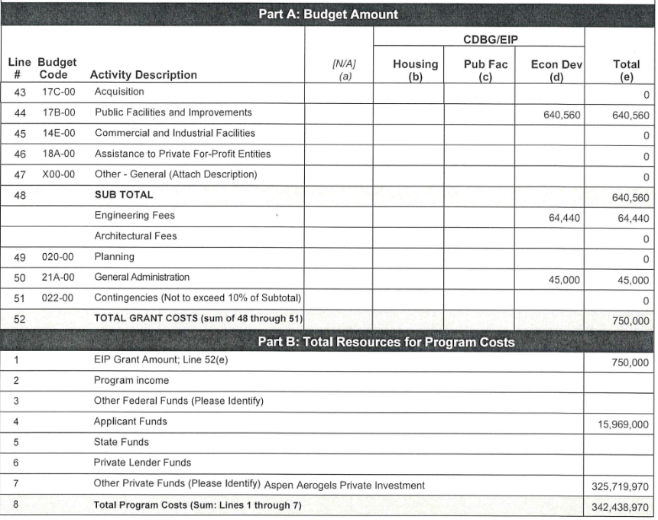
CDBG Form 7 Example

Slide 94
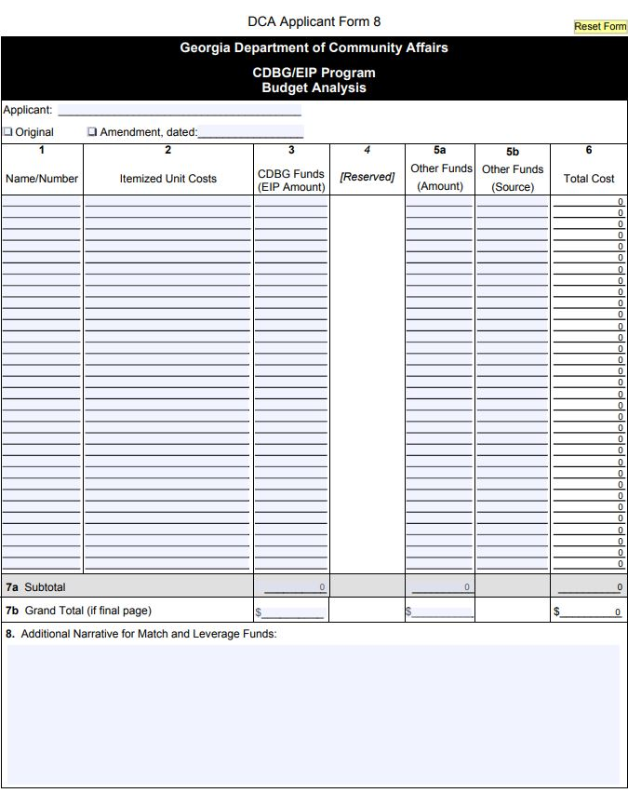
DCA Forms
Form 8-The purpose of this form is to allow applicants to describe, in detail, the resources available, or to be made available, for each activity. Applicants are encouraged to provide sufficient quantifiable data and to describe supporting efforts for the proposed program.

Slide 95
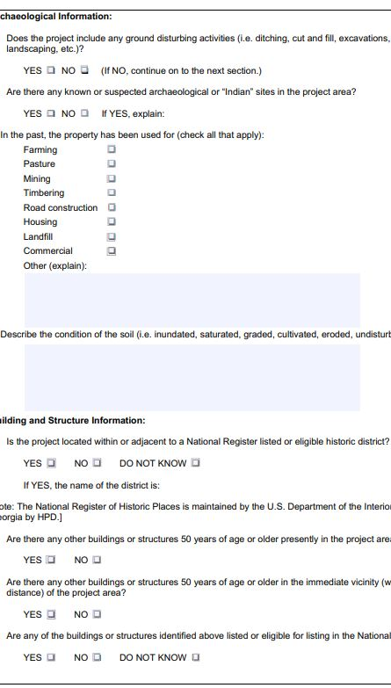
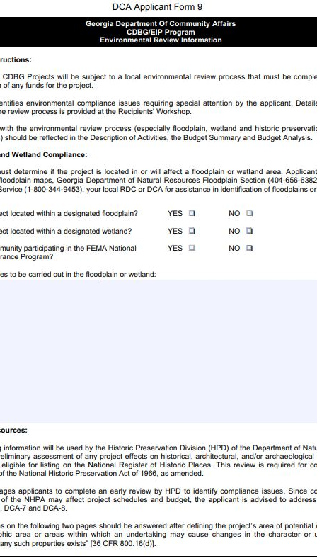
DCA Forms
Form 9- The purpose of this form is to assist applicants with compliance of NEPA regulations
Form 9 DCA form,9A Historic Preservation , 9B When to consult with Tribes

Slide 96
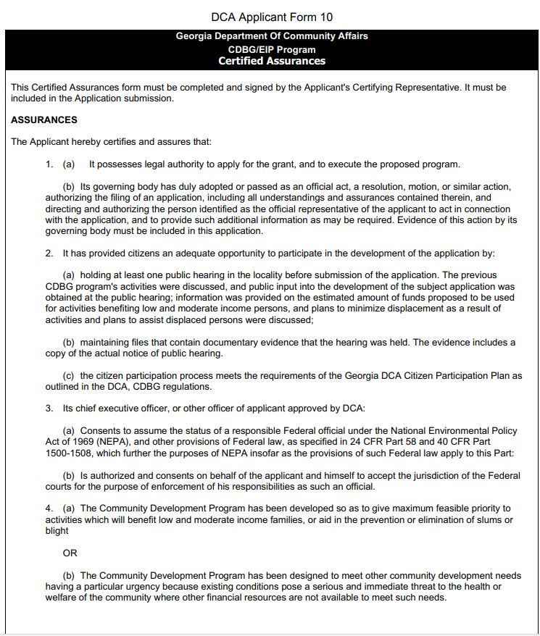
DCA Forms
Form 10- the purpose of this form is to confirm applicants has followed and will adhere to applicable Federal laws that apply to Federally-funded projects

Slide 97
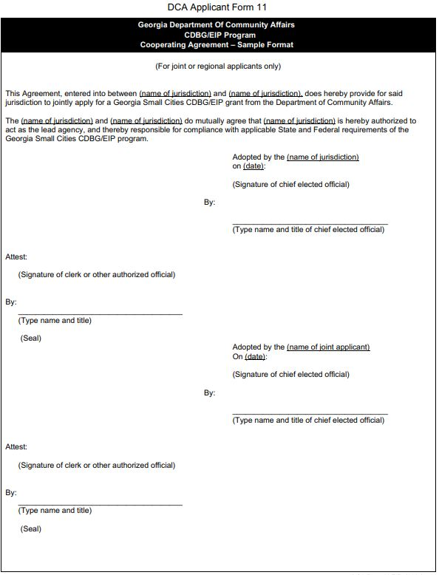
DCA Forms
Form 11- this form is only applicable to joint applications.
The cooperating agreement determines the lead agency and acknowledges an agreement between jurisdictions as applicants to the program

Slide 98
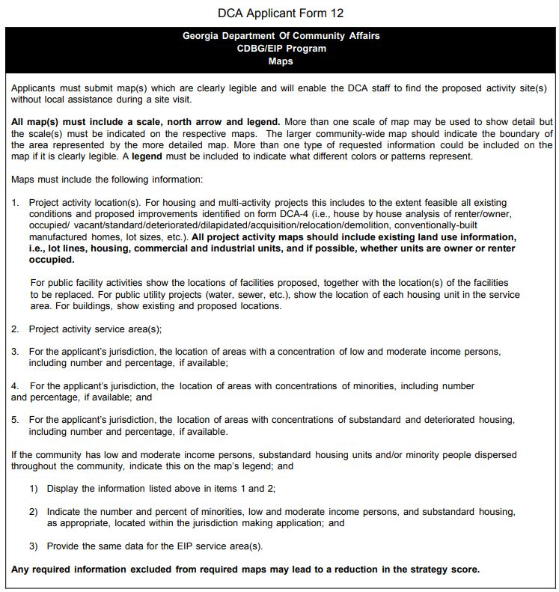
DCA Forms
Form 12-Purpose of this form is where Applicants submit map(s) that are clearly legible and will enable DCA staff to find the proposed activity site(s) without local assistance during a site visit

Slide 99
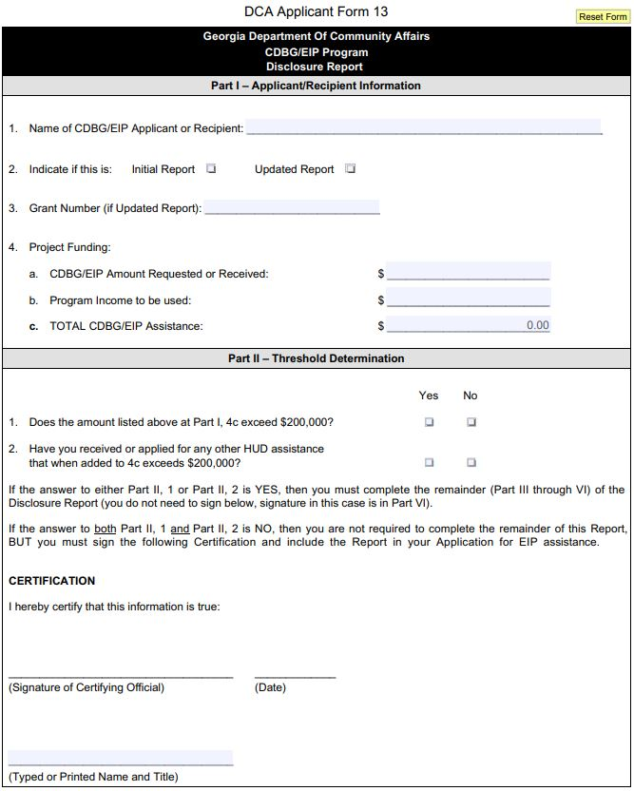
DCA Forms
Form 13-most applicants must complete all parts of the form. Part 2 threshold determination

Slide 100
EIP and RDF Capitalized Revolving Loan Funds(RLF’s)

Slide 101
Eligible Activities
DCA encourages local governments to think creatively and devise innovative approaches to implementing their RLF policies.
Local RLF’s can use funds...
  Funding gap for large projects – may request one-time waiver to DCA, if necessary,
  Working capital loans, and
  Overall, for activities which are carried out by public or private nonprofit entities that fulfill a National Objective, mainly the creation/retention of LMI jobs.

Slide 102
RLF Program
Eligible Activities
Loans to private, for-profit entities that: Creates/retains jobs for low-and moderate-income persons;
Prevents or eliminates slums and blight; or
Assists businesses that provide goods or services needed and affordable to, low-and moderate-income persons.
Loans for activities carried out by public or private nonprofit
Entities for Acquisition, construction, reconstruction, réhabilitation, or installation of (i) public facilities site improvements,
utilities, and (ii) commercial or industrial buildings

Slide 103
Ineligible Activities
Creation of a job that would cost more than $40,000 in RLF funds per job
Reimbursement of project costs prior to submission of RLF application
Refinancing of permanent debt
Payment of delinquent taxes or debt
Product development costs
General government expenses
Political activities

Slide 104
Local Revolving Loan Funds
EIP/RDF loan repayments capitalize local RLF loan. The repayments (including interest), and bank account interest retain federal identity. This is considered program income.
RLFs may be used for local CDBG eligible economic development needs.
Opportunities available to partner with local banks to finance eligible activities (same as EIP) that create employment for L/M persons.
50/40/10 Rule: Project funded with 50% RLF, 40% local bank, and 10% private funding.

Slide 105
Local Government Responsibility
Maintenance of accounting and financial management system that complies with generally accepted accounting principals and DCA’s guidelines for RLF financial management systems.
Maintenance of a loan servicing and monitoring capacity to ensure that loan payments are collected, that loan covenants are enforced, and that loan security is maintained.

Slide 106
COMPLIANCE ISSUES
Cash
Loans
Reports
Having too much cash on hand can put your RLF out of compliance.
RLFs may keep the greater of $125,000 or 30% of total assets on hand in cash.
Local RLFs must have made a loan within the last 5 years.
A community can be noncompliant if they have not submitted a semi-annual report in the last 6 months.
These are due two times per year and just one delinquent report can put your RLF out of compliance.

Slide 107
COMPLIANCE
Keep your RLF open
Close your RLF
Depending on the circumstance, you may need to...
Send cash back to DCA,
Make a new loan, or
Send in delinquent semi-annual reports
or
Closing your RLF can allow for you to receive bonus points on your CDBG annual competition application. This includes sending back all program income and if applicable, working with us to determine how receivables will be paid back to DCA.

Slide 108
Compliance Requirements
It is the responsibility of the local government to ensure that the RLF's proposed program, activities, and goals are in compliance with all applicable Federal and State laws, regulations and executive orders.
Citizen Participation
Environmental Review
Davis Bacon Act (if applicable)

Slide 109
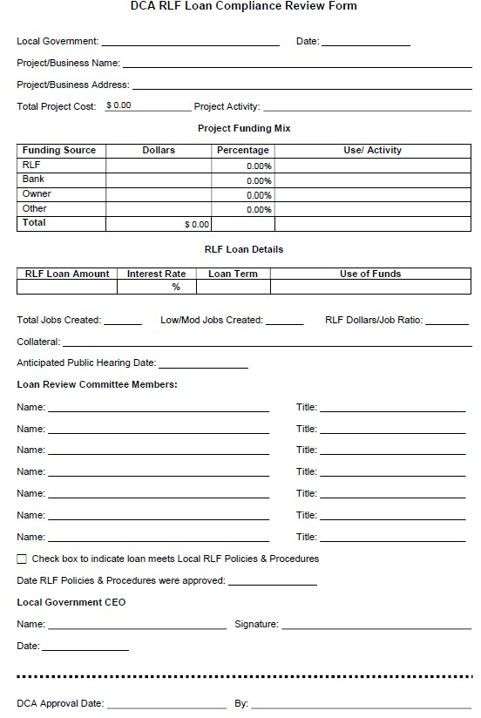
Making a
New Loan
As of January 31st, 2020, RLF Loan Compliance Review Forms are required for every loan.
This form should be submitted to DCA prior to issuing a loan to a business.

Slide 110
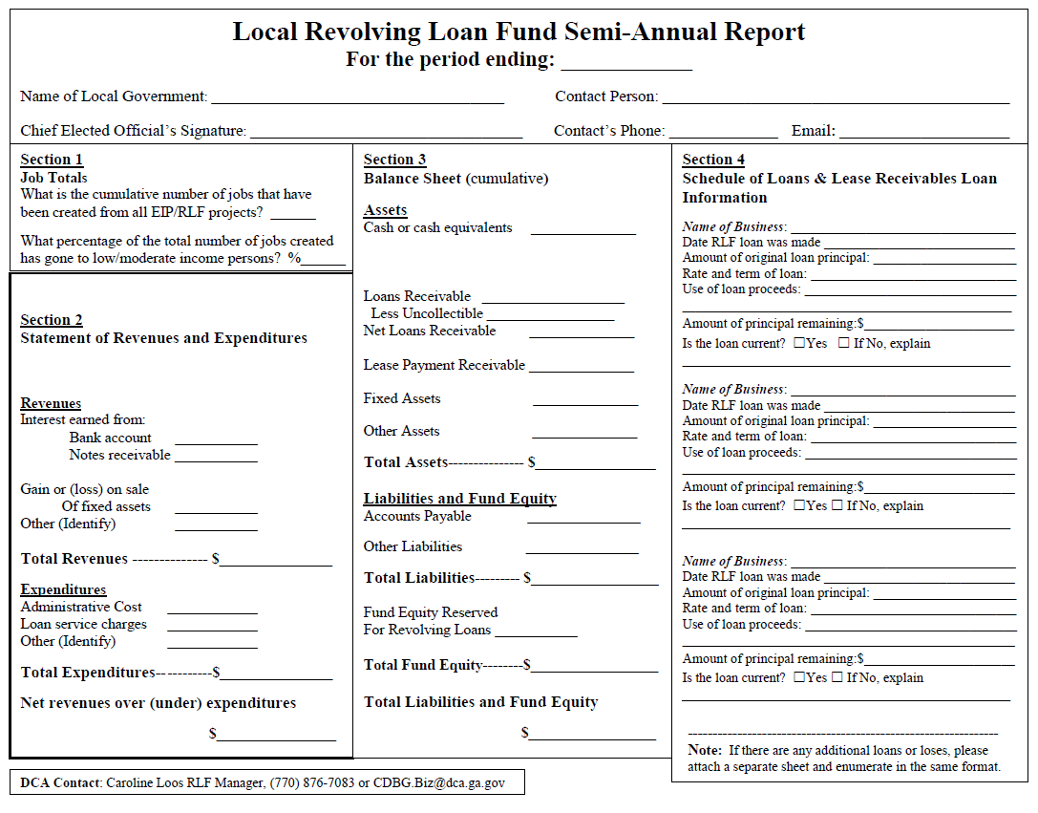
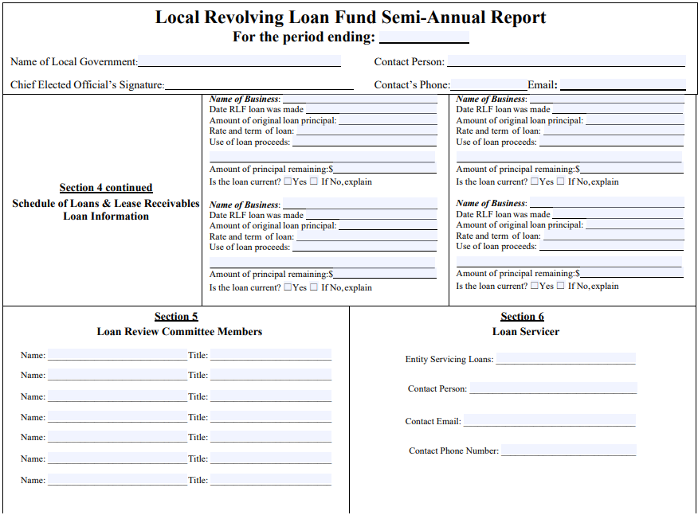
Reports
Reporting Periods
December 31st, 2025
Semi Annual Report due January 31st, 2026
June 30th, 2025
Semi Annual Report due July 31st, 2025
December 31st, 2025
Semi Annual Report due January 31st, 2025

Slide 111
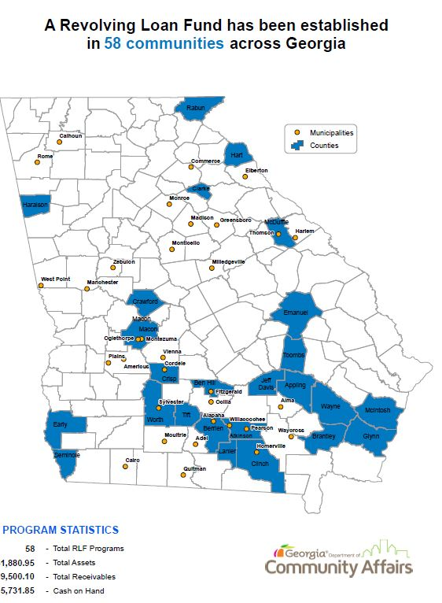
RLF Impact

Slide 112
Thanks!

