Slide 1
Documenting Compliance

Slide 2
Completeness of Documentation
56
applications submitted
43
administrative cure emails
1-14
cures per email
2026 Competition
53
applications submitted
42
administrative cure emails
1-8
cures per email
2025 Competition
Notes:
Address the graph data
As you can see completeness of documentation is important
Our goal is to decrease the number of admin cures which allows the review team to move along with the entirety of the review process faster
Several of the cures are consistent throughout the number of submittals – look at those in more detail which will include examples and screenshots
This presentation is also to serve any new, upcoming applicants

Slide 3
Documenting Compliance
Documentation Submittal
Completeness of Documentation
Common Mistakes
Examples
Notes:
For the remainder of the slides, we will be discussing:
Best way to submit documentation in Zengine
Why the Completeness of documentation is important
Several of the cures are consistent throughout the number of submittals – look at those in more detail which will include examples and screenshots

Slide 4
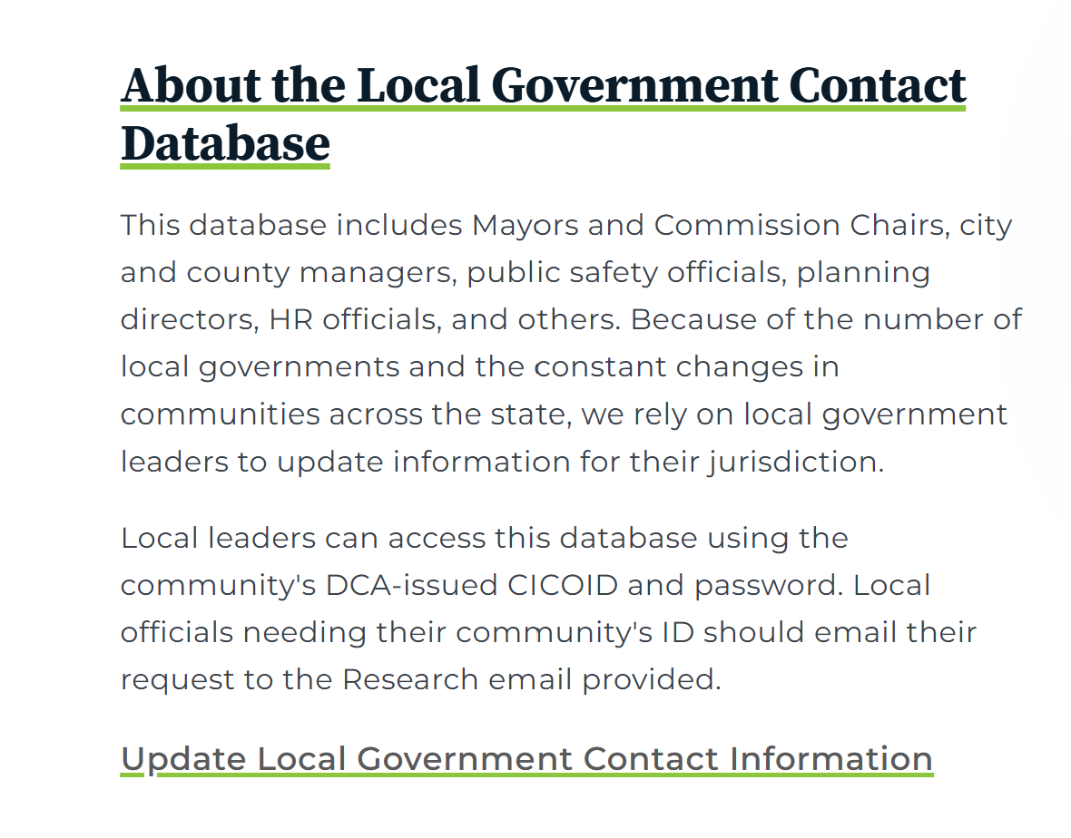
Internal Audit Reviews are conducted annually until the project is closed out.
Each Fiscal Year Financial Audit Report
Project Cost Schedule
Source and Application of Funds Schedule (or SEFA)
Applicants’ Manual: Restrictions on Eligibility for Competition
Recipients of prior CDBG funding must resolve all outstanding CDBG-related audit and/or monitoring findings before submission of an application to DCA.
Local Government Contact Database
Notes:
internal audit reviews and lack of communication for LG’s.
The reason we try to stay in contact for completion is because we can't formally closeout the award, until all audit reviews are complete.
The need to update the self reporting system with staff changes.

Slide 5
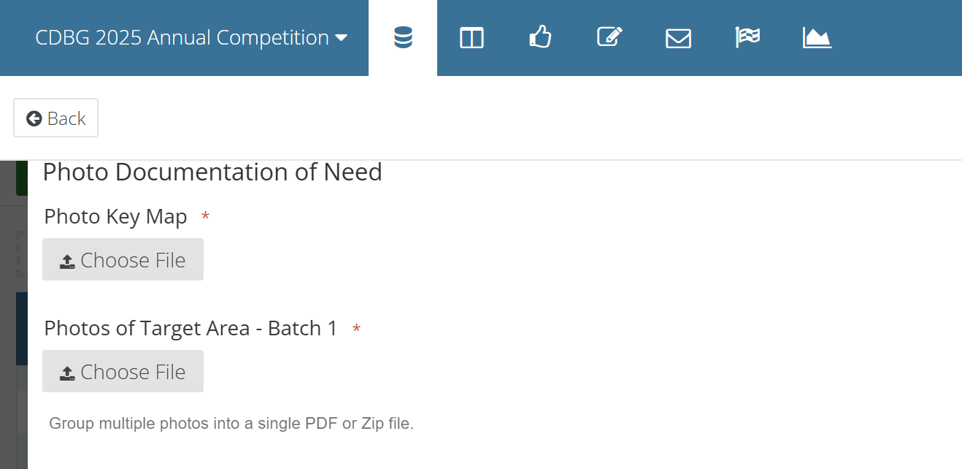
Documentation Submittal
ZIP
FILES?
Notes:
No Zip files – zengine does not always allow us to download the documentation. For the sake of time for the compliance review, please batch information/evidence into a single pdf.

Slide 6
Completeness Check Items
Resolution to Submit
Civil Rights Compliance Certification
Evidence of Compliance with System for Award Management (SAM/Unique Entity Identifier)
Acknowledgment of Subrecipient Language Access Plan (LAP)
Language Access Plan (LAP) Threshold Certification
Public Hearing Advertisement (Citizen Participation)
When to Consult Tribes (DCA-9B)
Wetland & Floodplain Maps
Concentration Map
DCA-13*
Service Delivery Strategy (SDS) & Local Comprehensive Plan
Procurement Documentation & Contracts
Conflict of Interest

Slide 7
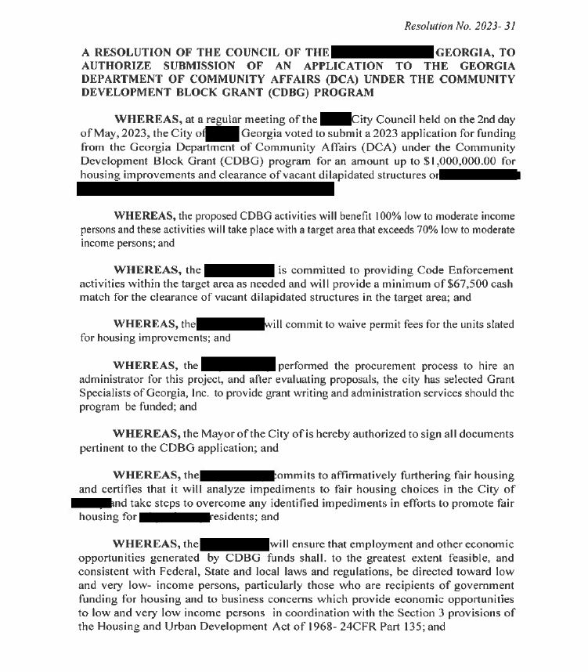
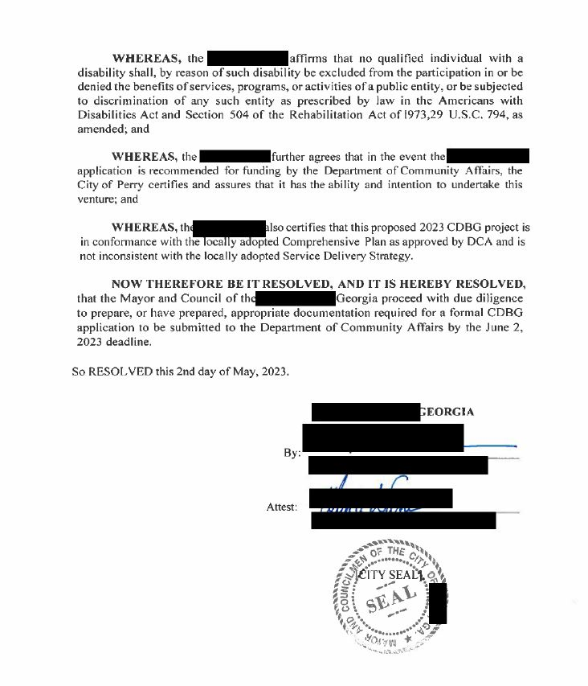
Resolution to Submit
Notes:
Common mistakes
lack of seal
and most recently the amount of funding being applied for was incorrect
Proposed activities not matching

Slide 8
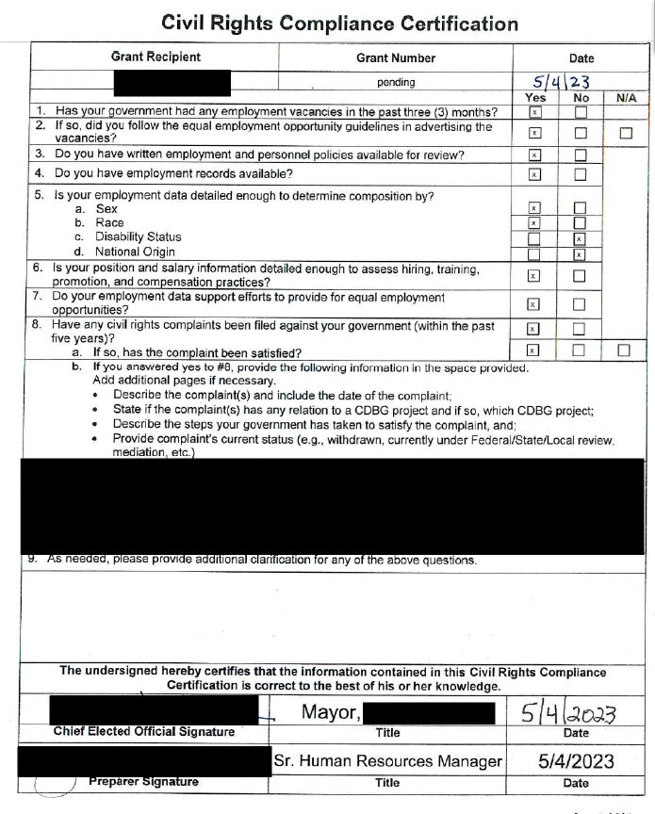
Civil Rights Certification Form
Common Mistakes
City/County name
Pending 2026
Date
All boxes must be completed (8a)
[remains our #1 admin cure to date]
Notes:
Common Mistakes
City/County name, Pending 2024 as grant #, or date are missing
Click before mentioning-*All boxes must be completed (8a)

Slide 9
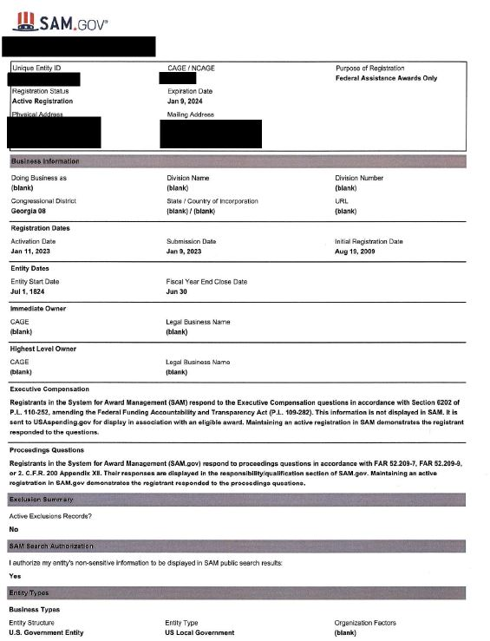
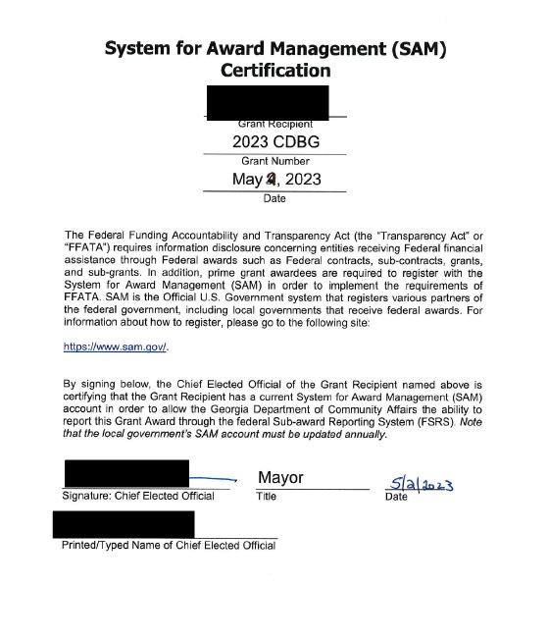
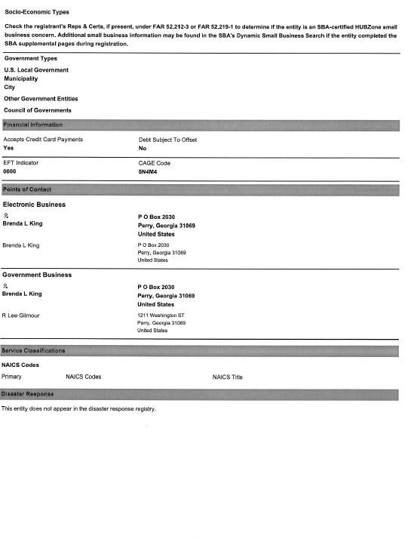
Evidence of Compliance with System for Award Management (SAM)
Notes:
The required information for SAM registration. The information contained in these forms is what we verify via SAM.gov. If there is an issue with your registration or it’s set to expire, please include a letter stating as much.
Our goals is not to be feverishly searching SAM.gov by city/county name to verify.

Slide 10
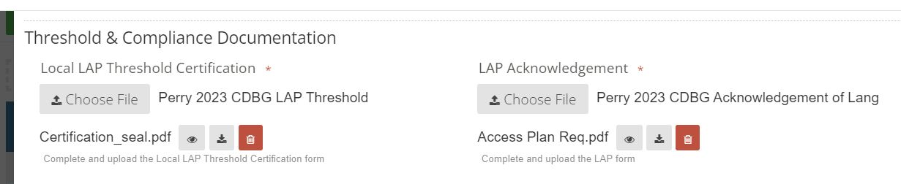
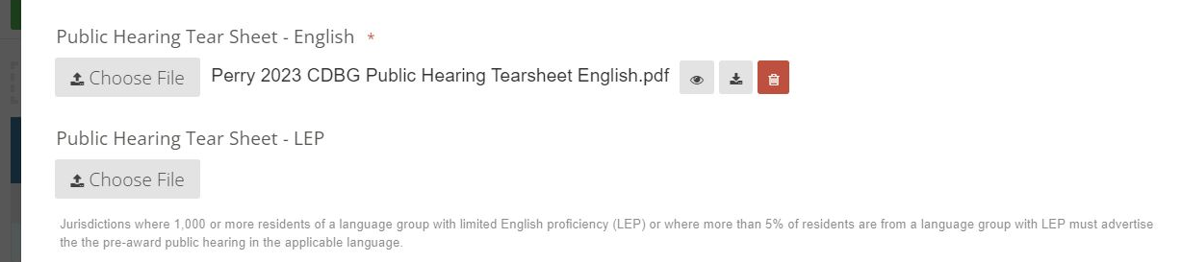
Language Access Plan (LAP)
Threshold Certification
Acknowledgement of LAP Requirement
Public Hearing (English/Spanish)
Notes:
The LAP documentation request covers 3 items, 4 if you are required to translate vital documentation.
Zengine screenshot indicates our requests

Slide 11
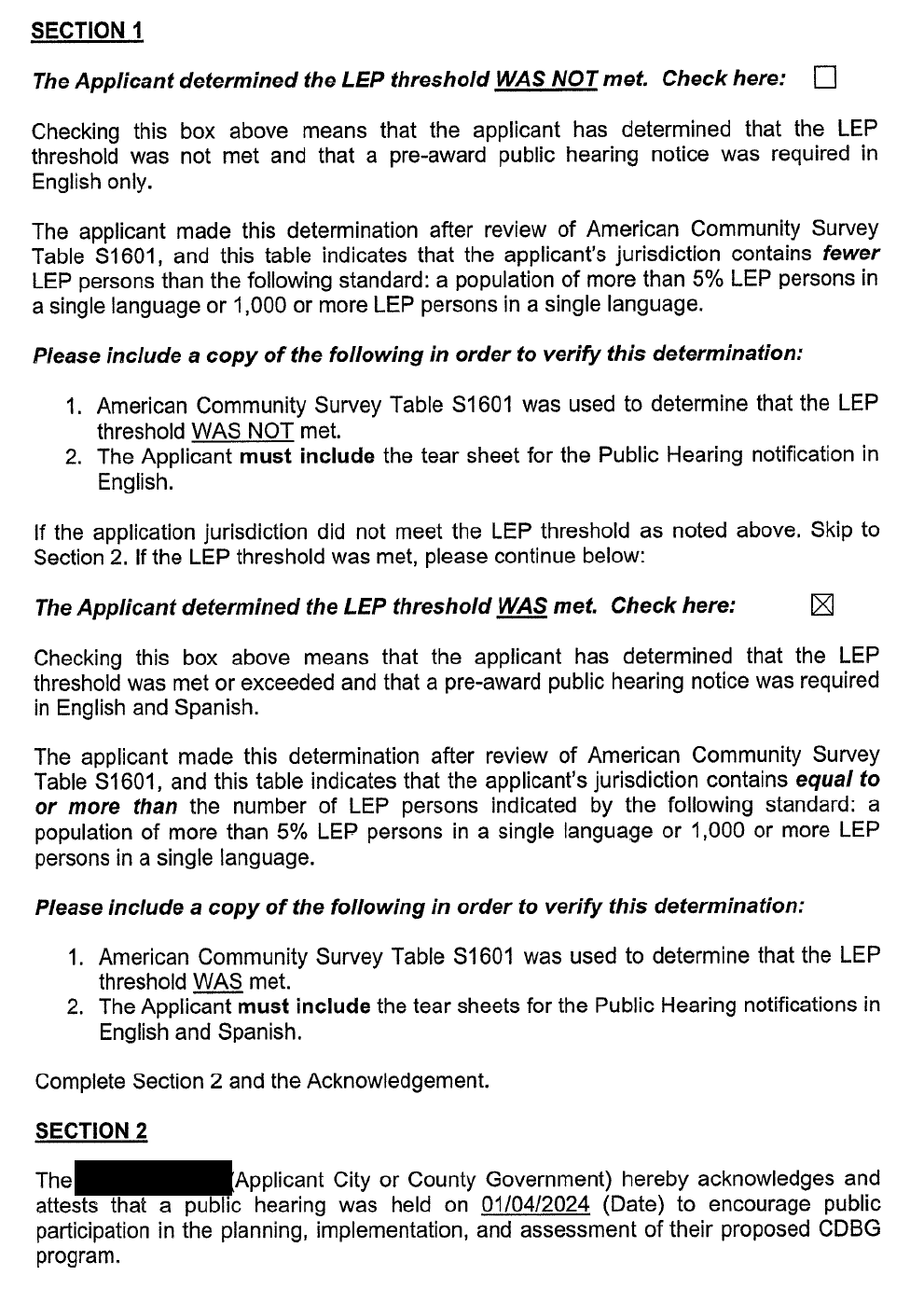
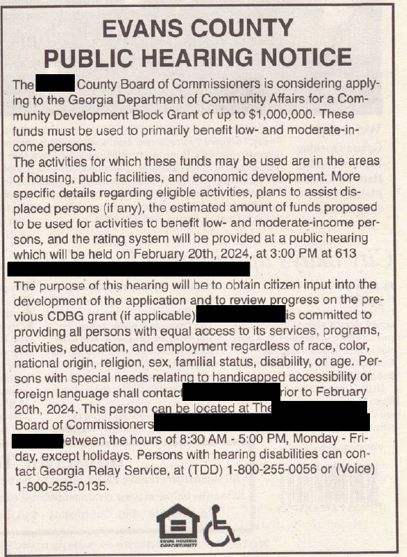
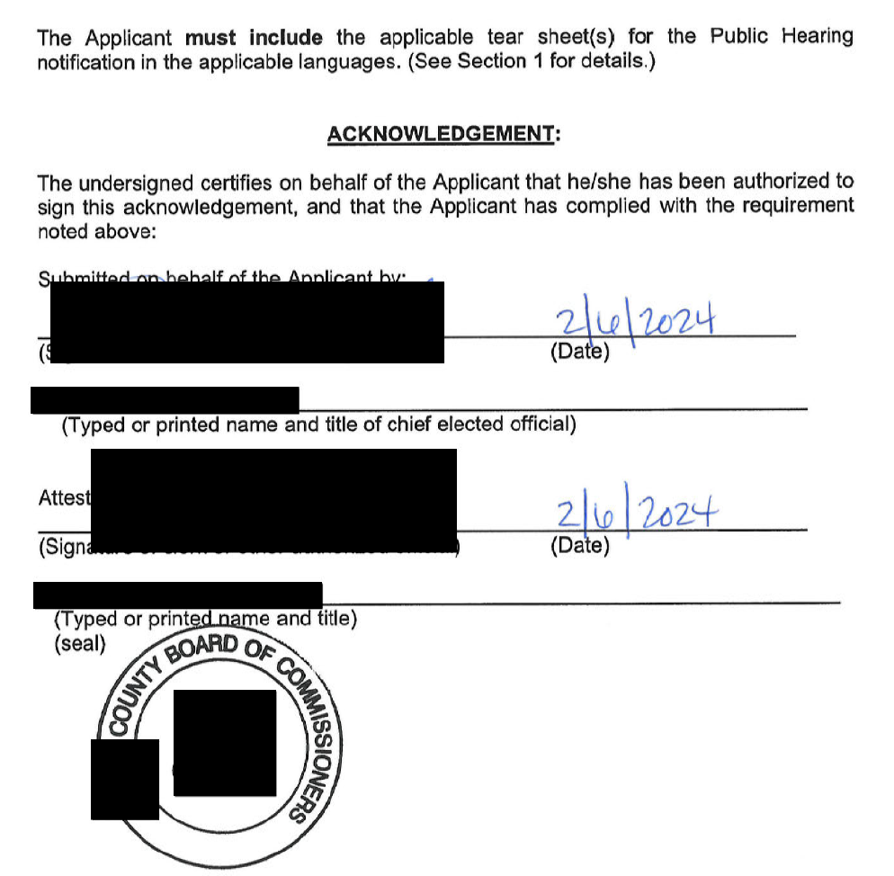
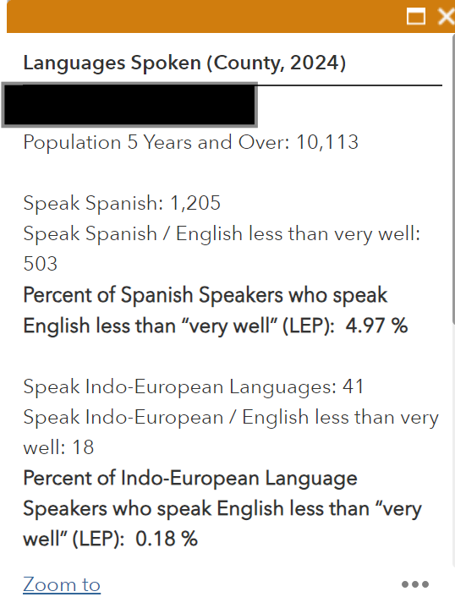
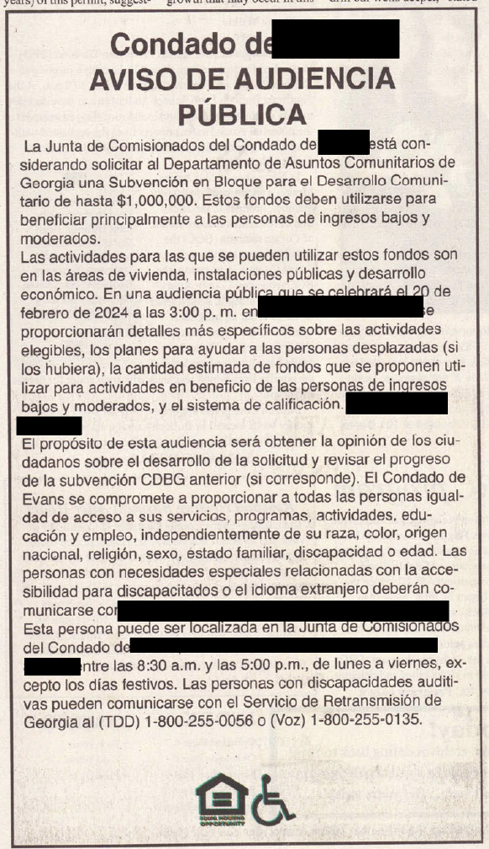
LAP Threshold Certification
Notes:
Common mistakes include
not indicating which box should be marked – either the threshold to translate IS or IS NOT met, we also see where this threshold is incorrectly determined which led to the LG publishing in English and Spanish although not required.
the public hearing date does not match the newspaper public hearing copy provided
Most common -The seal isn’t present
The forms should be evidenced with a copy of the DCA Map or Table Data (next 2 slides)

Slide 12
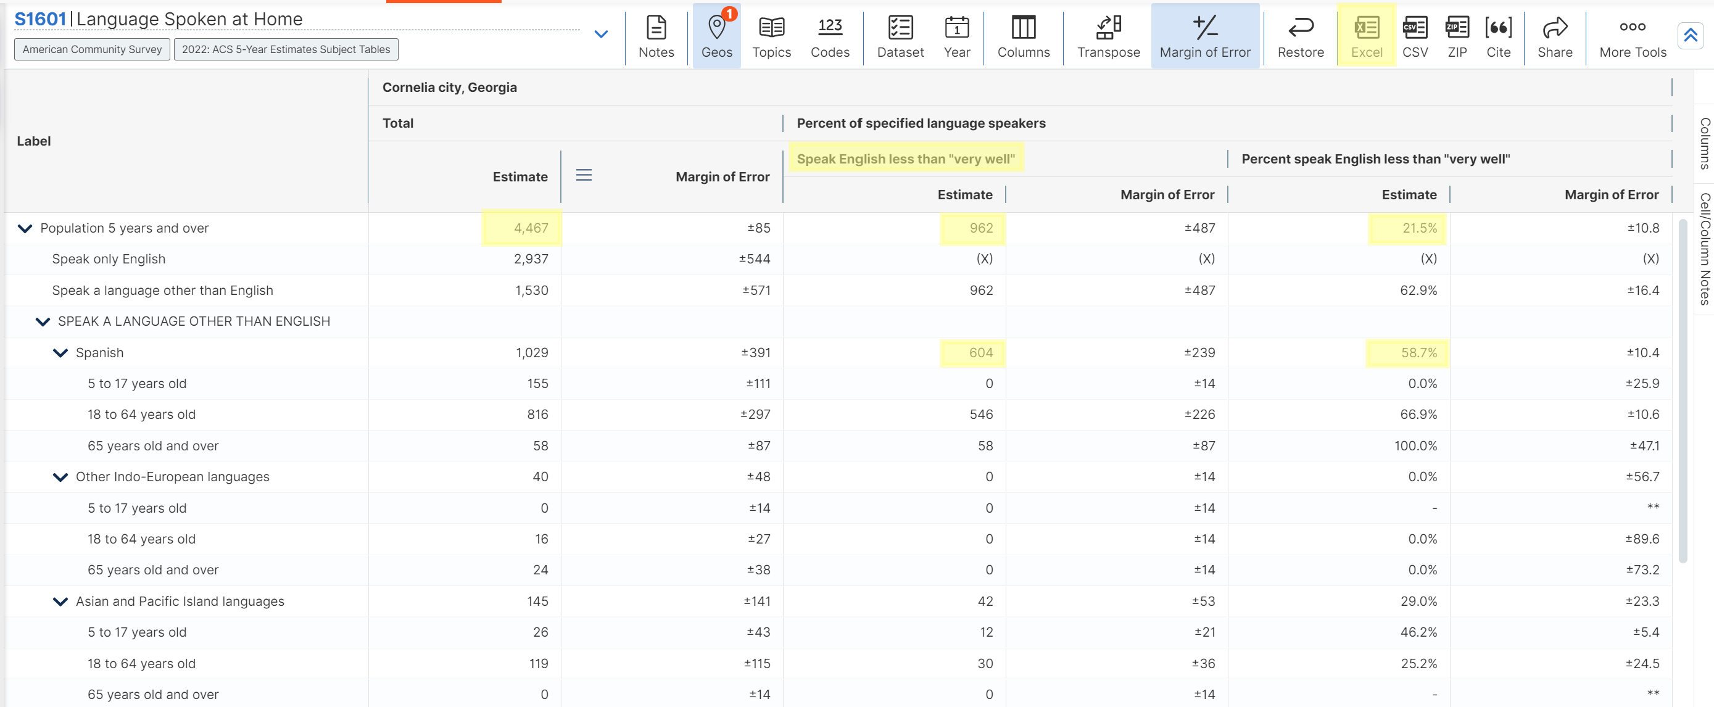
Notes:
Data used should be submitted.
When using the S1601, it is common for the LEP percentage to be calculated incorrectly.
If you are ever in doubt, please reach out to me for guidance.

Slide 13
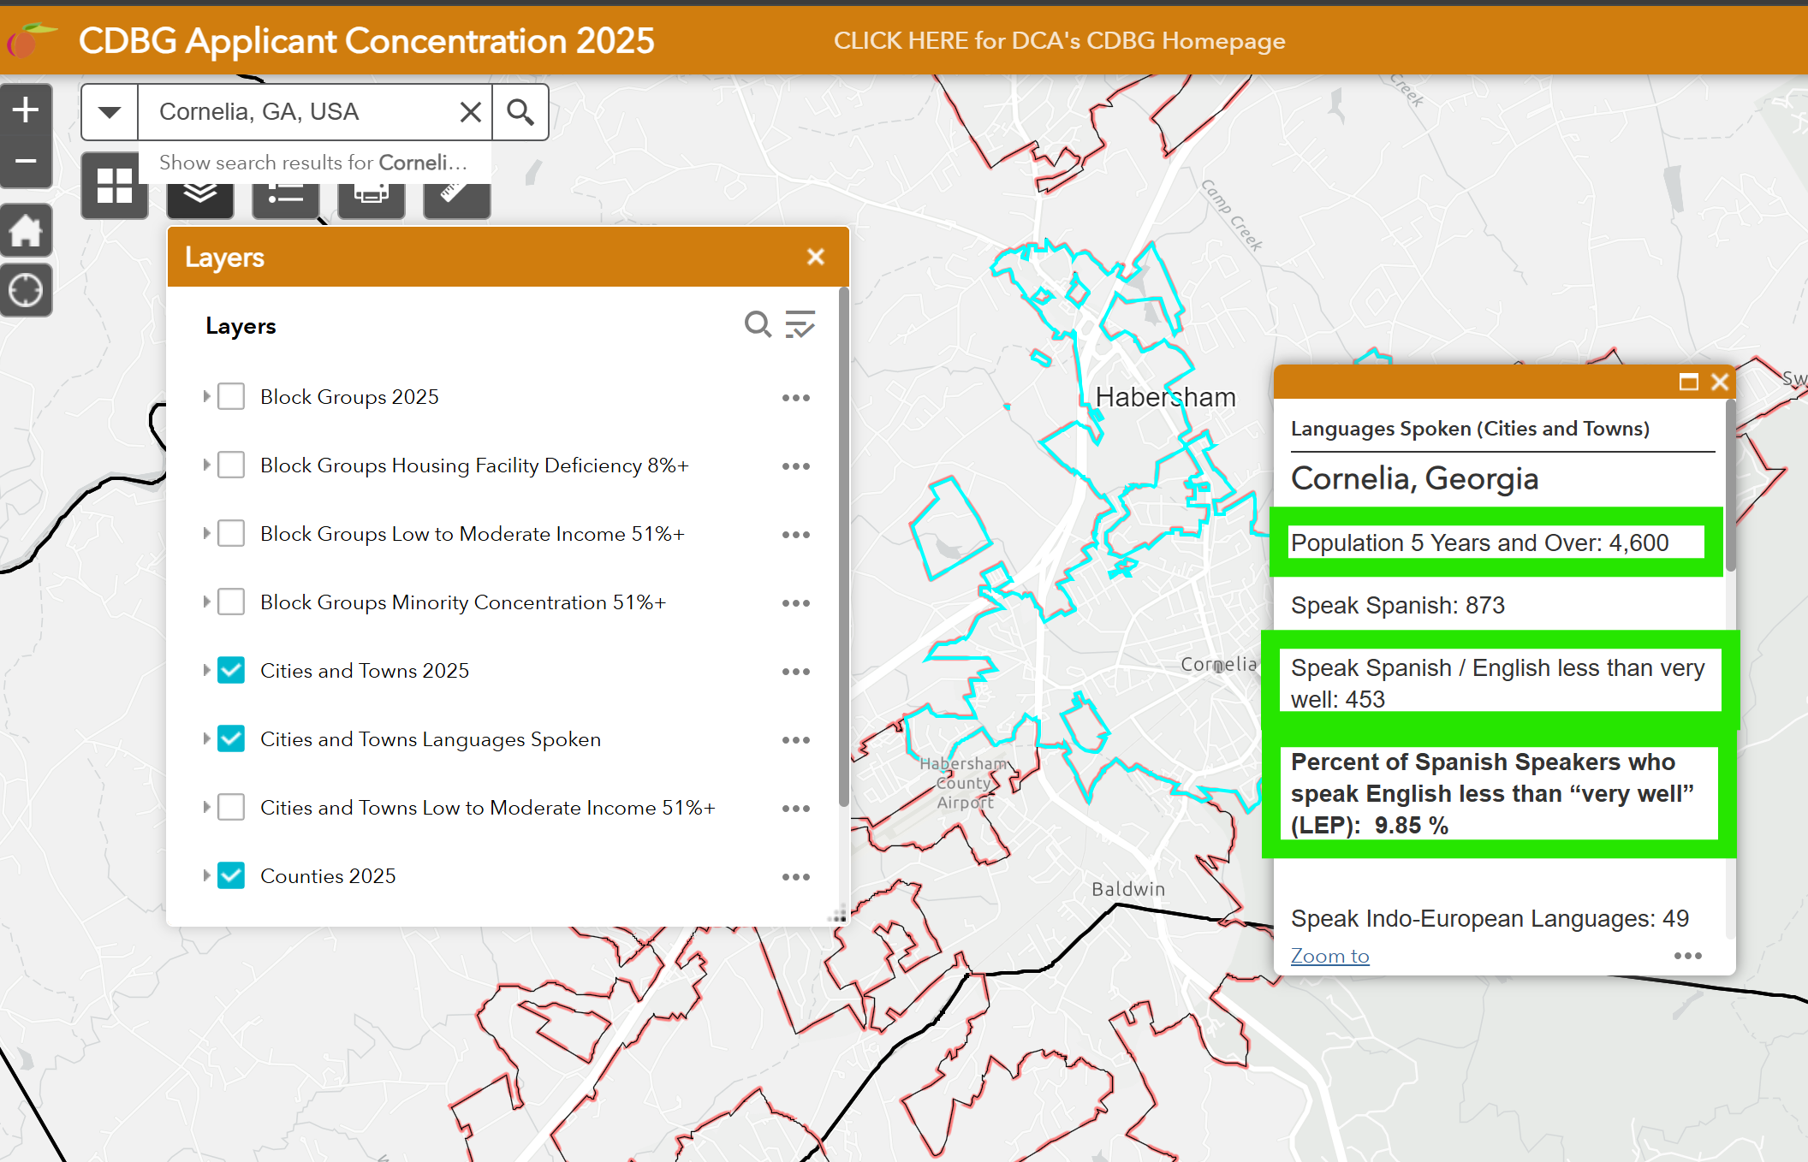
Notes:
CDBG Map breaks down the numbers for you.

Slide 14
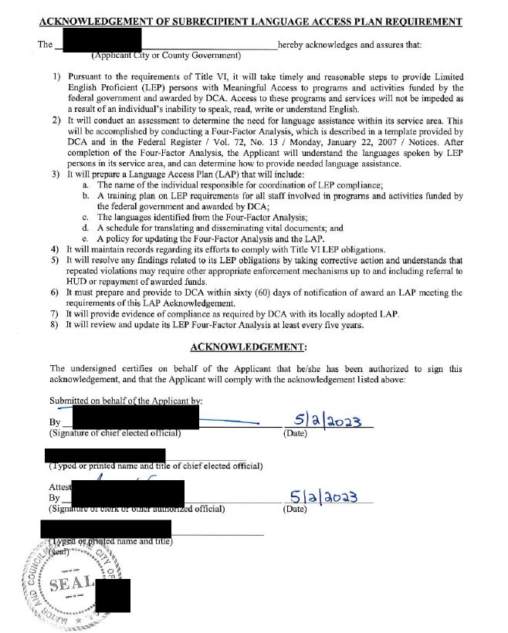
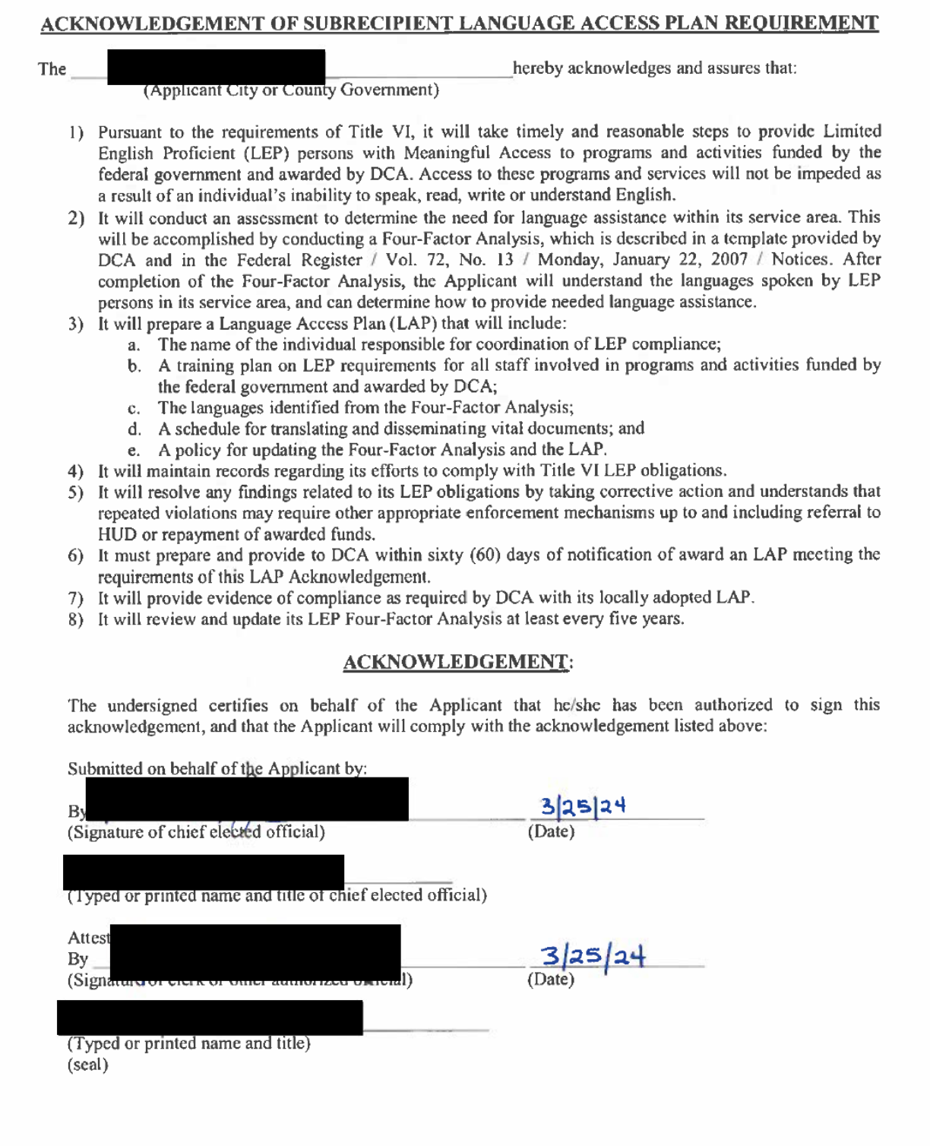
Acknowledgment of LAP Requirement
Notes:
Common mistakes include
The seal isn’t present

Slide 15
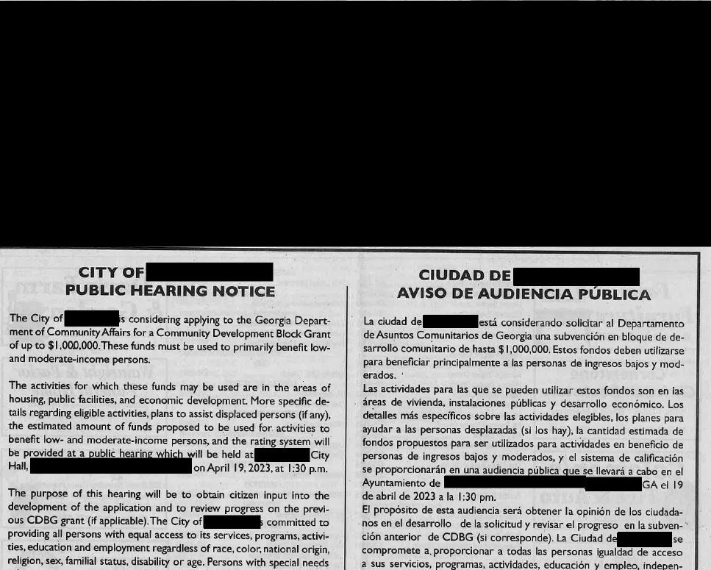
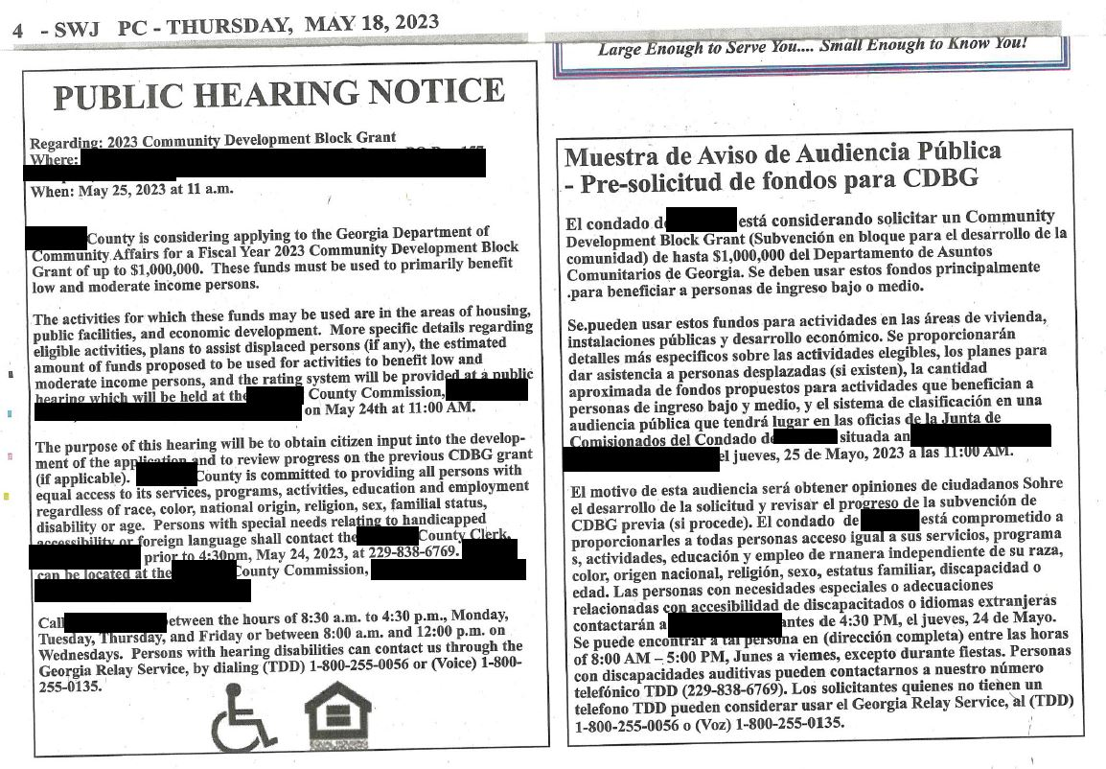
Public Hearing Evidence
Date Missing
Bottom Portion of the Advertisement is Missing
Notes:
If the threshold was met for translation of vital documentation you MUST publish in both languages and provide evidence of both advertisements.
On the left, the date was missing and the evidence provided did not include the bottom of the ads so we where unable to verify that all posting requirements were met.
On the right all requirements are included – the only difference is this application was not required to advertise in Spanish.

Slide 16
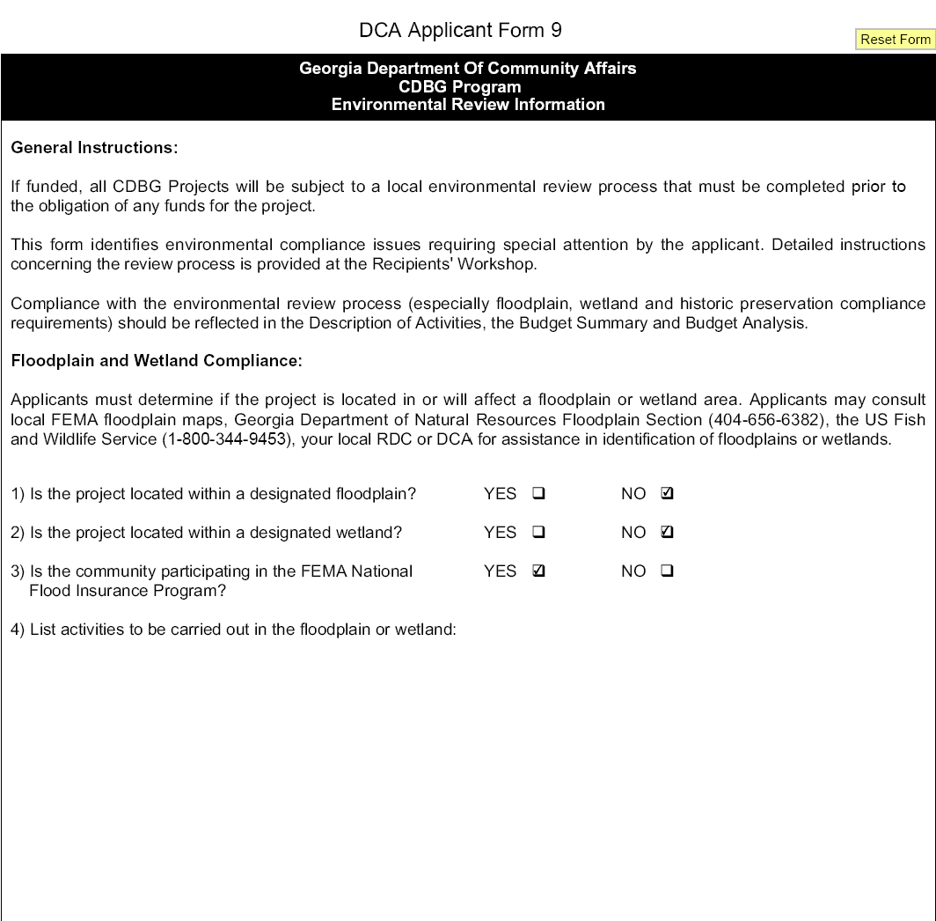
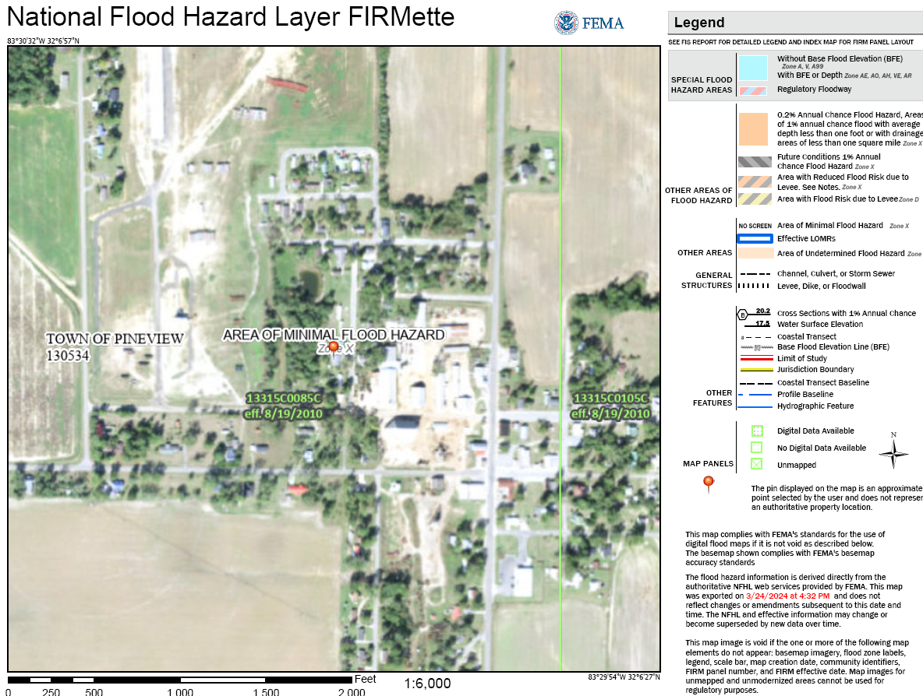
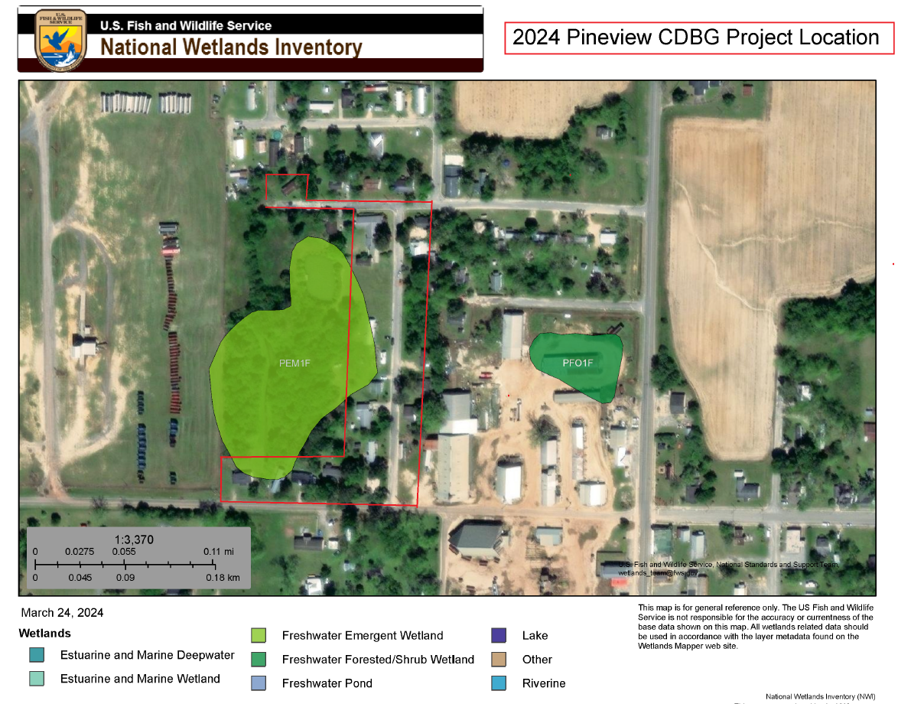
Environmental Review Form– DCA-09
Ensure consistency between floodplain and wetland maps and the way the question is answered.
Notes:
The 2024 round had a great deal of inconsistencies on form 9, please mark the floodplain and wetland boxes correctly.
Sample, floodplain is marked no which is correct but wetland is marked no, which is incorrect according to the wetlands map.

Slide 17
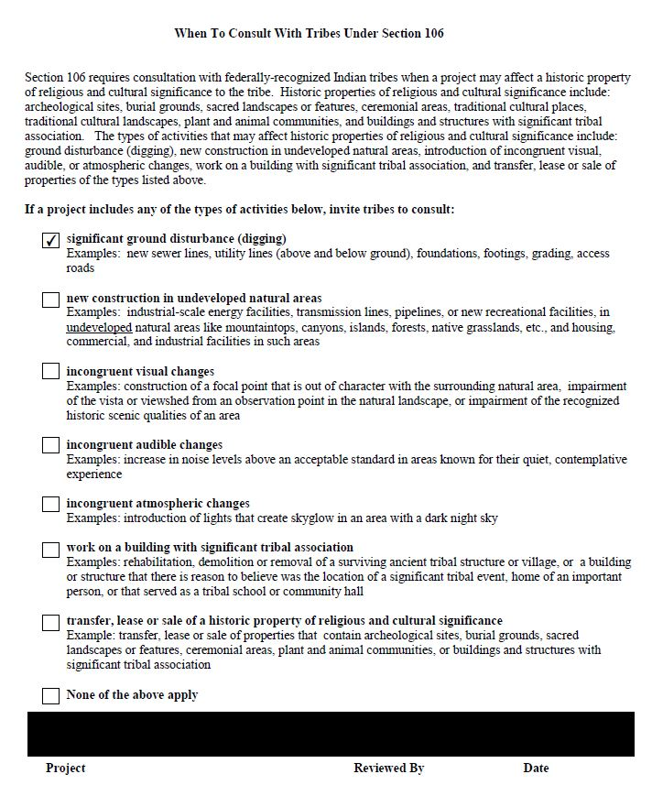
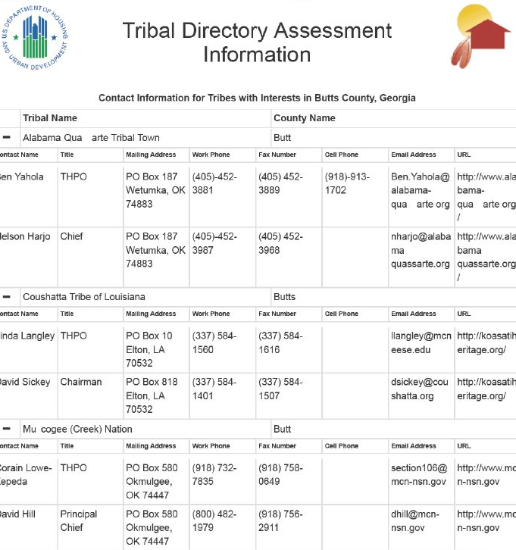
When to Consult with Tribes – DCA-09B
Notes:
Failure to include the TDAT list as required by the applcicants’ manual
indicate the types of activities the project includes

Slide 18
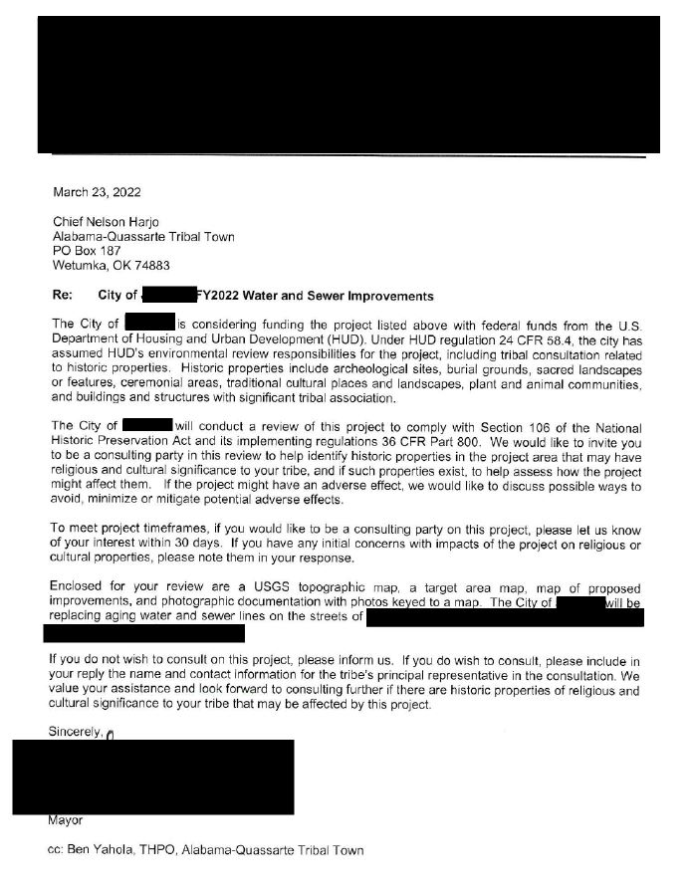
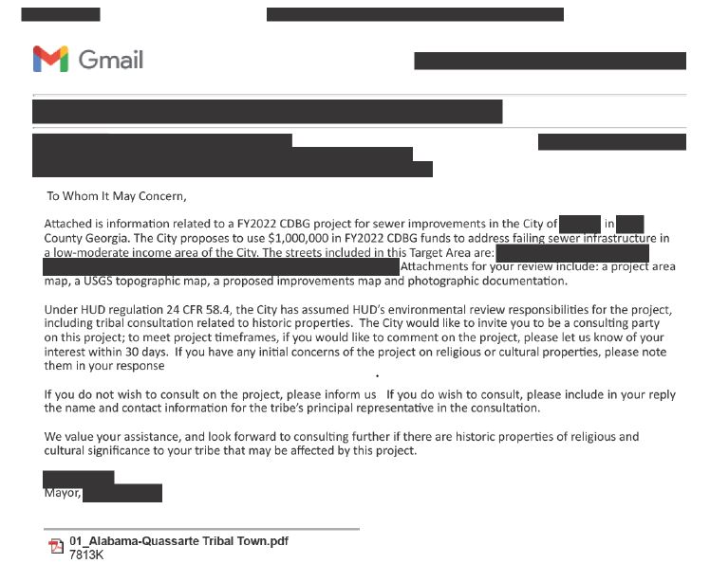
When to Consult with Tribes – DCA9B continued
Additional Evidence Required:
Project Location Map
Target Area Map
Proposed Improvements Map
Accompanying Photographs
Notes:
Addressing the tribe incorrectly
Not having the CEO sign the letter
Not providing evidence of correspondence being sent to the tribe
Evidence batch that is required to be submitted with each letter sent

Slide 19
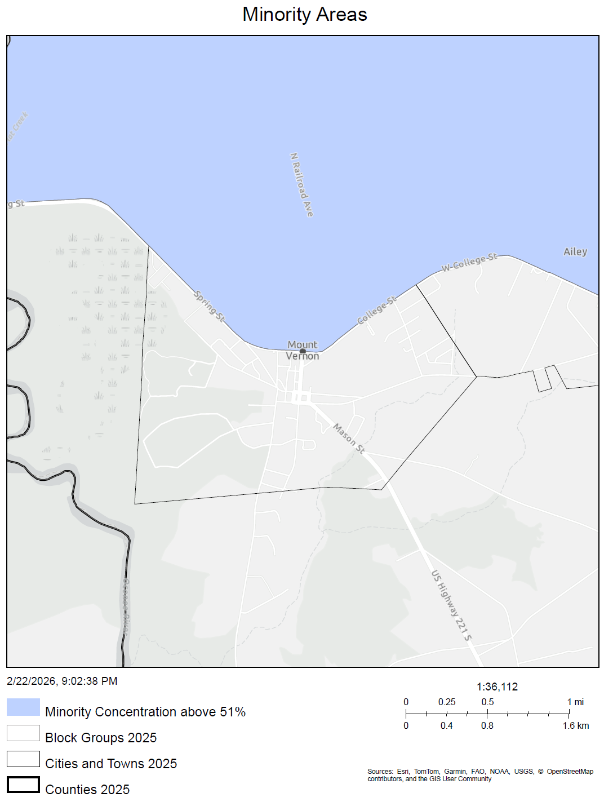
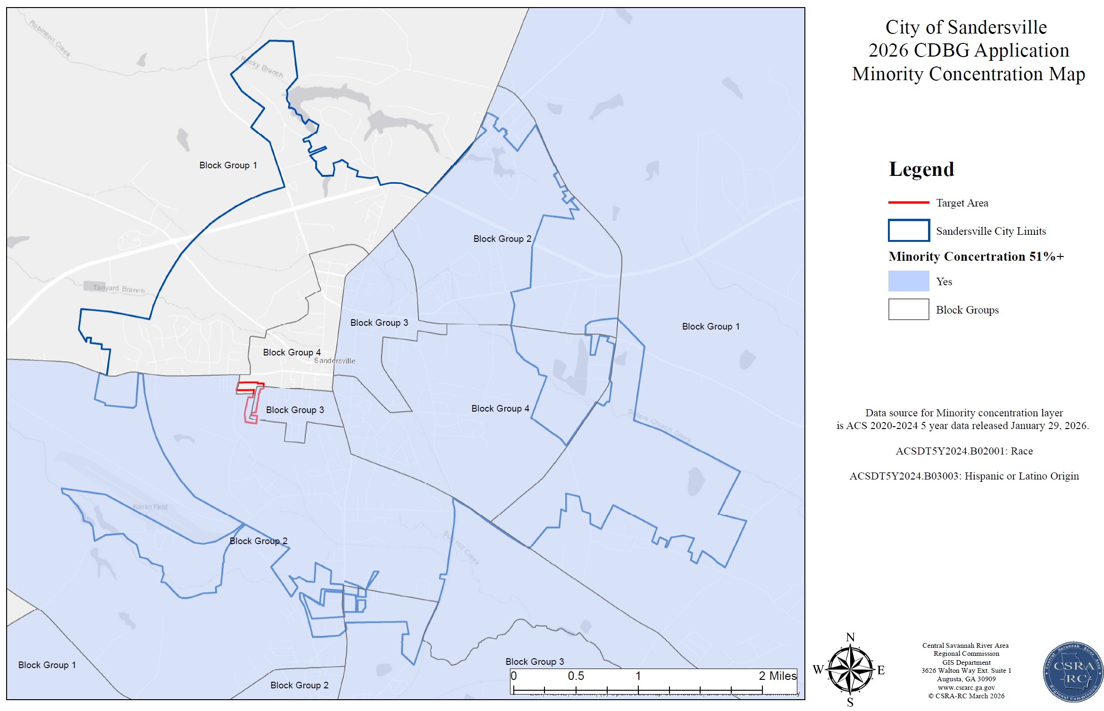
Concentration Map
Notes:
Each concentration map should be zoomed out for the city or county boundary/outline to be seen
The target area should be drawn in each map for determination of whether the TA is located in one of the concentration areas

Slide 20
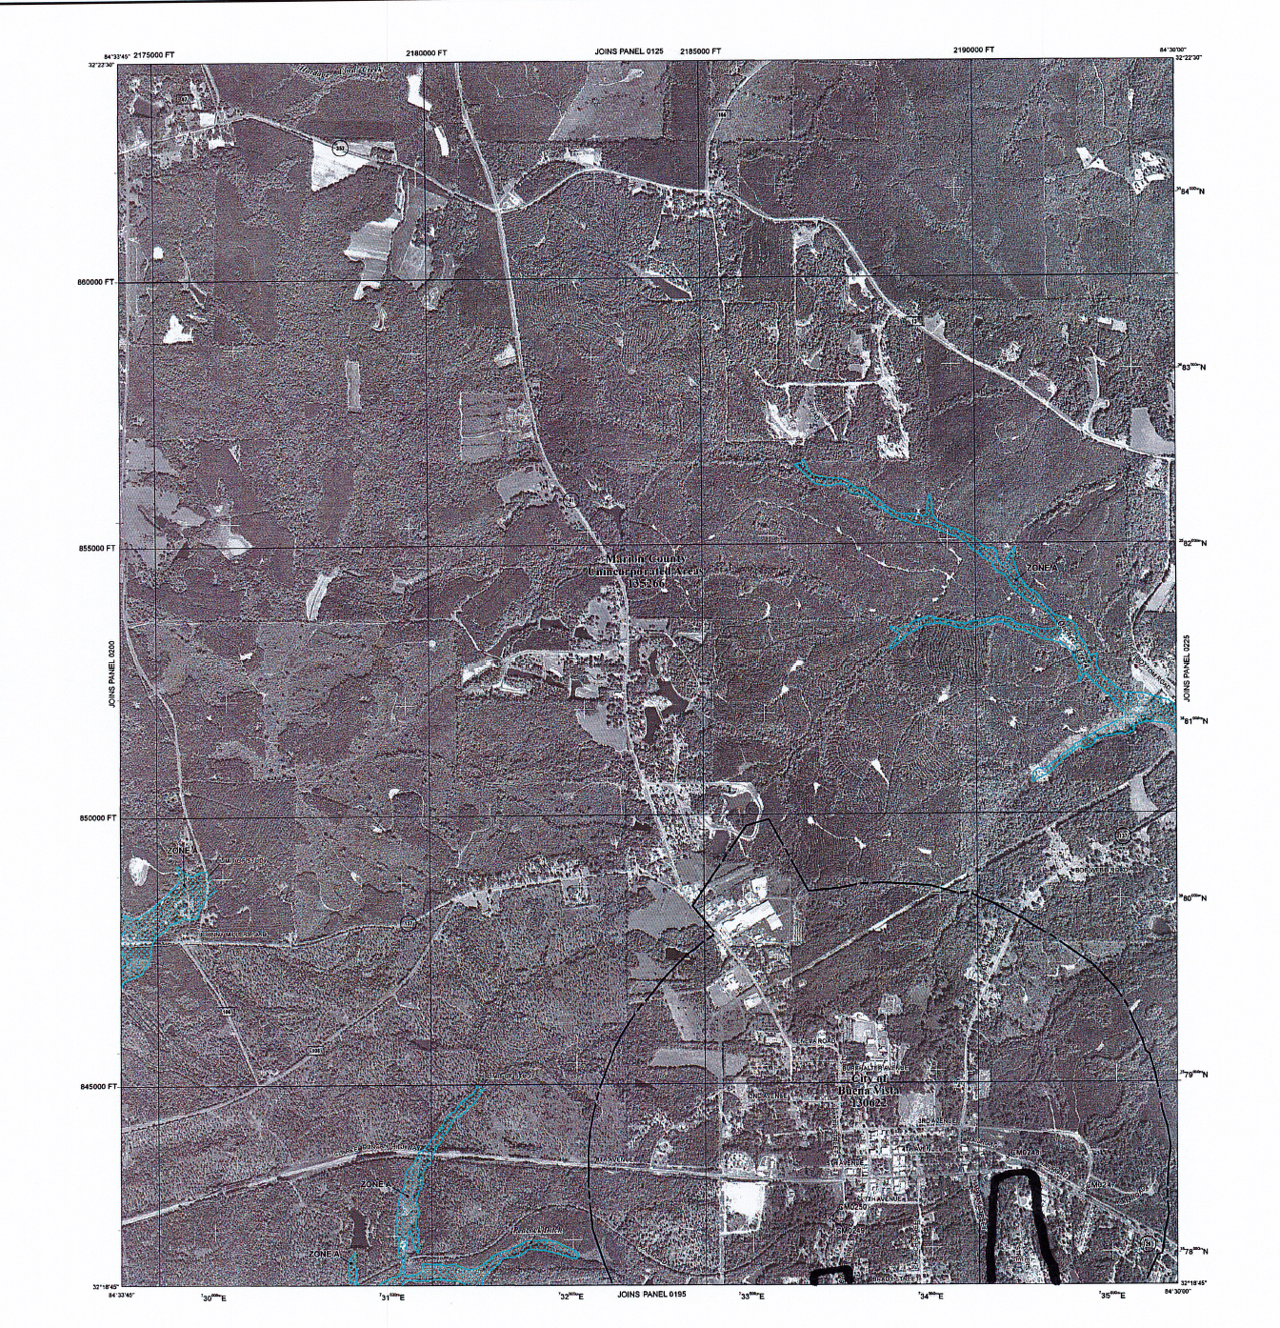
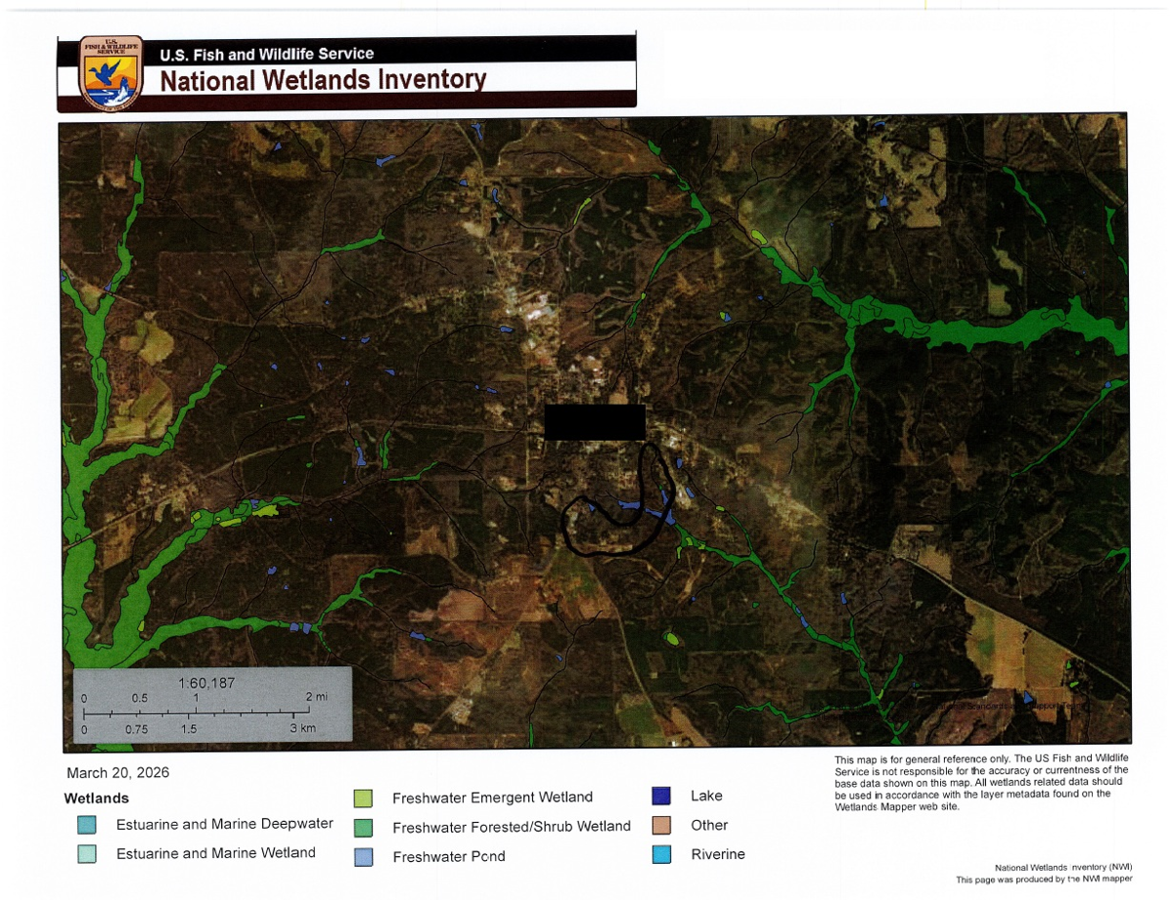
Insufficient Floodplain & Wetland Map
Notes:
Each concentration map should be zoomed out for the city or county boundary/outline to be seen
The target area should be drawn in each map for determination of whether the TA is located in one of the concentration areas

Slide 21
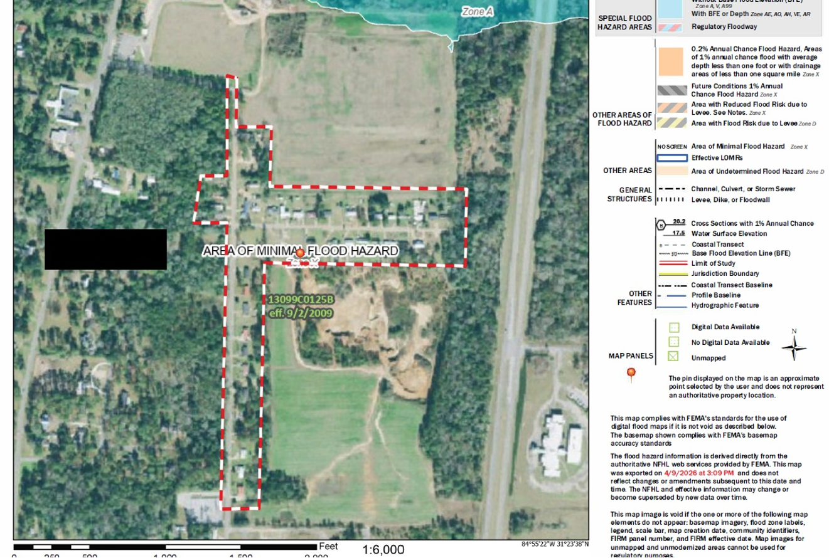
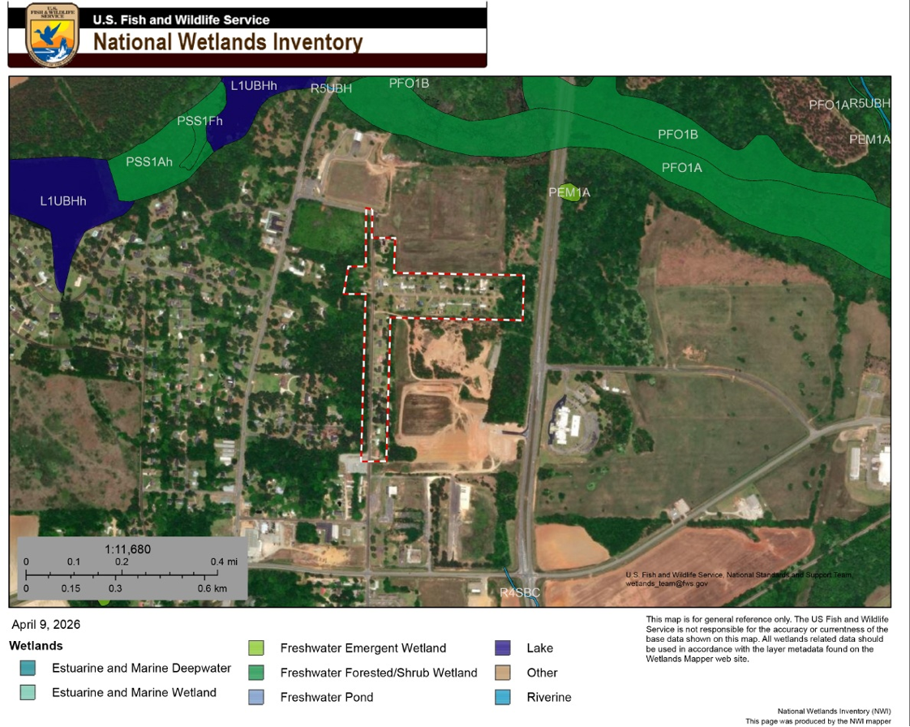
Sufficient Floodplain & Wetland Map
Notes:
Each concentration map should be zoomed out for the city or county boundary/outline to be seen
The target area should be drawn in each map for determination of whether the TA is located in one of the concentration areas

Slide 22
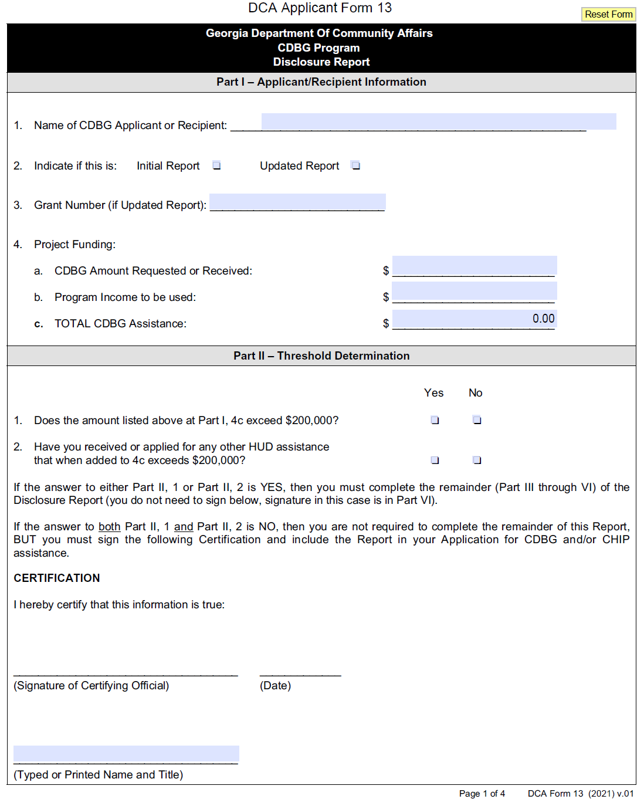
DCA-13 CDBG Program Disclosure Report
Part I will be more than $200,000 meaning, Part II, question 1 should be marked, yes.
Part III needs to indicate the City/County injection to the project. It does not require a signature if it is the initial submittal of the form.
Part IV should include professional firms hired for the project. It does not require a signature if it is the initial submittal of the form.
Part V should include DCA and the City/County and project improvements described as use.
For the initial submission of Form DCA-13, when the amount requested exceeds $200,000, only the fourth page (Part VI Certification) requires signature.
Detailed instructions are on page 108 of the Applicants’ Manual.
Notes:
The left image is hyperlinked and will take you to the full 4 page form.

Slide 23
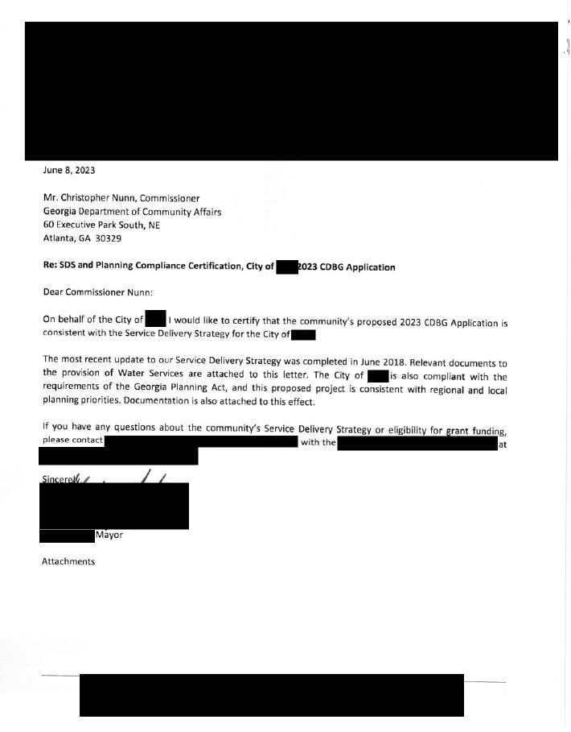
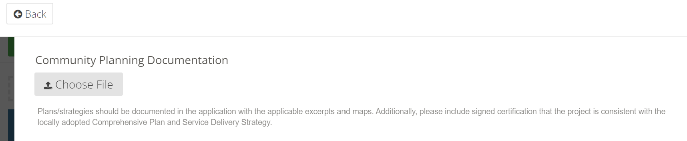
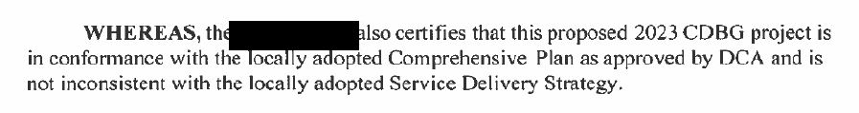
Service Delivery Strategy (SDS) & Local Comprehensive Plan
Notes:
Beginning in 2023, we added additional evidence for the SDS and Local Comprehensive Plan.
Compliance can be evidenced via the resolution or a letter signed by the CEO

Slide 24
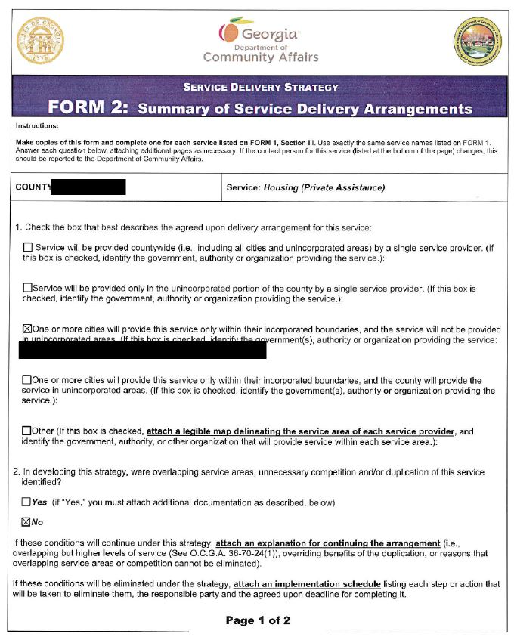
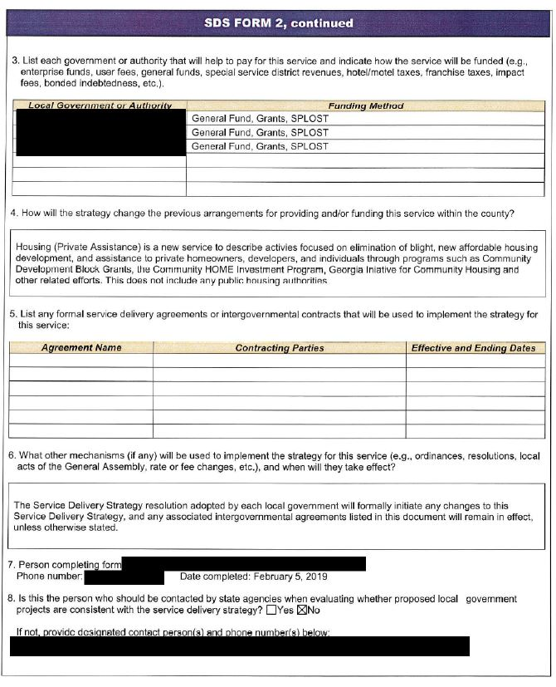
Service Delivery Strategy
Please include the service area map!
Notes:
Common mistakes
Not submitting the SDS Forms
Submitted the incorrect form, meaning the form is for a different service and does not match the project service proposed
*The accompanying maps should also be included with the SDS form.

Slide 25
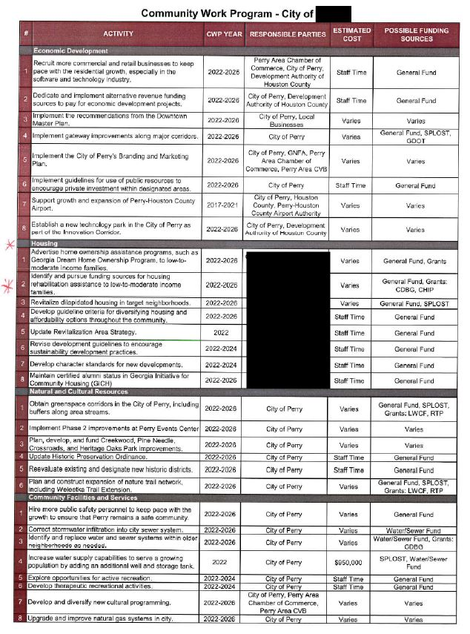
Local Comprehensive Plan
“One of the review factors considered as a project strategy question is the conformance of the proposal with the locally adopted Comprehensive Plan, as approved by DCA. In order to demonstrate conformance, applicants should discuss on Form DCA-5 how the proposal conforms to the Plan, including citations or quotes from pertinent pages of the Plan.”
Notes:
At minimum the LG’s community work program evidencing the proposed project is required. We are also looking for experts that are consistent with the proposed project.

Slide 26
Professional Procurement
RFP/RFQ
Proof of Publication
Proof of Distribution
Scoring Sheets
Meeting Minutes
Executed Contracts
Notes:
The following requirements apply to Administrator/Grant Writer and Engineer/Architect

Slide 27
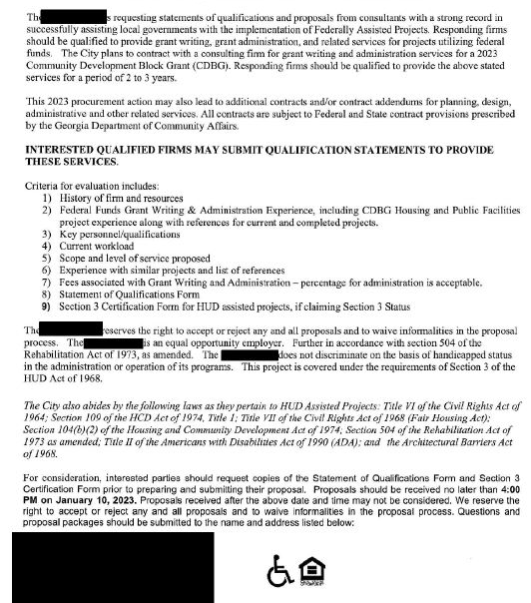
Request for Qualifications (RFQ) or
Request for Proposals (RFP)
Common Mistakes
Proposal due date is not a minimum of 30 days
Funding Program and Funding Year are not listed
Notes:
Common Mistakes
Proposal due date is not a minimum of 30 days
Funding Program and Funding Year are not listed

Slide 28
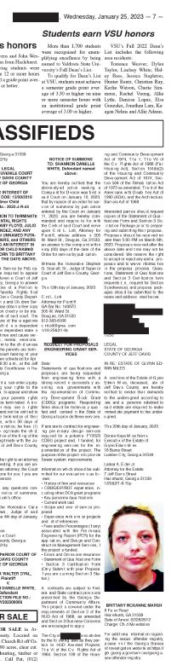
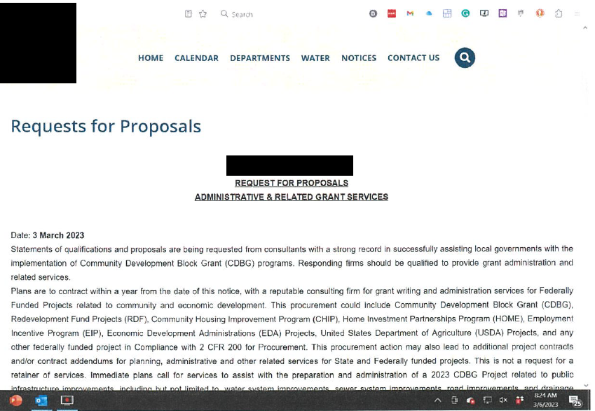
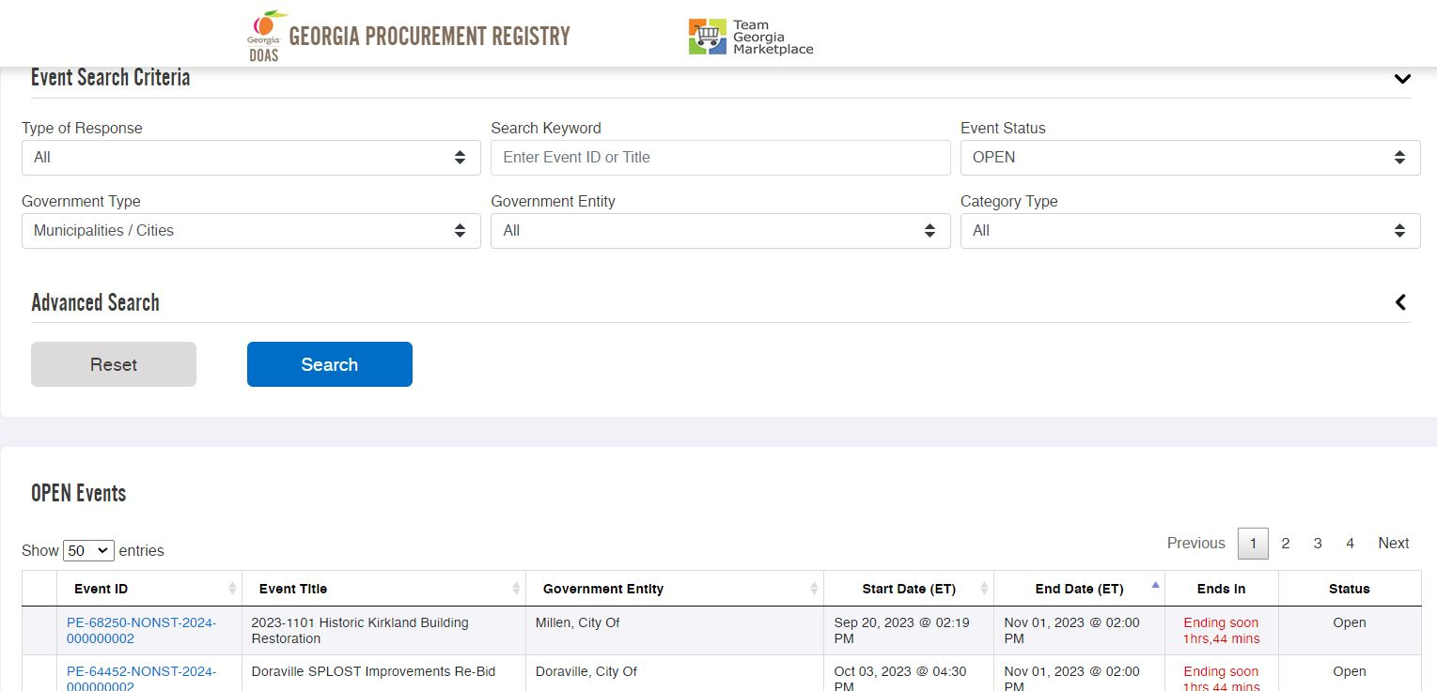
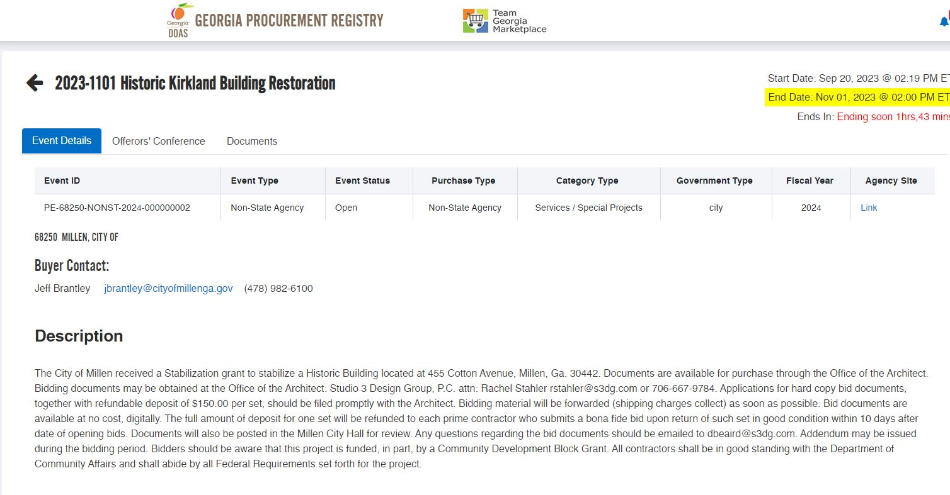
Proof of Publication
Newspaper with adequate circulation or local government website.
Georgia Procurement Registry (if contract is $100,000 or more)
All advertisements should include “the project is subject to Buy America, Buy American Act (BABA)”.
Notes:
Minimal Requirements are:
Publications of the RFP via newspaper or website.
Proof that a minimum of 30 days was allowed for responses.
If the contract will be for more than $100,000, GPR advertisement must be provided.
Publications should also have Section 3 and BABA language on the landing page

Slide 29
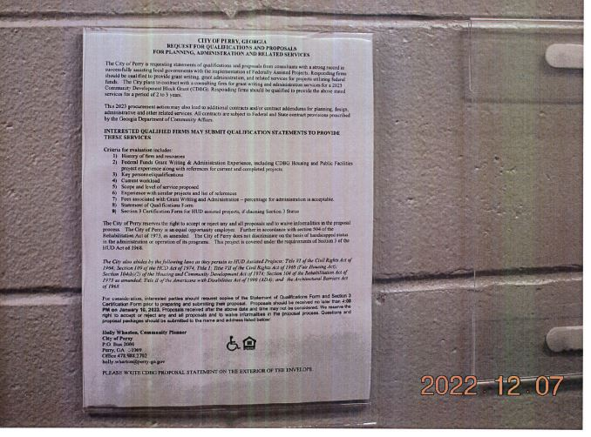

Proof of Publication (additional locations)
Notes:
Other locations where the RFP was listed to foster as many responses as possible can also be provided.

Slide 30
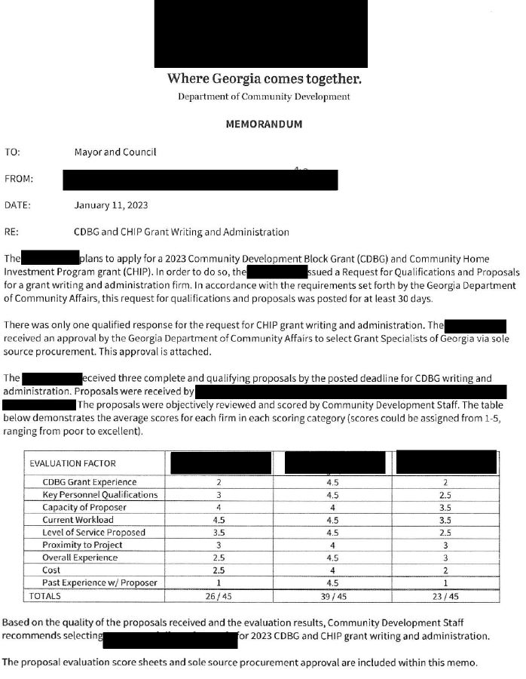
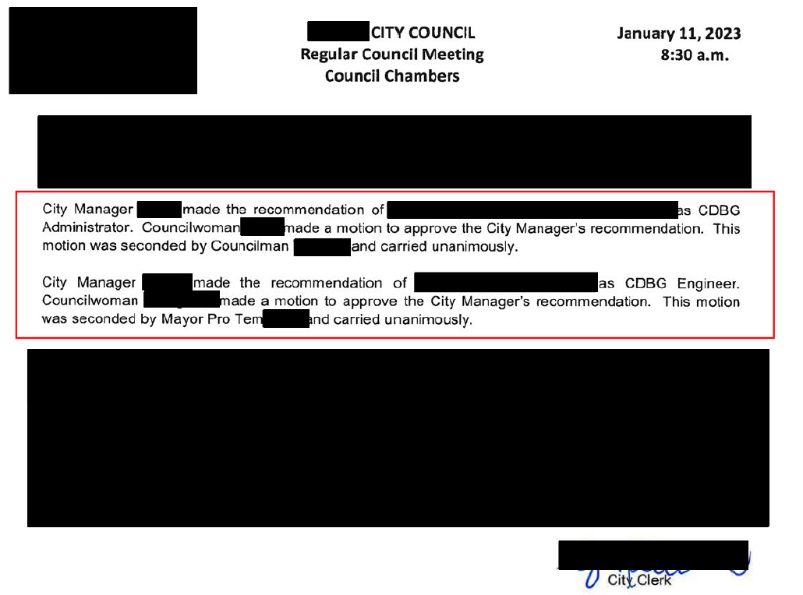
Scoring Sheets & Meeting Minutes
Notes:
*If the highest score is not chosen, please indicate why in the minutes or a letter from the CEO

Slide 31

Executed Contracts
Common Mistakes
No Signature
Lack of BABA language
Applicant did not provide both professional services executed contracts
Services or Scope described in the Engineer/Architect Contract do not mirror the project scope of services
No Contract provided from the Regional Commission, or the contract provided is not executed
Notes:
Most common mistakes for 2025 and 2024 annual round were the lack of signature to indicate full execution and BABA language
Name off the others.

Slide 32
Sole Source Requests
Chief Elected or Authorized Official’s request letter
Description of Procurement Methodology
Tear Sheet of the Bid Advertisement or RFP/RFQ
Local Government’s Attorney Opinion
Proof of Distribution (Professional Services Procurement)
  list of the active, qualified consultants or engineers/architects that were mailed the RFPs/RFQs (7 for grant administrators and 10 for engineers/architects)
  certified return receipt documentation or adequate email documentation
This approval must be received prior to the application deadline for professional services.

Slide 33

Common
Procurement
Mistakes
Did not allow at least 3o days for responses
Did not retain proof of solicitation delivery (read receipts) or a memorandum of the process
Meeting minutes indicated the highest scored respondent was not selected without explanation
Sole Source (professional services) approval was not obtained prior to application submission

Slide 34
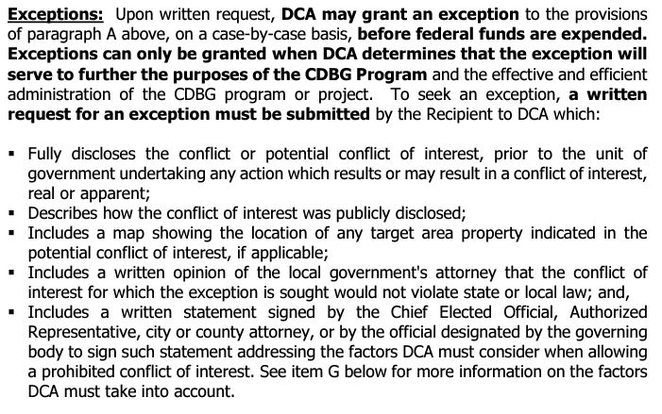
Conflict of Interest (COI)
Common Mistakes
No attorney letter
No description of the public disclosure
No map included indicating the location of the COI in the target area
Notes:
While not required to be submitted for clearance in the application, if a Conflict of Interest cannot be cleared from the application submission, a special condition will be created, if the project is awarded. However, the common mistakes are listed here.

Slide 35
Thanks!
Brittney Hickom
Brittney.Hickom@dca.ga.gov
Direct: 470-698-8166
Compliance Officer
dca.georgia.gov

