Slide 1
Compliance & Mapping
Updated September 2026

Slide 2
Overview
Research Team Requirements
Planning Team Requirements
GIS Team Requirements

Slide 3
Office of Research
Creates and collects reports and surveys from Governments and Authorities
Report of Local Government Finance (RLGF)
Government Management Indicators Survey (GOMI)
Debt Issuance Report
Annual Authority Registration and Financial Report (AARF)
Hotel/Motel Tax
Wage and Salary Report
Contacts Database

Slide 4
Report of Local Government Finance Survey (RLGF)
What is it?
When is it due?
Report of debts, expenditures, revenues, and assets for a fiscal year
Gives financial context for future legislative actions when all governments are analyzed in the Financial Highlights Report
Managed by Office of Research
180 days/6 months after the end of the Fiscal Year
Example:
  Fiscal year end: December 31st, 2026
  RLGF Due date: June 30th, 2027

Slide 5
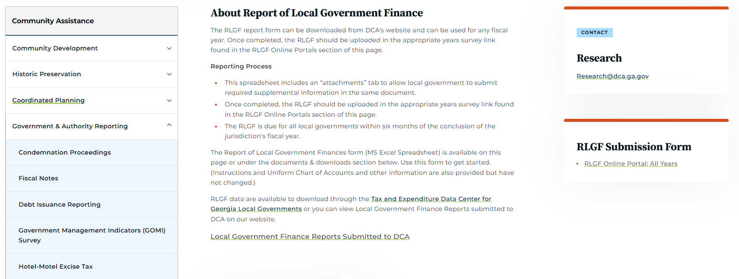
How to Turn in the RLGF
Navigate to Government and Authorities Reporting page on DCA Website
Navigate to RLGF sub page,
Download the RLGF excel doc on the documents page
Fill out this excel sheet, all 6 pages and contact information
Submit the excel document to the portal linked on the RLGF sub page

Slide 6
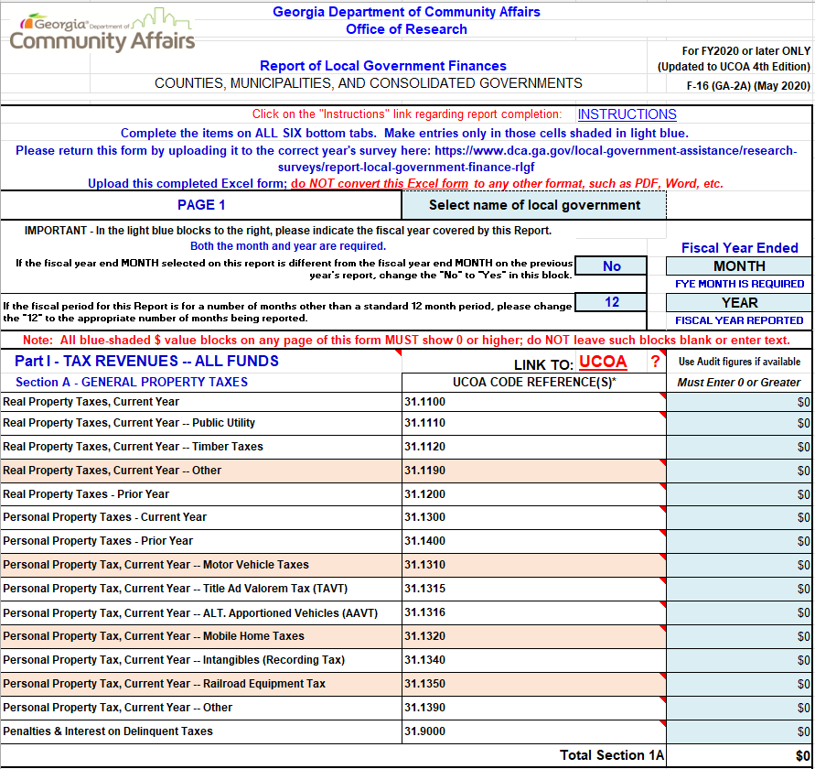
Sample RLGF View

Slide 7
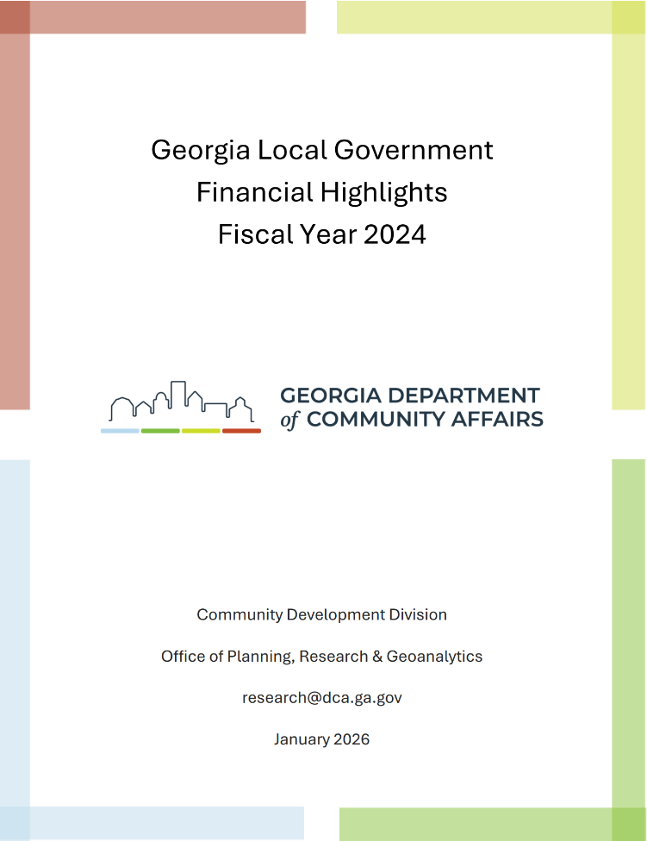
What is the Financial Highlights Report?
Report comparing debts, revenues, expenditures, and assets of local governments across two previous years
Aids legislators in understanding government financials at a local level
In 2026, the FY2024 report was produced because not all FY2025 reports were due yet

Slide 8
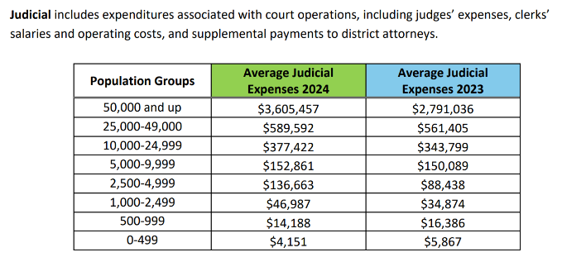
Sample of Financial Highlights Report
Judicial Expenditures: Municipalities

Slide 9
Government Management Indicator Survey (GOMI)
What is it?
When is it due?
Report of a government’s management, services, facilities, zoning, development, safety, and other general functions
Managed by Office of Research
June 30th every year
This is for every government and will not change
GOMI 2026 – June 30th, 2026 deadline
GOMI 2027 – June 30th, 2027 deadline

Slide 10
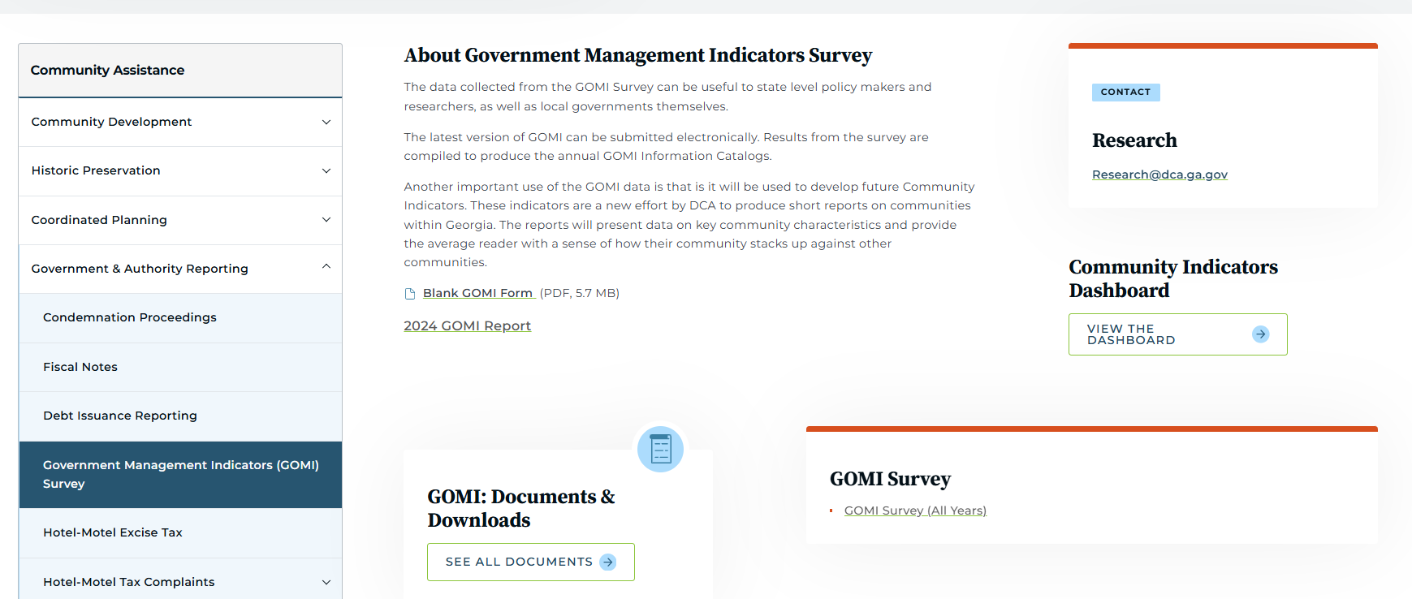
How to Turn in the GOMI
Navigate to Government & Authorities Reporting page on the DCA Website
Navigate to the GOMI Survey sub page
Select GOMI Survey (All Years) and fill out the linked survey

Slide 11
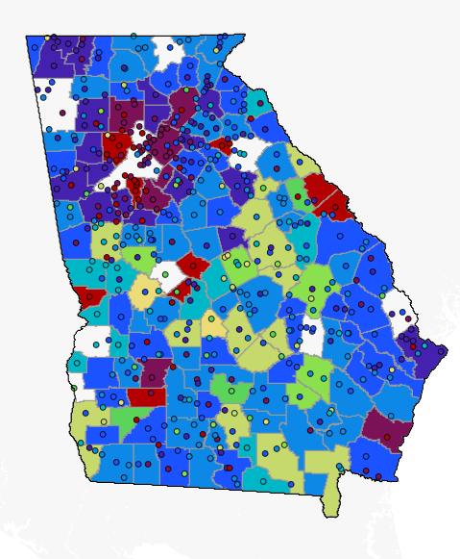
Uses for the GOMI
Data collected is useful for policy making by looking at how governments operate
Indicators are an effort by the DCA to produce reports on communities to help shape future decisions
Reports are accessible for anyone to see on the DCA Website or through an open records request
Interactive Indicators Map
- Experience Arc GIS website (2025)

Slide 12
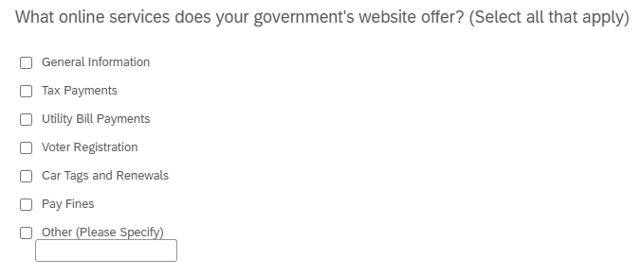
Sample Question

Slide 13
RLGF and GOMI Questions
Please contact the Research team at the DCA
research@dca.ga.gov

Slide 14
Office of Planning
Creates and collects reports and surveys from Governments on planning resources
Comprehensive Plans
Service Delivery Strategy (SDS)
Capital Improvement Element (CIE)
Impact Fees
Annexation Arbitration
Development of Regional Impact (DRI)
Regional Planning

Slide 15
Comprehensive Plans
What is it?
When is it due?
Document assessing current conditions while visioning for the future which guides investment and programming for a jurisdiction.
Managed by Office of Planning
Every five years for all cities and counties, exact date varying
Check with the DCA Planning team for specific questions

Slide 16
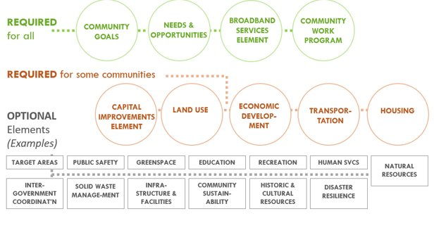
Plan Elements
**Visual Concept by Ozgur Basak Alkan, Perkins+Will

Slide 17
Required Elements
Goals – what the community aspires to long-term
Needs/Opportunities – what the community needs and opportunities it sees in the short-term
  Involves a SWOT analysis
Broadband Services – required following the passage of the Achieving Connectivity Everywhere (ACE) Act in 2018
Community Work Program – list of projects to be undertaken over the upcoming 5 years based off of the designated goals/needs and opportunities.
  This is accompanied by a Report of Accomplishments which provides a status on all of the projects in the previous plan's work program. Projects are typically identified as complete, ongoing, postponed, or cancelled/not accomplished.

Slide 18
Community Involvement
The comprehensive plan must be developed with community involvement and input from stakeholders and the public.​
Community involvement is required to include the following:
2 public hearings: one at the beginning of the planning process and one at the end for the community to review the draft plan.
A steering committee including community stakeholders, local economic development practitioners, and local staff.
Community involvement can go beyond the minimum requirements to include surveys, open houses, stakeholder interviews, and more!
All input opportunities should be documented.

Slide 19
How to Turn in the Comp Plan
The plan can be prepared in-house by a local government, by a consultant/ outside firm, or by the Regional Commission.
The plan is transmitted via resolution by city council/county commission to the Regional Commission, which is then sent to DCA for review.

Slide 20
Service Delivery Strategy
What is it?
When is it due?
Local Government Agreement providing which services will go to specific areas of the county and how they are funded
Managed by Office of Planning
SDSs are due every 10 years

Slide 21
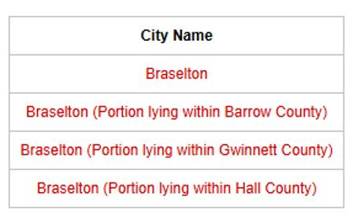
Who Works on an SDS
SDS is a county driven document, and must include cities that are both partially or wholly inside the county
Cities will participate in multiple SDS negotiations if they are in multiple counties

Slide 22
Updates to SDS Statute
Revised statute was effective January 1, 2026
Charged DCA with creating SDS rules for the first time, which also became effective January 1, 2026
New mapping standards for SDS maps were implemented (including submission of data used to create map)
ALL Regional Commissions and Local Governments were notified via email of this change, and deadline changes

Slide 23
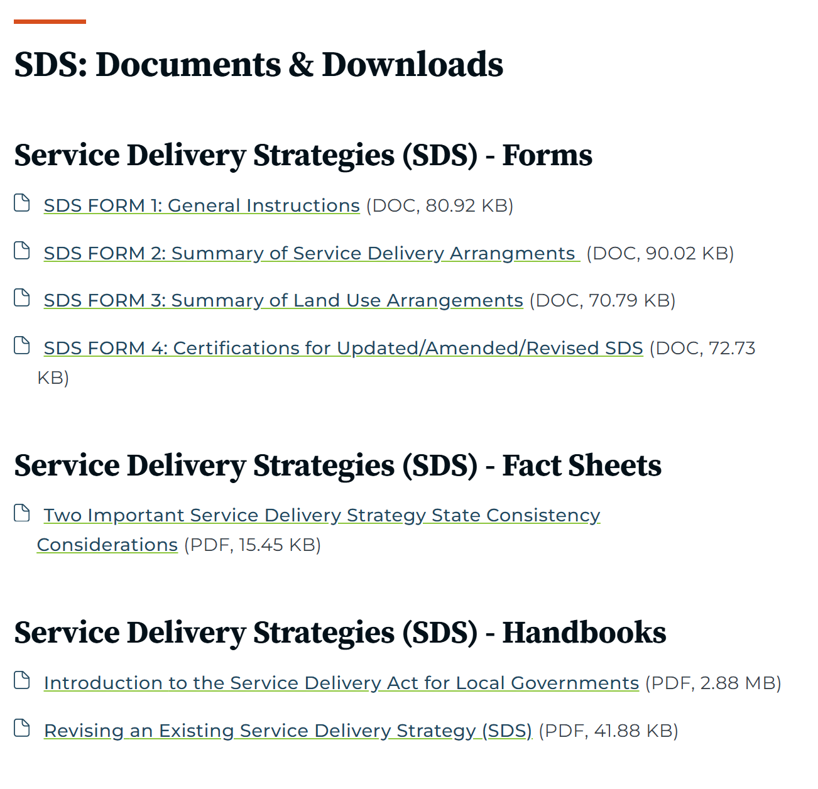
Where to Submit SDS
Forms were updated to better align with statute revisions and rules
Submission is no longer via email, instead on Survey123 portal found on Form 1
Can be found on the DCA Website

Slide 24
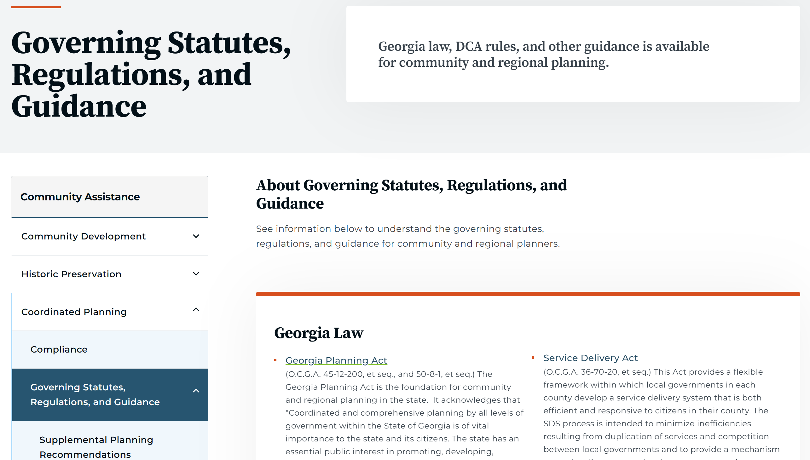
Where to Find New Rules and
Map Standards

Slide 25
Comp Plans and SDS Questions
Please contact the Planning team at the DCA
planning@dca.ga.gov

Slide 26
Mapping Requirements
Creates and collects reports and surveys from Governments on mapping
Service Delivery Strategy
Annexations
CDBG applicants map

Slide 27
Service Delivery Strategy - Mapping
What is it?
Why does mapping matter?
Local Government Agreement providing which services will go to specific areas of the county and how they are funded
Managed by Office of Planning, assisted by the Office of Geoanalytics
Periodic updates to SDS requirements now require cities to include a map
A map identifying service areas is required, and this piece of the project is reviewed by the Office of Geoanalytics

Slide 28
Annexations and De-annexations
What is it?
Why does it matter?
Communities must report any annexation/de-annexation changes (boundary change) to the DCA and US Census Bureau via the Boundary and Annexation program
Office of Geoanalytics verifies the geospatial data and coordinates with the US Census Bureau to update municipal boundaries

Slide 29
CDBG Applicants Map
What is it?
Why does it matter?
An interactive map featuring different demographic breakdowns for each community
CDBG Applicant Concentration Map
Data source: American Community Survey 5 year data (usually released in December of each year)
Maps are required as part of CDBG applications because they show important demographic breakdowns of your community

Slide 30
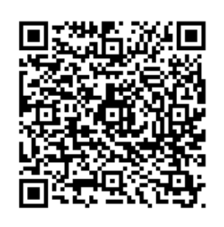
How do I check my compliance?
The DCA Website contains links to all compliance dashboards
SDS Compliance
DOAA Sanctuary Policy Requirements
Local Planning Compliance
DOAA E-Verify Compliance
Local Government Compliance (RLGF/GOMI)
Local Authority Compliance

Slide 31
Thanks!
Any questions?
Research Team
research@dca.ga.gov
dca.georgia.gov

