Slide 1
DCA CDBG Innovative Grant Program
Transformational Change through
Community Development
Notes:
Issued a NOFA for the CDBG Innovative Program on April 17, 2025

Slide 2
Purpose & Vision
Encourage projects that produce transformational change.
Transformational = long-term, systemic, and sustainable.
Provide financial 'kick-start' resources to communities.
Vision + Strategy + Community Commitment = Success.
Notes:
Transformational change section
Focus on transformational, not incremental, impact.
Sustainable section
Demonstrate sustainability and partnerships.
Kick-start section
Acts as leverage/catalyst funding
Requires sustainable funding beyond the grant.

Slide 3
Eligibility and Requirements
Eligible Applicants
Non-entitlement local governments
Eligible Activities
Any activities outlined in HCDA of 1974; benefitting 51% of LMI individuals
Project Threshold Requirements
Meet 4-yr implementation timeline, demonstrate need, feasibility, capacity / experience
Notes:
Part of Georgia’s CDBG program under DCA.
• Competitive grant awarded via NOFA.
• Complements other CDBG set-aside programs.
In addition to being an eligible applicant and the project being an eligible activity, projects must meet the following:
Timeline: Application must demonstrate project/program completion with all funds expended by within 4-years of award.
Capacity and Experience: The application must demonstrate that the applicant and any partners have the experience and capacity to provide, manage and complete the proposed project/program.
Demonstrated Need: The application must demonstrate the proposed project/program will meet an unmet need in the community. For example, a request for funding to consolidate water and/or wastewater systems must provide evidence to demonstrate previous inability to sustain a single system through rate studies or the water dashboard system offered through GEFA.
Feasibility: Project/program demonstrates ability to complete construction or development as well as long term viability.

Slide 4
Funding Amount & Caps
Total funds available: $10,000,000
Maximum award per application: $5,000,000
DCA may fully fund, partially fund, or decline applications

Slide 5
Match Requirement
Minimum 15% cash match required
$5,000,000 grant request = $750,000 match
Notes:
Exception: owner-occupied rehabilitation projects may be exempt.

Slide 6
Application Process
Pre-Application
Invitation to Submit Full Application
Full Application*
Review
Award
*Must be compliant with state reporting requirements before a full application will be accepted.
Notes:
Full Application
Can apply with open CDBG AC or set-aside awards

Slide 7
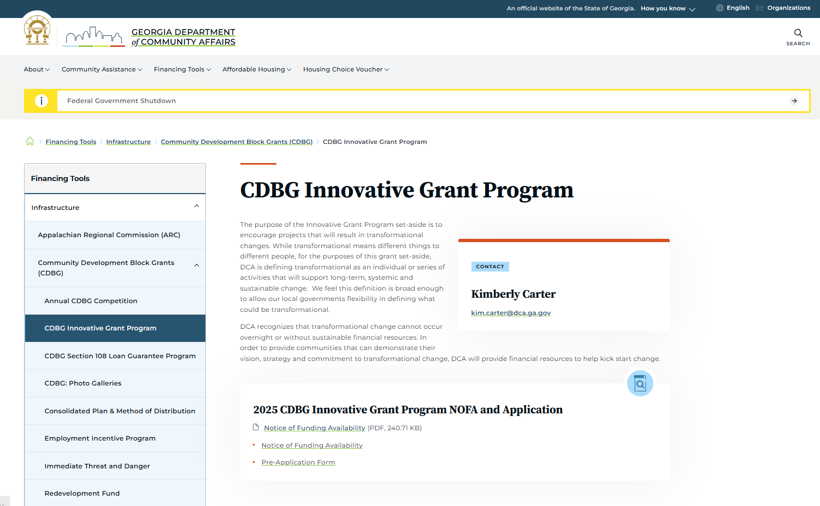

Slide 8
Pre-Application Content
Basic Project Information
Project Title
Project Description
National Objective
Proposed Activities
Project Timeline
Project location
SDS changes required?
Subrecipients/Partners
Innovation
Transformational Impact
Capacity and Experience
Demonstrated Need
Feasibility:
Compliance
Procurement
Budget Summary
  Amount Requested
  Total Project Costs
  Match Proposed
Public Benefit
  # of persons served
  # of LMI persons served
  # of Housing Units (if appl.)
Notes:
The specific contents of the pre-application are not binding. The final application details may be adjusted and different from the pre-application. The pre-application information will be utilized to provide technical assistance to the prospective applicant as well as to assist in preparation for the review process.
Innovation Section
Transformational Impact: Description of how this project will transform the community/region –
Capacity and Experience: The application must demonstrate that the applicant and any partners have the experience and capacity to provide, manage and complete the proposed project/program.
Demonstrated Need: The application must demonstrate the proposed project/program will meet an unmet need in the community
Feasibility: Project/program demonstrates ability to complete construction or development as well as long term viability.

Slide 9
Evaluation Criteria
Transformational potential
Sustainability and feasibility
Alignment with DCA and CDBG priorities
Leverage of resources and partnerships
Measurable outcomes and metrics

Slide 10
Timeline & Key Dates
Pre-app rolling acceptance; response ~2 weeks
Full applications due by deadline in invitation letters
Projects must finish within 4 years
Awards will be made until funds are exhausted
Notes:
Full Application invitations will expire 6 months issuance. Extensions may be requested

Slide 11
Implementation & Compliance
Must adhere to federal CDBG requirements
Procurement and environmental reviews
Monitoring and performance reporting
DCA oversight throughout the project

Slide 12
Paint the full picture in the pre-application
Request meeting with DCA to discuss project
Pre-agreement Cost Approval can be granted
Final Thoughts

Slide 13
If you can dream it,
you can do it!
-- Walt Disney

Slide 14
Thanks!
Glenn Misner
Director, CDBG Field Services & NSP
Community Finance Division
Glenn.misner@dca.ga.gov
Direct: 404/679-3138
dca.georgia.gov

