Slide 1
Consolidated Plan 2018-2022
Public Hearing #1
1/25/2018

Slide 2
INITIAL NEEDS ASSESSMENTS

Slide 3
Share of GA households with only one of the listed housing needs below
 | 0-30% AMI | 30-50% AMI | 50-80% AMI | 80-100% AMI | 100%+ AMI
Substandard housing – lacking complete plumbing or kitchen facilities | 1.40% | 0.98% | 0.63% | 0.53% | 0.20%
Severely overcrowded (with > 1.51 people/room) | 0.97% | 0.93% | 0.51% | 0.39% | 0.13%
Housing cost burden > 30% | 4.7% | 20.86% | 20.32% | 7.86% | 0.79%
Housing cost burden > 50% | 19.37% | 17.00% | 9.45% | 4.06% | 1.00%
Source: 2010-2014 CHAS
Notes:
The four housing problems are: 1) lacking complete kitchen facilities; 2) lacks complete plumbing facilities; 3) more than one person per room; 4) cost burden greater than 30%.

Slide 4
Share of GA households with one or more previously identified housing problems
 | Share of GA Renters |  |  |  |  | Share of GA Homeowners
Having 1 or more housing problems | 49.35% | 45.06% | 26.48% | 10.28% | 1.53% | 24.84% | 29.28% | 27.04% | 22.19% | 8.43%
Having no housing problems | 7.35% | 9.15% | 18.56% | 27.33% | 18.55% | 3.47% | 16.51% | 27.92% | 40.19% | 71.48%
Source: 2010-2014 CHAS

Slide 5
Home values and costs are growing…
 | 2006 | 2010 | 2016 | % change from 2006-2016 | % change from 2010-2016
Median Home Value | $156,800 | $160,100 | $166,800 | +6.37% | +4.18%
Median Contract Rent | $586 | $622 | $754 | +28% | +21.22%
Source: ACS 2006, 2010, 2016

Slide 6
Homeless Needs Assessment
4,192 exited homelessness in 2014 in the Balance of State CoC, w/ only 17% returning to homelessness within 2 years of exit
The average number of days persons experience homelessness is 146 days
Median length of homelessness is 25 days.
Jan. 23, 2017 homeless count:
169 unsheltered families with children
Of 1,843 persons residing in shelter/transitional housing, 63% were Black/African-American, 9% Hispanic
Of 1,873 persons residing in place not meant for habitation, 44% were Black/African-American, 4% Hispanic

Slide 7
Non-Homeless Special Needs Assessment
In 2015,
54,754 persons living with HIV/AIDS
2,741 new HIV diagnoses
HIV Housing Need
371: Estimated number of households that have unmet housing subsidy assistance need
187 in need of tenant-based rental assistance
184 in need of facility-based housing (permanent, short-term, or transitional)
Georgia Department of Public Health, HIV Surveillance Fact Sheet, Georgia, 2015
HOPWA CAPER and HOPWA Beneficiary Verification Worksheet

Slide 8
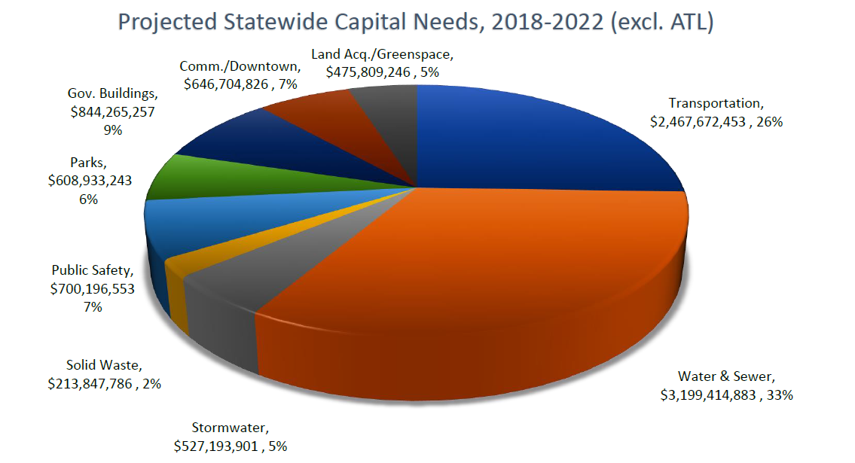
Non-Housing Community Development Needs
Source: Georgia Municipal Association, Capital Needs of Georgia’s Cities, 2018-2022; survey of GMA’s 521 member cities

Slide 9
STAKEHOLDER & RESIDENT FEEDBACK

Slide 10
Outreach Methods
21 local community discussions
2 Regional Con Plan Days
Valdosta (Oct. 18, 7 attendees)
Dublin (Oct. 19, 12 attendees)
2 Roundtables
ESG/HOPWA Roundtable at DCA (Nov. 7, 8 attendees)
CDBG Webinar (Nov. 28, 7 attendees; viewed 45 times online)
Surveys
Online Resident Survey (128 respondents)
Online Stakeholder Survey (412 respondents, including 18 CHDOs)
One-page homeless survey (pending, still in the field)

Slide 11
Survey Respondents
Resident Survey (128 respondents)
81.89% lived in single-family homes
80.47% owned their home
57.45% worked full time, 29.79% were retired
32.98% reported they or a member of their household had a disability
Stakeholder Survey (412 respondents, including 18 CHDOs)
Majority (81.6%) operated regionally
Nonprofits represented almost 45% of respondents
City/county staff and elected officials represented over 30% of respondents

Slide 12
Housing, homelessness, and special needs

Slide 13
What are the greatest unmet housing needs in your area? Please select all that apply.
Housing Need | Response
Emergency shelter for homeless/homeless shelter | 57.23%
Housing for low-income households (please specify income levels below) | 54.28%
Housing for families | 39.23%
Permanent housing solutions for chronic homelessness | 37.76%
Housing for seniors | 35.99%
Housing for adults with criminal (felony) histories | 32.74%
Housing for persons with serious mental illness | 30.68%
Homeownership opportunities (please specify income levels below) | 27.73%
Housing for other homeless populations (please specify below) | 24.78%
Other (please specify) | 23.89%
Workforce housing | 23.01%
Housing for persons with physical disabilities | 22.71%
Youth shelters | 19.17%
Housing for persons with addictions | 16.52%
Housing rehabilitation (please specify target populations below) | 14.75%
Housing for persons with cognitive disabilities | 13.57%
Housing for persons with HIV/AIDS | 9.73%
Stakeholder Survey
Notes:
Note
“If you ranked housing rehabilitation, for which population is housing rehabilitation most needed?” – renters at 61.13%, homeowners at 38.21%.
If you ranked “other homeless populations,” families at 72.94%, women at 46.20%, veterans at 44.55%, domestic violence survivors at 40.92%, men at 35.51%.

Slide 14
Please choose the three most important housing needs in your region.
Housing Need | Response
Extremely low-income households are at risk of homelessness. | 64.76%
Current renters are cost-burdened due to high rental rates in their community. | 53.01%
Households are “doubling-up” with family/friends into overcrowded living arrangements. | 34.34%
Housing conditions are unsafe, substandard, and/or lacking basic amenities. | 31.93%
Aspiring homeowners are unable to purchase a home in their community due to high housing costs. | 28.92%
There are insufficient housing options suitable for people with disabilities. | 28.01%
The existing housing stock is not energy efficient. | 19.58%
Currently homeowners are cost-burdened and facing potential foreclosure due to high-cost loans. | 10.24%
There is discrimination in the housing market on the basis of race, ethnicity, gender, disability, familial status (being pregnant or having children), or age. | 6.33%
Stakeholder Survey

Slide 15
Stakeholder Survey

Slide 16
Stakeholder Survey

Slide 17
Non-housing community development

Slide 18
Without an increase in overall funding, how would you like to see the spending change for current CDBG programs?
CDBG Annual Competition Grants ($27 million)
Economic Development ($8 million)
49.4%
9.7%
34.4%
52%
12.7%
30.7%
Redevelopment ($1.5 million)
Immediate Threat & Danger ($500,000)
50%
44.5%
41.8%
6.2%
37%
6.9%
Stakeholder Survey

Slide 19
Stakeholder Survey

Slide 20
Stakeholder Survey

Slide 21
If you could add or improve any of the following amenities or services in your community, which would you choose? Please select up to 3.
Community Amenities & Services | Response
Road improvements | 57.45%
Local businesses | 36.17%
Sidewalk improvements | 21.28%
Healthcare services | 21.28%
Affordable homes for purchase | 21.28%
Parks/recreation opportunities | 20.21%
Affordable rental units | 20.21%
Public transit | 19.15%
Programs or services for children and youth | 19.15%
Social services for low income residents | 18.09%
Grocery stores | 18.09%
Mental health services | 12.77%
Programs or services for seniors | 12.77%
Services for alcohol/drug abuse and recovery | 11.70%
Childcare providers | 8.51%
Services for victims/survivors of domestic violence | 8.51%
Other (please specify) | 8.51%
Resident Survey

Slide 22
If you don’t believe that benefits of living in your community are available to all residents, regardless of where they live, what three things would you change to improve the distribution of community benefits?
Community Strategies | Response
Reduce crime in low-income communities | 53.97%
Clean up environmental hazards in low-income communities | 44.44%
Make high-paying jobs closer to low-income neighborhoods | 33.33%
Distribute affordable housing to rent among all neighborhoods in my community | 31.75%
Ensure that healthy food is available in all neighborhoods | 30.16%
Expand transit access | 28.57%
Make sidewalks/parks more accessible to persons with disabilities | 26.98%
Allow children to attend schools outside of their neighborhoods | 26.98%
Distribute affordable housing to buy among all neighborhoods in my community | 20.63%
Ensure that Section 8 is available in all parts of the community | 14.29%
Other (please specify) | 11.11%
Distribute banks throughout my community | 9.52%
Resident Survey

Slide 23
CDBG - Rating and Selection Criteria
Demographic Need
Absolute Number in Poverty – 40 (Max Points)
Percent of Poverty Persons – 40 (Max Points)
Per Capita Income – 40 (Max Points)
Feasibility – 110 (Max Points)
Strategy – 110 (Max Points)
Impact – 110 (Max Points)
Leverage of Additional Resources – 25 (Max Points)
Bonus Points for Revitalization Area activities – 20 (Max Points)
Bonus Points for Readiness to Proceed – 5 (Max Points)
Bonus Points for Return of Revolving Loan funds (NEW) – 5 (Max Points)

Slide 24
What, if any, changes would you recommend regarding the scoring criteria?
Respondents liked points for readiness to proceed
Many comments focused on how to calculate area need
ACS Block Group too wide to reflect target neighborhood
Requested points for serving seniors, homeless, those w/ disabilities
Small communities felt at a disadvantage within the scoring system
Area Revitalization
“Future economic impact” carries more weight in rural areas than RAS
Some report that RAS designations are expensive/difficult to get
Stakeholder Survey

Slide 25
The time in which it takes recipients to expend the funds is not as rapid as would be desired. HUD evaluates the expenditure rate of CDBG funds across the country for agencies like ours. What changes to the CDBG process might you suggest to increase the rate at which funds are expended?
Respondents said DCA’s reduce time to award funds, provide money more quickly after grant approval, provide timely contracts,
One respondent suggested DCA move to an electronic grants management system where grantees could upload support and request draw downs.
Some comments asked DCA to “pre-approve contractors at application time, pre-screen employees for Davis Bacon,”
Some respondents suggested that the calendar used causes issues
“Our fiscal year is July…we’re not getting a full year to use the funds”
Stakeholder Survey

Slide 26
At the end of the day, DCA seeks to impact the day-to-day lives of Georgians. Are there ways that you believe Georgia’s CDBG funds could be more impactful to these residents we seek to serve?
Respondents requested more funding for housing, especially for the homeless and those with disabilities
Respondents urged projects to target needs of low-income residents
Support for research/evaluation of project impact
Stakeholder Survey

Slide 27
Fair housing

Slide 28
Stakeholder Survey

Slide 29
Stakeholder Survey

Slide 30
PROPOSED STRATEGIES & ACTIONS

Slide 31
For the next 5 years

Slide 32
Affordable Housing
Objective | Program | Funding | Goal Outcome Indicator | Predicted Outcome
Construction and rehabilitation of rental units | HOME | 79,600,000 | Rental units constructed | HOME: 1990; NHTF: 75
 | NHTF | $22,139,750 | Rental units rehabilitated
Homeownership assistance | HOME | 6,250,000 | Homeowner Housing Added | HOME: 63
 | CDBG | CDBG: 9,500,000; HOME 18,750,000 | Homeowner Housing Rehabilitated | HOME: 375; CDBG: 125
Tenant-Based Rental Assistance | HOME | 0 | Tenant-based rental assistance/rapid rehousing | HOME: 0

Slide 33
Homelessness
Objective | Program | Funding | Goal Outcome Indicator | Predicted Outcome
Emergency shelter & transitional housing | ESG | 8,945,500 | Homeless Person Overnight Shelter | 35,200
Rapid re-housing assistance | ESG | 8,857,000 | Tenant-based rental assistance/rapid rehousing | 12,500
Homeless outreach assistance | ESG | 2,753,500 | Other | 2,150

Slide 34
Non-Homeless Special Needs
Objective | Program | Funding | Goal Outcome Indicator | Predicted Outcome
Homeless prevention assistance | ESG | 2,810,250 | Homelessness Prevention | 4,200
HOPWA Tenant-Based Rental Assistance | HOPWA | 4,687,000 | Tenant-based rental assistance/rapid rehousing | 1,000
HOPWA Housing Assistance | HOPWA | 9,217,165 | HIV/AIDS Housing Operations | 1,000

Slide 35
Non-housing Community Development
Objective | Program | Funding | Goal Outcome Indicator | Predicted Outcome
Buildings | CDBG | 20,000,000 | Public facility or infrastructure activities other than low/moderate income housing benefit | 50,000
Infrastructure | CDBG | 109,250,000 | Public facility or infrastructure activities other than low/moderate income housing benefit | 200,000
Economic Incentive Program | CDBG | 40,000,000 | Jobs created/retained | 20,000
Immediate Threat & Danger Program | CDBG | 2,500,000 | Jobs created/retained | 25,000
Redevelopment | CDBG | 7,500,000 | Jobs created/retained | 750

Slide 36
For the next year

Slide 37
Program Allocation
 | Construction Rehab Rental Units (%) | Homeowner Assistance (%) | CHDO Loans (%) | CHDO Operating (%) | TBRA (%) | Buildings (%) | Infrastructure (%) | immediate Threat & Danger Program (%) | Economic Development (%) | Redevelopment (%) | Emergency Shelter & Transitional Housing (%) | Rapid Re-Housing Assistance (%) | Homeless Outreach Assistance (%) | Homeless Prevention Assistance (%) | HOPWA TBRA (%) | HOPWA (%)
CDBG | 0 | 5 | 0 | 0 | 0 | 11 | 58 | 1 | 21 | 4 | 0 | 0 | 0 | 0 | 0 | 0
HOME | 80 | 20 | 0 | 0 | 0 | 0 | 0 | 0 | 0 | 0 | 0 | 0 | 0 | 0 | 0 | 0
NHTF | 50 | 50 | 0 | 0 | 0 | 0 | 0 | 0 | 0 | 0 | 0 | 0 | 0 | 0 | 0 | 0
HOPWA | 0 | 0 | 0 | 0 | 0 | 0 | 0 | 0 | 0 | 0 | 0 | 0 | 0 | 0 | 34 | 66
ESG | 0 | 0 | 0 | 0 | 0 | 0 | 0 | 0 | 0 | 0 | 38 | 38 | 12 | 12 | 0 | 0

