Slide 2
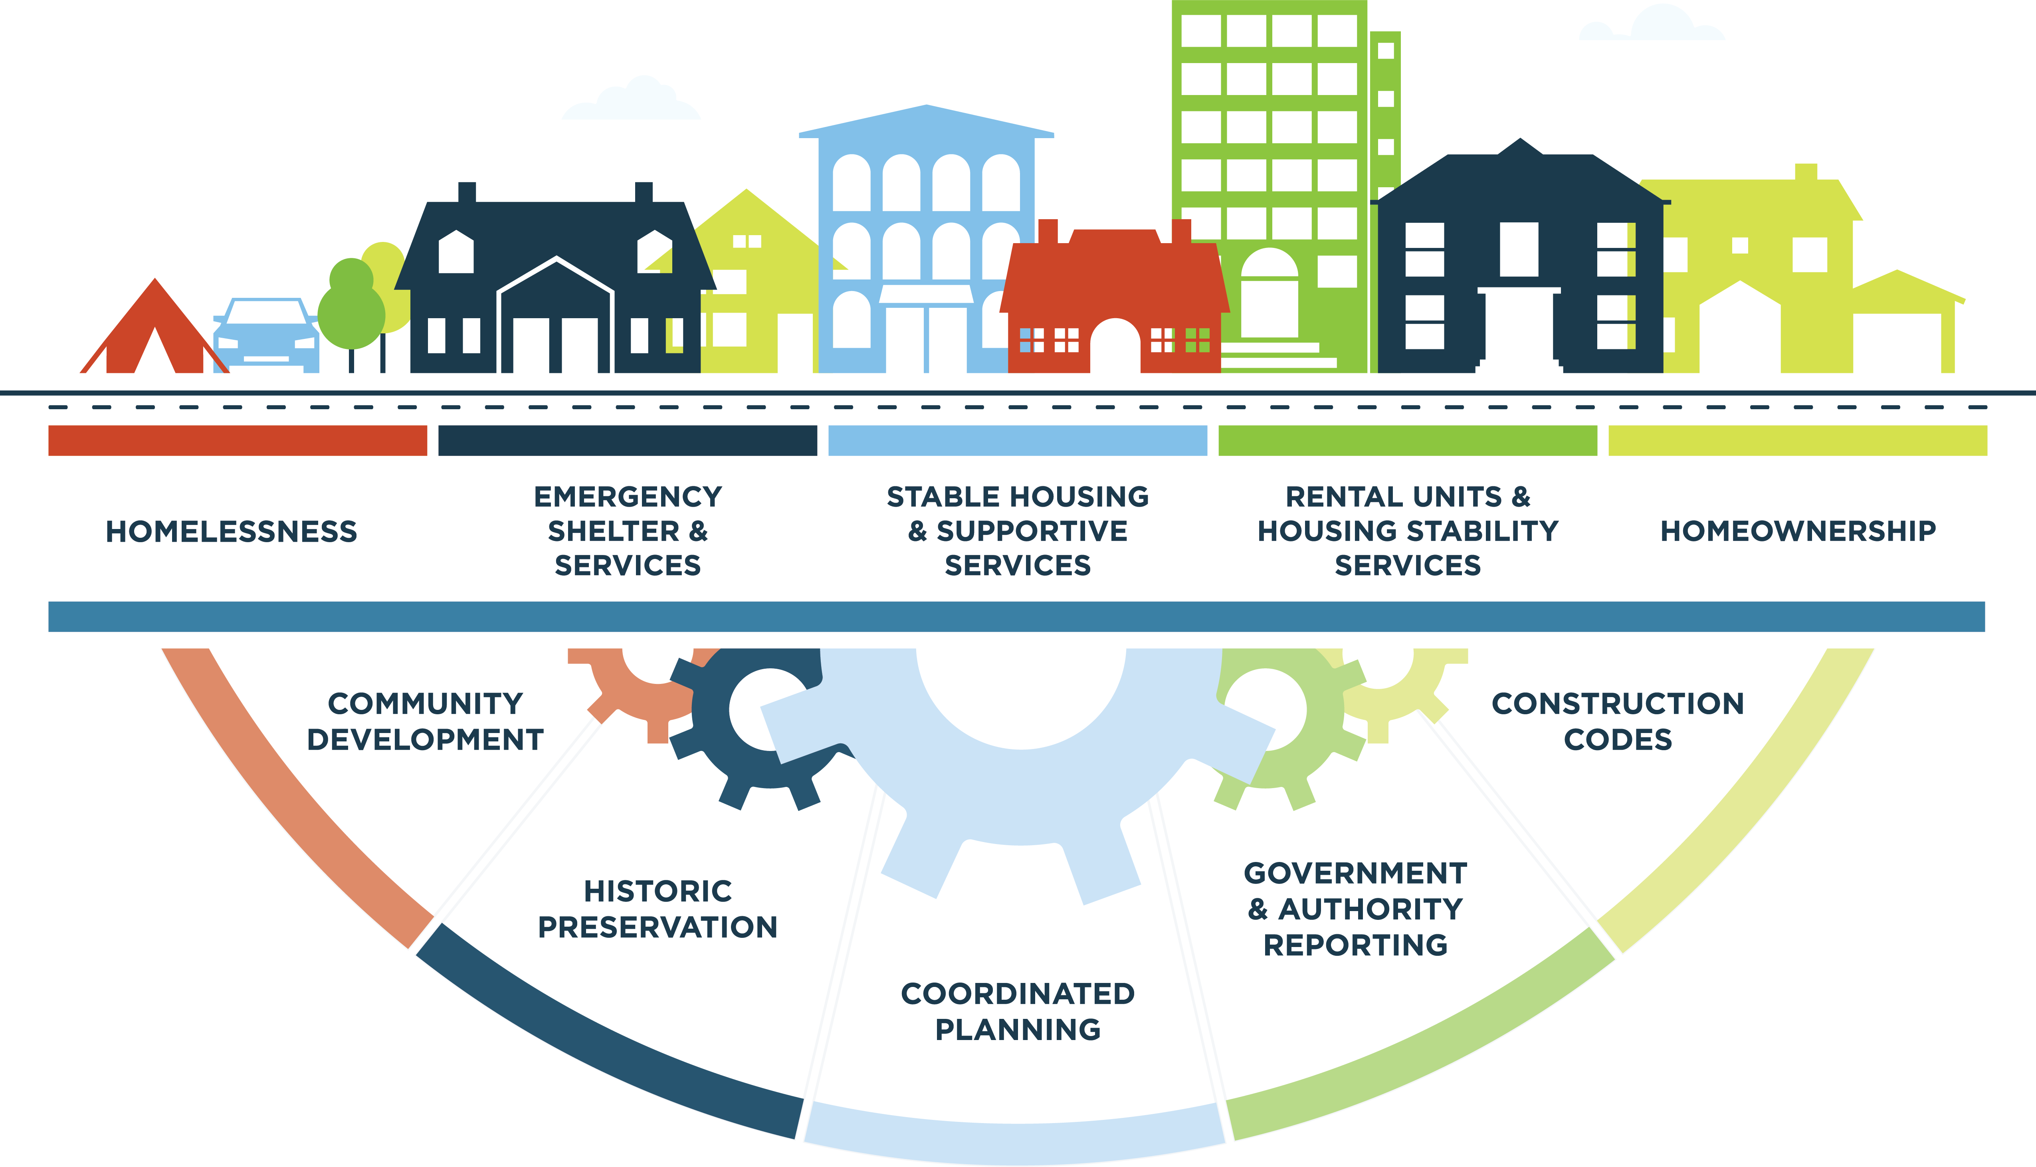
DCA Services

Slide 3




DCA Services
Funding
The disbursal of state and/or federal funds to support infrastructure, housing options, or economic development projects.
Incentives
Ways to encourage private investment in state communities and develop public-private partnerships.
Partnerships
Close relationships with private, for-profit, or non-profit entities to achieve a shared goal.
Technical Assistance
Engaging with experts in different fields, such as finance, planning, research, civic engagement, and governance.

Slide 4
DCA Leadership Team
Christopher Nunn
Commissioner
Christopher.Nunn@dca.ga.gov
Kyle Hood
Chief Operating Officer
Kyle.Hood@dca.ga.gov
William G. Dews
Chief Financial Officer
William.Dews@dca.ga.gov
Christy Barnes
General Counsel
Christy.Barnes@dca.ga.gov
Wesley Brooks
Deputy Commissioner, Homeownership
Wesley.Brooks@dca.ga.gov
Maureen Freehill
Deputy Commissioner,
Housing Assistance and Development
Maureen.Freehill@dca.ga.gov
Kimberly Carter
Deputy Commissioner,
Community Development, Community Finance and Historic Preservation
Kimberly.Carter@dca.ga.gov
Corinne Thornton
Director, Regional Services
Corinne.Thornton@dca.ga.gov
Laura Holland
Director, Strategy and Key Initiatives
Laura.Holland@dca.ga.gov
Ryan K. Evans
Director, External Affairs
Ryan.Evans@dca.ga.gov

Slide 5
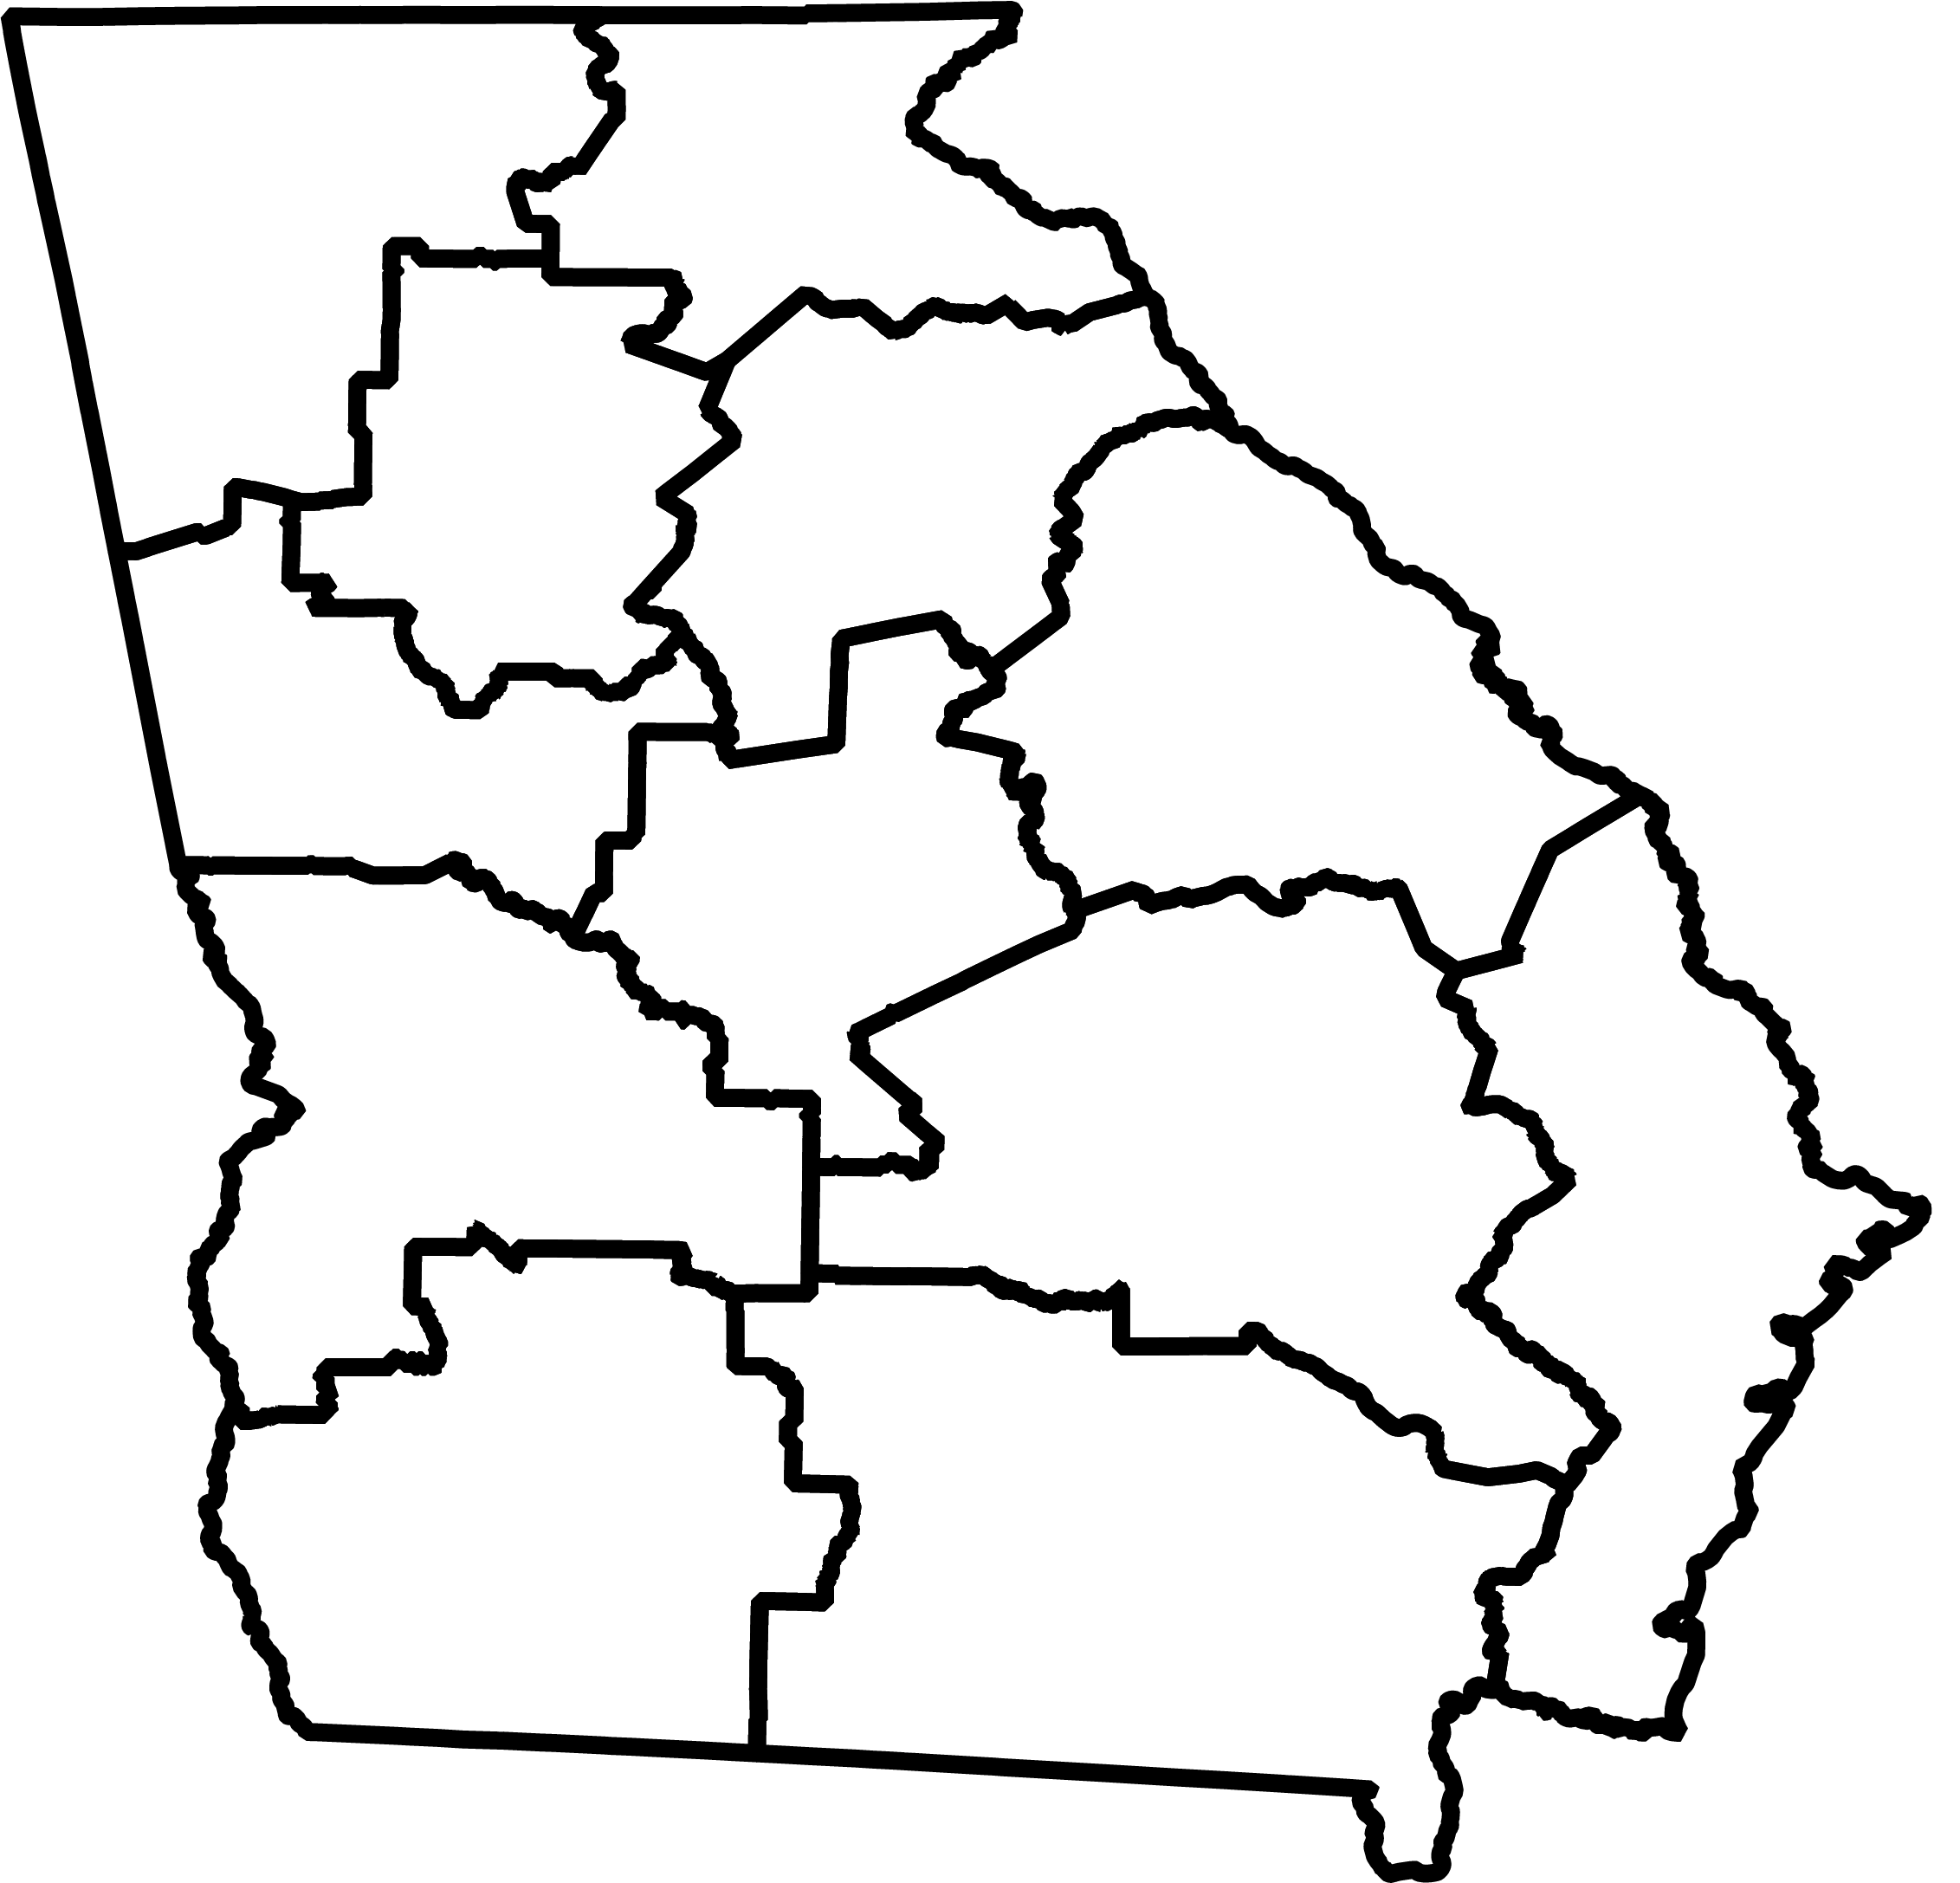
DCA Regional Representatives
The DCA Regional Representatives are a vital entry point to help navigate the agency’s diverse offering of federal and state resources.
Located in each of the state’s 12 service delivery regions
Access, organize, and manage the various types of assistance offered through DCA
Maintain a network of regional and statewide partners
Available to discuss a community’s needs and options
Help a community decide which tools are best to address its particular needs and manage the various types of assistance offered by DCA
Coordinate and facilitate many of the agency’s special initiatives

Slide 6

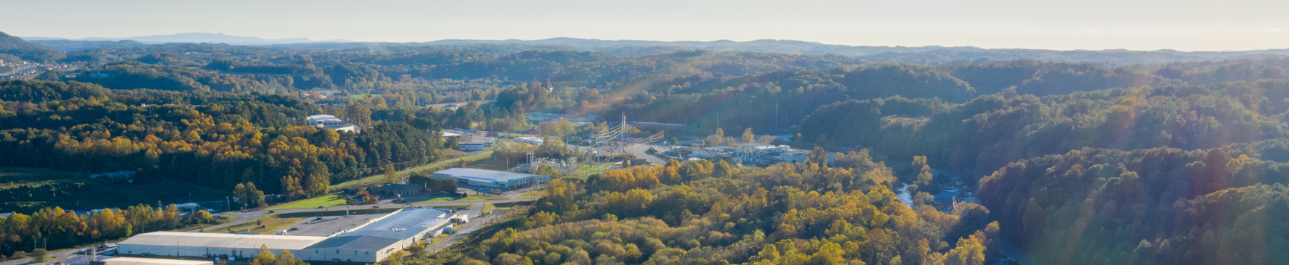
Our Programs
Mission
To help build strong, vibrant communities.
Vision
For Georgians of today and tomorrow to have the opportunity to live and work in thriving communities.
DCA achieves its mission and fulfills its vision by administering over 70 programs in the following categories:
Community Assistance
Financing
Tools
Affordable
Housing
Housing Choice Voucher
Partnerships

Slide 7
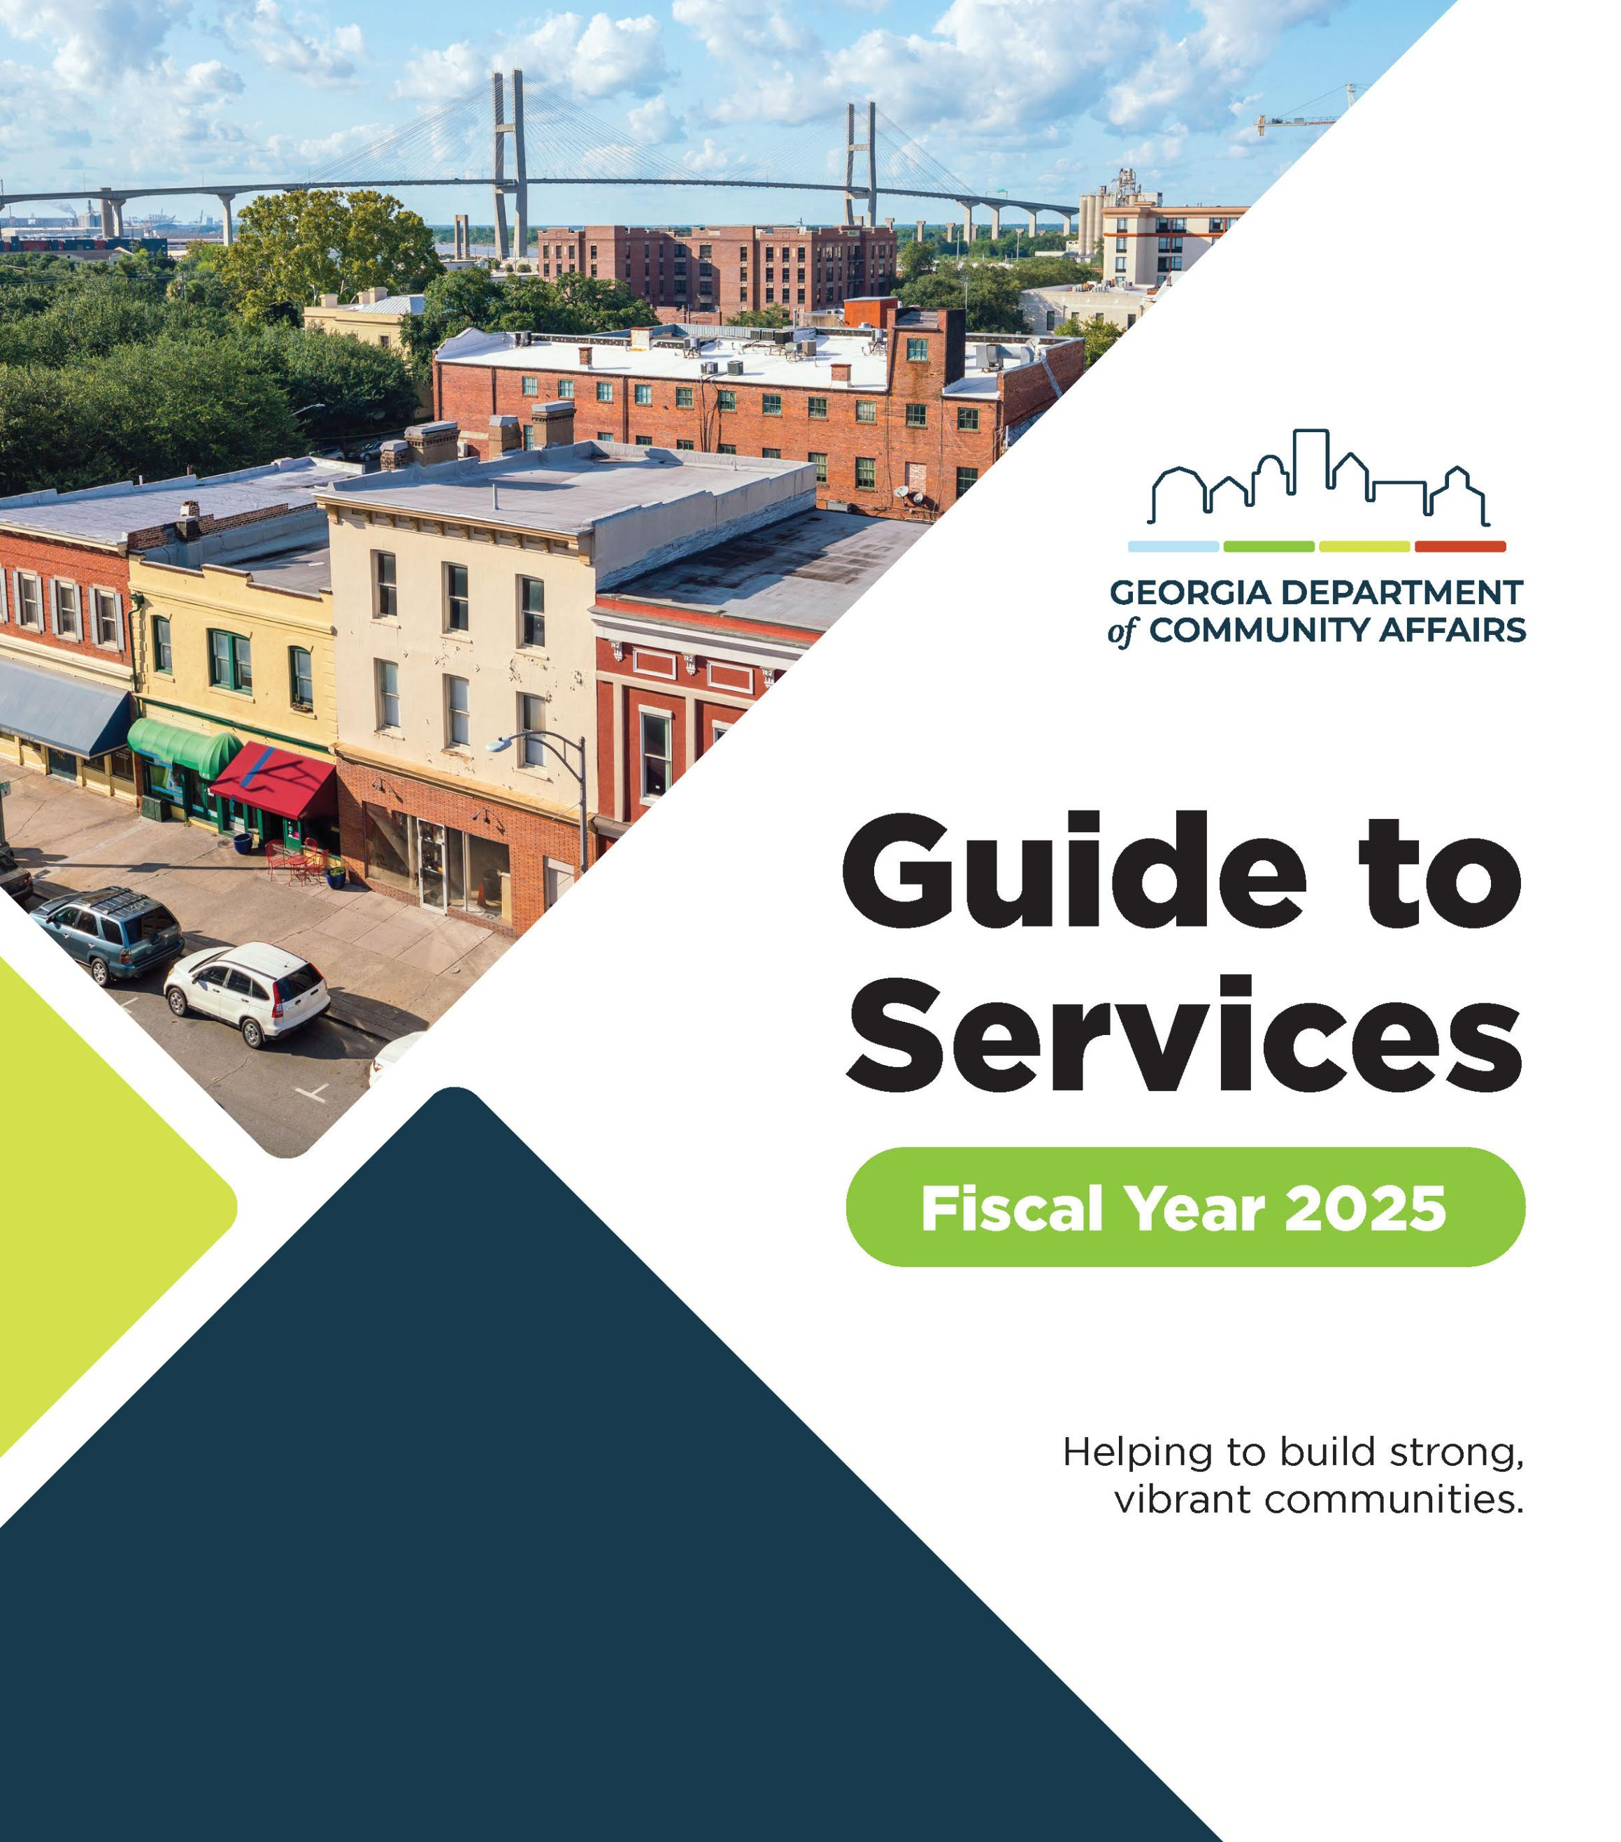
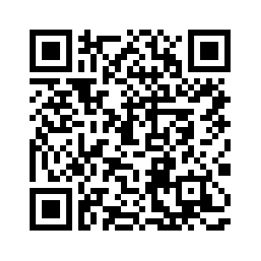
Learn more about DCA in the FY2025 Guide to Services.
Notes:
Update for 2026

Slide 8
Coordinated Planning
^{Community Assistance}
Community Planning Institute
DCA’s Office of Planning, in partnership with the Georgia Planning Association, offers the Community Planning Institute (CPI) to Georgia’s planning commissioners, elected officials, and local government staff.
Provides information about planning for land use, growth, and development.
Annual seminars are held for local planning commissioners, elected officials, staff, and other interested parties.
Courses are one or two days and cover a variety of community development topics such as preparation, effective use, and implementation tools for comprehensive plans.
Scholarships are available through the Denise Abboud Memorial Fund through the Georgia Planning Memorial Foundation.
Local Comprehensive Planning
DCA’s planning team partners with local governments, regional commissions, and private sector consultants across the state to work collaboratively to ensure that Georgia’s communities are equipped with plans that articulate straightforward, achievable visions for their futures and outline the steps necessary to turn these into reality.
DCA offers a variety of useful tools, resources, and educational opportunities to help county and city plans meet local needs while also complying with state requirements.
The program’s goal is for planning documents to provide a solid decision-making framework that assists in meeting the day-to-day challenges of governing while incrementally achieving long-term goals.
Funding | Incentive | Partnership | Technical Assistance

Slide 9

Government and Authority Reporting
^{Community Assistance}
Research and Surveys
DCA has various responsibilities, including providing the state with ample actionable data to make operations more meaningful and efficient for communities.
The Research & Surveys group collects, maintains, and publishes data on Georgia’s local governments and authorities. These types of programs are generally divided into areas of focus concerning the tracking of funds and the reporting of operations.
Tools, such as the Uniform Chart of Accounts, standardize accounting practices consistently used by communities throughout the state.
Others, such as the Contact Database, centralize information for public use.
Funding | Incentive | Partnership | Technical Assistance

Slide 10

Planning for Economic Development
^{Community Assistance}
Comprehensive Planning
  Required of every community and must be updated at least every 5 years
  DCA offers a variety of useful tools, resources, and educational opportunities to help county and city plans meet local needs while also complying with state requirements.
  The program’s goal is for planning documents to provide a solid decision-making framework that assists in meeting the day-to-day challenges of governing while incrementally achieving long-term goals.
Local Government Compliance
Know your status!
  Local Reporting Compliance
  Local Authority Reporting Compliance
  Local Planning Requirements Compliance
Funding | Incentive | Partnership | Technical Assistance

Slide 11
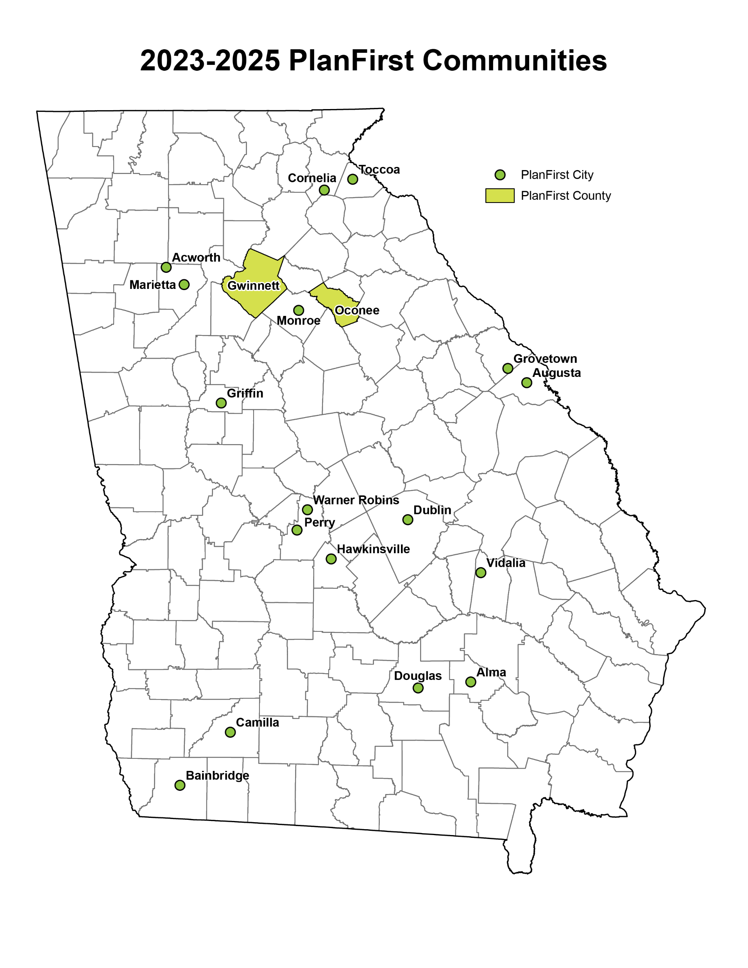
Comprehensive Planning
^{Community Assistance}
PlanFirst
PlanFirst recognizes and rewards communities that clearly demonstrate an established pattern of successfully implementing their Local Comprehensive Plan.
Any size community is encouraged to apply, provided it has a history of public involvement with plan development, active engagement in plan implementation, and proven progress with achieving the community’s stated vision or goals.
Incentives for local governments with this designation include the ability to apply for CDBG funds on an annual basis, bonus points on several DCA programs, and hands-on assistance from DCA staff to help implement community work and program activities.
Funding | Incentive | Partnership | Technical Assistance

Slide 12
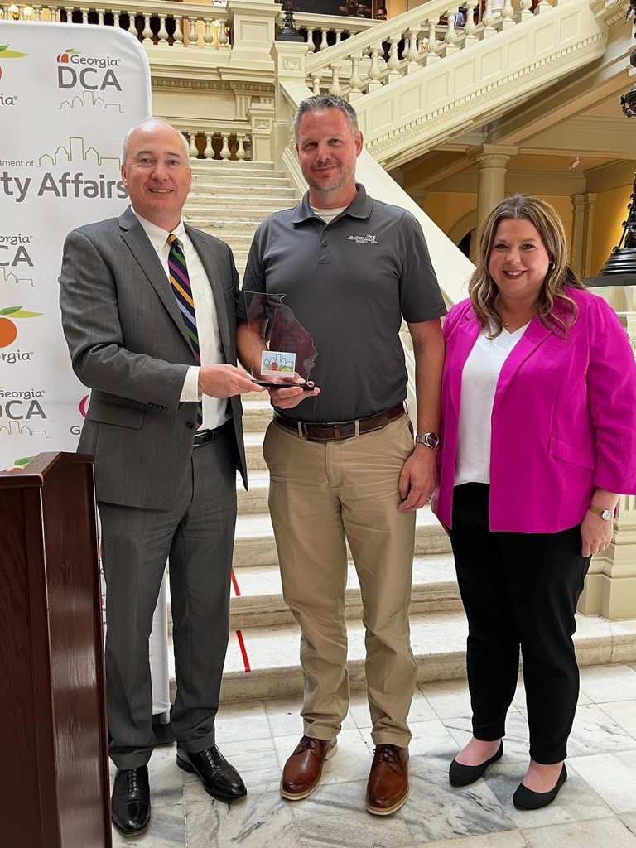

^{Community Assistance}
City of Bainbridge PlanFirst Designation
Funding | Incentive | Partnership | Technical Assistance

Slide 13
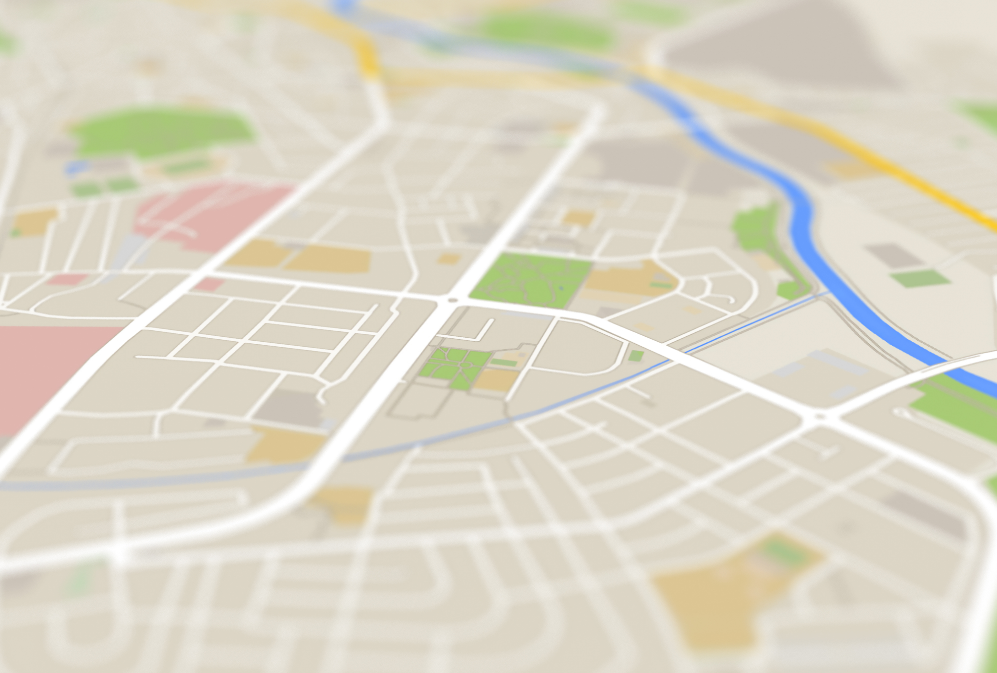
Local Zones & Designations
^{Financing Tools}
Opportunity Zones
  Redevelopment Tool
  $3,500 per job tax credit (2 job minimum threshold)
  Use of Job Tax Credits against 100 percent of Georgia income tax liability and withholding tax
Rural Zones
  Communities with population less than 15,000
  Program scheduled to sunset
  Tax credits
    Job tax credit
    Investment tax credit
    Rehab tax credit
Funding | Incentive | Partnership | Technical Assistance

Slide 14
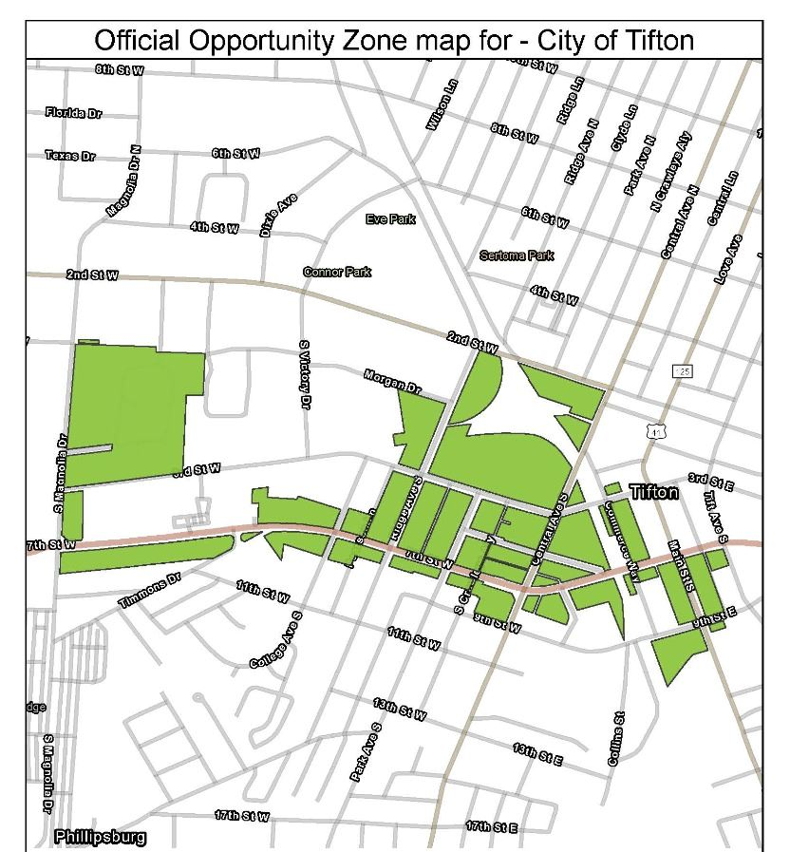
Opportunity Zone-Tifton
^{Financing Tools}
Funding | Incentive | Partnership | Technical Assistance

Slide 15
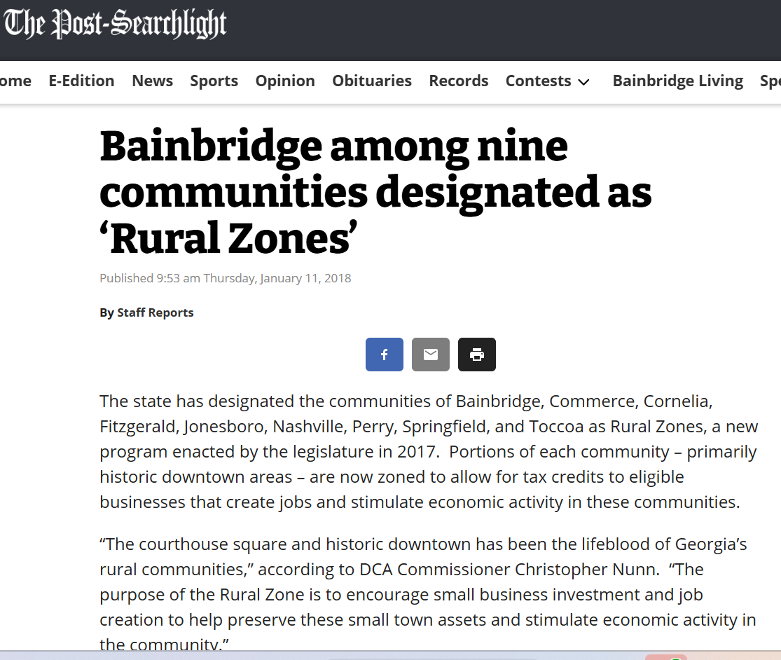
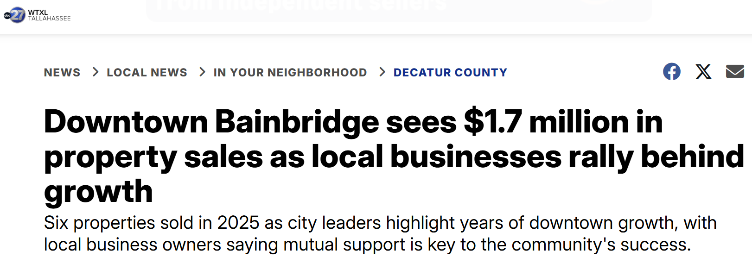
Rural Zone
^{Financing Tools}
Designated from 2018-2022
Incentivized private investment in downtown properties
Catalyzed additional investment beyond the designation period
Funding | Incentive | Partnership | Technical Assistance

Slide 16
Infrastructure
^{Financing Tools}
Community Development Block Grants (CDBG)
CDBG Annual Competition
  Federal funding assistance awarded to qualifying rural cities and counties to support infrastructure, neighborhood revitalization, and economic development projects. Eligible applicants selected for funding have the greatest need, as evidenced by poverty and per capita income, and whose applications most adequately address the needs of low- and moderate-income persons and have the greatest impact.
Employment Incentive Program
  This financing program may be used in conjunction with traditional private financing for economic development projects resulting in job creation or maintenance of jobs to low-to-moderate income persons.
Funding | Incentive | Partnership | Technical Assistance

Slide 17
Employment Incentive Program (EIP)
^{Financing Tools}
$1,000,000 maximum grant/loan amount
Non-entitlement local governments can apply for these funds at anytime during the year
  Local governments as applicants, not authorities
Projects must create/retain jobs primarily for low to moderate income persons
Must have dollar for dollar private match for every EIP dollar
Eligible activities include
  Public infrastructure grant
  Loan to for-profit entities (establishes RLF)
Funding | Incentive | Partnership | Technical Assistance

Slide 18
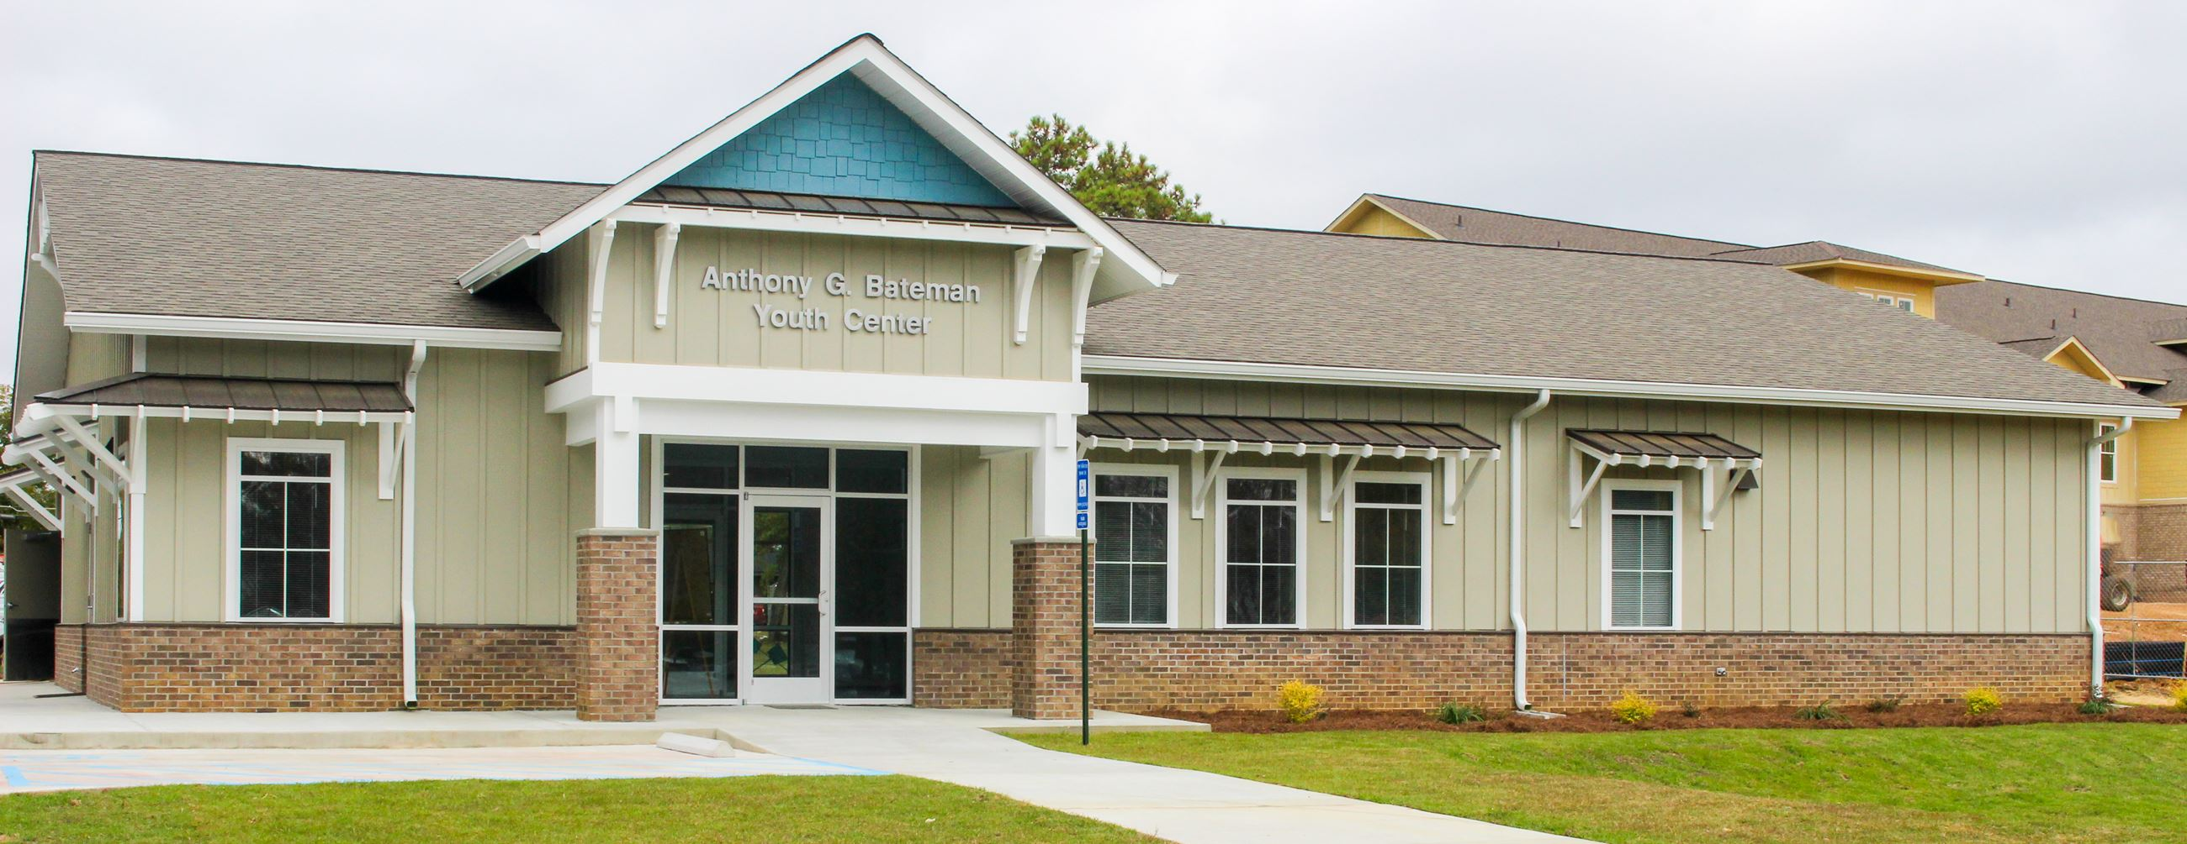
CDBG - Tifton
^{Financing Tools}
Funding | Incentive | Partnership | Technical Assistance

Slide 19
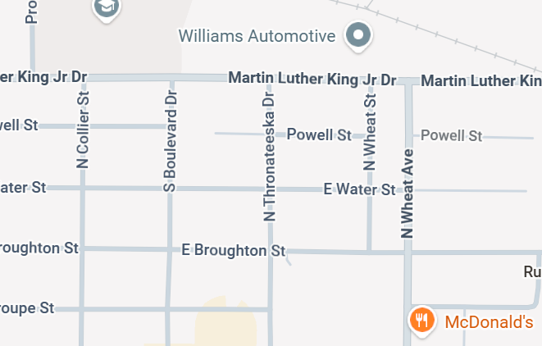
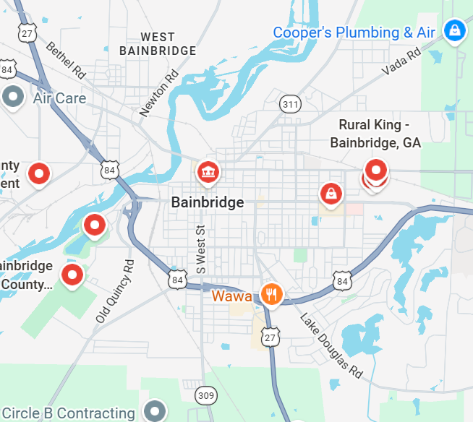
CDBG Annual Competition - Bainbridge
^{Financing Tools}
2021 - $750,000 in CDBG funds for street and drainage improvements.
2017 - $277,280 in CDBG funds for local stormwater and drainage improvements.
Funding | Incentive | Partnership | Technical Assistance

Slide 20
Employment Incentive Program (EIP)
^{Financing Tools}
Funding | Incentive | Partnership | Technical Assistance

Slide 21
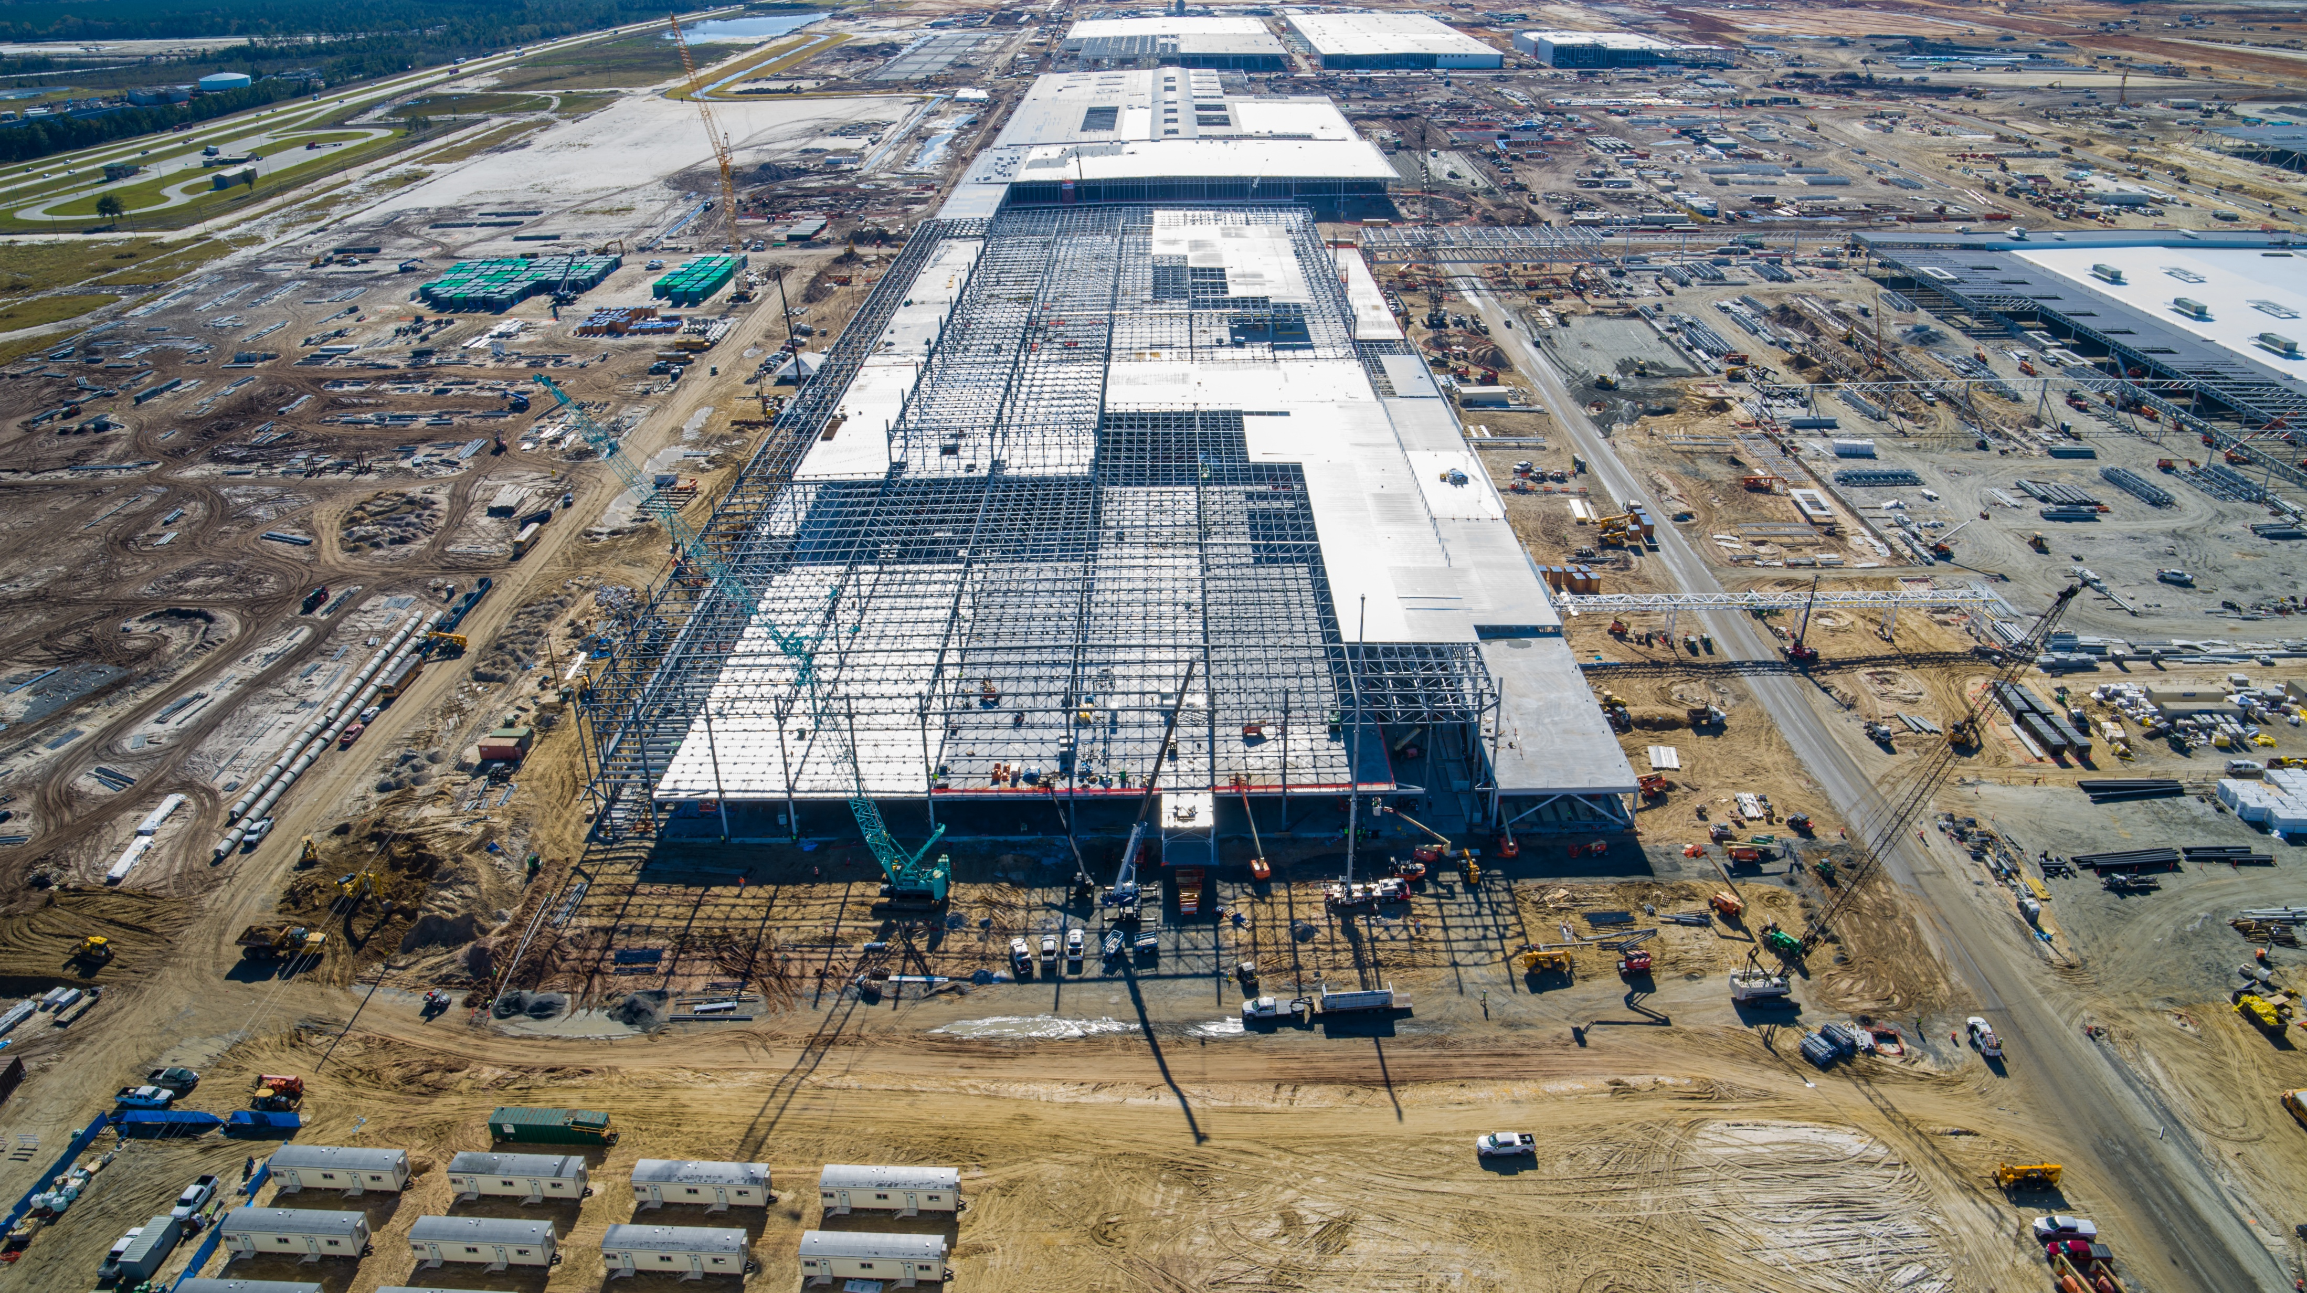
OneGeorgia Authority
^{Community Assistance}
OneGeorgia provides grants and loans typically for land acquisition and infrastructure development, machinery purchases, business relocation assistance, and other economic development capacity-building and job-creation projects.
Equity Fund
Workforce Housing Initiative
EDGE Fund
Site Development Initiative
Funding | Incentive | Partnership | Technical Assistance

Slide 22
OneGeorgia Authority
^{Community Assistance}
Equity Fund
  Assists rural communities in building the necessary infrastructure for economic development, including improvements to sewer and water lines, roads, and industrial parks. This can come in the form of grants or loans depending on the project type. Can assist with up to $500,000
Workforce Housing Initiative
  Provides flexible funding through the Equity Fund for eligible activities. Can assist with up to $1M in construction loan gap financing and/or $2.5M for public infrastructure activities that will support qualifying new workforce housing.
EDGE Fund
  Assists eligible applicants whose sites are being considered for business relocation or expansion while competing with another state for a project’s location. Local development authorities are required to apply for EDGE funding, and the application must be accompanied by a letter of recommendation from a state agency, typically the Georgia Department of Economic Development.
Site Development Initiative
  Assists local communities identify, submit, and develop sites critical to economic development. When speed to market is key, the program continuously identifies, assesses, and certifies development-ready sites across Georgia, making sure communities remain competitive. Can assist with Due Diligence support up to $250,000 or Site Improvement Funding up to $2M.
Funding | Incentive | Partnership | Technical Assistance

Slide 23
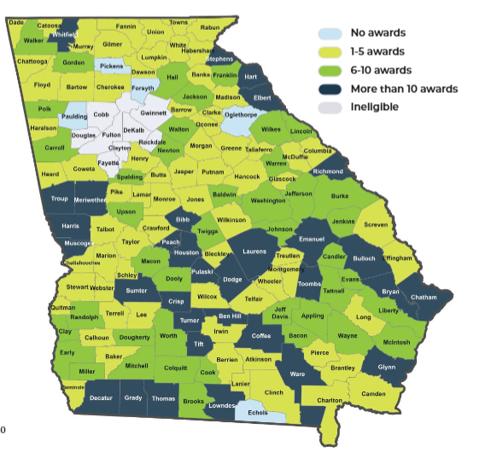
OneGeorgia Authority: Celebrating 25 Years
^{Community Assistance}
Funding | Incentive | Partnership | Technical Assistance

Slide 24
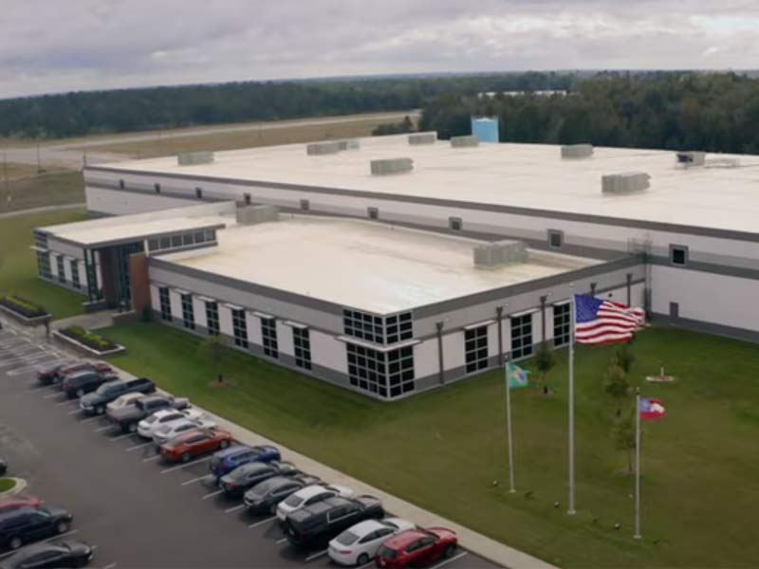
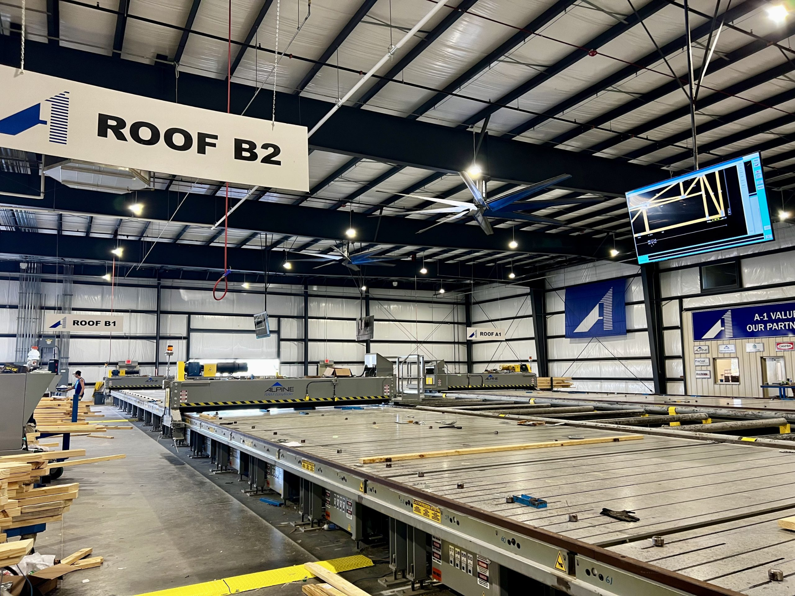
OneGeorgia Authority Examples - Bainbridge
^{Community Assistance}
Funding | Incentive | Partnership | Technical Assistance
Notes:
EDGE Award for Taurus – firearms manufacturing
EDGE Award for A-1 Roof Trusses ($17 Million Investment, 130 Jobs in Decatur County) - pre-engineered wood roof trusses

Slide 25
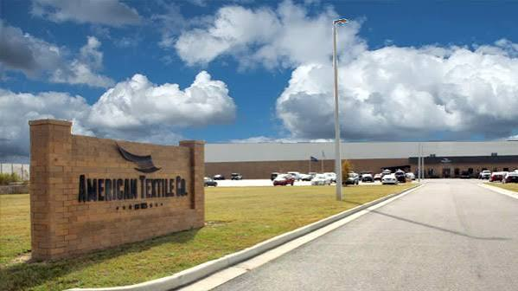
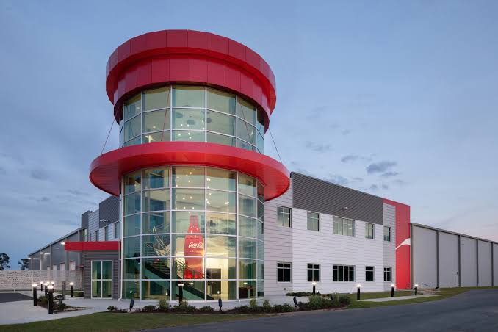
OneGeorgia Authority Examples-Tifton
^{Community Assistance}
Funding | Incentive | Partnership | Technical Assistance

Slide 26
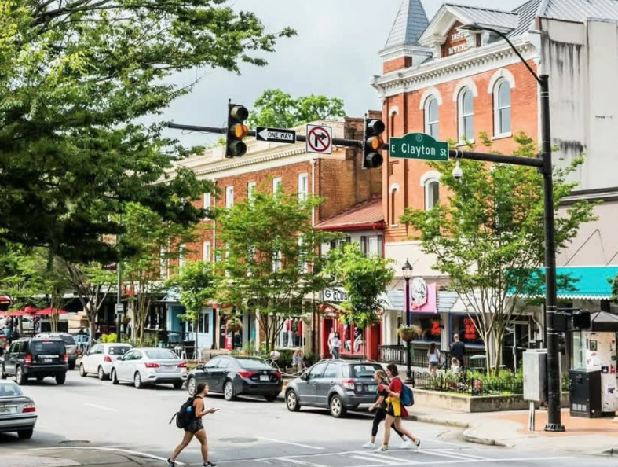
Downtown Development Revolving Loan Fund
^{Financing Tools}
Assists cities, counties, and development authorities in areas with less than 100,000 with efforts to revitalize and enhance downtown areas.
Provides below market rate gap financing to fund capital projects in core historic downtown areas and adjacent historic neighborhoods where the funds will spur commercial redevelopment.
Terms:
  $250,000 maximum
  3% interest rate or 2% if Main Street in good standing
  Repayment period: 15 years
Equity injection and commercial financing are typically required
  50-40-10 structure
  No application fees or loan origination fees
  Must demonstrate financing gap
Funding | Incentive | Partnership | Technical Assistance

Slide 27
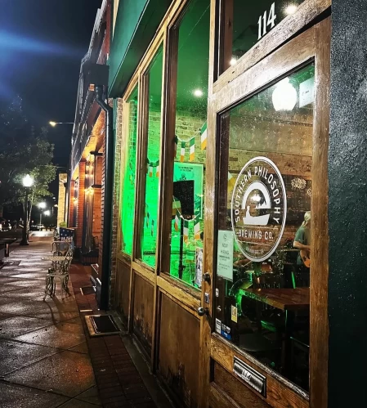
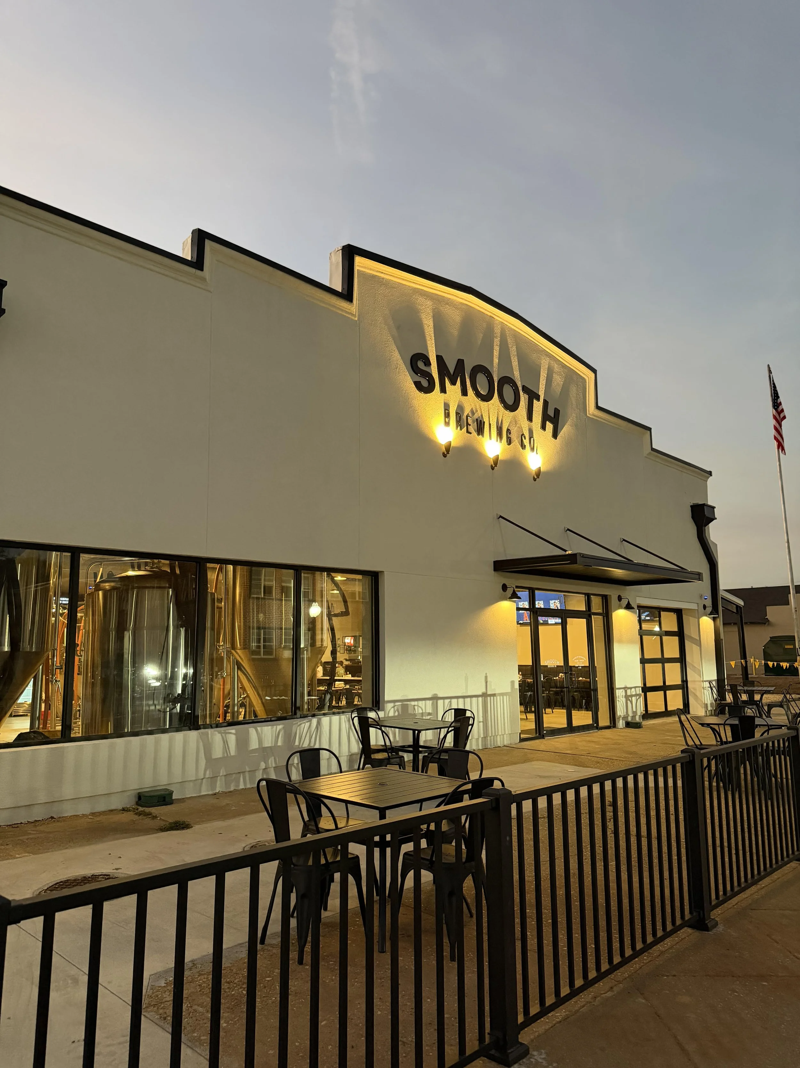
DD RLF: Bainbridge
^{Financing Tools}
VisitBainbridgeGA.com
SmoothBrewingCo.com
Funding | Incentive | Partnership | Technical Assistance

Slide 28
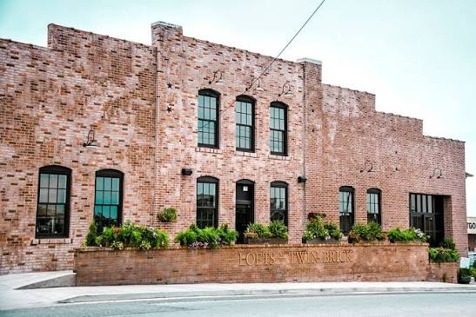
DD RLF: Tifton
^{Financing Tools}
Funding | Incentive | Partnership | Technical Assistance

Slide 29
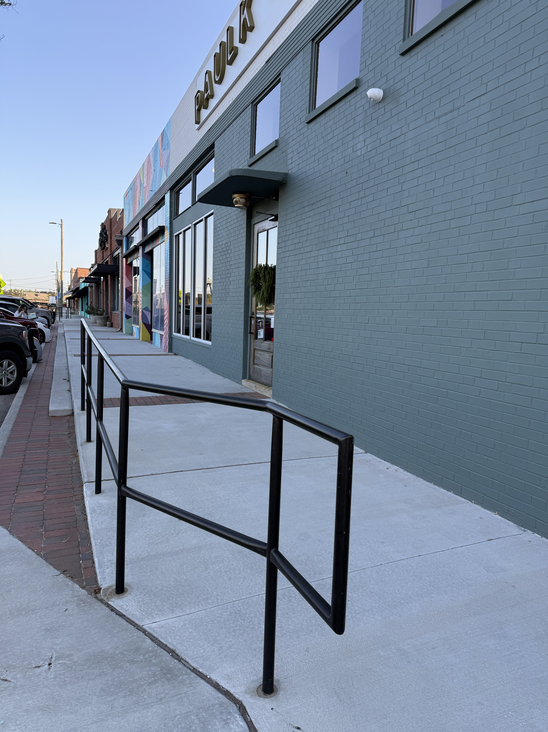
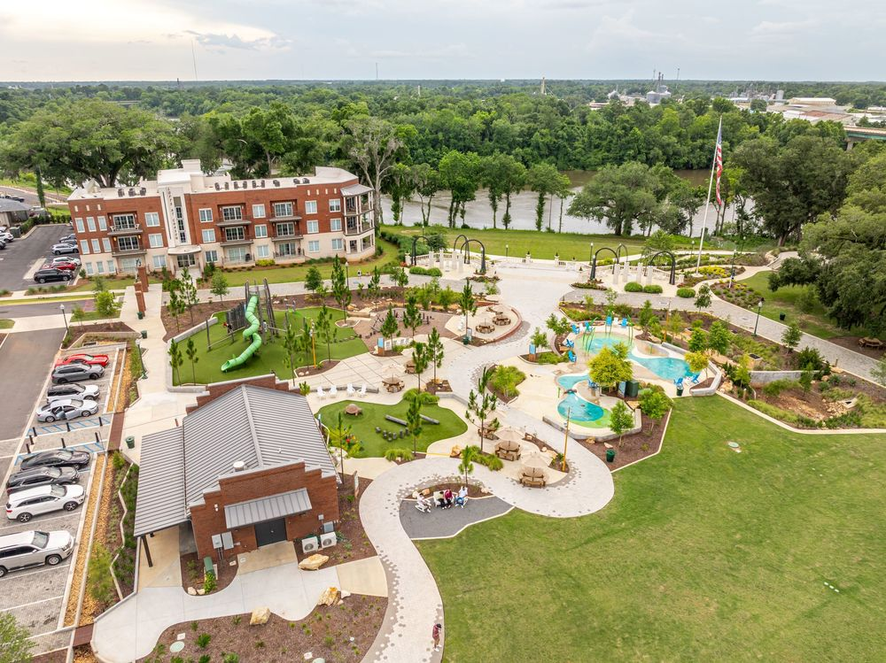
Rural Downtown Redevelopment Grant
^{Financing Tools}
Awards for this one-time funding were made in June 2022.
Helped implement transformative downtown projects
Commerce Way, Tifton
Chason Park, Bainbridge
Funding | Incentive | Partnership | Technical Assistance

Slide 30
Community Development Tools
^{Community Assistance}
Leadership Development Tools
Georgia Academy for Economic Development
Elected Official Training
Ongoing Programmatic Training
Downtown Development
Georgia Main Street Program
Historic Preservation
  Section 106 compliance
  Historic resources research and documentation
  Tax incentives and grants
  Community planning and outreach
Funding | Incentive | Partnership | Technical Assistance

Slide 31
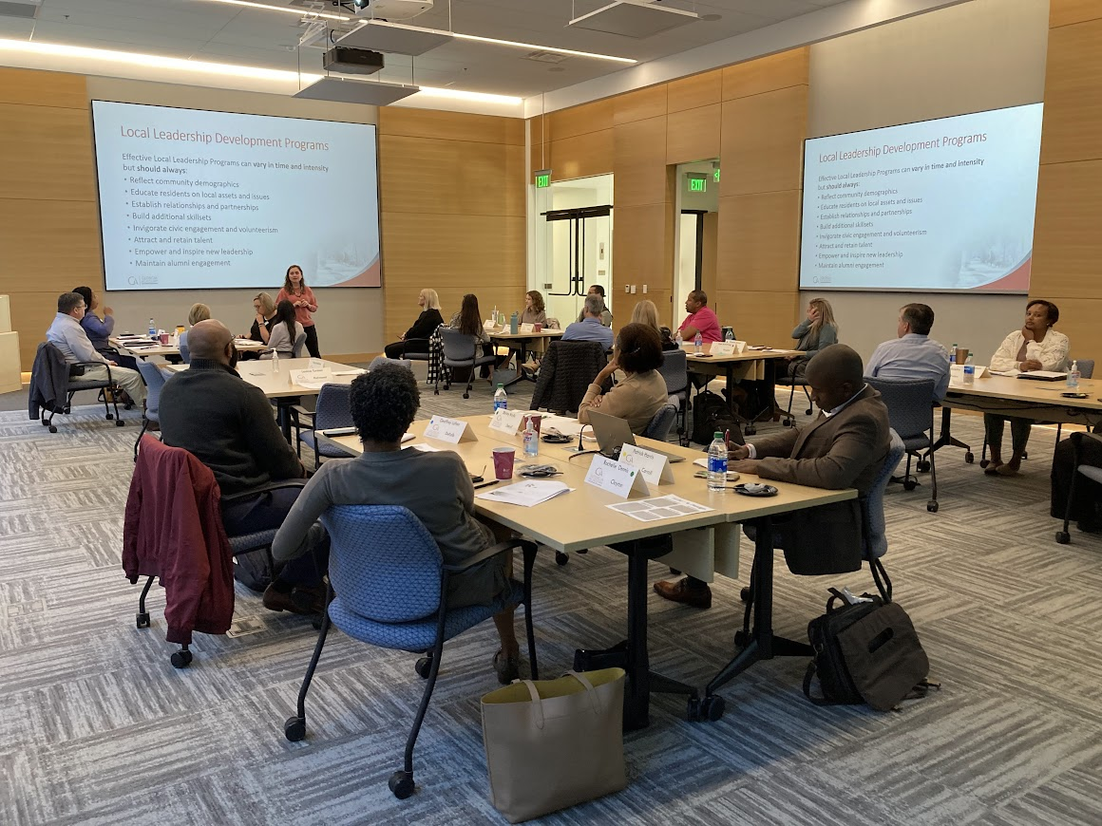
Georgia Academy for Economic Development
^{Partnerships}
Brings together elected officials, business and community leaders, and educators to understand the impact of leadership, community investment, and economic development within Georgia.
Since 1993, the Academy has been a strong partnership of state agencies, utility providers, educational institutions, and economic development professionals to carry out the program around the state.
The curriculum covers the essentials of economic development and dives into topics such as housing, collaboration, and economic development incentives.
More information about the Georgia Academy for Economic Development can be found at georgiaacademy.org.
Funding | Incentive | Partnership | Technical Assistance

Slide 32

Georgia Main Street
^{Partnerships}
The Georgia Main Street Program began in 1980 as one of the original pilot state coordinating programs of the National Main Street Initiative launched by the National Trust for Historic Preservation. The program launched with five local communities and has grown to serve 100+ communities statewide.
Communities can participate at the Georgia's Exceptional Main Streets (GEMS), Classic Main Street, or Downtown Affiliate level.
More information about the Georgia Main Street Program can be found at georgiamainstreet.org.
Funding | Incentive | Partnership | Technical Assistance

Slide 33
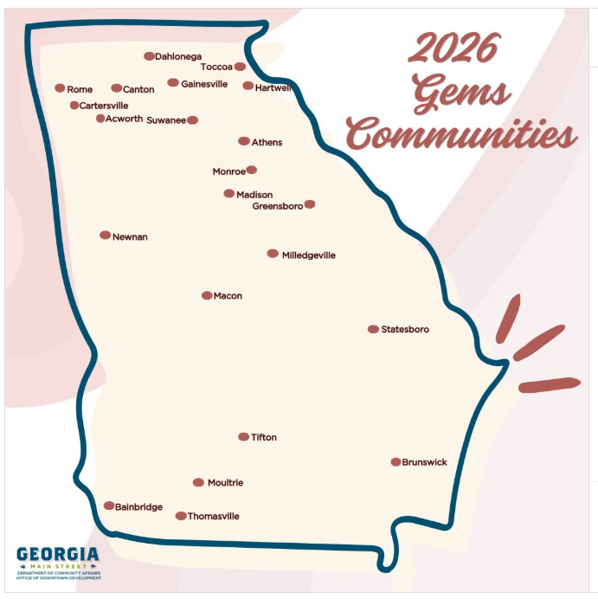
Georgia Main Street: GEMS Communities
^{Partnerships}
Funding | Incentive | Partnership | Technical Assistance

Slide 34

Housing Development
^{Affordable Housing}
Community HOME Investment Program
Grants funds to city and county governments, public housing authorities, and nonprofits to rehabilitate owner-occupied homes, and build or renovate affordable single-family homes for sale to eligible homebuyers.
Is funded by the U.S. Department of Housing and Urban Development (HUD) HOME Investment Partnership Program.
Funding is prioritized for communities with strong housing redevelopment plans.
Funding | Incentive | Partnership | Technical Assistance

Slide 35

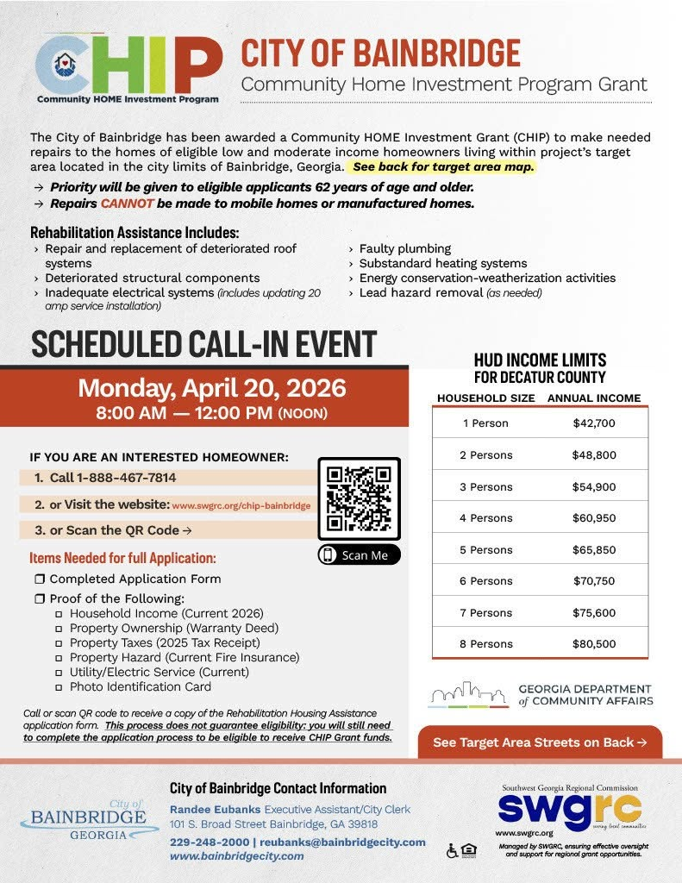
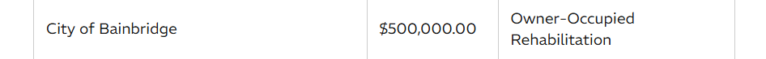
^{Affordable Housing}
Funding | Incentive | Partnership | Technical Assistance

Slide 36
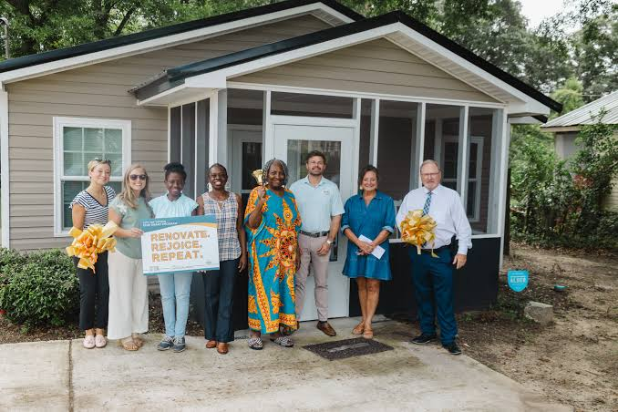
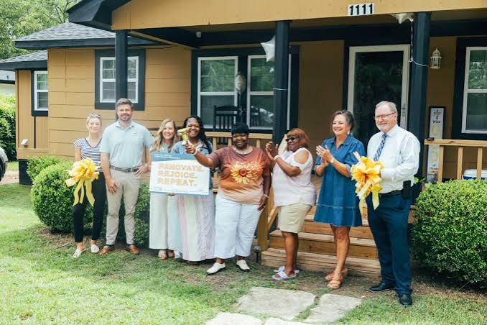
^{Affordable Housing}
Funding | Incentive | Partnership | Technical Assistance

Slide 37
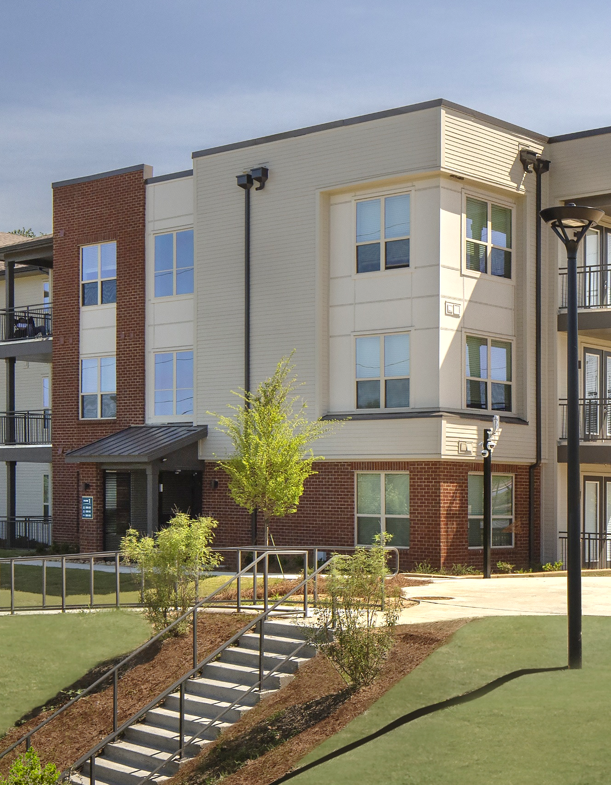
Housing Development
^{Affordable Housing}
Housing Tax Credit Program
The Housing Tax Credit is a federal tax credit created by President Ronald Reagan and Congress in the Tax Reform Act of 1986.
It is designed to encourage private sector investments in new construction, acquisition, and rehabilitation of affordable rental housing for low-income households.
Over the last three decades, the Housing Tax Credit has become the most successful affordable rental housing production program in history.
Developments that receive federal housing tax credits also receive Georgia housing tax credits of the same amount, which results in more private sector investment for affordable housing development.
Developments that receive tax credit awards are monitored continually and inspected on a three-year cycle to ensure safe, affordable, and decent housing for all program residents during the development’s Compliance Period and Extended Use Period.
Funding | Incentive | Partnership | Technical Assistance

Slide 38
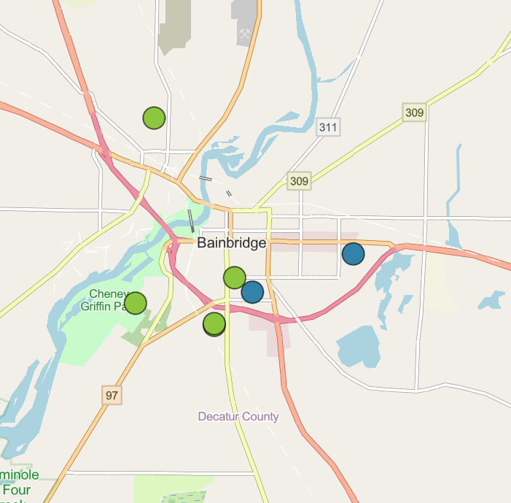
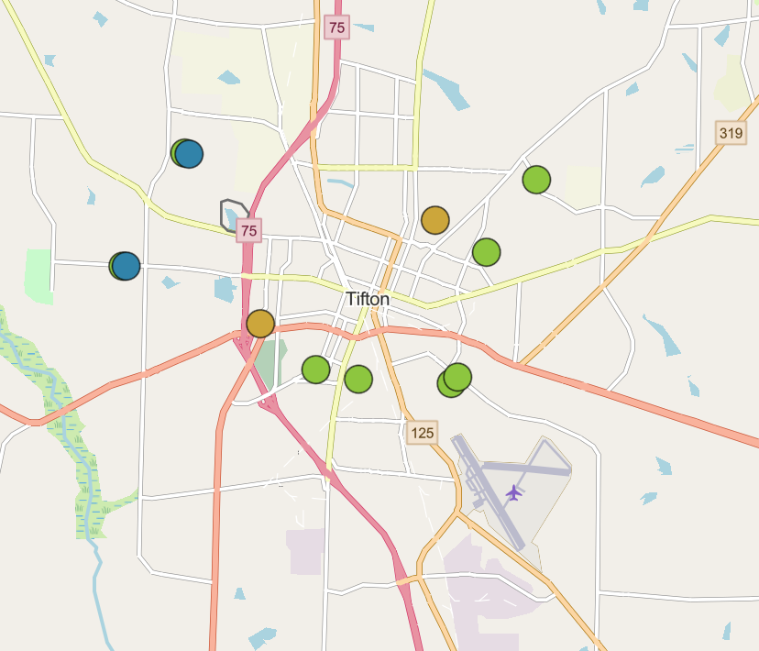
Housing Tax Credit Projects
^{Affordable Housing}
Funding | Incentive | Partnership | Technical Assistance

Slide 39
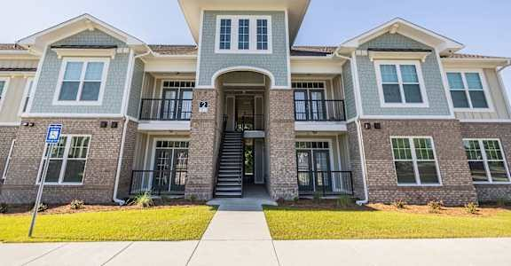
Housing Tax Credit Projects-Tifton-Nine Oaks
^{Affordable Housing}
Funding | Incentive | Partnership | Technical Assistance

Slide 40
Key Takeaways
A plan is the most important financial resource
You are not alone – strong statewide network of assistance
Early coordination is key
Don’t take our word for it – talk to your neighbors!

Slide 41
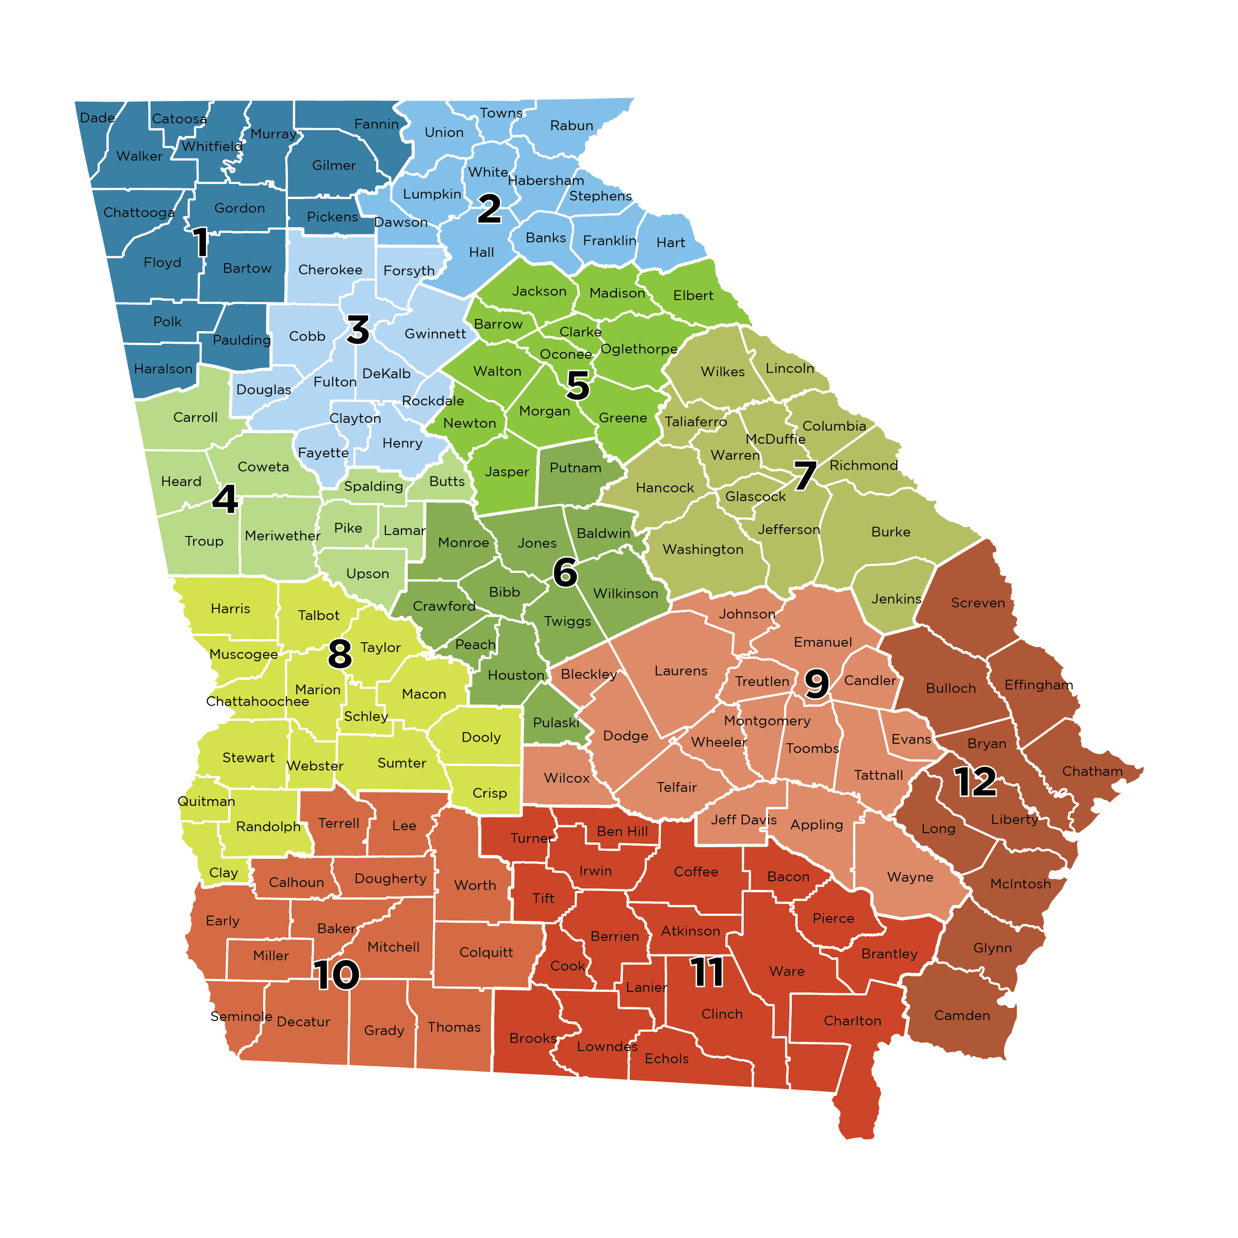
DCA Regions
DCA Regional Representatives
n Region 1 | Patrick Vickers | (404) 695-2093 | region1@dca.ga.gov
n Region 2 | Kathy Papa | (770) 362-7078 | region2@dca.ga.gov
n Region 3 | Tracie Sanchez | (470) 851-8827 | region3@dca.ga.gov
n Region 4 | Corinne Thornton | (706) 340-6461 | region4@dca.ga.gov
n Region 5 | Beth Eavenson | (404) 387-6977 | region5@dca.ga.gov
n Region 6 | Tonya Mole | (404) 852-6876 | region6@dca.ga.gov
n Region 7 | Tina Hutcheson | (478) 278-9434 | region7@dca.ga.gov
n Region 8 | Rebecca White | (404) 782-2394 | region8@dca.ga.gov
n Region 9 | Lynn Ashcraft | (478) 484-0321 | region9@dca.ga.gov
n Region 10 | Heather Sharpe | (470) 654-3920 | region10@dca.ga.gov
n Region 11 | Kelly Lane | (404) 227-3619 | region11@dca.ga.gov
n Region 12 | Jennifer Fordham | (912) 531-1746 | region12@dca.ga.gov

