Slide 1
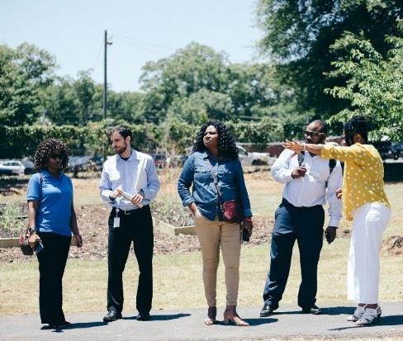
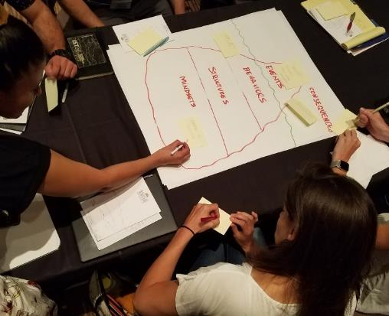
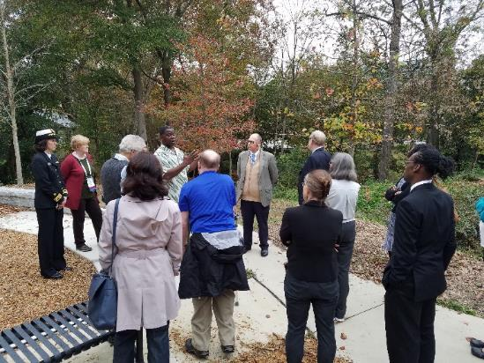
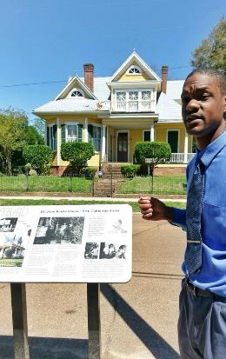
Planning for Community Health
Building Room for Possibilities: Tools to Advance a Collaborative Mindset
James E. Dills, MUP MPH
Community Planning Institute
Dublin, GA
1.6.2025
Notes:
Welcome / Hello / Hand-off from CHRIS180 (if they go first)
Sharing examples of projects and some tools we’ve used to effectively grow shared understanding of complex challenges to health and equity.
Pics are of a community tour led by the Griffin Housing Authority, an example of one of the tools we’ll share, a community leader in west Atlanta sharing his perspective with federal partners, and an entrepreneur in Natchez, MS

Slide 2
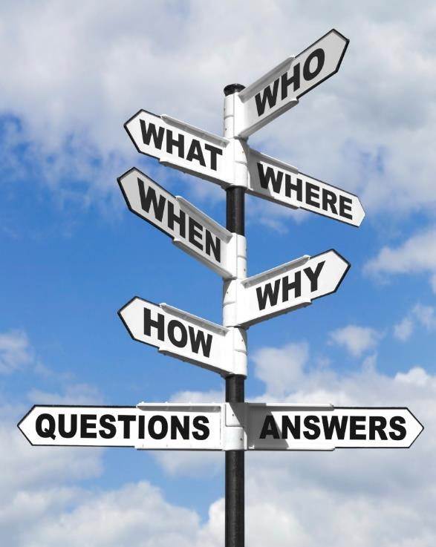
Presentation Overview
Goal: To introduce how public health perspectives can be incorporated in your planning efforts
Introduction
Images of Impact
Background on Public Health Perspectives
A Systems Approach for Planning & Health Integration
Resources
Discussion Q&A
Notes:
Review objectives and plan for our time together

Slide 3


Introduction
James E. Dills, MUP MPH
Senior Associate
jdills@gsu.edu
Georgia Health Policy Center
Andrew Young School of Policy Studies
Georgia State University
Notes:
Your name and professional background (any other information you are comfortable sharing)
Overview of Georgia Health Policy Center, including mission and values

Slide 4

Images of Impacts
Notes:
An effective way to start sharing perspectives and spur conversations during an engagement.
Instructions. 1 minute per image. Share what the image makes you think about in terms of health.
Be adaptive to room context: stickies and flipchart if possible. Popcorn if not.
Discuss/reflect briefly at the end.
Transition to HiAP as one way to get more people to “see” health perspectives on policy and decision-making across sectors.

Slide 5
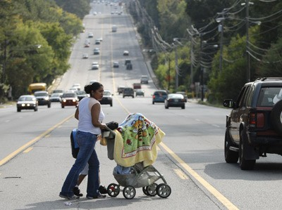
https://jsri.msu.edu/upload/ncera/NCERAWebinar_TransportationLimitations.pdf
What do you see in this picture that impacts health and wellbeing?
Image Source: https://jsri.msu.edu/upload/ncera/NCERAWebinar_TransportationLimitations.pdf

Slide 6
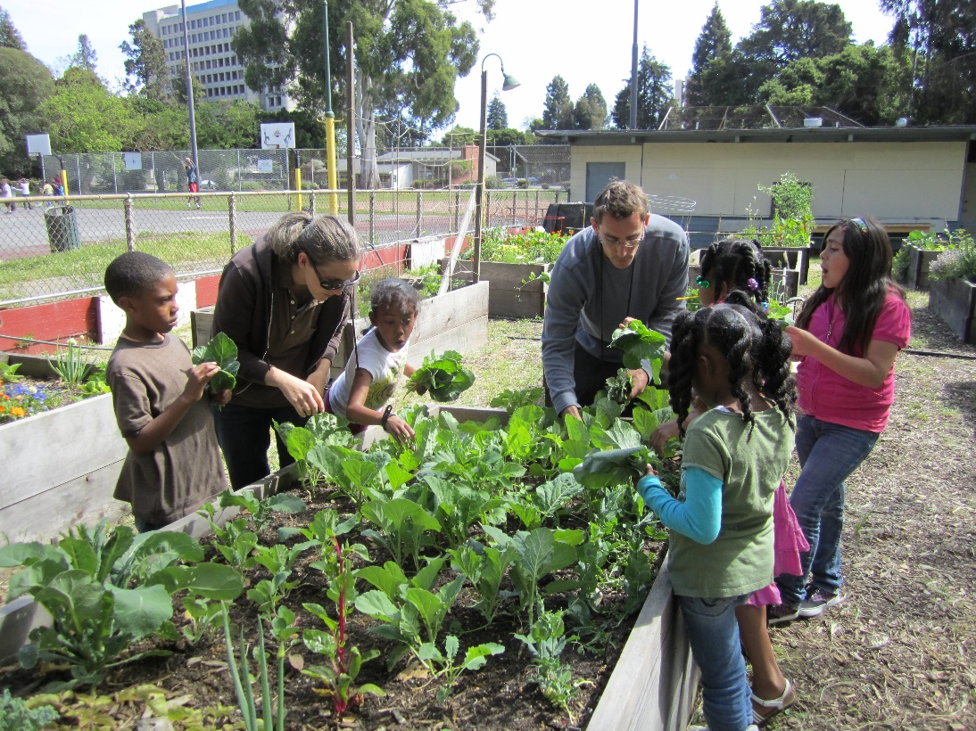
What do you see in this picture that impacts health and wellbeing?

Slide 7
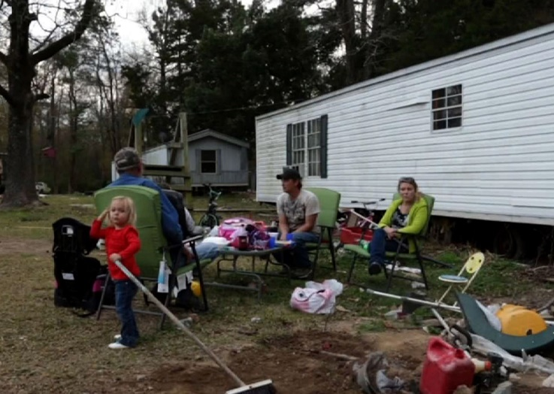
What do you see in this picture that impacts health and wellbeing?
Image: http://www.pbs.org/newshour/bb/trending-trailer-park-residents-face-harsh-evictions/

Slide 8

Background on Public Health Perspectives
Notes:
An effective way to start sharing perspectives and spur conversations during an engagement.
Instructions. 1 minute per image. Share what the image makes you think about in terms of health.
Be adaptive to room context: stickies and flipchart if possible. Popcorn if not.
Discuss/reflect briefly at the end.
Transition to HiAP as one way to get more people to “see” health perspectives on policy and decision-making across sectors.

Slide 9
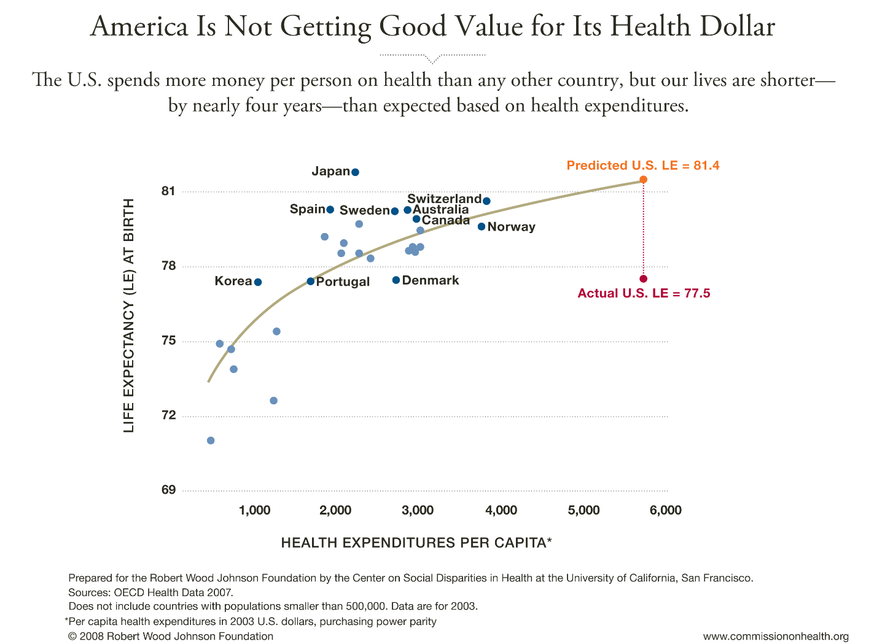

Slide 10
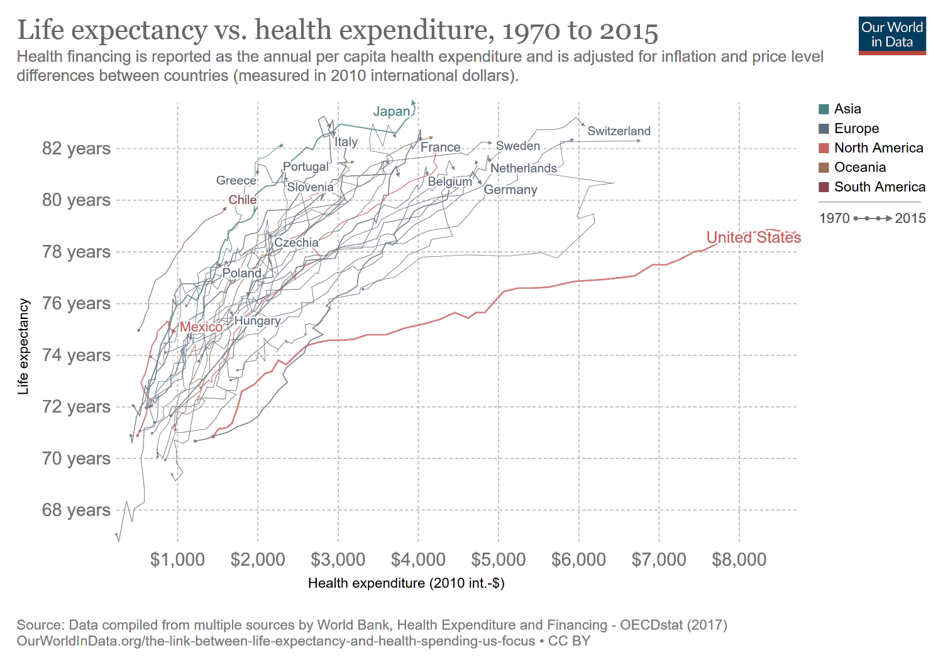

Slide 11
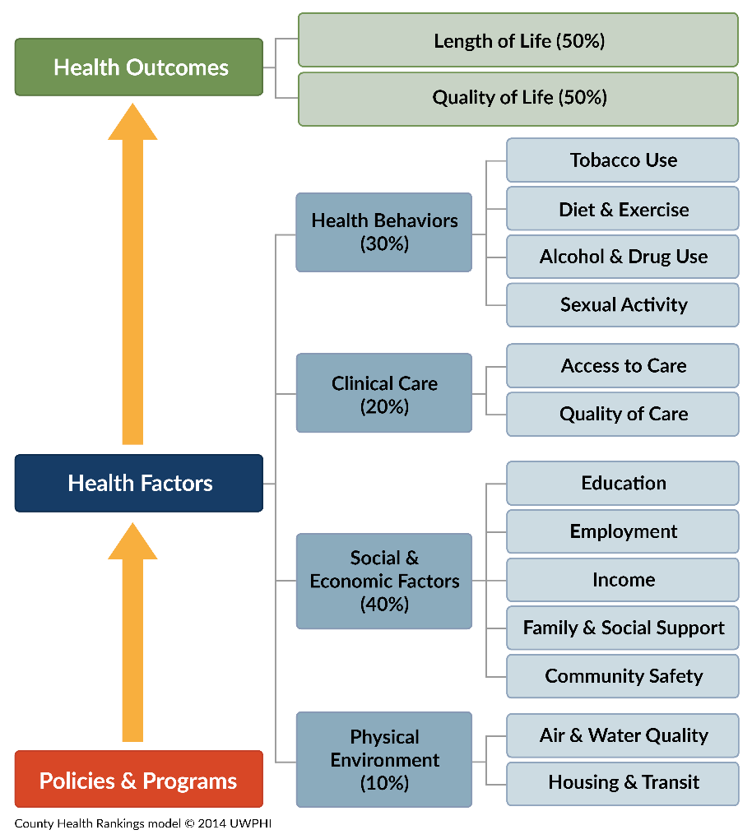
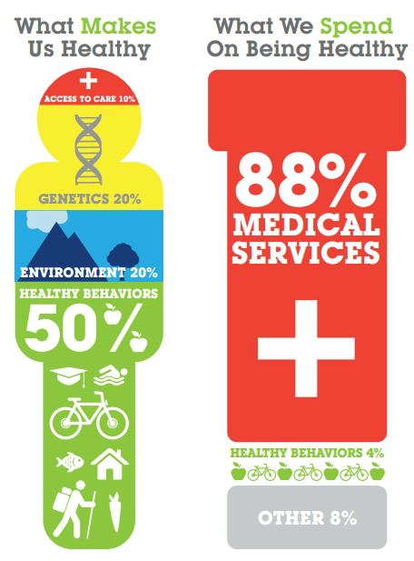
Source: The Bipartisan Policy Center

Slide 12
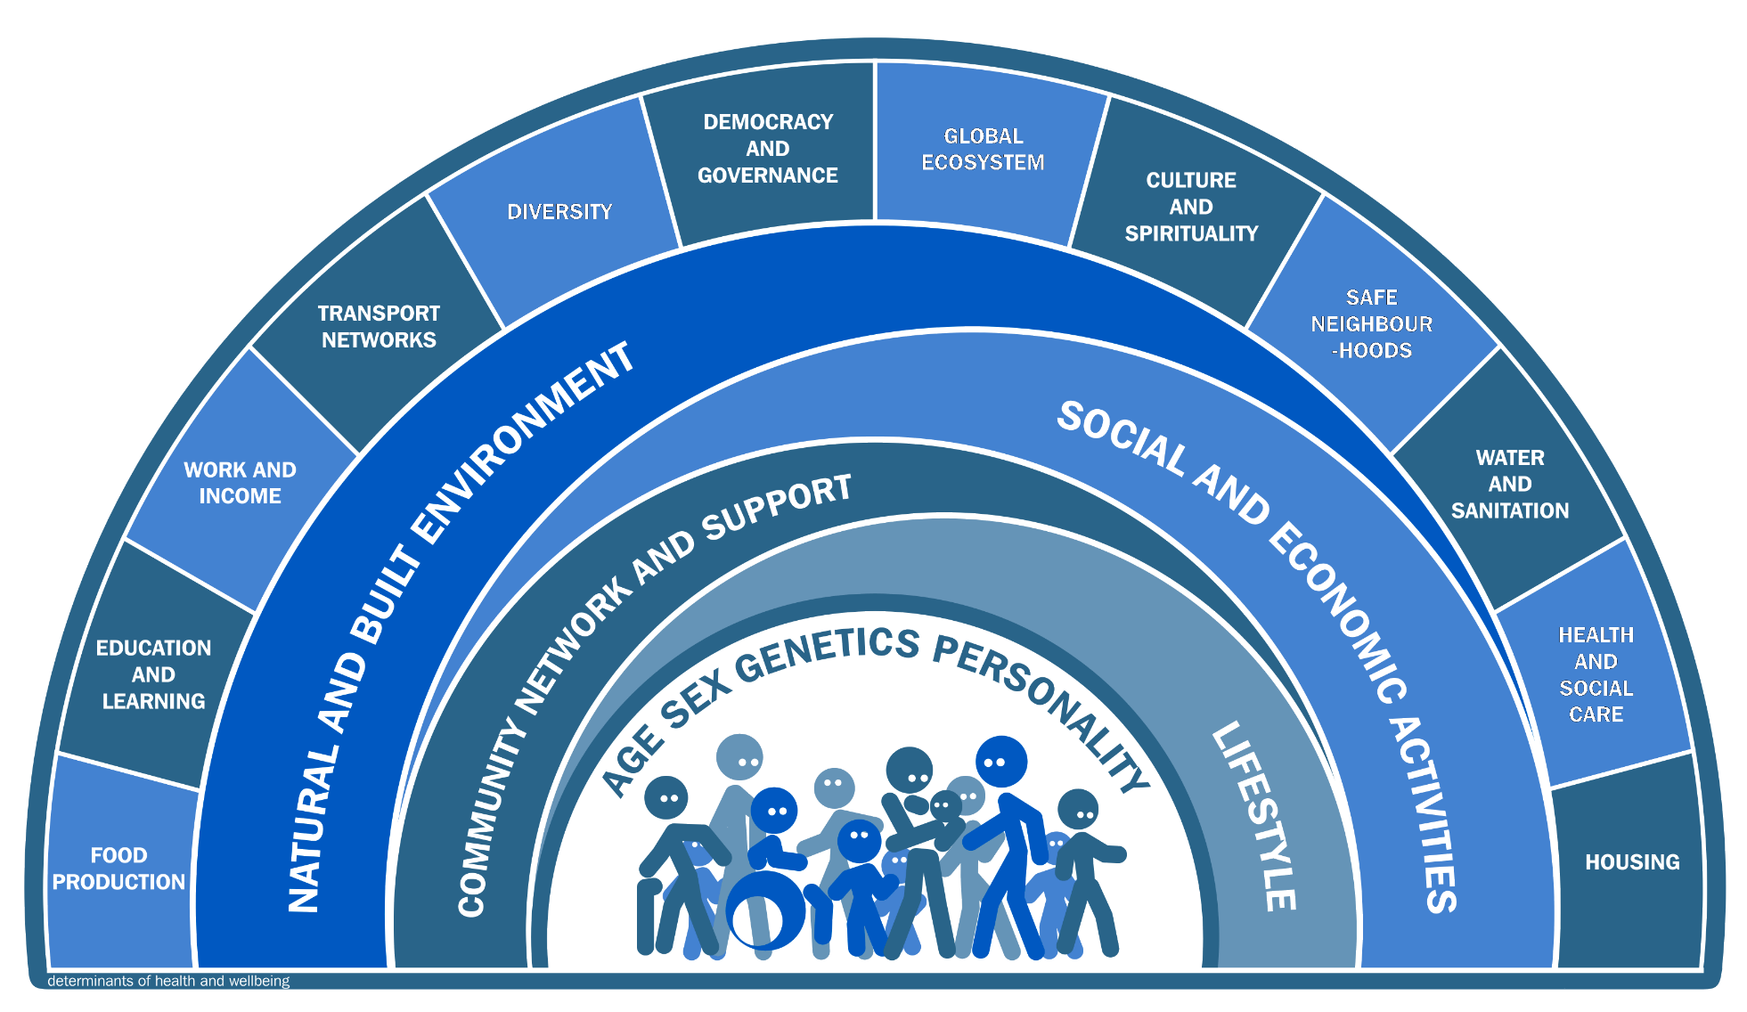
Health Determinants
Image Source: http://www.publichealthbydesign.com/resources/
Notes:
And there are great disparities among subpopulations. Expected life of african american man vs. white man etc…

Slide 13
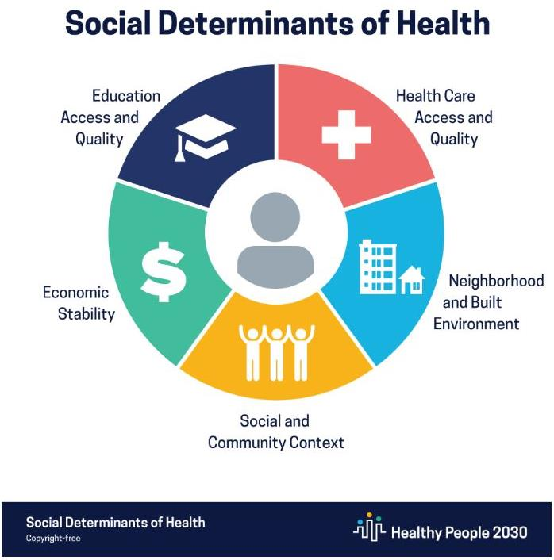
https://health.gov/healthypeople/priority-areas/social-determinants-health
Notes:
And there are great disparities among subpopulations. Expected life of african american man vs. white man etc…

Slide 14
In Georgia…
Areas of concern to public health and health care subject matter experts were:
Chronic disease. Diabetes, cardiovascular disease, obesity, and hypertension are contributing to death and disability among Georgians. As of 2022, 10.7% of adults in Georgia live with diabetes, and 37% of adults have obesity, both higher than the U.S. average.^{11,12} Furthermore, Georgia is in a geographic region called the “stroke belt,” an area in the southeastern U.S. with stroke death rates that are approximately 30% higher than in the rest of the U.S.¹³
Health care access. Primary care, mental health care, specialty care, and oral care access were important, especially for the more than 30% of Georgians who lived in a region designated as a Health Professional Shortage Area.¹⁴ Also included in this topic was access to affordable healthcare and health insurance.
Social determinants of health. Top priorities were access to safe, affordable housing, reliable transportation, and healthy, affordable food. Another important social determinant, poverty, impacted 18.4% of all Georgia households, with single female head of households having the highest poverty rates at 25.8%.¹⁵
Maternal mortality. The rate from 2018-2021 was 33.9 per 100,000 live births, compared to the U.S. rate of 23.5, with Black non-Hispanic women dying at more than twice the rate of other races.¹⁶
HIV/AIDS: The number of HIV infection diagnoses among adults and adolescents in 2020 was fourth-highest in the nation.¹⁷ This concern was noted by Georgians mainly in urban settings.

Slide 15
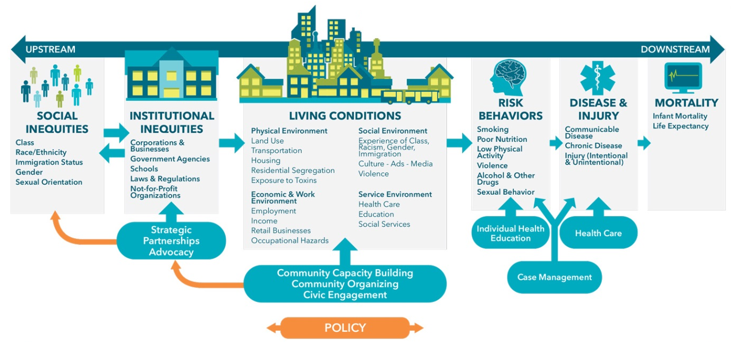
Moving Upstream & “Public Health 3.0”
Source: https://www.barhii.org/barhii-framework

Slide 16
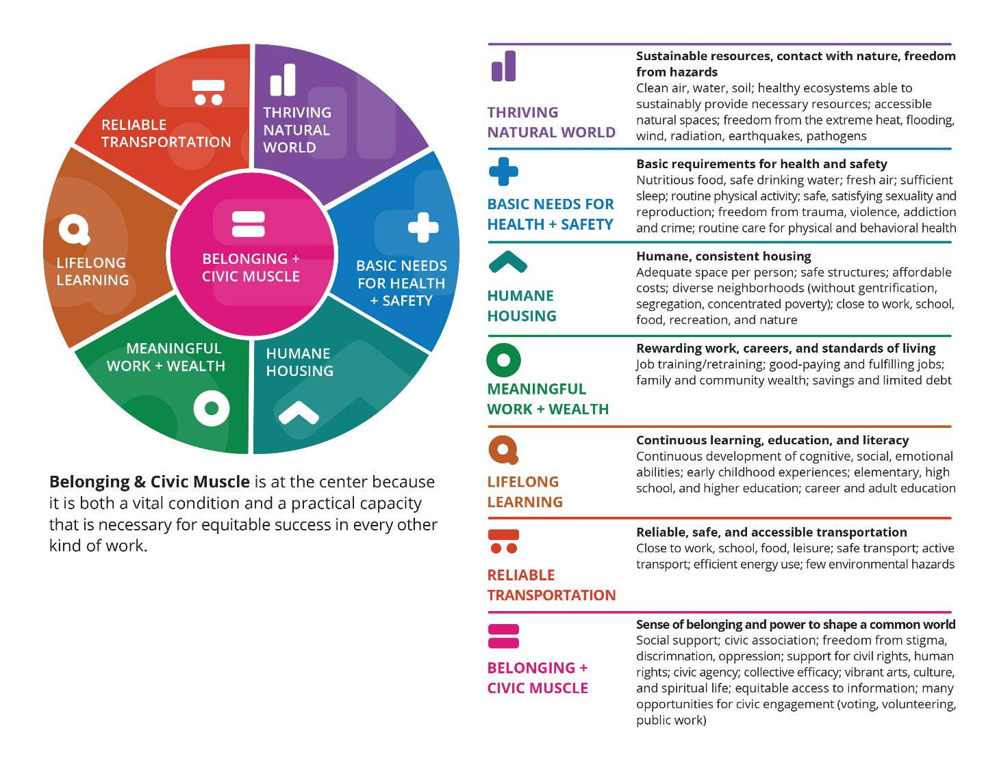
Vital Conditions for Health and Well-Being
Source: https://www.healthaffairs.org/content/forefront/organizing-around-vital-conditions-moves-social-determinants-agenda-into-wider-action

Slide 17
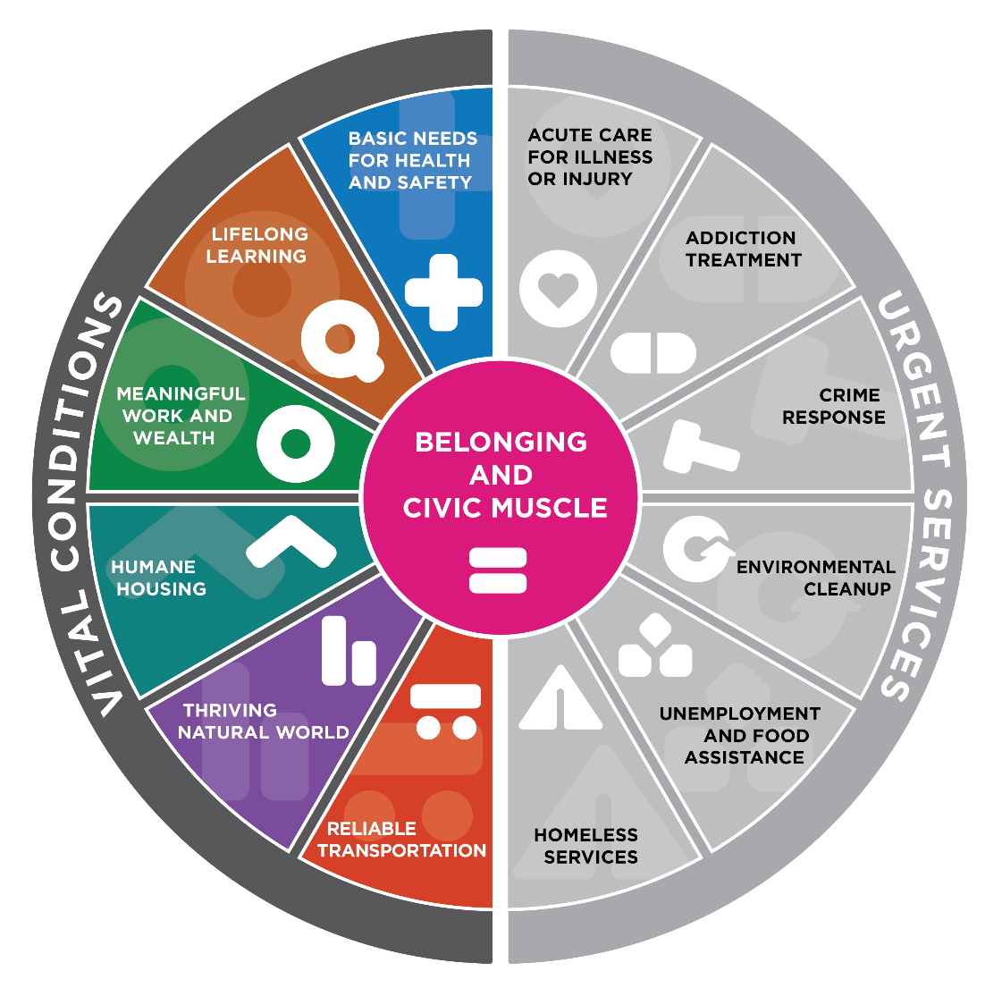
Vital Conditions for Health and Well-Being v. Urgent Services
Source: https://www.healthaffairs.org/content/forefront/organizing-around-vital-conditions-moves-social-determinants-agenda-into-wider-action

Slide 18

A Systems Approach for Planning & Health Integration

Slide 19

Health in All Policies
A “change in systems that determine how decisions are made and implemented by local, state, and federal governments to ensure that policy decisions have neutral or beneficial impacts on health determinants.”
http://www.naccho.org/uploads/downloadable-resources/NACCHO-HiAP-Report_Experiences-from-Local-Health-Departments-Feb-2017.pdf
Notes:
Define HiAP. Emphasize systems perspective to connect to iceberg.

Slide 20
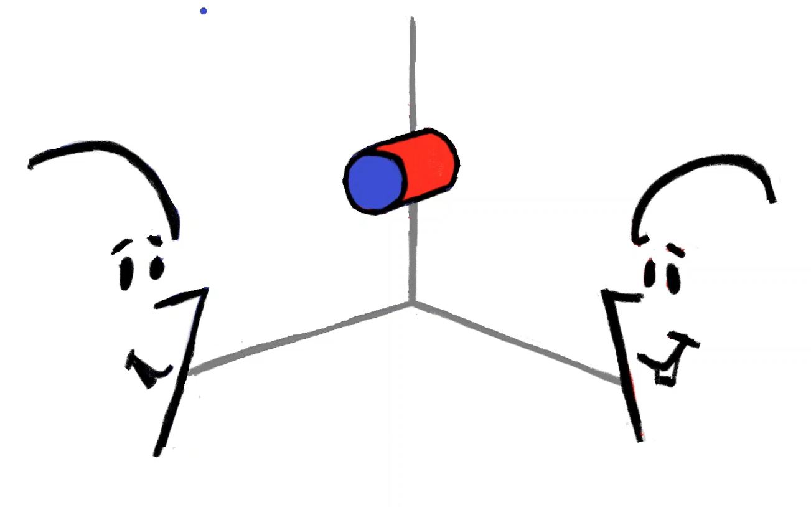
Sharing Perspectives
Notes:
Primer on importance of sharing perspectives on the systems we’re trying to improve – with special emphasis on persons with lived experience
Often people with different perspectives see different parts of the same thing.
Their experiences, training, and information shape their understanding of what produces undesirable outcomes.
We refer to this understanding as individuals’ “mental models”.
Discussing and diagramming [causal feedback loops] can help you show what you see, what other people see, and how that combines to show situations more completely.
The more complex a system is, the more lacking is any single view of it. Even this simple image illustrates how incomplete – and ultimately wrong – a partial perspective can be. The person viewing the object from the left will say it is round and blue. The one seeing it from the right will call it an orange square. It’s actually a cylinder, orange on its side and blue on its end. It is ALWAYS valuable to at least hear a variety of perspectives on what’s going on in a system. Different people have different vantage points; we have access to different (some correct, some maybe not) information; we have different personalities and experiences through which to interpret what we know and observe.

Slide 21
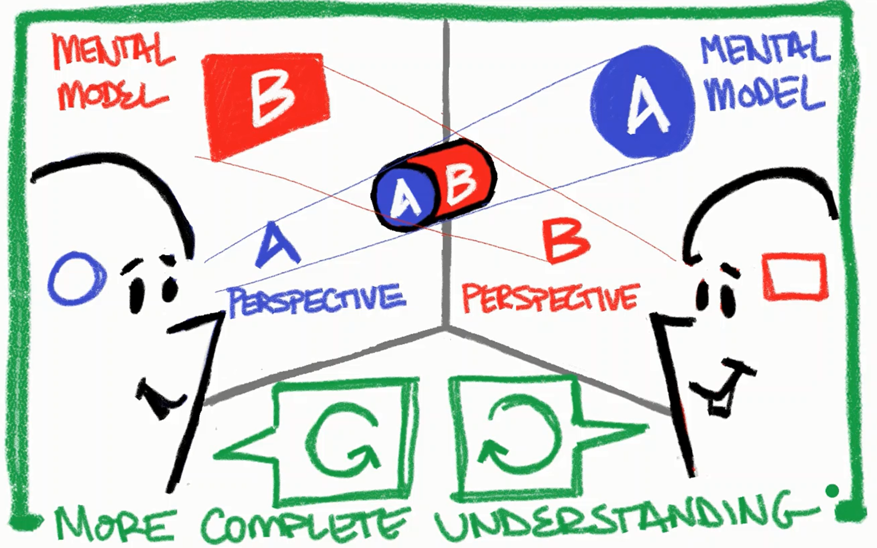
Sharing Perspectives
Notes:
Primer on importance of sharing perspectives on the systems we’re trying to improve – with special emphasis on persons with lived experience
Often people with different perspectives see different parts of the same thing.
Their experiences, training, and information shape their understanding of what produces undesirable outcomes.
We refer to this understanding as individuals’ “mental models”.
Discussing and diagramming [causal feedback loops] can help you show what you see, what other people see, and how that combines to show situations more completely.
The more complex a system is, the more lacking is any single view of it. Even this simple image illustrates how incomplete – and ultimately wrong – a partial perspective can be. The person viewing the object from the left will say it is round and blue. The one seeing it from the right will call it an orange square. It’s actually a cylinder, orange on its side and blue on its end. It is ALWAYS valuable to at least hear a variety of perspectives on what’s going on in a system. Different people have different vantage points; we have access to different (some correct, some maybe not) information; we have different personalities and experiences through which to interpret what we know and observe.

Slide 22
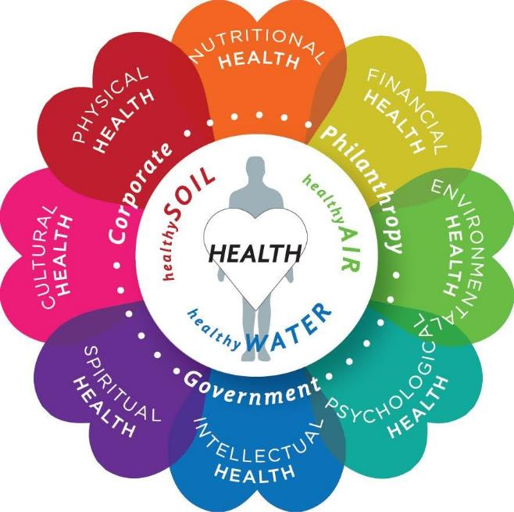
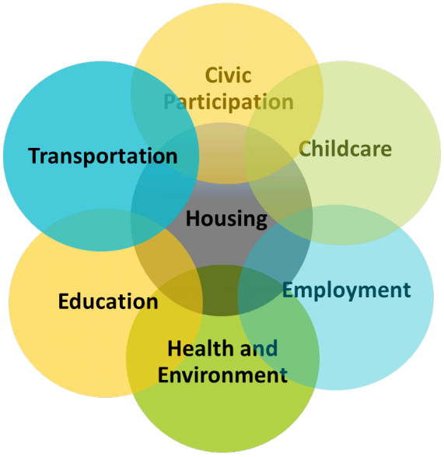
An Example of Different Perspectives…
Figure: Center For Healthy Air Water and Soil
Figure: Center for Social Inclusion

Slide 23
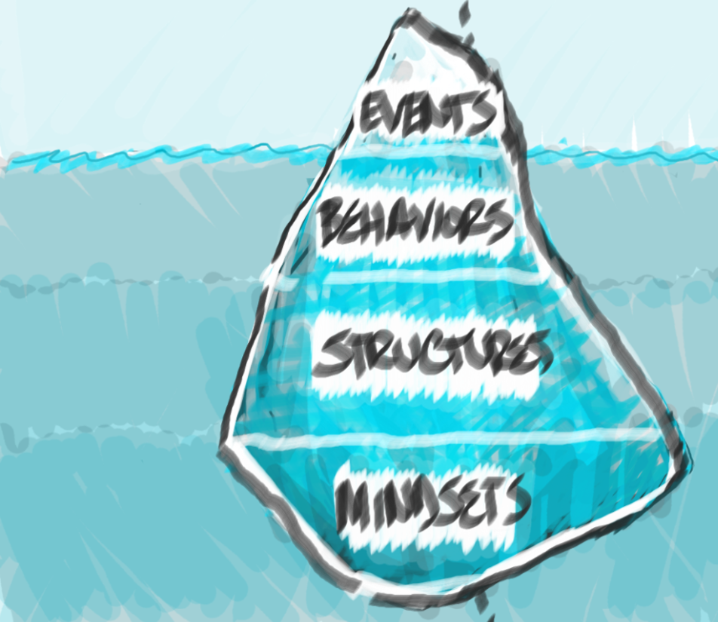
Systems Iceberg
A way to think about system complexity & identify opportunities for change
Notes:
You may have heard this before, but I’m going to introduce a quick metaphor for systems thinking. The iceberg metaphor is a simple framework for unraveling complexity, discovering root causes of outcomes, and identifying parts of the systems where you can exert influence to better achieve the outcomes you seek.
At the top are events – it’s often what we pay attention to the most, and how we define the problem we want to address. It’s reactionary. As we go deeper, we then begin to get to patterns of behavior. When we ask: “What is causing the pattern we’re observing?” the answer is usually some kind of structure, whether physical, organizational, and/or policies. This gets us to structures.
At the most upstream – highest leverage point is mindsets – which are the attitudes, beliefs, morals, expectations, and values that created, or allow structures to continue functioning as they are. These are the beliefs that we often learn unconsciously throughout our lives and are likely unaware of. Understanding potential partner or partner’s mental models of the system, and its elements is incredibly important and requires trusted and sustainable partnerships.
We often use this iceberg with coalitions to help them develop a shared picture of the problem they’re focused on, including surfacing each individual’s mindsets. This often helps them refine or redefine the problem they’re trying to fix (e.g., is it that we need to create more programs to feed people with food insecurity, or is it more about the structures that produce food insecurity, and the mindsets of those who work within those structures)?

Slide 24
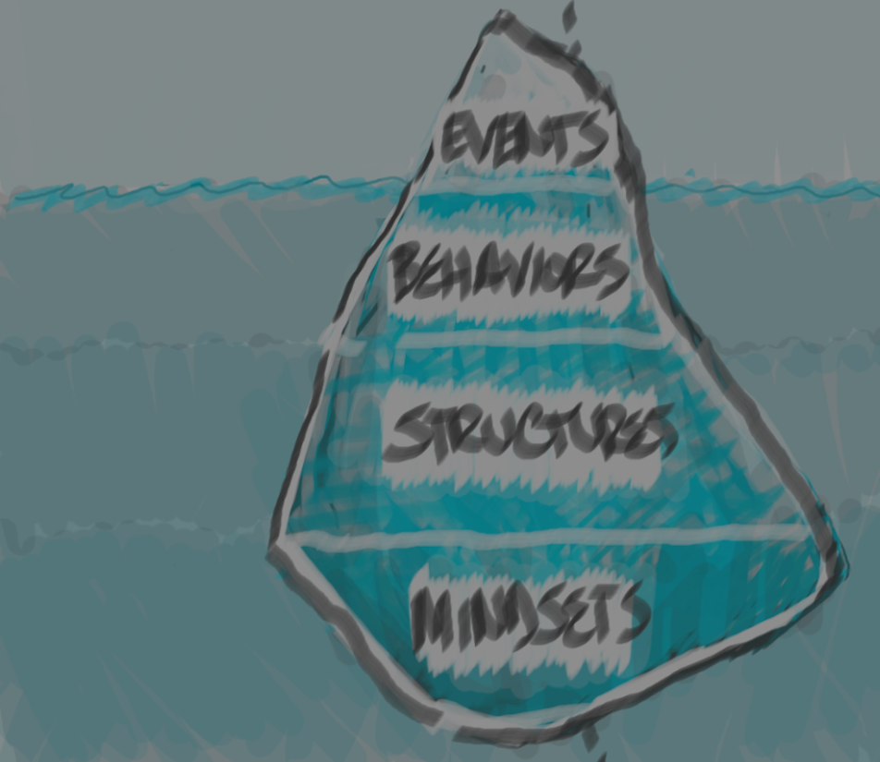

Systems Iceberg
EVENTS are just the tip of the iceberg…
The visible part of a system; to identify an event, you might ask yourself, “What is happening right now?”
If we only think about the event level when considering solutions, we might treat the symptoms of our problem without addressing the root cause.
Think about events in the context of outcomes
Notes:
Events: how we’d typically do things, our go to response, the information we take in consciously and respond to all day
The Event level is the visible part of a problem; to identify an event, you might ask yourself, “What is happening right now?”. If we only think about the event level when considering solutions, we might treat the symptoms of our problem without addressing the root cause.
Reconcile the event you react to with the outcomes you seek: Recognizing an event helps to identify the challenge; putting that event in the context of outcomes helps define the importance of addressing the challenge.

Slide 25
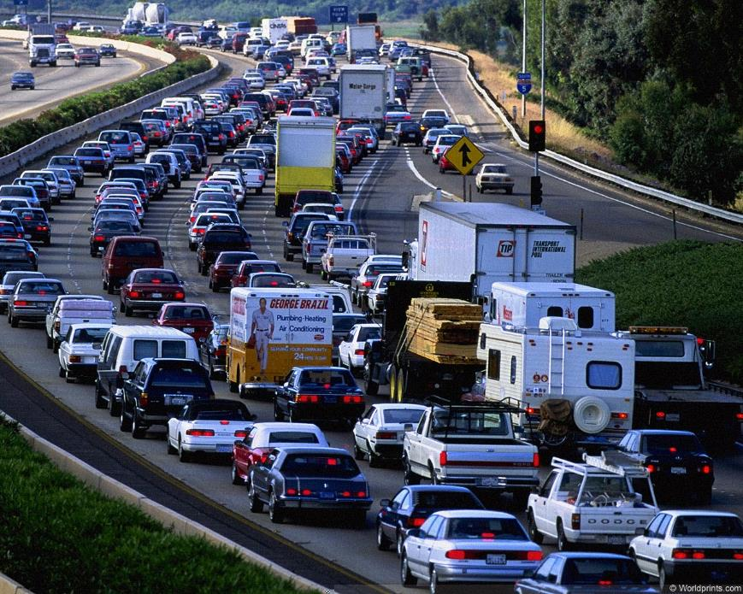
Systems Iceberg
Event: Traffic congestion
EVENTS are just the tip of the iceberg…
Outcome: Economic productivity
The visible part of a system; to identify an event, you might ask yourself, “What is happening right now?”
If we only think about the event level when considering solutions, we might treat the symptoms of our problem without addressing the root cause.
Think about events in the context of outcomes
Outcome: Quality of life
Outcome: Morbidity & Mortality
Notes:
Events: how we’d typically do things, our go to response, the information we take in consciously and respond to all day
The Event level is the visible part of a problem; to identify an event, you might ask yourself, “What is happening right now?”. If we only think about the event level when considering solutions, we might treat the symptoms of our problem without addressing the root cause.
Reconcile the event you react to with the outcomes you seek: Recognizing an event helps to identify the challenge; putting that event in the context of outcomes helps define the importance of addressing the challenge.

Slide 26
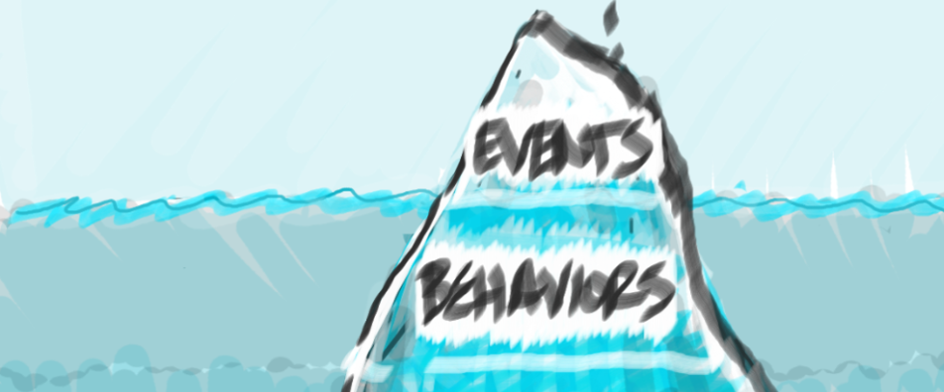
Systems Iceberg
Patterns of BEHAVIORS lead to the events we’re concerned about…
Some are just under the surface; others are deeper within the system
Consider “What has been happening over time?”
Include individual and system behaviors: What is the system doing?
Helps us to hypothesize what might happen in the future
Notes:
Patterns of behavior: trends over time, this relates to things like patterns in your NPMs over time as well as things like your staff retention trends
The Patterns/Trend level considers, “What has been happening over time?”. Understanding patterns over time helps us to hypothesize what will happen in the future if we don’t intervene. We commonly think about this level in the MCH field using data and trends over time.

Slide 27


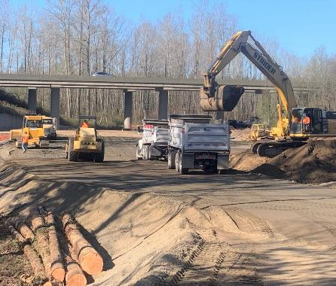
Systems Iceberg
Quality of life
Morbidity & Mortality
Traffic congestion
Economic productivity
Patterns of BEHAVIORS lead to the events we’re concerned about…
People drive to work
Some are just under the surface; others are deeper within the system
Consider “What has been happening over time?”
Include individual and system behaviors: What is the system doing?
Helps us to hypothesize what might happen in the future
Highway construction
Notes:
Patterns of behavior: trends over time, this relates to things like patterns in your NPMs over time as well as things like your staff retention trends
The Patterns/Trend level considers, “What has been happening over time?”. Understanding patterns over time helps us to hypothesize what will happen in the future if we don’t intervene. We commonly think about this level in the MCH field using data and trends over time.

Slide 28
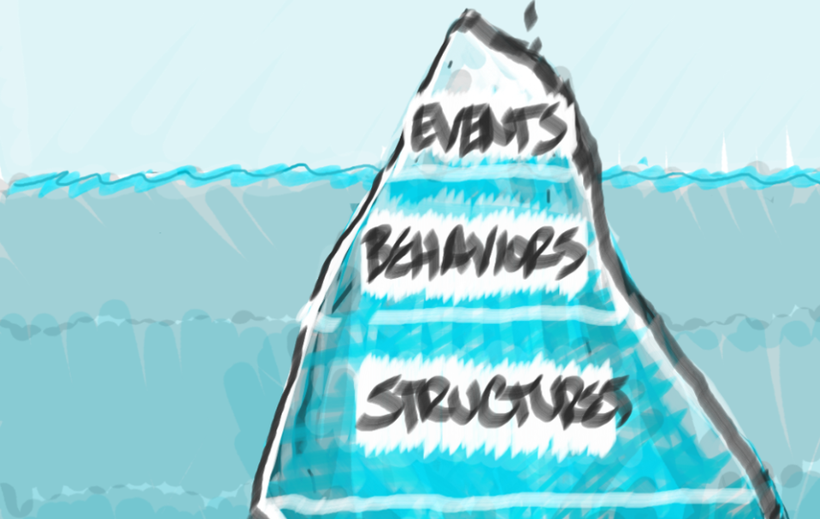
Systems Iceberg
System STRUCTURES set context for how elements interact to drive behavior
Describe causes of the patterns we observe
Includes physical environments, policies, and other rules
Ask “What elements influenced the patterns?” and “What are the relationships between them?”
Notes:
Systemic structures: this is starting to get at the reason that the patterns or trends exist in the first place, these are the parts of the system that drive patterns, including policies, rules, environments, contexts..
The Structure level asks us to describe the cause of the patterns we observe. Structures can be physical things, organizations, policies or behaviors (John Gerber). Guiding questions for understanding the structure of a problem include, “What are the variables that have influenced the patterns?” and “What are the relationships between the variables?”.

Slide 29



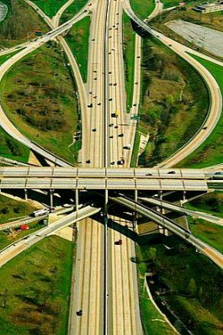
Systems Iceberg
Quality of life
Morbidity & Mortality
Traffic congestion
Economic productivity
System STRUCTURES set context for how elements interact to drive behavior
People drive to work
Highway construction
Remote work policies
Describe causes of the patterns we observe
Includes physical environments, policies, and other rules
Ask “What elements influenced the patterns?” and “What are the relationships between them?”
Existing road networks
Notes:
Systemic structures: this is starting to get at the reason that the patterns or trends exist in the first place, these are the parts of the system that drive patterns, including policies, rules, environments, contexts..
The Structure level asks us to describe the cause of the patterns we observe. Structures can be physical things, organizations, policies or behaviors (John Gerber). Guiding questions for understanding the structure of a problem include, “What are the variables that have influenced the patterns?” and “What are the relationships between the variables?”.

Slide 30
Systems Iceberg
MINDSETS underpin system structure
These are the assumptions, beliefs, and values that people hold about the system.
Ask “What beliefs keep the system in place?”
Inform mental models and can be conscious or subconscious
Can resist or support improvement relative to the change you want to see
Notes:
Mindsets: and at the root of it all are our mindsets, these are the assumptions, beliefs, and values that people or organizations operate with. They can resist or support improvement.
The Mindsets level comprises the assumptions, beliefs, and values that people hold about the system. This level explores the thinking that allows the problematic situation to persist by asking, “What beliefs keep the system in place?”. Mental models can be conscious or subconscious.

Slide 31

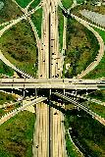

Systems Iceberg
Quality of life
Morbidity & Mortality
Traffic congestion
Economic productivity
MINDSETS underpin system structure
People drive to work
Highway construction
Remote work policies
Existing road networks
These are the assumptions, beliefs, and values that people hold about the system.
Ask “What beliefs keep the system in place?”
Inform mental models and can be conscious or subconscious
Can resist or support improvement relative to the change you want to see
Remote work less productive
Everyone can drive
Notes:
Mindsets: and at the root of it all are our mindsets, these are the assumptions, beliefs, and values that people or organizations operate with. They can resist or support improvement.
The Mindsets level comprises the assumptions, beliefs, and values that people hold about the system. This level explores the thinking that allows the problematic situation to persist by asking, “What beliefs keep the system in place?”. Mental models can be conscious or subconscious.

Slide 32

Systems Iceberg
Quality of life
Morbidity & Mortality
Traffic congestion
Economic productivity
People drive to work
Highway construction
A way to think about system complexity & identify opportunities for change
Remote work policies
Existing road networks
Remote work less productive
Everyone can drive
Notes:
As you populate the layers of your iceberg, you begin to recognize deeper components of the systems you’re thinking about.

Slide 33
Systems Iceberg
React
Increasing leverage for systems change as you go deeper under the surface
Anticipate
Design
Transform

Slide 34
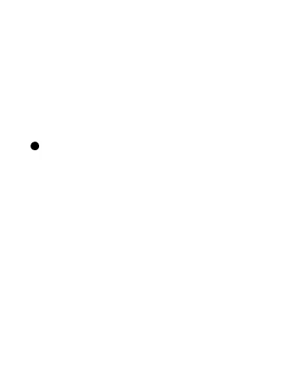
Surfacing Mindsets:
How do you think about your work?
Systems Thinking
Scientific Evidence
Equitable Solutions
Collaboration:
We can do this together!
Notes:
Review objectives and plan for our time together

Slide 35
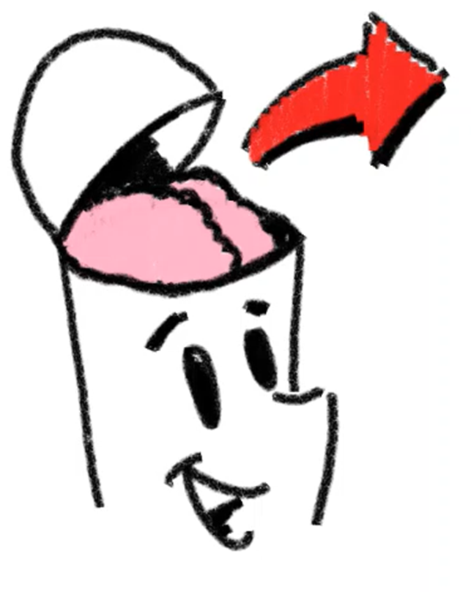
Surfacing Mindsets:
How does your community see itself?
Community mindset as an input into planning
Who do planners talk to and how?
How do decision-makers view the systems?
Notes:
Review objectives and plan for our time together

Slide 36
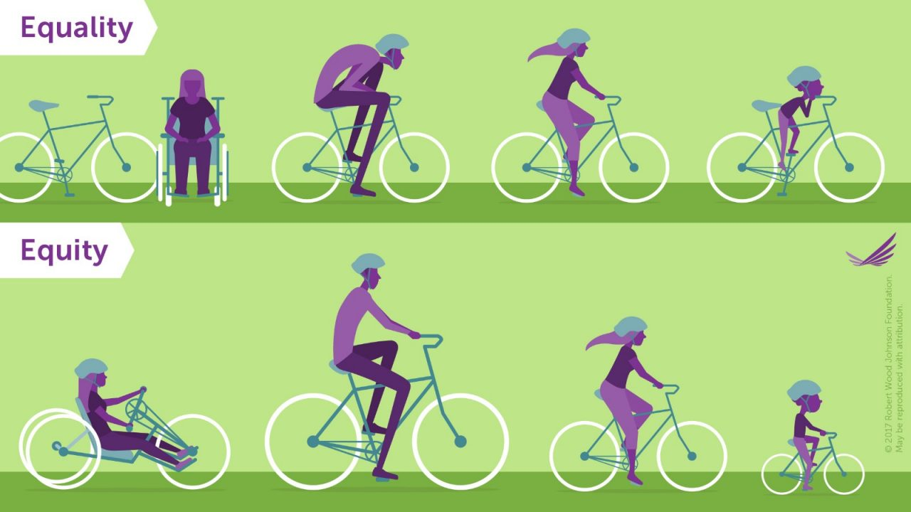
Mindsets on Equality & Equity
Notes:
Review objectives and plan for our time together

Slide 37
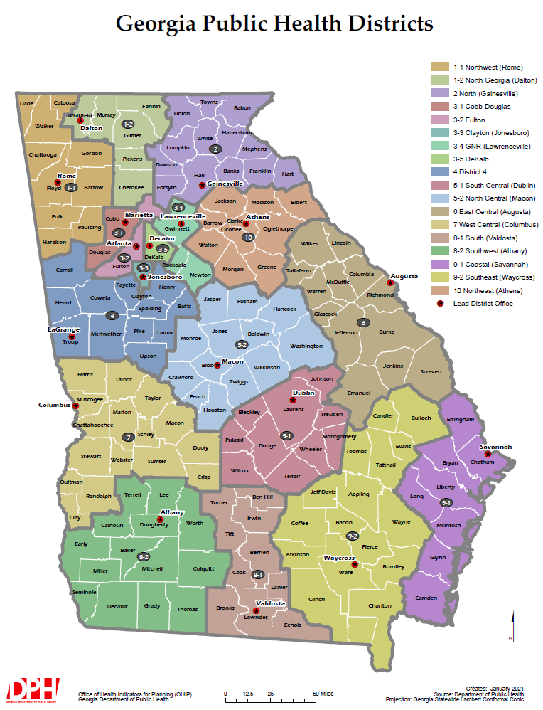
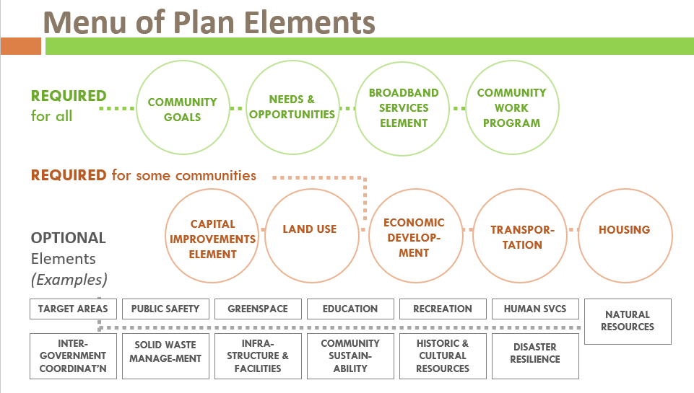
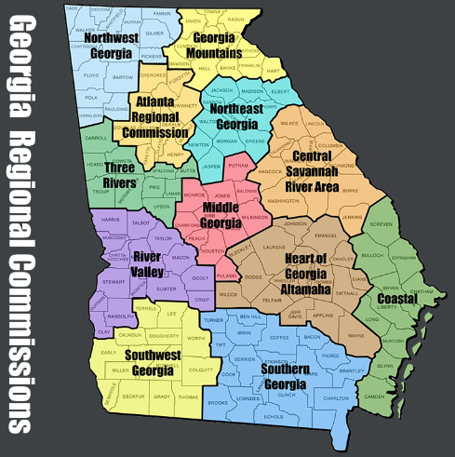

System Structures:
Comprehensive Plans & Health Improvement Plans
Notes:
Review objectives and plan for our time together

Slide 38

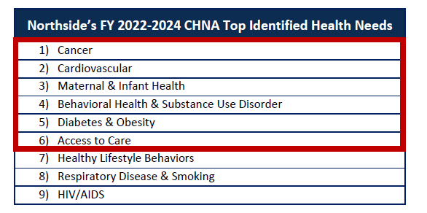

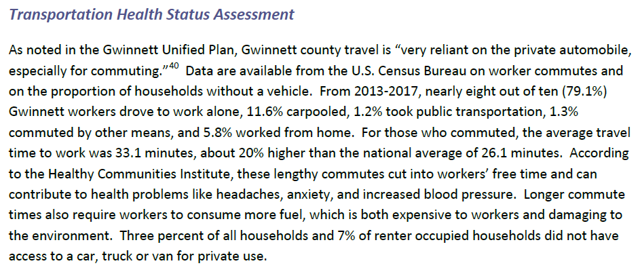
System Structures:
Comp Plans & State (and Local) Health Improvement Plans
Notes:
Review objectives and plan for our time together

Slide 39

System Structures:
Comp Plans & State (and County) Health Improvement Plans
ACTIVE TRANSPORTATION AND ACCESS
TO TRANSIT
Planning for the future of the City of Lawrenceville incorporates a holistic view of transportation. Infrastructure such as sidewalks, bike lanes, and trails are necessary for non-motorized modes of transportation such as walking and biking. These active modes of transportation foster active, healthy lifestyles, an increased quality of life, and can lead to reduced emissions which can improve air quality for the city’s residents.
Notes:
Review objectives and plan for our time together

Slide 40
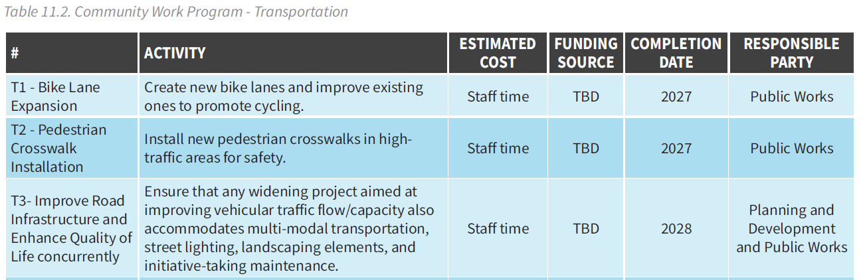
System Behaviors:
Applying Tools & Strategies / Implementing Plans
The Community Work Program translates the structure of the plan into actionable system behaviors
Notes:
Review objectives and plan for our time together

Slide 41
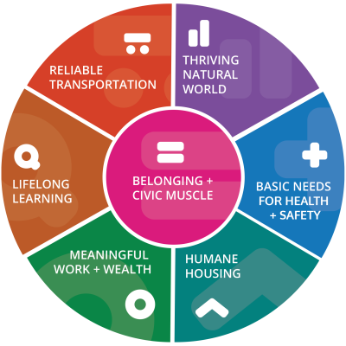
System Behaviors:
Encouraging Equitable Distribution of and Access to the Vital Conditions
Vital Conditions

Slide 42
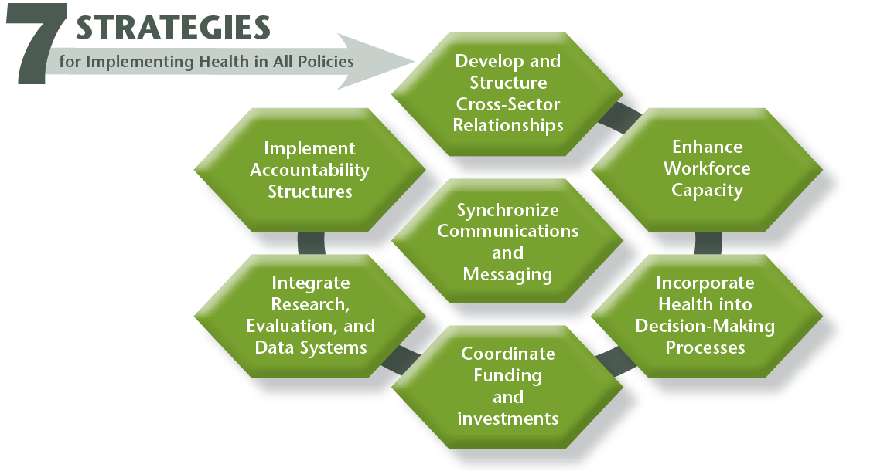
System Behaviors:
Applying Tools & Strategies / Implementing Plans
http://www.naccho.org/uploads/downloadable-resources/Programs/Community-Health/factsheet_hiap_dec2014-1.pdf
Notes:
Review objectives and plan for our time together

Slide 43
Health Impact Assessment (HIA):
A Tool for Collaboration
https://hiasociety.org/resources/Documents/HIA%20ME-%20PS%20v4%202022.pdf

Slide 44
What is HIA?
Definition
HIA is a structured process that uses scientific data, professional expertise, and stakeholder input to identify and evaluate public health consequences of proposals and suggests actions that could be taken to minimize adverse health impacts and optimize beneficial ones.
Values
Democracy
Equity
Sustainable Development
Ethical Use of Evidence
Comprehensive Approach to Health

Slide 45
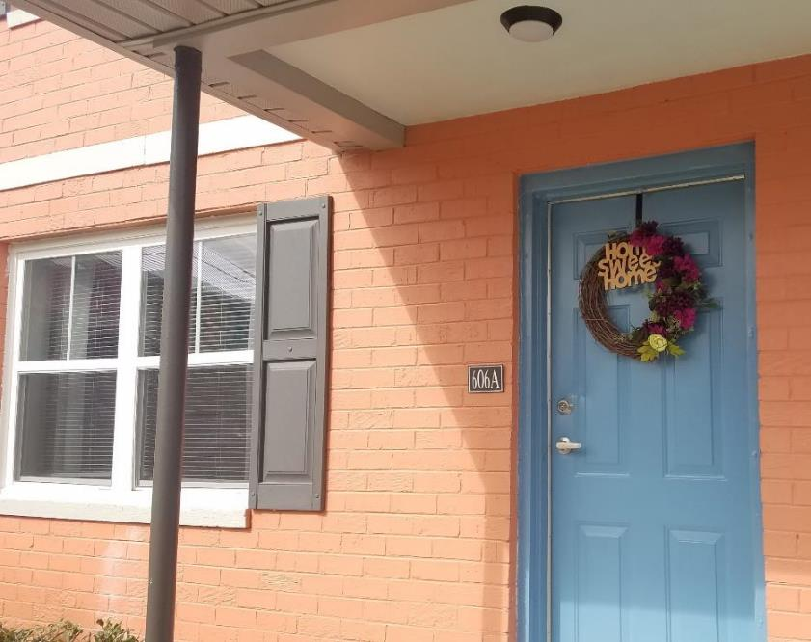
10+ Years of Systems Change & Learning with Affordable Housing & Health in GA
2012 – 2016: Foundational HIAs build content knowledge, relationships, and trust
  HIA of public housing relocations in Galveston, TX
  2015 Low Income Housing Tax Credit HIA in GA
  2016 Follow-up HIA for local housing developments in GA
2017: Evidence of mindset shift from ‘bricks and sticks’ to ‘platform for population health’
  Collaborative pursuit of funding opportunities
  Adapting to staffing changes
2018-2024: Thought partnership, capacity building, consulting roles, and inclusive engagement with communities
  GA Homes for Healthy Futures project
  Rapid HIA of 2015 Air Quality Recs
  Qualified Allocation Plan work groups
  Healthy Housing Initiative in development applications
  Health Action Plans through Enterprise Community Partners
Dills, J. E., Major, M. E., Marcus, M. J., Williams, T. S., & Alderman, L. (2024). Cultivating Health in All Policies Mindsets: An Ongoing Journey to Integrate Health and Housing in Georgia. International Journal of Environmental Research and Public Health, 21(12), 1639.
https://www.mdpi.com/1660-4601/21/12/1639

Slide 46
Events: What the System Produces…
“We are honored to accept the title of ‘Top State for Business’ for an unprecedented 11th year,” said Governor Brian Kemp.
Georgia ranked 37th in overall health in 2023
AND
https://gov.georgia.gov/press-releases/2024-09-13/gov-kemp-celebrates-top-state-business-ranking-workforce-summit#:~:text=Atlanta%2C%20GA%20%E2%80%93%20Governor%20Brian%20P,year%20by%20Area%20Development%20magazine.
https://www.americashealthrankings.org/explore/states/GA

Slide 47

Resources
Notes:
An effective way to start sharing perspectives and spur conversations during an engagement.
Instructions. 1 minute per image. Share what the image makes you think about in terms of health.
Be adaptive to room context: stickies and flipchart if possible. Popcorn if not.
Discuss/reflect briefly at the end.
Transition to HiAP as one way to get more people to “see” health perspectives on policy and decision-making across sectors.

Slide 48
Public Health Data Resources
Community Health Needs Assessments:
  https://www.irs.gov/charities-non-profits/community-health-needs-assessment-for-charitable-hospital-organizations-section-501r3
  All non-profit hospitals in your jurisdiction are required to have these – seek them out!
Community Health Assessments & Health Improvement Plans:
  https://www.cdc.gov/publichealthgateway/cha/plan.html
  Not all health districts/departments in GA complete these, but if yours does, these can be useful to understand local health issues and strategies
Community Commons Online Platform for Change-Makers:
  https://www.communitycommons.org/
County Health Rankings & Roadmaps:
  https://www.countyhealthrankings.org/
Policy Map Platform:
  https://www.policymap.com/

Slide 49
Built Environment & Health Resources
American Planning Association – Healthy Plan Making - Integrating Health Into the Comprehensive Planning Process: An analysis of seven case studies and recommendations for change:
  https://planning-org-uploaded-media.s3.amazonaws.com/legacy_resources/research/publichealth/pdf/healthyplanningreport.pdf
CDC Healthy Community Design Checklist Toolkit:
  https://www.cdc.gov/healthyplaces/toolkit/
CDC Division of Nutrition, Physical Activity, and Obesity – The Built Environment Assessment Tool Manual:
  https://www.cdc.gov/nccdphp/dnpao/state-local-programs/built-environment-assessment/index.htm
Urban Land Institute - Leveraging the Built Environment for Health Equity: Promising Interventions for Small and Medium-Size Cities
  https://www.urban.org/sites/default/files/publication/102557/leveraging-the-built-environment-for-health-equity.pdf
South Carolina Health + Planning Toolkit: A Healthy Eating and Active Living Policy Guide:
  https://scdhec.gov/sites/default/files/Library/SCHealthPlanningToolkit.pdf
Research Article - Inclusive Public Health Preparedness Program to Promote Resilience in Rural Appalachia (2016–2018):
  https://ajph.aphapublications.org/doi/full/10.2105/AJPH.2019.305086
Book - Making Healthy Places, Second Edition: Designing and Building for Well-Being, Equity, and Sustainability:
  https://islandpress.org/books/making-healthy-places-second-edition

Slide 50
Health in All Policies (HiAP) Resources
National Association of County and City Health Officials (NACCHO) Health in All Policies:
  https://www.naccho.org/programs/community-health/healthy-community-design/health-in-all-policies
CDC Policy Office Health in All Policies page:
  https://www.cdc.gov/policy/hiap/index.html
HI-C: Health Impact Checklist (Kansas Health Institute):
  https://www.khi.org/articles/2020-hi-c-health-impact-checklist/
Health Action Plans – Enterprise Community Partners:
  https://www.enterprisecommunity.org/impact-areas/resilience/health-and-housing/health-action-plan
Health Impact Project - Health Notes:
  https://www.pewtrusts.org/en/research-and-analysis/articles/2019/06/19/health-impact-project-health-notes
Health Lens Analysis: A Strategy to Engage Community in Environmental Health Research in Action:
  https://www.ncbi.nlm.nih.gov/pmc/articles/PMC8112597/
HiAP Practitioners’ Network
SOPHIA: https://hiasociety.org/

Slide 51
Health Impact Assessment Resources
Version 4 of Minimum Elements and Practice Standards for HIA:
  https://hiasociety.org/resources/Documents/HIA%20ME-%20PS%20v4%202022.pdf
Article about the ME/PS update:
  https://journals.iupui.edu/index.php/chia/article/view/25082
HIA Guidance and Tools from SOPHIA:
  https://hiasociety.org/HIA-Guidance-and-Tools
World health Organization HIA page:
  https://www.who.int/health-topics/health-impact-assessment#tab=tab_1
CDC HIA page:
  https://www.cdc.gov/healthyplaces/hia.htm
GHPC HIA Projects
  Health Impact Assessment Informs Low-Income Housing Tax Credit Policy:
  https://ghpc.gsu.edu/project/qap-qualified-allocation-plan/
  Georgia Affordable Housing Health Impact Assessment:
  https://ghpc.gsu.edu/project/georgia-affordable-housing-health-impact/

Slide 52
Systems Thinking Resources
GHPC Systems Thinking page
  https://ghpc.gsu.edu/tools-frameworks/systems-thinking/
MCH Navigator Systems Integration page:
  https://www.mchnavigator.org/transformation/resources/system-mapping-video-series.php
Iceberg presentation with facilitation questions:
  https://mchwdc.unc.edu/wp-content/uploads/sites/20881/2022/02/2022-Feb-Learning-Inst-Systems-Thinking.pdf
System Support Mapping
  https://kristenlich.web.unc.edu/home/system-support-mapping/
Root Cause Analysis:
  https://www.cms.gov/medicare/provider-enrollment-and-certification/qapi/downloads/guidanceforrca.pdf
Donella Meadows’ Thinking in Systems book is a great primer on systems thinking
  https://donellameadows.org/systems-thinking-book-sale
The Systems Thinker Website has lots of wonderful resources
  https://thesystemsthinker.com/

Slide 53
Key Takeaways
Public Health as a sector is primed for deeper collaboration with planning and other related professions. Shifting mindsets about public health as ‘regulatory and reactive’ to public health as ‘collaborative and preventive’ will open possibilities for plans that more strongly support healthy communities.
Protecting public health already underpins planning policy, and this can be leveraged to spur broader collaboration with health perspectives in your communities – Health is ALREADY in all policies!
Health needs are community needs and should be reflected in planning processes and documents.
Notes:
An effective way to start sharing perspectives and spur conversations during an engagement.
Instructions. 1 minute per image. Share what the image makes you think about in terms of health.
Be adaptive to room context: stickies and flipchart if possible. Popcorn if not.
Discuss/reflect briefly at the end.
Transition to HiAP as one way to get more people to “see” health perspectives on policy and decision-making across sectors.

Slide 54

Discussion
Q&A
Notes:
An effective way to start sharing perspectives and spur conversations during an engagement.
Instructions. 1 minute per image. Share what the image makes you think about in terms of health.
Be adaptive to room context: stickies and flipchart if possible. Popcorn if not.
Discuss/reflect briefly at the end.
Transition to HiAP as one way to get more people to “see” health perspectives on policy and decision-making across sectors.

Slide 55

Thank you for your time!
Jimmy Dills
jdills@gsu.edu

