Slide 1

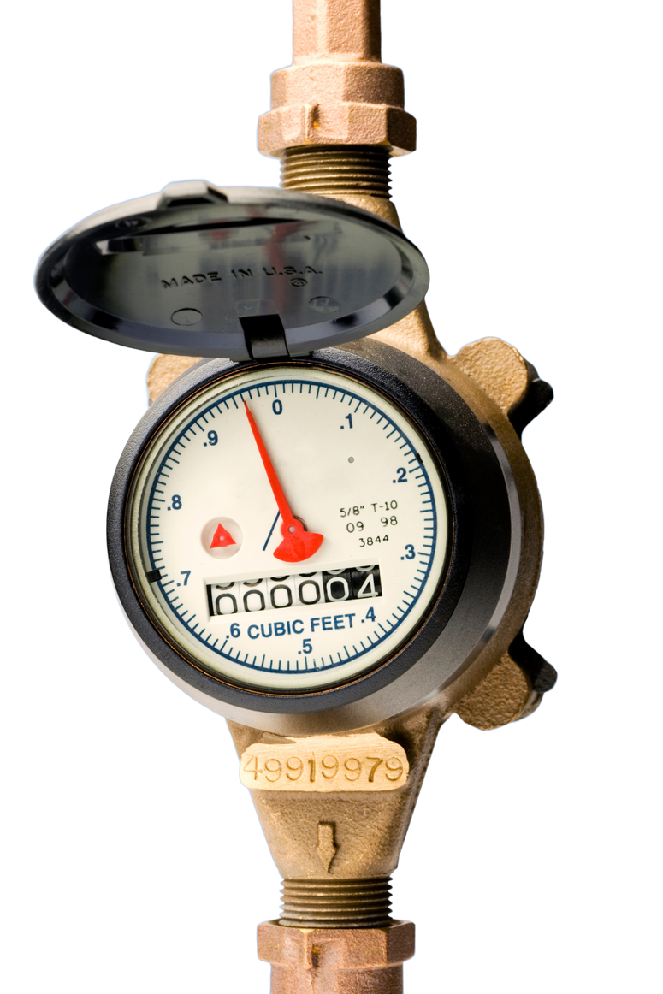
CITY OF DALLAS
AMI-ADVANCED METERING INFRASTRUCTURE
Presented by Kisha Moore/NWGRC and Amber Whisner/City of Dallas

Slide 2




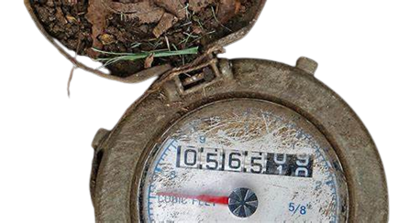
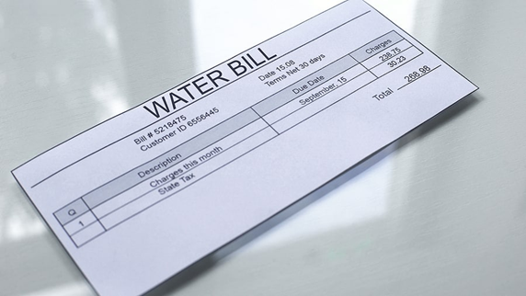
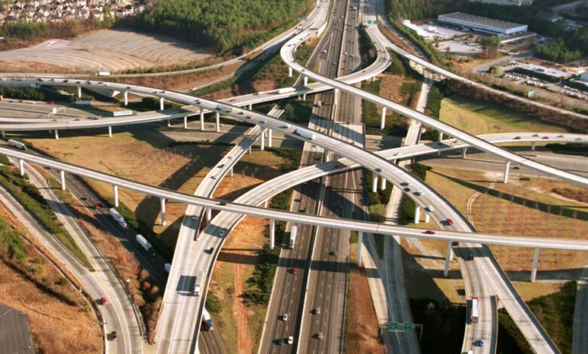
WHAT IS REALLY ANNOYING?

Slide 3
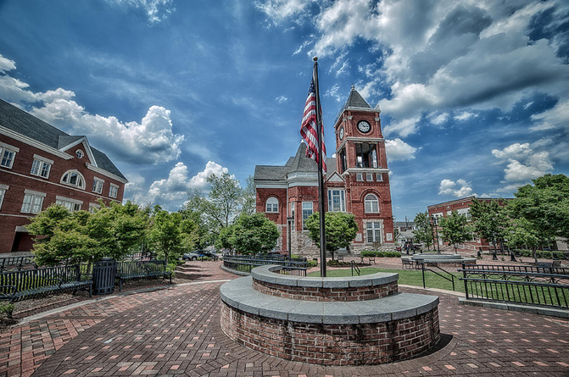
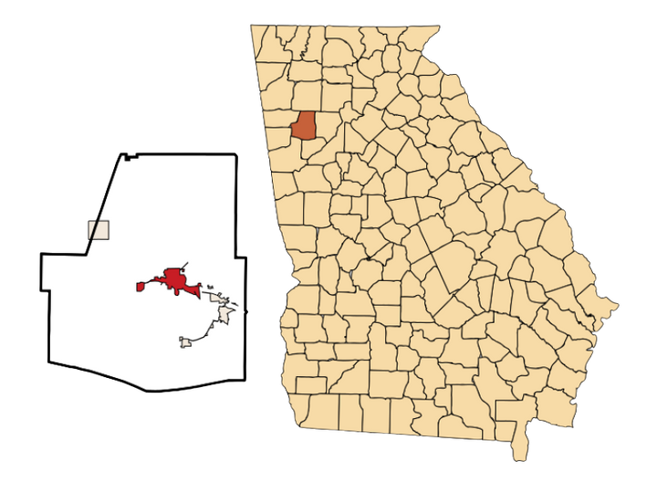
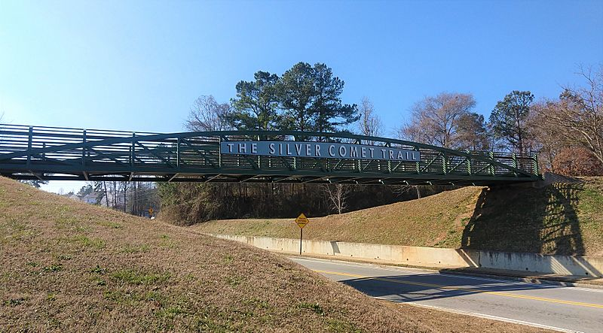
Geography/Demographics
  38 miles outside of Atlanta
  Paulding County
  Population of ~15,000 (2024)
  Dallas Theater
  Silver Comet Trail

Slide 4

What is advanced metering infrastructure?
A network system that provides a two-way communication between utilities and customers

Slide 5
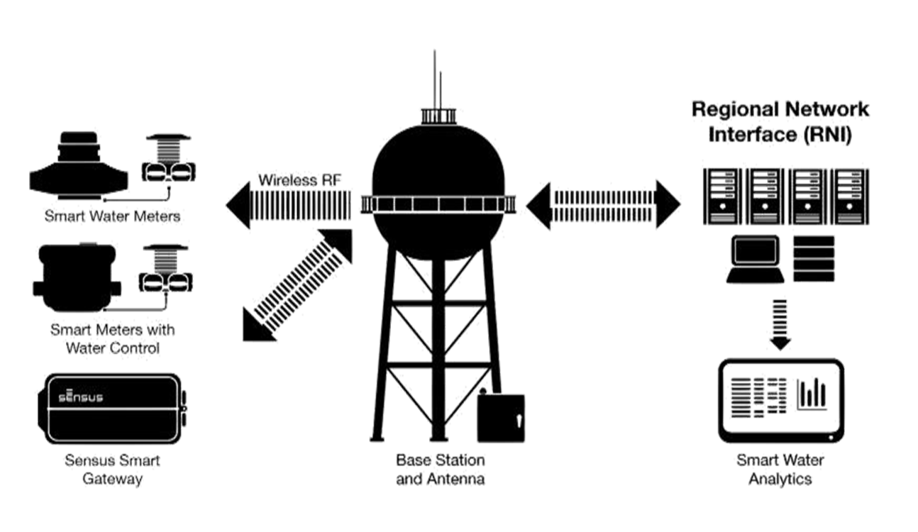


AMI changes everything. But How does it work?
The City of Dallas is saving gallons of water per month:

Slide 6
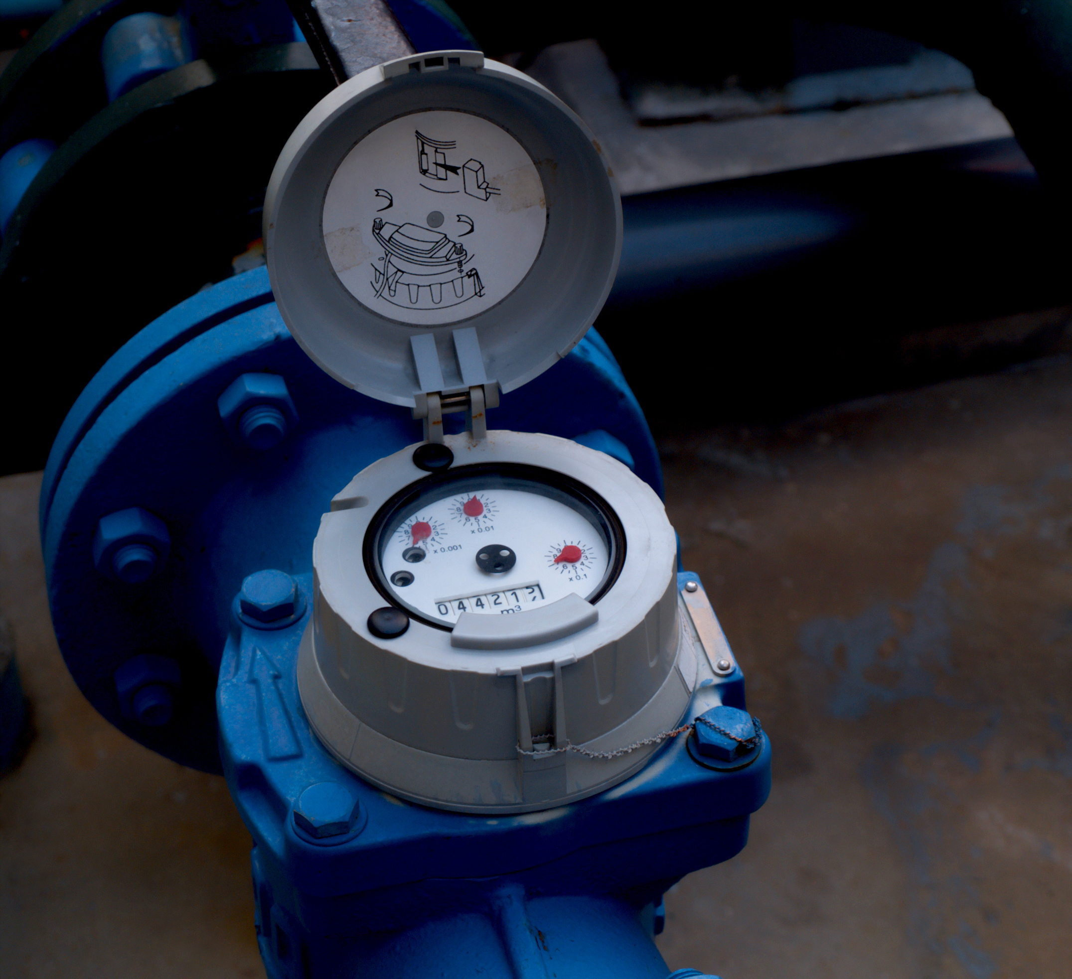
WHY AMI?
  It gives our customers more accurate reading on their water usage
  It gives Dallas the ability to alert customers when there is a problem
  More sustainable for the environment

Slide 7

Comprehensive Plan
Water quality and water conservation are mentioned in the last several Paulding County Comprehensive Plans. This allowed them to have the flexibility to pursue funding options and create water plans like the city’s long-range water plan, which was made in 2023. Proper planning is necessary to have a successful project as they have many moving parts

Slide 8
38
miles of water line
System Overview
3,700
Water Connections
14,000
Population
21
water purchased from 21 county interconnections
3
wells
2016
total water supplied 205.733 million gallons
2016
real water loss 29.134 million gallons
2016
apparent loss 5.605 million gallons

Slide 9

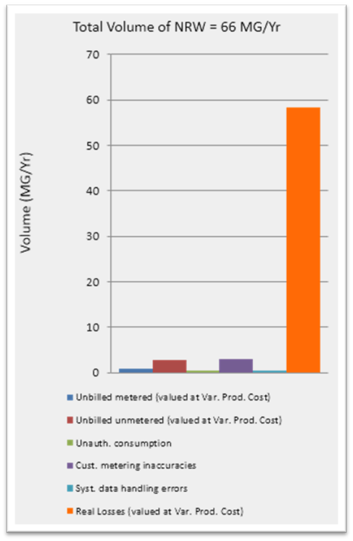
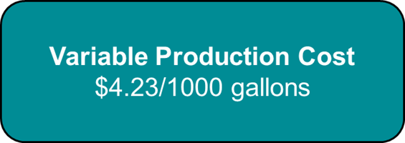
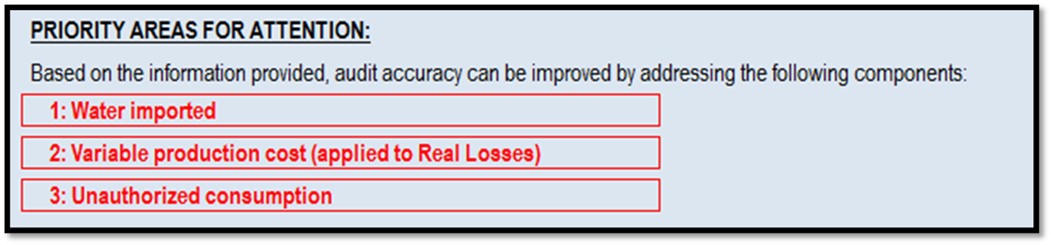
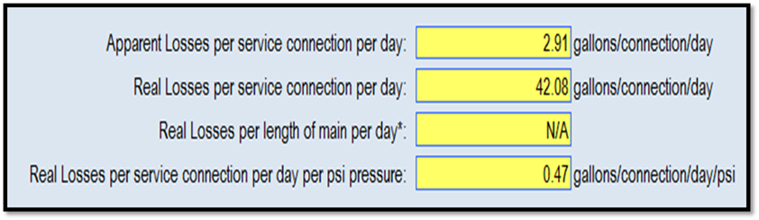
Audit

Slide 10
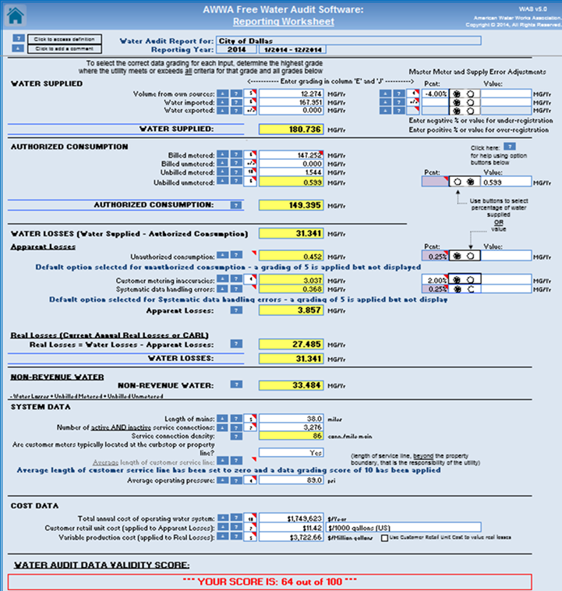
What does the Audit tell us?
  Blueprint of the water system
  How much water consumers are bringing into the system
  How much is leaving the system
  Things in the audit that can help the system improve

Slide 11
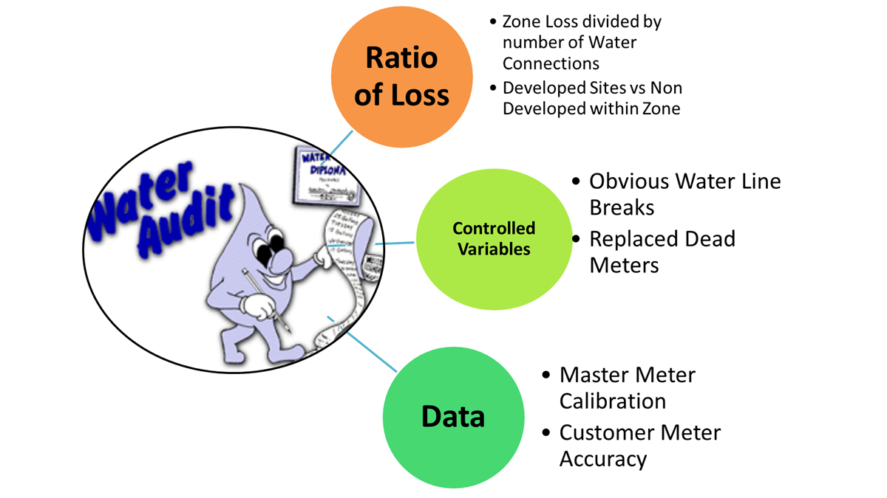
Water Loss Control Program Guidelines

Slide 12
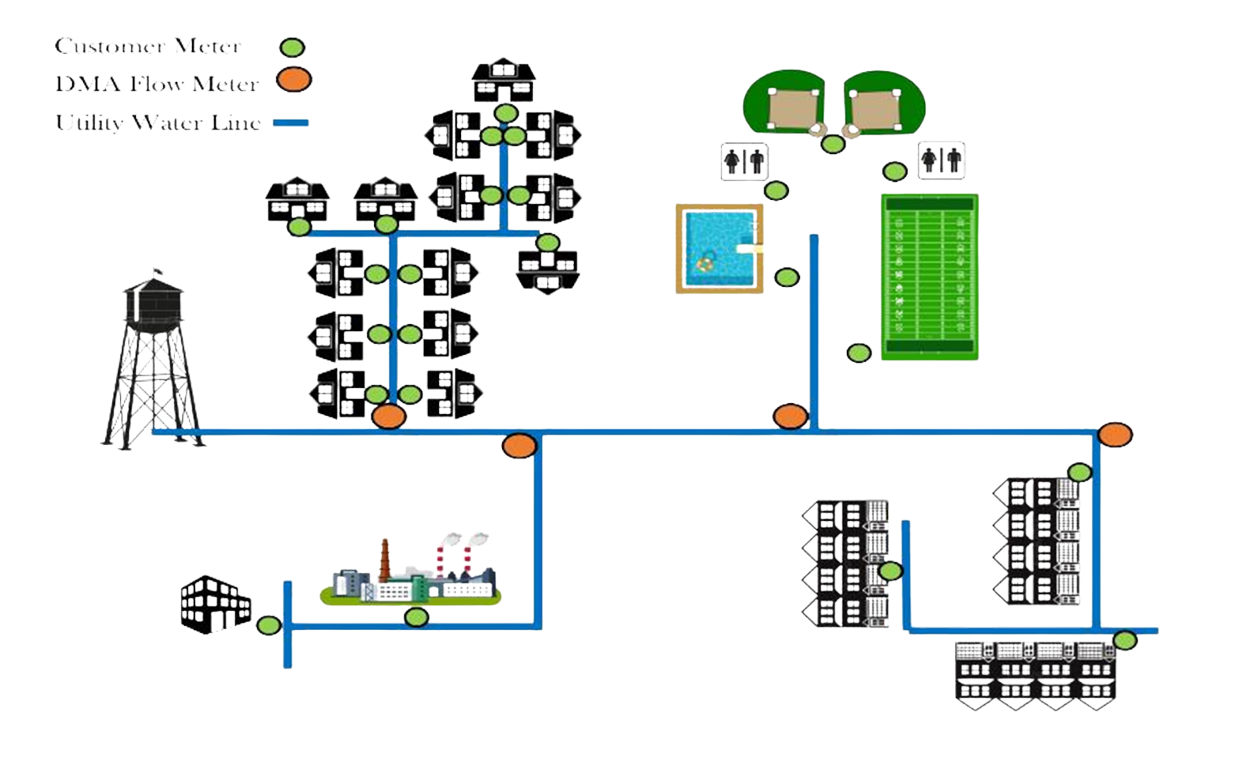

Slide 13
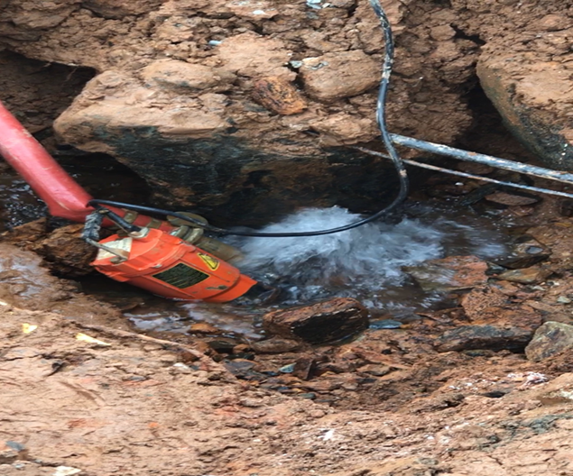
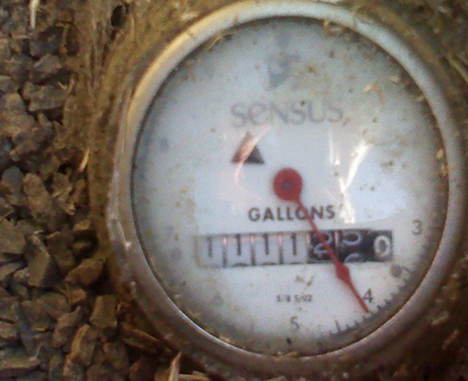

Types of Water Loss
Real Losses V. Apparent Losses
Cased by the physical loss of water. This typically happens from a leak either in someone's house, or in a water main.
Apparent losses are meter under-registration, water theft, and billing errors.

Slide 14
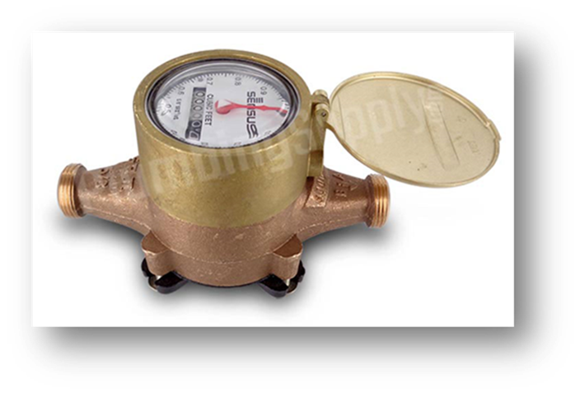
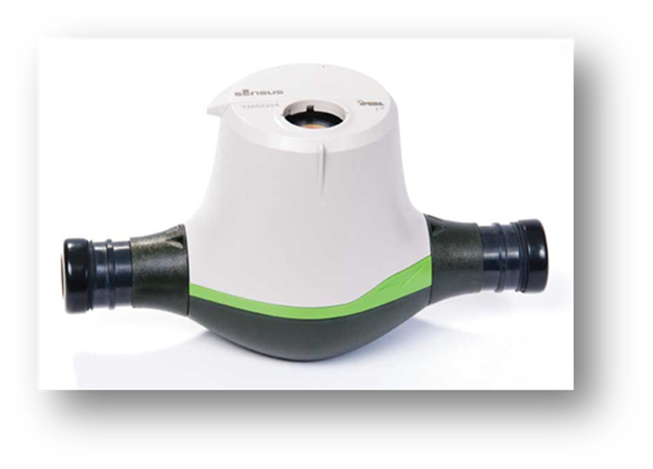
Meter Replacement Project
2015
Project began
12-15 years
New meter life cycle
2018-2020
All meters replaced during this time will be fully operational on the AMI system
2027
Next phase of meter replacement program will begin

Slide 15
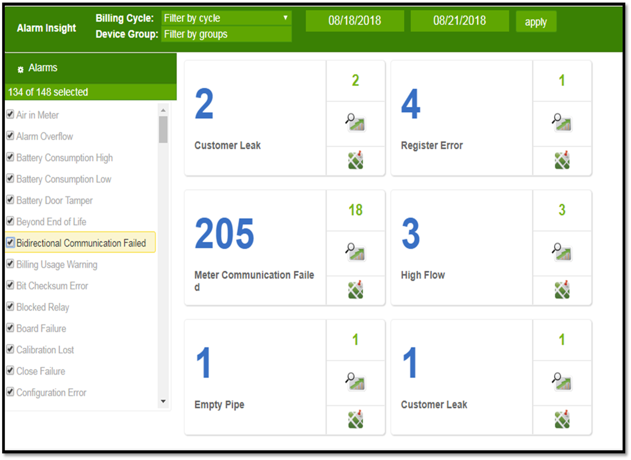
The system automatically alerts to potential leaks in each District Meter Area (DMA). It also alerts to high flow areas, and places where the meter has fallen out of communication for the system.

Slide 16
Corrective Actions Taking Place
Meter Testing
Leak Detection
Meter testing should be done on a regular basis on both older meter that have not been replaced yet as well as new electronic meters as precautionary
As DMA’s are completely transferred over to AMI, leak detection should be done more frequently
Pressure Management & Monitoring
Utilize Component Analysis Tool
Set up pressure monitoring areas in each DMA using Sensu products that can connect with the AMI analytics software so that regular monitoring and management can take place
provided by American Water Works Association (AWWA) for additional steps and courses of action

Slide 17

SUCCESS!
This measure is expected to drop water loss from roughly 47 million gallons per year to less than 10 million gallons per year

Slide 18
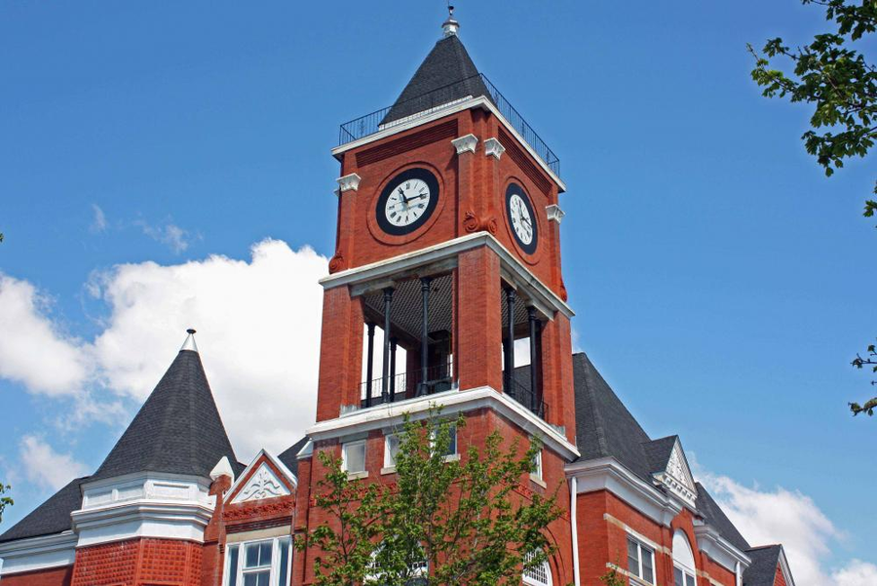
Find out More about the City of Dallas’ Success!
•Dallas saves 12 million gallons of water thanks to smart meters
•georgia-city-charges-forward-on-water-conservation-initiative.pdf
•Georgia City charges forward on water loss control with Sensus

Slide 19
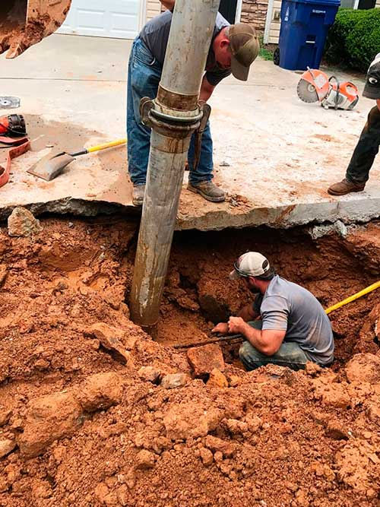
Thank you!
Amber Whisner
Director of Business Development/City of Dallas
Kisha Moore
Community and Economic Development Representative /NWGRC

