Slide 1



Phase II Sewer Rehabilitation Project for
The City of Cochran
presented by Richard Newbern, City Manager
On July 22, 2025

Slide 2

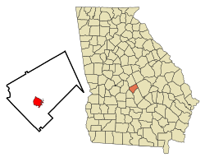
The City of Cochran
The City of Cochran is located in Bleckley County, Georgia, United States.
As of 2023, it had a population of 5,026 people.
It is the county seat of Bleckley County.
The City of Cochran is described as a charming rural community located in central Georgia, exemplifying small-town southern living.
Cochran and Bleckley County are characterized by a relaxed rural lifestyle and a strong sense of community
Cochran operates under a mayor-council system of government where the elected mayor and city council provide policy direction and oversight while a professional city manager handles the administrative operations of the city.

Slide 3
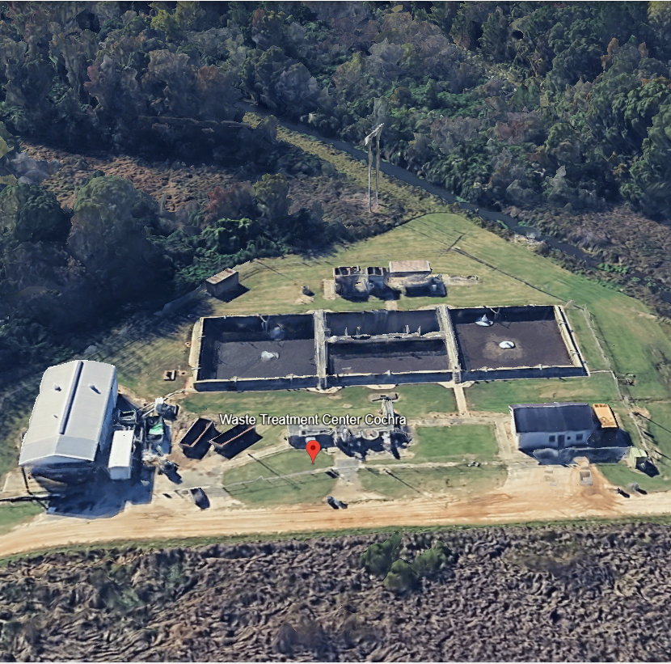
Cochran’s WasteWater Treatment Facility
The city operates a modern plant built in 2002 that processes 430,000 gallons per day, utilizing technology like sequencing batch reactors, filters, and UV disinfection.
The City maintains 5 lift stations as part of the wastewater system and inspects each of them 5 days per week.
The city utilizes belt press equipment for sludge processing
Notes:
We have a tertiary plant

Slide 4
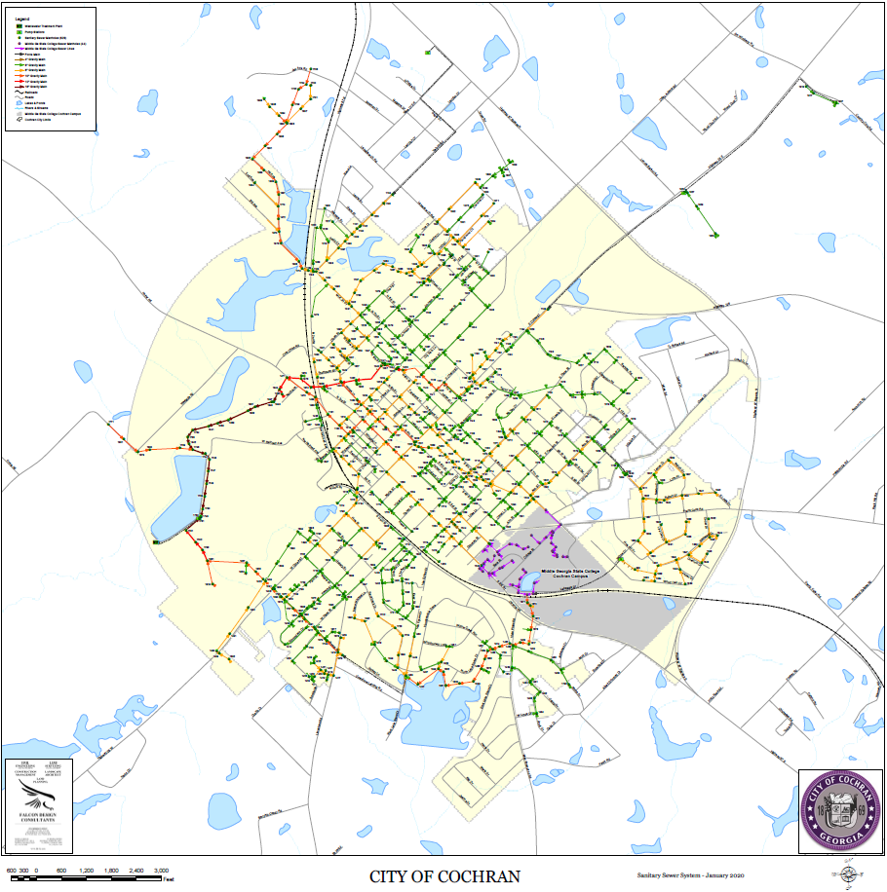
Aging infrastructure requires maintenance and upgrades
Cochran’s waste water system consists of 27 Miles of sewer lines.
Much of the wastewater treatment Infrastructure for the city of Cochran dates back to the 1950s and 1960s.
With age, sewer lines commonly experience corrosion and deterioration, root intrusion, joint failures and pipe separation, structural collapse or cracking all of which create infiltration and flow problems.

Slide 5

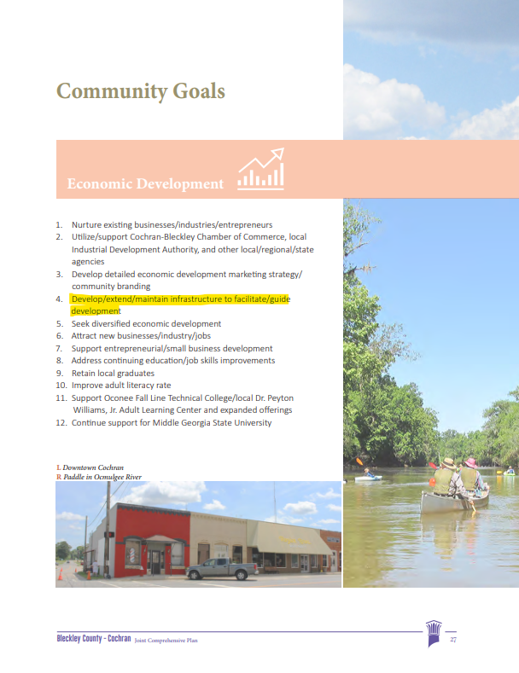
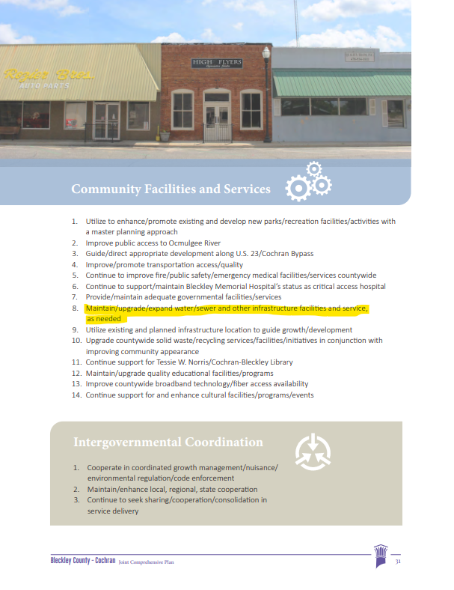
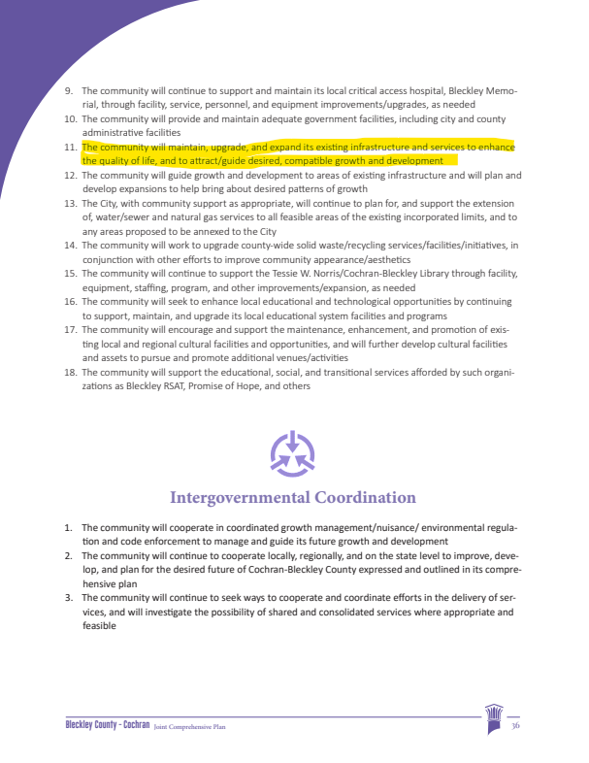
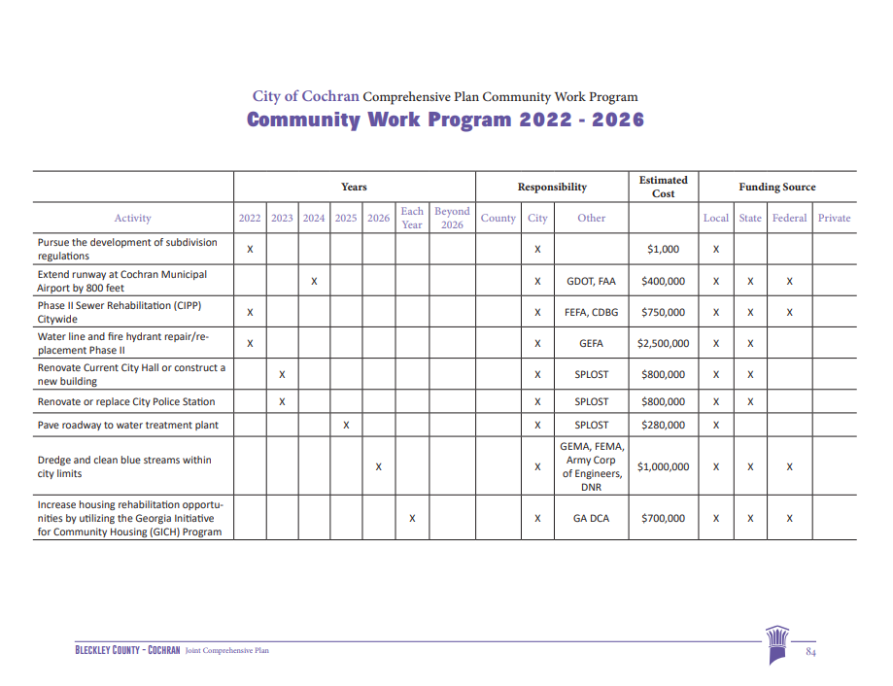
Growing a better Bleckley
OUR COMPREHENSIVE PLAN CALLS FOR RENOVATIONS OF OUR INFRASTRUCTURE IN SEVERAL PLACES AS WELL AS PAGE 84 IN OUR COMMUNITY WORK PROGRAM
Notes:
Our comp plan calls for renovations of our infrastructure in several places. Pages 27, 31 and 36 and then in our Community Work Program on page 84.

Slide 6
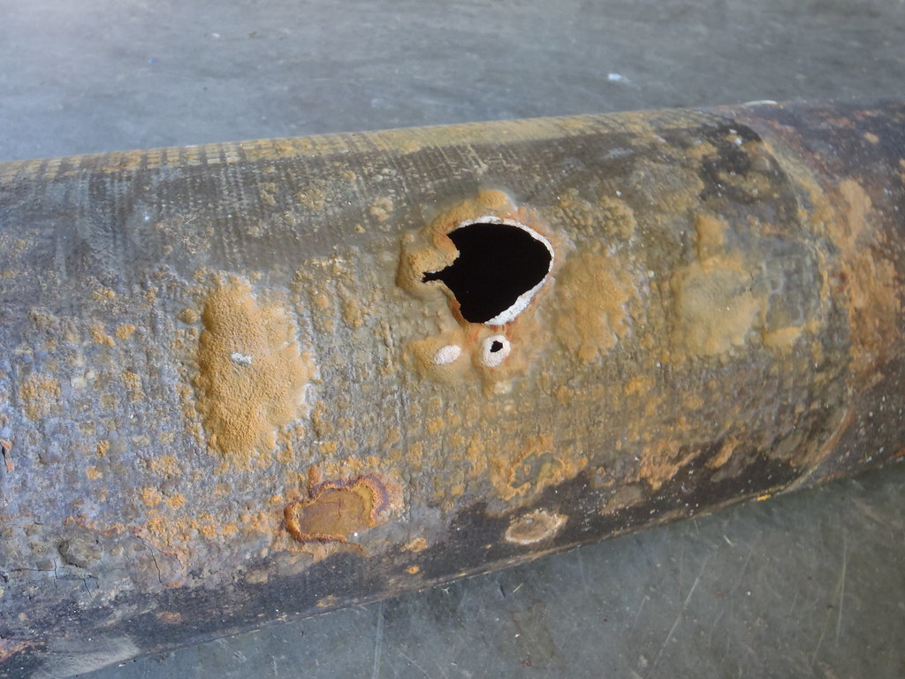
IN 2018 THE CITY OF COCHRAN COMPLETED A COMPREHENSIVE CONDITION ASSESSMENT OF ALL 27 MILES OF SEWER COLLECTION LINES IN TOWN.
A TOTAL OF SIX MILES OF SEWER LINES SERVING RESIDENCE AND BUSINESSES WERE IDENTIFIED AS DETERIORATED AND IN NEED OF REPAIR OF REPLACEMENT.
TRADITIONAL SOLUTIONS INVOLVE EXPENSIVE EXCAVATION WORK THAT INCLUDE TRAFFIC DISRUPTION, PROPRTY DAMAGE LIABILITY, EXTENDED TIMELINES ON TOP OF ESCALATED EXPENSE.

Slide 7
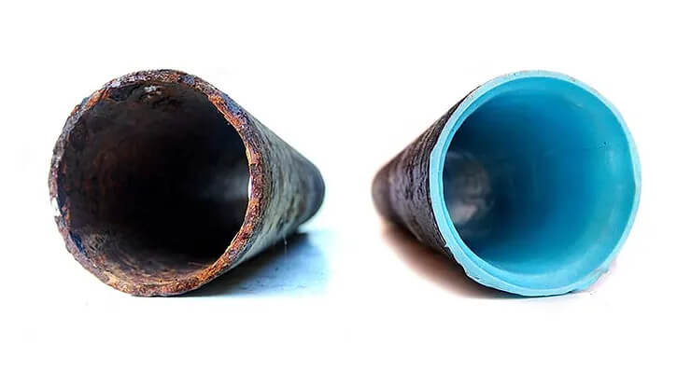
Slip lining or Cured in place pipe (CIPP)
Slip lining is a trenchless pipe rehabilitation method where a geothermal compound is pumped into deteriorated sewer lines creating a permanent interior coating that reinforces the original sewer line. This technique is used to restore structural integrity, prevent leaks, and extend the lifespan of pipelines like sewers, storm drains, and water mains. Slip lining is a cost-effective alternative to traditional pipe replacement

Slide 8

The city of Cochran obtained a 2.5 million dollar loan through gefa to finance this and other infrastructure improvement projects. The loan was given with a 1.3% interest rate to be repaid over a 20 year period. Based on Cochran’s low to moderate income status Cochran was granted a 25% forgiveness on this loan.

Slide 9

The project was advertised for bid
In response, The city of Cochran received 7 bids including the winning bid from The renee group out of Atlanta.

Slide 10
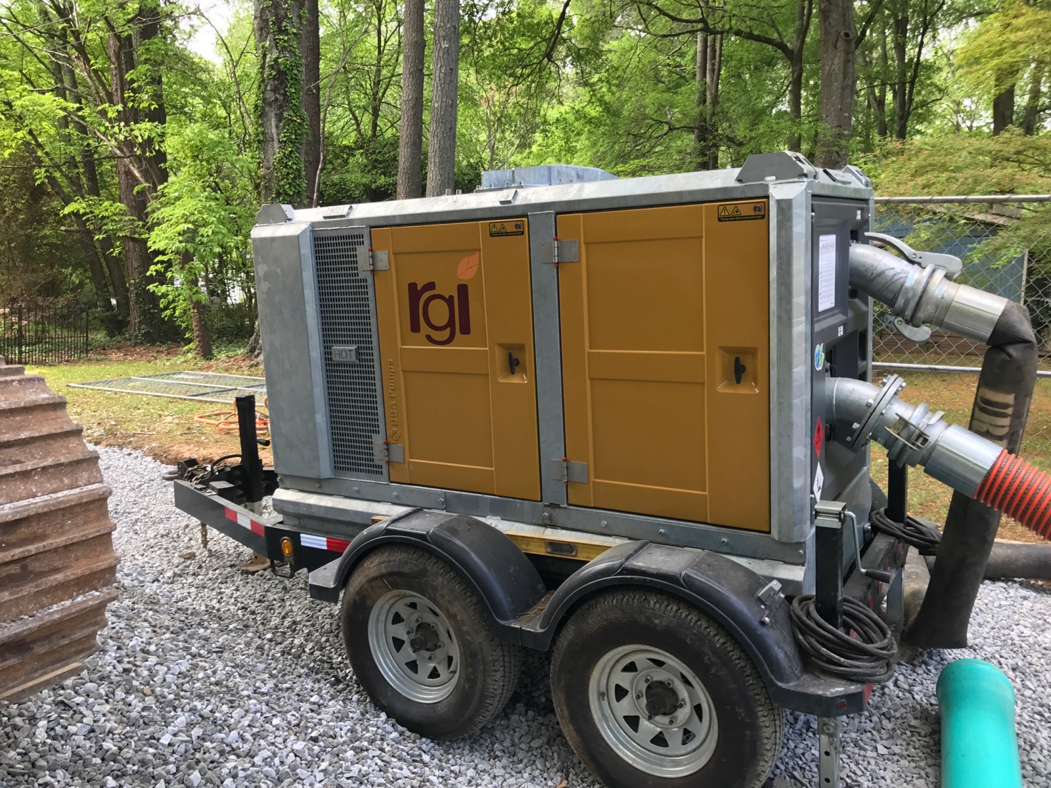
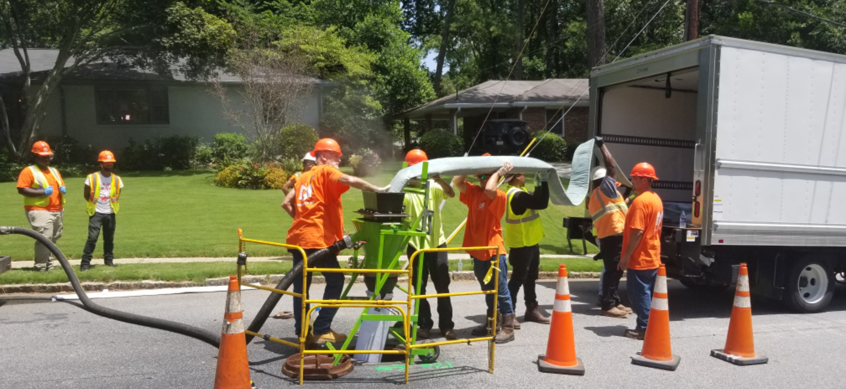
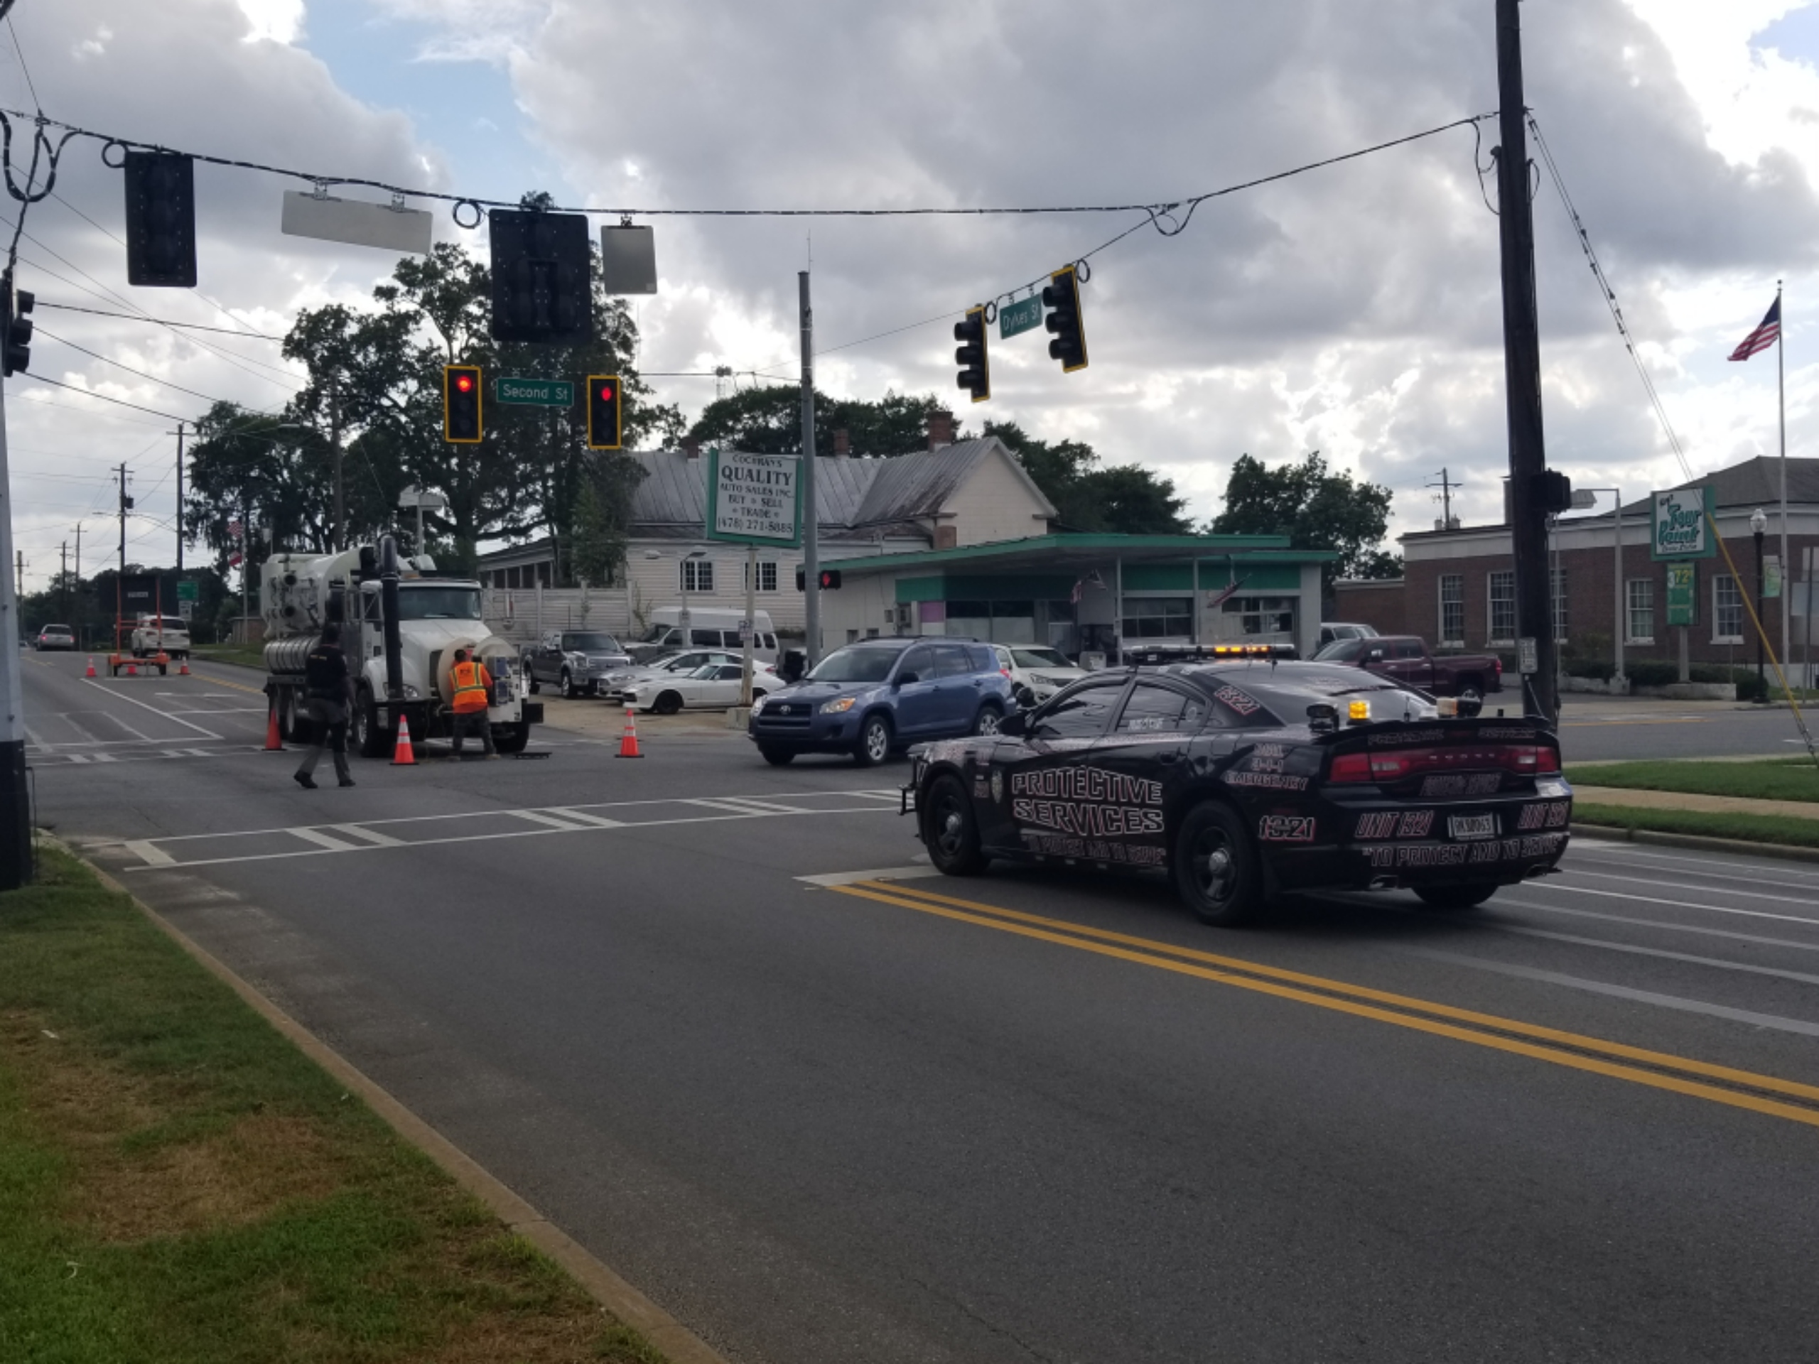
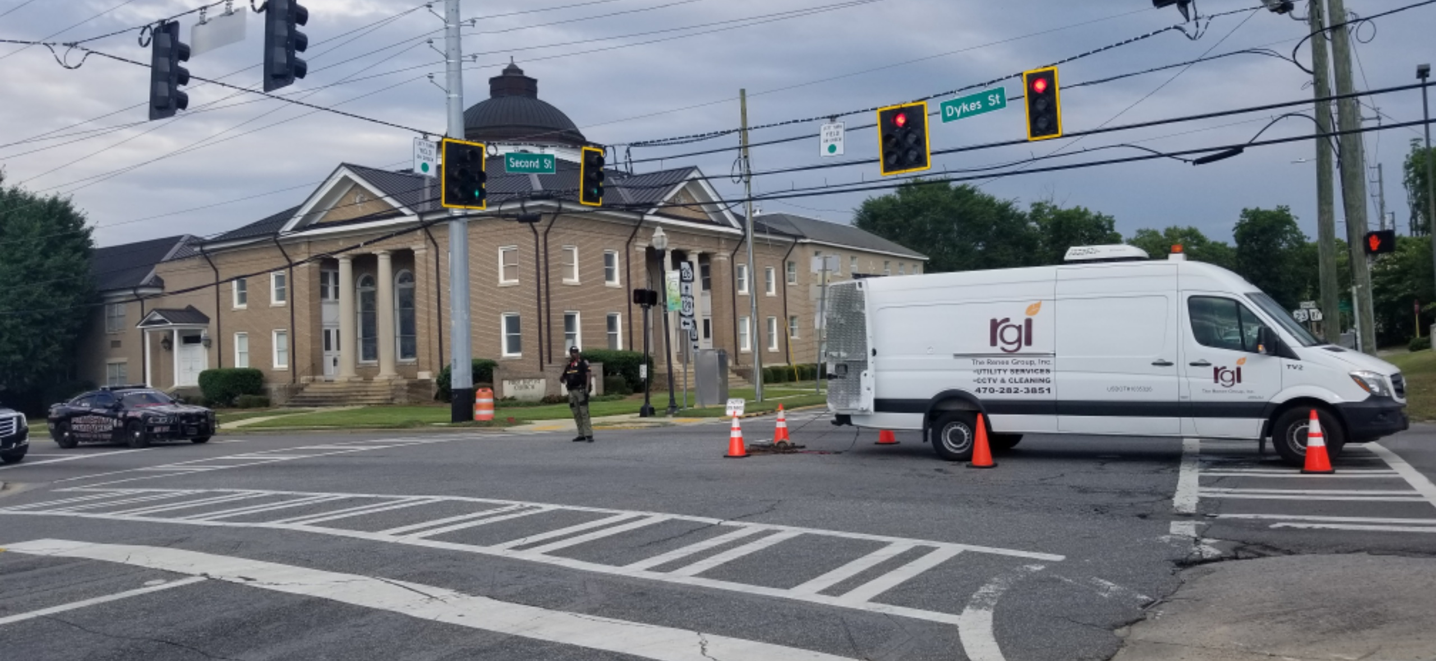
Project implementation by the Renee group
In 2021, the City of Cochran successfully implemented their Phase II Sewer Rehabilitation Project. This was a $1.3 million improvement to the City's sewer collection system.
This project greatly improved the reliability and efficiency of the City's sewer collection system, directly meeting the City’s goal of improving water and sewer infrastructure.

Slide 11


collaboration
Public Works Department
As we do with most projects, the City of Cochran leaned on the combined efforts of several of our branches to complete Phase II of our sewer rehabilitation project.
Notes:
Public works, Admin, Council, Falcon Design, Renee Group, community

Slide 12
Takeaway
Phase II of our Sewer Rehabilitation project was a success for the city of Cochran.
It resulted in a more efficient return flow to our wastewater treatment plant and it extended the life of our city’s infrastructure.
In addition, We learned the value of a thorough preconstruction meeting and the importance of community education during project implementation.

Slide 13
In 2024 Senator Jon Ossoff secured a $700,000 grant for the City of Cochran to be used for wastewater improvement projects, which include main sewer lift station repair and relocation of the facility’s belt press
The City of Cochran will continue to maintain and upgrade our aging infrastructure for the citizens of Cochran
Notes:
You may have noticed the title of this project was “Phase 2”. We are constantly working towards improving our infrastructure for generations who will live and work in Cochran, Georgia.

