Slide 1
Citizen Participation &
Section 504 Requirements

Slide 2

Citizen Participation
Notes:
Citizen Participation which is a very important portion of the application.

Slide 3

Public Hearings
Applicants must hold at least one public hearing, prior to application, to allow citizen participation, views, questions and input.
Hearing should be held early in process to take citizen input into consideration
Hearings held after application is prepared are not allowing citizen participation
Include estimated amount of funds proposed
Discuss plan to minimize displacement and assist any displaced persons
Sample hearing notices in Appendix of Applicants’ Manual – English & Spanish
Notes:
At least one public hearing should be held prior to the application submission to allow for citizen participation, views, questions, and input.
Should be held early in the process.
Hearings held after the application is prepared are not allowing for citizen participation
Should include the estimated amount of funds proposed
Should discuss plan to minimize displacement and assist any displaced persons
Sample hearing notices in Appendix of Applicants’ Manual – English & Spanish
We’ll look at the language requirements later on

Slide 4

Public Hearings
Notices must provide five (5) full days notice prior to hearing
1st day begins on the day following the published notice
  Monday – Ad appears in newspaper
  Tuesday – Day 1
  Wednesday – Day 2
  Thursday – Day 3
  Friday – Day 4
  Saturday – Day 5
  Sunday – Hearing can take place today or any subsequent day
Placed in non-legal section of the general circulation local newspaper in block form
Notes:
The 1st day of advertisement does not count. A full 24 hours must pass before the 1st day can begin. Only the days between the publication and the hearing date count toward that 5 day notification period. In the example you see the ad is placed in the paper on Monday and the hearing could take place on Sunday but of course most would hold it the next day.
-The publication should be Placed in non-legal section of the general circulation local newspaper in block form.

Slide 5

Public Hearings
Must be held at time and locations convenient to potential or actual beneficiaries with accommodation of the handicapped (notices should include information to accommodate special needs).
The needs of non-English speaking residents should be met in areas of significant concentration.
Must maintain evidence of compliance.
Certified minutes must be kept.
The applicant must maintain detailed minutes of this hearing, a "tear sheet" or affidavit pertaining to the public notice and documentation as to whether or not meeting "special needs" was required and, if applicable, addressed.

Slide 6
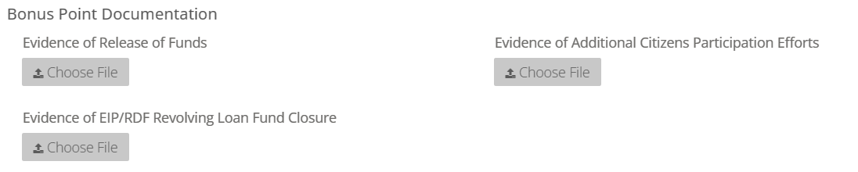
Bonus Points - Robust Citizen Participation
Extra efforts to provide an opportunity for citizens, especially LMI citizens, to participate in an advisory role in the planning, implementation, and assessment of the programs and projects funded through CDBG activities.
Water Bill Announcements
Social Media Announcements
Meeting times and frequency
Flyers - when, where, how often
Informative / interactive webinars
Notes:
For Robust Citizen Participation. Here we have some examples of outreach and engagement that may assist in the efforts to provide an opportunity for LMI citizens to participate in an advisory role in the planning, implementation, and assessment of the programs.
Water Bill Announcements
Social Media Announcements
Meeting times and frequency – making these more convenient for working persons / hold more than one meeting
Flyers - when, where, how often
Informative / interactive webinars
In the portal there is a specific section for this information to be uploaded.

Slide 7
Robust Citizen Participation Example
Provided a cover sheet detailing the extra steps taken for robust citizen participation efforts
Advertised in The Bleckley Buzz (Chamber of Commerce newsletter)
Included a survey in the utility mail: “On April 26, 2023, approximately 2,000 Neighborhood Conditions Surveys were included in the monthly statements mailed to City of Cochran utility customers. Data will continue to be collected and discussed at upcoming GICH Team meetings and at City Department Head Meetings”.
Online survey was made available via the city website
Advertised public hearing at multiple locations: Cochran Housing Authority Bulletin Board, Bleckley County Health Department Bulletin Board, Bleckley County Department of Family and Children Services Bulletin Board, Bleckley County Courthouse Bulletin Board, and City of Cochran Auditorium Door Posting
At the CDBG pre-application citizen participation public hearing, residents were asked to indicate on the sign-in sheet as to their interest and willingness to serve as a member of a CDBG Committee that the city is forming.
Notes:
City of Cochran, 2023 round
QCR gave 10 points for CP efforts
The packet was 125 pages, much of which was the newsletter, but it was concise and contained all of the information detailed in the cover sheet.
**if your extra efforts occur only 2 months prior to application submission, the review panel will not consider a large amount of points

Slide 8
Language Access Requirements
Title VI of the Civil Rights Act of 1964 and pursuant to EO 13166 requires meaningful access to information and services for Limited English Proficiency (LEP) persons*.
  Persons who do not speak English as their primary language and who have a limited ability to read, write, speak, or understand English, and may be entitled to language assistance with respect to a particular type of service, benefit, or encounter.
  Noted as speaking English less than “very well” in America Community Survey (ACS) Data Table S1601: Language Spoken at Home
Notes:
While EO13166 has been revoked, agencies are not required to change current policies, according to newly enacted EO 14224.
“Agency heads should make decisions as they deem necessary to fulfill their respective agencies' mission and efficiently provide Government services to the American people. Agency heads are not required to amend, remove, or otherwise stop production of documents, products, or other services prepared or offered in languages other than English”
Speaking on the provision of translated services, we need to define what a limited English proficiency or LEP persons are – which is
a. Persons who do not speak English as their primary language and who have a limited ability to read, write, speak, or understand English, and may be entitled to language assistance – so how do we determine this?
b. We do so by using the America Community Survey (ACS) Language Spoken at Home – also known as Data Table S1601
i. Of course there are different thresholds depending on what you find in the data

Slide 9
Language Access Requirements
The size of the language group determines the recommended provision for written language assistance:
Translate vital documents
1,000 or more in a single language or more than 5% of the eligible population or beneficiaries and more than 50 in number.
Translated written notice of right to receive free oral interpretation of documents.
More than 5% of the eligible population or beneficiaries and 50 or less in number
No written translation is required.
5% or less of the eligible population or beneficiaries and less than 1,000 in number
Notes:
The size of the language group determines the recommended provision for written language assistance:
If you have to publish for a public hearing in a language other than English than your data will meet the criteria of
1,000 or more in a single language OR more than 5% of the eligible population or beneficiaries and more than 50 in number – that speak English less than very well. We will visit two examples after this since this process can be quite confusing
Translated written notice of right to receive free oral interpretation of documents.
More than 5% of the eligible population or beneficiaries and 50 or less in number – we rarely see this triggered
No written translation is required.
% or less of the eligible population or beneficiaries and less than 1,000 in number - this is the most common data that we see

Slide 10
What is a Vital Document?
A vital document is any document that is critical for ensuring meaningful access to the recipients' major activities and programs by beneficiaries generally and LEP persons specifically. Whether or not a document (or the information it solicits) is "vital" may depend upon the importance of the program, information, encounter, or service involved, and the consequence to the LEP person if the information in question is not provided accurately or in a timely manner.
A list of vital documents to be translated (if necessary) and schedule for translating and disseminating vital documents:
The following list of vital HUD/CDBG Documents will be translated into the Spanish language and made available:
Pre-award Public Notice | Prior to award
Post-award Public Hearing Notice | Within 60 days of award
Environmental Notices | As required
GA DCA/HUD Brochures, Poster, Fliers | On permanent display or as required
Fair Housing Materials | On permanent display or as required.
SAMPLE
Notes:
From time to time we receive questions on what is considered a vital document.

Slide 11
Meaningful Access - Data
American Community Survey Data
  Table S1601 5-Year Estimates
    Language Spoken at Home
  Table C16001 5-Year Estimates
    Language Spoken at Home for the Population 5 Years and Over
  Hosted on https://data.census.gov/
DCA’s CDBG Applicant Concentration Map
  https://georgia-dca.maps.arcgis.com/apps/webappviewer/index.html?id=a547b61dac0545d29101ff902cbf8c3e
Notes:
In order to obtain the necessary data, you can use data.census.gov or you can use the CDBG applicant concentration map which is where the information provided in the required LAP is verified by DCA staff.
C16001 is a resource for specific language groups.
Presents a comprehensive list of languages spoken at home by the population 5 years and over, along with estimates of English proficiency
More detailed breakdown of specific languages compared to Subject Tables

Slide 12
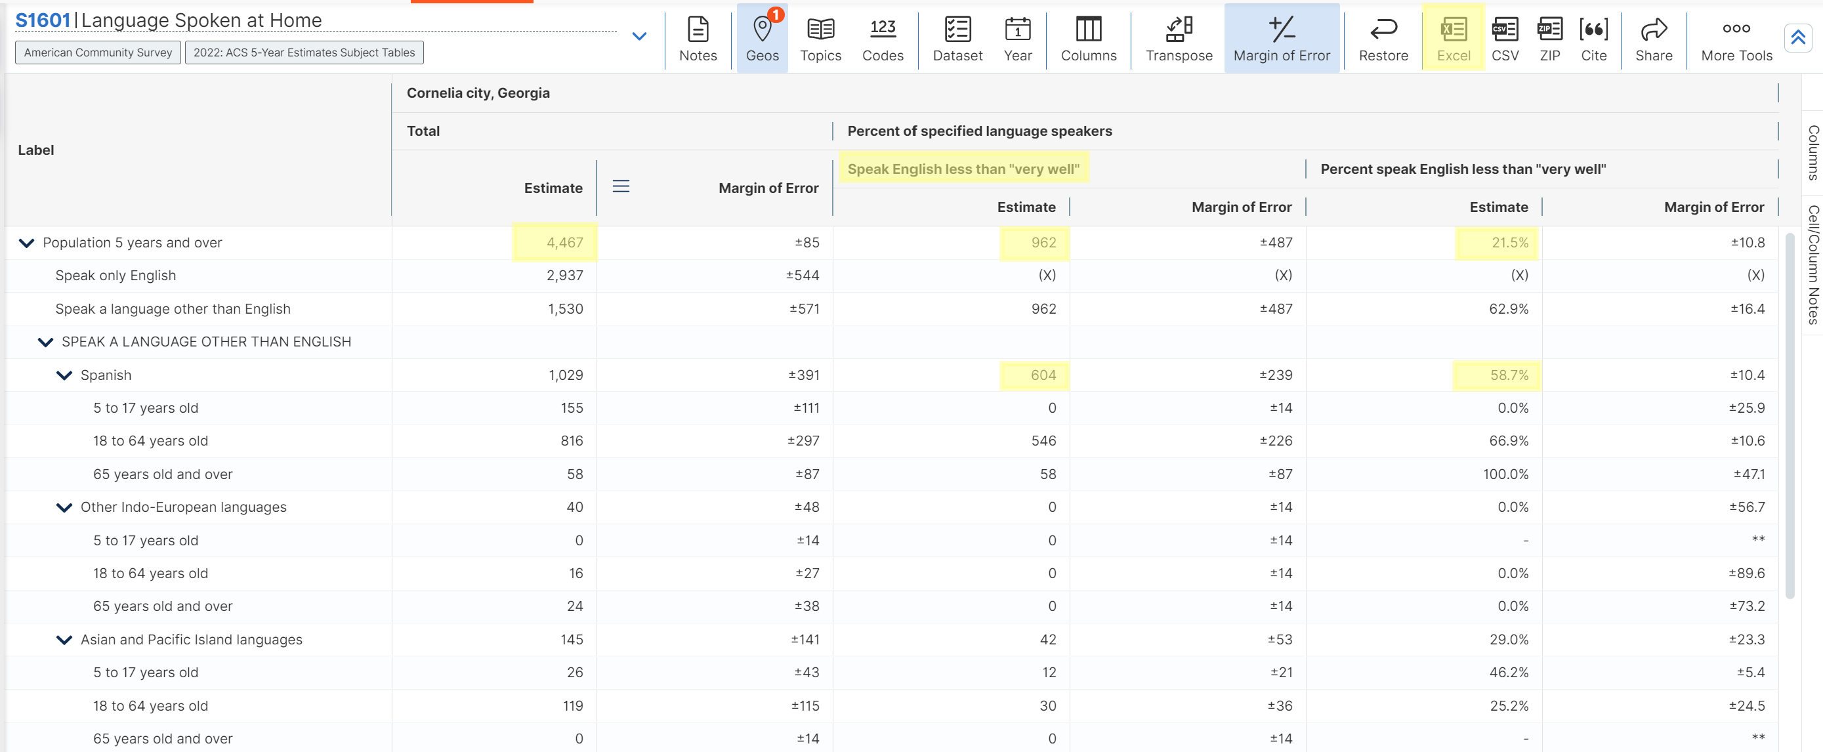
604 / 4,467 = .1352 x 100 = 13.52%
Notes:
Here is an example of the table S1601. As you can see it’s the city of Cornelia, this can be downloaded in excel. You have a total speaking population that is 5 years and older – 4,467. In that total population 962 speak English less than very well – that is also estimated to be 21.5%. According to our guidance we want to determine if the threshold is exceeded In a single language. If we scroll down we see the languages listed but see the bulk of them are in Spanish. The estimate is out of that Spanish population. 58.7% of all Spanish speaking people in Cornelia speak Spanish less than very well. BUT we need to convert the estimated number to reflect correctly, and this is where it gets a little tricky. 604 divided by the total population of 4,467 times 100 is 13.52% which is greater than the 5% and more than 50 therefore the threshold has been met triggering translation of vital documents.

Slide 13
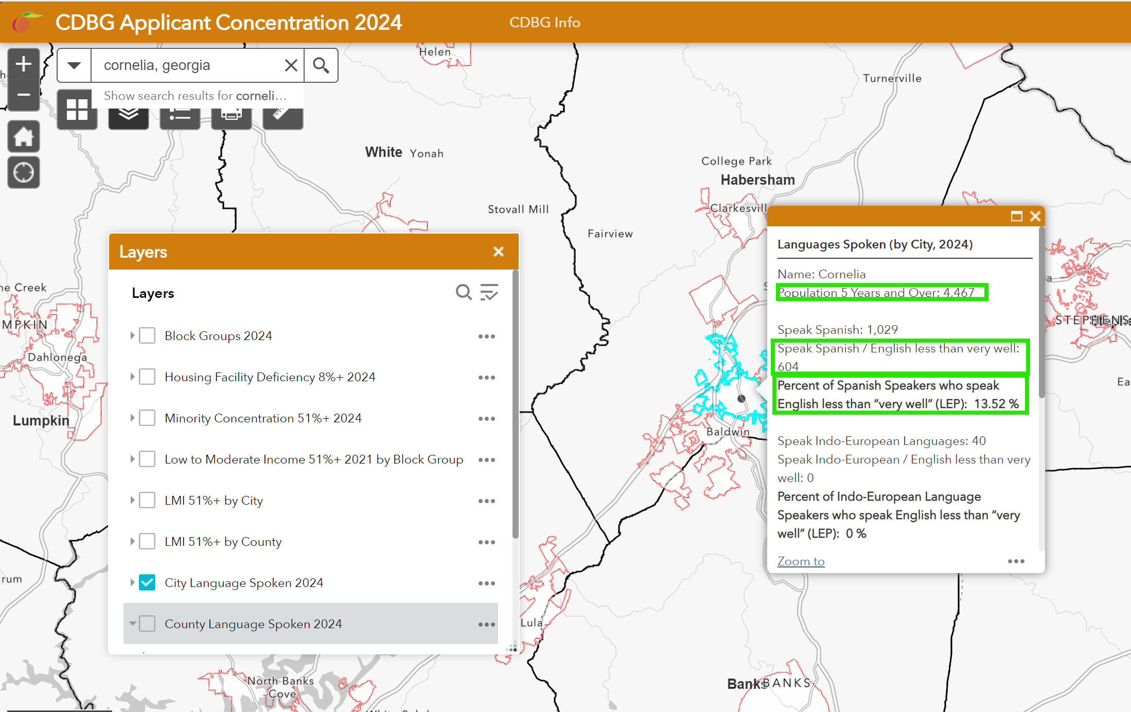
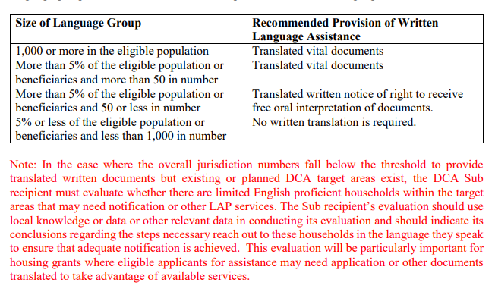
Notes:
Now let’s take a look at the CDBG Concentration map.
As you can see, you need to select your layers, in this case it’s the city language spoken.
Search for the city in the search bar
On the right is the data box that will pop up for your search
Here you see the highlighted areas is the data that you need for your determination
Here you see the percentage is calculated for you for which is an advantage
Again, the data indicates more than 5% of the eligible population or beneficiaries and more than 50 in number required the translation of vital documents.

Slide 14
CDBG Application:
Required Documentation & Common Mistakes
Required Documentation
Acknowledgement form
Threshold certification form
Notice Tear Sheet
Table S1601/DCA Mapping Tool Screenshot
Common Mistakes
Incorrect hearing date is published
Not published in English and Spanish
Threshold for translation is incorrectly determined
Helpful Hint – Utilize the DCA CDBG Concentration Map for Determination
Notes:
Public hearing documentation that is required with application submittal
LEP Acknowledgement form
Threshold certification form
Notice Tear Sheet (a copy of the newspaper ad)
Table S1601/data
Common mistakes include
the publication date is not clear/listed on the LEP certification form
Incorrect hearing date is published in English and Spanish
Threshold for translation is incorrectly determined
We'll look at this in more detail tomorrow also

Slide 15
Resources
Language Access Plan Template for CDBG & DCA’s Sub-Recipient
Language Access Plan Template Guidance for CDBG
https://dca.georgia.gov/financing-tools/infrastructure/community-development-block-grants-cdbg/compliance-administration-0
Notes:
Here we have a link that houses the LAP template and guidance. If you’re awarded, it will become a Special Condition that you have an LAP. There’s a four factor analysis for the process and the link can assist you with that.

Slide 16

Notes:
Moving on to Section 504

Slide 17
Important Facts
Provides rights to persons with disabilities in HUD-funded programs and activities.
Persons with disabilities, persons associated with persons with disabilities, and other persons engaged in certain protected activities under the law, are protected by Section 504.
Prohibits discrimination on the basis of disability in any program or activity that receives financial assistance from any federal agency, including HUD as well as in programs conducted by federal agencies including HUD.
HUD's regulations for Section 504 that apply to federally-assisted programs or activities may be found in the Code of Federal Regulations at 24 C.F.R. part 8.
Notes:
Section 504 does the following:

Slide 18
There are eight (8) specific requirements which have an immediate effect on CDBG Recipients:
1. CDBG recipients must file an assurance of compliance. The Certified Assurances in the CDBG Application included this assurance.
2. CDBG recipients must issue periodic public notices of non-discrimination. This can be accomplished by including appropriate language in public hearing notices. The sample hearing notices included in this Manual reflects this requirement.
3. Employment practices are also covered by Section 504. Any CDBG recipient employing 15 or more persons must:
    a. Designate at least one person to coordinate efforts to comply with the regulation (Section 504 Coordinator); and
    b. Adopt formal grievance procedures that incorporate due process standards and that provide for the prompt and equitable resolution of discrimination complaints.
4. Communications: When a recipient communicates with applicants and beneficiaries by telephone, a telecommunication device for deaf persons (TDD's) or an equally effective system is required. The Georgia Relay Service (voice at 1-800-255-0135 or TDD at 1-800-255-0056 or at 711) is also available to provide this service.

Slide 19
5. All meeting and public hearing spaces must be accessible, and procedures should be in place to ensure that persons with impaired vision or hearing can notify the local government that assistance is required. As applicable, please complete the DCA Meeting Checklist located in Appendix 1.
6. The regulations require each recipient to conduct a self-evaluation. The evaluation must be done in consultation with interested persons, including individuals with handicaps or organizations representing such people.
7. When the self-evaluation identifies structural changes as being required, a written transition plan must also be prepared. The transition plan sets forth the steps necessary to complete the changes, including a time schedule. The plan should identify the agency official responsible for implementation of the plan.
8. Grant recipients and their grantees/contractors share joint responsibility for carrying out activities in conformance with applicable Section 504 requirements (list of responsibilities can be found in the Recipients’ Manual).

Slide 20
504 Requirements
Applies to recipients of federal funds
Similar to Americans with Disability Act
If more than 15 employees, 504 Coordinator
  No additional pay
  Coordinates efforts to comply with regulation (maintain records)
Complete DCA 504 Meeting Checklist (reasonable timeframe to the project)
Written transition plan if structural changes required
  Steps necessary to complete changes
  Time schedule to complete
  Identify agency official responsible for implementation
Notes:
From a 10,000 feet up, the information here is what is most important for todays presentation.

Slide 21
Thanks!
Brittney Hickom
Brittney.Hickom@dca.ga.gov
Direct: 470-698-8166
Compliance Officer
dca.georgia.gov

