Slide 1


Community HOME Investment Program
2025 Grant Application Webinar

Slide 2



2025 CHIP Application Webinar
Overview of the 2025 Application
Scoring Criteria
Submission Instructions using Emphasys

Slide 3
Community
HOME
Investment
Program
Funded with Federal HOME dollars from HUD
Not a direct beneficiary program
Average 10-15 grants awards per year
Awards an annual allocation statewide

Slide 4

What is HOME?
HOME Investment Partnership Program
  Formula grant allocated to states and local governments
  Usually includes partnerships with nonprofits
  Largest federal block grant designed to provide decent, safe, sanitary, and affordable housing for very low to low-income households
    Household income cannot exceed 80% of the Area Median Income(AMI) limit

Slide 5
How Does CHIP Meet the Affordable Housing Needs of Georgians?
New Construction of single-family homes
Owner-Occupied housing rehabilitation
Resource Center for residents across the state seeking housing assistance.

Slide 6
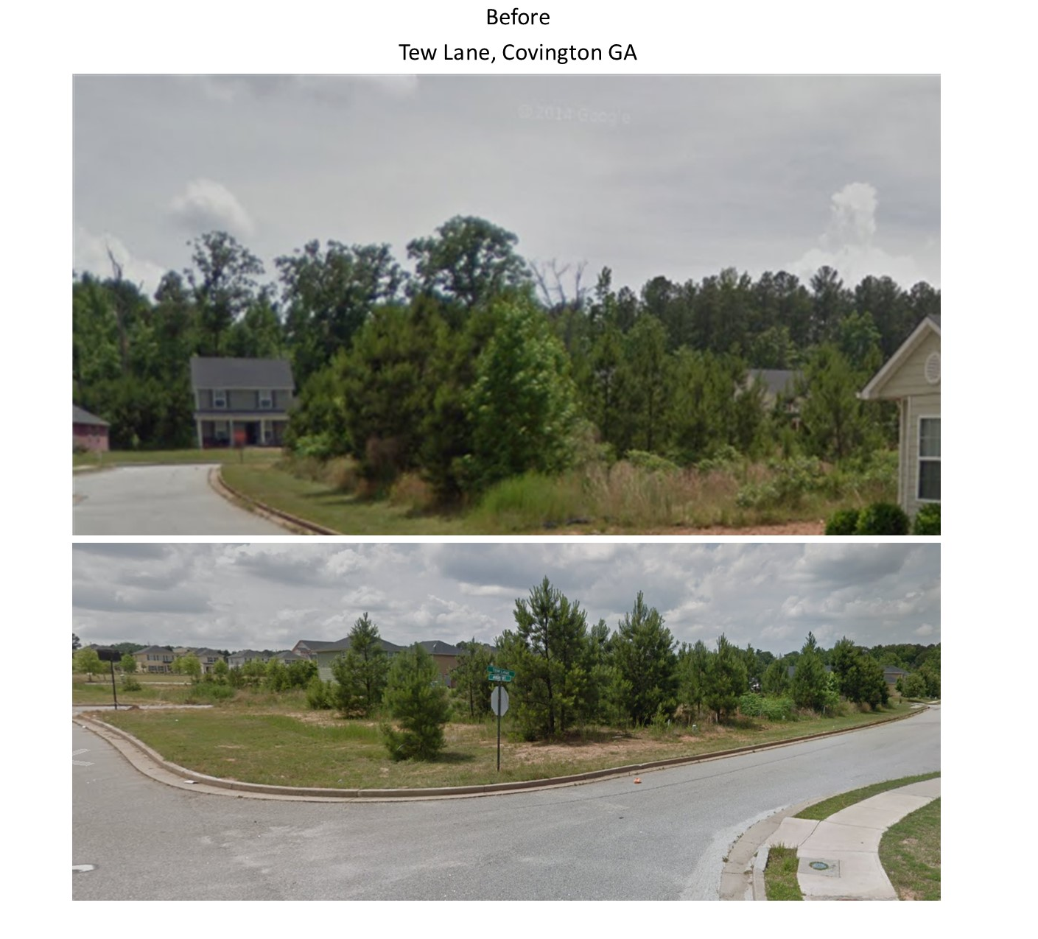
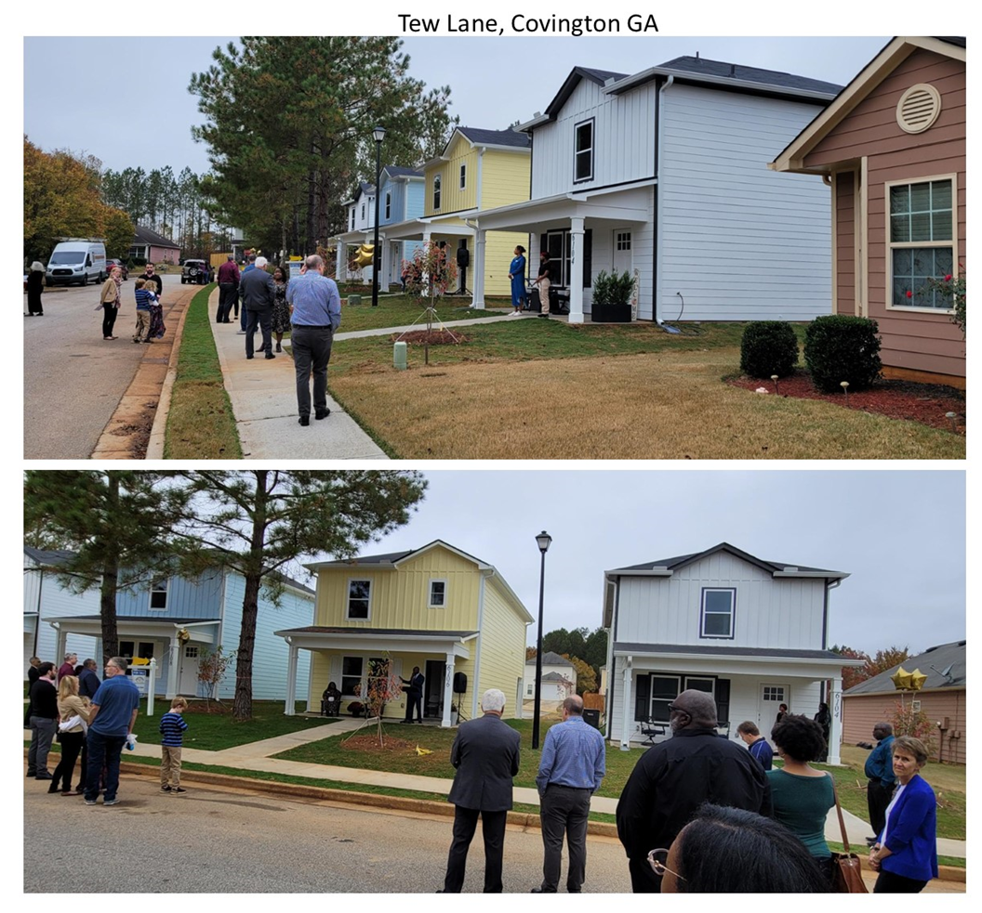
Covington Housing Authority- New Construction

Slide 7
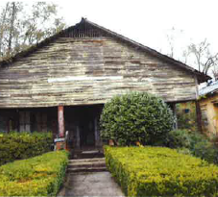
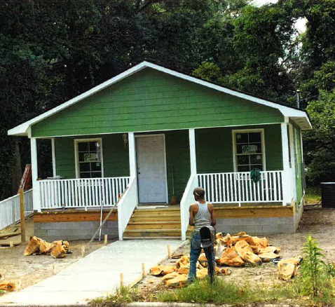
City of Moultrie

Slide 8

CHIP Accomplishments
900+
Households projected to be assisted between 2016-present; 4-7 HH are assisted per award
$74M
Awarded since 2014
174
Local governments. Public housing authorities and nonprofits awarded since 2014

Slide 9

CHIP Application
Two Project Types:
Owner-Occupied Housing Rehabilitation
Single-Family New Construction for Homeownership
Applicants may submit one application. Application fee: $500
Submit the application form and attachments through the Emphasys portal.
Notes:
When applying for CHIP funds, there are two application types, owner-occupied rehab and single-family new construction. Applicants may only apply for one type of grant. All applications should be submitted via email.

Slide 10
What Does CHIP Provide?
New Construction
Up to $1.5 million for New Construction/Reconstruction
Used to acquire, rehabilitate, or newly construct single-family units to be sold to very low to low-income home buyers.
Single-family units are defined as structures with 1-4 units.
Owner-Occupied Housing Rehabilitation
Up to $500,000 for owner-occupied housing rehabilitation/ reconstruction
Single-family units are defined as structures with 1-4 units.

Slide 11


How to Apply
2025 CHIP Application

Slide 12

Eligible Applicants
City and County Governments NOT PJs
Public Housing Authorities
Nonprofits with 501(c)(3) or (c)(4) designation (New Construction only , if new CHIP applicant)
Notes:
Current CHIP grantees must have spent down their current awards by 50% in order to be eligible

Slide 13
Ineligible Participating Jurisdictions (PJ)
Albany
Athens
Atlanta
Augusta
Canton
Columbus
Macon
Marietta
Roswell
Savannah
Clarke County
Clayton County
Cherokee County
Cobb County
Dekalb County
Fulton County
Gwinnett County
Muscogee County
Richmond County

Slide 14

Owner-Occupied Set-Aside Consideration
Awards will be made to applicants that would normally not receive a CHIP award. The applicant must:
  Be a Local government
  Have a need for owner-occupied housing rehabilitation
  Not received CHIP funds or State CDBG funds for housing in the last ten years
  Demonstrate current and/or past community development efforts to better improve their community.
  Must procure a grant administrator to be eligible.

Slide 15
Other Applicant Considerations
New Construction Applicants- Governments
State CDBG-funded recipients that are currently contracted or have completed a CDBG-funded construction or infrastructure activity within the last 3 years may be eligible for set-aside points if the applicant can demonstrate that the CDBG activity will assist or complement their proposed CHIP-funded activity
Owner-Occupied Applicants- Nonprofits
Nonprofits that have not received a CHIP award in the last ten (10) years may not be eligible for owner-occupied housing rehabilitation. Additionally, administering this program has proven challenging for organizations that do not have financial resources outside of CHIP. New applicants must demonstrate in their application that they have successfully managed a federally funded housing program.

Slide 16
Grant Administrators
Applicants may choose to enter into a contract with an experienced grant administrator to carry out CHIP-funded activities.
If the applicant chooses to work with a grant administrator, the applicant must solicit the grant administrator's services through a formal documented procurement process at least thirty (30) days prior to submitting the CHIP application.
Procurement does not apply to applicants using their local Regional Commission as their grant administrator and/or grant writer.

Slide 17
CHIP Application – Four Categories
Budget
Need
Capacity/Resources
Affordable Housing Plan
Notes:
While reviewing the application, the DCA looks at 4 major components, the applicant’s budget for the project, the communities’ need, the resources or capacity of the applicant, and the applicant’s master plan for housing in the community.

Slide 18
General Info and Budget
Contact Info
B. Proposed Activity
C. Proposed Budget/Leverage
Match -cash or in-kind sources (land values, waived permit fees, dedicated staff salaries, etc.)
Tips
List appropriate contact people for questions
Email DCA for grant administrator recommendations

Slide 19
Capacity
Applicant’s Experience with grant activity
Applicants must demonstrate the projects were completed on budget and met the performance objectives.
Attach narrative
Staff Experience
Grant administrator, unless staff or Regional Commission staff
Attach narrative, resumes, and procurement process

Slide 20

Capacity
Attach a narrative explaining CHIP grant accomplishments.
For grants that have been closed out, the narrative should include the following:
  Grant contract date
  Grant completion date when DCA completed the final monitoring and closed the grant
  Amount awarded
  Amount expended
  Number of homeowners proposed to be assisted
  Number of homeowners assisted
  Detail explaining whether the objectives of the grant were met and if not why
  Funded budget and any remaining balances
For grants that are underway, the narrative should include the following:
• Grant contract date
  Expected completion date
  Amount awarded
  Amount expended to date
  Number of homeowners proposed to be assisted
  Number of homeowners assisted to date

Slide 21
Capacity- No CHIP Award
If the applicant has not received a CHIP grant in the past but has other relevant affordable housing rehabilitation or new construction experience, especially if the grantee has managed CDBG, NSP, or other HOME-funded projects, attach a detailed narrative of the applicant’s accomplishments. The narrative should include the following:
Date range for the projects from start to finish
Indicate whether the project was completed on time, and if not, please explain
Fund sources for the projects and any remaining balances
Number of homes built/renovated and/or
Number of homeowners/homebuyers assisted
Photos for projects completed, if available

Slide 22
Capacity
All requested information must be clearly documented and included. Points will not be provided for incomplete documentation of the requested experience.

Slide 23
Capacity- All Applicants
Capacity and Readiness to Proceed
Applicant Experience Credit provided if the applicant provides the following criteria:
Include the resumes of staff with relevant housing experience narrative and/or grant administrators who will be responsible for administering the CHIP grant if awarded. | 5
Included a detailed narrative and photos to show previous experience. The narrative should include: Date range for the projects from start to finish and indicate whether the project was completed on time- 5 pts. Fund sources for the projects and any remaining balances- 4 pts. Number of homeowners/homebuyers assisted- 4 pts. Photos included- 4 pts. | 17
Capacity to administer new CHIP grants:
Grantee has managed CHIP in the past or is a current grant recipient | 3
Capacity Experience Subtotal | 25
Grant Administrator Experience (if a grant administrator must be procured to administer the grant)
Experience managing housing rehabilitation:
1-2 years | 1
3-5 years | 3
Over 5 years | 5
OR
Experience managing CHIP:
1-2 years | 4
3-5 years | 6
Over 5 years | 8
Capacity to administer new CHIP award:
6-10+ open awards | 2
1-5 open awards | 5
Grantee Administrator Subtotal | 15
Capacity Subtotal | 40

Slide 24
Capacity- Set Aside
Owner-Occupied Rehabilitation Set-Aside
Detailed narrative and photos of community development efforts
Engagement of the community
Provide communitywide improvements for the residents
Extra priority will be given to communities
Demonstrate partnerships with local organizations for community development
Provide assistance to distressed areas or underserved population
No federal or state housing assistance in 10 years or more
Notes:
Capacity

Slide 25
Need
Target Area
Attach narrative and map
Geographic Priority
Underfunded area
See Appendix A
Federally declared disaster area (FEMA Individual Assistance)
Poverty Rate
Use DCA website map tool
More pts for higher poverty rate for owner- occupied rehab
More pts for lower poverty rate for new construction

Slide 26

Need-
Owner-Occupied Housing Rehabilitation
Current Housing Conditions
For Owner-Occupied Home Repair Applications
Is there a need for owner-occupied home repairs in the target area?
Include:
Detailed Narrative of housing conditions
Photos of multiple representative houses

Slide 27
Need-
New Construction
Reconstruction Housing Development
Real Estate Market Analysis
For New Construction of Single-Family Homes Applications
Should the State invest in creating single-family affordable housing in your target area?
Is there a market for new construction in your targeted area?
Use the CHIP Map tool
Current housing stock doesn’t meet demand
Median home value unaffordable
Quality neighborhood amenities narrative

Slide 28
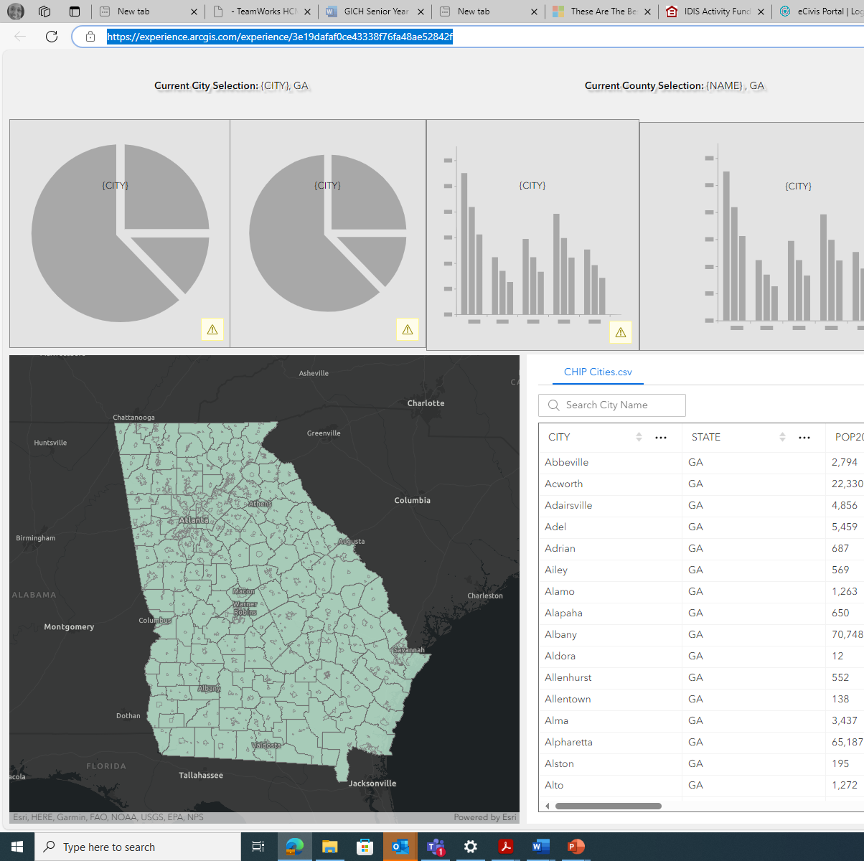
Need
https://experience.arcgis.com/experience/3e19dafaf0ce43338f76fa48ae52842f

Slide 29
Planning
Up to 5 points for participation in GICH Program
Affordable Housing Plan-Pts for each criteria-
Nonprofits and Public Housing Authorities
County and City Governments

Slide 30
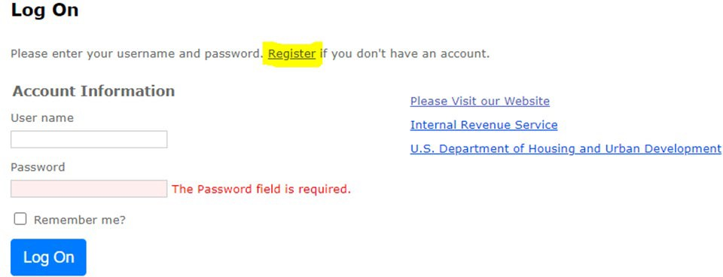
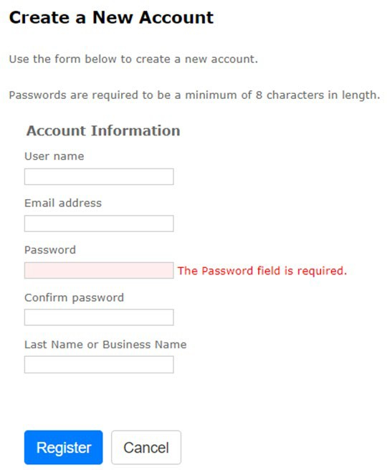
Welcome To Emphasys
Click the link (Georgia DCA - Housing Finance & Development (emphasys-hft.com)) to register for the Emphasys Developer Account and access the Application Collector Portal

Slide 31
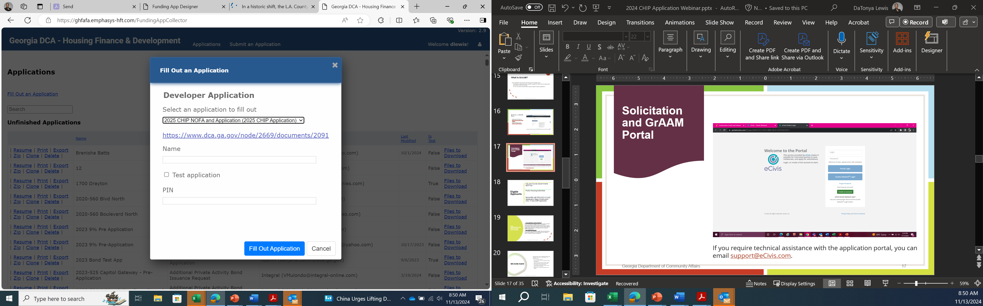
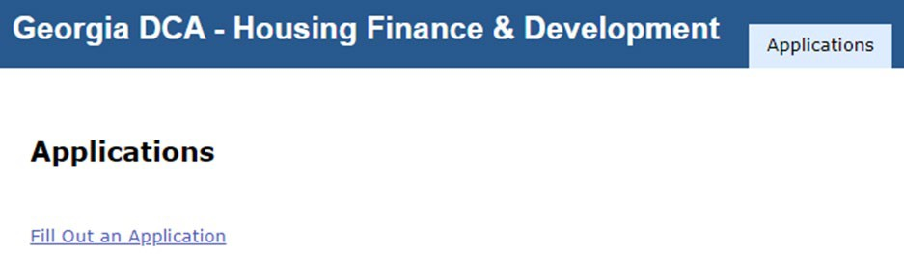
Welcome to Emphasys
Click Fill Out an Application
Choose 2025 CHIP NOFA and Application

Slide 32

What Happens Next?
Feb.–Mar.
Scoring
Mar.–Apr.
Award in March- early April
Apr.–July
Contracting phase April-July
June–Aug.
Awardee training in last quarter
1 Sep.
Grant activities start September1
1 Sep. 2025 – 31 July 2028
3-year program

Slide 33

2025 CHIP Application: Submission
Deadline: January 31, 2025
Request Word version of application form
Complete the application and submit the application and attachments through the Emphasys portal
Submit $500 application fee by mail to mailing address

Slide 34
Contacts
DaTonya Lewis – Community Housing Program Manager
(404) 852-2160 / datonya.lewis@dca.ga.gov
Gloria K. Hough– Community Housing Grants Coordinator
(404) 679-0626 / gloria.hough@dca.ga.gov
Linda Ballard– Single Family Housing Grants Coordinator
(404) 982-3463 / linda.ballard@dca.ga.gov
Tracy Ponder– Community Housing Grants Specialist
(470) 653-3446 / tracy.ponder-farley@dca.ga.gov
Christopher Hurley– Community Housing Outreach Coordinator
(470) 773-8892 / chris.weed-hurley@dca.ga.gov
Notes:
Open the chat to CHIP staff for Chris to mention his presentations

