Slide 1
Community HOME Investment Program
(CHIP)
Grant Application Webinar

Slide 2
2022 CHIP Application Webinar: Purpose
Overview of the CHIP Program
The 2022 Application:
Changes from 2021 Application
Overview of Application
Scoring Criteria
Submission Instructions using GrAAM
How to ask questions during the webinar

Slide 3
Georgia Department of Community Affairs
60+ Programs
6 Divisions
400+ Employees
Administers Federal and State Funds (HOME)
Services:
  Safe and Affordable Housing
    CHIP
    Rental Development
    GA Dream
    Housing Choice Vouchers (Section 8)
    Homeless
  Community and Economic Development
    CDBG
    Historic Preservation Division
  Local Government Assistance
    Planning
    Construction Codes
    Research and Surveys
    Partnerships

Slide 4
What is HOME?
HOME Investment Partnership Program
  Formula grant allocated to states and local governments
  Usually includes partnerships with nonprofits
  Largest federal block grant designed provide decent, safe, sanitary and affordable housing for very low to low in come households
    Household income cannot exceed 80% of the Area Median Income(AMI) limit

Slide 5
What Is CHIP?

Slide 6
Community HOME Investment Program
Funded with Federal HOME dollars from HUD
Not a direct beneficiary program
Average 10-15 grant awards per year
Awards $5-7 million statewide annually
Provide Affordable Housing across the state of Georgia

Slide 7
2021 CHIP Awards
Cities | CHIP Funds Awarded | Activity
Americus | $ 400,000.00 | Owner-occupied Rehabilitation
Byron | $ 400,000.00 | Owner-occupied Rehabilitation
Cochran | $ 400,000.00 | Owner-occupied Rehabilitation
Centerville | $ 400,000.00 | Owner-occupied Rehabilitation
Gainesville | $ 600,000.00 | New Construction
Douglas | $ 400,000.00 | Owner-occupied Rehabilitation
Newnan | $ 400,000.00 | Owner-occupied Rehabilitation
Vienna | $ 400,000.00 | Owner-occupied Rehabilitation
Nonprofits | CHIP Funds Awarded | Activity
Atlanta Neighborhood Development Partnership (ANDP) (South Dekalb County | $ 600,000.00 | New Construction
Family Community Housing Association (FCHA)(Covington) | $ 400,000.00 | Owner-occupied Rehabilitation
Habitat for Humanity of Conyers Rockdale | $ 600,000.00 | New Construction
Jackson Habitat for Humanity | $ 300,000.00 | New Construction
New Foundations Development, Inc (NFD) (Calhoun, GA) | $ 400,000.00 | Owner-occupied Rehabilitation
PUSH Ministry (South Atlanta) | $ 400,000.00 | Owner-occupied Rehabilitation
Rabun County Habitat for Humanity | $ 449,200.00 | New Construction

Slide 8
CHIP Accomplishments
Over $60 million awarded since 2010
  Awards made to 164 PHAs, local governments and non-profits
  Each award averages 4-7 households assisted
    Type of assistance provided includes:
      New construction
        Homebuyer subsidy- down payment, interest rate buydown, closing costs
      Reconstruction
      Acquisition and rehabilitation
      Owner-occupied rehabilitation

Slide 9
What Does CHIP Provide?
Up to $600,000 for New Construction/Reconstruction
Used to acquire, rehabilitate, or newly construct single-family units to be sold to low- and moderate-income home buyers.
Single-family units are defined as structures with 1-4 units.

Slide 10
What Does CHIP Provide?
Up to $400,000 for owner-occupied housing rehabilitation/ reconstruction
  Increase from the 2020 CHIP application
Before
After

Slide 11
2021 CHIP Application: Goals
To award funds in communities with:
Capacity to Carry Out Activity
Justified Need for Housing Activity
Redevelopment Planning
$7 million in HOME funds will be awarded for the following:
7 awards for owner-occupied housing rehab activities
5 awards for new construction of single-family homes
3 awards set-aside for owner-occupied housing rehabilitation applicants that have not received a CHIP or CDBG home repair grant award in previous years.

Slide 12
2022 CHIP Application
Two Application Forms:
Owner-Occupied Housing Rehabilitation
Single-Family New Construction for Homeownership
Applicants may apply for both but only one will be selected
Submit the application form and attachments by email

Slide 13
New to 2021 and 2022 CHIP Application
3 awards will be made to applicants that would normally not receive a CHIP award. The applicant must:
  Be a Local government
  Have a need for owner-occupied housing rehabilitation
  Not received CHIP funds or State CDBG funds in the last ten years
  Demonstrate current and/or past community development efforts to better improve their community.
  Must procure a grant administrator to be eligible.
  Applications must be uploaded through the GrAAM portal

Slide 14
What is GrAAM?
Grant Application Administration and Management (GrAAM) system
The system is powered by eCivis, a grants management vendor who has implemented grant systems across the country.
It is the new online tool DCA will be using for all grant and loan applications.

Slide 15
2022 CHIP Application: Solicitation and GrAAM Portal Submission
Watch 'DCA CHIP Webpage and Application' | Microsoft Stream
Watch '2022 CHIP Application Process' | Microsoft Stream

Slide 16
2022 CHIP Application:
Applicants
City and County Governments NOT PJs
Public Housing Authorities
Nonprofits with 501(c)(3) or (c)(4) designation

Slide 17
2022 CHIP Application: Ineligible Participating Jurisdictions
Albany
Athens
Atlanta
Augusta
Canton
Columbus
Macon
Marietta
Roswell
Savannah
Clarke County
Clayton County
Cherokee County
Cobb County
Dekalb County
Fulton County
Gwinnett County
Muscogee County
Richmond County

Slide 18
2022 CHIP Application: Format
Two Application Uploads
Owner-Occupied Housing Rehabilitation
Single-Family Home Construction for Homeownership
Applicants may apply for both but only one will be selected

Slide 19
2022 CHIP Application: Owner-Occupied Housing Rehabilitation
$400,000 for housing rehab grants
Up to $60,000 per home for repairs (to code), lead testing and abatement
  $4,000/home in project delivery costs for the grantee
Funds provided to homeowner as a 0% interest 5-year forgivable loan

Slide 20
2022 CHIP Application: Single Family Development Grants
$600,000 for housing construction
  5% per home in project delivery costs to grantee
15% or up to $20,000 for developer fee
$14,999 homebuyer subsidy secured with 5 yr lien
Grantees “recycle” sales proceeds into more affordable housing activities
Homes must be sold within 9 months of construction completion

Slide 21
2022 CHIP Application: Scoring
Capacity
Need
Planning
Capacity
Budget/Leverage/Match
Bonus: up to 6 pts

Slide 22
2022 CHIP Application: General Info, Budget and Leverage
A. Contact Info
B. Proposed Activity
C. Proposed Budget/Leverage
  Match -cash or in-kind sources (land values, waived permit fees, dedicated staff salaries, etc.)
Tips:
List appropriate contact people for questions
Email DCA for grant administrator recommendations

Slide 23
2022 CHIP Application: Capacity
Owner-Occupied Rehabilitation Set-Aside
Detailed narrative and photos of community development efforts
    Engagement of the community
    Provide communitywide improvements for the residents
  Extra priority will be given to communities
      Demonstrate partnerships with local organizations for community development
    Provide assistance to distressed areas or underserved population
  No federal or state assistance in 10 years or more

Slide 24
2022 CHIP Application: Capacity
Applicant’s Experience with grant activity
Applicants must demonstrate the projects were completed on budget and met the performance objectives.
Attach narrative
Staff Experience
Grant administrator, unless staff or Regional Commission staff
Attach narrative, resumes, and procurement process

Slide 25
2022 CHIP Application: Need
Target Area
Attach narrative and map
Geographic Priority
Underfunded area
  See Appendix A
Federally declared disaster area (FEMA Individual Assistance)
Poverty Rate
Use DCA website map tool
More pts for higher poverty rate for owner- occupied rehab
More pts for lower poverty rate for new construction

Slide 26
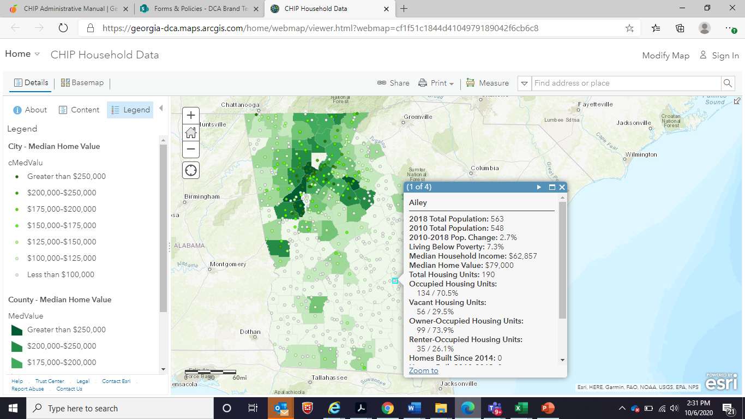
2022 CHIP Application: Need
CHIP Map Tool: DCA website

Slide 27
2022 CHIP Application: Need
Owner-Occupied Rehabilitation
Current Housing Conditions
For Owner-Occupied Home Repair Applications
Is there a need for owner-occupied home repairs in the target area?
Include:
Detailed Narrative of housing conditions
Photos of multiple representative houses

Slide 28
2022 CHIP Application: Need
New/Reconstruction Housing Development
Real Estate Market Analysis
For New Construction of Single-Family Homes Applications
  Should the State invest in creating single-family affordable housing in your target area?
  Is there a market for new construction in your targeted area?
Use the CHIP Map tool:
Current housing stock doesn’t meet demand
Median home value unaffordable
Quality neighborhood amenities narrative

Slide 29
2022 CHIP Application:
Planning
Up to 5 points for participation in GICH Program
Affordable Housing Plan-Pts for each criteria-
Nonprofits and Public Housing Authorities
County and City Governments

Slide 30

2022 CHIP Application: Attachments
All required application documents including narratives, maps and other support material should be clearly labeled and submitted in the following format:
Section 1- General Information
CHIP 2022 Application Form
IRS Nonprofit Designation Letter (as applicable)
Signed Certification Assurances Form
Procurement of Grant Administrator Documentation
Proposed Budget
Section 2: Capacity
Include the following narratives and Documentation:
Experience Narrative
Administration Experience
Qualified Partners List
Construction Plans (New Construction)
Section 3- Need
Include the following narratives and Map(s)
Target Area Narrative and Map
Current Housing Conditions Narrative
Real Estate Development Market Analysis (New Construction)
Section 4- Planning
Include the following narratives and Documentation:
Affordable Housing Plan

Slide 31

2022 CHIP Application: Submission
Deadline: Emailed on January 31, 2022
Request Word version of application form
Complete the application and submit application and attachments through the GrAAM portal
Submit $250 application fee by mail to mailing address

Slide 32
2022 CHIP Application: What Happens Next?
Scoring: February-March
Award in March
Awardee training in April
Contracting phase April-July
Grant activities start August 1
2-year program (Aug 1, 2022-July 31, 2024)

Slide 33
CHIP Contact Information
DaTonya Lewis, Community Housing Program Manager
Datonya.Lewis@dca.ga.gov
404-852-2160
Samanta Carvalho, Director, Office of Community Housing Development Samanta.Carvalho@dca.ga.gov
404-679-0567
Application submission upload: https://gn.ecivis.com/GO/gn_redir/T/x88cfj54bzvk
CHIP website:
https://www.dca.ga.gov/safe-affordable-housing/rental-housing-development/home-investment-partnership-program-home-1

Slide 34
Any questions?
Thank you!

