Slide 1
The Latest on Opportunity Zones
Katie Kramer
Vice President
Council of Development Finance Agencies
October 30, 2018

Slide 2
Legal Disclaimer
CDFA is not herein engaged in rendering legal, accounting, financial or other advisory services, nor does CDFA intend that the material included herein be relied upon to the exclusion of outside counsel or a municipal advisor. This publication, report or presentation is intended to provide accurate and authoritative general information and does not constitute advising on any municipal security or municipal financial product. CDFA is not a registered municipal advisor and does not provide advice, guidance or recommendations on the issuance of municipal securities or municipal financial products. Those seeking to conduct complex financial transitions using the best practices mentioned in this publication, report or presentation are encouraged to seek the advice of a skilled legal, financial and/or registered municipal advisor. Questions concerning this publication, report or presentation should be directed to info@cdfa.net.

Slide 3
CDFA’s Five Focus Areas
Education
Advocacy
Research
Resources
Networking

Slide 4
CDFA represents the leaders and dealmakers in the development finance industry.

Slide 5
Opportunity Zones
8,700 Opportunity Zones across the United States
Nominated by Governors in early 2018. All Opportunity Zones designated by the U.S. Department of the Treasury as of June 2018.
Opportunity Zones are low-income census tracts eligible for investment from Opportunity Funds.
Source: Economic Innovation Group

Slide 6
Opportunity Zones
Approximately 35 million people live in Opportunity Zones
56% of those residents are minorities
294 Zones are tribal lands
76% are in metropolitan areas
Source: Economic Innovation Group

Slide 7
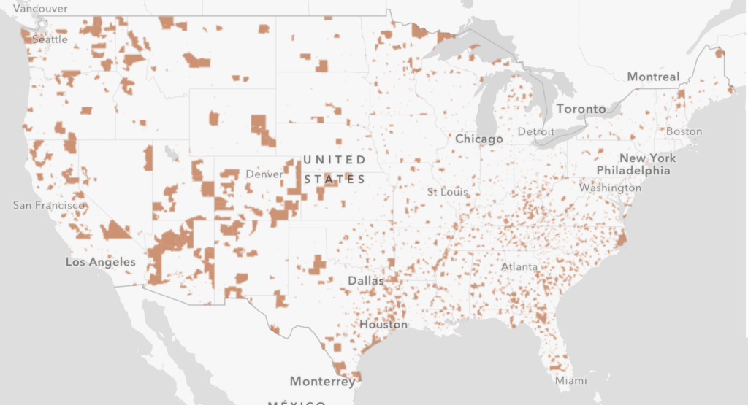
Opportunity Zones
Source: Economic Innovation Group: www.eig.org

Slide 8
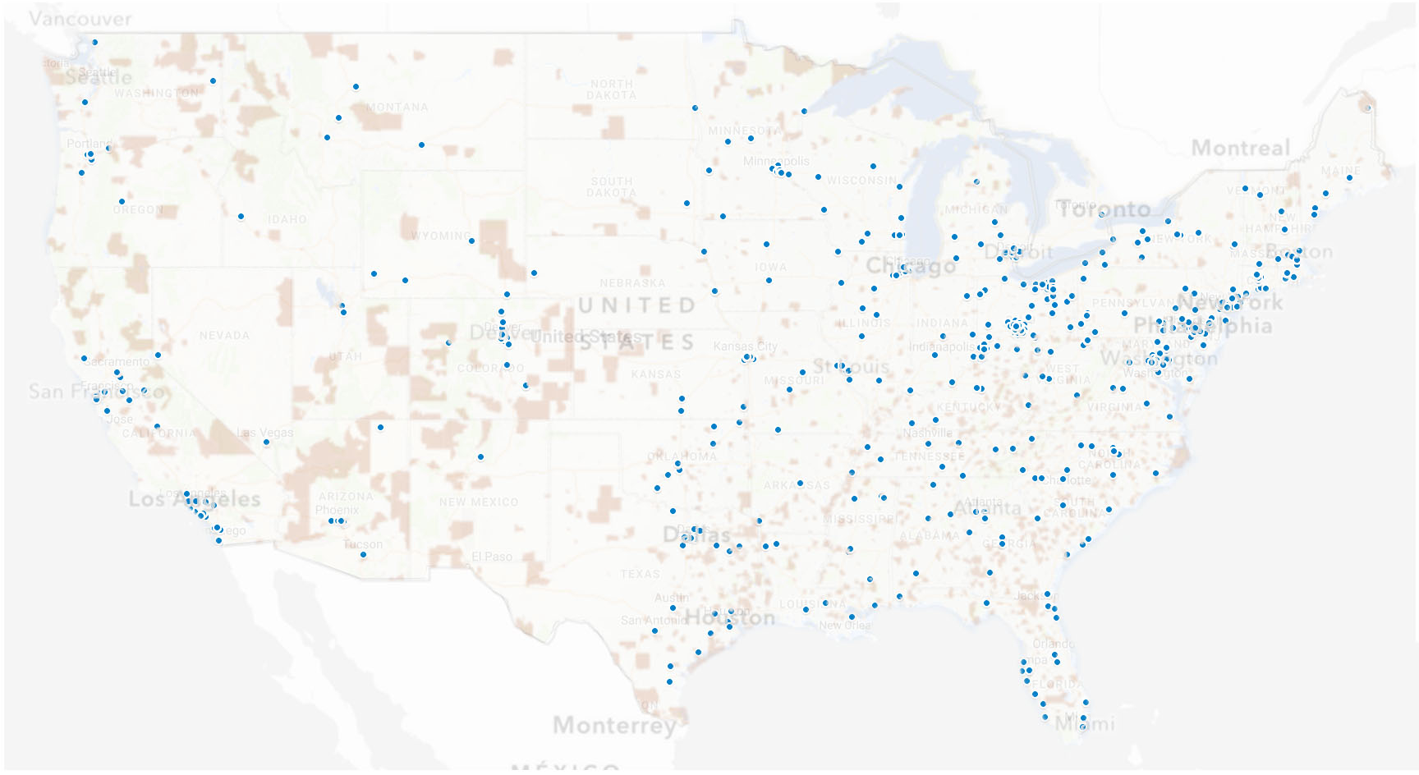
CDFA Members + Opportunity Zones

Slide 9
Opportunity Funds
Opportunity Funds can help tap into the estimated $6 trillion market for unrealized capital gains.
What are the benefits of investing in Opportunity Funds?
Defer taxes owed on federal capital gains taxes by moving them into an Opportunity Fund. If invested for 5 years, receive a 10% reduction in the tax. If invested for 7 years or more, receive a 15% reduction in the tax.
Investors can defer the tax on their capital gains until the earlier of the date the Opportunity Fund investment was sold or December 31, 2026.
For investments held at least 10 years, any earnings realized by an
Opportunity Fund are not subject to federal capital gains taxes.

Slide 10
Opportunity Funds
Opportunity Funds must make equity investments.
Investors can capitalize Opportunity Funds using gains realized within 180 days of a sale. No limit on size of funds, number of funds, or how many Opportunity Zones the fund invests in.
Opportunity Funds must invest at least 90% of their assets in qualified investments located in Opportunity Zones.
Opportunity Funds can make equity investments in qualified businesses or real estate projects.
Opportunity Fund investors are seeking responsible exit solutions in order to realize the tax-free earnings after the 10 year period.

Slide 11
STATE of the STATES
Download in the CDFA Opportunity Zones Resource Center
www.cdfa.net/resources

Slide 12
STATE of the STATES
The Pulse on Opportunity Zones

Slide 13
STATE of the STATES
State Agency Structures

Slide 14
STATE of the STATES
State Agency Structures

Slide 15
STATE of the STATES
Opportunity Zones Investment Strategies

Slide 16
STATE of the STATES
Opportunity Zones Investment Strategies

Slide 17
State & Local Engagement with OZ
Understand not every Opportunity Zone will receive investment without local leadership.
Develop a strategy to identify potential investments and make those opportunities known to investors.
Early research shows Opportunity Fund capital will meet about 5-30% of capital needed for a project. Identify local programs available for debt financing or other incentives now and make those resources known.
Identify projects and local economic development strategies and clearly communicate how investors can engage.

Slide 18
Advancing Development Finance
Knowledge, Networks & Innovation
Join CDFA Today!
Discounted Registration Rates for CDFA Trainings & National Summit
Reduced Rates for Publications in the CDFA Bookstore & Special Offers from Industry Partners
Exclusive Access to the CDFA Online Resource Database and Federal Financing Clearinghouse
Free Job and RFP Postings
www.cdfa.net
@cdfa_update

