Slide 2
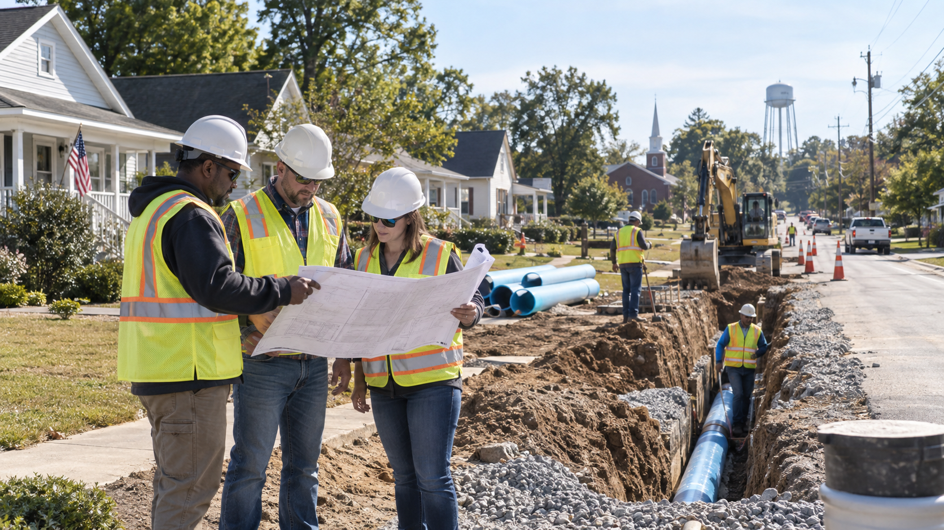
CDBG Overview
& 2026 MOD Changes
Community Block Grant Summit | New Recipient Orientation
high-level overview
Georgia Department of Community Affairs
Notes:
Welcome participants and set expectations: this is a beginning-of-Summit orientation for new recipients.
Emphasize that the detailed Method of Distribution and National Objective session will be provided on Day 3 for 2027 applicants.

Slide 3

What is CDBG?
A flexible federal resource for local community development needs.
Established by the Housing and Community Development Act of 1974
Designed to help state and local leaders stimulate community development and job growth
Used to address physical, economic, and social deterioration in low- and moderate-income neighborhoods and communities
local needs + federal purpose
Georgia Department of Community Affairs | CDBG Program
3
Notes:
Explain that CDBG is flexible, but not unrestricted.
CDBG must connect local needs to eligible activities and a national objective.

Slide 4
Georgia’s State CDBG goals
The State program balances community priorities, fairness, housing, infrastructure, and economic opportunity.
Priorities
Address State and community priorities
Strong,
vibrant
communities
Fairness
Ensure all applications are treated fairly
Housing
Promote affordable housing development and preserve existing housing stock
Infrastructure
Preserve and develop basic infrastructure and public facilities
Economic development
Support job training and job creation benefiting LMI persons
Georgia Department of Community Affairs | CDBG Program
4
Notes:
Briefly introduce the program goals as the logic behind funding choices and requirements.

Slide 5
How the Method of Distribution organizes funds
Set-asides address specific needs; the Annual Competition remains the primary competitive channel.
HUD allocation
Set-asides
Annual Competition
Annual federal allocation to the State
ITAD, EIP, RDF, Innovative Grant, Section 108 pledge
Balance available after administration, TA, and set-asides
Examples from the MOD materials: ITAD, EIP, RDF, Innovative Grant, Section 108, and the Annual Competition are all part of the State CDBG structure.
Georgia Department of Community Affairs | CDBG Program
5
Notes:
Use this to introduce the MOD without diving into all scoring criteria.
Remind new recipients that program type determines the applicable requirements and documentation.

Slide 6

Who can participate?
State CDBG serves non-entitlement communities.
Eligible applicants are cities and counties that do not participate in HUD’s Entitlement Program.
Eligibility check
Confirm non-entitlement status early.
Watch for incorporated cities located in HUD Entitlement Urban Counties.
For service projects, confirm the applicant is an authorized provider through the SDS.
city/county status
+
urban county participation
+
service authority
new recipient takeaway: status matters before scope
Georgia Department of Community Affairs | CDBG Program
6
Notes:
Keep this practical: many eligibility questions are resolved before applications or awards move too far.
Avoid reading the long entitlement list; tell participants where to verify if needed.

Slide 7

Every CDBG project passes two gates
A project is not CDBG-eligible unless both conditions are satisfied.
1
Eligible Activity
Listed under Section 105(a) of the Housing and Community Development Act.
AND
2
National Objective
Principally benefits LMI persons, addresses slum/blight, or responds to urgent need.
Georgia Department of Community Affairs | CDBG Program
7
Notes:
This slide is the bridge to the Day 3 deep dive.
New recipients should understand that local importance alone is not enough; the project must meet both federal gates.

Slide 8
National objectives at a glance
Most Annual Competition projects are structured around LMI benefit.
Low/Moderate Income Benefit
Slum / Blight
Urgent Need
Area benefit
Area basis
Recent condition
Limited clientele
Spot basis
Serious threat
Housing
No other resources
Jobs
Helpful framing: the national objective tells the “why” behind the project and defines the documentation you must keep.
Georgia Department of Community Affairs | CDBG Program
8
Notes:
Avoid detailed national objective rules here; Day 3 will cover those.
Emphasize that the objective should be known before project design is finalized.

Slide 9
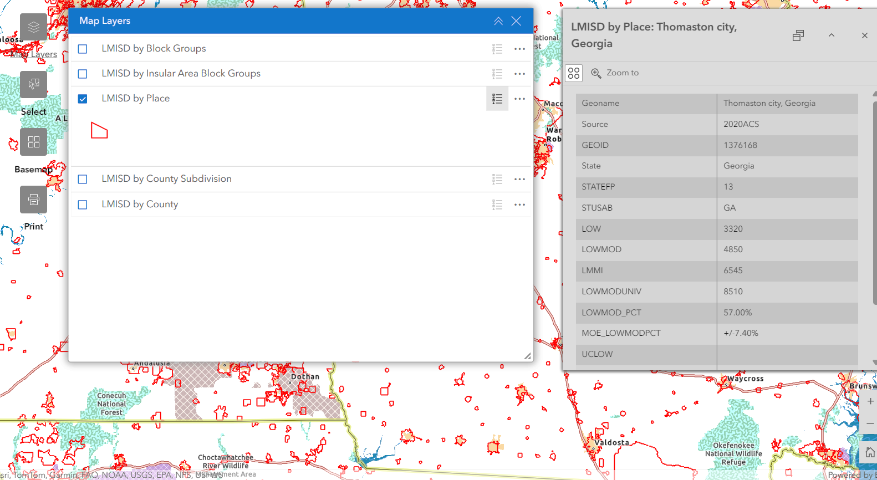
Documenting LMI benefit: two common paths
Choose the path that matches the project type and service area.
Direct count
Housing
Job creation
Limited clientele such as senior centers or health centers
Some groups are presumed LMI
Area benefit
Use HUD data when it fits; use a local survey when the project service area needs a more precise count.
Water/sewer, streets, drainage
Primarily residential target area
70% LMI required; rounding not allowed
HUD LMISD or local survey
Georgia Department of Community Affairs | CDBG Program
9
Notes:
Use this to introduce the difference between direct count and area benefit.
For new recipients, reinforce that documentation methods should be planned before records are needed.

Slide 10
Common project types recipients may see
Different project types share the same federal framework but have different documentation and delivery issues.
Buildings
community facilities, health centers, senior centers
Housing
Rehab, reconstruction (owner-occupied) and/or Homebuyer Assistance
Streets / Drainage
paving, sidewalks, stormwater improvements
Water / Sewer
installation, replacement, fire coverage
Multi-Activity
combined housing and infrastructure and/or buildings
Economic Development
jobs, private leverage, public benefit
New recipient takeaway: once awarded, the approved scope matters. Keep activities, service areas, beneficiaries, and costs aligned with the award.
Georgia Department of Community Affairs | CDBG Program
10
Notes:
This is not intended to teach all eligible activities.
Focus on reminding recipients that scope control is a compliance issue after award.

Slide 11
How we shaped the 2026 MOD changes
The 2026 MOD was informed by broad outreach, focused stakeholder discussion, and formal public comment.
BROAD INPUT FOCUSED DISCUSSION FORMAL PUBLIC COMMENT
1
General Pulse Survey
2
Three Listening Sessions
3
Public Hearing
Initial outreach - February 2026
March 2026
April 15, 2026
• Targeted eligible local governments that had not applied in the past 5–7 years.
• Asked what keeps communities from applying for — or successfully administering — CDBG.
• Surfaced barriers such as capacity, match, complexity, upfront costs, and compliance.
• Included experienced local governments, Regional Commissions, and grant administrators.
• Used the same presentation and survey across all three sessions for consistent feedback.
• Tested the MOD for clarity, equity, competitiveness, and accessibility.
• Conducted with the Annual Action Plan public hearing.
• Provided a formal opportunity for public comment on the proposed MOD changes.
• Completed the feedback cycle before finalizing the 2026 MOD.
What we heard
Capacity & complexity • Match & rising project costs • Demographic scoring • Performance period • ITAD flexibility • Funding structure
Those themes were carried forward into the policy changes summarized next.
Georgia Department of Community Affairs | CDBG Program
11

Slide 12
2026 MOD changes: the big picture
Five changes are most important for this overview.
1
Period of Performance
Standard award period increases from 2 years to 36 months.
2
State Reporting Cure
Up to 60 days to resolve state reporting compliance after notification.
The next slides translate the changes into recipient-level takeaways.
3
Match Requirements
New tiered match structure based on grant request amount.
4
Multi-Activity Cap
Maximum award increases from $1.25M to $1.5M.
5
ITAD Modifications
Expanded flexibility and revised funding structure.
Georgia Department of Community Affairs | CDBG Program
11
Notes:
This is the overview slide that anchors the MOD portion.
Avoid reading every word; call out the five changes and move to practical implications.

Slide 13
Project delivery: more time, not less urgency
The proposed standard period becomes 36 months, with early progress still expected.
Current
Proposed
Substantial progress expected within 12–18 months
2-year performance period
36-month
(3-year) standard period
Clear special conditions early
Complete environmental review before commitments
Procure properly and keep records
Start construction and draw funds on schedule
Recipient takeaway: use the longer period to manage complexity, must not delay launch.
Georgia Department of Community Affairs | CDBG Program
12
Notes:
Explain that DCA still expects active progress within the first 12 to 18 months.
This helps new recipients understand why early project management is important even with a longer award period.

Slide 14

Application readiness: the state reporting cure period
The proposed cure period is narrow: it applies to state reporting compliance only.
Proposed 60-day cure period
Local Government Audit Act
Service Delivery Strategy (HB 489)
Qualified Local Government status
GOMI and RLGF reporting
For new recipients: keep reporting compliance current year-round so eligibility questions do not overshadow project need.
What it is
Additional time to resolve state reporting issues after notification.
What it is not
A blanket cure for application deficiencies, late procurement, or missing project documentation.
Georgia Department of Community Affairs | CDBG Program
13
Notes:
Stress that this is a state reporting cure only.
This helps avoid misunderstanding that all threshold issues can be fixed after the deadline.

Slide 15
Funding structure changes recipients should recognize
The MOD changes affect match, multi-activity projects, and ITAD requests.
Annual Competition Match
Multi-Activity Cap
ITAD Program
$0–$500k: 0%
$500,001–$750k: 5%
$750,001–$1M: 10%
$1M+: 15%
$1,250,000
→
$1,500,000
Standard cap: $200,000
Higher with DCA approval
Minimum 10% match
May cover up to 90% of cost
Example: The match requirement for a $1M project would be $37,500. $250K(.05) + $250K (.1) = $37,500
ITAD flexibility also allows consideration outside declared disaster areas when the direct threat and need for immediate action are properly certified.
Georgia Department of Community Affairs | CDBG Program
14
Notes:
This slide is intended as a concise summary, not as application instructions.
Refer detailed questions to the Day 3 MOD session and current manuals.

Slide 16

New recipient first steps
A strong start is the best compliance strategy.
1
Confirm scope, budget, beneficiaries, and special conditions.
2
Do not commit funds before the required environmental review clearance.
3
Procure professional services and construction in accordance with requirements.
4
Set up project files for national objective, labor, financial, and procurement records.
5
Track milestones, draws, and communication with DCA from the beginning.
Ask questions early—before you bid, commit, amend, or change the project.
Georgia Department of Community Affairs | CDBG Program
15
Notes:
This slide turns the overview into practical orientation.
Encourage recipients to contact DCA before major project decisions.

Slide 17

Next stop: Day 3 deep dive
CDBG MOD Overview & Meeting the National Objective
Helpful resources
CDBG Applicants’ Manual
HUD Guide to National Objectives and Eligible Activities
HUD Income Survey Toolkit
DCA CDBG Annual Competition page
For 2027 applicants, Day 3 will cover application-level strategy, national objective documentation, surveys, threshold items, and resources in detail.
Questions?
Thank you for helping build strong, vibrant communities.
Georgia Department of Community Affairs | CDBG Program
16
Notes:
Close by setting up Day 3 as the detailed technical session.
Invite questions that are appropriate for a high-level overview.

