Slide 1
2024 CDBG SUMMIT
CDBG
Method of Distribution Overview & Meeting the National Objective
Glenn Misner

Slide 2

Helping to build strong, vibrant communities.
Notes:
Within the past 5 years Georgia’s program has assisted 292,673 persons of which about 92% are low-to-moderate income persons.
Persons are assisted through the provision of services via senior centers, healthcare facilities, Youth centers, housing rehab and reconstructions, water/sewer improvements, and street and drainage improvements, and jobs created through our Economic Development programs.

Slide 3
CDBG Authorization
Established by the Housing and Community Development Act in 1974 as a tool for giving state and local leaders help to stimulate community development and job growth.
Flexible funding solution to address physical, economic and social deterioration in low to moderate income neighborhoods and communities.
Celebrating its 52nd anniversary in 2026, CDBG is one of the longest continuously run programs at the U.S. Department of Housing and Urban Development (HUD)

Slide 4
Goals of the State’s Program
Address State and Community priorities
Ensure fairness in the treatment of all applications
Promote development of affordable housing
Assist communities in preserving and developing basic infrastructure and public facilities
Support economic development activities that principally benefit low- and moderate- income persons through job training and job creation
Notes:
Emphasis on community priorities. Some state priorities established
by earning bonus points for project type: w/s and housing.
2. MOD – Generally described as distributing through a competitive means.
amended through public hearing/participation process.
3. CDBG, in most cases, cannot be used for new construction of dwellings.
Mostly infrastructure to support new construction.
4. Most CDBG funding is allocated to water, sewer, street, and drainage projects.
5. 2 Economic Development Set-aside programs, but can also submit to AC

Slide 5
CDBG Programs and Allocations
The Georgia CDBG Program is comprised of the following:
Program | Allocation
Immediate Threat and Danger Program Set-Aside | $500,000
Employment Incentive Program Set-Aside | $4,000,000
Redevelopment Fund Program Set-Aside | $1,500,000
Innovative Grant Program Set-Aside | $10,000,000
Loan Guarantee Program (Section 108) | Pledge not to exceed $5,000,000
Annual Competition FY25 allocation will be $40,945, 091 FY 26 allocation should be approx. $40 mill | Balance of HUD allocation after administration, technical assistance and set-asides
Notes:
Deadline for annual competition – April 4,2025
FY22 $41,685,004
FY21 $43,093,364
$40,984,884
The Section 108 Program is a loan guarantee program, which enables the state to authorize
UGLG to borrow funds. The state pledges future CDBG funds as security for the loan.
– HUD acts as the guarantor of a 108 loan made from private market funds,
promising investors that the loan will be repaid

Slide 6
Eligible Applicants
Non-entitlement communities
Cities/Counties that do not participate in the Entitlement Program
The following entitlement communities are not eligible to participate in the State CDBG Program:
  The Cities of Albany, Atlanta, Brunswick, Dalton, Gainesville, Hinesville, Marietta, Rome, Roswell, Sandy Springs City, Savannah, Smyrna City, South Fulton, Valdosta, and Warner Robins.
  The Counties of Cherokee County, Clayton County, Cobb County, DeKalb County, Fulton County, Gwinnett County, and Henry County.
  The Consolidated Governments of Athens/Clarke County, Augusta/Richmond County, Columbus Consolidated Government, and Macon/Bibb County.
  Any incorporated city within a HUD Entitlement Urban County that has chosen to participate with the Urban County through a Cooperating Agreement.
Notes:
The State CDBG program is designed to Assist units of local government that do not
Participate in HUDs Entitlement or Urban County program. I
ndividuals, for-profit and Non-profit entities are not eligible to
apply Directly for CDBG but should partner with
A local government on projects that meet the Community’s needs.
Under the State CDBG Program, UGLG are responsible for:
Prioritizing the types of activities they apply for
Carrying out eligible activities
Complying with federal and state requirements
Handling local citizen participation

Slide 7
Eligible Projects
For any activity(ies) carried out by a grantee to be considered eligible, two conditions must be met:
  The activity(ies) must meet a National Objective
  AND
  2. The activity(ies) must be listed in the law as eligible.
  Section 105(a) of the Housing and Community Development Act of 1974 (HCDA)

Slide 8
National Objective Requirement
National Objectives
Low / Mod
Slum / Blight
Urgent Need
Area Benefit
Limited Clientele
Area Basis
Spot Basis
Housing
Jobs
Notes:
All projects funded with CDBG dollars must meet one or more of the following national objectives.
1. Low to Moderate Benefit
Area Benefit - Projects benefit a geographic area also known as a target area or city-wide area—
each activity (e.g., water improvements) must benefit at least 70% LMI persons and each geographic area chosen must contain a population of at least 70% LMI persons.
Limited Clientele - CDBG provides a “place or physical space” for LMI persons to receive a benefit (e.g., health center, senior center, etc.)
Those who use the building are called beneficiaries 70% of recipients of benefit must be LMI income persons; or
HUD presumes 100% of the recipients of the service as LMI
abused children battered spouses
elderly persons severely disabled
Homeless illiterate adults
Persons living with AIDS Migrant Farm Workers
Housing - 100% of recipients of benefit must be for LMI Households
These are direct beneficiaries living in the home
Work is done on private property (generally owner-occupied)
Jobs – Mainly seen in Economic Development Projects
o 51% of jobs must be held or made available to LMI persons
2. Removal of Slum and Blight
DCA’s Redevelopment Fund Program generally addresses this National Objective
Requires designation of blight on an Area/Spot basis by the local government and must meet a definition of slum, blighted, deteriorated or deteriorating area under state or local law.
3. Urgent Need
DCA’s Immediate Threat & Danger Program generally addresses this National Objective

Slide 9
I. Documenting LMI Benefit
Two Methods
Direct count based on client records
  Housing
  Job Creation such as Employment Incentive Program (EIP), etc.
  Limited Clientele for Community Services Buildings
    Health Centers, Senior Centers, etc.
    Some projects may benefit certain groups presumed to be LMI
    Only need a count of the # of people​
    Elderly, Severely Disabled, Homeless, Battered or Abused Men, Women, of Children, Migrant Workers, Persons Living w/ AIDS, Illiterate
Notes:
2 ways to document LMI benefit - Client records or survey data
If LMC not presumed - the documentation of the number of persons to benefit must include family size and income data
Adults meeting the Bureau of the Census' Current Population Reports definition of “severely disabled”.

Slide 10
I. Documenting LMI Benefit
Two Methods - Continued
Area Benefit based on survey data
  Water and sewer projects​
  Streets and drainage projects, etc.​
Must be primarily residential Target Area
70% of beneficiaries must be LMI (rounding not allowed)
  HUD Data – Place level for rural areas
  Local Survey – Door-to-Door or Random Sample
    Door-to-Door must result in 90% response rate
    Random Sample – Appendix C Guide to Acceptable Survey Methodology & Sample Survey Form
Notes:
HUD LMISD data is grouped by geography - block group (urban and based on population) and places (for rural areas).
If the available LMI Survey Data geographies provided do not reasonably correspond to the service area, it may not be appropriate to use the LMISD to qualify an LMA activity.
If working with a large data set, use the random sample method.

Slide 11
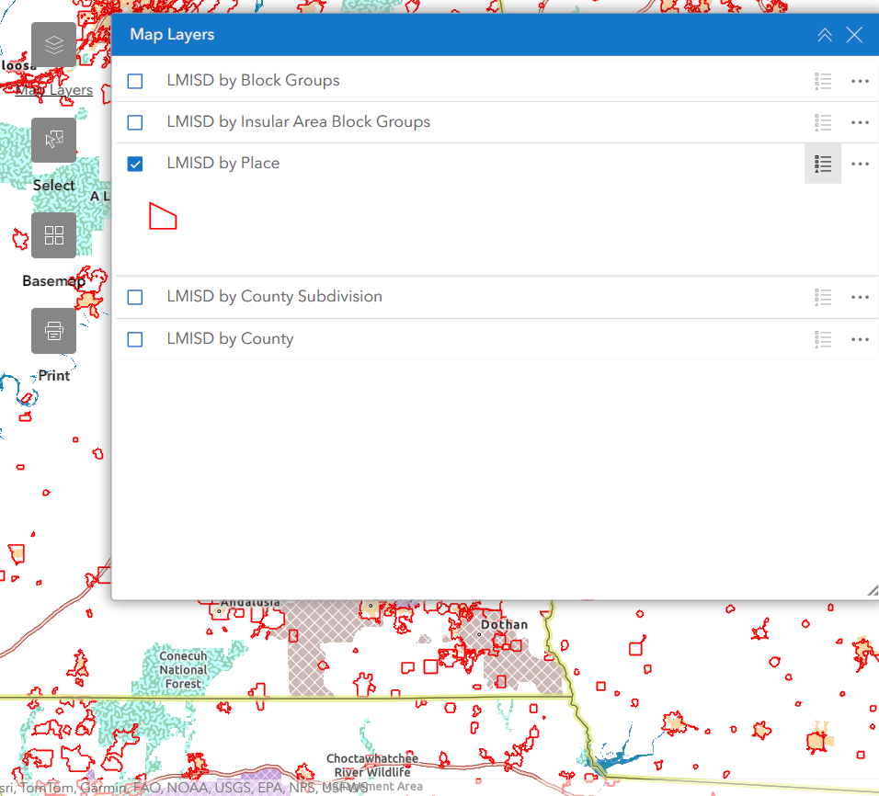
HUD Data & Tools
https://www.hudexchange.info/programs/acs-low-mod-summary-data/
  Notice CPD-24-04: Low- and Moderate-Income Summary Data Updates
  Notice CPD-14-013: Guidelines for Conducting Income Surveys to Determine the Percentage of LMI Persons in the Service Area of a CDBG-Funded Activity
https://hud.maps.arcgis.com/home/item.html?id=ffd0597e8af24f88b501b7e7f326bedd
Notes:
The place geography reflects the jurisdiction of a city, town, or other place. In rural settings, the place geography typically reflects UGLG jurisdictions and lends well to qualifying for area benefit for activities benefiting the whole town.
If the available LMISD geographies provided do not reasonably correspond to the service area, it may not be appropriate to use the LMISD to qualify an LMA activity. Grantees may consider conducting a methodologically-sound local income survey to determine LMA compliance for the specific service area.

Slide 12
All Applicants using LMISD data must use 2016-2020 data
Effective August 1, 2024
Notes:
Based on HUD’s transition policy outlined in CPD notice 24-04

Slide 13
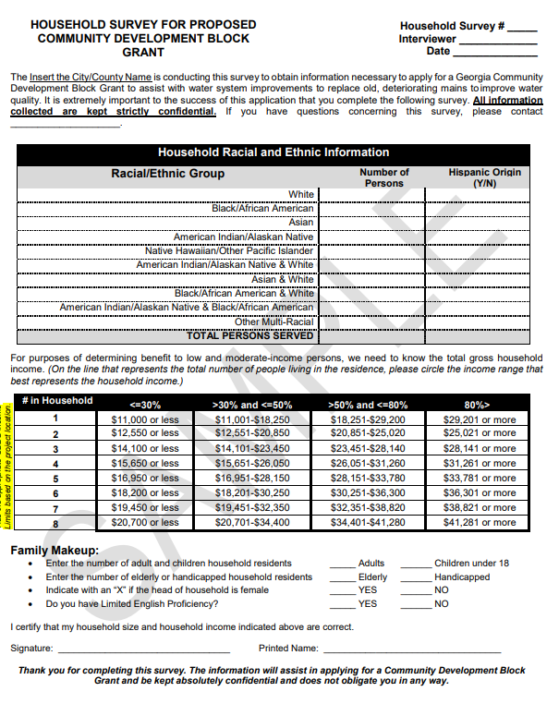
Local Survey
Guide to Acceptable Survey Methodology & Survey sample –
Appendix C
Notes:
Electronic surveys this option included in HUD’s Income Survey Toolkit (taken down)

Slide 14
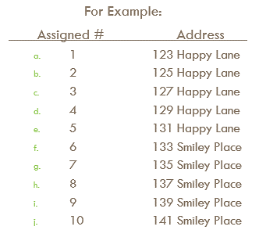
Random Sampling Method – Appendix C
Obtain an address list & place into an excel file assigning a number to each address
Review the sample size requirements and decide on the best method of solicitation
Use a random number generator - there are free online options
https://www.hudexchange.info/programs/cdbg/cdbg-income-survey-toolkit
Notes:
Define the universe . The actual toolkit has been taken down, but they do provide some mobile tools for compiling results.

Slide 15
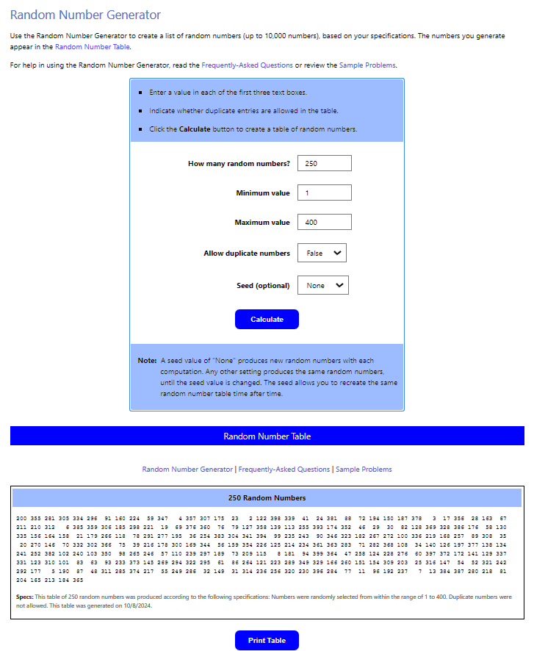
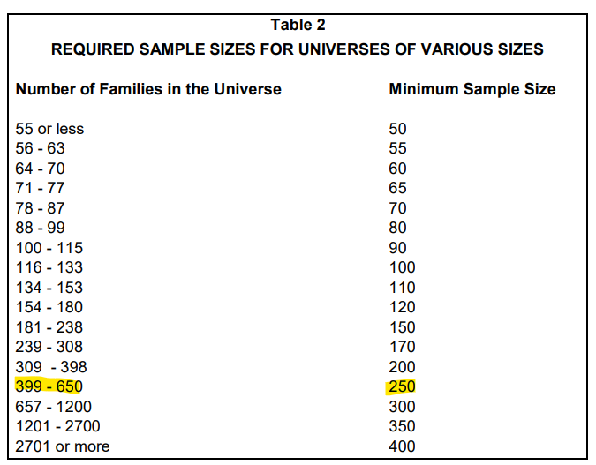
http://stattrek.com/statistics/random-number-generator.aspx
Notes:
If there are a total of 400 addresses listed, then the required sample must consist of at least 250 surveys. Should select more than 250 in case some households are not responsive. HUD accepts a MOE of 10%.
Mark the list of addresses using the random numbers generated.
Going door-to-door (e.g., every other address) until you accumulate enough surveys to meet the minimum sample size is not random.

Slide 16
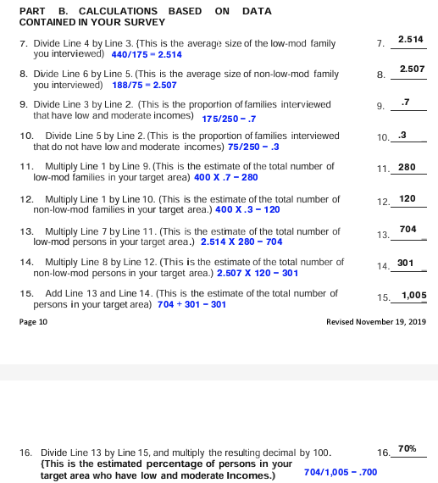
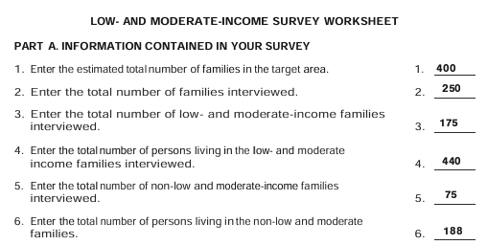
Low- and Moderate-Income Survey Worksheet
Notes:
Data used to complete DCA-6 and Survey Summary Table

Slide 17
2. What’s an Eligible Project?
All projects must conform to eligible activities listed under Section 105(a) of the HCDA of 1974.
Examples include, but may not be limited to:
Water and Sewer
Storm drainage
Street improvements
Housing clearance
Publicly owned buildings (not used for general operation of government)
Housing rehabilitation, reconstruction, Homebuyer Assistance
Fire protection
Senior Centers
Health Centers
Boys & Girls Clubs

Slide 18

CDBG Ineligible Activities
Ineligible Activities
Buildings for the Conduct of Government (except removal of architectural barriers)
Direct grant assistance to a for-profit business
General Governmental Expenses
Operating & Maintenance Expenses
New Housing Construction (not reconstruction) except in limited circumstances
Lobbying Efforts
Furnishings and Personal Property
Operating and Maintenance Expenses
Land Acquisition that is not directly tied to a national objective

Slide 19
Application Types
Single Activity – Building
  Domestic Violence Shelter
Single Activity – Housing
  Rehabilitation/ Reconstruction of owner-occupied units
Single Activity - Street/Drainage
  Street paving and drainage improvements
Single Activity - Water/Sewer
  Water and/or sewer improvements (installation or replacement)
Multi-Activity - Housing + Infrastructure and/or Buildings
  Street and Drainage improvements with homeowner housing rehabilitation
Multi-Infrastructure
  CDBG funds used for Water/Sewer and Street/ or Drainage

Slide 20
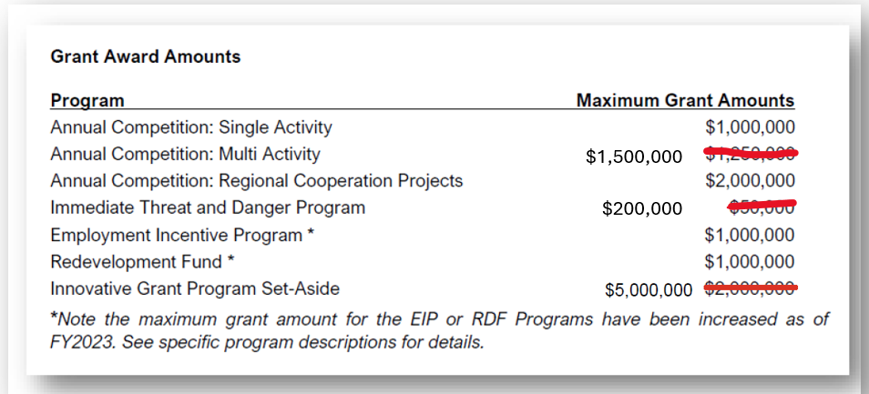
Grant Award Amounts

Slide 21

2027 Applications
Due by 11:59:59 Friday, April 2, 2027

Slide 22
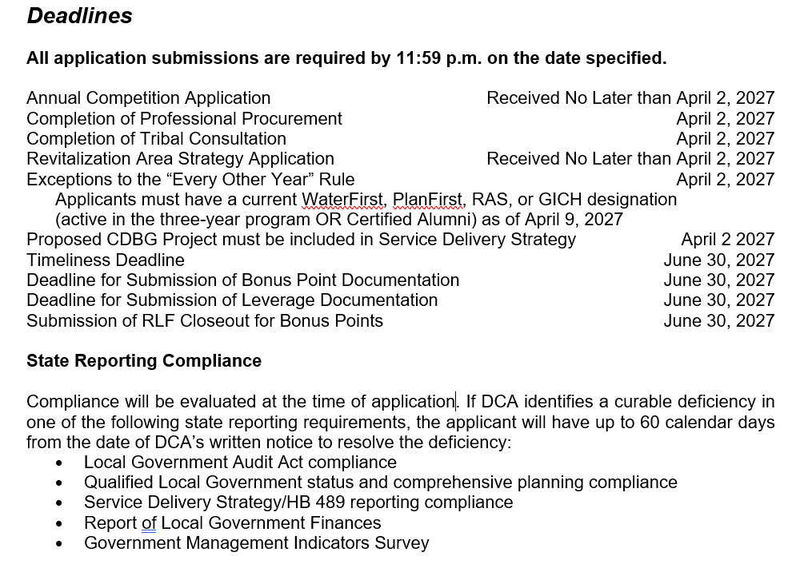
Threshold Requirements
Annual Competition
Notes:
The 60-day cure period applies only to state reporting compliance. It does not extend the application deadline or cure substantive deficiencies involving application completeness, professional procurement, environmental review, project-specific SDS consistency, eligibility for an every-other-year exception, or RLF compliance.

Slide 23
Under State statutes, applicants must comply with State planning and financial reporting laws.
These laws include:
The Georgia Planning Act (O.C.G.A. 45-12-200 et seq. and 50-8-1 et seq.),
The Service Delivery Act (O.C.G.A. 36-70-20 et seq.),
Government Management Indicators Survey (O.C.G.A. 36-81-8)
DCA Local Government Finance Report requirements (O.C.G.A. 36-81-8), and
Local Government Audit Act (36-81-1 et seq.)
Notes:
NEW 60-day cure period. Fletcher Morris and Jackie Neubert will be presented on QLG/ SDS/ GIS/ RLGF/ GOMI/ Audits on compliance day.

Slide 24
Local Government Planning & Reporting Compliance
Service Delivery Strategy (O.C.G.A. §36-70-20): State law requires that all projects funded be consistent with the community’s adopted Service Delivery Strategy (O.C.G.A. §36-70-20). The following components will be required for all applicants:
  1.An approved SDS on file with DCA, in compliance with applicable state law; and
  2.An approved SDS indicating that the applicant is an authorized provider of the service for which it is requesting CDBG funds (including housing).
It will not be necessary for an SDS to specifically identify that grant funds are a funding mechanism if other legal and appropriate funding sources are cited within the SDS document. Although it is prudent for a community’s SDS to contemplate the use of grant funds to support service provision, that language will not be included in the evaluation for the 2027 CDBG competition.

Slide 25
Revolving Loan Fund Compliance
Their Semi-Annual report is not up to date, i.e., submitted within 30 days of the end of the reporting period;
The Fund has more cash on hand than the greater of a) $125,000 or b) 30% of total assets;
The Fund has not made a loan or grant within the past five years.
The out of compliance RLFs must either be brought into compliance or closed by April 2, 2027, for the CDBG Annual Competition application to be eligible for funding.

Slide 26
June 30th Deadline
Application will be closed, can provide via email to CDBG.Biz@dca.ga.gov
Bonus Points
  Environmental clearance
  Return of Revolving Loan Funds (RLF) will apply for 2 application cycles
Leverage Documentation
  cash above the required minimum cash match amount
  purchase of equipment and furnishings with non-CDBG funds
  additional grants and loans from other sources
  “Reasonable” value assigned to donated and “in-kind”
Notes:
Only items that would not otherwise have been provided will be counted.
For example, a maximum $5,000 donation of services to develop the PER is acceptable.

Slide 27
Timeliness Deadline
June 30, 2027
Previous Annual Competition Projects funded in…
2026
  Meet an exception to the “every other year” rule by application deadline. Exceptions outlined in 2026 CDBG Applicants’ Manual.
      PlanFirst, WaterFirst, GICH, RAS
  All Special Conditions Cleared (including Housing Policies & Procedures)
  Design Work Completed
  Environmental Clearance
2025
75% of budget funds drawn and expended
2024 or earlier
100% funds drawn and expended
All previously funded applicants
All findings cleared
Notes:
PlanFirst community
Water First communities must propose water improvements as the primary purpose of the grant in order to apply annually
The GICH Georgia Initiative for Community Housing exception applies only if the 2024 CDBG application involves a housing component.
Proposed project takes place within the designated Revitalization Area Strategy (RAS) area

Slide 28

Funding Limits and Match Requirements for Annual Competition
Applicants may apply for:
Single-Activity Project - up to $1,000,000
Multi-Activity Project - up to $1,500,000
Local Match Requirements (except single-activity housing projects):
Regional Cooperation Project – up to $2,000,000
0% match requirement for grant requests of $500,000 and less
5% match requirement for grant requests of $500,001 to $750,000
10% match requirement for grant requests of $750,001 to $1,000,000 ($1mill project has a required match of $37,500)
15% match requirement for grant requests of $1,000,001 or more ($1.5M project has a required match of $250K (.05) + $250K (.1) + $500K (.15) = $112,500 )
Notes:
The match must be cash, whether loans, bond proceeds, grants, or appropriated funds. The source can be either private or other non-CDBG public funds. “In Kind” Services are not considered cash. (CHIP funds are not eligible for match)
$750,000 required match of $22,500 (5% of 450,000)
$1,000,000 required match of $22,500 + 25,000 = $47,500
$1,250,000 required match of 47,500 + 37,500 = 85,000

Slide 29
Scoring
Categories | Max Points
Program Feasibility | 50
Program Strategy | 50
Program Need | 125
Program Impact
Cost Per Person | 30
Demographic Need - absolute number in poverty | 15
Demographic Need - percent of poverty persons | 15
Demographic Need - median household income | 15
Leverage of Additional Resources | 20
Bonus points for Revitalization Area Activities | 20
Bonus points for State Priority Projects | 10
Bonus points for Regional Cooperation | 20
Bonus points for Robust Citizen Participation Activities | 10
Bonus points for Readiness to Proceed | 5
Bonus points for Return of RLF Funds | 5
Bonus points for Workshop Attendance | 10
Bonus points for Senior GICH Community | 20
Point Reduction for Missing Elements | Up to -25 Pts.
Maximum Total Points | 420
Notes:
Strategy – an evaluation of the relationship of the project to the needs described and the broader community development initiatives being undertaken by the applicant
Feasibility - tests for items beyond the Threshold requirements that are critical in carrying out the project in a timely manner, within budget, in compliance with HUD’s requirements, and that establish clear standards for project implementation, such as complete engineering and architectural reports and consistency across narratives, budgets, and cost estimates.
Need - access the living conditions of target area residents. A high need is defined as significant health and safety issues and a low need is defined as minimal health and safety issues or amenity issues only. The quality of the need documentation is critical in establishing the level of need.
Impact - a quantitative analysis as the basis for this scoring component.

Slide 30

Competitive Advantage
State Priority Projects (10 Points) – Water/Sewer/Housing
Closing RLF (5 Points) – Return of Funds
Readiness to Proceed (5 Points) – Environmental Clearance
Bonus Points
Regional Impact (20 Points) - Multiple Jurisdictions or Two or More Counties
Revitalization Area Strategy (20 Points)
June 30th Deadline
Leverage - additional resources committed to and directly related to the project. Calculation based on per capita average and percentile ranking among types of projects. Up to 20 points available.
Notes:
Homeowner participation will not be counted as leverage for single-activity housing applicants is not counted towards leverage.
Leverage definition - cash above the required minimum cash match amount, the purchase of equipment and furnishings with non-CDBG funds, and additional grants and loans from other sources. Only items that would not otherwise have been provided will be counted.
Multi-activity and Multi-infrastructure projects will be analyzed and the budget pro-rated to determine if the majority of the project (greater than 50%) qualifies for the bonus points
The proposed project must evidence a regional initiative through a revenue and cost sharing agreement or other intergovernmental agreement by multiple jurisdictions or two of more counties that results in regional impacts, benefits, or service delivery
For the annual competition, there are 3 point-based
additions to the method of distribution.

Slide 31
Robust Citizens Participation
A maximum of ten (10) bonus points may be earned for projects displaying a robust citizens participation process.
Some examples include, but not limited to
  Water bill announcements
  Meeting times and frequency
  Flyers
  Informative/ interactive webinars
Extra efforts to provide an opportunity for citizens, especially LMI citizens, to participate in an advisory role in the planning, implementation, and assessment of the programs and projects funded through CDBG activities
Notes:
The goal of these bonus points is to incentivize communities who undertake a robust citizens participation process which provides citizens -- especially low- and moderate-income citizens of the community where CDBG-funded activities will take place -- an opportunity to participate in an advisory role in the planning, implementation, and assessment of the programs and projects. These bonus points will be allocated using a scaled approach for efforts above and beyond the minimum Citizen Participation Requirements out lines in the CDBG Applicants’ Manual.

Slide 32
Accessing the Application

Slide 33
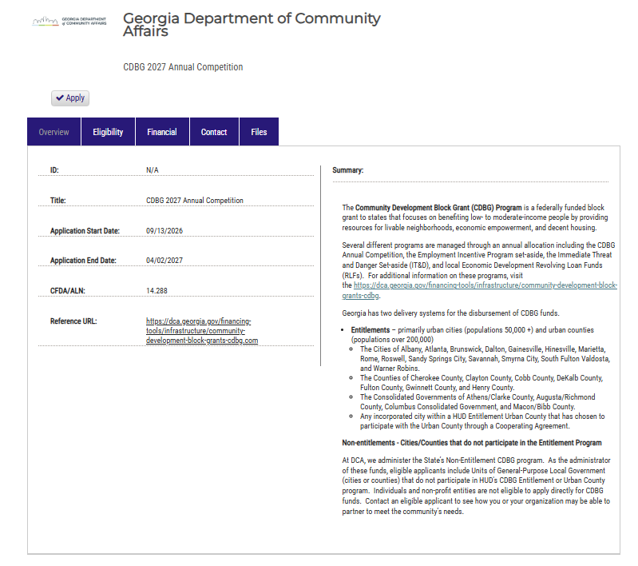
Accessing the Application
https://gn.ecivis.com/GO/gn_redir/T/18o2757vo914v

Slide 34
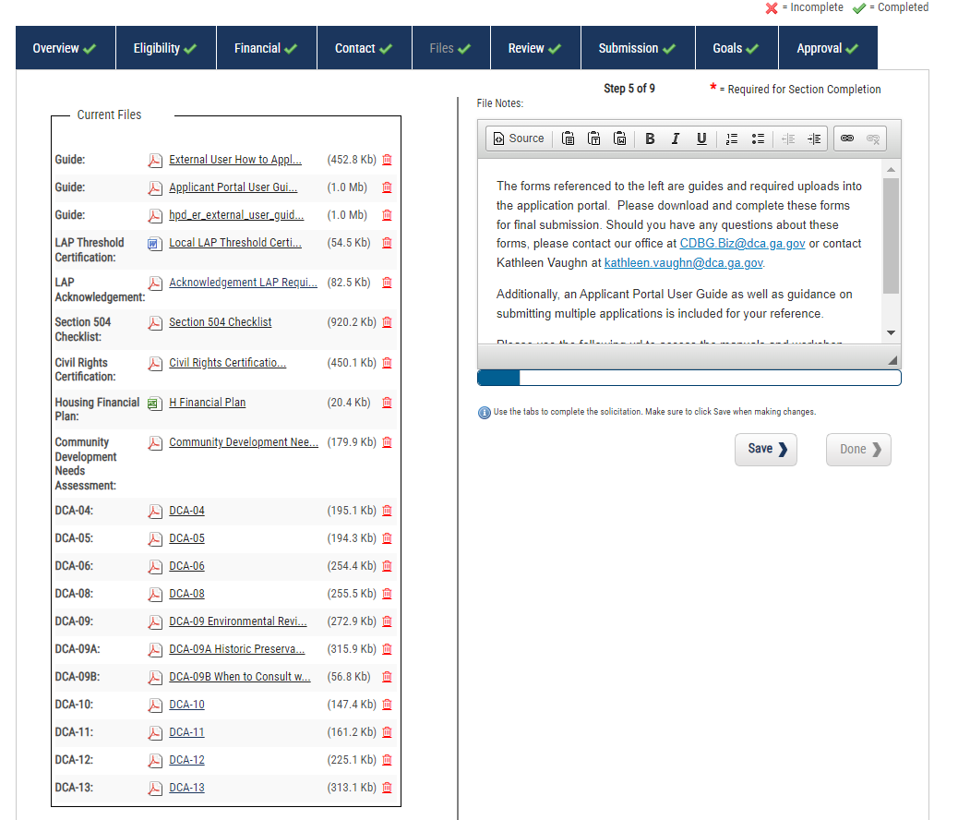
Accessing the Application

Slide 35
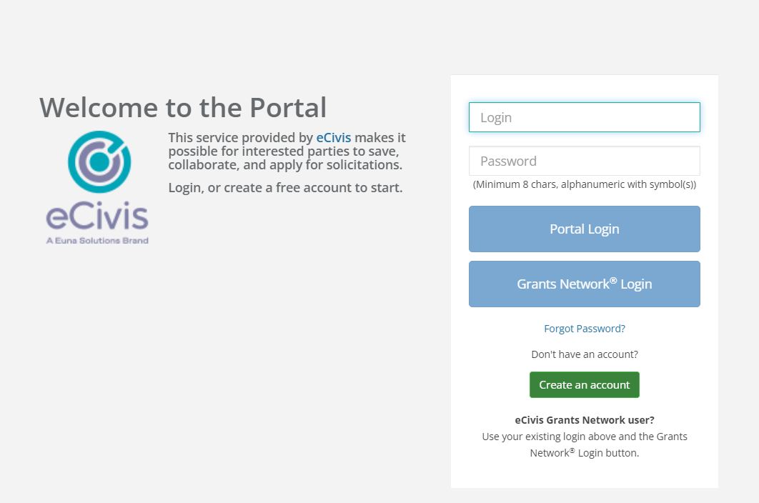
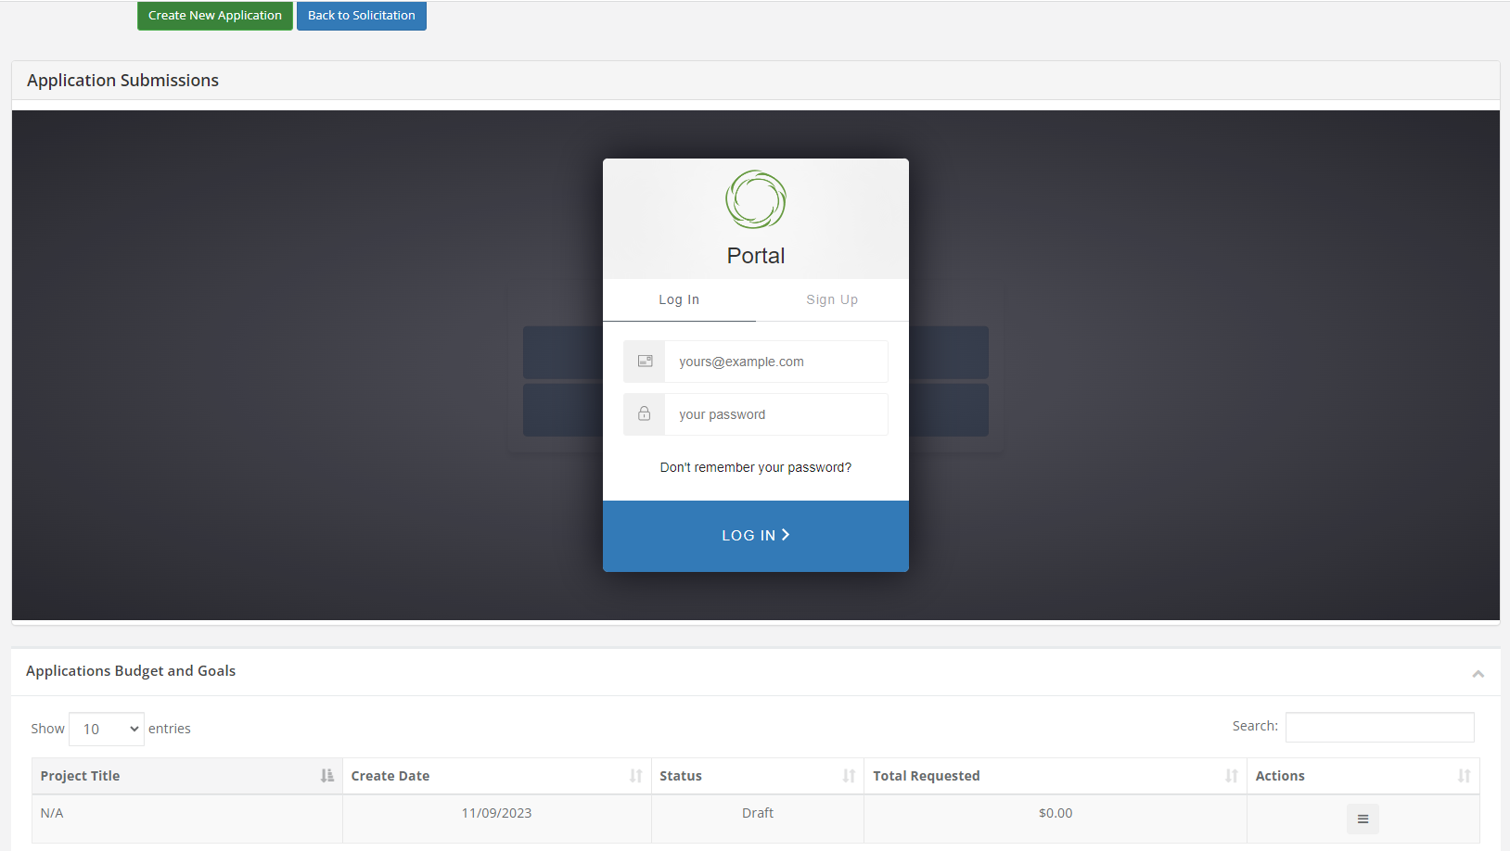
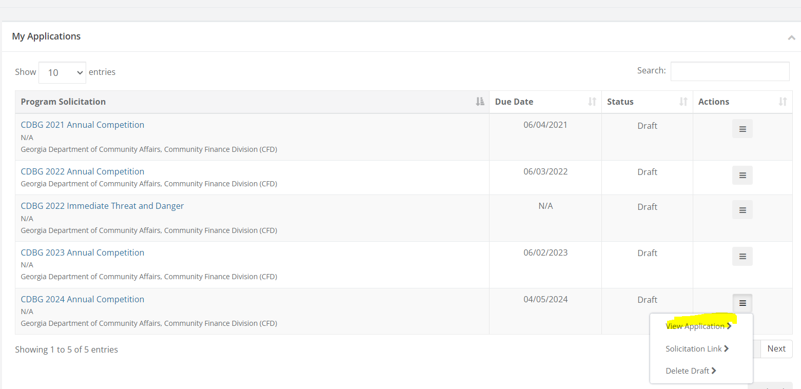
Accessing the Application
1
2
3

Slide 36
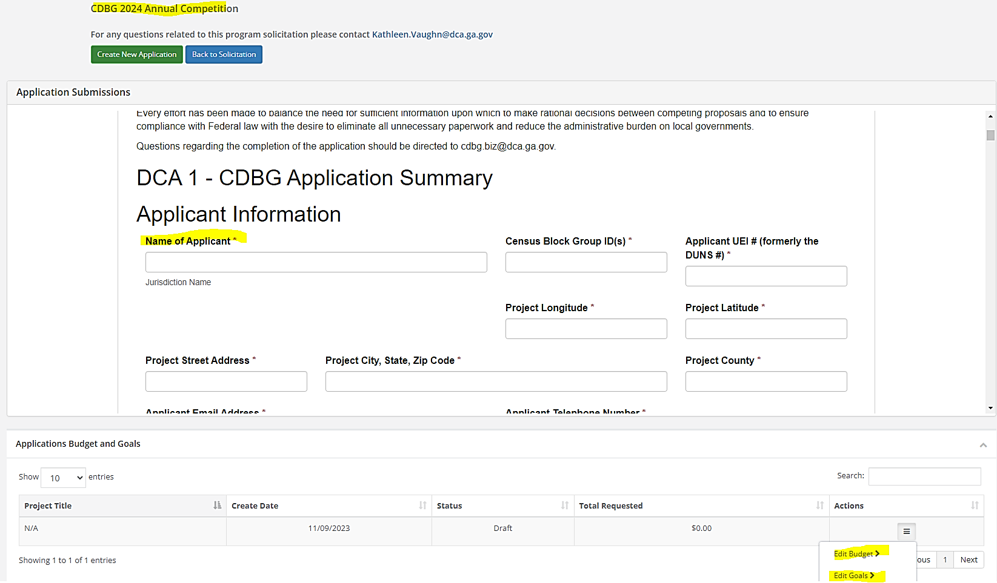
Block Group ID (12-digit code including State Code, County Code, Census Tract and Block Group)

Slide 37
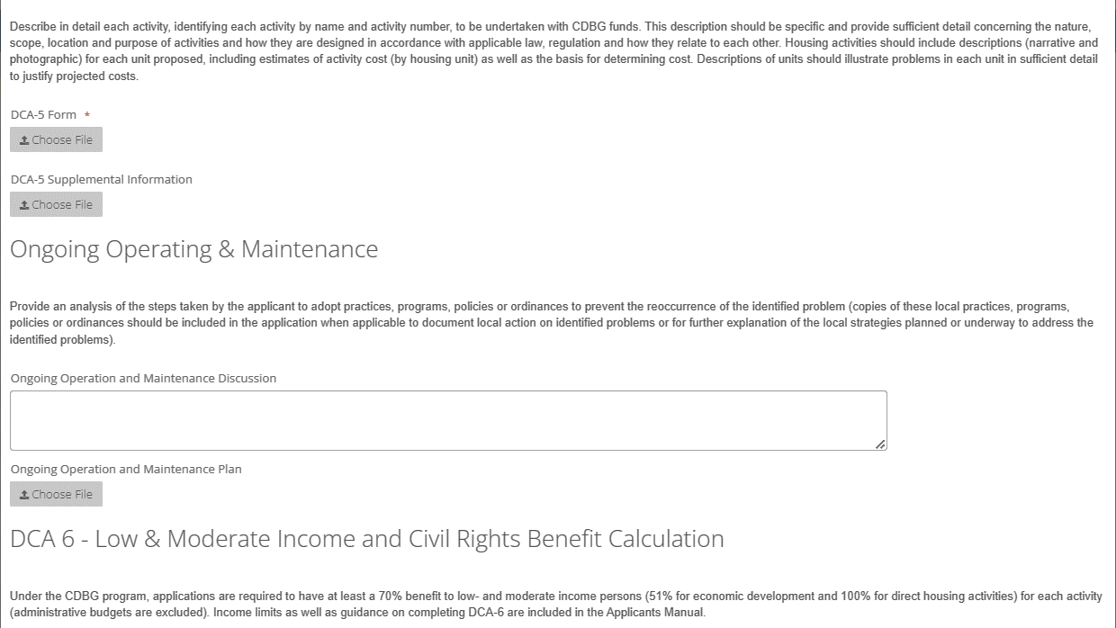

Slide 38
Resources
HUD Exchange CDBG LMI Data
https://www.hudexchange.info/programs/cdbg/cdbg-low-moderate-income-data/
Guide to National Objectives and Eligible Activities for State CDBG Programs
https://www.hudexchange.info/resource/2179/guide-national-objectives-eligible-activities-state-cdbg-programs/
FY27 CDBG Applicants’ Manual
https://dca.georgia.gov/financing-tools/infrastructure/community-development-block-grants-cdbg/annual-cdbg-competition/cdbg
Solicitation Link
https://gn.ecivis.com/GO/gn_redir/T/c60t5im4lcb
HUD’s Income Survey Toolkit
https://www.hudexchange.info/programs/cdbg/cdbg-income-survey-toolkit/
Notes:
Review the solicitation link and application

Slide 39
Thanks!
Any questions or comments?

