Slide 1
March 7, 2024
Glenn Misner

Slide 2
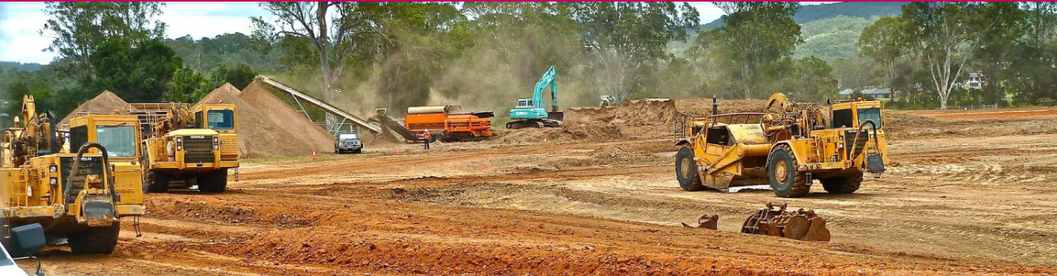
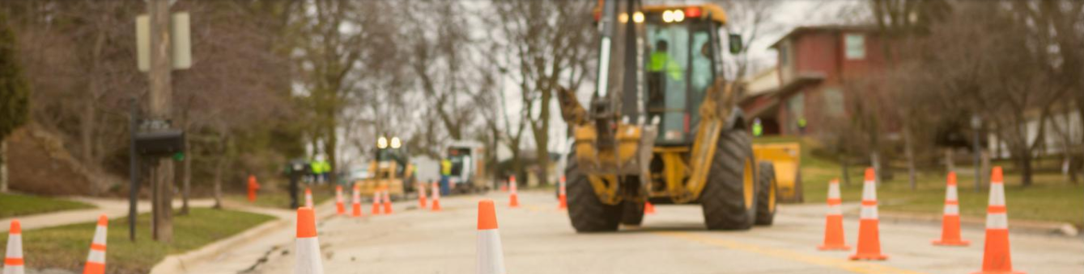
Community Development Block Grant (CDBG)
Program Overview

Slide 3
Purpose of Today’s Presentation
General Overview of the CDBG program
Statutory requirements
  National objectives
  Eligible Applicants
  Eligible Activities
Funding Limits and Match Requirements
Goals of the Program
Highlight successful projects
Looking Forward…
Notes:
Georgia’s rural communities face serious community and economic development challenges. Out dated water and sewer systems, streets, sidewalks, drainage, fire protection, lack of or deteriorating safe and sanitary housing. This list is daunting.
The Georgia Department of Community Affairs is committed to helping rural Georgia face these challenges ensuring that communities maintain their infrastructure at levels that meet current and future citizen needs.

Slide 4

CDBG Authorization
Established by the Housing and Community Development Act in 1974 as a tool for giving state and local leaders to help stimulate community development and job growth.
Flexible funding solution to address physical, economic and social deterioration in low to moderate income neighborhoods and communities.
Celebrating its 50th anniversary in 2024, CDBG is one of the longest continuously run programs at the U.S. Department of Housing and Urban Development (HUD)
Notes:
President Gerald Ford enacted the Housing and Community Development Act more than 40 years ago as an important source of funding for small rural communities to use in identifying solutions to address physical, economic and social deterioration in low to moderate income areas.

Slide 5
CDBG National Objectives
Benefit to Low and Moderate
income persons;
Prevention or elimination of
slums or blight;
Urgent Need
Notes:
All activities funded by CDBG must meet one of these broad federally-mandated National Objectives.
At least 70% Benefit to Low and Moderate income persons; - Low- and moderate-income person means…
Living at 80 percent or less of Area Median Income
Prevention or elimination of slums or blight;
Community Development needs having a particular urgency, posing serious and immediate threat to the health or welfare of a community

Slide 6
Who Can Apply?
Georgia has two delivery systems for CDBG funding:
1. Entitlement Communities – Receive funding directly from HUD
2. State CDBG Program for
Non-Entitlement Communities –
- DCA administers CDBG using a competitive application process
- Cities (generally below 50,000 in population) and Counties (generally below 200,000 in population) are eligible
Notes:
Georgia has two delivery systems for CDBG funding:
1. Entitlement Communities – Receive funding directly from HUD
2. State Small Cities Program for
Non-Entitlement Communities –
- DCA administers using a competitive application process
- Cities and Counties (generally below 50,000 in population) are eligible

Slide 7
What’s an Eligible Project?
All projects must conform to eligible activities listed under Section 105(a) of the HCDA of 1974.
Examples include, but may not be limited to:
  Water and Sewer
  Storm drainage
  Street improvements
  Housing demolition
  Publicly owned buildings (not used for general operation of government).
  Housing rehabilitation or reconstruction
  Senior Centers
  Health Centers
  Boys & Girls Clubs
Notes:
The activities a community can undertake with CDBG funds is comprehensive and flexible.

Slide 8
Funding Limits and Match Requirements
Applicants may apply for -
  Single-Activity Project - up to $1,000,000
  Multi-Activity Project - up to $1,250,000
  Regional Cooperation Projects ------------ $2,000,000
  Innovative Projects ---------------------------- $2,000,000 -UNDER REVIEW
Local Match Requirements - Annual Competition:
Grants up to $300,000, or grants for single activity housing projects - no matching funds required.
Grants of $300,001 to $750,000 - 5% local matching funds required.
Grants $750,001 to $1,000,000 - 10% local matching funds required.
Grants of more than $1,000,001 – 15% local matching funds required.

Slide 9
What Are We Trying To Accomplish?
Community Planning - Projects demonstrating thoughtful planning in prioritizing needs and capital
Public Facility Improvements - Projects addressing health and safety, improved quality of life, greater availability, accessibility and affordability of services.
Housing Improvements – Creating affordable standard housing
New Job Creation - Projects creating new jobs for low and moderate income people, which increases the per capita income and reduces unemployment in a community.

Slide 10

Building a Great Place to Live
Notes:
--Since 1974, CDBG has invested $144 billion to create viable communities nationwide
-- In the last 10 years, CDBG has
created or retained more than 400,000 permanent jobs
rehabilitated more than 1.3 million homes
and helped more than 33 million people benefit from improved public facilities
--This is the really big CDBG picture nation-wide
--State of Georgia since 2013
33 public non-governmental buildings serving over 48,000 people
278 infrastructure projects serving 62,300
52 Economic Development projects creating or retaining 3,644 jobs
268 units rehabbed
30 ITAD projects benefitting over 27,000 people
--Now we will encourage you to focus on your own community

Slide 11
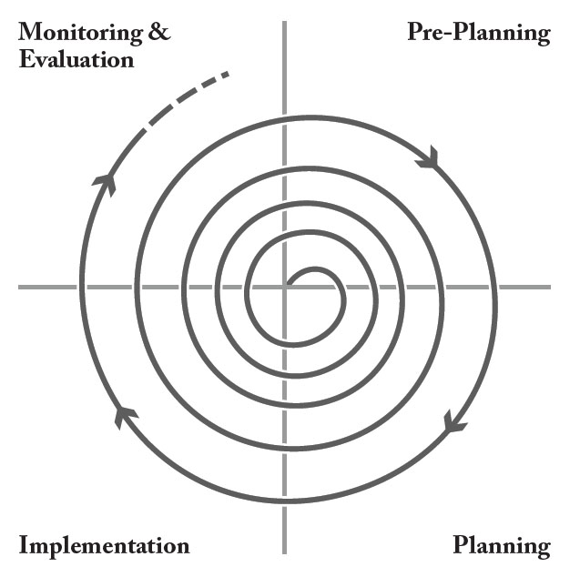
Planning and CDBG
Notes:
--We will be focusing on CDBG implementation at this workshop
--Let’s also remember the role of planning, goal setting, evaluation and outreach to partners and stakeholders as you proceed
--Like to spend time in implementation
--Need to spend time on planning
--Premortem/Preparade
--Process never ends – no “one and done”

Slide 12
Planning as Priority-Setting
  Long Term Immediate
  Plans deal with both the immediate and the long term but pull it all together in the Work Program.
Community Goals
Needs & Opportunities
Community Work Program

Slide 13

Planning and CDBG
Planning considers the whole
  Widens options/Avoid a narrow focus
  Gather data
    Look for bright spots
    What needs improvement?
Notes:
--See slide
--Also note areas for data gathering – public facilities (capital budgets), housing surveys, other community and economic development needs
--Data and community participation will be the backdrop for shaping your future as changes occur

Slide 14
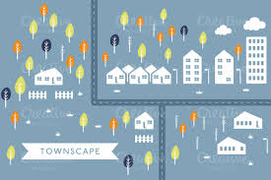
Planning and CDBG
Use DCA programs to step back and gain perspective
  Comp Plan
  PlanFirst
  GICH
  RAS
Notes:
--See slide and refer to DCA programs

Slide 15
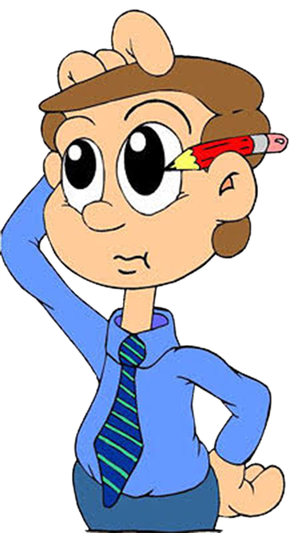
Now What?
You’ve planned—we hope.
You’re ready for implementation.
So what’s important?
Notes:
--See slide/transitional slide

Slide 16
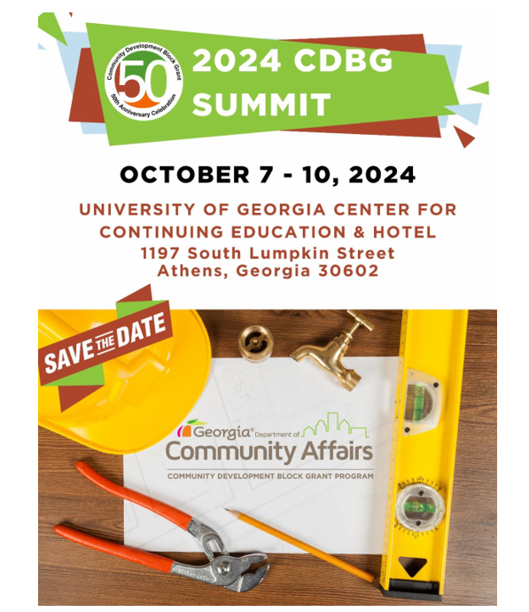
How to Apply for CDBG?
Attend the CDBG Summit
  October 7 – 10 @ UGA Athens
  Focus on Recipients of 2024 Awards AND
  Application process for the FY25 CDBG Round
Applicants’ Manual (DCA.GA.GOV)
  Includes detailed information
  on writing a competitive application
Application Deadline
  TBD – probably 1st week in April 2025
Also, attend the DCA Fall Conference – Dates TBD October 2024
  Overview of ALL DCA programs
  Register at DCA.GA.GOV

Slide 17
CDBG Innovative Grant Program
Notice of Funding Availability to be published soon
Amount of Funds Available for Award
  DCA anticipates that approximately ten million dollars ($10,000,000) will be available under this NOFA. DCA reserves the right to fund, in whole or in part, any, all, or none of the applications submitted in response to this NOFA.
Maximum Amount of Grant Request
  DCA will award up to $2,000,000 per application.
  Application due date: TBD
Match Requirement
  The minimum match requirement is 15% of the amount of the grant request.
  $2,000,000 award will have a $300,000 match
  $1,000,000 award will have a $150,000 match

Slide 18
CDBG Innovative Grant Program
The goal of the Innovative Program is to provide financial resources to communities who have developed plans that will create transformational change within the community upon the plan’s implementation.
Expected outcomes:
  Successful applicants will develop projects that not only provide a resource to Low-and Moderate-Income households to improve the quality of life through housing improvements, enhanced infrastructure, etc., but more importantly begin answering the question of how the proposed project will develop solutions toward the upward mobility of the individuals to be assisted.
  Comprehensive and sustainable framework for community revitalization.
Notes:
A corridor revitalization effort that addresses blighting influences, enhances mobility access to employment centers, job skills training, and/or locations providing essential services;
Consolidation of water and/or wastewater systems between jurisdictions whereby current maintenance of one or more of the systems may not be financially viable in isolation, but when paired with other systems results in greater levels of service provision through system upkeep, reduced overhead, and economies of scale:
Deployment of broadband services throughout portions of the community to support educational, health care, employment/economic development and/or other initiatives that currently limit quality of life and opportunities for low-and-moderate income persons, providing the opportunity to improve the standard of living for community residents; or
Development of a plan to address mental health issues within the community, supported by wrap-around services, including, but not limited to safe, affordable housing for those receiving services.

Slide 19
CDBG Innovative Grant Program
What’s Eligible?
A sampling of ideas that could be transformative, if fully developed, may include, but not be limited to:
  A corridor revitalization effort
  Consolidation of water and/or wastewater systems
  Development of a plan to address mental health issues
  Whole neighborhood revitalization using multiple resources…..
    CDBG
    CHIP
    LIHTC
    Other
Notes:
A corridor revitalization effort that addresses blighting influences, enhances mobility access to employment centers, job skills training, and/or locations providing essential services;
Consolidation of water and/or wastewater systems between jurisdictions whereby current maintenance of one or more of the systems may not be financially viable in isolation, but when paired with other systems results in greater levels of service provision through system upkeep, reduced overhead, and economies of scale:
Deployment of broadband services throughout portions of the community to support educational, health care, employment/economic development and/or other initiatives that currently limit quality of life and opportunities for low-and-moderate income persons, providing the opportunity to improve the standard of living for community residents; or
Development of a plan to address mental health issues within the community, supported by wrap-around services, including, but not limited to safe, affordable housing for those receiving services.

Slide 20
Success Story
Rusher St. - City of Washington, GA
Notes:
The most successful CDBG projects demonstrate vision, a clear strategy and the use of CDBG as a
catalyst to bring multiple resources to bear to transform a neighborhood, a community, or the lives of
people in need.

Slide 21
Rusher Street
Rampant Drug Use
Non-conforming Lots
Abandoned, substandard, and dilapidated housing
Blight
Substandard water and sewer infrastructure
Narrow streets; lack of drainage system

Slide 22
City of Washington - Making the Pieces Fit
The City of Washington secured designations and public/private partnerships that included:
  Adoption of an Urban Redevelopment Plan (O.C.G.A. 36-61)
  The establishment of an Urban Redevelopment Authority (URA)
  Enterprise Zone/Opportunity Zone
  Historic Preservation Tax Credits
  Brownfield Programs and Incentives
  GICH (class of 2011)
  Entrepreneur Friendly Designation
  Camera Ready and Work Ready
  UGA Small Business Development Center
  Used combination of GICH, CDBG, RAS, AND CHIP to accomplish goals of the URP

Slide 23
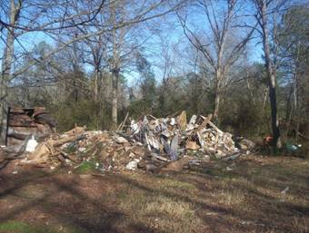
Washington established an Enterprise Zone
Developed Nuisance Ordinance and Non-Conforming Use Ordinance as a way to handle properties that contribute to blight

Slide 24
Washington - Implementing an Urban Redevelopment Plan

Slide 25
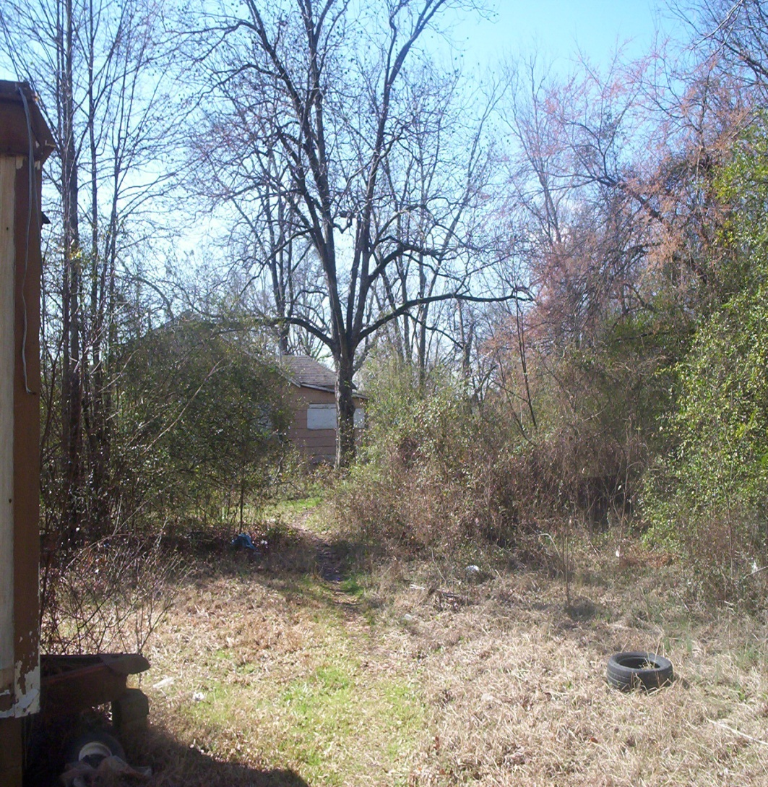
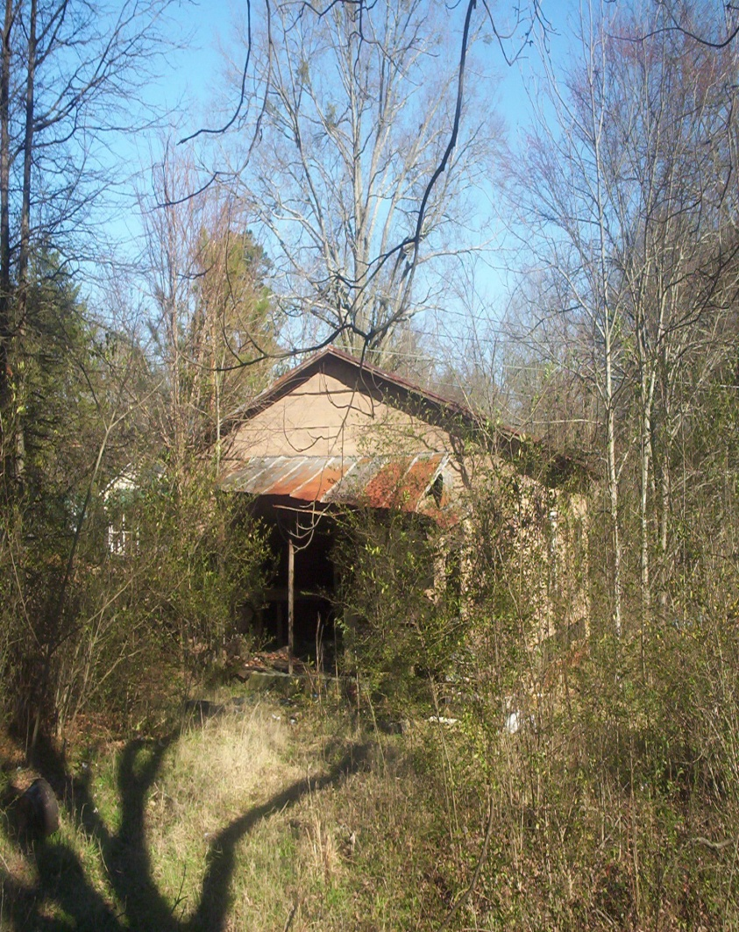
Washington - “Rusher Street” Before

Slide 26
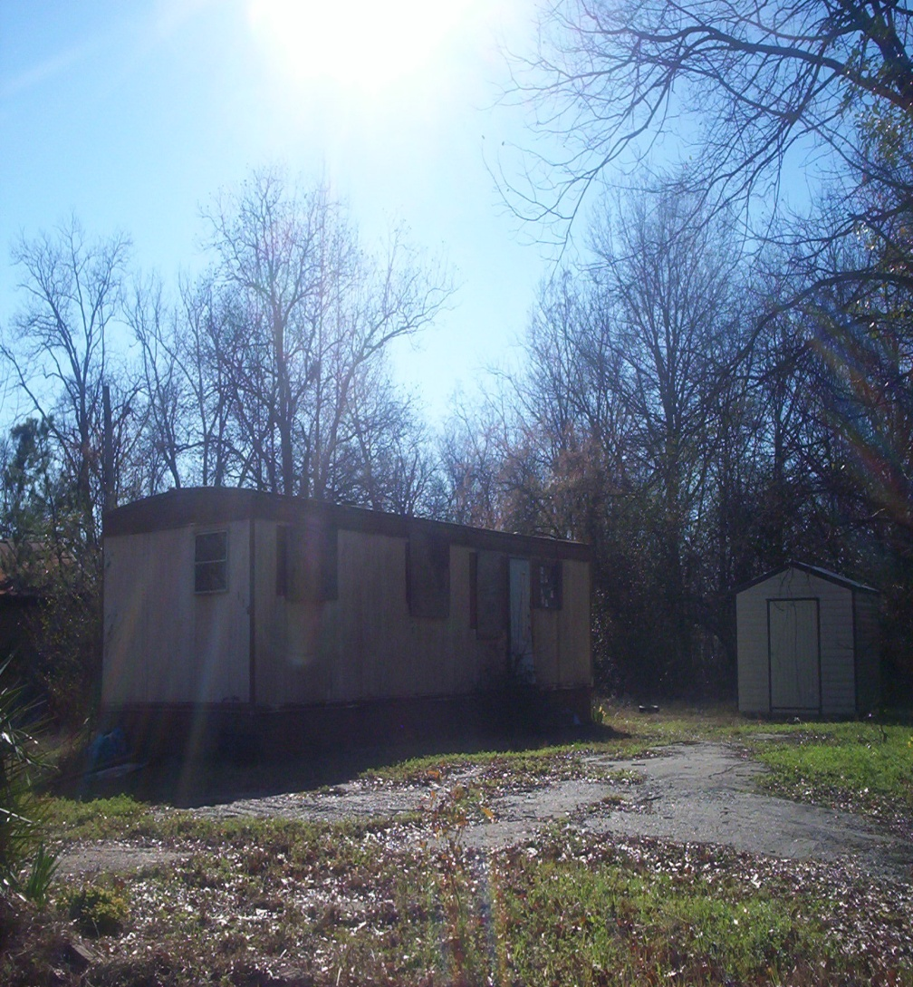
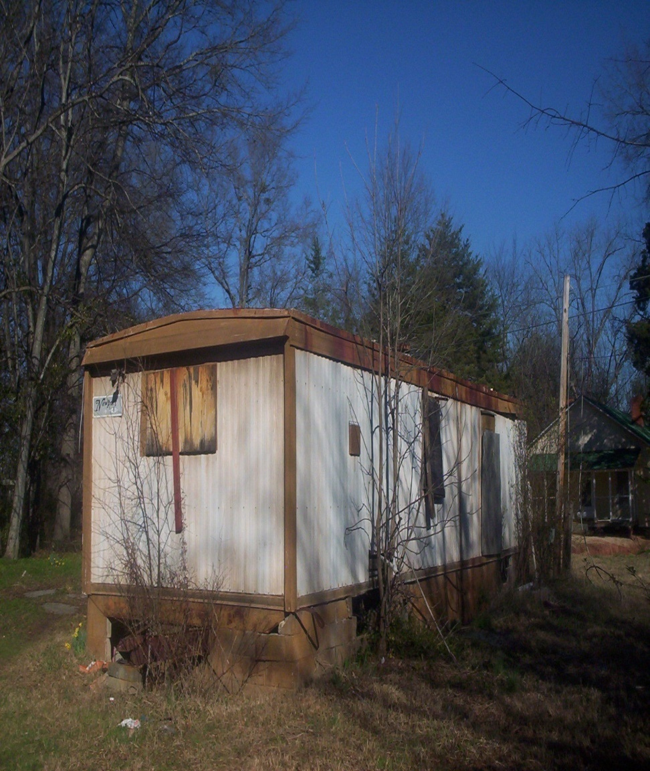
“Rusher Street” Before

Slide 27
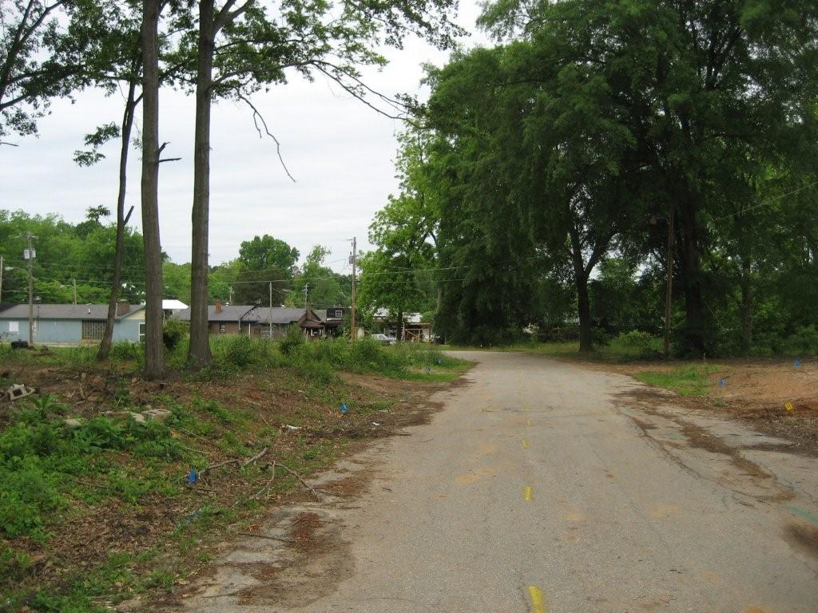
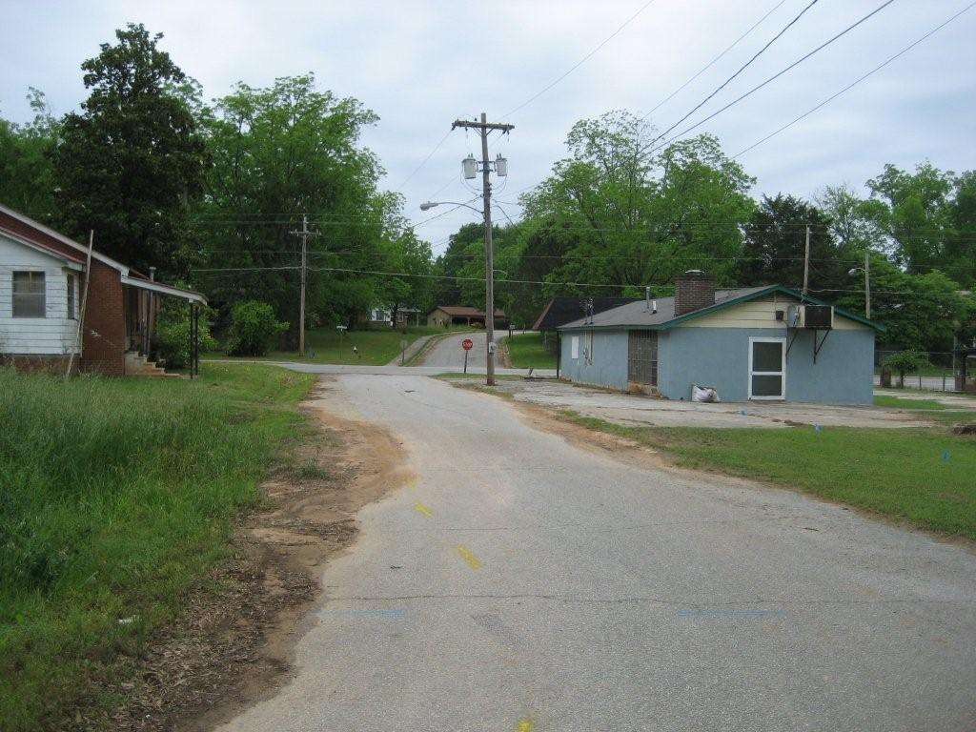
“Rusher Street” Before

Slide 28
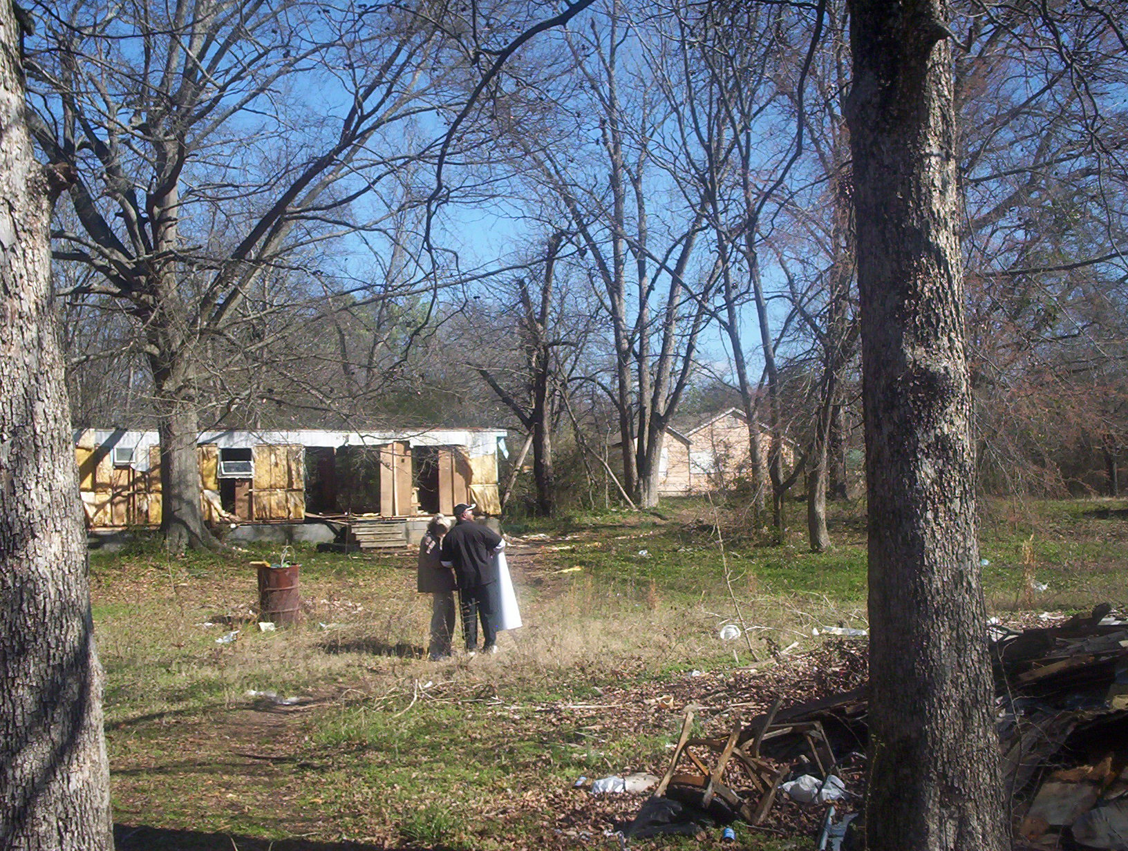
“Rusher Street” Before

Slide 29
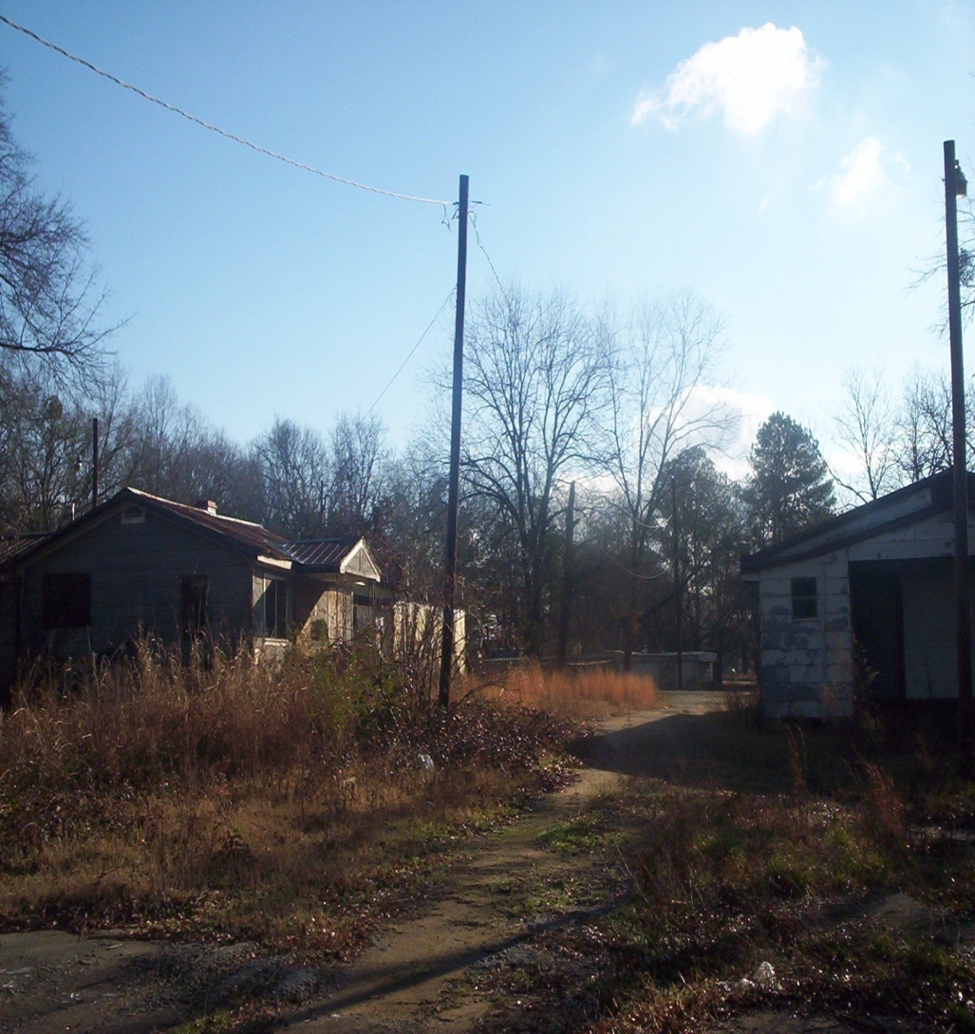
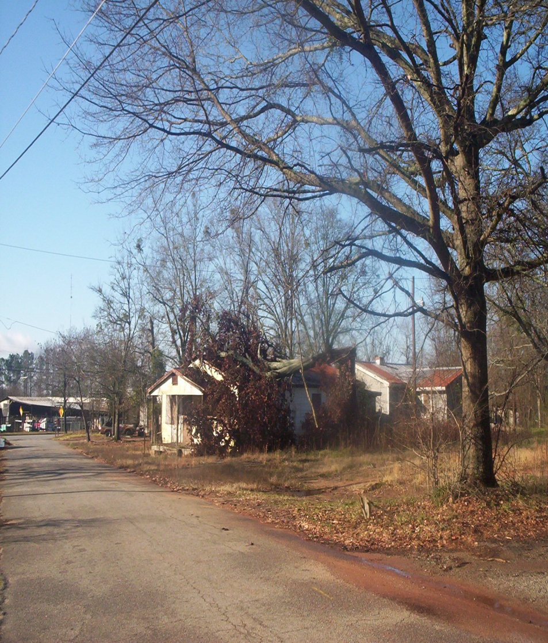
“Rusher Street” Before

Slide 30
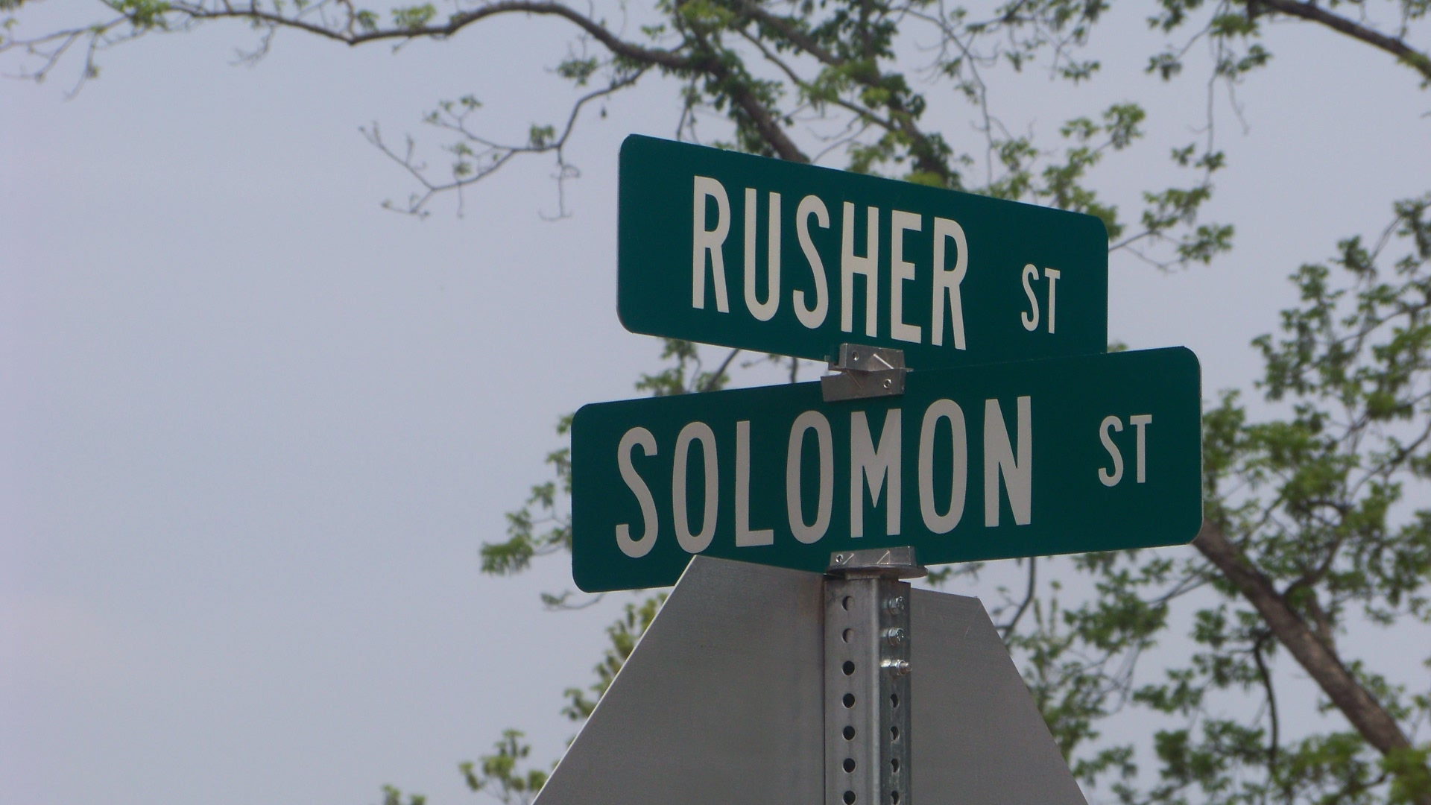
“Rusher Street” After

Slide 31
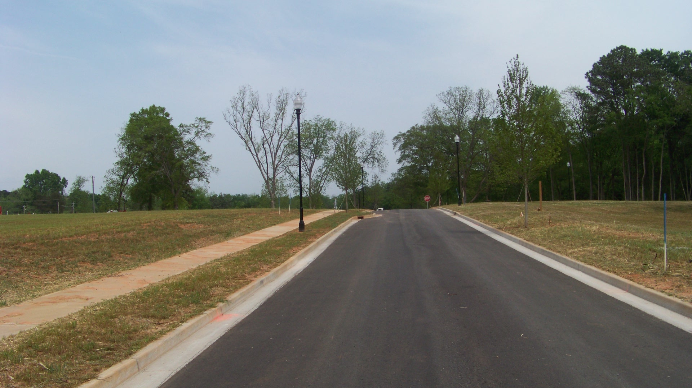
“Rusher Street” After

Slide 32
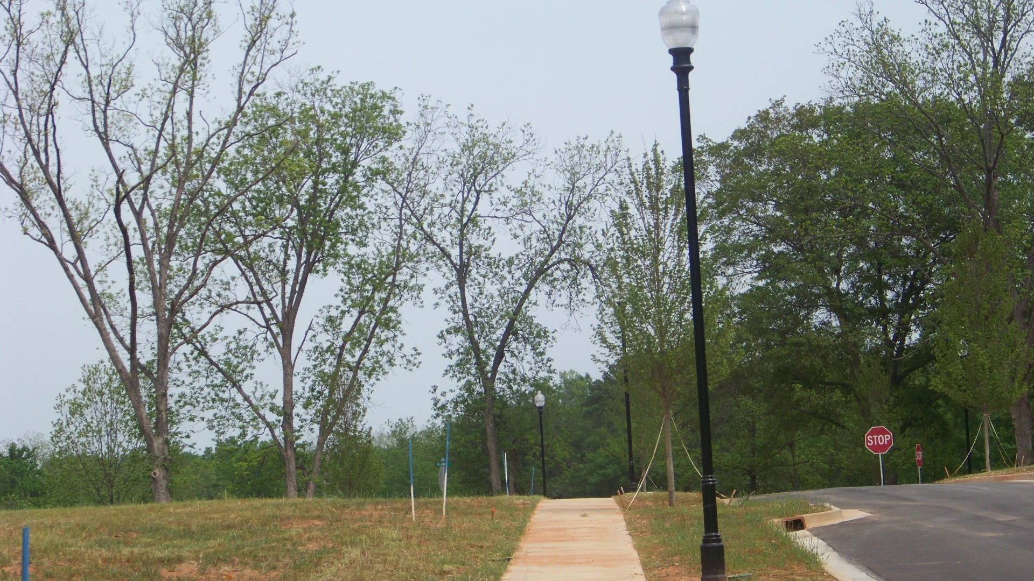
“Rusher Street” After Pictures

Slide 33
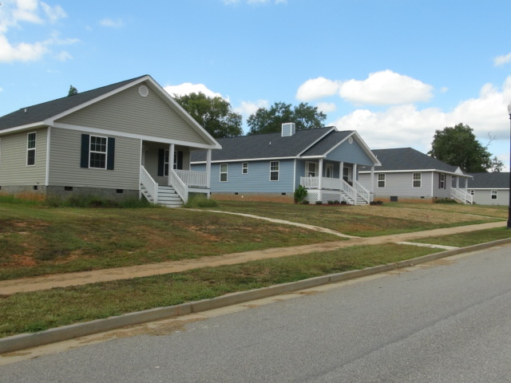
“Rusher Street” After

Slide 34
Questions??
  Glenn Misner(404) 679-3138
  glenn.misner@dca.ga.gov

Slide 35


