Slide 1

Build America, Buy America, Act (BABA) Requirements for CDBG Projects
Crystal Gaillard

Slide 2
What is BABA?
Enacted in the Infrastructure Investment and Jobs Act signed by President Biden on November 15, 2021.
Requires that products purchased in connection with infrastructure projects funded by Federal financial assistance programs must be produced in the United States.
  This requirement is known as the “Buy America Preference (BAP).”
The following products used in Federally funded infrastructure projects must be produced in the United States:
  Iron and steel;
  Manufactured products; and
  Construction materials.
For the purposes of BABA, an infrastructure project is defined as any project that includes the following activities:
  Construction,
  Alteration,
  Maintenance,
  Repair.
Notes:
Government-wide law applicable to all Federal infrastructure spending.

Slide 3
Definitions
Buy America Preference (BAP)
Federal Financial Assistance (FFA)
Infrastructure
Statutory requirement that Federal funding for infrastructure projects use “covered materials” that are “American-made.”
Grants
Cooperative agreements
Non-cash contributions
Direct assistance
Loans
Loan guarantees
Other financial assistance
Buildings and real property
  Including housing
Utilities
Water systems (drinking water and wastewater)
Electrical transmission facilities and systems
Broadband infrastructure
Transportation infrastructure

Slide 4
Definitions Cont’d
Construction Materials
Manufactured products
Iron and steel
Includes all raw materials used in construction, including:
metals other than iron/steel,
plastic materials such as PVC pipe,
glass,
lumber,
drywall.
Does not include cement and aggregates (stone, sand, gravel).
A material or supply used in an infrastructure project that is not iron or steel or a construction material.
When two or more materials are combined, they should be treated as a manufactured product.
Includes materials that are primarily composed of iron or steel.

Slide 5

Produced in the United States means:
For Iron or Steel:
- All manufacturing processes, from the initial melting stage through the application of coatings, occurred in the United States

Slide 6
Produced in the United States means:
For “Manufactured Products”:
• The manufactured product was manufactured in the United States;
and
• The cost of the components of the manufactured product that are mined, produced, or manufactured in the United States is greater than 55 percent of the total cost of all components of the manufactured product, unless another standard for determining the minimum amount of domestic content of the manufactured product has been established”
• More information on component costs at: eCFR :: 2 CFR 184.5

Slide 7
Examples – Manufactured Products
HVAC Systems for a Public Building
A city government uses federal funds to upgrade an HVAC system in a public facility.
The HVAC unit must be manufactured in the U.S.
Key components such as compressors, motors, and control boards must be at least 55% U.S.-sourced.
If imported circuit boards or cooling coils make up more than 45% of the product’s total cost, it does not comply with BABA.
Domestic content MUST be more than 55% of all components MUST be sourced from the U.S.

Slide 8
Produced in the United States means:
For Construction Materials:
• All manufacturing processes for the construction material occurred in the United States
• Information on manufacturing processes for covered construction materials is here: eCFR :: 2 CFR 184.6

Slide 9
Examples – Construction Materials
Plastic Piping for Water Infrastructure
A water infrastructure project requires PVC pipes for a public water system.
The plastic resins and pipe extrusion process must occur in the U.S.
If raw polymer pellets are imported and only shaped into pipes domestically, it does NOT comply.
If the entire resin production, pipe extrusion, and finishing occur in the U.S., it meets BABA standards.
The construction material MUST be manufactured in the United States.
All steps in the production process MUST occur domestically, including melting, refining, processing, and finishing.

Slide 10
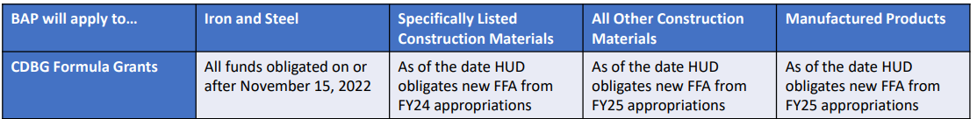

HUD Construction Materials Groups
HUD’s waiver breaks construction materials into two groups for the purposes of HUD’s phased implementation: “specifically listed” and “all other construction materials.”
Specifically Listed
  Metals other than iron or steel (non-ferrous metals)
  Lumber
  Composite building materials
  Plastic and polymer-based pipe and tube (e.g., PVC pipe)
All Other Construction Materials
  Glass
  Drywall
  Other construction materials
Manufactured Products
  A material or supply used in an infrastructure project that is not iron or steel or a construction material.

Slide 11
CPD Notice 25-01
Notice CPD-25-01: CPD Implementation Guide for BABA’s BAP
OMB’s Implementation Guidance on Application of Buy America Preference in Federal Financial Assistance Programs for Infrastructure M 24-02
  OMB acknowledged at 2 CFR 184.4(d) that some projects may be “private” in nature and are not considered public infrastructure subject to BABA.
CPD provides further clarification on when grantees should apply BABA’s requirements to housing projects as described in M-24-02.
  Housing projects with one to four units are considered “private,” consistent with HUD’s definition of single-family housing. Housing projects with one to four units, including onsite utilities and related activities are therefore not considered public infrastructure and are not subject to the BAP.
  Housing projects with five or more units are considered public infrastructure. Housing projects with five or more units are therefore subject to the BAP unless another BABA waiver or exemption applies.
Notes:
Housing – no more special condition compliance.

Slide 12
HUD General Waivers
Phased Implementation
Exigent Circumstances
De Minimis, Small Grants, & Minor Components
  Waiver published March 15, 2023, establishes a phased implementation Phased Implementation schedule for application of the BAP to HUD programs.
  BAP may be waived if projects must be completed immediately to protect life, ensure safety, or prevent the destruction of property
  Effective until November 23, 2027
  BAP waived for projects if cost is equal to or less than current Simplified Acquisition Threshold of $350,000
  BAP waived for a de minimis portion that comprises no more than 5 percent of the total cost of covered materials used in a project, up to $1 million
  Effective until November 23, 2027
Notes:
BABA only applies to the purchase of iron and steel and requires that all manufacturing from the initial melting stage through the application of coatings occur in the United States;
BABA does NOT apply to “infrastructure” projects where the total cost of the project is $350,000 or less; and Note: Last year the value was $250K, but the simplified acquisition threshold changed.
BABA does NOT apply to housing rehabilitation or renovation projects if the total cost of the work per house is $250,000 or less.
HUD is issuing this waiver to facilitate the effective implementation of the BAP and will therefore not permit the artificial subdivision of infrastructure projects to fit within the scope of this waiver of the BAP. Thus, for purposes of this waiver, HUD will evaluate the total cost of the infrastructure project as it would for purposes of the review contemplated under 24 CFR Part 58, i.e., by defining the scope consistent with 24 CFR 58.2(a)(4), as “the activity, or a group of integrally related activities, designed by the recipient to accomplish, in whole or in part, a specific objective.”
for the purposes of determining the applicability of this waiver in connection with the maintenance and repair of public housing, HUD will evaluate the infrastructure project as including the single relevant procurement contract for such maintenance or repairs, or, where applicable, the collection of procurements focused on the same specific objective (e.g., construction of a resident service space) or limited scope of work (e.g., lead based paint abatement).

Slide 13
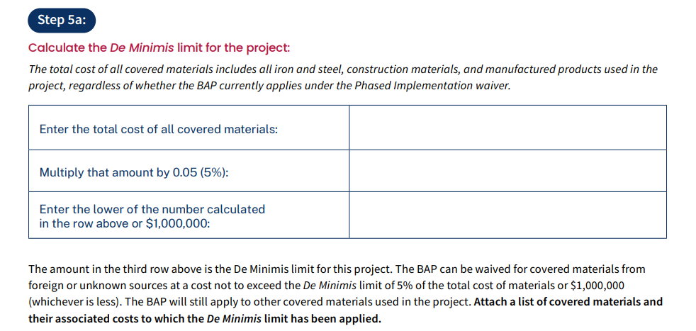
De Minimis Limit – 5% of total costs not to exceed $1mill (Effective until November 23, 2027)
If a project's total material cost is $450,000, the de minimis waiver can be used to purchase up to $22,500 in materials from foreign sources
Notes:
Applies to all covered materials regardless of whether BAP applies under the Phased Implementation Waiver. Please consult with DCA if you think a general waiver will apply.

Slide 14
Project-Specific Waivers
Three categories of waivers:
  Public interest: BAP would be inconsistent with the public interest.
    Most difficult project specific waiver to obtain, per HUD
  Nonavailability: covered materials are not produced in the US in sufficient and reasonably available quantities or of a satisfactory quality.
  Unreasonable cost: inclusion of domestically produced covered materials will increase the cost of the overall project by more than 25 percent.

Slide 15
Project Specific Waivers
Considerations:
  Consult with DCA regarding the availability of General Waivers
  Market research to support the need for a waiver, such as documenting results of supplier scouting services from the Manufacturing Extension partnership.
  HUD Grantees must submit waiver through HUD’s portal
  https://www.hudexchange.info/resource/7058/baba-waiver-system-grantee-user-manual/
HUD coordinates with Office of Management and Budget/MIAO
Ultimate approval is provided by Office of Management and Budget/MIAO
15-day comment period
MIAO publication
To date, HUD has not submitted any project-specific waivers.

Slide 16
Phased Implementation
BAP now applies to projects with FFA greater than $250K:
2023 Projects – iron, steel
2024 Projects – iron, steel, specifically listed construction materials
2025 Projects – iron, steel, specifically listed construction materials, & manufactured products
BAP does not apply to:
Non-infrastructure funding.
Infrastructure projects with a total costs of $350K or less
CDBG-DR, CDBG-MIT, CDBG –CV projects
Projects qualifying under another HUD general waiver
Notes:
Project’s cost is equal to or less than the current Simplified Acquisition Threshold of $350,000, which is more than the value of $250k listed last year.

Slide 17
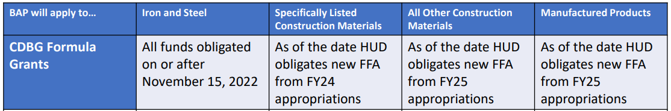
BABA Applicability
The BAP is now in effective
2023 Projects - iron or steel
2024 Projects – iron, steel, specifically listed construction materials
2025 Projects – iron, steel, specifically listed construction materials, & manufactured products
Notes:
2. Specifically Listed
Metals other than iron or steel (non-ferrous metals)
Lumber
Composite building materials
Plastic and polymer-based pipe and tube (e.g., PVC pipe)

Slide 18
Demonstrating Compliance
Prior to the drawdown of construction funds, the Certificate of Origin must be provided.
Recipients will ensure the products delivered to the construction site are accompanied by proper documentation that demonstrate compliance with the law and made available to the funding authority upon request.
Signed certification letter from the manufacturer for the project is the most direct and effective form of compliance documentation for ensuring products used on site are BABA-compliant prior to their installation
Notes:
Link to project
Link to Product
Attestation statement
Manufacturing location or locations
Representative’s signature certifying knowledge of manufacturing processes.

Slide 19
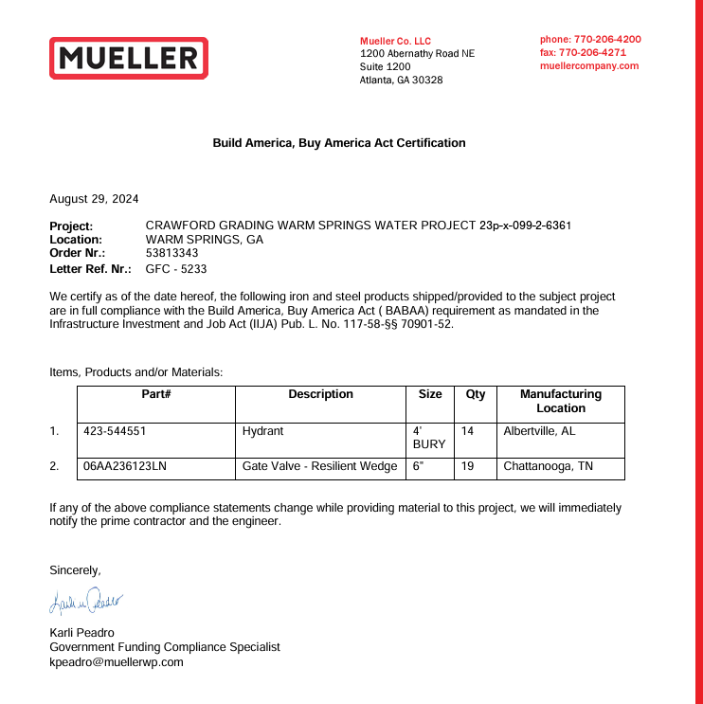
Manufacturer’s Certification
Basic elements of sufficient documentation:
  Project name, project location, contract number, or project number
  Description of product(s) (simple explanation sufficient to identify the product(s)), or an attached purchase order, invoice, or bill of lading.
  Attestation statement referencing Infrastructure Investment and Jobs Act (“IIJA”) or the Bipartisan Infrastructure Law (BIL) and American Iron and Steel (AIS) requirements
  Manufacturing location (s)
  Signature of representative certifying knowledge of manufacturing processes.

Slide 20
Contract Requirements
Architect/ Engineer contract should include, as a basic service, obtaining and maintaining all BABA documentation (particularly manufacturers’ certifications) during construction, which shall be transferred to the recipient. The architect or engineer will need to certify to this action at the project’s end.
At a minimum, the following must be included in all construction contract documents: All requirements of the Build America, Buy America (BABA) Act, 41 USC 8301 note, and all applicable rules and notices, as may be amended, shall be complied with if applicable to the infrastructure project. Pursuant to HUD’s Notice, “Public Interest Phased Implementation Waiver for FY 2022 and 2023 of Build America, Buy America Provisions as Applied to Recipients of HUD Federal Financial Assistance” (88 FR 17001), any funds obligated by HUD on or after the applicable listed effective dates, are subject to BABA requirements, unless excepted by a waiver.
Contractors must provide manufacturers’ certifications for all BABA compliant items to the responsible party before a request for reimbursement to the agency is made.
Notes:
contractor construction contract(s) must include a requirement to procure and install only items that comply with BABA or are subject to an approved waiver.

Slide 21
Bid Requirements
Advertisement for Bids
This agreement is for services related to a project that is subject to the Build America, Buy America Act (BABAA) requirements under Title IX of the Infrastructure Investment and Jobs Act (“IIJA”), Pub. L. 177-58. Absent an approved waiver, all iron, steel, manufactured products, and construction materials used in this project must be produced in the United States, as further outlined by the Office of Management and Budget’s Memorandum M-22-11, Initial Implementation Guidance on Application of Buy America Preference in Federal Financial Assistance Programs for Infrastructure, April 18,2022.
Instructions to Bidders
Any request for substitute or “or equal” shall include the Manufacturer’s Certification of compliance with the Build America, Buy America Act (BABAA) requirements mandated by Title IX of the Infrastructure Investment and Jobs Act (“IIJA”), Pub. L. 177-58. If the Instructions include a Federal requirements section, include the following: BABAA requirements apply to this project.
Bid Form
Bidder’s representation section: Bidder is familiar with all laws and regulations that may affect cost, progress, and performance of the work, including BABAA requirements.

Slide 22
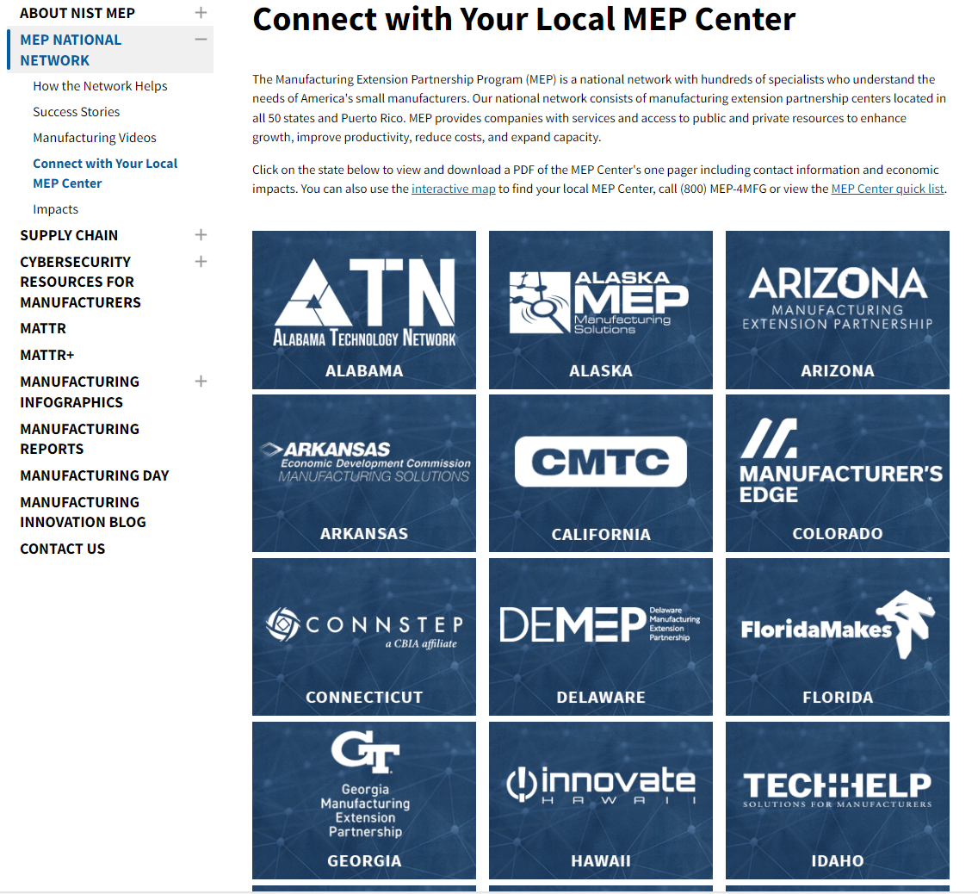
Georgia Manufacturing Extension Partnership (GaMEP) at Georgia Tech
Georgia Manufacturing Extension Partnership (GaMEP) at Georgia Tech | NIST
Offers supplier scouting for free

Slide 23
General Condition
The following general condition has been added:
The Recipient, by signing these conditions, is certifying that it will comply with the requirements of the Build America, Buy America Act ("BABA" or "the Act") as enacted on November 15, 2021, as part of the lnfrastructure lnvestment and Jobs Act (lUA).Public Law 117-58. The Act establishes a domestic content procurement preference, the BAP, for Federal infrastructure programs. The Recipient must ensure that none of the funds made available for infrastructure projects may be obligated unless it has taken steps to ensure that the iron, steel, manufactured products, and construction materials used in a project are produced in the United States. The Act further defines a project to include "the construction, alteration, maintenance, or repair of infrastructure in the United States" and includes within the definition of infrastructure those items traditionally included along with buildings and real property. Thus, new awards of Federal Financial Assistance from a program for infrastructure, and any of those funds obligated by the grantee or Recipient, are covered under the BABA provisions of the Act, 41 U.S.C. 8301 note, unless covered by a waiver.

Slide 24
Special Condition
The Recipient must submit for DCA's review and written approval a certification, signed by the chief elected official, stating the Recipient will adhere to the requirements of the The Build America, Buy America Act (BABA), enacted in the Infrastructure Investment and Jobs Act on November 15, 2021. BABA requires products purchased in connection with infrastructure projects funded by Federal financial assistance programs to be produced in the United States, known as the “Buy America Preference (BAP)”. Specifically, this is a statutory requirement that Federal funding for infrastructure projects use “covered materials” that are “American-made.” The BAP applies to the following products: Iron and steel; Manufactured products; and Construction materials. For 2026 awards, BAP will include iron, steel, specifically listed construction materials, & manufactured products

Slide 25
Resources
HUD Waivers
https://www.hud.gov/program_offices/general_counsel/baba
CPD Notice 25-01
https://www.hudexchange.info/news/notice-cpd-2025-01-cpd-implementation-guidance-for-babas-bap/
OMB Memos - M-22-11 & M-24-02
https://www.whitehouse.gov/wp-content/uploads/2022/04/M-22-11.pdf
https://www.whitehouse.gov/wp-content/uploads/2023/10/M-24-02-Buy-America-Implementation-Guidance-Update.pdf
OMB proposed rule – Guidance for Grants & Agreements (add a new part 184 of 2 CFR and revise 2 CFR 200.322)
https://www.federalregister.gov/documents/2023/08/23/2023-17724/guidance-for-grants-and-agreements
HUD’s BAP Checklist
https://files.hudexchange.info/resources/documents/Optional-Buy-America-Preference-Checklist.pdf

Slide 26
Thanks!
Crystal Gaillard
Crystal.Gaillard@dca.ga.gov
dca.georgia.gov

