Slide 1
Application Development

Slide 2
Application Summary
Resolution to Submit
Proposed Accomplishments
Community Development Needs Assessment
Form DCA 4
Photo Map
Photos of Need
Form DCA 5
O&M Discussion and Plan
Form DCA 6
Copy of Survey Form
Table of Survey Results
Form DCA 8
Match and Leverage Documentation
Form DCA 9 – Environmental Review Information
9A – Historic Preservation Environmental Review
9B – When to Consult with Tribes
Form DCA 10 – Certified Assurances
Maps
Target Area Map
Concentration Map – Low/Mod
Concentration Map – Minority
Concentration Map – Housing Deficiency
Topographic Map
Floodplain Map
Wetlands Map
Form DCA 13 – Disclosure Report
Application Format

Slide 3
Community Development Needs Assessment
Analyze the Jurisdiction’s Overall needs
Water
Sewer
Drainage
Streets
Public Buildings
Housing
Economic Development

Slide 4
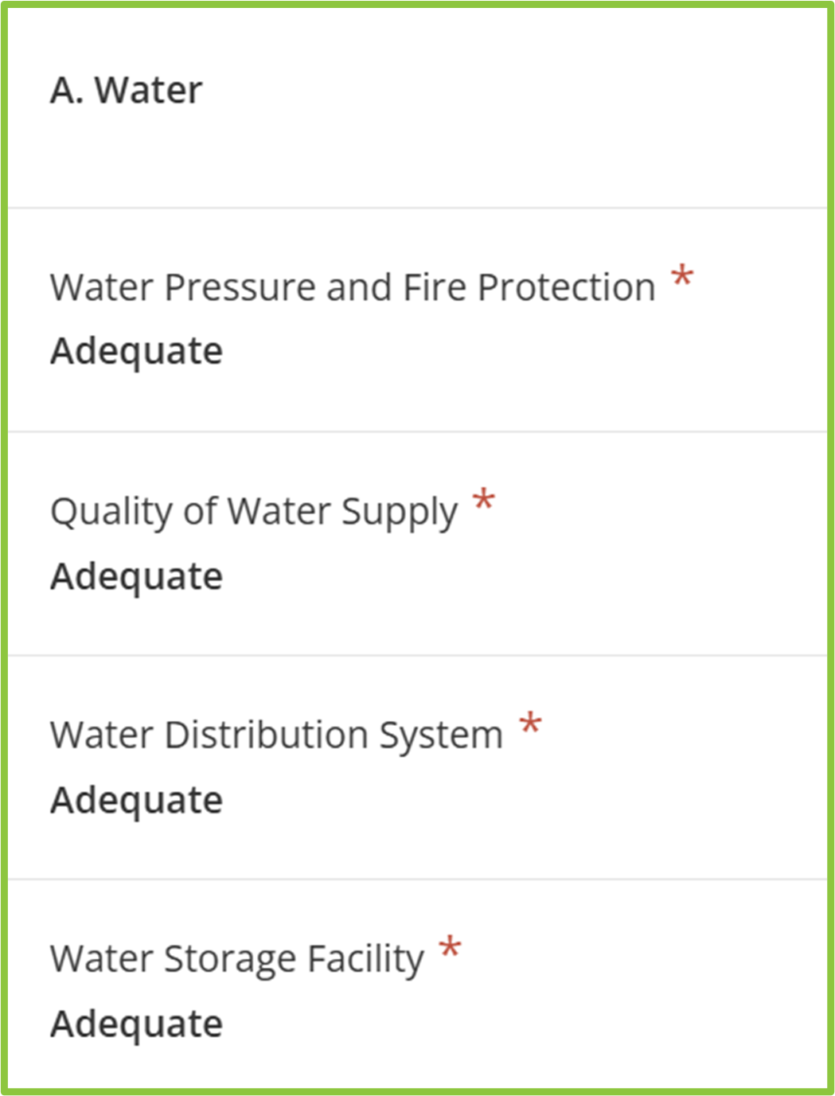
Community Development Needs Assessment
This will assist DCA in determining whether the applicant is making a comprehensive examination of its community development needs before deciding which target area(s) to address.
Items to Remember:
A brief explanation is required for items marked “inadequate”.
The applicant must note how identified needs will be met.

Slide 5
Alternative Target Areas
Briefly describe the areas, neighborhoods, or other districts within the jurisdiction and their needs.
Discuss why these areas and projects were not selected for the application.
Please do not include project alternatives/alternative solutions in this section. Project alternatives/Alternative Solutions should be addressed in DCA-5 and the PER/PAR.

Slide 6
Target Area Selection
Explain the rationale for the Target Area Selection.
Band-Aid here, Band-Aid there? Phased approach? Citizen Complaints? Constant work orders?
Note - while the proposed project in the community’s application does not have to be the highest priority community need, the rationale for the activity’s selection must be present.

Slide 7


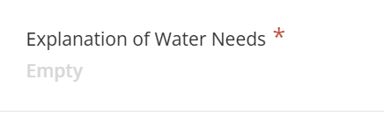

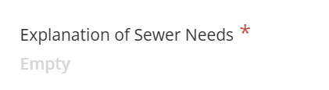
Target Area Needs
When a target area(s) is chosen, the applicant must provide a detailed review of the target area’s community development needs and how the needs will be met.

Slide 8
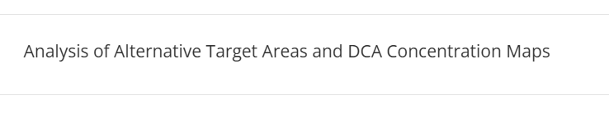
Concentration Maps
Is the selected Target Area within an area of concentration?
If not – provide an explanation (in the section shown below) of why a target area inside of an area of concentration was not chosen.

Slide 9
DCA 4
Discuss the specific needs to be addressed.
Describe the problem and how it affects the PEOPLE.
Keep the focus on the needs of the residents.
Document, document, document the need.
Numerically list the application’s needs/claims.

Slide 10
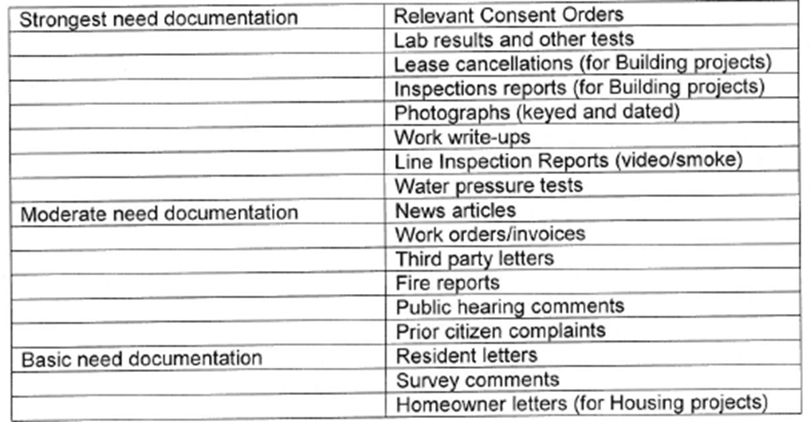
DCA 4 – Documenting the Need
To a great extent, an applicant’s need score is determined by the documented severity of need compared to other similar applications.
*This list is not exhaustive, your application may have documentation not listed

Slide 11
DCA 6
For a complete DCA-6, follow instructions pages 89-91.
Be sure to include # low and moderate income households and # of households above low-and-moderate-income levels.
Include who did interviews, when they were completed (time and date), how survey was completed.
Make survey times catch people who work during normal workday hours.
If you have any questions about survey methodology, please contact DCA staff for assistance.

Slide 12
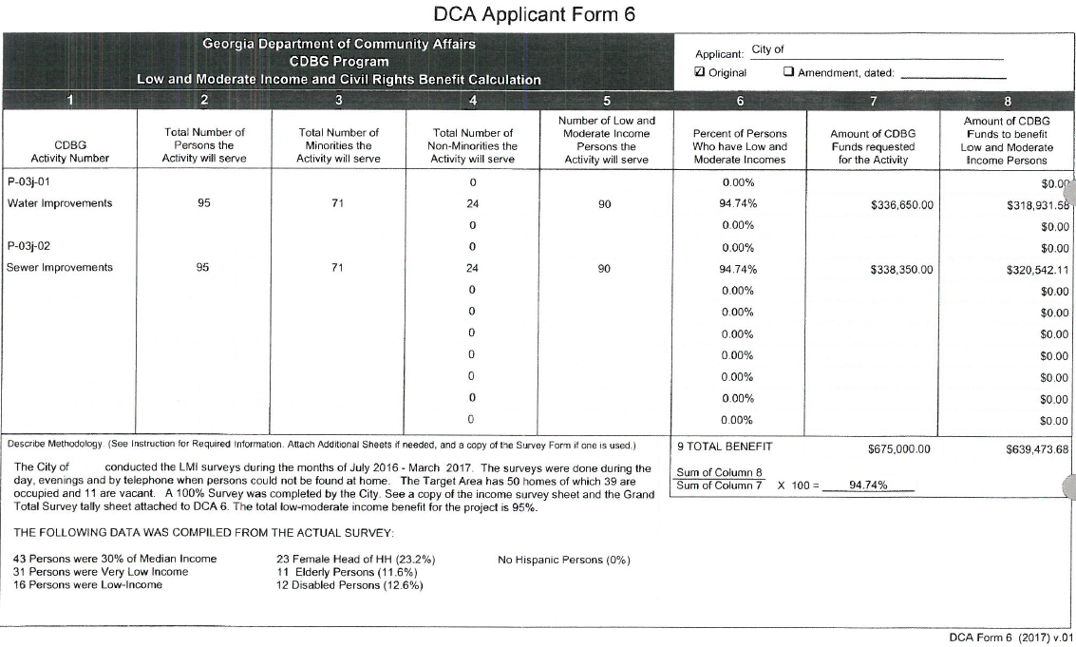
DCA 6 – Sample Form

Slide 13
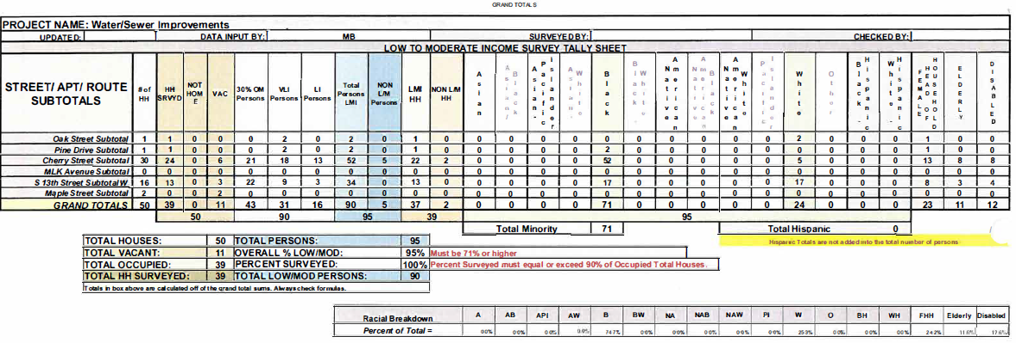
DCA 6 – Summary Table

Slide 14
DCA 8 – Note on Contingency
Contingency is no longer an Activity for CDBG Funds.
No longer shown on DCA-8 (CDBG Funds).
10% Contingency still allowed on construction.
Must be shown in cost estimate in PER/PAR; or Cost Estimate for housing.
If paid with CDBG Funds, include in construction activity (water, sewer, building, streets, housing).
Contingency paid with local funds does not count toward Leverage. Show as separate line item.

Slide 15
DCA 8 – Note on Contingency
Example:
Water project construction cost is $500,000 according to PER cost estimate
Contingency shown in PER is 10%, $50,000
Amount shown for Water under CDBG funds would be $550,000
If Contingency paid with local funds, list as a separate line item (application will not receive credit for local contingency in Leverage)

Slide 16
Thanks!
dca.georgia.gov

