Slide 1
FY2027 CDBG Summit
Application Development Neighborhood Revitalization
Glenn Misner

Slide 2
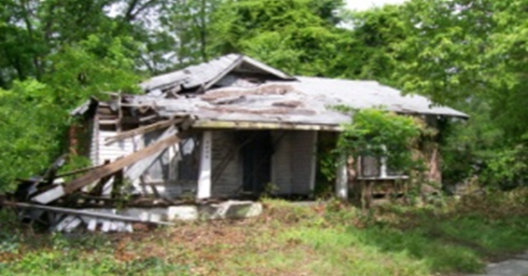
Look familiar???

Slide 3
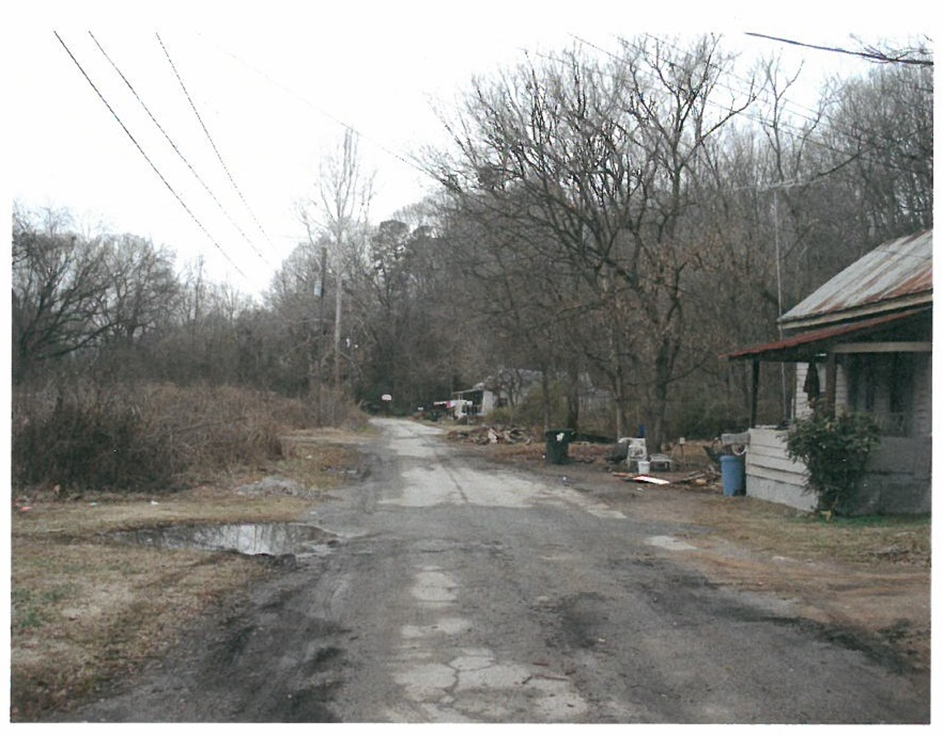

Slide 4
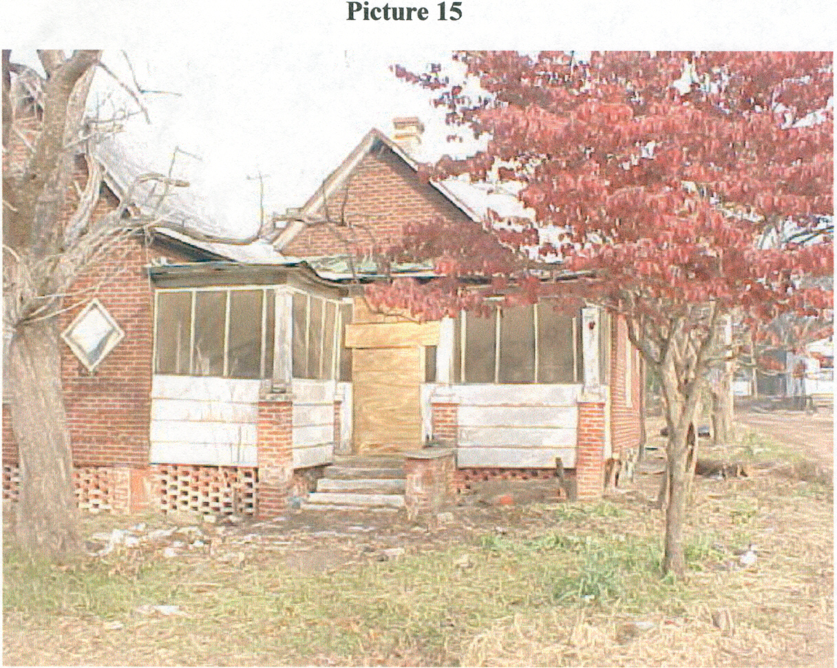

Slide 5
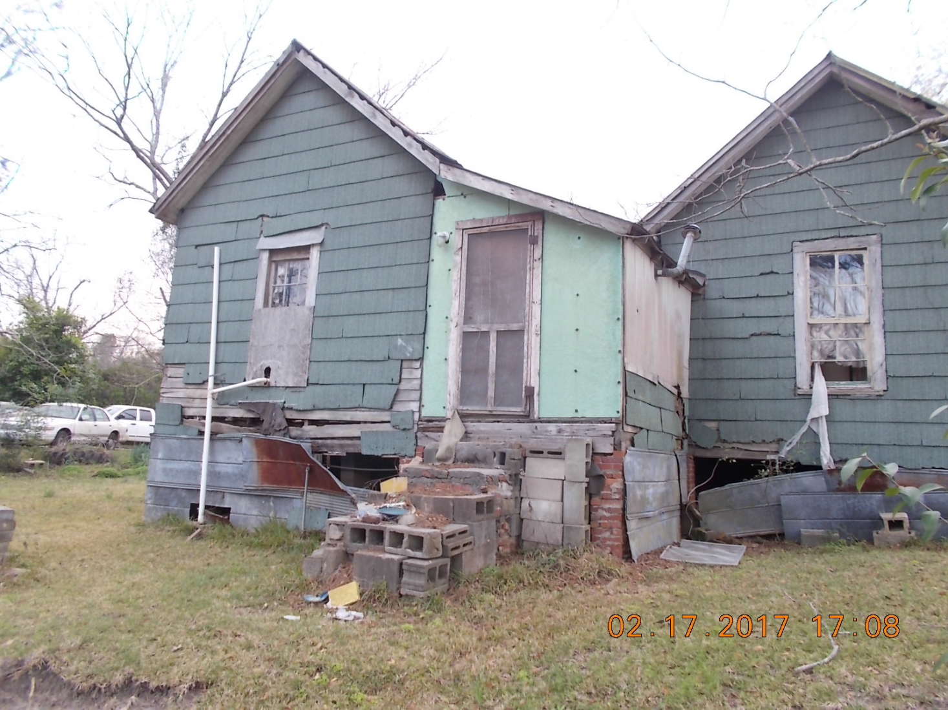

Slide 6
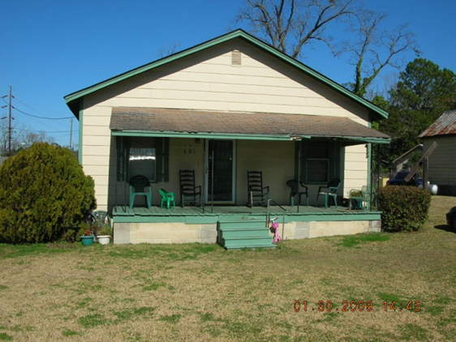

Slide 7
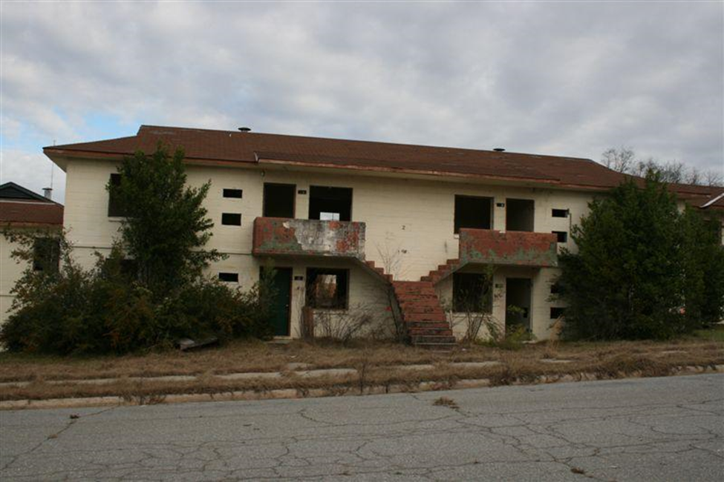

Slide 8
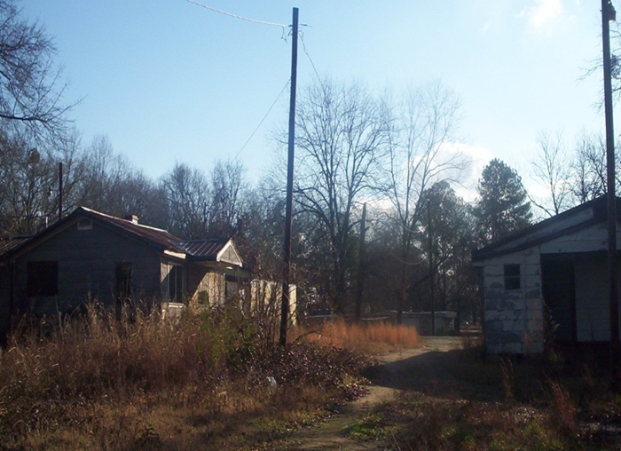

Slide 9
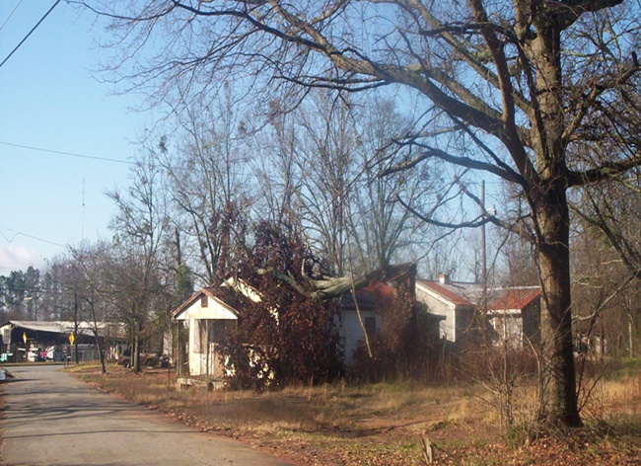

Slide 10
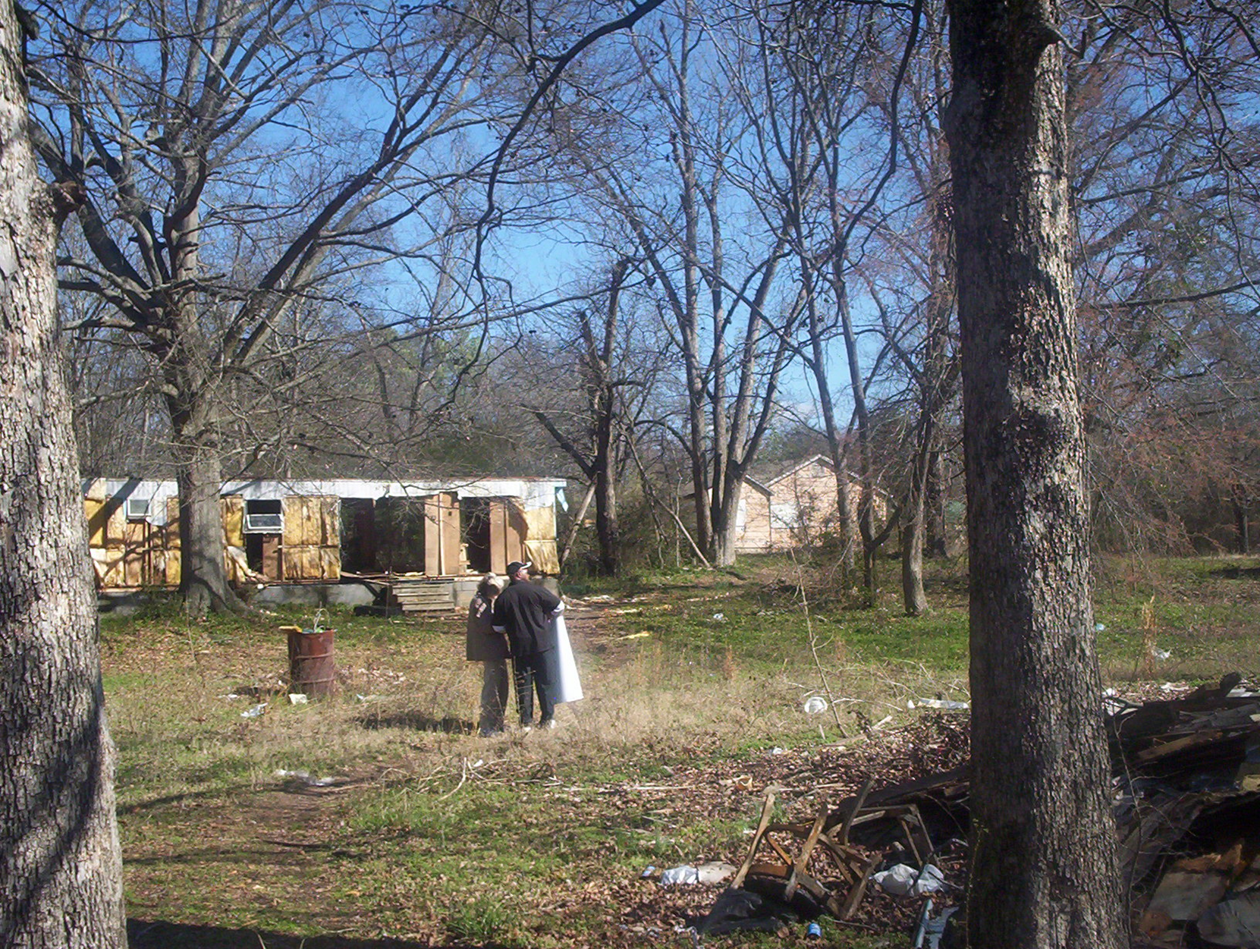

Slide 11
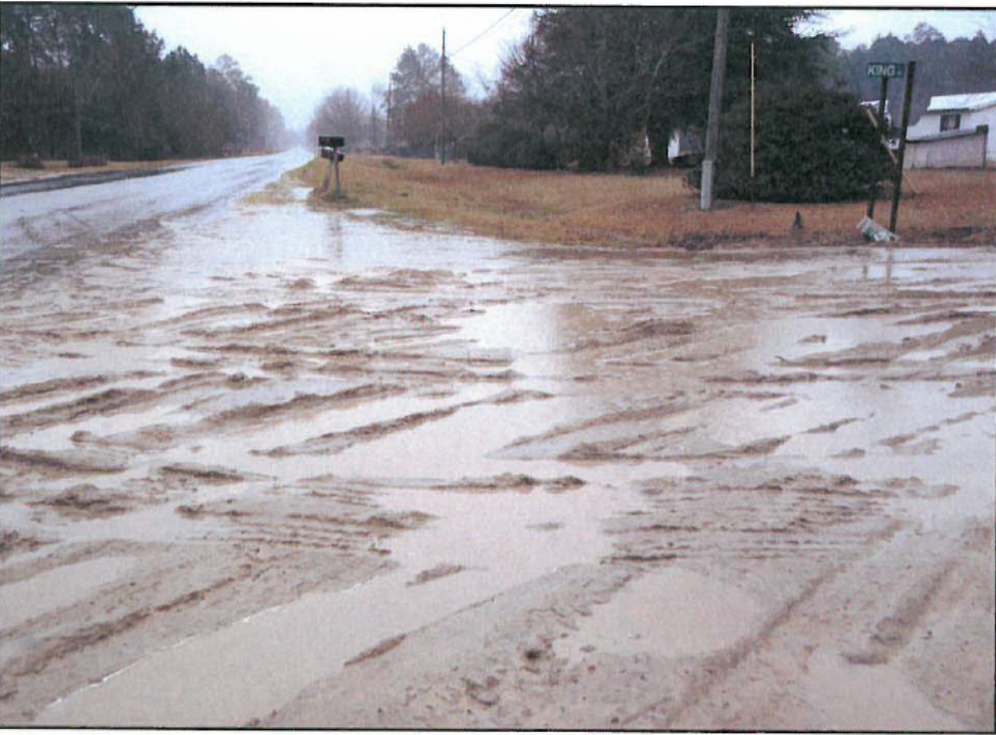

Slide 12
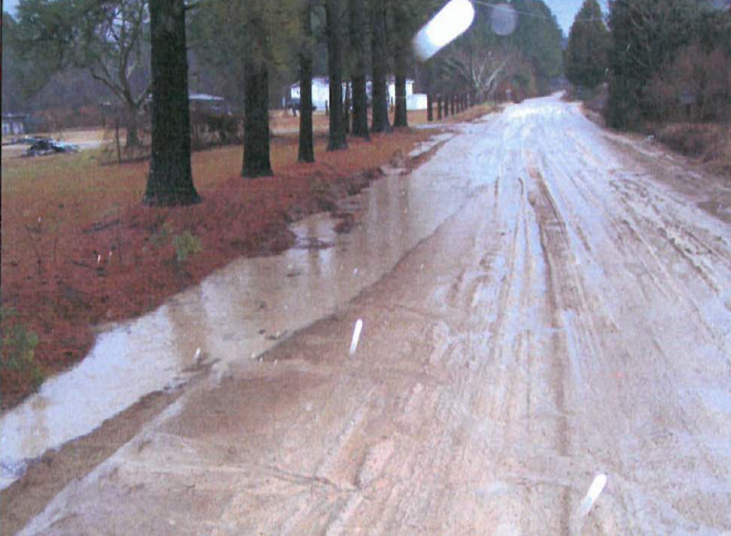

Slide 13
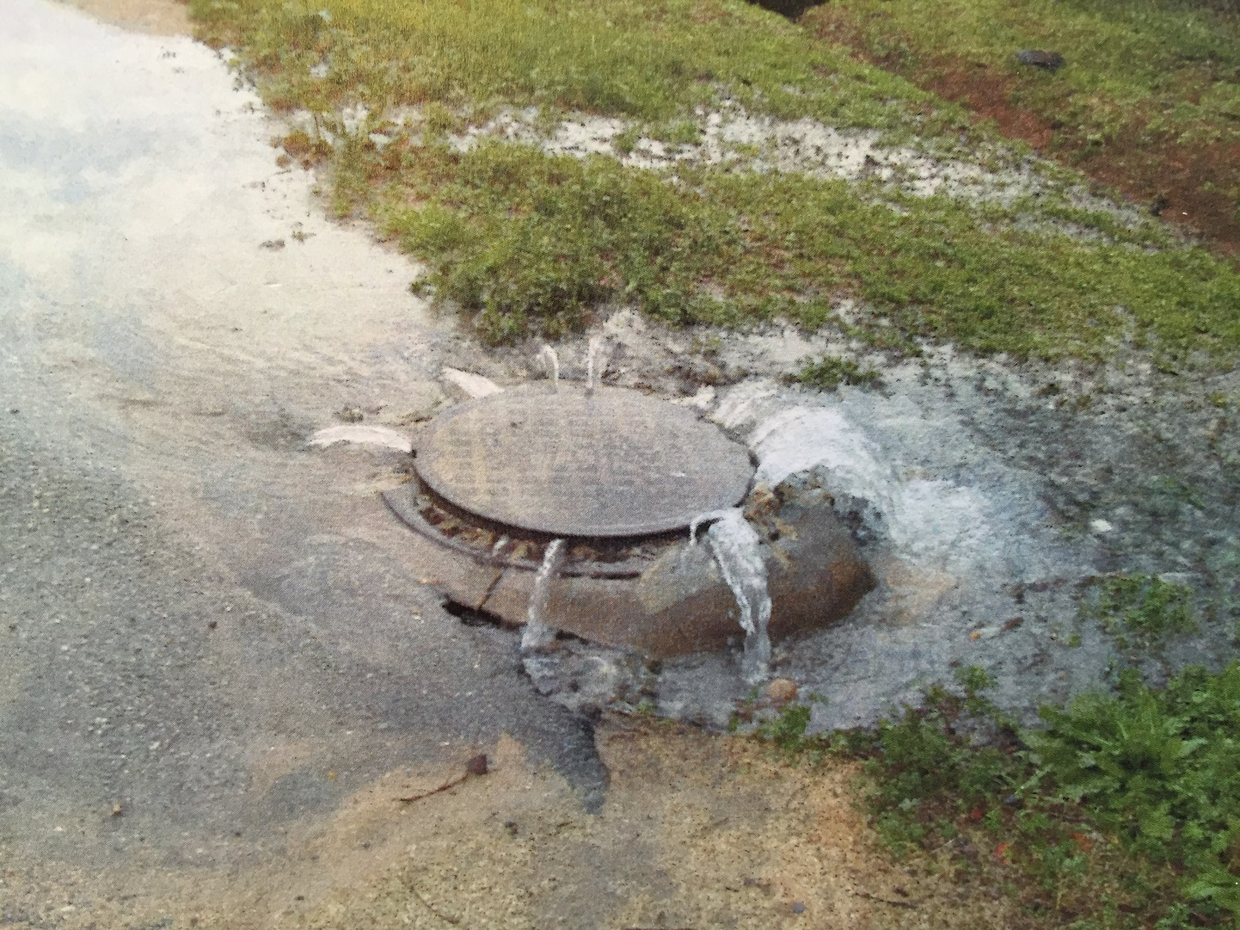

Slide 14
CDBG Annual Competition
Funding Limits
Single Activity CDBG (Annual Competition)
Employment Incentive Program $1,000,000
Redevelopment Fund Program
Multi-Activity ---------------------------------------------- $1, 500,000
Regional Cooperation Projects ----------------------- $2,000,000
Innovative Projects -------------------------------------- $5,000,000

Slide 15
CDBG Annual Competition
      Electronic submission through DCA’s
      GrAAM System Application
      Due Date:
April 2, 2027

Slide 16
CDBG Annual Competition
Changes – New and from past rounds - still in effect:
  Increased Funding Limit – Multi-Activity
  3 Year performance period
  Increased PDC’s
  Modified Score Values
  DCA 3 replaced with Community Needs Assessment
  Bonus Points for “ROBUST” Citizen Participation
  GICH Certified Alumni may apply every year

Slide 17
CDBG Annual Competition
Raised limit of the amount allowable for the rehabilitation of MHU’s to $20,000 (including CDBG funds AND owner/other contributions) for MHU units.
  Financial Plan Form is a pdf with formulas.

Slide 18
CDBG Neighborhood Revitalization
Types of Grants
  Single Activity:
    Housing Activities Only
    Infrastructure Activities Only
    Public Building Only
  Multi-Activity:
    Housing PLUS Infrastructure and/or Building Activities

Slide 19
CDBG Neighborhood Revitalization
Assessing Needs
  What are the needs community wide?
  The required Public Hearing is the opportunity for citizen input
  Are there concentrations of substandard housing? Are there infrastructure needs?
  Determine the project area (TARGET AREA)

Slide 20
Single Activity
Neighborhood Revitalization
Addresses Housing Activities
May Include Several Activities
  Rehabilitation
  Reconstruction
  Homebuyer Assistance
  Acquisition
  Relocation
  Demolition/Clearance

Slide 21
Single Activity
Neighborhood Revitalization
Who May Receive Assistance?
  Individual or Family Home-Owners (Owner Occupants)
  Investor Owners (Rental Units)
  Occupants must meet Low-Moderate Income definition
  Must possess clear Deed to property
      “Life Estate” agreement is OK
  Properties must be within Applicant Jurisdiction

Slide 22
Single Activity
Neighborhood Revitalization
Eligible Activities:
Rehabilitation – To repair and/or bring to Code/Program Property Standards existing substandard housing unit.
Reconstruction – Where unfeasible to Rehab - Demolish and construct new unit on same site - Owner Occupied ONLY.

Slide 23
Single Activity
Neighborhood Revitalization
Eligible Activities:
Acquisition - Of Real Property
Disposition - Costs Incidental to disposing of property acquired with CDBG funds
Code Enforcement - but…

Slide 24
Single Activity
Neighborhood Revitalization
Eligible Activities:
Clearance – Of dilapidated structures, out-buildings, etc.
  Get owner commitment – in writing
Interim Assistance
Relocation – Temporary or Permanent
  Temporary relocation is not mandatory for owner occupied units
Removal of Architectural Barriers

Slide 25
Single Activity
Neighborhood Revitalization
Eligible Activities:
Home Buyer Assistance
  Down Payment
  Closing costs
  Principle Reduction Payment
  Interest buy-down
  NOTE: DCA policy mandates use of fixed rate mortgages on all CDBG funded projects

Slide 26
Multi-Activity – Maximum $1,250,000
Multi-Activity:
“Comprehensive Neighborhood Revitalization”
Includes Housing and Public Facilities Activities
Inter-related Activities
Same Target Area
Comprehensive (Meets all/most of the Needs in the Target Area
Application MUST show a reasonable distribution of funds between activities – Especially with new limit

Slide 27
Revitalization Area Strategy (RAS)
Officially adopt a local Redevelopment Plan in accordance with the Urban Redevelopment Act O.C.G.A. 36-61
Eligible area of Census Block Group(s) of 20% or greater poverty level.
Develop strong local partnerships focusing local resources within the Revitalization Area.
Submit application for designation to DCA.
Must be designated by DCA through application
Electronic Submission for NEW and Annual Reports required

Slide 28
CDBG - Neighborhood Revitalization
Application Review Process
Each application is read and reviewed by the Housing Panel
Rank and Score based on:
  Feasibility of Project
  Strategy Proposed
  Impact of Project
  Project Need

Slide 29
Questions?

Slide 30
CDBG - Neighborhood Revitalization Application
Review Process
Malisa Thompson

