Slide 1
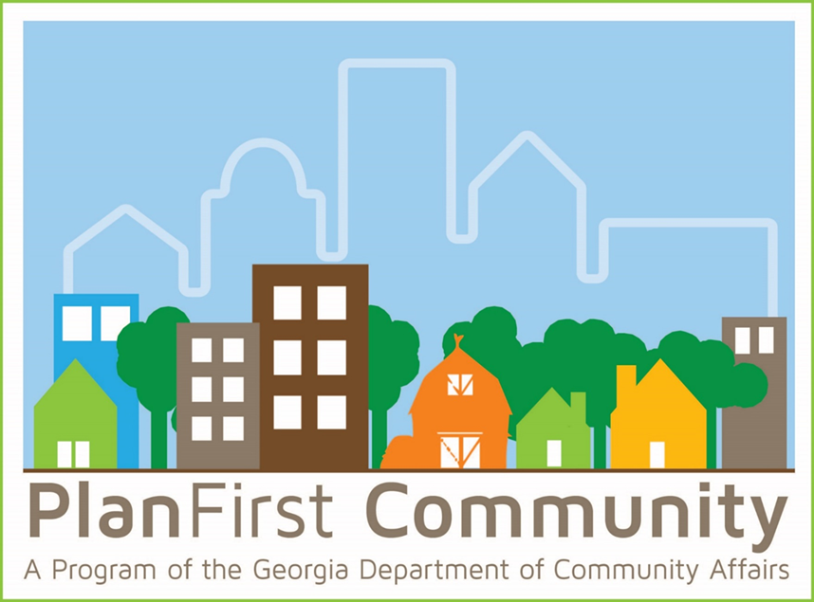
The PlanFirst Program
Notes:
Hello,
For those I haven’t met, I’m Daniel Gaddis, the Planning Outreach Coordinator. I joined DCA in November of last year. My experience includes time as a planner and economic development project manager in the metro-Atlanta area as well as a consultant working with federal grants, public power, and energy efficiency programs. I’m glad to be back working with local governments in Georgia on planning initiatives.
We are very excited about this year with PlanFirst. Lots of great things happening. Our 2025-2027 application is already on our website, we have a Planning Day at the Capitol scheduled for March 14 for our newest class of PlanFirst communities and we have this webinar scheduled for new applicants and a renewal webinar next week.

Slide 2
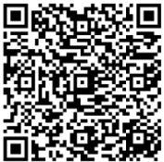
The PlanFirst Program upcoming dates
Webinar for renewal applicants with their current PlanFirst term ending Dec. 31 2025: Wednesday, Feb. 26 9-10 am
Check for eligibility to our team by April 15 (simply email planning@dca.ga.gov and ask for eligibility)
Application due May 15
Daniel Gaddis, Planning Outreach Coordinator
Notes:
Besides this event today, we are also hosting a webinar for renewal communities next week
You’ll see the other deadlines. To check eligibility, please email planning@dca.ga.gov before April 15. The application is due May 15, 2024.

Slide 3
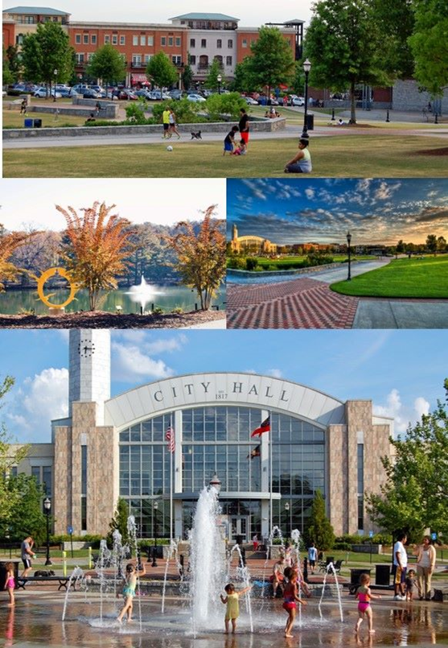
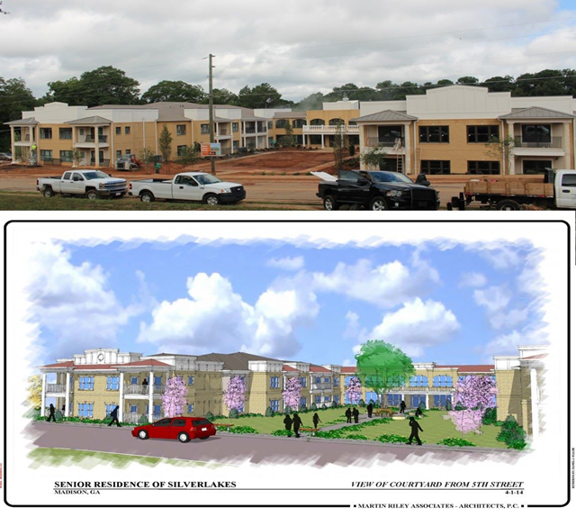
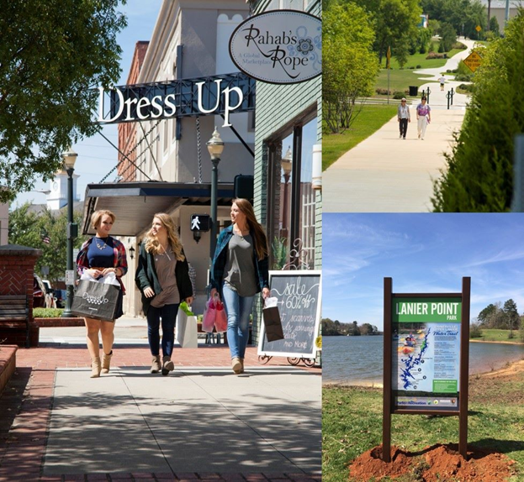
What is PlanFirst ?
Notes:
Put simply, a PlanFirst community is one that is recognized by the State of Georgia’s Department of Community Affairs for implementing their comprehensive plan in an exemplary way.
Through a community’s goals, leadership, public participation, and implementing their plan, communities that are designated a PlanFirst community are going above and beyond what is required to make sure they are keeping effective planning a very high priority.

Slide 4
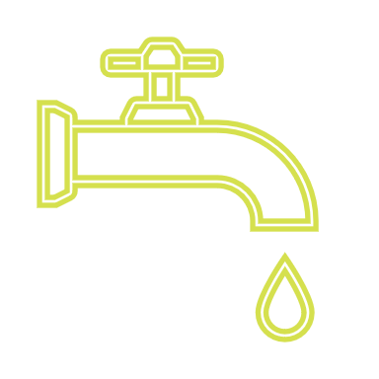
Why do you want to participate ?
Recognition
Community Development Block Grants
GEFA loan interest reduction
LIHTC and Other DCA programs
NEW
Notes:
There are several great reasons to apply-each of which may be different reasons for different communities. The last circle here shows the newest incentive we are very excited about it!
For applications for both the 4% and 9% housing tax credits, if the proposed development falls within the boundaries of a PlanFirst community, it is eligible for an additional 3 points. If you are a community where a housing authority and developers are working to address housing shortages, then applying for this designation is well worth the effort. Oftentimes, these applications are decided by fractions of a point.
To expound: the applicant’s local government must have a qualifying Community Revitalization Plan (CRP) (see pages 104-105 of the QAP).

Slide 5
Benefits of PlanFirst
Statewide recognition for outstanding planning and implementation.
Eligibility to apply EVERY year for CDBG funding.
3 bonus points on Housing Tax Credits application.
3 bonus points on CHIP (Community Home Investment Program)
Reduction on certain DCA loans: EIP, Redevelopment Fund and DDRLF.
Reduction on certain GEFA state loans.
2 free registrations at any Community Planning Institute per 3/year cycle.
Notes:
Ok, we’re gonna camp here for a while. And I propose you all listen closely, cause there may be a quiz after this.
As we think about the suite of benefits available to for PlanFirst communities, the architects of this program inserted benefits for communities of all sizes, needs, and demographics. We know that Georgia’s communities are diverse and we have reflected that diversity in this program’s design and benefits.
State-wide recognition by DCA, the use of the PlanFirst logo, announcements on the website and DCA social media, invitation to the Capitol for Planning Day at the Capitol, recognition in a State Senate and State House Resolution honoring your community, and hopefully a photo opportunity with Governor Kemp. We also want to tout your successes and tell your story as a PlanFirst community-we have our PlanFirst communities to submit a success story-this can look like a housing project, stormwater infrastructure improvements, improved transportation, an economic development project, downtown redevelopment, improved parks, the list goes in. We want to celebrate your successes at the state level and we want to invite communities to learn about what you did that overcame challenges, how you engaged with your community, how you tapped critical stakeholders, how you led in your region, all for the benefit of other similar communities that are dealing with the same issues.
Here’s probably one of the biggest benefits in the PlanFirst package. Annual access to apply to Community Development Block Grants instead of bi-annually.
Bonus 3 points on the LIHTC-Part of the Community Revitalization Plan in the application. This is applicable to the 4% and 9% applications.
3 bonus points on CHIP applications-the CHIP program is federally funded and provided grants to city and county governments, public housing authorities, and nonprofits to rehabilitate OWNER occupied homes and to build and renovate affordable single-family homes for sale to eligible homebuyers. The funding limits are $500,000 for housing rehabilitation and $1.5M for new construction and reconstruction of affordable single-family homes.
100 basis point reduction, or 1%, for loans through the Employment Incentive Program • 100 basis point reduction, or 1%, for loans through the Redevelopment Fund Program • 100 basis point reduction, or 1%, for loans through the Downtown Development Revolving Loan Fund Program
Access to the Georgia Environmental Finance Authority (GEFA) state loans at an interest rate that is reduced by 50 basis points, or ½ percent. As an example of this benefit, the interest rate savings over the life of a 20-year water or sewer loan of $200,000 would be just over $13,000.
For over 20 years, Georgia Planning Association and DCA have partnered to provide Community Planning Institute, a 2 day workshop that is aimed at Planning Commissioners, elected officials, and city/county staff on all things comprehensive planning, how to best utilize DCA funds, and success stories of planning initiatives in Georgia communities. That will continue as well when we meet in the-so please consider this benefit.
GO TO SECOND SLIDO

Slide 6
PlanFirst benefits
½%
Reduction on GEFA loans.
1%
Employment Incentive Program reduction.
1%
Redevelopment Fund Loan reduction.
1%
Downtown Revolving Loan Fund reduction.
3
Bonus points on LIHTC and CHIP applications.
Satisfaction points of being a PlanFirst community…
Notes:
Here are some of the financial benefits displayed in a different visual. Check out that last metric. Probably the best.

Slide 7
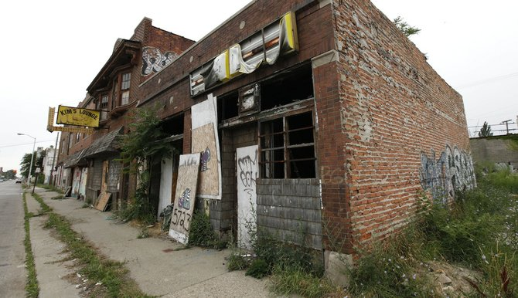
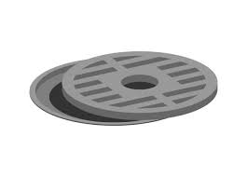
Alphabet soup-lightning round
GEFA
RDF
LIHTC
CPI
CDBG
DDRLF
EIP
Notes:
Now, let’s see if ya’ll were listening.
Ok, welcome to Alphabet Soup Lightning Round! The winner is the table with the most correct answers-because this is a lightning round, we have to move fast.
All you have to do is tell me the what the program acronym stands for by dropping the answer in the chat.
I’ll also ask you what is a defining feature or important information to know about each specific program. But don’t worry-that’s not part of the competition.
Yall ready?
Any questions before we begin?
#1 CPI
Community Planning Institute
What is it? Two-day planning workshop aimed at planning commissioners, elected officials, and planning staff.
#2 GEFA
Georgia Environmental Financing Authority
What is it? Provides low-interest loans for public water, wastewater, and solid waste infrastructure.
#3 LIHTC
Low income housing tax credit
What is it? Provides housing tax credits to qualified developers serving households with incomes between 20%-80% Area Median Income. 4% and 9% credits.
#4
RDF
Redevelopment Fund
What is it? Economic development fund from CDBG that addresses specifically slum and blight.
#5 CDBG
Community Development Block Grant
What is it?
HUD fund provided to states that focuses on low-to moderate income people by providing funding in primarily residential areas. Grants over $300K require local matching funds.
#6 DDRLF Downtown Development Revolving Loan Fund
What is it?
Financing for populations less than 100K that have a viable downtown development project-funds can be real estate acquisition, development, redevelopment, and new construction; max loan is $250K
#7 EIP
Employment Incentive Program
Economic Development Fund that generates jobs for low-to-moderate income persons and involves assisting private businesses.

Slide 8
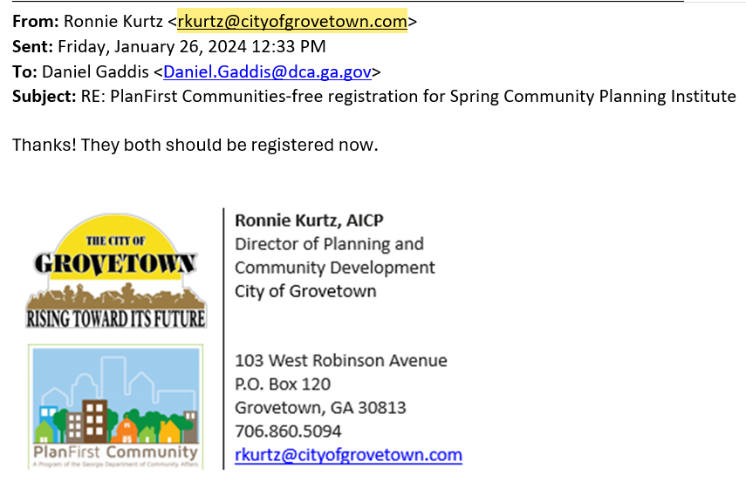
Notes:
I’ve encouraged our active PlanFirst communities to place the logo in their email signature. Here we have the PlanFirst email signature badge in the wild. This signals to all internal and stakeholders that this community is serious about public engagement, accomplishing goals, and casting a community-held vision for the future. This PlanFirst badge is used pretty widely on the community websites. Hopefully this can be a conversation starter and can facilitate some learnings about best practices.

Slide 9
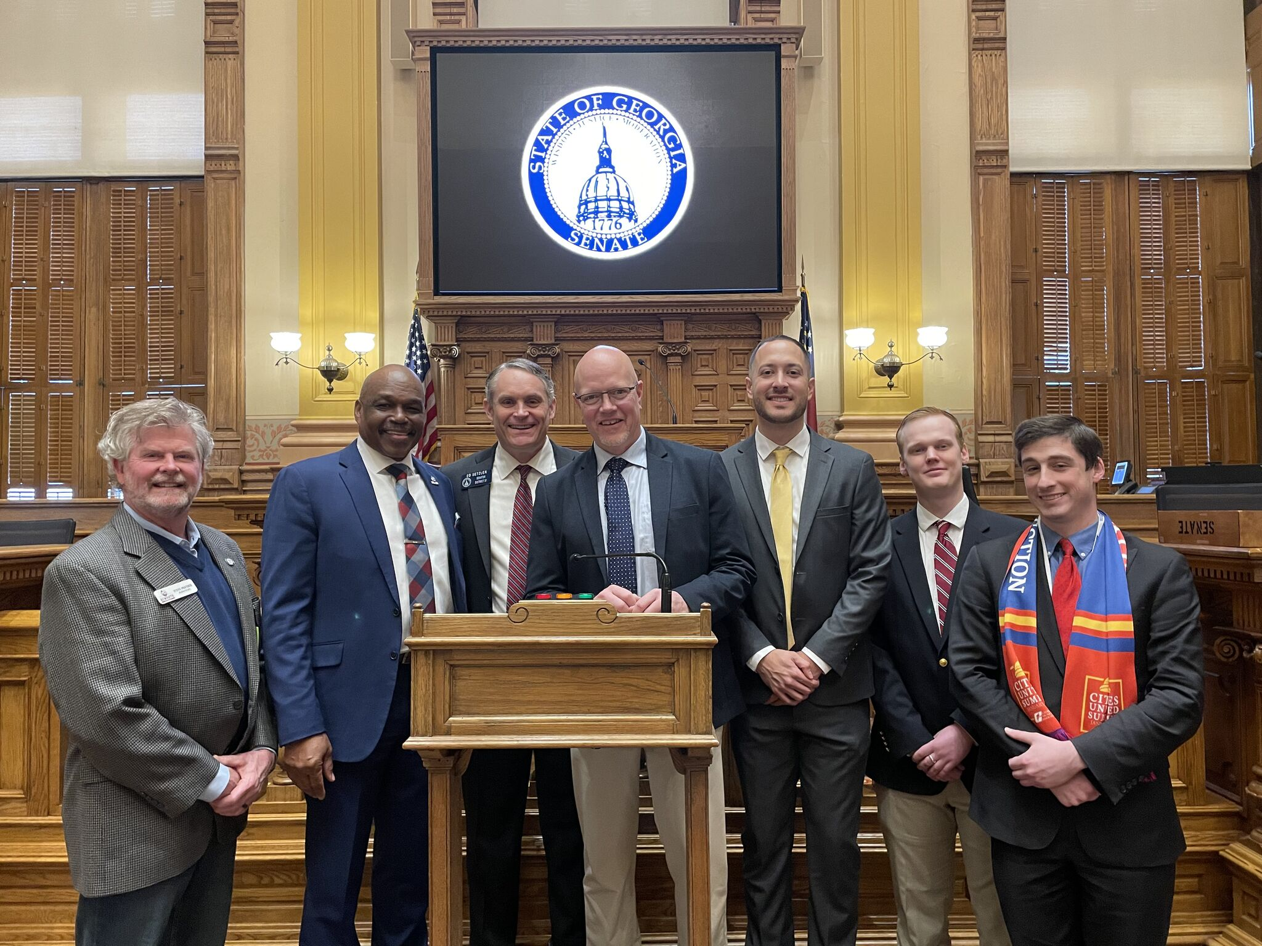
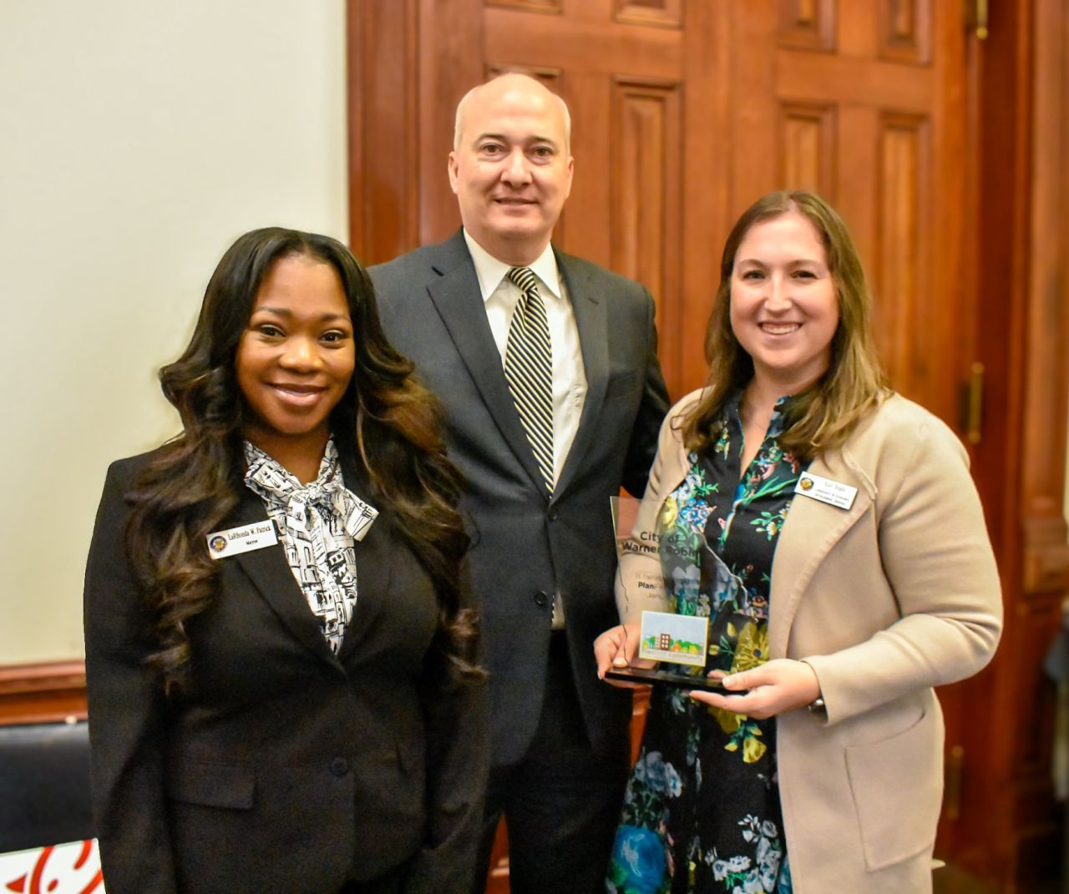
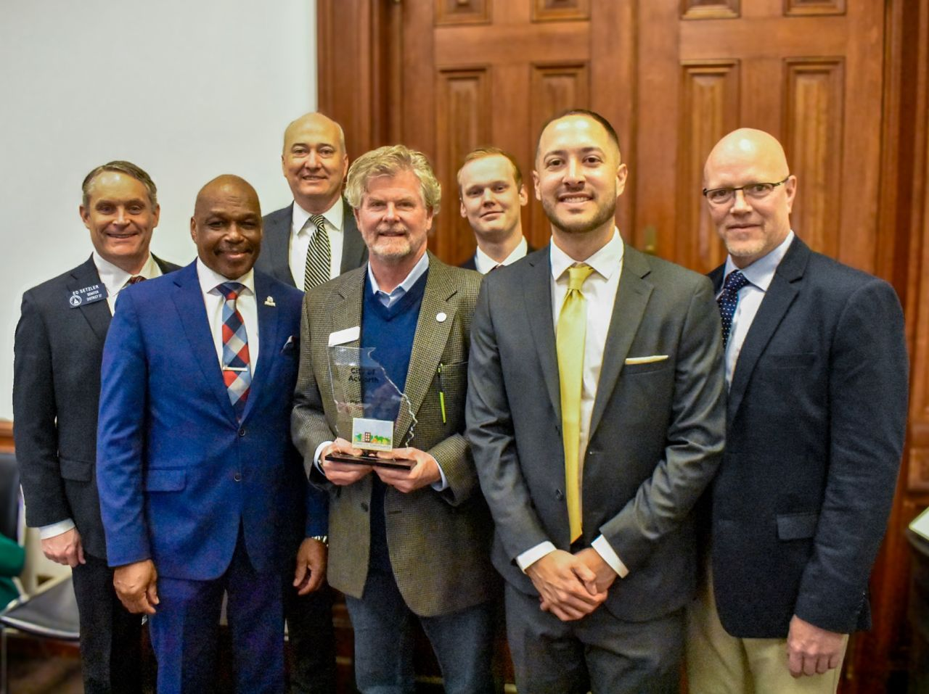
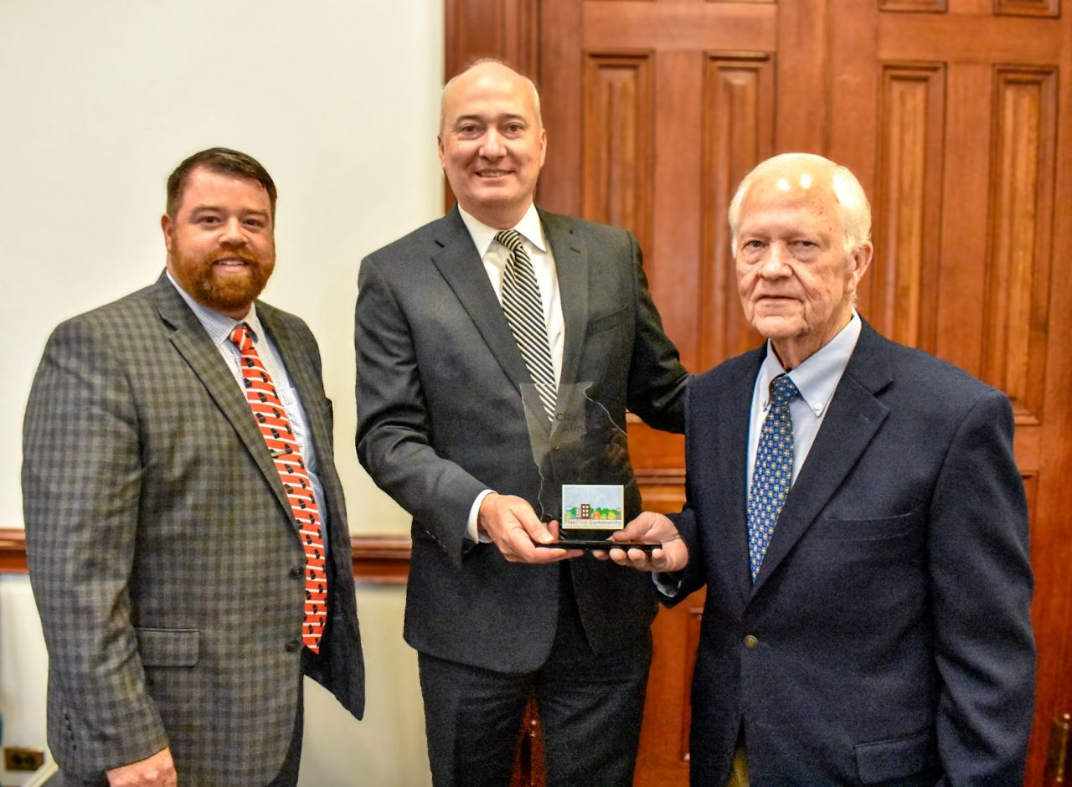
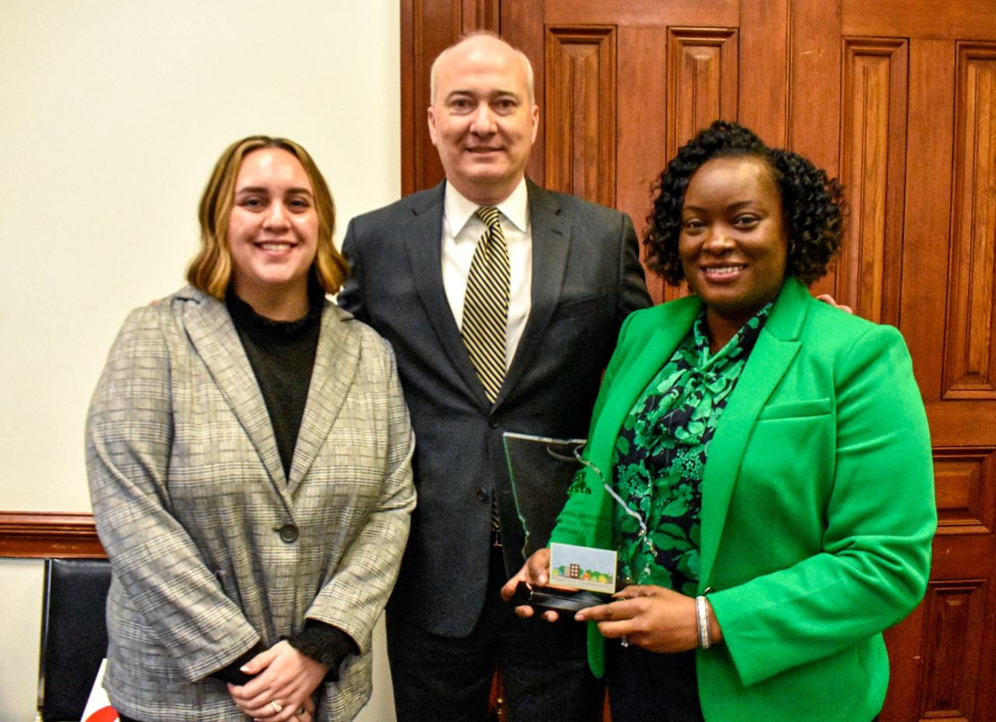
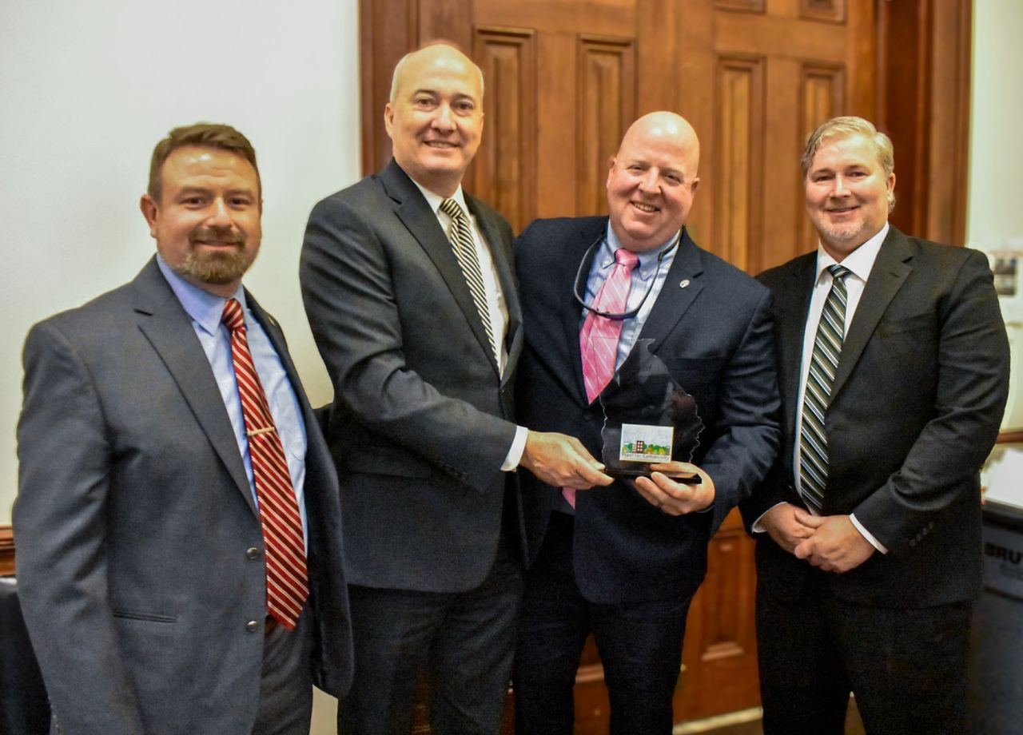
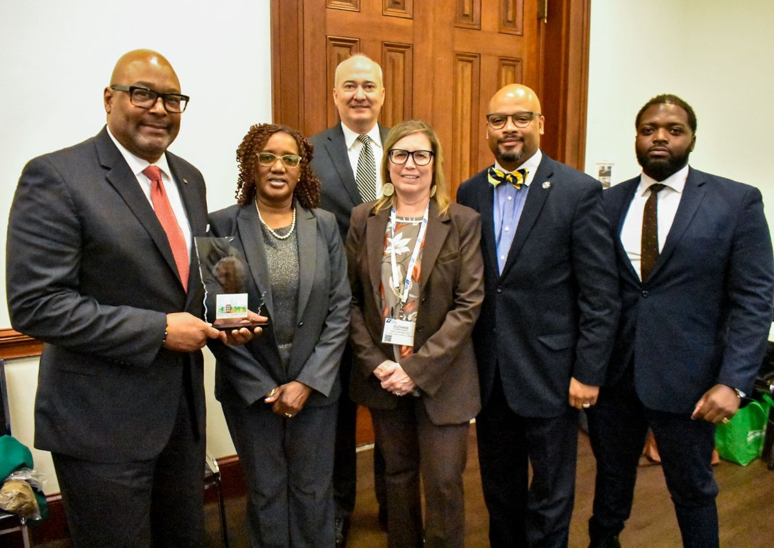
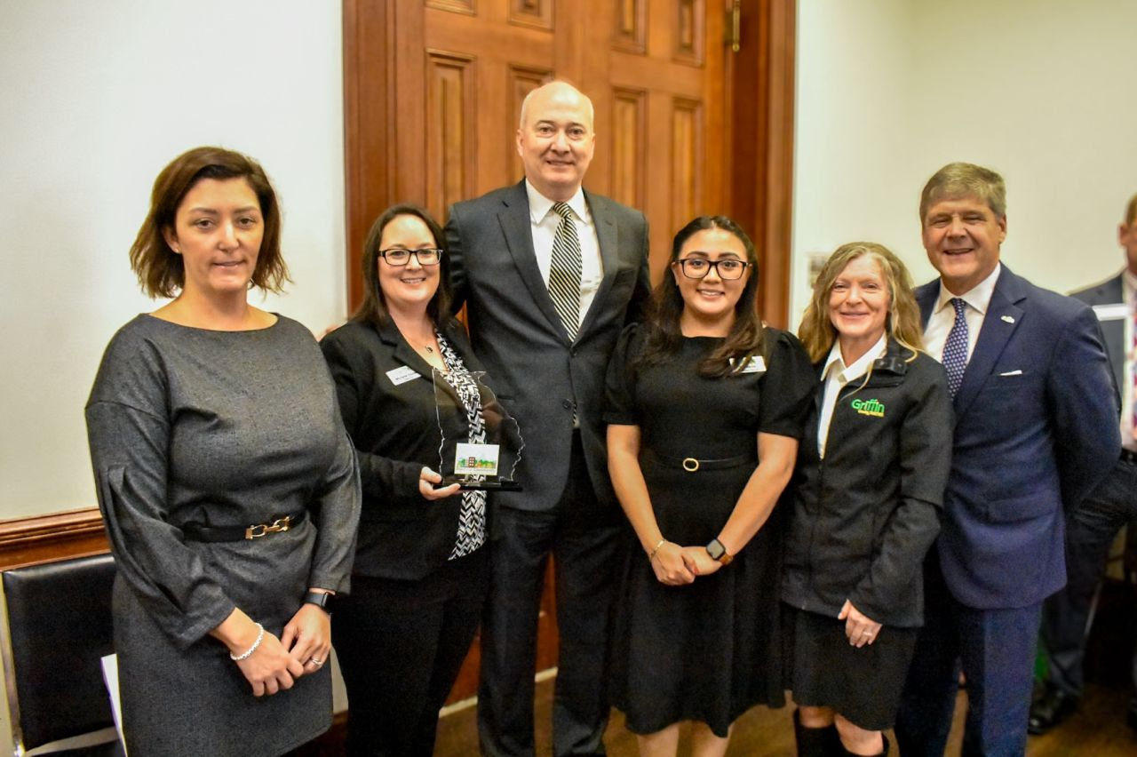
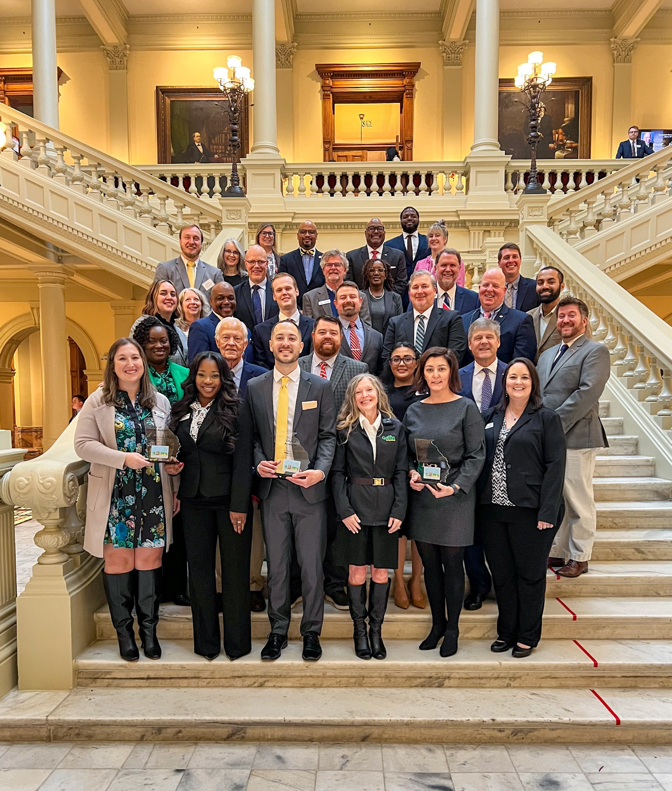
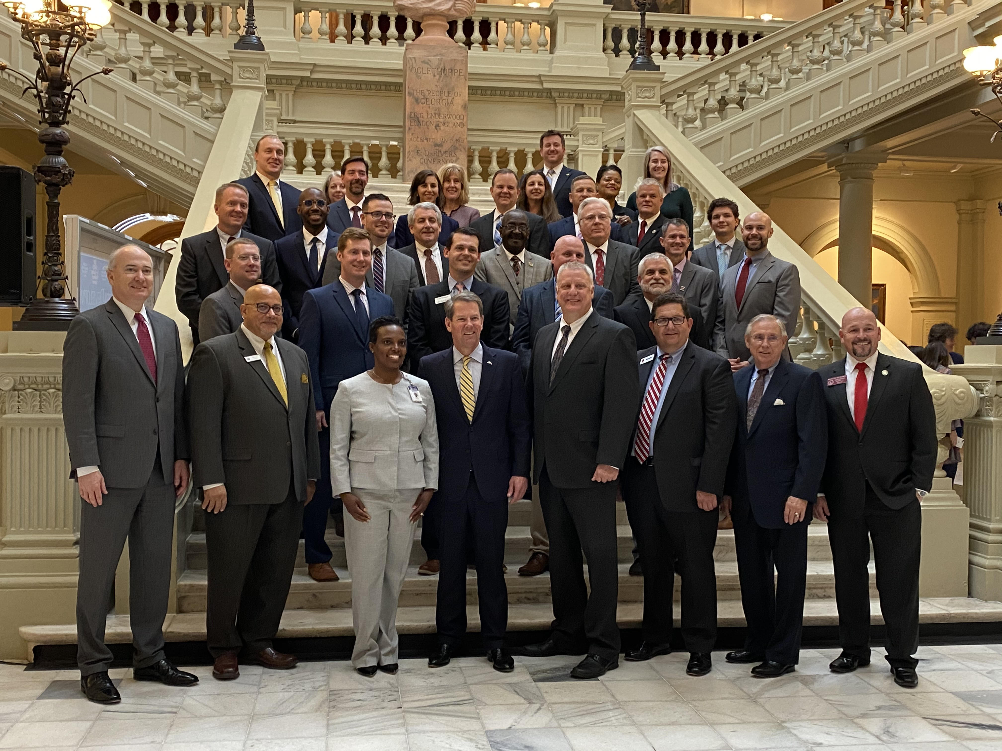
Notes:
Here’s another benefit that falls into the recognition piece. Planning Day at the Capitol-honoring the commitment of these communities to exemplary comp planning. You can see on the left, this picture was taken less than a month ago at the Capitol. The picture on the right was taken in 2020 and we had the pleasure of the Governor attending our event.
HIT NEXT
Besides the photo opp and a plaque given out by Commissioner Nunn, these communities are also recognized by a House and Senate Resolution. It’s my hope that we can facilitate more discussion from our communities and state legislators about planning issues.

Slide 10
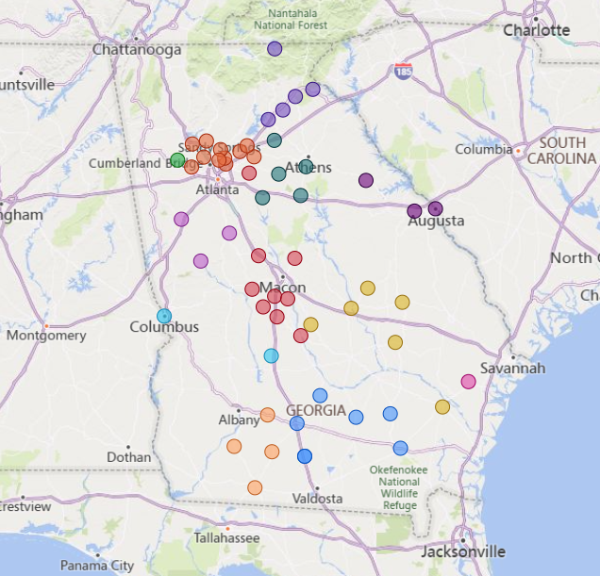
PlanFirst Communities
There have been 57 PlanFirst designated communities since 2015.
Notes:
Currently, there are 19 active PlanFirst communities across the state, and those include, Acworth Alma Augusta Bainbridge Camilla Cornelia Douglas Dublin Griffin Grovetown Gwinnett County Hawkinsville Marietta Monroe Oconee County Perry Toccoa Vidalia and Warner Robins

Slide 11
How do I participate?
You must be a Qualified Local Government, and have a history of same.
Must also have a verified SDS, and have submitted the required surveys (GOMI, RLGF).Government and have met (and hopefully exceeded) the MINIMUM Performance Standards established by the local regional commission.
Must illustrate how planning is important to your community.
Required to reach out planning@dca.ga.gov by April 15 to check eligibility.
Must completely fill out the application and sign it - due May 15.
Notes:
There are some restrictions to who can even apply for PlanFirst designation. QLG status-cannot have lost status more than 4 weeks (28 days) and/or more than twice within the 10 year period.
This program is at its core about the comprehensive plan-so making sure you meet all your plan submission deadlines is key to your eligibility.
The service delivery strategy must be verified by us, as well as submitting the required annual survey of the Government Management Indicators as well as the Report of Local Government Finances.
As you know may already know, we also require that the applicant community adheres to the regional commission’s minimum performance standards.
If you don’t know these mean, don’t worry, I can explain them to you. Just email me at planning@dca.ga.gov

Slide 12
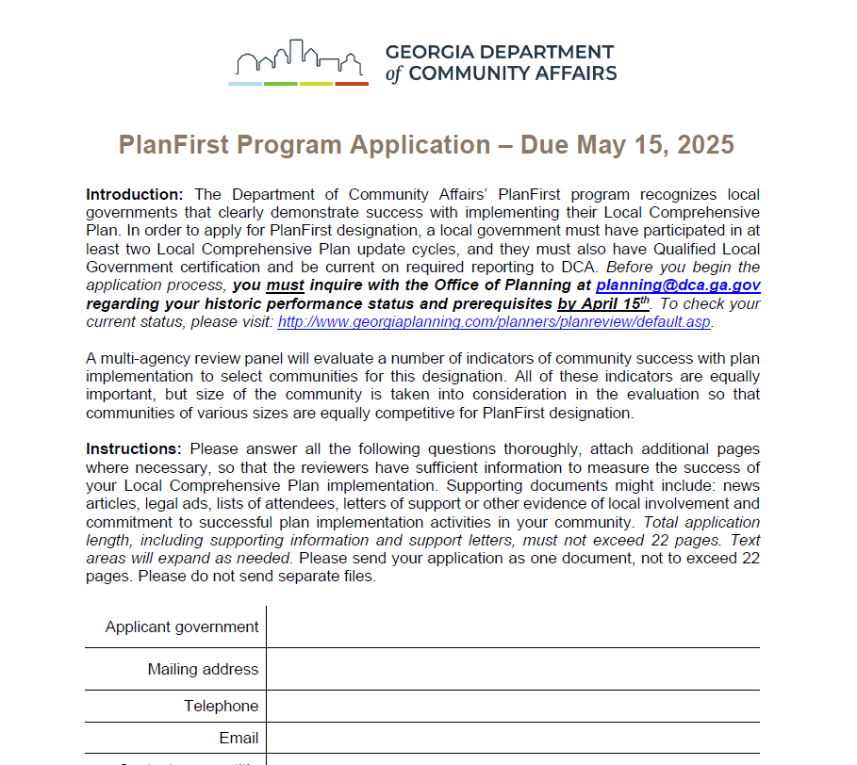
FOUR INDICATORS
Goals
Leadership
Participation
Implementation
Notes:
You might be wondering what the application is asking and by what metrics are the communities being judged? It’s helpful to view the application in 4 major buckets: Goals, Leadership, Participation, and Implementation. We’ll talk about all of these briefly.

Slide 13
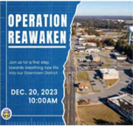
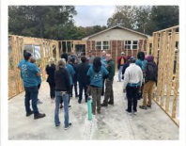
Indicator: Goals
Community and Leadership Support
Ambitious and Achievable
Steer Local Decision-Making
Consistent Progress
City of Warner Robins
Notes:
Do the goals enjoy community and leadership support? Is the community reaching for aspirational and ambitious goals? Are they achievable? Do these goals actually move the needle on decision making? What about consistent progress?

Slide 14
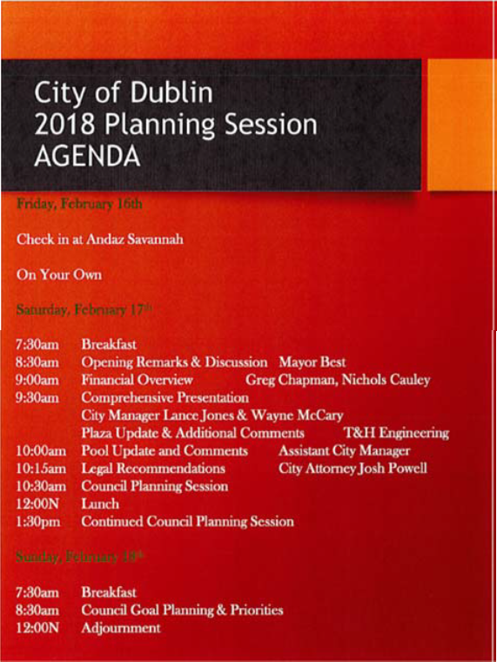
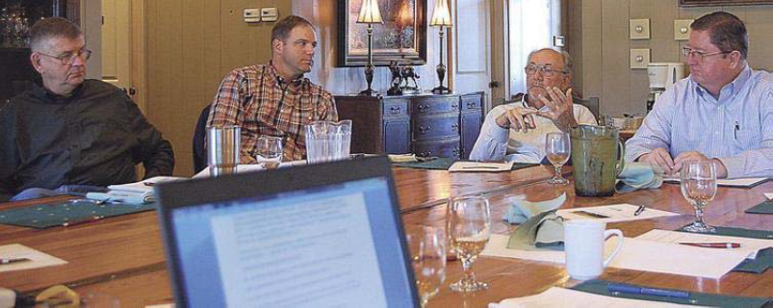
Indicator: Leadership
Effective Planning Staff
Active Planning Commission
Effectively Evaluate Planning
Trained Local Officials
Collaborative Partnerships
Notes:
How is planning done effectively? What’s the staff make-up? Is the Planning Commission active? Are local officials going out and getting the recommend training? Are community leaders being brought to the table?

Slide 15
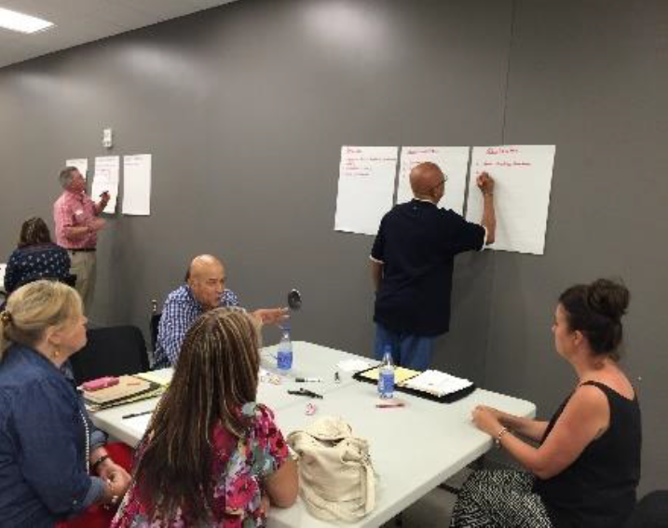
Indicator: Participation
Lots of Opportunities for Community Input
Community Input Incorporated in Your Plan
Steering Committee Guided Process
Effective Outreach Process
Advocates
Jones County Plan Meeting
City of Powder Springs
Notes:
How is the community being engaged? Is the community input actually incorporated or is it just tokenism?

Slide 16
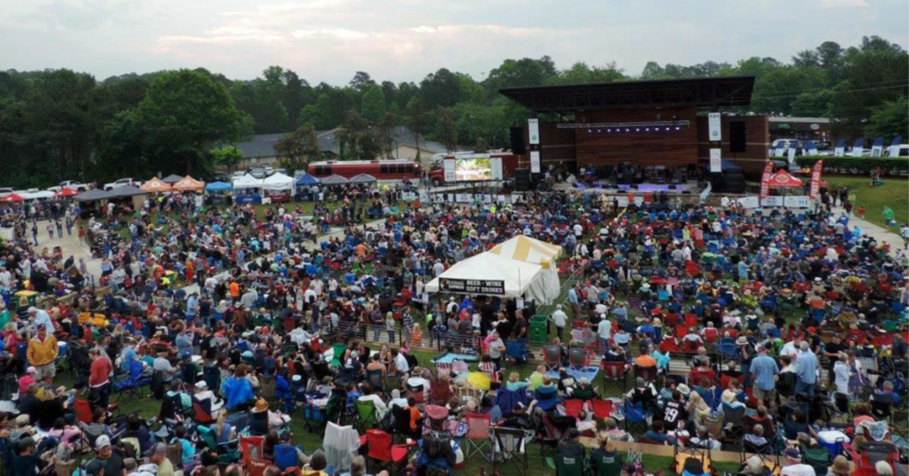
Indicator: Implementation
Action Items in Work Program
Work Program Addresses Local Needs
Good Track Record
Consistent Capital Budget
Recent
Amphitheater in Woodstock City Park
Notes:
How effective has the local government been in implementation? Have they been consistently finished planned projects? Are there recent projects highlighted?

Slide 17
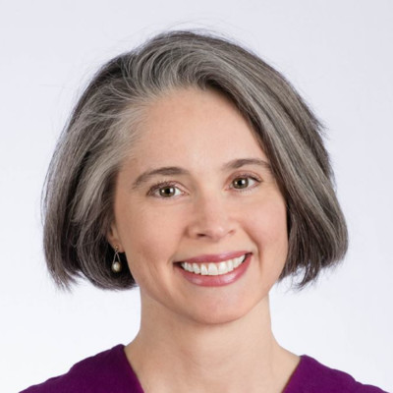
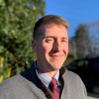
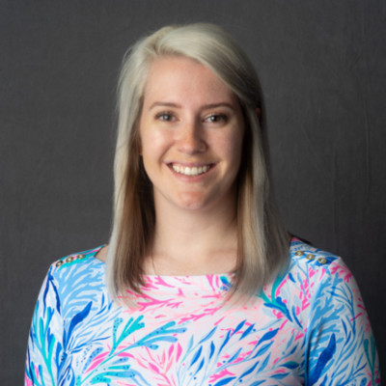
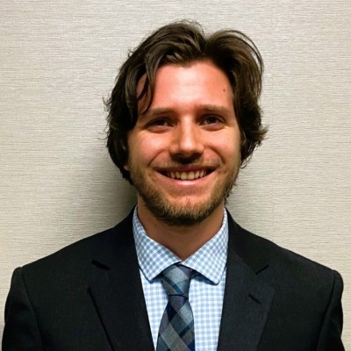
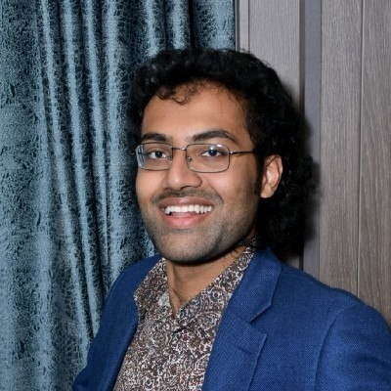
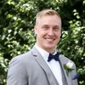
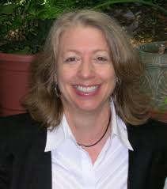
Who reviews?
DCA Regional Representatives
Historic Preservation Division
Office of Downtown Development
Planning, Research, and Geoanalytics team
Other PlanFirst communities!
Notes:
Another question I get often is about how many PlanFirst applicants actually get designated? This number varies wildly depending on the quality of the applications, but our overall average rate of designation is 58%. That number includes all new and renewal applications. In 2024, we designated 8 out of 20 applicant communities. In 2023, we designated 5 of 8 applicant communities.

Slide 18
Answer the question completely.
Notes:
This is the biggest takeaway from our team’s years of reviewing applications. When I started this role, I asked the question, “what is the number one bit of advice you could offer to an applicant community. Resoundingly, this was the answer.

Slide 19
Question E: Indicator Leadership
E. Describe your staffing arrangement (local government staff or contracted relationship) for handling community planning issues. Explain why that is the most appropriate arrangement for your community dynamics. Include the number of staff devoted to planning, staff qualifications, continuing education, and organizational structure.
Notes:
Ok, let’s dive into some of the application questions.
This question is indicative of the types of questions you’ll see on the
Here’s a perfect example of a question that often doesn’t get answered in its entirety. Specifically, there’s one sentence in here that people forget about. Can anyone guess which sentence gets missed? Red, blue, or green?
Answer: Blue!

Slide 20
Lowest scoring question (2023)
Q. Describe how your Community Work Program drives your community’s resource allocation decisions (i.e. annual budget, capital budget, staff resources, facilities, etc.). Provide examples.
3.07
Stated broadly that has money allocated for projects in the CWP and did not provide an example.
Answered how the CWP is funded, but doesn’t explain how it drives allocation decisions.
Would like more detail.
Only one short, rather non-descriptive paragraph was provided.
Notes:
I went through all our team reviews and found the lowest scored question and it was question Q.
The bullets are some of the feedback for some of the scores.

Slide 21
Example of answer to question (Q) with highest score (2023)
The Community Work Program includes measurable action items that will improve the City of Hawkinsville. The work programs identify the timeframe, costs estimate and funding sources, responsible party (i.e., City of Hawkinsville, Pulaski County, Hawkinsville-Pulaski County Chamber of Commerce, Hawkinsville Downtown Development Authority), and cross-references the appropriate Needs and Opportunities elements. The city references the Community Work Program during the budgeting process weighing priorities and available funding sources for capital infrastructure improvements such as drainage, water and wastewater systems, and parks. Unfortunately, Pulaski County has seen a significant decline in population over the last several years. In the City of Hawkinsville, this was reflected as a 13% population decline between the 2010 Census and 2020 Census. As a result, it is difficult to show major investments in any part of the city as the community experiences some economic struggles. With that said, the dollars that are spent align with the CWP. This includes the city’s significant investment of SPLOST dollars as a match for CDBG projects to help with maintaining infrastructure. Furthermore, the investment of more than $500,000 in the city’s Veterans Memorial Park is another example of matching expenses to key priorities. Much of the city’s capacity for matching grant funds has been diminished due to these investment. As a result, PlanFirst designation would be a helpful tool for the city to continue making infrastructure improvements at a more competitive rate.
Notes:
Here we have the highest scoring answer from the 2023 application. This answer scored the highest of all the applicants both from the Planning, Research and Geoanlytics team as well as the Regional reps/communities.
The question was: Describe how your Community Work Program drives your community’s resource allocation decisions (i.e. annual budget, capital budget, staff resources, facilities, etc.). Provide examples.

Slide 22
2nd lowest scoring question (2023)
P. Describe how individual projects/activities in your Community Work Program advance items discussed in both your Goals Element and Needs and Opportunities Element. Examples should clearly illustrate the linkage of the different plan Elements.
Average score:
3.22
Does not illustrate the linkage between different plan elements.
I don’t see the “linkage” needed for this question.
They discuss one CWP project, but now how it ties to goals/needs.
Never gave a specific example project or activity to tie back to how it accomplishes the goals/needs and opportunities element.

Slide 23
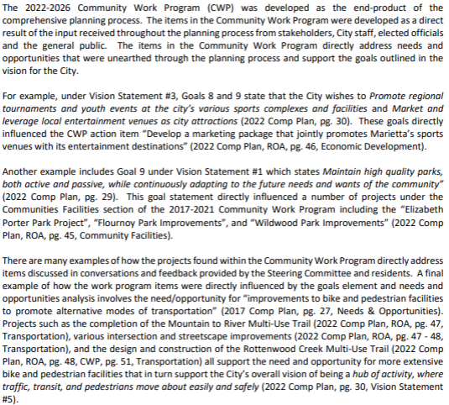
4.15
Example of answer to question (P) with highest score (2023)
Notes:
Here we have the highest scoring answer from the 2023 application. This answer scored the highest of all the applicants both from the Planning, Research and Geoanalytics team as well as the Regional reps/communities.
The question was: Describe how your Community Work Program drives your community’s resource allocation decisions (i.e. annual budget, capital budget, staff resources, facilities, etc.). Provide examples.

Slide 24
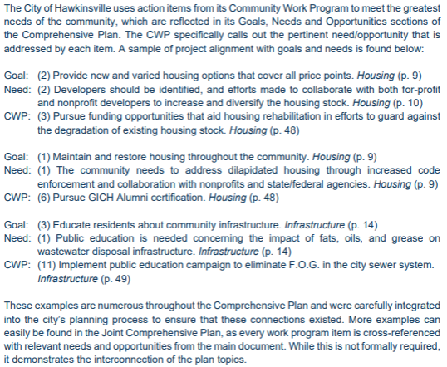
4.14
Example of answer to question (P) with highest score (2023)
Notes:
Here we have the highest scoring answer from the 2023 application. This answer scored the highest of all the applicants both from the Planning, Research and Geoanlytics team as well as the Regional reps/communities.
The question was: Describe how your Community Work Program drives your community’s resource allocation decisions (i.e. annual budget, capital budget, staff resources, facilities, etc.). Provide examples.

Slide 25
Highest scoring questions (2024)
F. Demonstrate that you have an active Planning Commission or similar body to steer local planning decisions. State why each member’s input is valued. Include the meeting schedule, a list of members, their affiliations, title, and background information that is pertinent to their role. If you do not have a planning Commission, please address how current land use decisions are made.
4.04
Yes, they include their meeting schedule, list of members, affiliations, titles, and background info. They also state that the commission input is taken very seriously by the mayor and board.
Meeting schedule-check.
Good mix of expertise from real estate to finance to community development and historic pres. I definitely appreciate how Mr. Prince is representing the Board of Education perspective.
Organized and active PZ Commission - good mix of people, included agenda example

Slide 26
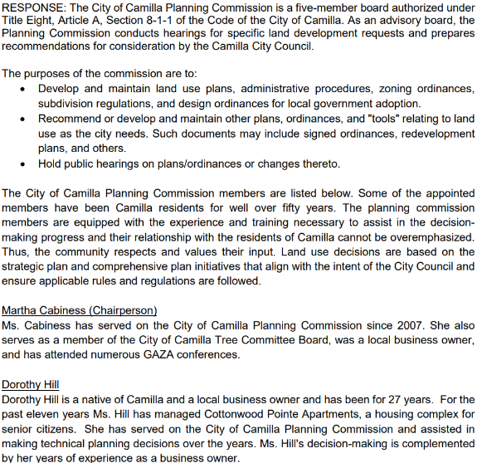
Example of answer to question (F) with highest score (2024)
F. Demonstrate that you have an active planning commission or similar body to steer local planning decisions. State why each member’s input is valued. Include the meeting schedule, a list of members, their affiliations, title, and background information that is pertinent to their role. If you do not have a planning commission, please address how current land use decisions are made.
4.6
Notes:
4.6 Camilla

Slide 27
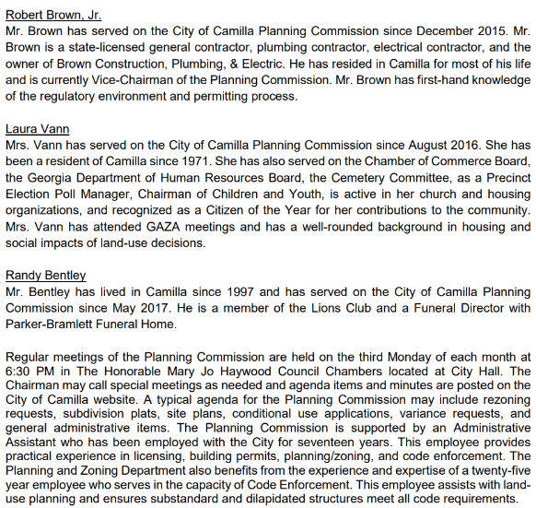
Example of answer to question (F) with highest score (2024) continued
4.6
Notes:
4.6 Camilla

Slide 28
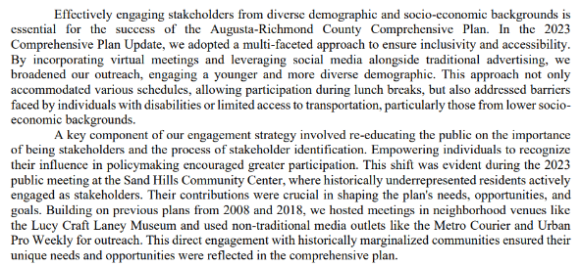
Question M:
Lowest scoring questions (2024)
3.17
Community | Score
A* | 1.6
B* | 1.7
C* | 3.5
D* | 2.0
E | 0.8
F | 2.0
G | 2.9
H* | 3.9
I | 1.9
J | 3.2
K* | 2.1
L | 3.4
Notes:
M. How do you ensure that your planning outreach and engagement activities are responsive to stakeholders representing all demographic and socio-economic backgrounds? Give specific details about your efforts to engage hard to reach populations and underrepresented groups and voices. Provide examples from your previous comprehensive planning processes.
This question was the lowest scoring question overall. This came in as an average score of 3.17
Of the applications that were selected as PlanFirst designees, their average score was: 3.36
Of those applications that were not selected, their score was 2.32. Meaning the difference there between the PlanFirst designees on this question vs. those that weren’t selected is just over a full point.
Highest scoring answer on this one.

Slide 29
Question O:
Lowest scoring questions (2024)
(2nd lowest score overall)
3.37
O. List any active advocates you have for Local Comprehensive Plan implementation (such as activist citizens, organizations or neighborhood groups) that affect decisions made by community leaders. How have they affected these decisions?
Notes:
This question was the 2nd lowest scoring question overall. This came in total as a 3.37.

Slide 30
Question O:
Lowest scoring questions (2024)
(2nd lowest score overall)
Community | Score
A* | 3.5
B* | 3.6
C* | 3.5
D* | 3.7
E | 1.4
F | 2.6
G | 1.9
H* | 4.4
I | 0.9
J | 2.4
K* | 3.5
L | 2.1
O. List any active advocates you have for Local Comprehensive Plan implementation (such as activist citizens, organizations or neighborhood groups) that affect decisions made by community leaders. How have they affected these decisions?
Notes:
Highest scored answer:
Of the applications that were selected as PlanFirst designees, their average score was: 3.7
Of those applications that were not selected, their score was 1.90. Meaning the difference there between the PlanFirst designees on this question vs. those that weren’t selected is a full 1.8 points!

Slide 31
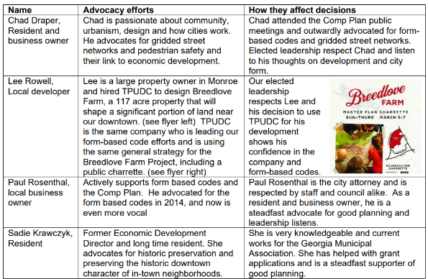
Question O:
Example of highest scoring question (2024)
4.44
Notes:
O. List any active advocates you have for Local Comprehensive Plan implementation (such as activist citizens, organizations or neighborhood groups) that affect decisions made by community leaders. How have they affected these decisions?

Slide 32
Softball
Question L
Specify the members of your Local Comprehensive Plan’s steering committee and their role in the community (e.g. planning commissioner, school board member, neighborhood association, or business owner). Also, please share how the steering committee contributed to the development of the Local Comprehensive Plan, including how many times they met throughout the process.
Notes:
After reviewing the application several times, I can say that there is definitely one softball question. This is a question, that provided your local government keeps decent records and communicates well, that it should be simply plugging in known information. This question is one that lends credibility to the idea that starting early will help you be successful. For example, it takes time to track down your steering committee folder, and making sure you have all the information. If you don’t have complete information on your steering committee, you may have to do some googling, or make some calls or send some emails. Notice that this question, like most questions on the application are multi-part.

Slide 33
Tips and tricks
01
Read the questions carefully and make sure you answer the question asked in its entirety.
02
Remember-this is about the Comprehensive Plan, not any other strategic plan, like an area plan, or corridor study.
03
Reference the plan with the correct section, date of the plan, and page number.
Notes:
1-You’ll notice that many of the questions are multi-part. Don’t neglect a part of the answer as the reviewers are trained to make sure that all parts are answered. 2. At the most fundamental level, this is a designation for a Georgia community that demonstrates exemplary Comprehensive Planning. Although adjacent or related planning efforts may merit mentioning, keeping your answers tied to the comprehensive plan is the most important idea.
3. Reviewers like to see the correct section referenced. This helps contextualize your answers and helps everyone make a reference to the plan to follow up.

Slide 34
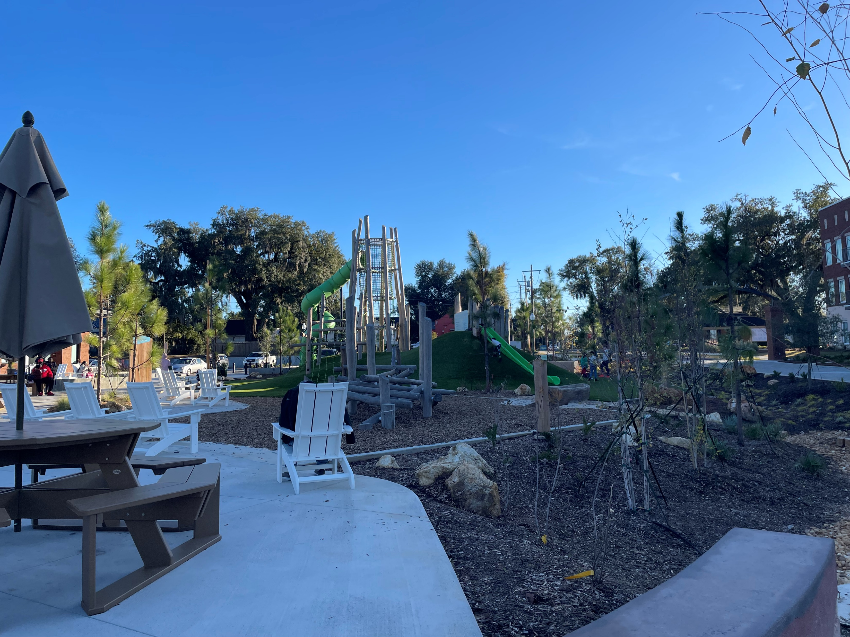
Tips and tricks
04
Tell a complete story with pictures-in focus and clearly identified.
05
Elaborate beyond yes or no answers, explain and be thoughtful and thorough in your answers.
Notes:
We all know that stories resonate better when accompanied by images. Have a new park, streetscaping, or innovative downtown seating projects? Show them to us! Working on stormwater improvements? Show us your sewers! Most of your reviewers can’t go in person to your community, so tell us and show us.
Tip 4 is self explanatory. We do get pictures that are out of focus. We’re not expecting professional photography, but images that aren’t in focus or if the subject isn’t centered can definitely take away from your score.
Lastly, don’t be vague and short. Let your answers be accurate and thorough.

Slide 35
Additional tips for success
Use the application for ideas for your implementation.
Start early! The application is due May 15.
Let other community staff and trusted professionals review your application.
Examples, examples, examples!.
Notes:
Revisit the application regularly throughout the year. Allow the application to provide ideas for your community’s implementation of the Comprehensive Plan. For example, question N is, “After adoption of your Local Comprehensive Plan, what active, ongoing, outreach processes
have you used to solicit input on planning matters from a cross-section of the community?” If you are thinking through a new corridor study, or have received an application for a large-scale rezoning project, consider how you are engaging the public? Are you utilizing creative methods to solicit feedback from a variety of diverse stakeholders? Next. This application is robust. Just like when were in school, we can all tell when a test or paper was part of a cram session and the answers were hammered out the night before-powered by redbull and vending machine food. Allow several weeks to gather the information you need. This will help your answers be as clear and thoughtful as can be. Also, starting early will give you time to go through several reviews, which we all know will result in a better product.
That brings me to the third suggestion-allow your application to be reviewed. Have your reviewers check for consistency, grammar, syntax, and quality of content. Sometimes, when working on a project like this, it’s easy to get tunnel vision about a certain answer. Others can provide a fresh perspective and can help you focus your answers to make them easier to understand and to allow your point to come across in a cogent, concise way. This last tip is probably a make or break point. After reviewing several applications, answers, and reviews, one of the biggest positives and negatives are examples. When examples aren’t provided. Reviewers score very negatively. When quality examples are provided, reviewers take note and score very highly. You probably won’t be designated a PlanFirst community if quality examples aren’t provided. When you are at a Council or Commission meeting, and you notice an activist citizen regularly speaking on issues, where it makes sense, bring that person into your comprehensive planning process, engage with that person and the neighborhood or group that that person represents. Note that engagement on your application.

Slide 36
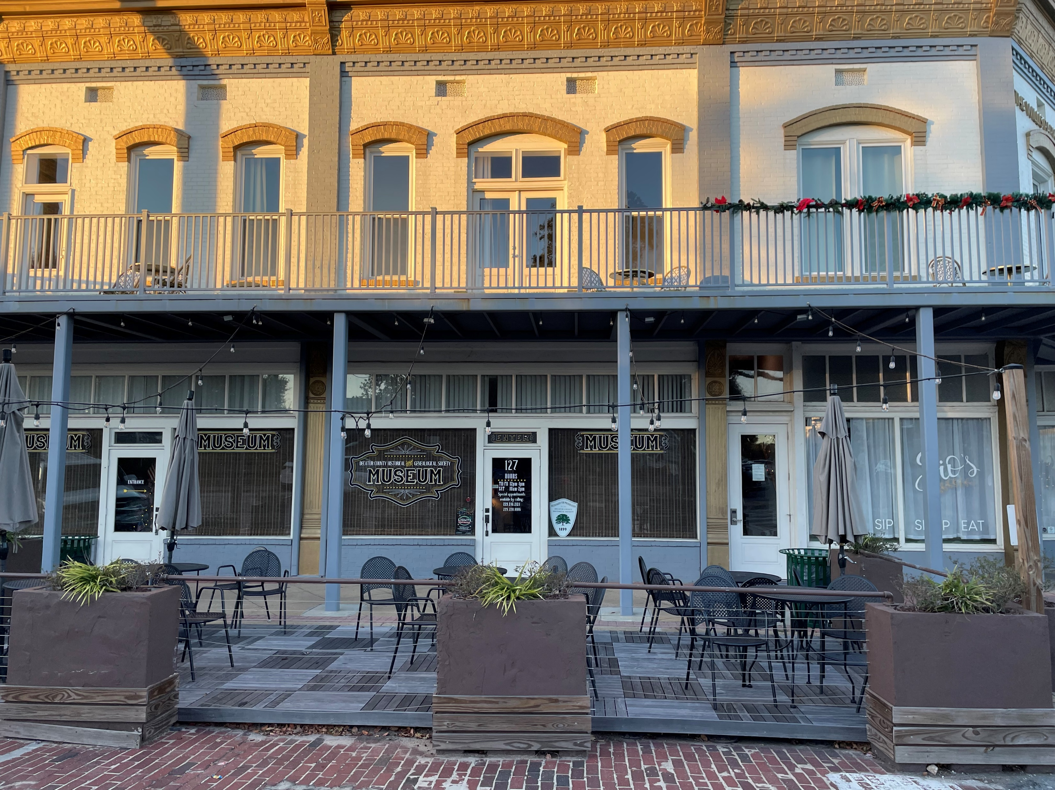
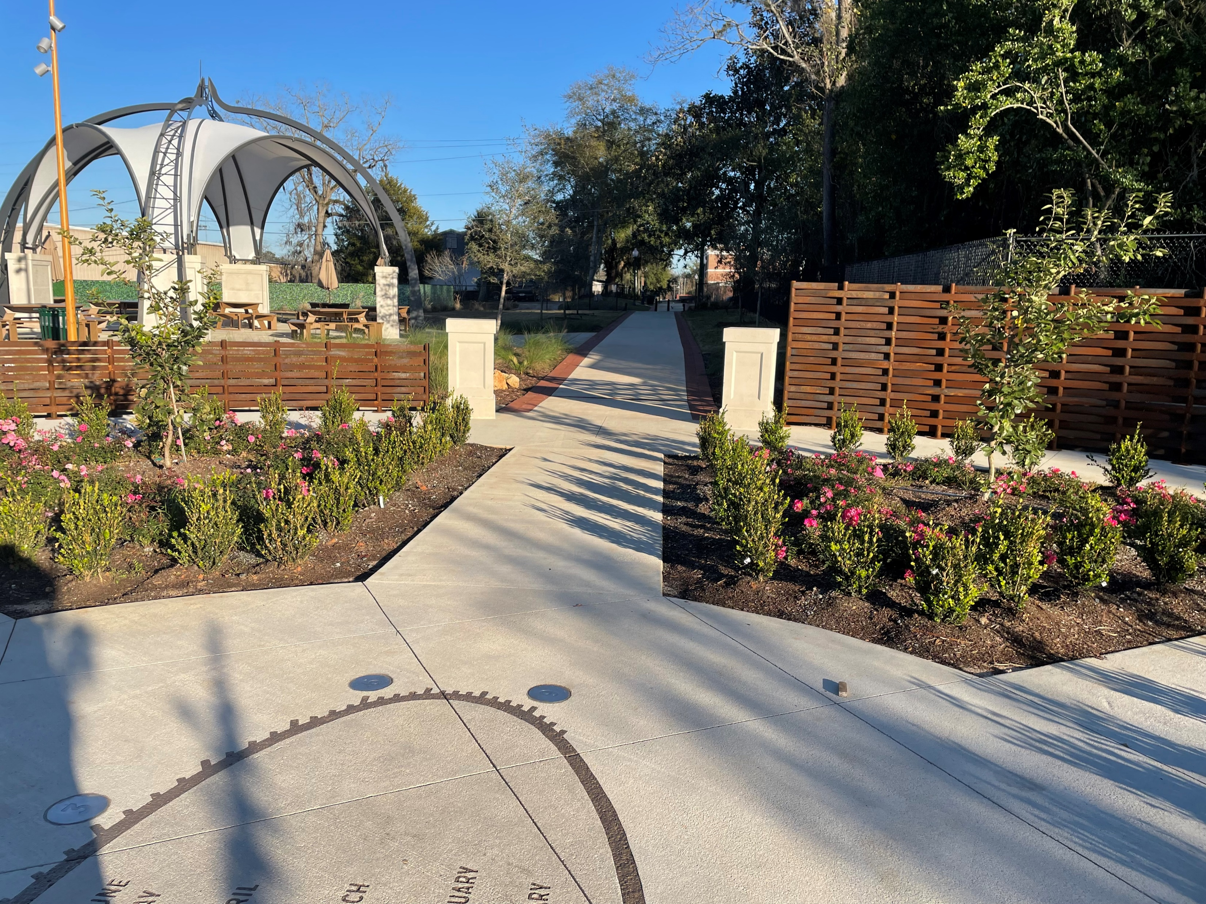
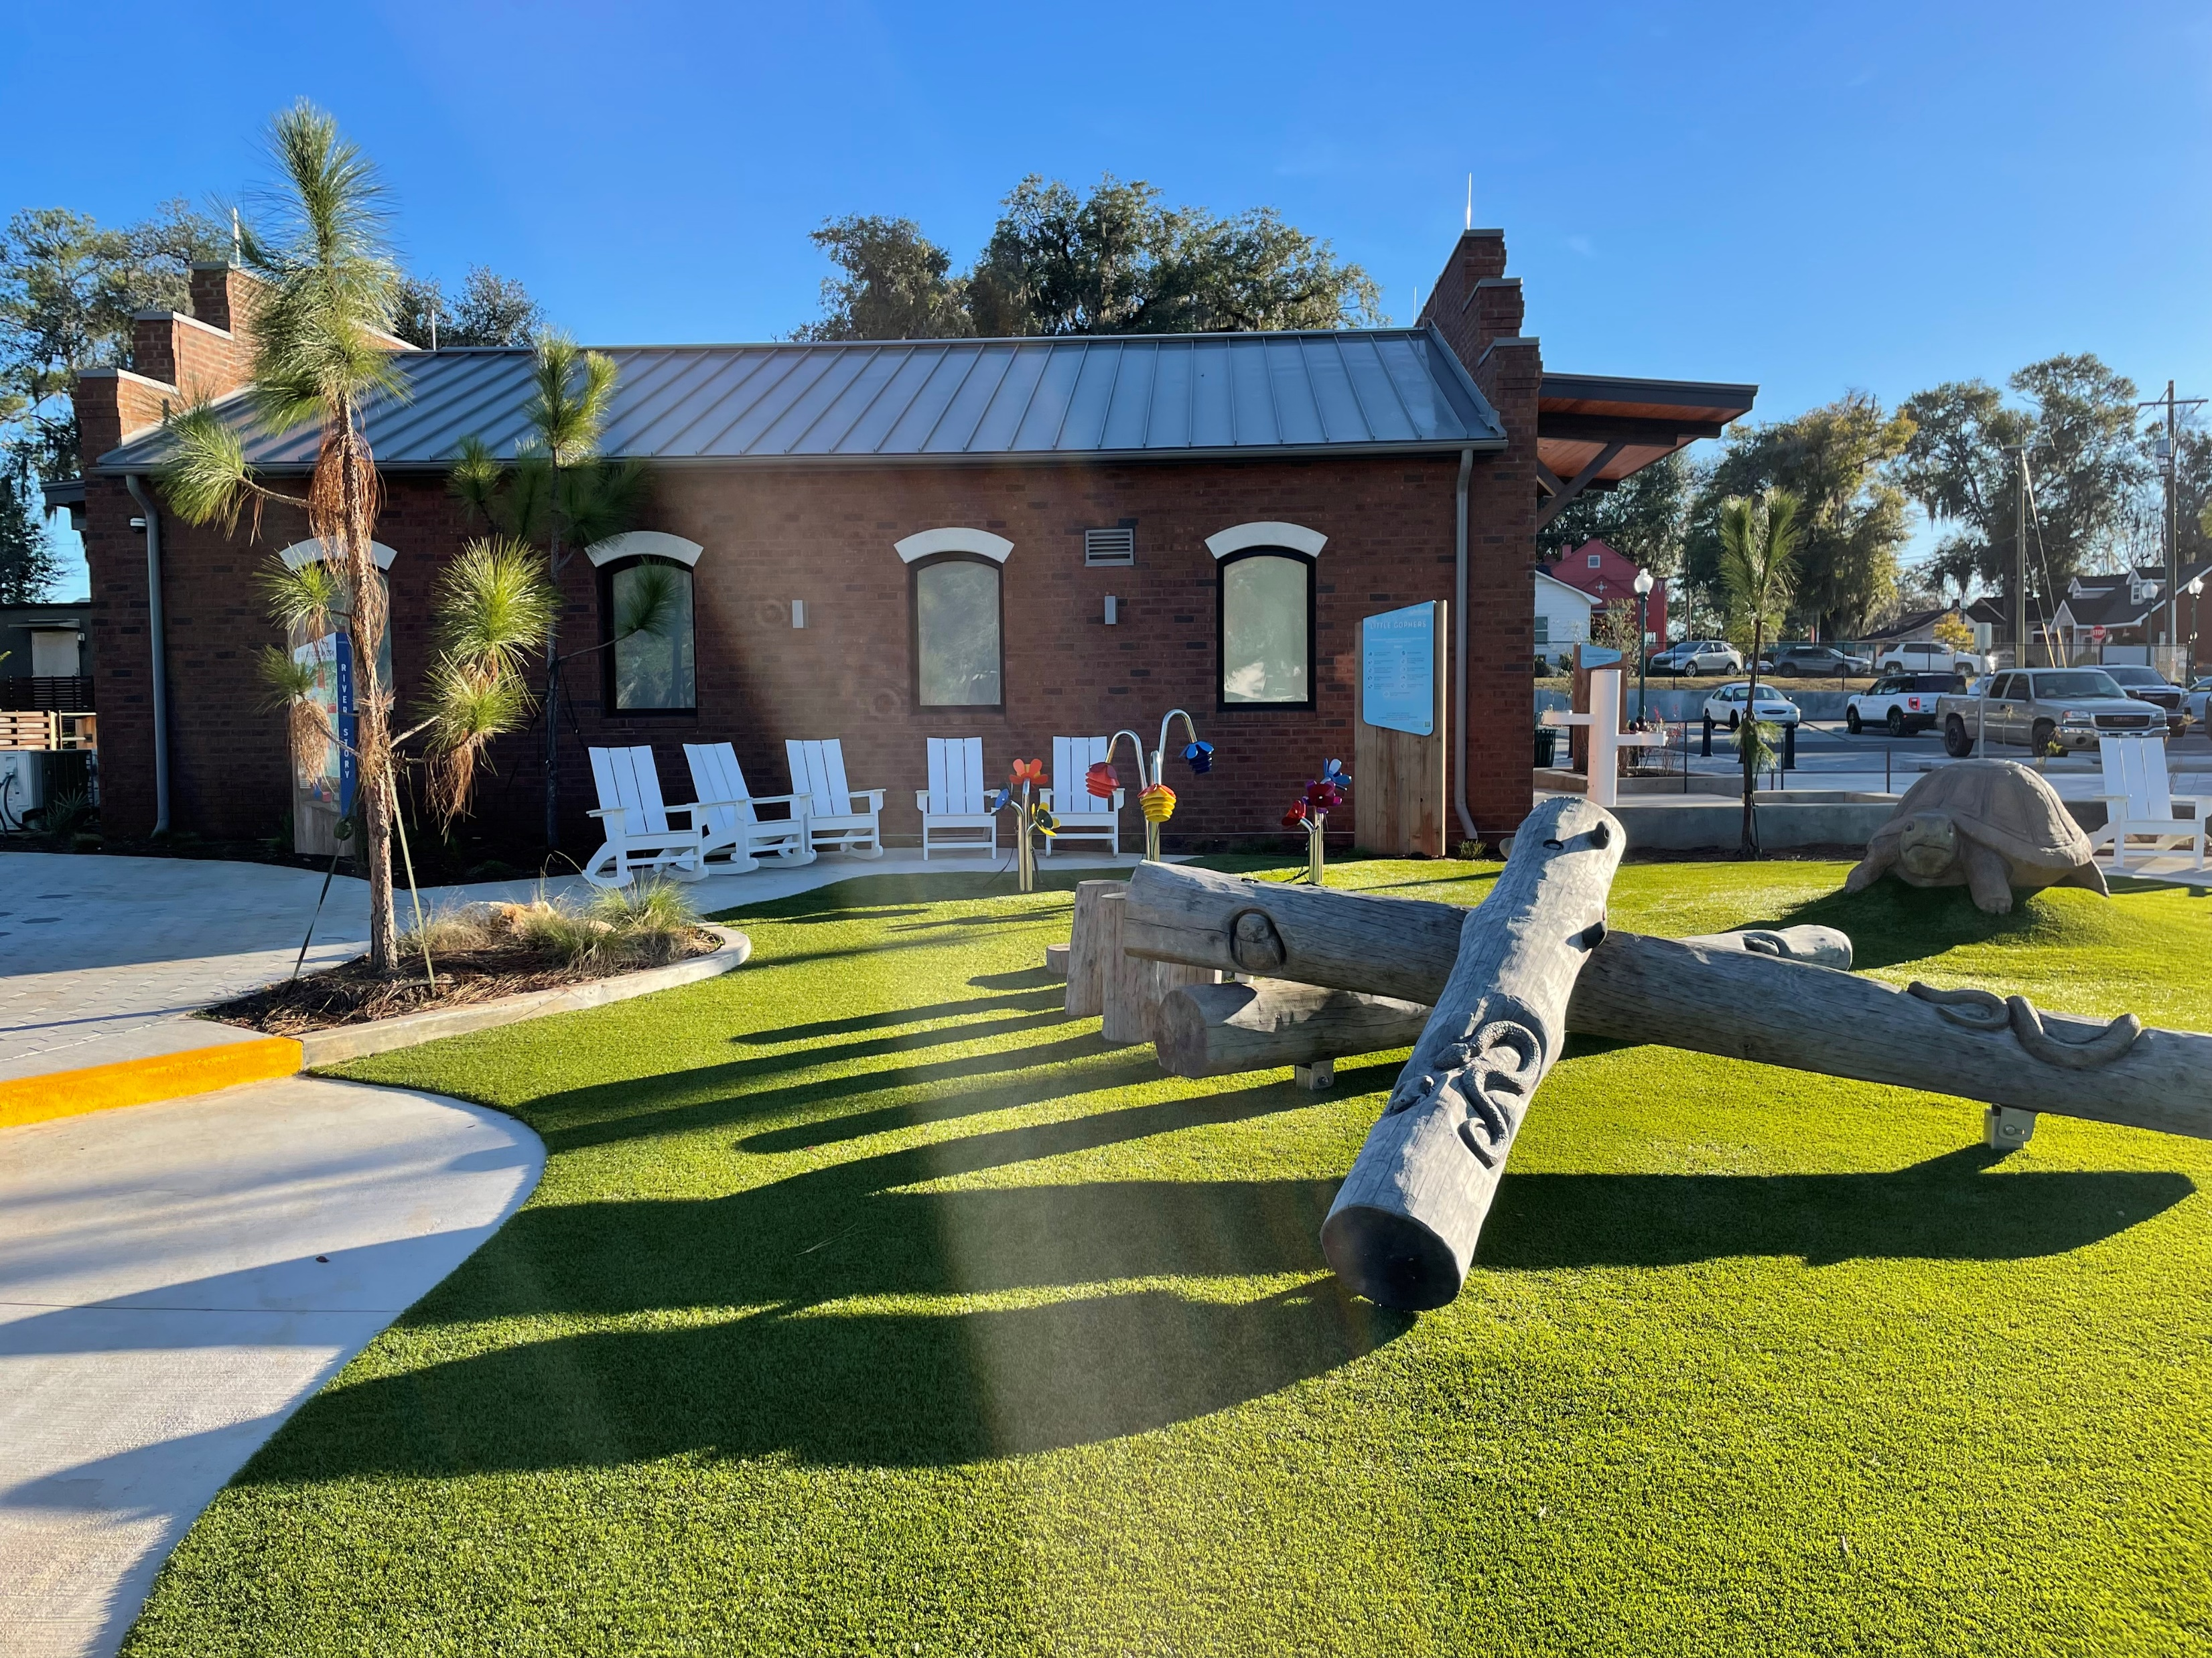
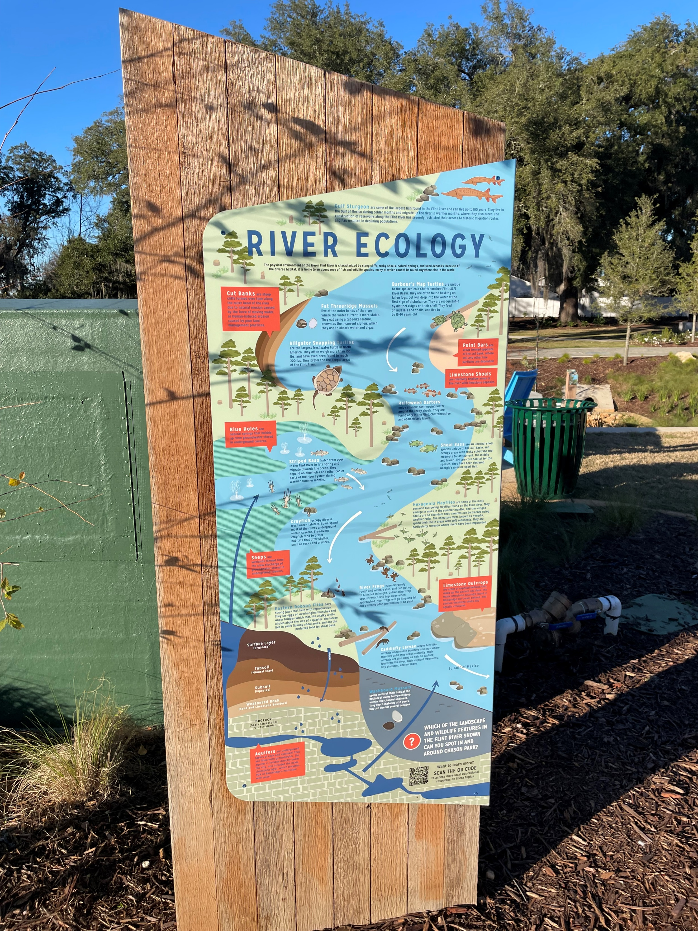
Invite us into to your community through pictures.
Notes:
We know our Georgia communities are doing good things. Good storytelling can be augmented by pictures. Review your Community Work Program and then take a drive around your community. Take photos and upload them along with your presentation. Take several photos and keep the best ones! This will stimulate your thinking and will be a huge help on boosting your application’s chances.

Slide 37
Reviewer responses
Responses
These are potentially great partnerships, but it is not clear how they advocate for the plan. They gave 1 example of this at the end. How do they affect comm. leader decisions?
They seem to have misunderstood what this section was meant to do. But they didn't list any citizen groups that affected changes, they just mentioned citizens in general and only gave one example.
no documentation no real discussion of processes, No supporting documentation.
Mentioned plan implementation meetings with MCRC but agenda and sign-in examples are from 2019. If it's being done every year, could a more recent agenda and sign-in sheet been included? Mentions CM regularly references plan but no specific examples (i.e. agenda, Minutes, etc.) from City Council retreat or Directors retreat to show regular evaluation of plan effectiveness.
seems like they have no outreach during the planning process for hard to reach populations or varied socio ec backgrounds 9.6% speak spanish
vague examples
Cannot read the inserted table.
Notes:
Here is a collection of reviewer responses on some of the lowest rated questions. I took a sampling of several answers that reflected the same idea.

Slide 38
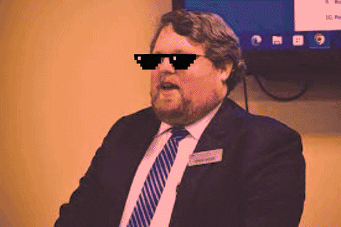
Application: Lessons Learned
The answers need to be very specific: answer the question you’re asked
Regional Commissions can be a benefit in help filling out the application!
Answers have changed somewhat over the years - focus now is more on how they achieved their goals by planning rather than “Look how great we are”
Renewals aren’t automatic, not everybody renews, for different reasons

Slide 39
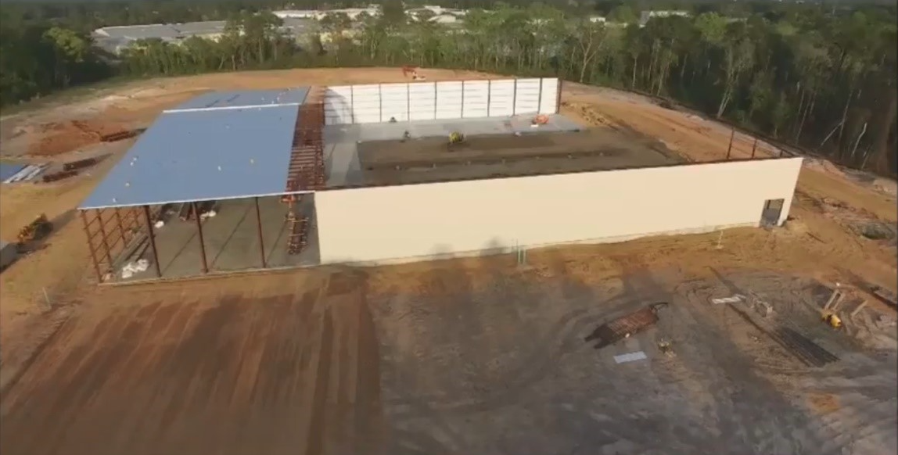
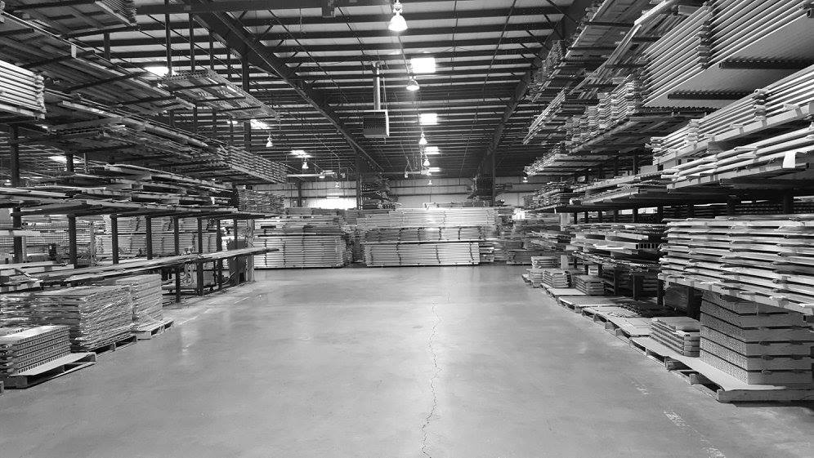
PlanFirst incentives-a success story
PlanFirst community 2017-2025
2017 EIP winner-100 jobs created-infrastructure for Elixer Extrusions manufacturing
2018 CDBG award winner-$459,895-water and sewer improvements.
2019 CDBG award winner-$373,727-drainage and street improvements
2020 CDBG award winner-$750,000-public facility to address mental health benefitting 951 persons
2022 CDBG Annual Competition-$1,000,000 expansion of Early Head Start facility benefiting 125 persons.
2022 GEFA loan to upgrade wastewater treatment plant-$3,000,000-interest rate savings on a 20 year loan~$170,000
Notes:
Here we have one of our PlanFirst superstars- the City of Douglas, Georgia! The City of Douglas is a small, rural town of roughly 12,000 in population. The city of Douglas is the County seat of Coffee County and is one of the few three-time PlanFirst designees in the state.
You can see that the City of Douglas was relentless! They took advantage of 3 successive years of applying for CDBG funds-
They took a short breather in 2021. But then 2022-expanded their head start facility and invested in the youth of the community.
That same year, Douglas enjoyed a half percent interest rate reduction on a $3,000,000 GEFA loan which amounts to roughly $170,000 in savings. Douglas has been extremely active even outside of these PlanFirst available funds. Truly, they are demonstrating how a local government can really push activities that align with their community’s vision and goals.

Slide 40
Notes:
Here’s before and after pictures of a residential area in Douglas that made sewer and street improvements with CDBG funds.

Slide 41
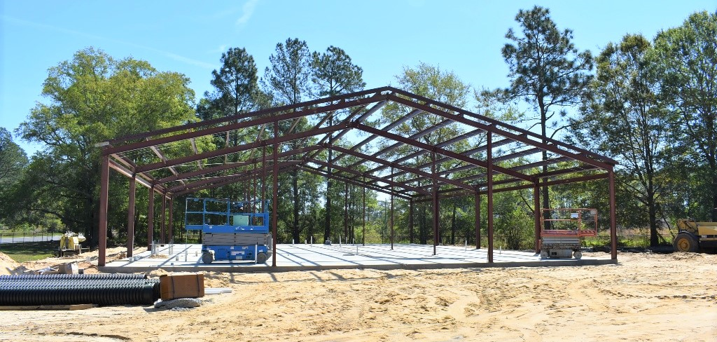
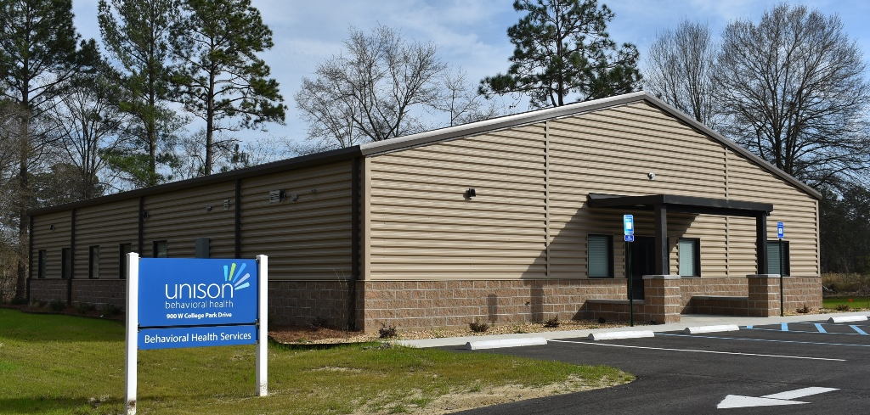
Notes:
The City of Douglas recognized that like many communities in our state, substance abuse and mental health issues were challenges that needed to be addressed. For their 2020 CDBG funds, Douglas was awarded $750,000 to build a mental health/substance abuse treatment facility to address these issues, estimated to benefit 951 people. The City, local employers, and most importantly the residents of Douglas, all stand to gain from this facility and the services it offers.

Slide 42
Daniel Gaddis, AICP
Daniel.Gaddis@dca.ga.gov
Direct: 404.679.4934
Cell: 470.352.0395
Planning Outreach Coordinator
Notes:
Lastly, I want to share that we are taking a new approach to our Success Stories and Best Practices initiatives. This year, we will be asking for information about projects that our PlanFirst communities have undertaken and then sharing those out with the state. We hope to host a webinar where we can invite other communities that are looking to address issues such as housing stock, blight, stormwater, promoting walkability and bikability, economic development and others. Using the PlanFirst communities as thought-leaders and sharing the challenges and successes they’ve dealt with can be encouraging and instructive to others.
Any questions I can answer for you all?

