Slide 1
CDBG-DR 2023-2024
Hurricane Applicant Workshop:
Infrastructure Program

Slide 2
Introductions
Rachel Rhodes, CDBG-DR Operations Manager
  Rachel.Rhodes@dca.ga.gov
Gabriela (Gaby) Montelli, CDBG-DR Project Specialist
  Gabriela.Montelli@dca.ga.gov
Kathleen Tremblay, CDBG-DR Program Director
  Kathleen.Tremblay@dca.ga.gov

Slide 3
Specifically
Hurricane Idalia (DR-4738)
Tropical Storm Debby (DR-4821)
Hurricane Helene (DR-4830)
The State of Georgia has allocated $ 50 million for public infrastructure to help recover from the impacts of disasters in 2023 and 2024.

Slide 4
Infrastructure Timeline
Applicant workshops
  March 30 - April 2, 2026
  In-person sessions
  Webinar – TBD (April)
Accepting Applications
  May 4 - September 4, 2026
  (20 weeks)
Site visits after receipt of applications
  September - October 2026
Estimated Award Date
  January 2027

Slide 5
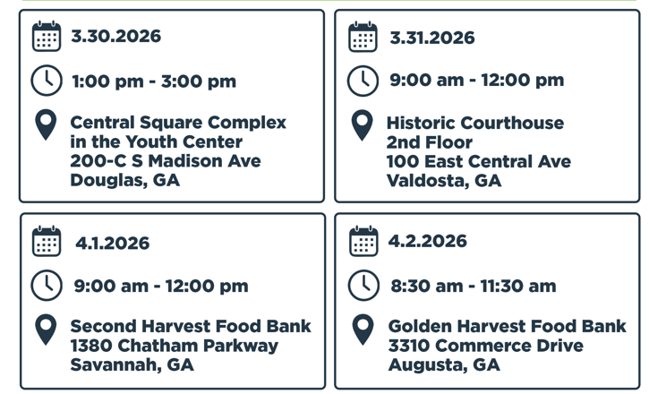
Workshop Schedule

Slide 6
Infrastructure Description
Infrastructure – funds for local governments to apply for public infrastructure needs, including but not limited to water/sewer/stormwater, streets/bridges, & drainage, building and communications, etc. ​
CDBG-DR funds are used to address infrastructure damage tied back to disasters to ensure communities can recover and maintain their essential services.
Not limiting the project types, projects will be determined by the community’s needs

Slide 7
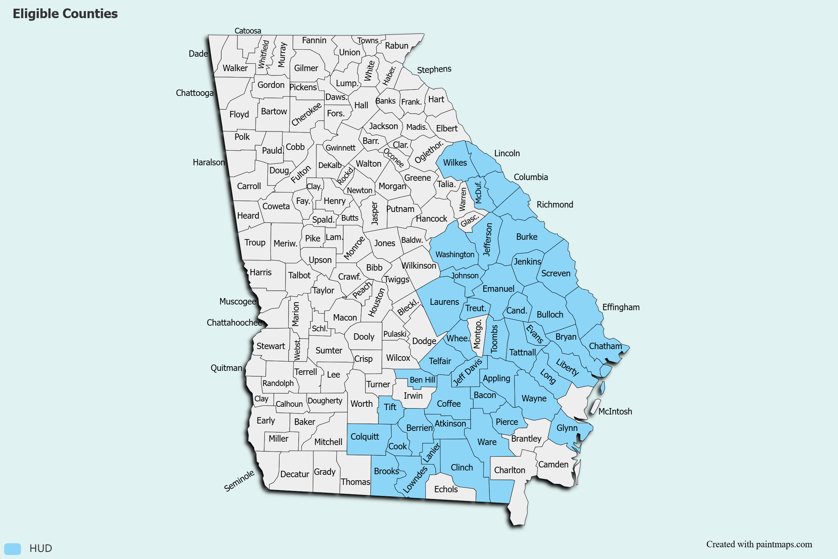
Eligibility

Slide 8
Eligible Activities
Must be eligible under 24 CFR Part 570/The Housing and Community Development Act of 1974
Projects must have a tie-back to the disaster (direct or indirect)
Projects must mitigate against the effects of future disasters
Projects should primarily benefit low-to-moderate income persons

Slide 9

Competitive Public Infrastructure
TELL A COMPELLING STORY
Include public feedback, letters, photos, and declarations of support
Be detailed with descriptions and the effects the disaster and selected project will have on your target area
This Photo by Unknown Author is licensed under CC BY

Slide 10
Competitive Public Infrastructure
Tips & Tricks
Plan your target area first – not your national objective
Consider alternatives
Notify the public early and often
Choose a grant writer/administrator wisely
Choose an engineer/architect wisely
Attend an in-person applicant workshop
Take advantage of bonus point possibilities

Slide 11
Key Points to Know
Individual or joint Activities: Joint activity proposals are generally required when fewer than 51 percent of the beneficiaries are located within the subrecipient's jurisdiction.
Period of performance: All Unmet Needs Infrastructure recipients are required to expend one hundred percent (100%) of all funds within thirty-six months (36) from the date of the grant award unless the activity is extended by DCA.
Activity Delivery Cost: are those allowable costs incurred for implementing and carrying out eligible CDBG-DR activities. - Use the chart for limits on professional fees
Leverage: If noted in the application, DCA will verify that the leverage and activities proposed by the local government have, in fact, been provided. Points are awarded for the leverage provided in the application. Grants will not be closed, and final payments may not be made prior to this verification.
Determining LMI: DCAʼs Infrastructure Program requires applicants to document and report the beneficiaries of each proposed application activity. To do this, the applicant must first define a target area(s). Activity target areas should be reasonably delineated based on the intended beneficiaries of the low-to moderate-income area benefit (LMA) activity.

Slide 12
Key Points to Know
LMA Alternative: New guidance from the Universal Notice acknowledged how the far-reaching nature of infrastructure activities service areas presents challenges for meeting the low- and moderate-income area benefit (LMA) national objective criteria at 24 CFR 570.208(a)(1) and 24 CFR 570.483(b)(1) and 24 CFR 570.483(b)(1).
This alternative allows for an Urgent Need National Objective to have some LMA benefit.
Example scenario:
The target area for a project has a 40% LMI population, which is under the 51% required for the LMA National Objective. The Urgent Need National Objective may be used, but 40% of the LMI population will still count towards the State's 70% LMI expenditure requirement. If the project is $1,000,000, then $400,000 of those funds will count toward LMI.

Slide 13
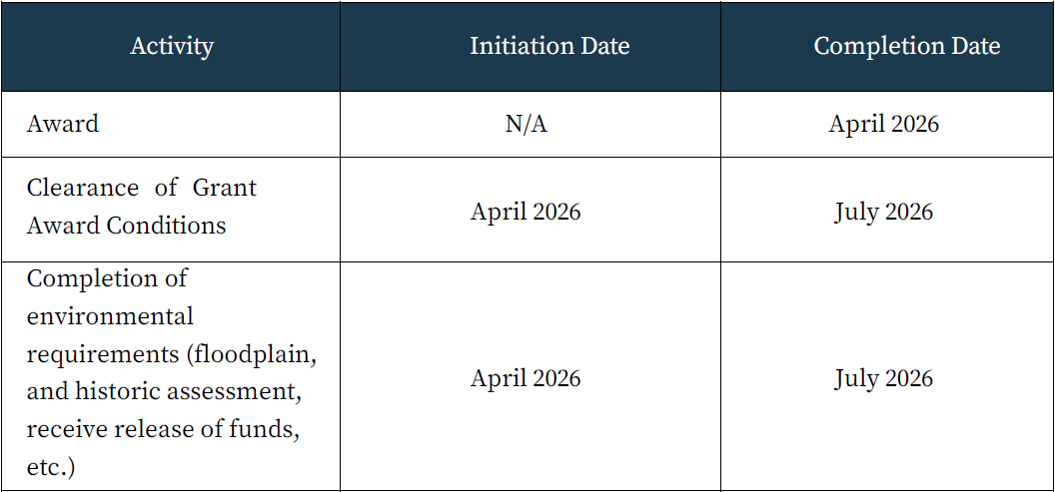
Key Points to Know
Sample Project Implementation Schedule

Slide 14
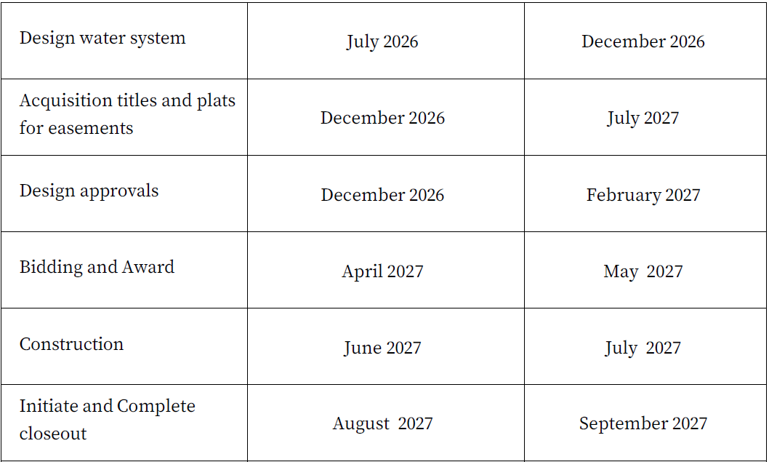
Key Points to Know
Sample Project Implementation Schedule cont.

Slide 15
Key Points to Know
Operations and Maintenance: Communities are required to detail how they intend to fund, with local dollars, the long- term operations and maintenance of the infrastructure activities.
DCA DR FORM C (IMPORTANT)
Per Federal Register Notice 84 FR 28836, a duplication of benefit occurs when a person, household, business, or other entity receives disaster assistance from multiple sources for the same recovery purpose, and the total assistance received for that purpose is more than the total need. The amount of the DOB is the amount received in excess of the total need for the same purpose.

Slide 16
Scoring Rubric
Categories | Maximum Points | Percentage of Points
Cost to Implement/Calculated Benefit | 90 | 32%
Program Strategy | 60 | 21%
Leverage of Additional Resources | 40 | 14%
Demographic Need | 30 | 11%
Program Feasibility | 30 | 11%
Bonus Point Opportunities | 30 | 11%
Maximum Total Points | 280 | 100%

Slide 17
Cost to Implement
The purpose of the Cost to Implement/Calculated Benefit score is to gauge the positive result that is expected once the project is completed and to access the living conditions of target area residents. This criterion is a combination of objective factors and qualitative factors in order to be able to compare similar projects against each other.
Any applicant that scores 0 points on this criterion will be ineligible for funding.

Slide 18
Program Strategy
All applications will include a detailed approach to addressing the target area’s disaster mitigation needs using the proposed CDBG-DR assistance, along with other near-term sources of assistance and other resources. Resources could include, for example, local code enforcement efforts and the implementation of other local ordinances. The application should demonstrate how CDBG-DR funding, along with other efforts, will mitigate against disaster risks. Additionally, applicants must describe how the proposed infrastructure activities will affect members of protected classes under Fair Housing and Civil Rights Laws, racially and ethnically concentrated areas, and vulnerable communities. Projects that negatively impact members of protected classes will not be considered for funding.

Slide 19
Demographic Need
Demographic Need points will be calculated by DCA based on three factors: absolute number of people in poverty, percentage of people in poverty, and median income. The number and percentage of persons in poverty, and the median household income, will be based on the most recent data that is consistent with the same point in time for all applicants.

Slide 20
Leverage
Total dollar value of leverage for each applicant will be calculated and then divided by the total population of the applicant in order to obtain a per capita leverage figure reflective of each applicant's relative effort. The applications will then be ranked by per capita leverage, from no leverage (no points) to the highest per capita leverage (maximum 40 points), with points assigned based on the percentile ranking. If no applicant has $0 leverage, a proxy score of $0 will be assigned to ensure that, if leverage is provided by the applicant, a score greater than $0 results.
  For example, if an applicant’s per capita leverage amount is $300 and if $300 represents a percentile score of 50 percent, the leverage points will be 15 (.50 x 30= 15).

Slide 21
Program Feasibility
The Program Feasibility criterion is designed to test for items beyond the threshold requirements that are critical in carrying out the project in a timely manner, within budget, in compliance with HUD’s requirements, and that establish clear standards for project implementation, such as complete engineering and architectural reports and consistency across narratives, budgets, and cost estimates.

Slide 22
Bonus Points Available
Readiness to Proceed (shovel-ready)
7 BONUS POINTS
Environmental is complete and approved by DCA
7 BONUS POINTS
All real estate acquisition is complete (including easements and rights-of-way) is compete
7 BONUS POINTS
Applicant session attendance IN PERSON
9 BONUS POINTS

Slide 23
Bonus Points
Readiness to Proceed points will be based on the following factors:
Plans and specifications for the project are finalized and have been approved by the appropriate local, state, or federal authorities (7 points).
All real estate (including easements and rights-of-way) needed for the project have been acquired in accordance with applicable requirements (7 points).
All Environmental Reviews (including the Section 106 Review & NEPA Review) for the project have been completed, and documentation has been provided (7 points).
Attendance at an in-person applicant workshop session by a staff member of the local government or the contracted grant writer/administrator (9 points).

Slide 24
Reference
Please always refer back to the CDBG-DR Applicants Manual!
CDBG-DR Applicants Manual
All updates for CDBG-DR are available on the website:
https://dca.georgia.gov/financing-tools/disaster-relief/community-development-block-grant-disaster-recovery-program-cdbg-dr
CDBG-DR staff will be available for one-on-one conversations until May 3, 2026 – after the application is open, communication with potential applicant communities is limited to technical assistance with the application portal and/or Duplication of Benefit questions.

Slide 25
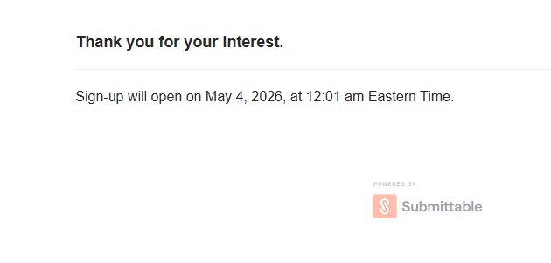
Application Portal Demonstration
Notes:
https://gn.ecivis.com/GO/gn_redir/T/1xsfpw2i5yox1

Slide 26


Slide 27
Thanks!
Rachel Rhodes
Rachel.Rhodes@dca.ga.gov
Cell: 470-316-4950
CDBG-DR Operations Manager
dca.georgia.gov

