Slide 1
2023 9% Tax Credit Pre-Application Submission Instructions Emphasys
January 27, 2023

Slide 2
Emphasys
2023 Pre-Application documents will be submitted through Emphasys
Fees will not be processed through Emphasys at this time. DCA will invoice all Applicants for the appropriate Application Fee.

Slide 3
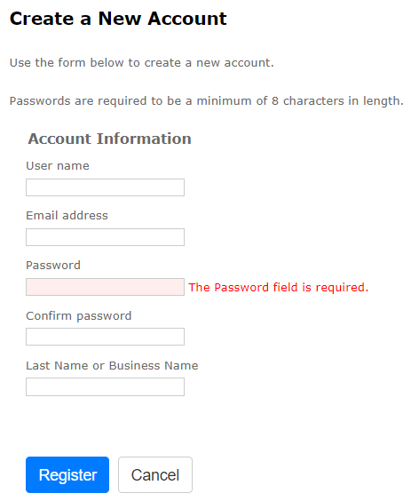
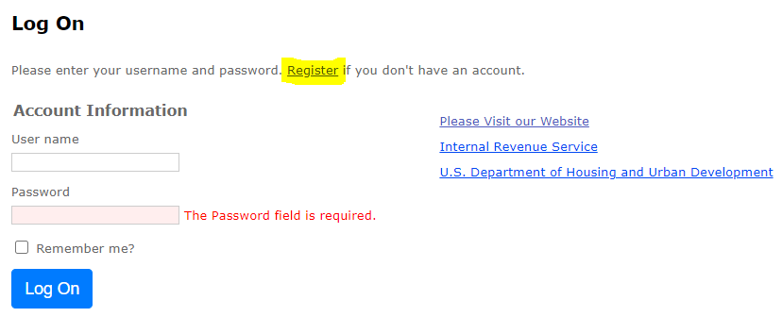
Registration
Follow this link to register for the Emphasys Developer account and access the Application Collector Portal, where you will complete and submit the application.
Upon first visit to the Application Collector Portal, click “Register” to create an account.
If you already have an account, use the same login information to access the portal. If you are locked out of the account, please contact DCA.
You can create a new account for a partnership if partnering with another developer on an application. If this is the company’s first visit to the Application Collector Portal, click “Register” to create account.

Slide 4
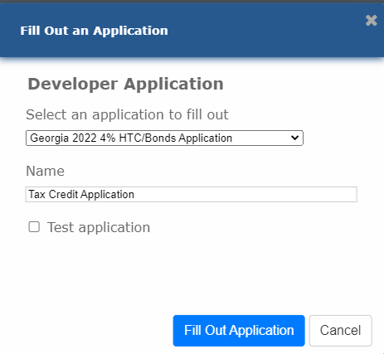
Application Submission in Emphasys
Click “Fill Out an Application”
Select “2023 9% Pre Application”
Enter name of project
Do not check the box next to “Test application”
Click “Fill Out Application”
Note: You may receive an error that says, “The application name already exists.” In that case, please rename the Application.

Slide 5
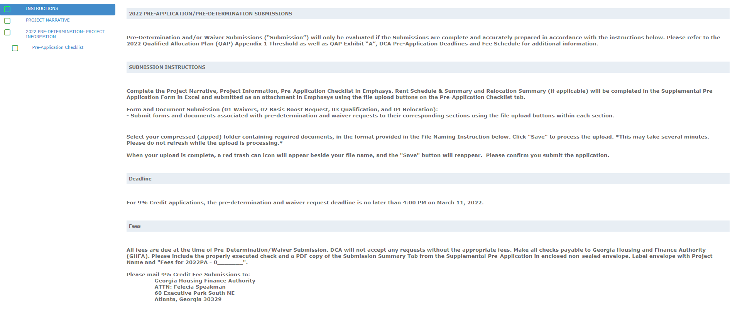
Pre-Application Submission in Emphasys

Slide 6
Example: Project Narrative

Slide 7
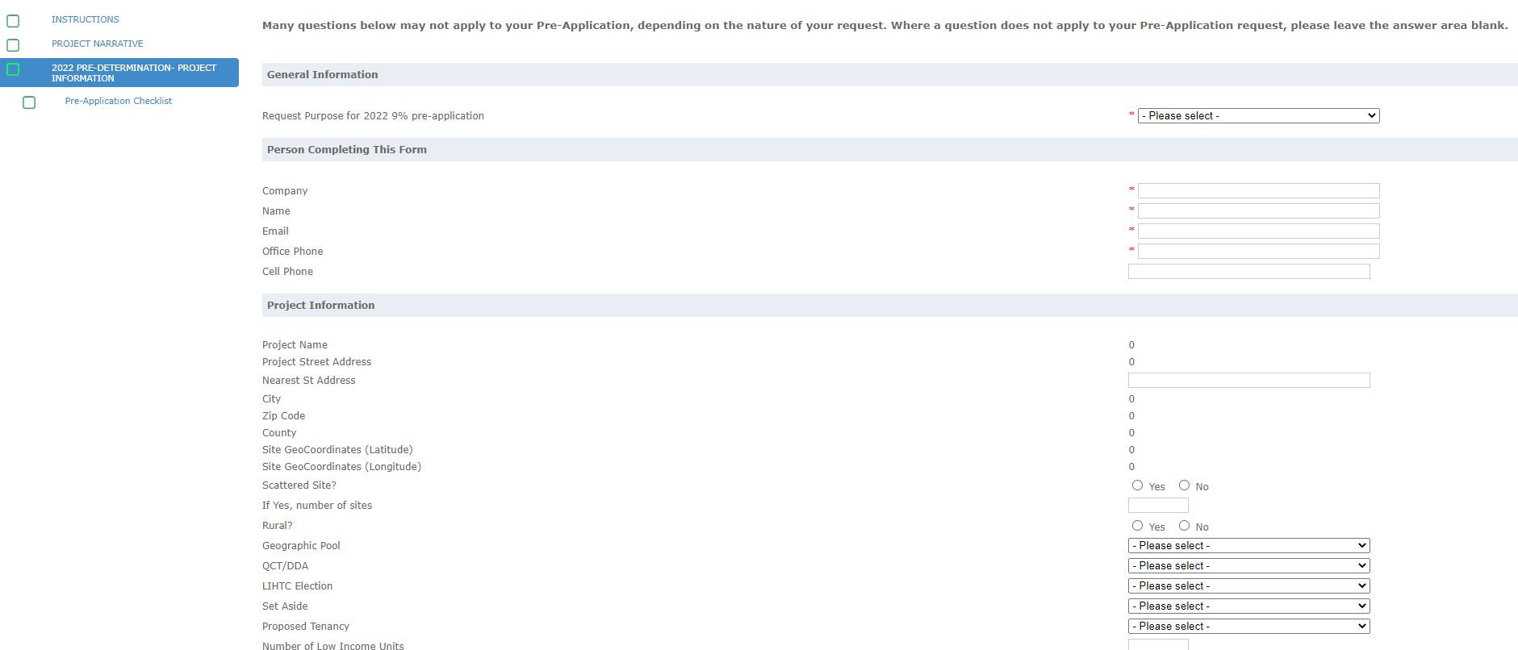
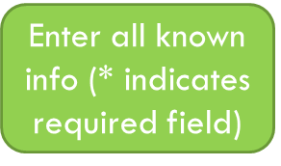
Example: Pre-Determination Submission Form

Slide 8
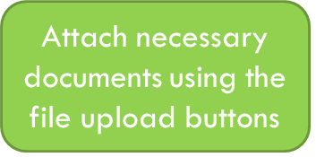
Example: Pre-Application Checklist
Attach completed Supplemental
Pre-Application Form
Click to add rows for multiple attachments

Slide 9
File Naming Instructions
Refer to these File Naming instructions when attaching documents. Attach as a Zip File for each section, if possible.

Slide 10
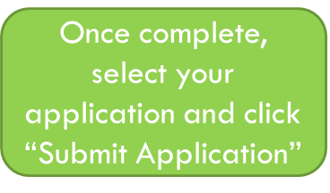
Finalize/Submit Applications
Click on “Submit an Application”
Select your Application from the drop-down list
Click “Submit Application”

Slide 11
Submit Applications – Click OK
After Selecting “Submit Application,” the window below will appear. Select “OK” to finalize submission.
No changes can be made after submitting the application.

Slide 12
Questions?
If you have questions or issues, please contact:
Meagan Cutler, Meagan.Cutler@dca.ga.gov
Paul Brown, Paul.Brown@dca.ga.gov

