Slide 1
2022 9% Pre-App Submission Instructions Emphasys

Slide 2
Emphasys
New platform for application and documentation submission
2022 Pre-Application documents will be submitted through Emphasys
Fees will not be processed through Emphasys at this time
All fees are due at the time of Pre-Determination/Waiver Submission. Please make all checks payable to Georgia Housing and Finance Authority (GHFA). DCA will not accept any requests without the appropriate fees.
Please include the check and a PDF copy of the Submission Summary Tab from the Supplemental Pre-Application Form (available on the DCA Website). The Supplemental Pre-Application Form is required for every pre-application.
Fees must be delivered to Georgia Housing and Finance Authority, 60 Executive Park South NE, Atlanta, Georgia 30329. Please address all fees to the attention of Felecia Speakman.

Slide 3
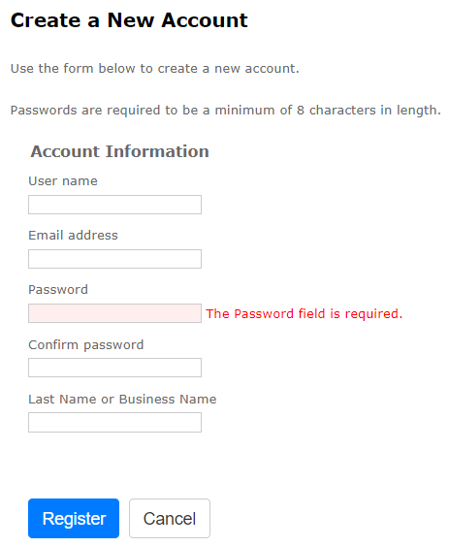
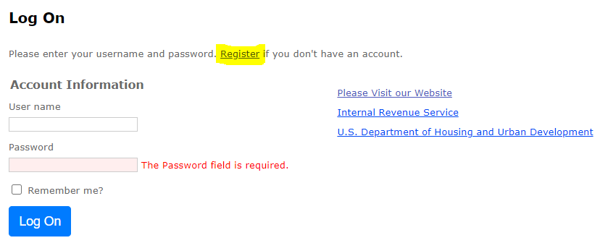
Registration
Follow this link to register for Emphasys Developer account and access Application Collector Portal, where you will submit application documents
Upon first visit to the Application Collector Portal, click “Register” to create account

Slide 4
Pre-Application Submission in Emphasys
Click “Fill Out an Application”
Select “2022 9% Pre-Application Submission”
Enter name of project
Do not check box next to “Test application”

Slide 5
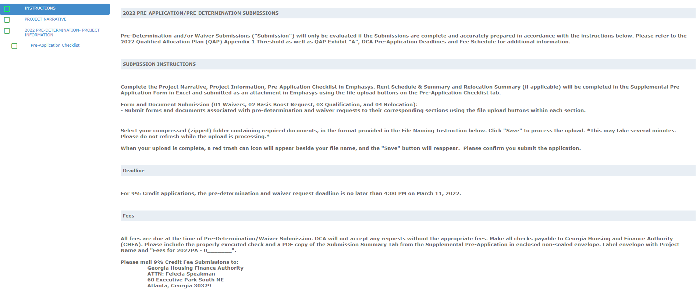
Pre-Application Submission in Emphasys

Slide 6
Example: Project Narrative

Slide 7
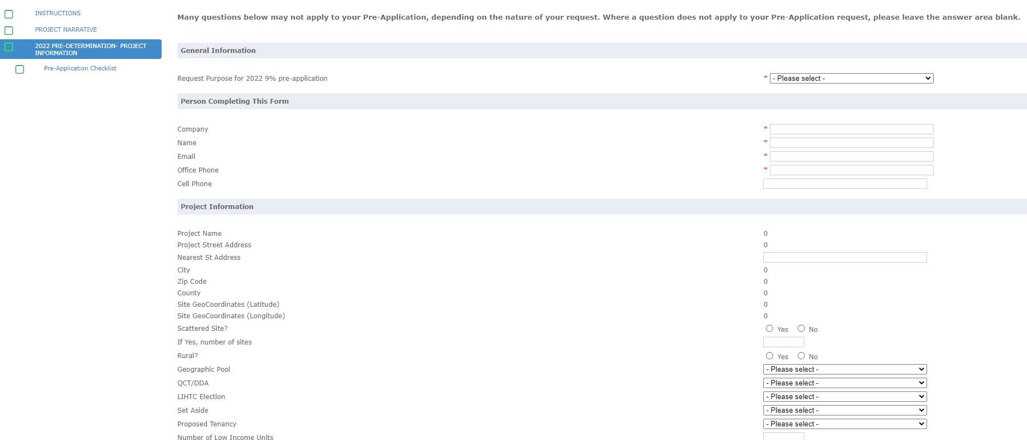
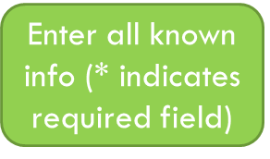
Example: Pre-Determination Submission Form

Slide 8
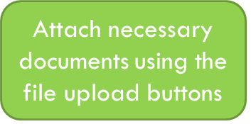
Example: Pre-Application Checklist
Attach completed Supplemental
Pre-Application Form
Click to add rows for multiple attachments

Slide 9
File Naming Instructions
Refer to these File Naming instructions when attaching documents. Attach as a Zip File for each section, if possible.

Slide 10
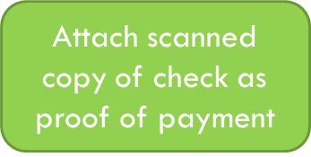
Example: Fees

Slide 11
Error with Submissions?
An error (“Missing Sections”) will show up for any fields you did not select “Save and Next”
Click “Save and Next” even if no documents are needed/uploaded.

Slide 12
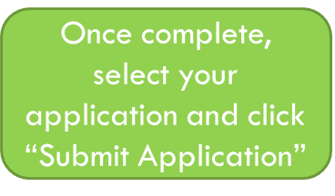
Finalize/Submit Applications

Slide 13
Submit Applications – Click OK

