Slide 1
2021 9% Pre-App Submission Instructions Emphasys

Slide 2
Emphasys
New platform for application and documentation submission
2021 Pre-Application documents will be submitted through Emphasys
Fees will not be processed through Emphasys at this time
All fees are due at the time of Pre-Determination/Waiver Submission. Please make all checks payable to Georgia Housing and Finance Authority (GHFA). DCA will not accept any requests without the appropriate fees.
Please include with check a printed paper copy of completed Pre-Application Submission Form and Checklist (the tab showing Total Fees Due) for ID purposes. Before printing, confirm that new "Check Nbr" box located beside Total Fees amount on form has been utilized.
Fees must be delivered to DCA Offices, 60 Executive Park South NE, Atlanta, Georgia 30329. Please address all fees to the attention of Felecia Speakman.

Slide 3
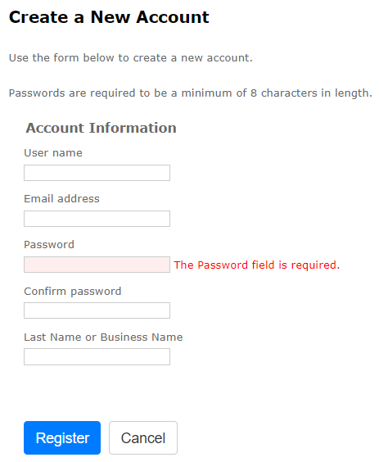
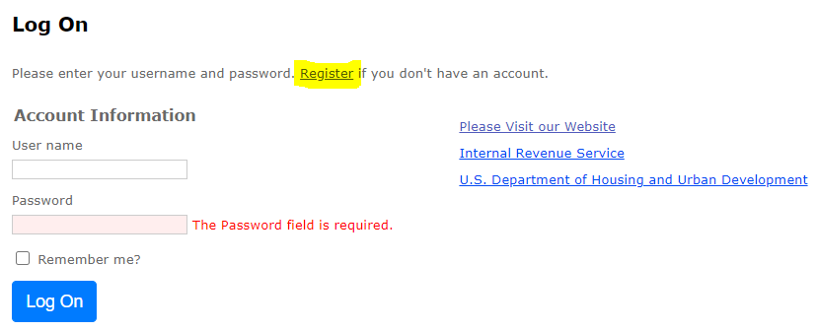
Registration
Follow this link to register for Emphasys Developer account and access Application Collector Portal, where you will submit application documents
Upon first visit to the Application Collector Portal, click “Register” to create account

Slide 4
Pre-Application Submission in Emphasys
Click “Fill Out an Application”
Select “2021 9% Pre-Application Submission”
Enter name of project
Do not check box next to “Test application”

Slide 5
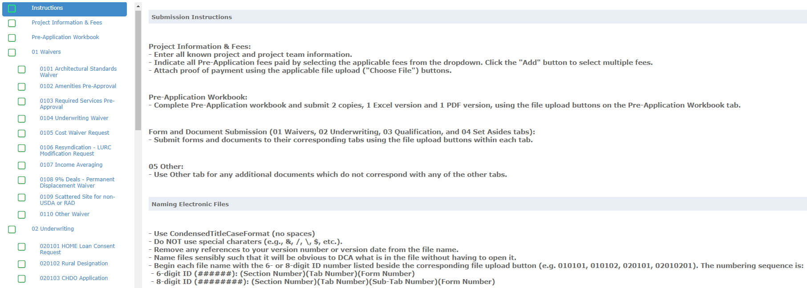
Pre-Application Submission in Emphasys

Slide 6
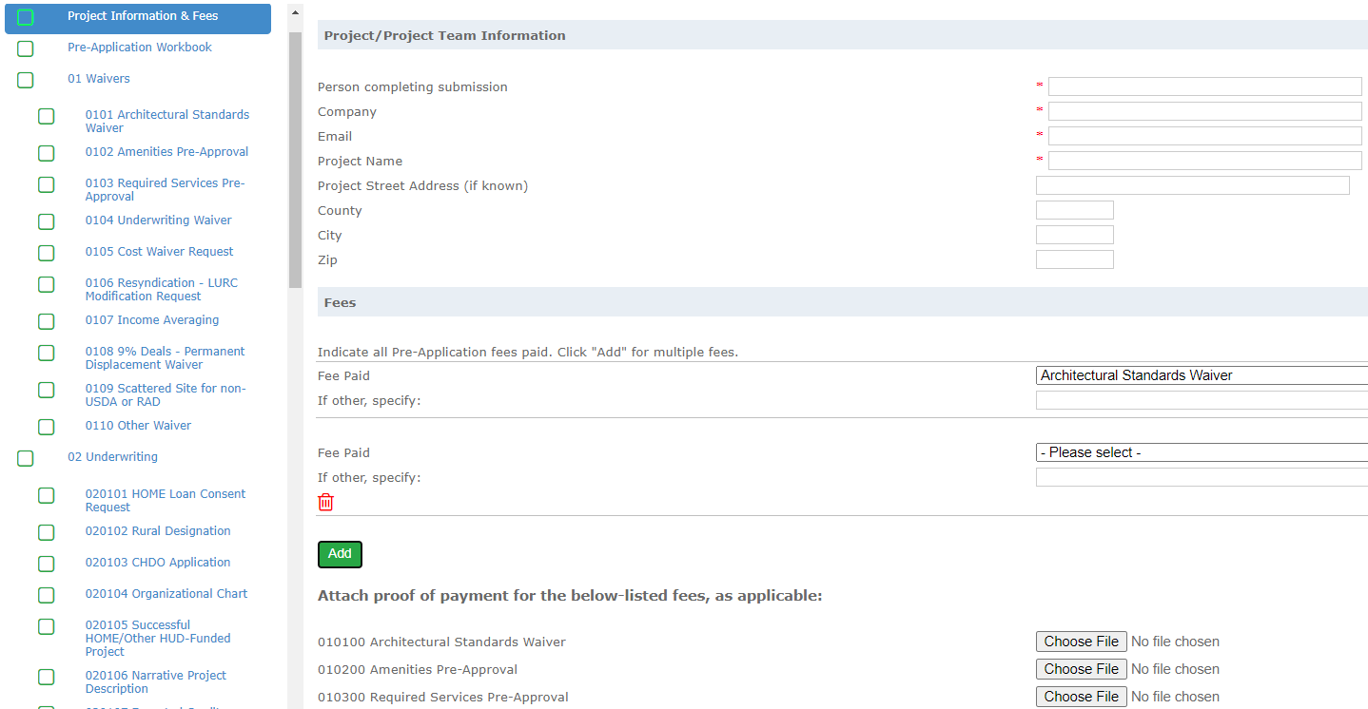
Example: Project Information & Fees Tab
Enter all known info (* indicates required field)
Indicate all fees paid
Click to add rows for multiple fees
Attach proof of payment using the applicable file upload buttons

Slide 7
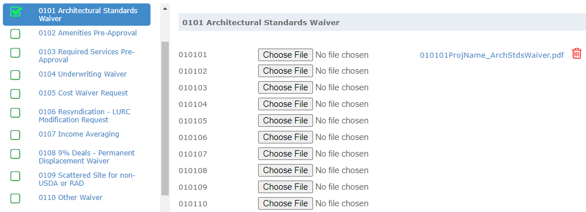
Example: Architectural Standards Waiver Tab
Submit Architectural Standards Waiver Request and all supporting documentation in this tab
Begin each file name with the ID number listed beside the corresponding file upload button

Slide 8
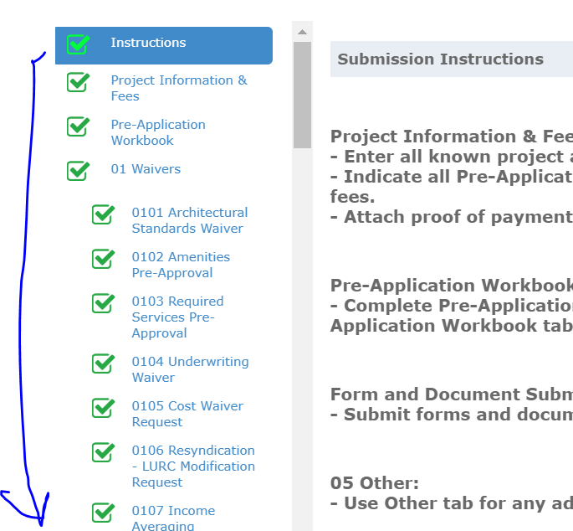
To Submit Applications
All Boxes need to be checked
Hit “Save and Next”

Slide 9
Hit “Save and Next” on all Tabs

Slide 10
Error with Submissions??
An error (“Missing Sections”) will show up for any fields you did not select “Save and Next”
Click “Save and Next” even if no documents are needed/uploaded.

Slide 11
Finalize/Submit Applications

Slide 12
Submit Applications – Click OK

