Slide 1
2021 9% Core Application Submission Instructions Emphasys
05/06/2021

Slide 2
Emphasys
New platform for application and documentation submission
2021 Application documents will be submitted through Emphasys
Fees will not be processed through Emphasys at this time
All fees are due at the time of Application Submission. Please make all checks payable to Georgia Housing and Finance Authority (GHFA). DCA will not accept any applications without the appropriate fees.
Please include with check a printed paper copy of completed Part I. Project Information from Core App for ID purposes.
Fees must be delivered to DCA Offices, 60 Executive Park South NE, Atlanta, Georgia 30329. Please address all fees to the attention of Felecia Speakman.

Slide 3
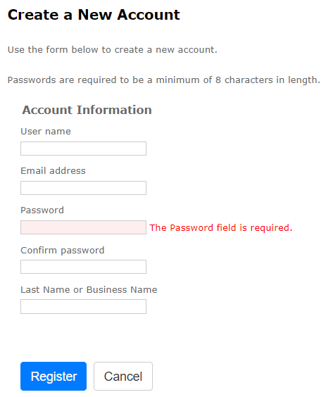
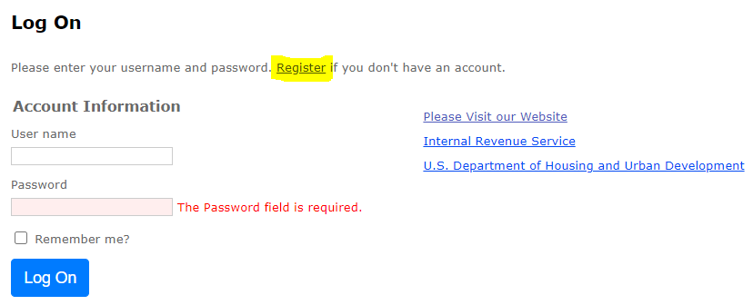
Registration
Follow this link to register for Emphasys Developer account and access Application Collector Portal, where you will submit application documents
Use the same login information used for the relevant pre-application submission, if applicable.
You can create a new account for a partnership if partnering with another developer on an application.
If this is the company’s first visit to the Application Collector Portal (i.e., there was no pre-application submission), click “Register” to create account.
Use Same Login Information from Pre-App Submission

Slide 4
Application Submission in Emphasys
Click “Fill Out an Application”
Select “2021 9% Application Submission”
Enter name of project
Do not check box next to “Test application”
When done, select “Fill Out Application”

Slide 5
Application Submission in Emphasys

Slide 6
Example: Application Information & Fees Tab
Enter all known info (* indicates required field)
Attach proof of payment for Application Fee and Third Party Review Fees (all copies of checks should be in one attachment/file)
Once all required fields are entered or attached, Select “Save and Next”

Slide 7
Example: 9% Application Submission Tab
“Zip” the Application folder on your computer (using DCA format folder)
Upload the “zipped” folder
Wait for the zip folder to upload (may take several minutes)
Once it no longer says “Processing, please wait…” and the zip folder name has appeared,
click “Save”
The Green Check next to 9% Application Submission confirms that this upload is complete, and you do not need to click “Save” again
Note: To make the upload process faster, close extra windows and quit additional applications running in the background.

Slide 8
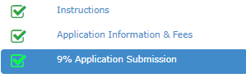
To Submit Applications
All Boxes need to be checked. If all boxes are not checked, the application is not complete.
Hit “Save and Next” on all Tabs (even if no documents are needed/uploaded).

Slide 9
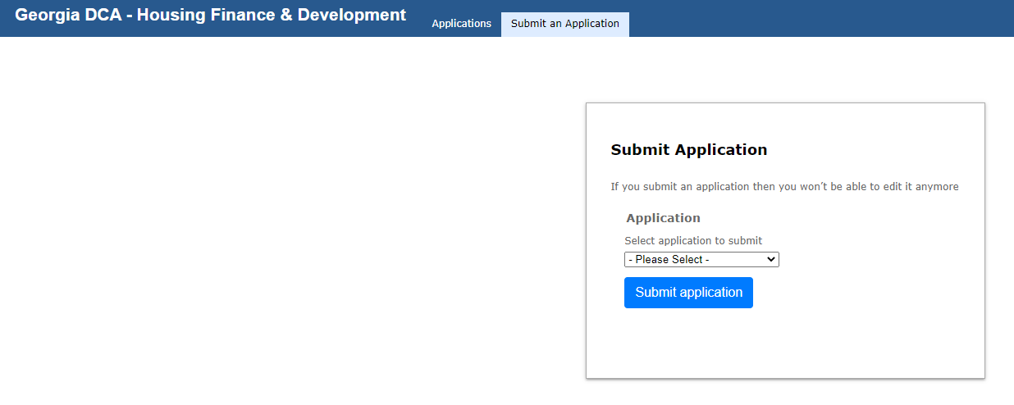
Finalize/Submit Applications
Select your Application from the drop-down list
Select “Submit Application”

Slide 10
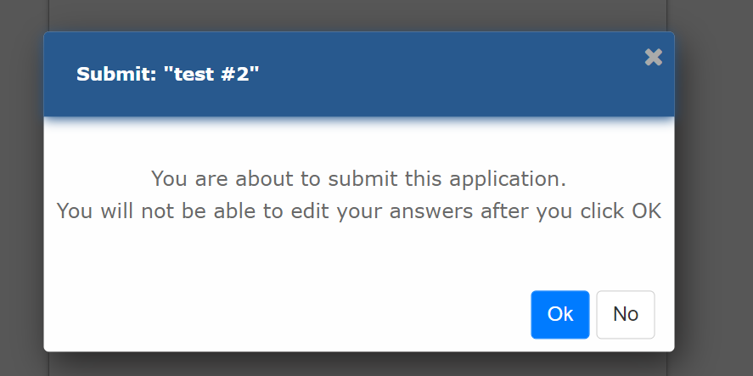
Submit Applications – Click OK
After Selecting “Submit Application,” the window below will appear. Select “OK” to finalize submission. You will not be able to edit the application after Selection “OK”

Slide 11
Error with Submissions?
An error (“Missing Sections”) will show up for any fields you did not select “Save and Next”
Click “Save and Next” even if no documents are needed/uploaded.

Slide 12
Questions?
If you have questions or issues, contact:
Ryan Fleming, Ryan.Fleming@dca.ga.gov
Meagan Cutler, Meagan.Cutler@dca.ga.gov
Mitch Kelly, Mitchell.Kelly@dca.ga.gov

