Slide 1
4% Tax Credit Application Submission Instructions Emphasys

Slide 2
Emphasys
New platform for application and documentation submission.
4% Tax Credit Application will be submitted through Emphasys.
Fees will not be processed through Emphasys at this time. DCA will invoice all Applicants for the appropriate Application Fee.

Slide 3
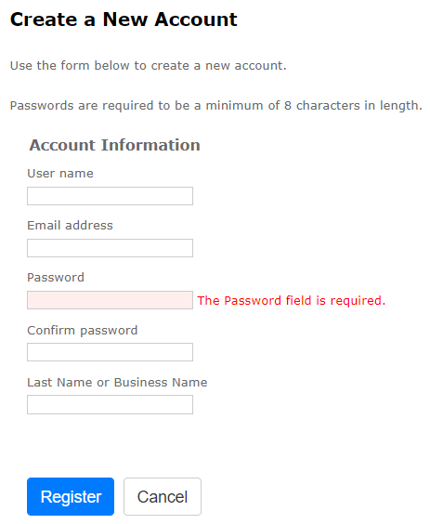
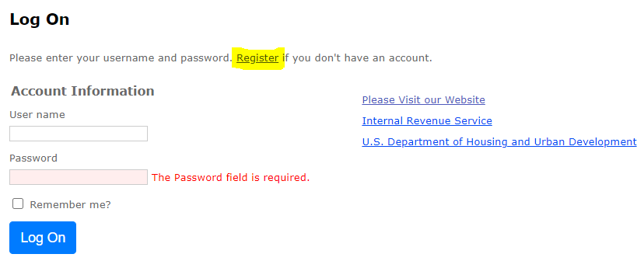
Registration
Follow this link to register for the Emphasys Developer account and access the Application Collector Portal, where you will complete and submit the application.
Upon first visit to the Application Collector Portal, click “Register” to create an account.
If you already have an account, use the same login information to access the portal. If you are locked out of the account, please contact DCA.
You can create a new account for a partnership if partnering with another developer on an application.
If this is the company’s first visit to the Application Collector Portal, click “Register” to create account.

Slide 4
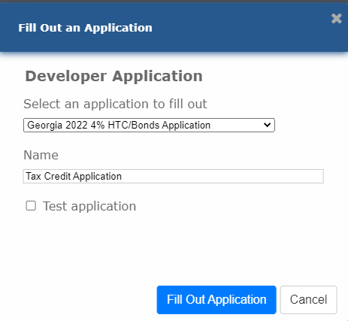
Application Submission in Emphasys
Click “Fill Out an Application”
Select “Georgia 202x 4% HTC/Bonds Application” (current year)
Enter name of project
Do not check the box next to “Test application”
Click “Fill Out Application”
Note: You may receive an error that says, “The application name already exists.” In that case, please rename the Application.

Slide 5
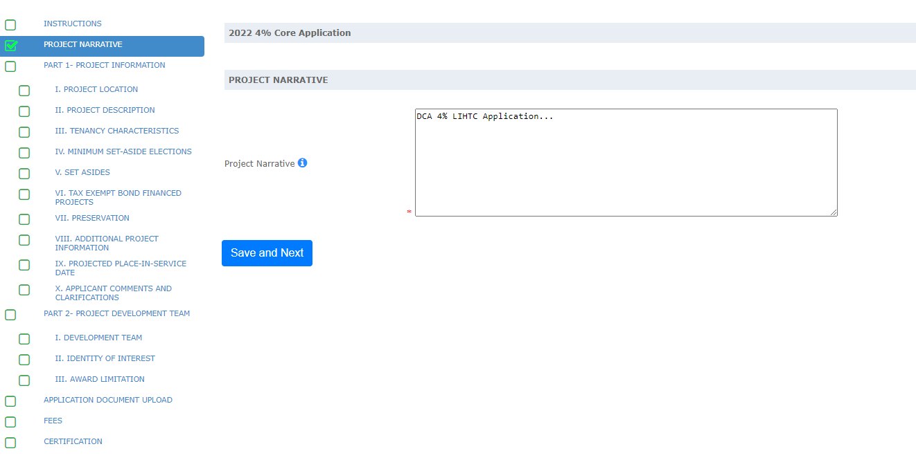
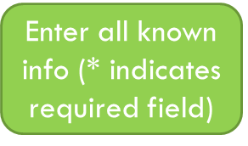
Application Submission in Emphasys
Click “Save and Next” after entering the information. A green checkmark will appear beside the page name in the column on the left side of the browser window.
A green checkmark will NOT appear if any * indicated required fields are left incomplete.
Click “Save and Next” even if no information/ documents are needed on some pages.

Slide 6
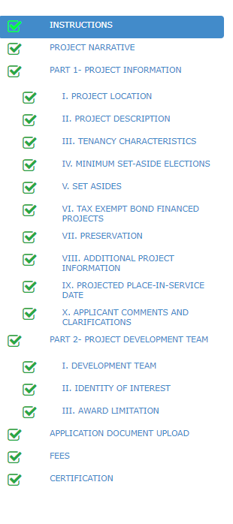
To Submit Applications
All Boxes on the left side panel need to be checked. If all boxes are not checked, the application is not complete.
Hit “Save and Next” on all Tabs (even if no information/ documents are needed).

Slide 7
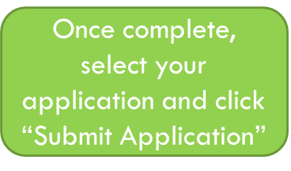
Finalize/Submit Applications
Click on “Submit an Application”
Select your Application from the drop-down list
Click “Submit Application”

Slide 8
Submit Applications – Click OK
After Selecting “Submit Application,” the window below will appear. Select “OK” to finalize submission.
No changes can be made after submitting the application.

Slide 9
Questions?
If you have questions or issues, please contact:
Meagan Cutler, Meagan.Cutler@dca.ga.gov
Sanjana Zahin, Sanjana.Zahin@dca.ga.gov

