Slide 1
4% Bond Application Submission Instructions Emphasys

Slide 2
Emphasys
4% Bond Pre-Application and Full Application documents must be submitted through the Emphasys Developer Portal.
Link: https://ghfadp.emphasys-hft.com/Account/Login

Slide 3
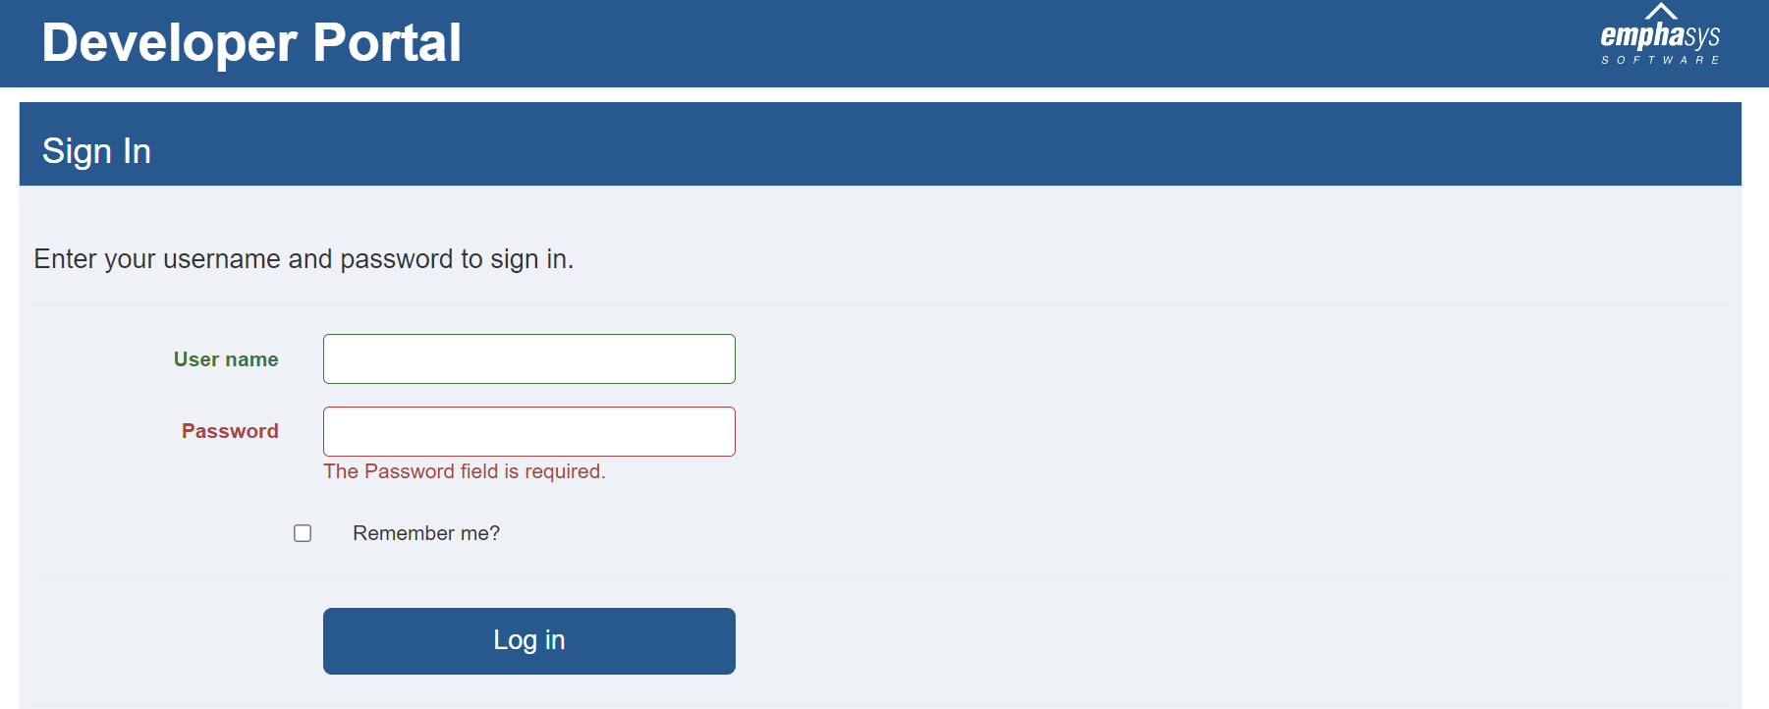
4% Application Submission in Emphasys
Log in to the Developer Portal using the same login information that was used to submit the 4% HTC/Bonds Competitive Round Application. If you are locked out of the account, please contact DCA.

Slide 4
4% Application Submission in Emphasys
The request to submit both the 4% Pre-Application and Full Application will appear separately on the Developer portal.
Please submit the Pre-Application or Full Application (As applicable).
The submission process for both Pre-Application and Full Application is the same.

Slide 5
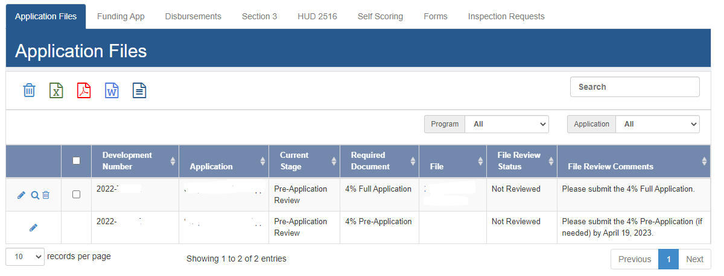
4% Application Submission in Emphasys
Application in Developer portal:
2022-5xx
Requested Documents

Slide 6
4% Application Submission in Emphasys
Click on the edit pencil button on the left to edit the application.
Edit Application

Slide 7
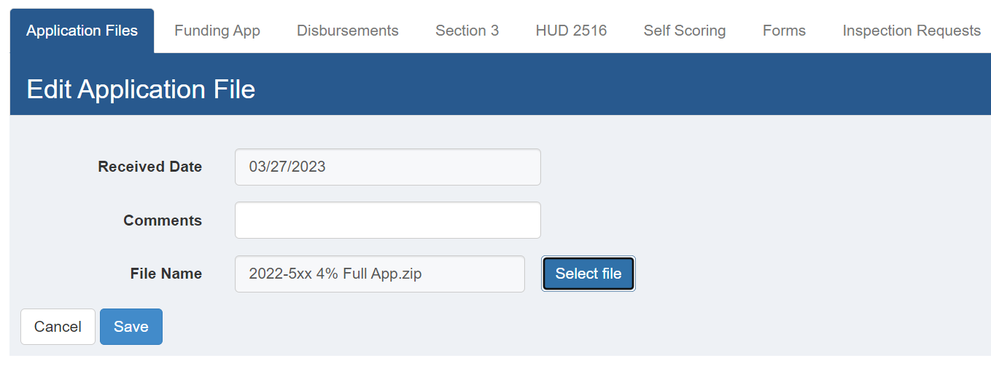
4% Application Submission in Emphasys
Click on “Select File” to choose the 4% Application file. Please note, only one file can be selected. DCA recommends creating a zip file of the application.
Provide comments as appropriate.
Click “Save” button to upload the file.

Slide 8
4% Application Submission in Emphasys
The uploaded file name will appear under the file section, which will automatically be uploaded on the DCA Emphasys Application review portal.
No further action is needed.

Slide 9
Questions?
If you have questions or issues, please contact:
Meagan Cutler, Meagan.Cutler@dca.ga.gov
Sanjana Zahin, Sanjana.Zahin@dca.ga.gov

