Slide 1
2022 9% Tax Credit Application Submission Instructions Emphasys

Slide 2
Emphasys
New platform for application and documentation submission.
2022 9% Tax Credit Application will be submitted through Emphasys.
Fees will not be processed through Emphasys at this time
All fees are due at the time of Application Submission. Please make all checks payable to Georgia Housing and Finance Authority (GHFA). DCA will not accept any applications without the appropriate fees.
Fees must be delivered to DCA Offices, 60 Executive Park South NE, Atlanta, Georgia 30329. Please address all fees to the attention of Felecia Speakman.
Please include with check a printed paper copy of completed Part I. Project Identification from Core Application Workbook in Excel for ID purposes.

Slide 3
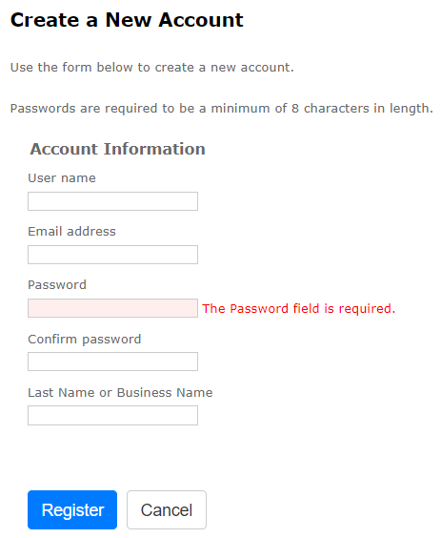
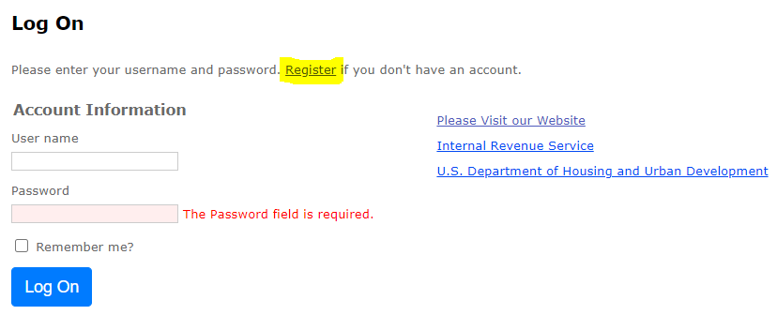
Registration
Follow this link to register for Emphasys Developer account and access Application Collector Portal, where you will submit application documents.
Upon first visit to the Application Collector Portal, click “Register” to create an account.
Use the same login information used for the relevant pre-application submission, if applicable.
You can create a new account for a partnership if partnering with another developer on an application.
If this is the company’s first visit to the Application Collector Portal (i.e., there was no pre-application submission), click “Register” to create account.

Slide 4
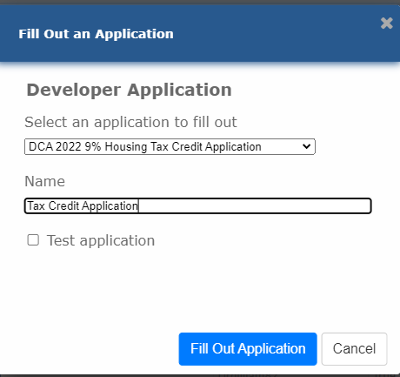
Application Submission in Emphasys
Click “Fill Out an Application”
Select “DCA 2022 9% Housing Tax Credit Application”
Enter name of project
Do not check box next to “Test application”
Click “Fill Out Application”
Note: You may receive an error that says, “The application name already exists.” In that case, please rename the Application.

Slide 5
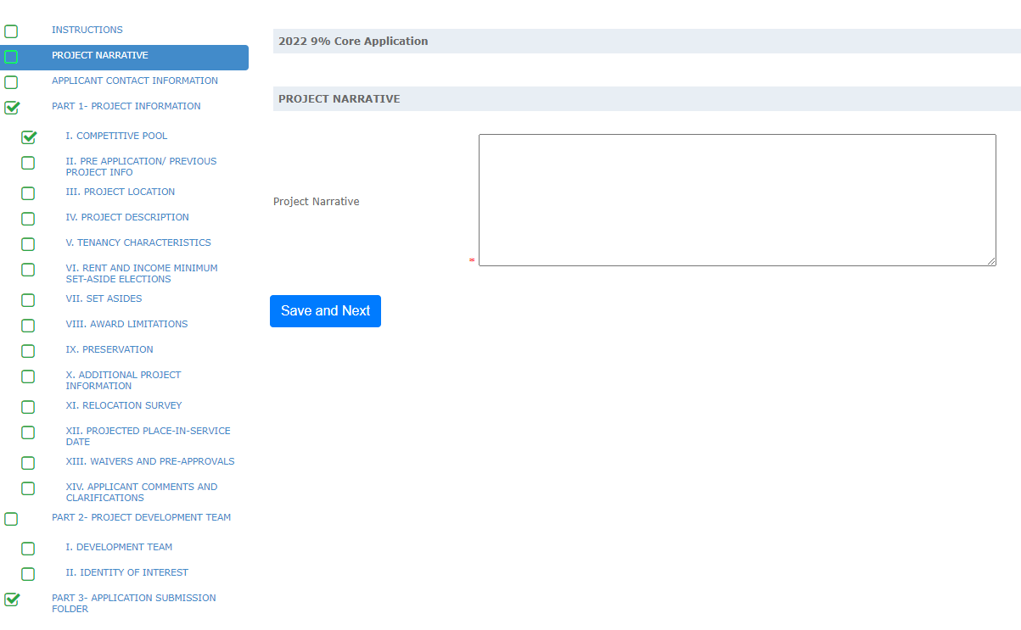
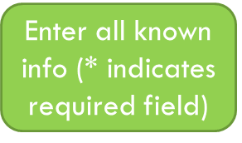
Application Submission in Emphasys
Click “Save and Next” after entering the information. A green checkmark will appear beside the page name in the column on the left side of the browser window.
A green checkmark will NOT appear if any * indicated required fields are left incomplete.
Click “Save and Next” even if no information/ documents are needed on some pages.

Slide 6
Example: 9% Application Submission Tab
“Zip” the Application folder on your computer (using DCA format folder)
Upload the “zipped” folder
Wait for the zip folder to upload (may take several minutes)
Once it no longer says “Processing, please wait…” and the zip folder name has appeared,
click “Save”
The Green Check next to Application Submission Folder confirms that this upload is complete, and you do not need to click “Save” again
Note: To make the upload process faster, close extra windows and quit additional applications running in the background.

Slide 7
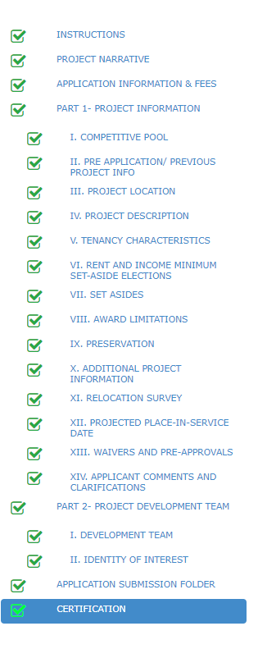
To Submit Applications
All Boxes need to be checked. If all boxes are not checked, the application is not complete.
Hit “Save and Next” on all Tabs (even if no information/ documents are needed).

Slide 8
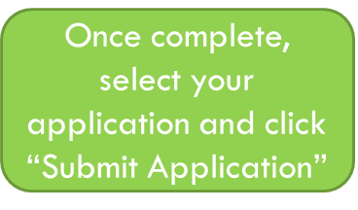
Finalize/Submit Applications
Click on “Submit an Application”
Select your Application from the drop-down list
Click “Submit Application”

Slide 9
Submit Applications – Click OK
After Selecting “Submit Application,” the window below will appear. Select “OK” to finalize submission.
After submitting the application, should any changes become necessary, the applicant can revert the application, make necessary changes and submit the application again within the application submission deadline.
NO CHANGES CAN BE MADE AFTER THE SUBMISSION DEADLINE.

Slide 10
Questions?
If you have questions or issues, please contact:
Mitch Kelly, Mitchell.Kelly@dca.ga.gov
Sanjana Zahin, Sanjana.Zahin@dca.ga.gov

